Slide 1
Chapter 3: Introduction to Classes and Objects
Objects and
Instance attributes and variables

Slide 2
Objectives
Object state and instance attributes
Objects and Instance variables
Primitive types and reference type
Practical Organization

Slide 3
The Anatomy of an Object
An object has:
    reference (also called Object Identifier (OID))
        A unique identifier provided by the Object System and that makes the object unique. It is acquired at birth and does not change during the life of the object.
    State
        Represents the data that the object contains.
    Behavior
        Represents the services (the methods) that the object may perform.
The features of an object are its attributes and operations.
    an instance attribute is an element of the object state.
    an operation is an element of the object behavior.

Slide 4
Object State
All objects of the same class have the same characteristics (attributes) and the same behavior (methods).
Each object has a value for each instance attribute.
The state of an object encompasses:
  all of the instance attributes of the object
  the current data values assigned to these attributes.
When we talk about the current state of the object, we are really talking about the current values of its attributes.
The values of instance attributes can change over time.
A complete set of the specific values of these attributes forms a specific state of the object.
Object: Course
studentName
Mohammed
courseCode
CSC 112

Slide 5
State vs. Attribute
An instance attribute is an element of the object state.
The state of an object is defined by the set of values held by all its attributes.
Class attributes do not belong to the object state.
The characteristics (set of attributes) of an object almost never change during the object’s life.
The data values of the instance attributes change.
  ☞ The attribute set is (usually) a static concept.
  ☞ While state is (usually) a dynamic concept.

Slide 6
Object Creation
Step 1 : First declare a variable of the given class. This variable is called instance variable or object reference variable.
      ClassName variableName ;
Step 2: Next, create the object that you refer to. The syntax for instantiating an object is:
    new ClassName();
Step 3: Finally, initialize the instance variable declared in 1 by assigning the newly created object to the instance variable. Just as with variable assignment or initialization. The syntax for initializing an object to an instance variable is:
      variableName = new ClassName();
The three steps 1,2 and 3 may be combined within the same statement as following (declaration statement with initial value):
    ClassName variableName = new ClassName();

Slide 7
Object Creation
A. The instance variable is allocated in memory.
crs
B. The object is created
Object: Course
A
studentName
courseCode
Course crs;
B
crs = ;
new Course ( )
C. The reference of the object created in B is assigned to the variable.
crs
crs
C
Object: Course
studentName
courseCode
Code
State of Memory
Notes:
If the variable refers to an object, then the assignment and the corresponding effect to the memory allocation are different. Notice the content of the variable is not the value itself, as is the case with primitive data, but the address of, or reference to, the memory location where the object data is stored. We use arrows to indicate this memory reference.

Slide 8
Objects and Instance variables
Once the Student class is defined, we can create several instances.
course
1
Object: Course
Course course1, course2;
course1 = new Course( );
course2 = new Course( );
studentName
course
2
courseCode
Instance variable
Object: Course
Object reference
studentName
courseCode
Object state

Slide 9
Instance VS. Primitive Variables
Primitive variables hold values of primitive data types.
Instance variables hold references of objects: the location (memory address) of objects in memory.
Note: Memory addresses are usually written in hexadecimal notation, beginning with a 0x (for example, 0x334009). These addresses are unique for each object and are assigned while a program runs.

Slide 10
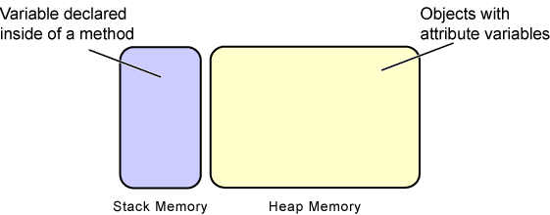
Heap and Stack Memory
Objects and their attributes and methods are usually stored in heap memory.
    Heap memory is dynamically allocated memory chunks containing objects while they are needed by the program.
Other variables are usually stored in stack memory.
    Stack memory is used for storing items which are only used for a brief period of time (shorter than the life of an object), such as variables declared inside of a method.

Slide 11
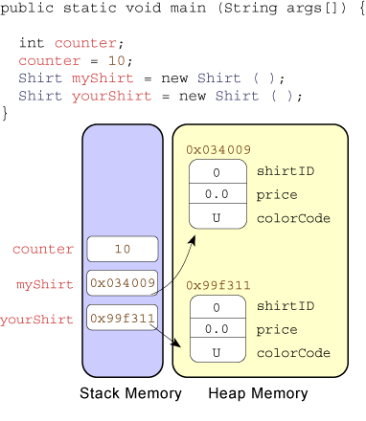
How Objects, Primitive and Instance Variables are Stored in Memory
Primitive variables are stored in the stack memory.
Instance variables are stored in stack memory.
Objects are stored in heap memory.
The myShirt and yourShirt instance variables are referring to different Shirt objects.

Slide 12
Assigning Objects’ References to the same Instance Variable
crs
Course
Course
A
Course crs;
crs = new Course ( );
crs = new Course ( );
B
A. The variable is allocated in memory.
B. The reference to the new object is assigned to crs.
C. The reference to another object overwrites the reference in crs.
C
Code
State of Memory
Notes:
If the variable refers to an object, then the assignment and the corresponding effect to the memory allocation are different. Notice the content of the variable is not the value itself, as is the case with primitive data, but the address of, or reference to, the memory location where the object data is stored. We use arrows to indicate this memory reference.

Slide 13
Assigning an Object Reference From One Variable to Another
crs1
crs2
Course
A
Course crs1, crs2,
crs1 = new Course( );
crs2 = crs1;
B
A. Variables are allocated in memory.
B. The reference to the new object is assigned to crs1 .
C
C. The reference in crs1 is assigned to crs2.
Code
State of Memory
Notes:
This sample code shows the effect of two reference variables pointing to the same object, which is perfectly legal. This slide highlights the critical fact that the name (variable) and object are two distinct and separate entities. It is no problem to have multiple variables referring to a single object, much as a single person can be referred by many different names.

Slide 14
Assigning an Object Reference From One Variable to Another
A. Variables are allocated in memory.
crs1
crs2
A. Variables are assigned references of objects.
crs1
A
Course
Course
Course crs1, crs2,
crs1 = crs2;
B
crs2
crs1 = new Course( );
crs2 = new Course( );
C. The reference in crs2 is assigned to crs1.
crs1
Course
Course
crs2
C

Slide 15
Accessing Instance Attributes
In order to access attributes of a given object:
    use the dot (.) operator with the object reference (instance variable) to have access to attributes’ values of a specific object.
        instanceVariableName.attributeName
course1.StudentName= “Majed AlKebir“;
course2.StudentName= “Fahd AlAmri “;
course2
course1
Object: Course
Object: Course
studentName
Fahd AlAmri
studentName
Majed AlKebir
courseCode
courseCode

Slide 16
Object vs. Class
A class could be considered as a set of objects having the same characteristics and behavior.
An object is an instance of a class.

Slide 17
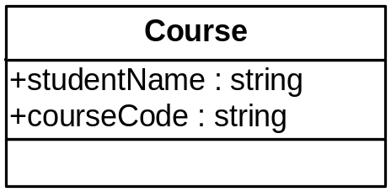

class Course {
// Instance attributes
public String studentName;
public String courseCode ;
}
public class CourseRegistration {
public static void main(String[] args) {
Course course1, course2;
//Create and assign values to course1
course1 = new Course( );
course1.courseCode= new String(“CSC112“);
course1.studentName= new String(“Majed AlKebir“);
//Create and assign values to course2
course2 = new Course( );
course2.courseCode= new String(“CSC107“);
course2.studentName= new String(“Fahd AlAmri“);
System.out.println(course1.studentName + " has the course “+
course1.courseCode);
System.out.println(course2.studentName + " has the course “+
course2.courseCode);
}
}

Slide 18
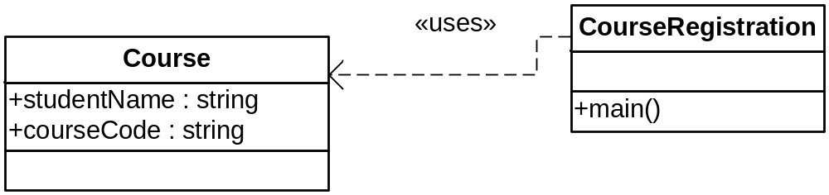
Practical hint
Class Course will not execute by itself
  It does not have method main
CourseRegistration uses the class Course.
  CourseRegistration, which has method main, creates instances of the class Course and uses them.

Slide 19
Class and Instance Attributes
Instance attributes (and methods) are:
    associated with an instance (object) of the class.
    and accessed through an object of the class.
    each object of the class has its own distinct copy of instance attributes (and methods)
Class attributes (and methods):
    live in the class
    can also be manipulated without creating an instance of the class.
    are shared by all objects of the class.
    do not belong to objects’ states.

Slide 20
Class Attributes and Objects
A class attribute is in one fixed location in memory.
Every object of the class shares class attributes with the other objects.
Any object of the class can change the value of a class attribute.
Class attributes (and methods) can also be manipulated without creating an instance of the class.

Slide 21
Class Attributes Declaration
The class attributes (and methods) are declared as instance attribute but with the static modifier in addition.
  <modifiers> <data type> <attribute name> ;
Modifiers
Data Type
Name
  public static int studentNumber ;

Slide 22
Class Attributes Access
Class attributes (and methods) can also be manipulated without creating an instance of the class.
  <class name>.<attribute name>
Class Name
Attribute Name
  Course.studentNumber = 0 ;

Slide 23
class Course {
// attributes
public String studentName;
public String courseCode ;
public static int studentNumber;
}
public class CourseRegistration {
public static void main(String[] args) {
Course course1, course2;
//Create and assign values to course1
course1 = new Course( ); Course.studentNumber = 1;
course1.courseCode= new String(“CSC112“);
course1.studentName= new String(“Majed AlKebir“);
//Create and assign values to course2
course2 = new Course( ); Course.studentNumber ++;
course2.courseCode= new String(“CSC107“);
course2.studentName= new String(“Fahd AlAmri“);
System.out.println(course1.studentName + " has the course “+
course1.courseCode + “ ” + course1.studentNumber);
System.out.println(course2.studentName + " has the course “+
course2.courseCode + “ ” + course2.studentNumber);
}
}

