Slide 1
Chapter 5: Classes and Objects in Depth
Getters, Setters and Constructors

Slide 2
How Private Attributes could be Accessed
Private attributes are not accessible from outside.
    Except from objects of the same class.
They are accessible:
    From inside: from the object containing the data itself.
    From objects of the same class.
They are accessible from outside using accessor operations:
    Getters
    Setters

Slide 3
class Course {
// Data Member
private String studentName;
private String courseCode ;
}
public class CourseRegistration {
public static void main(String[] args) {
Course course1, course2;
//Create and assign values to course1
course1 = new Course( );
course1.courseCode= “CSC112“;
course1.studentName= “Majed AlKebir“;
//Create and assign values to course2
course2 = new Course( );
course2.courseCode= “CSC107“;
course2.studentName= “Fahd AlAmri“;
System.out.println(course1.studentName + " has the course “+
course1.courseCode);
System.out.println(course2.studentName + " has the course “+
course2.courseCode);
}
}

Slide 4
Getters
The object point of view
The user point of view
Are operations performed by the object returning to outsiders data retrieved from the object state.
Are services called from outside allowing to retrieve data from the object state.
:Y (Client)
object:X
Getters are:
  Public
  With no parameters
  With return value
public
private
Data
Data
Getters

Slide 5
Template for Getters
public class ClassName {
private dataType1 attribute1;
. . .
private dataTypen attributen;
. . .
public dataType1 getAttribute1() {
return attribute1;
}
. . .
public dataTypen getAttributen() {
return attributen;
}
. . .
}

Slide 6
Setters
The object point of view
The user point of view
Are operations performed by the object allowing to receive and store in the object state the data provided by outsiders.
Are services used by outsiders allowing to provide to the object the data that should be stored in the object state.
:Y (Client)
object:X
Setters are:
  Public
  With 1 parameter
  With no return value
public
private
Data
Data
Setters

Slide 7
Template for Setters
public class ClassName {
private dataType1 attribute1;
. . .
private dataTypen attributen;
. . .
public void setAttribute1(dataType1 param){
attribute1 = param;
}
. . .
public void setAttributen(dataTypen param) {
attributen = param;
}
. . .
}

Slide 8
public class Course {
// Attributes
private String studentName;
private String courseCode ;
...
public String getStudentName() {
return studentName;
}
public String getCourseCode() {
return courseCode;
}
...
public void setStudentName(String val) {
studentName = val;
}
public void setCourseCode(String val) {
courseCode = val;
}
}

Slide 9
public class CourseRegistration {
public static void main(String[] args) {
Course course1, course2;
//Create and assign values to course1
course1 = new Course( );
course1.setCourseCode(“CSC112“);
course1.setStudentName(“Majed AlKebir“);
//Create and assign values to course2
course2 = new Course( );
course2.setCourseCode(“CSC107“);
course2.setStudentName(“Fahd AlAmri“);
System.out.println(course1.getStudentName() +
" has the course “ + course1.getCourseCode());
System.out.println(course2.getStudentName() +
" has the course “ + course2.getCourseCode());
}
}

Slide 10
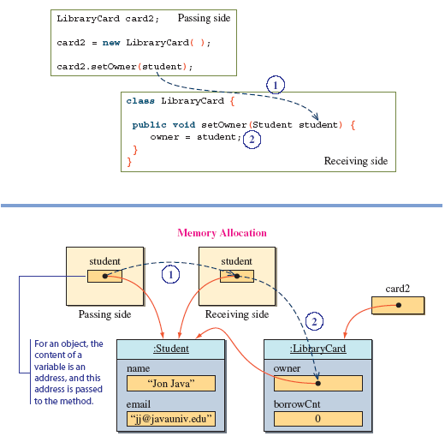
Passing an Object to a Setter

Slide 11
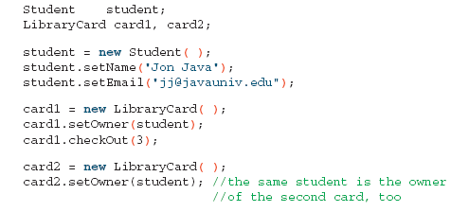
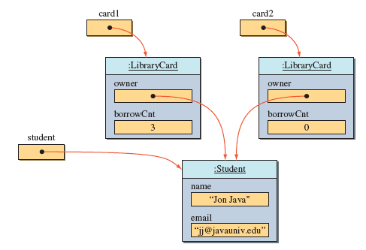
Setters and Sharing Objects
The same Student object reference is passed to card1 and card2 using setters
Since we are actually passing the same object reference, it results in the owner of two LibraryCard objects referring to the same Student object

Slide 12
Class Constructors
A class is a blueprint or prototype from which objects of the same type are created.
Constructors define the initial states of objects at birth.
    ClassName x = new ClassName();
A class contains at least one constructor.
A class may contain more than one constructor.

Slide 13
The Default Class Constructor
If no constructors are defined in the class, the default constructor is added by the compiler at compile time.
The default constructor does not accept parameters and creates objects with empty states.
    ClassName x = new ClassName();

Slide 14
Class Constructors Declaration
  public <constructor name> ( <parameters> ){
  <constructor body>
  }
The constructor name: a constructor has the same names as the class .
The parameters represent values that will be passed to the constructor for initialize the object state.
Constructor declarations look like method declarations except that:
    they use the name of the class
    and have no return type.

Slide 15
Example of a Constructor with No-Parameter
public class Kasree {
private int bast;
private int maquam;
public Kasree() {
bast = 0; maquam =1;
}
. . .
}
A. The instance variable is allocated in memory.
x
B. The object is created with initial state
Object: Kasree
bast
0
1
maquam
C. The reference of the object created in B is assigned to the variable.
x
A
Kasree x;
B
x = ;
Object: Kasree
new Kasree ( )
bast
0
1
maquam
C
State of Memory
Code

Slide 16
Class with Multiple Constructors
public class Kasree {
private int bast;
private int maquam;
public Kasree() {
bast = 0; maquam =1;
}
public Kasree(int a, int b) {
bast = a;
if (b != 0) maquam = b;
else maquam = 1;
}
. . .
}
A. The constructor declared with no-parameter is used to create the object
x
Object: Kasree
bast
0
1
maquam
B. The constructor declared with parameters is used to create the object
y
Kasree x , y;
A
Object: Kasree
x = new Kasree()
y = new Kasree(4, 3);
bast
4
B
3
maquam
State of Memory
Code

Slide 17
Overloading
Two of the components of a method declaration comprise the method signature:
    the method's name
    and the parameter types.
The signature of the constructors declared above are:
    Kasree()
    Kasree(int, int)
Overloading methods allows implementing different versions of the same method with different method signatures.
    This means that methods within a class can have the same name if they have different parameter lists.

Slide 18
Overloading (cont.)
Overloaded methods are differentiated by:
    the number,
    and the type of the arguments passed into the method.
You cannot declare more than one method with:
    the same name,
    and the same number and type of parameters.
The compiler does not consider return type when differentiating methods.
    No declaration of two methods having the same signature even if they have a different return type.

Slide 19
Intra-Constructors Calls
A constructor of a class may use an other constructor of the same class.
public class Kasree {
private int bast;
private int maquam;
public Kasree(int a, int b) {
bast = a;
if (b != 0) maquam = b;
else maquam = 1;
}
public Kasree() {
Kasree(0, 1);
}
. . .
}
Kasree x , y;
x = new Kasree()
y = new Kasree(4, 3);
Client Side

