Slide 1
Flow of Control
Chapter 3

Slide 2
Objectives
Use Java branching statements
Compare values of primitive types
Compare objects such as strings
Use the primitive type boolean
Use simple enumerations in a program
Use color in a graphics program
Use JOptionPane class to create yes-no dialog box

Slide 3
Outline
The if-else Stetement
The Type boolean
The switch statement
(optional) Graphics Supplement

Slide 4
Flow of Control
Flow of control is the order in which a program performs actions.
  Up to this point, the order has been sequential.
A branching statement chooses between two or more possible actions.
A loop statement repeats an action until a stopping condition occurs.

Slide 5
The if-else Statement: Outline
Basic if-else Statement
Boolean Expressions
Comparing Strings
Nested if-else Statements
Multibranch if-else Statements
The switch Statament
(optional) The Conditional Operator
The exit Method

Slide 6
The if-else Statement
A branching statement that chooses between two possible actions.
Syntax
  if (Boolean_Expression)
  Statement_1
  else
  Statement_2

Slide 7
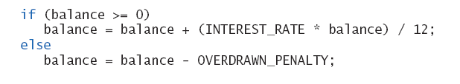
The if-else Statement
Example

Slide 8
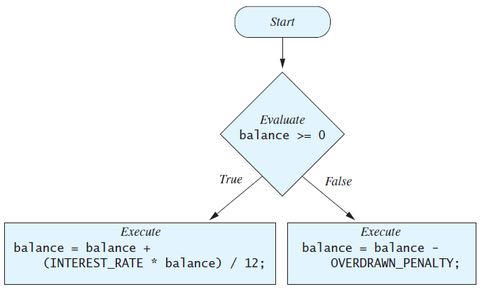
The if-else Statement
Figure 3.1 The Action of the if-else Statement sample program Listing 3.1

Slide 9
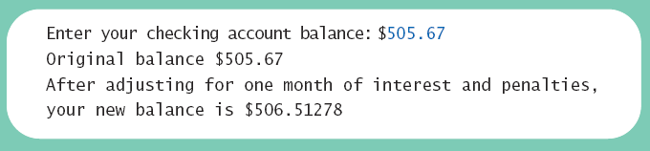
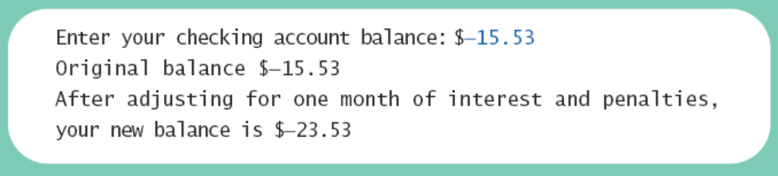
The if-else Statement
Sample
screen output

Slide 10
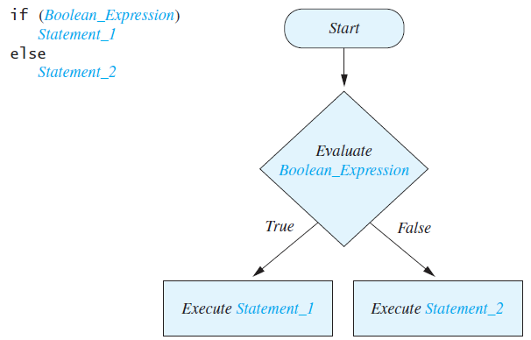
Semantics of the if-else Statement
Figure 3.2

Slide 11
Compound Statements
To include multiple statements in a branch, enclose the statements in braces.
  if (count < 3)
  {
  total = 0;
  count = 0;
  }

Slide 12
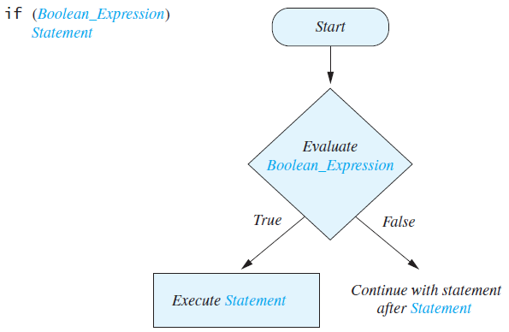
Omitting the else Part
FIGURE 3.3 The Semantics of an if Statement without an else

Slide 13
Introduction to Boolean Expressions
The value of a boolean expression is either true or false.
Examples
  time < limit
  balance <= 0

Slide 14
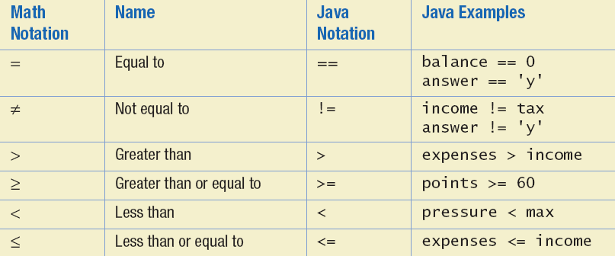
Java Comparison Operators
Figure 3.4 Java Comparison Operators

Slide 15
Compound Boolean Expressions
Boolean expressions can be combined using the "and" (&&) operator.
Example
  if ((score > 0) && (score <= 100))
  ...
Not allowed
  if (0 < score <= 100)
  ...

Slide 16
Compound Boolean Expressions
Syntax
  (Sub_Expression_1) && (Sub_Expression_2)
Parentheses often are used to enhance readability.
The larger expression is true only when both of the smaller expressions are true.

Slide 17
Compound Boolean Expressions
Boolean expressions can be combined using the "or" (||) operator.
Example
  if ((quantity > 5) || (cost < 10))
  ...
Syntax
  (Sub_Expression_1) || (Sub_Expression_2)

Slide 18
Compound Boolean Expressions
The larger expression is true
  When either of the smaller expressions is true
  When both of the smaller expressions are true.
The Java version of "or" is the inclusive or which allows either or both to be true.
The exclusive or allows one or the other, but not both to be true.

Slide 19
Negating a Boolean Expression
A boolean expression can be negated using the "not" (!) operator.
Syntax
  !(Boolean_Expression)
Example
  (a || b) && !(a && b)
  which is the exclusive or

Slide 20
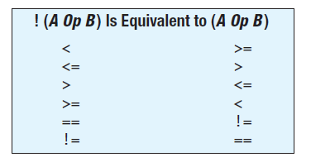
Negating a Boolean Expression
Figure 3.5 Avoiding the Negation Operator

Slide 21
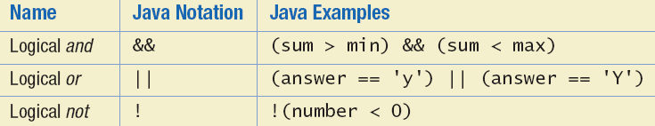
Java Logical Operators
Figure 3.6

Slide 22
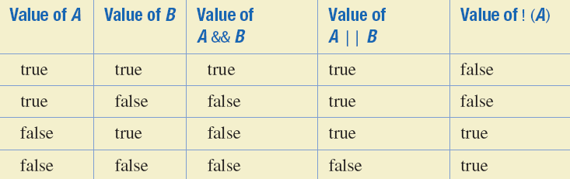
Boolean Operators
FIGURE 3.7 The Effect of the Boolean Operators && (and), || (or), and ! (not) on Boolean values

Slide 23
Using ==
== is appropriate for determining if two integers or characters have the same value.
  if (a == 3)
  where a is an integer type
== is not appropriate for determining if two floating points values are equal. Use < and some appropriate tolerance instead.
  if (abs(b - c) < epsilon)
  where b, c, and epsilon are floating point types

Slide 24
Using ==
== is not appropriate for determining if two objects have the same value.
  if (s1 == s2), where s1 and s2 refer to strings, determines only if s1 and s2 refer the a common memory location.
  If s1 and s2 refer to strings with identical sequences of characters, but stored in different memory locations, (s1 == s2) is false.

Slide 25
Using ==
To test the equality of objects of class String, use method equals.
  s1.equals(s2)
  or
  s2.equals(s1)
To test for equality ignoring case, use method equalsIgnoreCase.
  ("Hello".equalsIgnoreCase("hello"))

Slide 26
equals and equalsIgnoreCase
Syntax
  String.equals(Other_String)
  String.equalsIgnoreCase(Other_String)

Slide 27
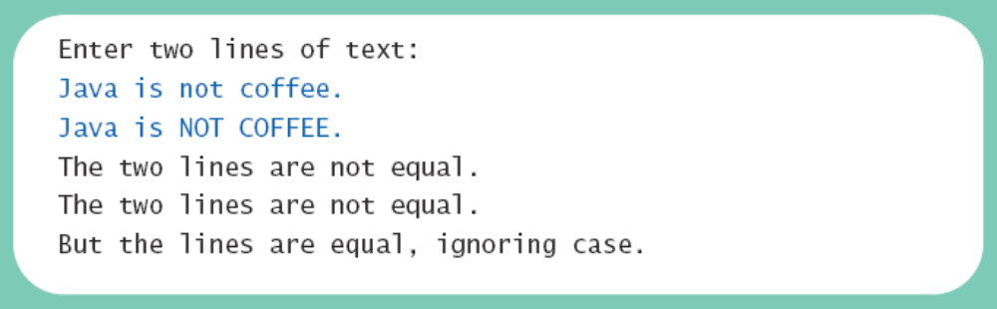
Testing Strings for Equality
View sample program Listing 3.2
class StringEqualityDemo
Sample
screen output

Slide 28
Lexicographic Order
Lexicographic order is similar to alphabetical order, but is it based on the order of the characters in the ASCII (and Unicode) character set.
  All the digits come before all the letters.
  All the uppercase letters come before all the lower case letters.

Slide 29
Lexicographic Order
Strings consisting of alphabetical characters can be compared using method compareTo and method toUpperCase or method toLowerCase.
  String s1 = "Hello";
  String lowerS1 = s1.toLowerCase();
  String s2 = "hello";
  if (s1.compareTo(s2)) == 0
  System.out.println("Equal!");

Slide 30
Method compareTo
Syntax
  String_1.compareTo(String_2)
Method compareTo returns
  a negative number if String_1 precedes String_2
  zero if the two strings are equal
  a positive number of String_2 precedes String_1.

Slide 31
Nested if-else Statements
An if-else statement can contain any sort of statement within it.
In particular, it can contain another if-else statement.
  An if-else may be nested within the "if" part.
  An if-else may be nested within the "else" part.
  An if-else may be nested within both parts.

Slide 32
Nested Statements
Syntax
  if (Boolean_Expression_1)
  if (Boolean_Expression_2)
  Statement_1)
  else
  Statement_2)
  else
  if (Boolean_Expression_3)
  Statement_3)
  else
  Statement_4);

Slide 33
Nested Statements
Each else is paired with the nearest unmatched if.
If used properly, indentation communicates which if goes with which else.
Braces can be used like parentheses to group statements.

Slide 34
Nested Statements
Subtly different forms
First Form
if (a > b)
{
if (c > d)
e = f
}
else
g = h;
Second Form
if (a > b)
if (c > d)
e = f
else
g = h;
// oops

Slide 35
Compound Statements
When a list of statements is enclosed in braces ({}), they form a single compound statement.
Syntax
  {
  Statement_1;
  Statement_2;
  …
  }

Slide 36
Compound Statements
A compound statement can be used wherever a statement can be used.
Example
  if (total > 10)
  {
  sum = sum + total;
  total = 0;
  }

Slide 37
Multibranch if-else Statements
Syntax
  if (Boolean_Expression_1)
  Statement_1
  else if (Boolean_Expression_2)
  Statement_2
  else if (Boolean_Expression_3)
  Statement_3
  else if …
  else
  Default_Statement

Slide 38
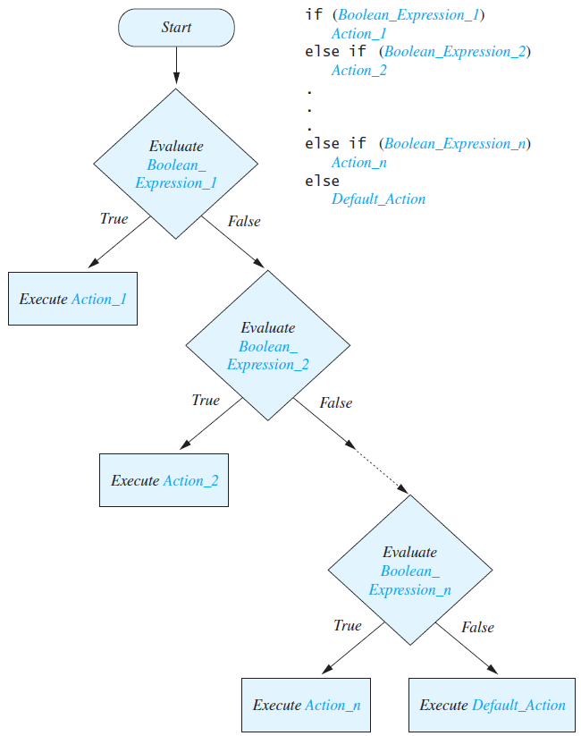
Multibranch if-else Statements
Figure 3.8
Semantics

Slide 39
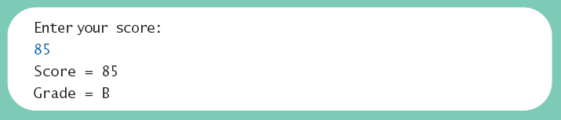
Multibranch if-else Statements
View sample program Listing 3.3
class Grader
Sample
screen output

Slide 40
Multibranch if-else Statements
Equivalent code
if (score >= 90)
grade = 'A';
else if ((score >= 80) && (score < 90))
grade = 'B';
else if ((score >= 70) && (score < 80))
grade = 'C';
else if ((score >= 60) && (score < 70))
grade = 'D';
else
grade = 'F';

Slide 41
Case Study – Body Mass Index
Body Mass Index (BMI) is used to estimate the risk of weight-related problems
BMI = mass / height²
  Mass in kilograms, height in meters
Health assessment if:
  BMI < 18.5 Underweight
  18.5 ≤ BMI < 25 Normal weight
  25 ≤ BMI < 30 Overweight
  30 ≤ BMI Obese

Slide 42
Case Study – Body Mass Index
Algorithm
  Input height in feet & inches, weight in pounds
  Convert to meters and kilograms
    1 lb = 2.2 kg
    1 inch = 0.254 meters
  Compute BMI
  Output health risk using if statements
View sample program Listing 3.4
class BMI

Slide 43
The Conditional Operator
if (n1 > n2)
  max = n1;
  else
  max = n2;
  can be written as
  max = (n1 > n2) ? n1 : n2;
The ? and : together are call the conditional operator or ternary operator.

Slide 44
The Conditional Operator
The conditional operator is useful with print and println statements.
  System.out.print("You worked " +
  ((hours > 1) ? "hours" ; "hour"));

Slide 45
The exit Method
Sometimes a situation arises that makes continuing the program pointless.
A program can be terminated normally by
  System.exit(0).

Slide 46
The exit Method
Example
  if (numberOfWinners == 0)
  {
  System.out.println ("Error: Dividing by zero.");
  System.exit (0);
  }
  else
  {
  oneShare = payoff / numberOfWinners;
  System.out.println ("Each winner will receive $" + oneShare);
  }

Slide 47
The Type boolean
The type boolean is a primitive type with only two values: true and false.
Boolean variables can make programs more readable.
  if (systemsAreOK)
  instead of
  if((temperature <= 100) && (thrust >= 12000) && (cabinPressure > 30) && …)

Slide 48
Boolean Expressions and Variables
Variables, constants, and expressions of type boolean all evaluate to either true or false.
A boolean variable can be given the value of a boolean expression by using an assignment operator.
  boolean isPositive = (number > 0);
  ...
  if (isPositive) ...

Slide 49
Naming Boolean Variables
Choose names such as isPositive or systemsAreOk.
Avoid names such as numberSign or systemStatus.

Slide 50
Precedence Rules
Parentheses should be used to indicate the order of operations.
When parentheses are omitted, the order of operation is determined by precedence rules.

Slide 51
Precedence Rules
Operations with higher precedence are performed before operations with lower precedence.
Operations with equal precedence are done left-to-right (except for unary operations which are done right-to-left).

Slide 52
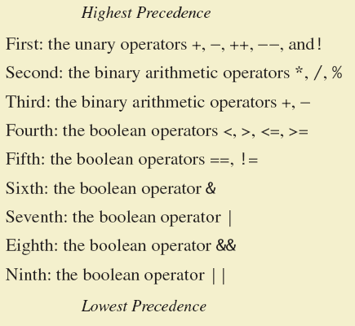
Precedence Rules
Figure 3.9

Slide 53
Precedence Rules
In what order are the operations performed?
  score < min/2 - 10 || score > 90
  score < (min/2) - 10 || score > 90
  score < ((min/2) - 10) || score > 90
  (score < ((min/2) - 10)) || score > 90
  (score < ((min/2) - 10)) || (score > 90)

Slide 54
Short-circuit Evaluation
Sometimes only part of a boolean expression needs to be evaluated to determine the value of the entire expression.
  If the first operand associated with an || is true, the expression is true.
  If the first operand associated with an && is false, the expression is false.
This is called short-circuit or lazy evaluation.

Slide 55
Short-circuit Evaluation
Short-circuit evaluation is not only efficient, sometimes it is essential!
A run-time error can result, for example, from an attempt to divide by zero.
  if ((number != 0) && (sum/number > 5))
Complete evaluation can be achieved by substituting & for && or | for ||.

Slide 56
Input and Output of Boolean Values
Example
  boolean booleanVar = false;
  System.out.println(booleanVar);
  System.out.println("Enter a boolean value:");
  Scanner keyboard = new Scanner(System.in);
  booleanVar = keyboard.nextBoolean();
  System.out.println("You entered " + booleanVar);

Slide 57
Input and Output of Boolean Values
Dialog
false
Enter a boolean value: true
true
You entered true

Slide 58
Input Validation
You should check your input to ensure that it is within a valid or reasonable range. For example, consider a program that converts feet to inches. You might write the following:
What if:
  The user types a negative number for feet?
  The user enters an unreasonable value like 100? Or a number larger than can be stored in an int? (2,147,483,647)
  int feet = keyboard.nextInt();
  int inches = feet * 12;

Slide 59
Input Validation
Address these problems by ensuring that the entered values are reasonable:
int feet = keyboard.nextInt();
if ((feet >= 0) && (feet < 10))
{
int inches = feet * 12;
...
}

Slide 60
The switch Statement
The switch statement is a mutltiway branch that makes a decision based on an integral (integer or character) expression.
  Java 7 allows String expressions
The switch statement begins with the keyword switch followed by an integral expression in parentheses and called the controlling expression.

Slide 61
The switch Statement
A list of cases follows, enclosed in braces.
Each case consists of the keyword case followed by
  A constant called the case label
  A colon
  A list of statements.
The list is searched for a case label matching the controlling expression.

Slide 62
The switch Statement
The action associated with a matching case label is executed.
If no match is found, the case labeled default is executed.
  The default case is optional, but recommended, even if it simply prints a message.
Repeated case labels are not allowed.

Slide 63
The switch Statement
Syntax
  switch (Controlling_Expression)
  {
  case Case_Label:
  Statement(s);
  break;
  case Case_Label:
  …
  default:
  …
  }

Slide 64




The switch Statement
View sample program Listing 3.5
class MultipleBirths
Sample
screen output

Slide 65
The switch Statement
The action for each case typically ends with the word break.
The optional break statement prevents the consideration of other cases.
The controlling expression can be anything that evaluates to an integral type.

Slide 66
Switch Statement
switch ( <arithmetic expression> ) {
<case label 1> : <case body 1>
…
<case label n> : <case body n>
}
Arithmetic Expression
switch ( coutryCode ) {
case 1: System.out.print(“Assalamo Alaikom");
break;
case 2: System.out.print(“Hello");
break;
case 3: System.out.print(“Bojour");
break;
case 4: System.out.print(“Bonas Dies");
break;
}
Case Label
Case Body
Introduction to OOP
Dr. S. GANNOUNI & Dr. A. TOUIR
Page <number>
Notes:
This is the general syntax rule for a switch statement. The case body may contain zero or more statements.

Slide 67
Switch With No break Statements
true
N == 1 ?
x = 10;
switch ( N ) {
case 1: x = 10;
case 2: x = 20;
case 3: x = 30;
}
false
true
N == 2 ?
x = 20;
false
true
N == 3 ?
x = 30;
false
Introduction to OOP
Dr. S. GANNOUNI & Dr. A. TOUIR
Page <number>
Notes:
This flowchart shows the control flow of a switch statement when case bodies do not include the break statement. The flow will first start from the matching case body and then proceed to the subsequent case bodies.

Slide 68
Switch With break Statements
true
N == 1 ?
x = 10;
switch ( N ) {
case 1: x = 10;
break;
case 2: x = 20;
break;
case 3: x = 30;
break;
}
false
break;
true
N == 2 ?
x = 20;
false
break;
true
N == 3 ?
x = 30;
false
break;
Introduction to OOP
Dr. S. GANNOUNI & Dr. A. TOUIR
Page <number>
Notes:
By placing a break statement at the end of a case body, the control flow will jump to the next statement that follows this switch statement. By placing a break statement at the end of each case body, the case bodies become mutually exclusive, i.e., at most one case body will be executed.

Slide 69
switch With the default Block
switch (ranking) {
case 10:
case 9:
case 8: System.out.print("Master");
break;
case 7:
case 6: System.out.print("Journeyman");
break;
case 5:
case 4: System.out.print("Apprentice");
break;
default: System.out.print("Input error: Invalid Data");
break;
}
Introduction to OOP
Dr. S. GANNOUNI & Dr. A. TOUIR
Page <number>
Notes:
If the ranking is 10, 9, or 8, then the text “Master” is displayed. If the ranking is 7 or 6, “Journeyman” is displayed. If the ranking is 5 or 4, “Apprentice” is displayed. If there’s no matching case, the default case is executed and an error message is displayed. If a default case is included, then it is executed when there are no matching cases. You can define at most one default case.
A default case is often used to detect an erroneous value in the control variable.
Although not required, it is a standard to place the default case at the end.

Slide 70
switch Statements
switch (status) {
case 0: compute taxes for single filers;
break;
case 1: compute taxes for married file jointly;
break;
case 2: compute taxes for married file separately;
break;
case 3: compute taxes for head of household;
break;
default: System.out.println("Errors: invalid status");
System.exit(0);
}

Slide 71
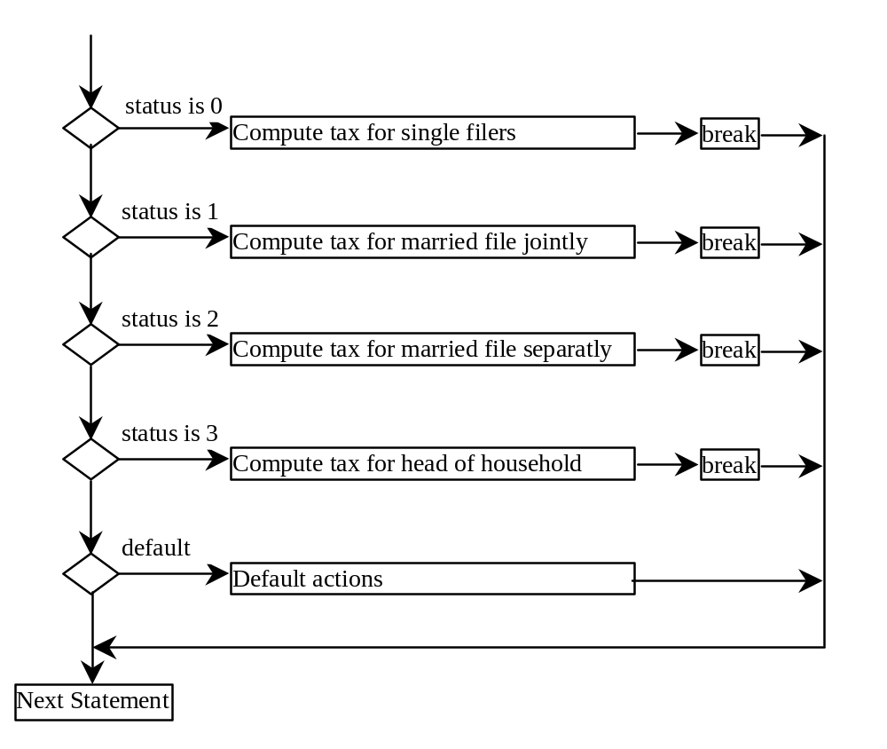
switch Statement Flow Chart

Slide 72
switch Statement Rules
The switch-expression must yield a value of char, byte, short, or int type and must always be enclosed in parentheses.
switch (switch-expression) {
case value1: statement(s)1;
break;
case value2: statement(s)2;
break;
…
case valueN: statement(s)N;
break;
default: statement(s)-for-default;
}
The value1, ..., and valueN must have the same data type as the value of the switch-expression. The resulting statements in the case statement are executed when the value in the case statement matches the value of the switch-expression. Note that value1, ..., and valueN are constant expressions, meaning that they cannot contain variables in the expression, such as 1 + x.

Slide 73
switch Statement Rules
The keyword break is optional, but it should be used at the end of each case in order to terminate the remainder of the switch statement. If the break statement is not present, the next case statement will be executed.
switch (switch-expression) {
case value1: statement(s)1;
break;
case value2: statement(s)2;
break;
…
case valueN: statement(s)N;
break;
default: statement(s)-for-default;
}
The default case, which is optional, can be used to perform actions when none of the specified cases matches the switch-expression.
The case statements are executed in sequential order, but the order of the cases (including the default case) does not matter. However, it is good programming style to follow the logical sequence of the cases and place the default case at the end.

Slide 74
Trace switch statement
animation
Suppose ch is 'a':
switch (ch) {
case 'a': System.out.println(ch);
case 'b': System.out.println(ch);
case 'c': System.out.println(ch);
}

Slide 75
Trace switch statement
animation
ch is 'a':
switch (ch) {
case 'a': System.out.println(ch);
case 'b': System.out.println(ch);
case 'c': System.out.println(ch);
}

Slide 76
Trace switch statement
animation
Execute this line
switch (ch) {
case 'a': System.out.println(ch);
case 'b': System.out.println(ch);
case 'c': System.out.println(ch);
}

Slide 77
Trace switch statement
animation
Execute this line
switch (ch) {
case 'a': System.out.println(ch);
case 'b': System.out.println(ch);
case 'c': System.out.println(ch);
}

Slide 78
Trace switch statement
animation
Execute this line
switch (ch) {
case 'a': System.out.println(ch);
case 'b': System.out.println(ch);
case 'c': System.out.println(ch);
}

Slide 79
Trace switch statement
animation
Execute next statement
switch (ch) {
case 'a': System.out.println(ch);
case 'b': System.out.println(ch);
case 'c': System.out.println(ch);
}
Next statement;

Slide 80
Trace switch statement
animation
Suppose ch is 'a':
switch (ch) {
case 'a': System.out.println(ch);
break;
case 'b': System.out.println(ch);
break;
case 'c': System.out.println(ch);
}

Slide 81
Trace switch statement
animation
ch is 'a':
switch (ch) {
case 'a': System.out.println(ch);
break;
case 'b': System.out.println(ch);
break;
case 'c': System.out.println(ch);
}

Slide 82
Trace switch statement
animation
Execute this line
switch (ch) {
case 'a': System.out.println(ch);
break;
case 'b': System.out.println(ch);
break;
case 'c': System.out.println(ch);
}

Slide 83
Trace switch statement
animation
Execute this line
switch (ch) {
case 'a': System.out.println(ch);
break;
case 'b': System.out.println(ch);
break;
case 'c': System.out.println(ch);
}

Slide 84
Trace switch statement
animation
Execute next statement
switch (ch) {
case 'a': System.out.println(ch);
break;
case 'b': System.out.println(ch);
break;
case 'c': System.out.println(ch);
}
Next statement;

Slide 85
Enumerations
Consider a need to restrict contents of a variable to certain values
An enumeration lists the values a variable can have
Example
enum MovieRating {E, A, B}
MovieRating rating;
rating = MovieRating.A;

Slide 86
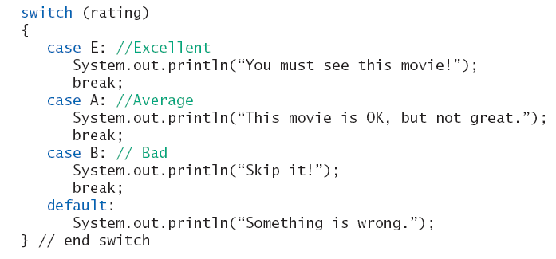
Enumerations
Now possible to use in a switch statement

Slide 87
Enumerations
An even better choice of descriptive identifiers for the constants
enum MovieRating
{EXCELLENT, AVERAGE, BAD}
rating = MovieRating.AVERAGE;
case EXCELLENT: ...

Slide 88
(Optional) Graphics Supplement: Outline
Specifying a Drawing Color
A JOptionPane Yes/No Window

Slide 89
Specifying a Drawing Color
When drawing a shape inside an applet’s paint method, think of the drawing being done with a pen that can change colors.
The method setColor changes the color of the "pen."
  canvas.setColor(Color.YELLOW);
Drawings done later appear on top of drawings done earlier.

Slide 90
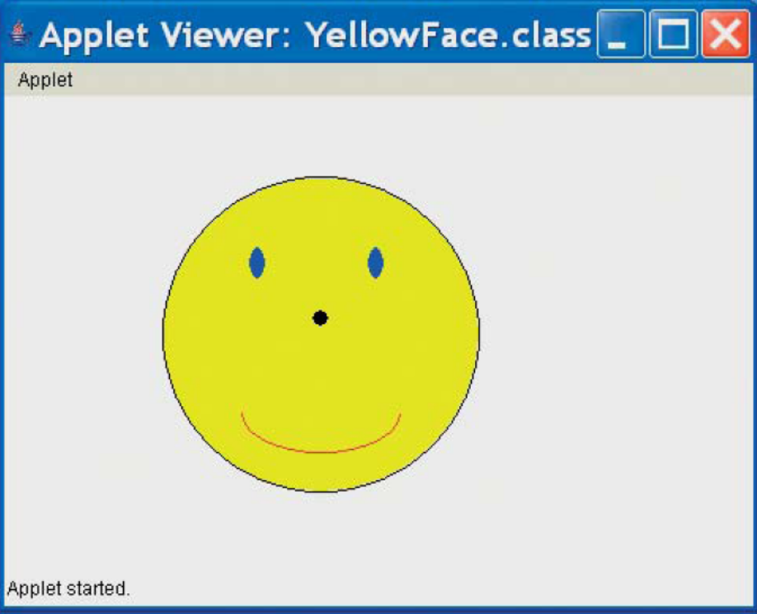
Specifying a Drawing Color
View sample program, Listing 3.6
class YellowFace
Sample
screen output

Slide 91
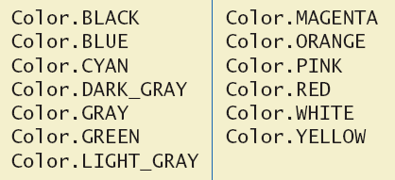
Specifying a Drawing Color
Figure 3.10 Predefined Colors for the setColor Method

Slide 92
A Dialog Box for a Yes-or-No Question
Used to present the user with a yes/no question
The window contains
  The question text
  Two buttons labeled yes and no.

Slide 93
A Dialog Box for a Yes-or-No Question
Example
  int answer =
  JOptionPane.showConfirmDialog(null,
  "End program?",
  "Click Yes or No:",
  JOptionPane.YES_NO_OPTION);
  if (answer == JOptionPane.YES_OPTION)
  System.exit(0);
  else if (answer == JOptionPane.NO_OPTION)
  System.out.println("One more time");

Slide 94
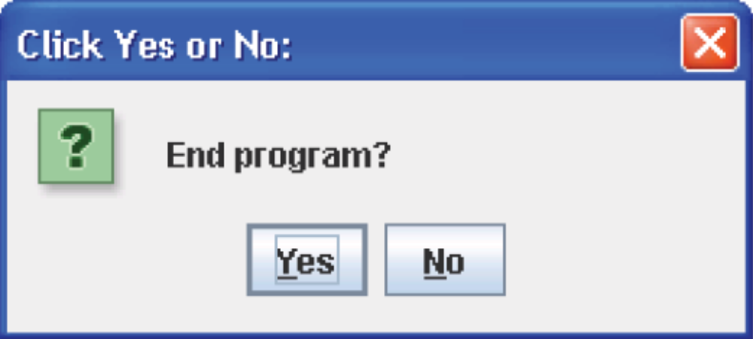
A Dialog Box for a Yes-or-No Question
Figure 3.11 A Yes-or No-Dialog Box

Slide 95
Summary
You have learned about Java branching statements.
You have learned about the type boolean.
(optional) You have learned to use color and the JOptionPane yes/no window.

