Slide 1
More About Objects and Methods
Chapter 6

Slide 2
Objectives
Define and use constructors
Write and use static variables and methods
Use methods from class Math
Use predefined wrapper classes
Use stubs, drivers to test classes and programs

Slide 3
Objectives
Write and use overloaded methods
Define and use enumeration methods
Define and use packages and import statements
Add buttons and icons to applets
Use event-driven programming in an applet

Slide 4
Constructors: Outline
Defining Constructors
Calling Methods from Constructors
Calling a Constructor from Other Constructors

Slide 5
Defining Constructors
A special method called when instance of an object created with new
  Create objects
  Initialize values of instance variables
Can have parameters
  To specify initial values if desired
May have multiple definitions
  Each with different numbers or types of parameters

Slide 6
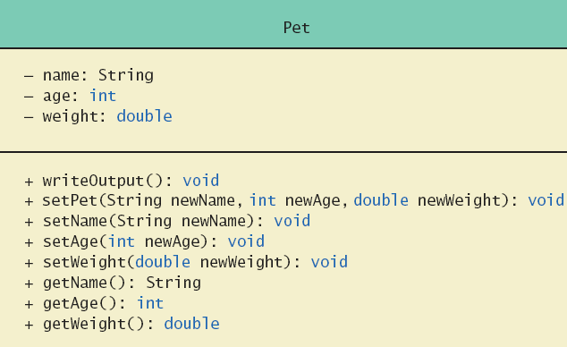
Defining Constructors
Example class to represent pets
Figure 6.1 Class Diagram for Class Pet

Slide 7
Defining Constructors
Note sample code, listing 6.1
class Pet
Note different constructors
  Default
  With 3 parameters
  With String parameter
  With double parameter
Note sample program, listing 6.2
class PetDemo

Slide 8
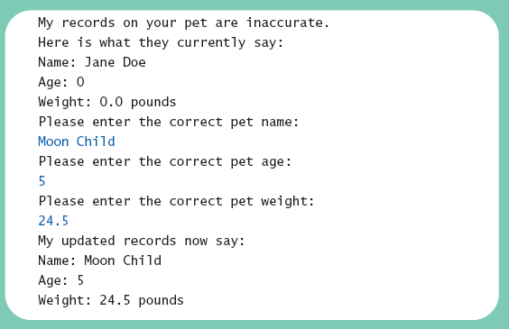
Defining Constructors
Sample
screen output

Slide 9
Defining Constructors
Constructor without parameters is the default constructor
  Java will define this automatically if the class designer does not define any constructors
  If you do define a constructor, Java will not automatically define a default constructor
Usually default constructors not included in class diagram

Slide 10
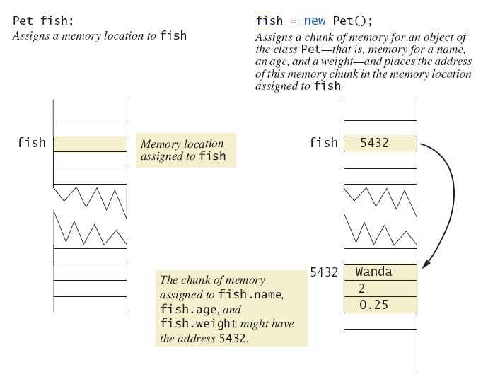
Defining Constructors
Figure 6.2 A constructor returning a reference

Slide 11
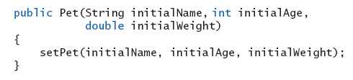
Calling Methods from Other Constructors
Constructor can call other class methods
View sample code, listing 6.3
class Pet2
  Note method set
  Keeps from repeating code

Slide 12
Calling Constructor from Other Constructors
From listing 6.3 we have the initial constructor and method set
In the other constructors use the this reference to call initial constructor
View revised class, listing 6.4
class Pet3
  Note calls to initial constructor

Slide 13
Static Variables & Methods: Outline
Static Variables
Static Methods
Dividing the Task of a main Method into Subtasks
Adding a main Method to a class
The Math Class
Wrapper Classes

Slide 14
Static Variables
Static variables are shared by all objects of a class
  Variables declared static final are considered constants – value cannot be changed
Variables declared static (without final) can be changed
  Only one instance of the variable exists
  It can be accessed by all instances of the class

Slide 15
Static Variables
Static variables also called class variables
  Contrast with instance variables
Do not confuse class variables with variables of a class type
Both static variables and instance variables are sometimes called fields or data members

Slide 16
Static Methods
Some methods may have no relation to any type of object
Example
  Compute max of two integers
  Convert character from upper- to lower case
Static method declared in a class
  Can be invoked without using an object
  Instead use the class name

Slide 17
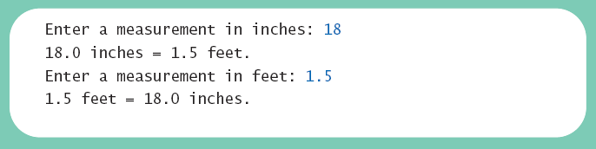
Static Methods
View sample class, listing 6.5
class DimensionConverter
View demonstration program, listing 6.6
class DimensionConverterDemo
Sample
screen output

Slide 18
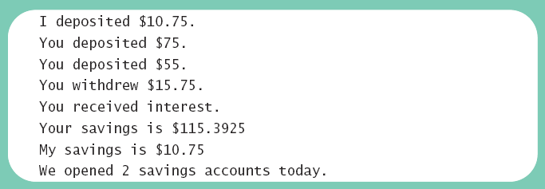
Mixing Static and Nonstatic Methods
View sample class, listing 6.7
class SavingsAccount
View demo program, listing 6.8
class SavingsAccountDemo
Sample
screen output

Slide 19
Tasks of main in Subtasks
Program may have
  Complicated logic
  Repetitive code
Create static methods to accomplish subtasks
Consider example code, listing 6.9
a main method with repetitive code
Note alternative code, listing 6.10
uses helping methods

Slide 20
Adding Method main to a Class
Method main used so far in its own class within a separate file
Often useful to include method main within class definition
  To create objects in other classes
  To be run as a program
Note example code, listing 6.11
a redefined class Species
  When used as ordinary class, method main ignored

Slide 21
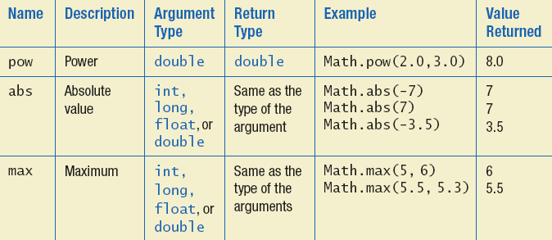
The Math Class
Provides many standard mathematical methods
  Automatically provided, no import needed
Example methods, figure 6.3a

Slide 22
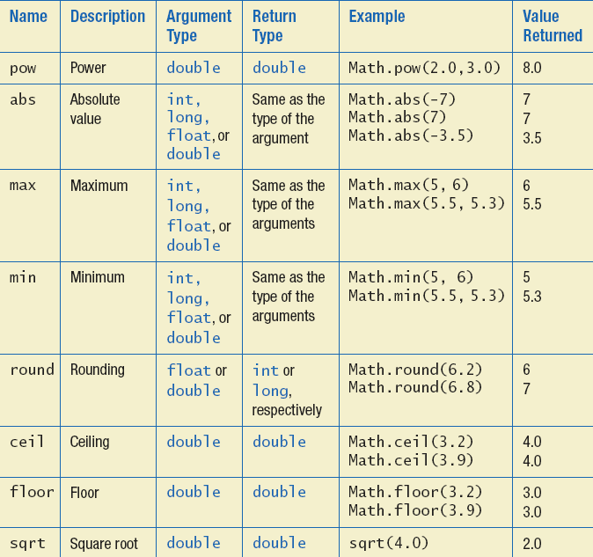
The Math Class
Example methods, figure 6.3b

Slide 23
Random Numbers
Math.random()returns a random double that is greater than or equal to zero and less than 1
Java also has a Random class to generate random numbers
Can scale using addition and multiplication; the following simulates rolling a six sided die
  int die = (int) (6.0 * Math.random()) + 1;

Slide 24
Wrapper Classes
Recall that arguments of primitive type treated differently from those of a class type
  May need to treat primitive value as an object
Java provides wrapper classes for each primitive type
  Methods provided to act on values

Slide 25
Wrapper Classes
Allow programmer to have an object that corresponds to value of primitive type
Contain useful predefined constants and methods
Wrapper classes have no default constructor
  Programmer must specify an initializing value when creating new object
Wrapper classes have no set methods

Slide 26
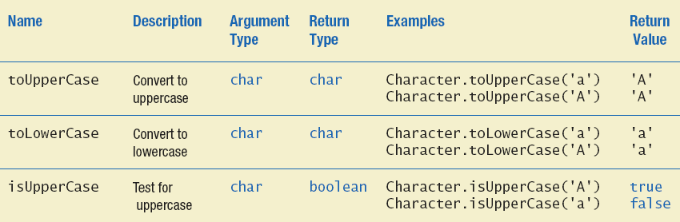
Wrapper Classes
Figure 6.4a Static methods in class Character

Slide 27
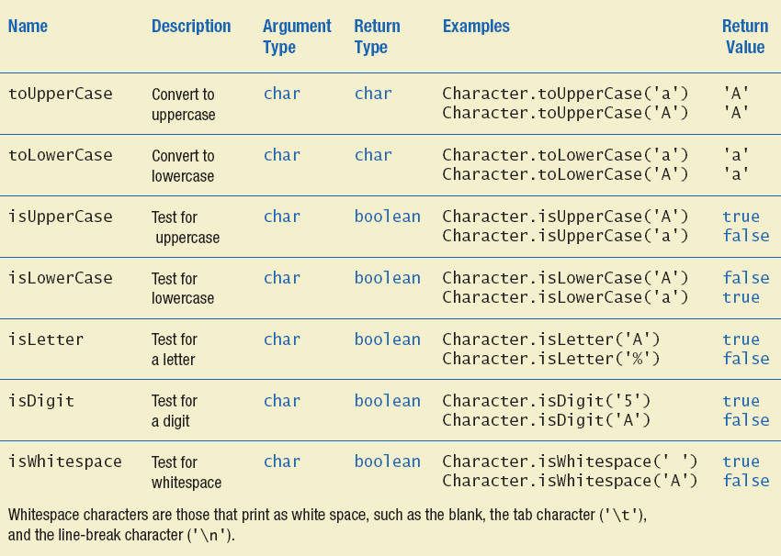
Wrapper Classes
Figure 6.4b Static methods in class Character

Slide 28
Writing Methods: Outline
Case Study: Formatting Output
Decomposition
Addressing Compiler Concerns
Testing Methods

Slide 29
Formatting Output
Algorithm to display a double amount as dollars and cents
1. dollars = the number of whole dollars in amount.
2. cents = the number of cents in amount. Round if there are more than two digits after the decimal point.
3. Display a dollar sign, dollars, and a decimal point.
4. Display cents as a two-digit integer.

Slide 30
Formatting Output
View sample code, listing 6.12
class DollarFormatFirstTry
  Note code to separate dollars and cents
  Note if-else statement
View sample program, listing 6.13
class DollarFormatFirstTryDriver
  Note call to the write method

Slide 31
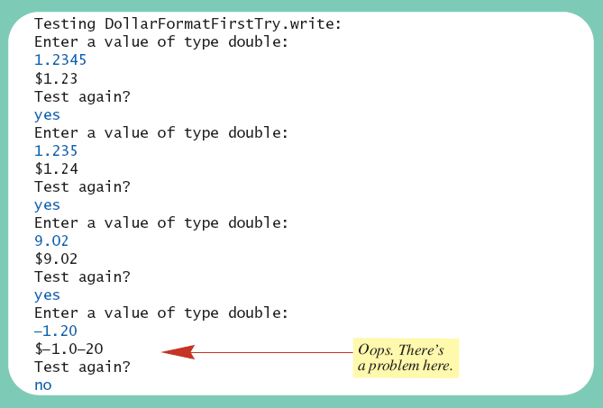
Formatting Output
Sample
screen output

Slide 32
Formatting Output
View corrected code, listing 6.14
class DollarFormat
  Note code to handle negative values
Program in listing 6.13 will now print values correctly

Slide 33
Decomposition
Recall pseudocode from previous slide
With this pseudocode we decompose the task into subtasks
  Then solve each subtask
  Combine code of subtasks
  Place in a method

Slide 34
Addressing Compiler Concerns
Compiler ensures necessary tasks are done
  Initialize variables
  Include return statement
Rule of thumb: believe the compiler
  Change the code as requested by compiler
  It is most likely correct

Slide 35
Testing Methods
To test a method use a driver program
  Example – code in listing 6.13
Every method in a class should be tested
Bottom-up testing
  Test code at end of sequence of method calls first
Use a stub – simplified version of a method for testing purposes

Slide 36
Overloading: Outline
Overloading Basics
Overloading and Automatic Type Conversion
Overloading and the Return Type
Programming Example: A Class for Money

Slide 37
Overloading Basics
When two or more methods have same name within the same class
Java distinguishes the methods by number and types of parameters
  If it cannot match a call with a definition, it attempts to do type conversions
A method's name and number and type of parameters is called the signature

Slide 38

Overloading Basics
View example program, listing 6.15
class Overload
Note overloaded method getAverage
Sample
screen output

Slide 39
Overloading and Type Conversion
Overloading and automatic type conversion can conflict
Recall definition of Pet class of listing 6.1
  If we pass an integer to the constructor we get the constructor for age, even if we intended the constructor for weight
Remember the compiler attempts to overload before it does type conversion
Use descriptive method names, avoid overloading

Slide 40
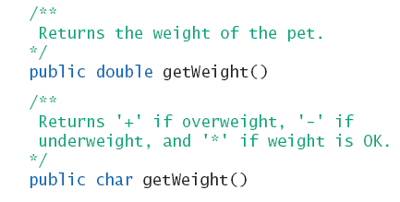
Overloading and Return Type
You must not overload a method where the only difference is the type of value returned

Slide 41
Programming Example
A class for money
View sample class, listing 6.16
class Money
Note use of
  Private instance variables
  Methods to set values
  Methods for doing arithmetic operations

Slide 42
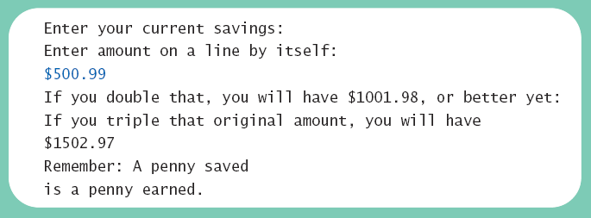
Programming Example
View demo program, listing 6.17
class MoneyDemo
Sample
screen output

Slide 43
Information Hiding Revisited
Privacy Leaks
Instance variable of a class type contain address where that object is stored
Assignment of class variables results in two variables pointing to same object
  Use of method to change either variable, changes the actual object itself
View insecure class, listing 6.18
class petPair

Slide 44
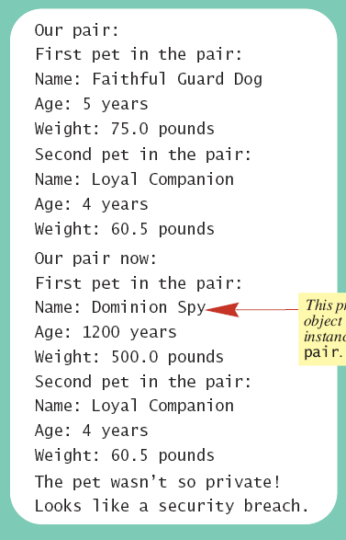

Information Hiding Revisited
View sample
program,
listing 6.19
class Hacker
Sample
screen output

Slide 45
Enumeration as a Class
Consider defining an enumeration for
suits of cards
enum Suit {CLUBS, DIAMONDS, HEARTS, SPADES}
Compiler creates a class with methods
  equals
  compareTo
  ordinal
  toString
  valueOf

Slide 46
Enumeration as a Class
View enhanced enumeration, listing 6.20
enum Suit
Note
  Instance variables
  Additional methods
  Constructor

Slide 47
Packages: Outline
Packages and Importing
Package Names and Directories
Name Clashes

Slide 48
Packages and Importing
A package is a collection of classes grouped together into a folder
Name of folder is name of package
Each class
  Placed in a separate file
  Has this line at the beginning of the file
  package Package_Name;
Classes use packages by use of import statement

Slide 49
Package Names and Directories
Package name tells compiler path name for directory containing classes of package
Search for package begins in class path base directory
  Package name uses dots in place of / or \
Name of package uses relative path name starting from any directory in class path

Slide 50
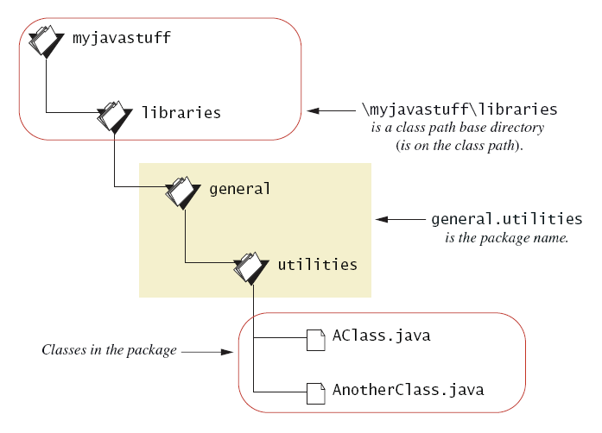
Package Names and Directories
Figure 6.5 A package name

Slide 51
Name Clashes
Packages help in dealing with name clashes
  When two classes have same name
Different programmers may give same name to two classes
  Ambiguity resolved by using the package name

Slide 52
Graphics Supplement: Outline
Adding Buttons
Event-Driven Programming
Programming Buttons
Programming Example: A Complete Applet with Buttons
Adding Icons
Changing Visibility
Programming Example: An Example of Changing Visibility

Slide 53
Adding Buttons
Create object of type Jbutton
  Then add to content pane
Possible to associate an action with a button
View applet example, listing 6.21
class PreliminaryButtonDemo

Slide 54
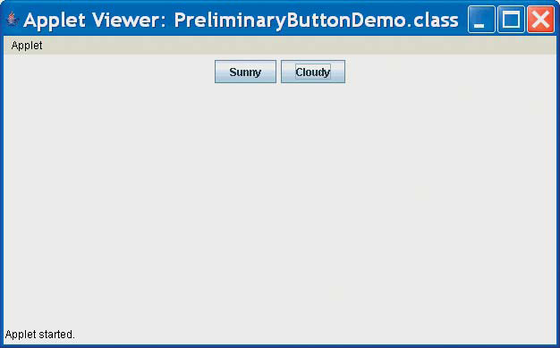
Adding Buttons
Applet Output
If the user clicks either of these buttons, nothing happens.

Slide 55
Event-Driven Programming
Applets use events and event handlers
An event
  An object that represents some user action which elicits a response
  Example: clicking on button with mouse
Listener objects are specified to receive the events
  Listener objects have event handler methods

Slide 56

Event-Driven Programming
Figure 6.6 Event firing and an event listener
This event object is the result of a button click. The event object goes from the button to the listener.
This listener object performs some action, such as making text visible in the applet, when it receives the event object.

Slide 57
Programming Buttons
When an event is "sent" to the listener object …
  A method of the listener object is invoked
  The event object is given to the listener object method as the argument
For each button
  Specify the listener object (register the listener)
  Methods to be invoked must be defined

Slide 58
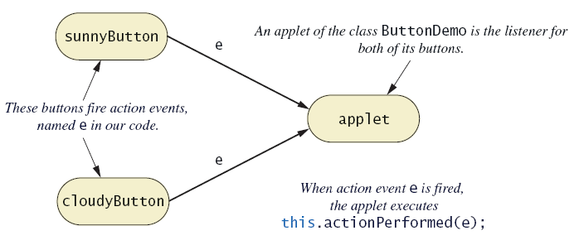
Programming Buttons
Figure 6.7 Buttons and an action listener

Slide 59
Programming Buttons
Buttons fire events as objects of class ActionEvent
Event objects handled by action listeners
To make a class an action listener
  Add phrase implements ActionListener to heading of class definition
  Register the action listener by invoking addActionListener
  Add definition named actionPerformed to class

Slide 60

Programming Buttons
To be an action listener, a class must have
  A method named actionPerformed
  The method has a parameter of type ActionEvent
  This is the only method required by the ActionListener interface
Syntax

Slide 61
Programming Example
A Complete Applet with Buttons
View applet code, listing 6.22
class ButtonDemo
Note features
  Specification implements ActionListener
  Invocation of addActionListener
  Method actionPerformed

Slide 62
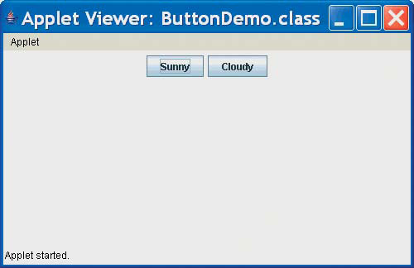
Programming Example
Initial applet output

Slide 63
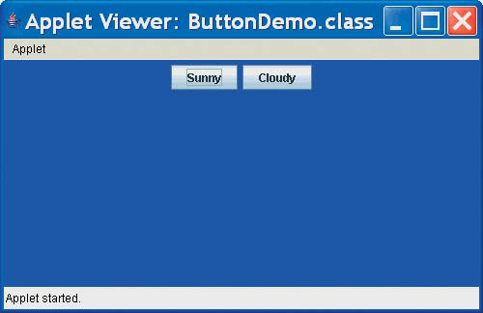
Programming Example
Applet output after clicking Sunny

Slide 64
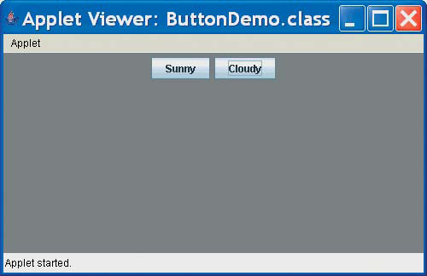
Programming Example
Applet output after clicking Cloudy

Slide 65
Adding Icons
An icon is a picture
  Usually small (but not necessarily)
  Often a .GIF or .JPEG file
  Picture file stored in same folder as program
Icon can be added to a label, button, or other component
Class ImageIcon used to convert digital image to icon

Slide 66
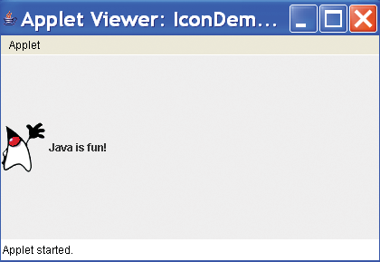
Adding Icons
View sample applet, listing 6.23
class IconDemo
Note
  Creation of icon
  Attaching
  icon to label
Sample
screen output

Slide 67
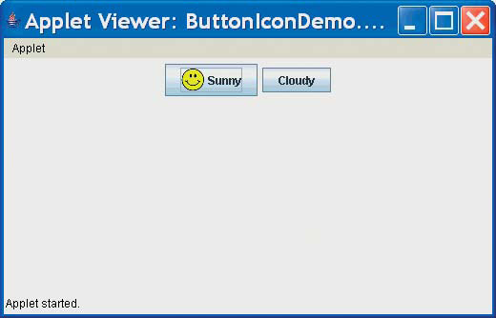
Adding Icons
Figure 6.8 A button containing an icon

Slide 68
Changing Visibility
Components have a method named setVisible
  Changes component from visible to invisible (or the other way)
An invisible component is considered not there
  Thus an invisible button would be inoperable

Slide 69
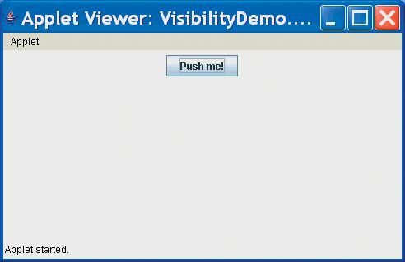
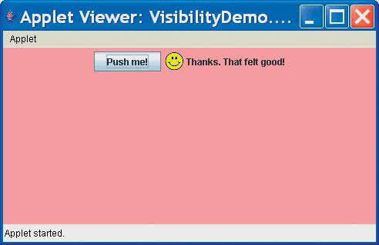
Programming Example
An Example of Changing Visibility
View sample applet, listing 6.24
class VisibliityDemo

Slide 70
Summary
Constructor method creates, initializes object of a class
Default constructor has no parameters
Within a constructor use this as name for another constructor in same class
A static variable shared by all objects of the class

Slide 71
Summary
Primitive type has wrapper class to allow treatment as an object
Java performs automatic type cast between primitive type and object of wrapper class as needed
Divide method tasks into subtasks
Test all methods individually

Slide 72
Summary
Methods with same name, different signatures are overloaded methods
An enumeration is a class – can have instance variables, constructors, methods
A package of class definitions grouped together in same folder, contain a package statement at beginning of each class

