Slide 1
Chapter 1 Introduction to Computers, Programs, and Java

Slide 2
Objectives
To write a simple Java program (§1.7).
To display output on the console (§1.7).
To explain the basic syntax of a Java program (§1.7).
To create, compile, and run Java programs (§1.8).

Slide 3
A Simple Java Program
Listing 1.1
//This program prints Welcome to Java!
public class Welcome {
public static void main(String[] args) {
System.out.println("Welcome to Java!");
}
}
Welcome
IMPORTANT NOTE: (1) To enable the buttons, you must download the entire slide file slide.zip and unzip the files into a directory (e.g., c:\slide) . (2) You must have installed JDK and set JDK’s bin directory in your environment path (e.g., c:\Program Files\java\jdk1.6.0_14\bin in your environment path.
Run

Slide 4

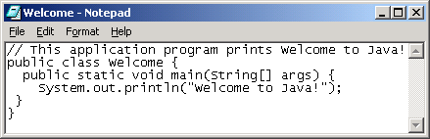
Creating and Editing Using NotePad
To use NotePad, type
notepad Welcome.java
from the DOS prompt.

Slide 5

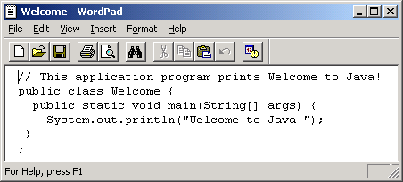
Creating and Editing Using WordPad
To use WordPad, type
write Welcome.java
from the DOS prompt.

Slide 6
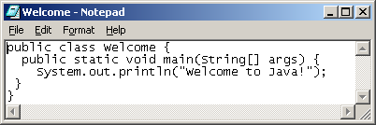
Creating, Compiling, and Running Programs

Slide 7

Compiling Java Programs
The Java compiler produces bytecode (a “.class” file) not machine code from the source code (the “.java” file).
Bytecode is converted into machine code using a Java Interpreter
Source Code
Bytecode

Slide 8
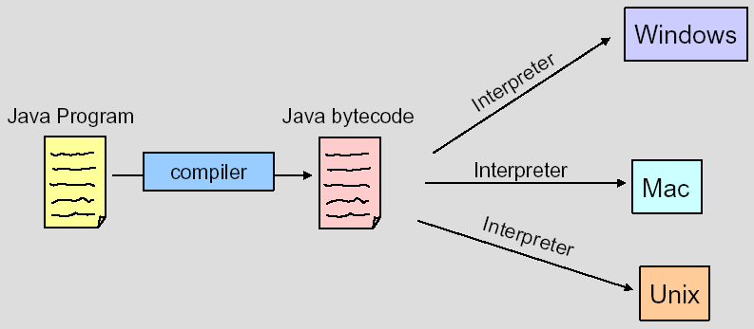
Platform Independent Java Programs Compiling
You can run bytecode on an computer that has a Java Interpreter installed
“Hello.java”
“Hello.class”

Slide 9
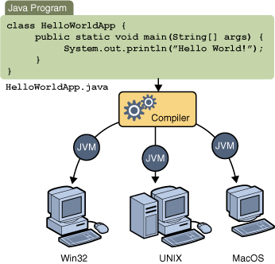
Multipurpose Java Compiling

Slide 10
Compiling Java Source Code
You can port a source program to any machine with appropriate compilers. The source program must be recompiled, however, because the object program can only run on a specific machine. Nowadays computers are networked to work together. Java was designed to run object programs on any platform. With Java, you write the program once, and compile the source program into a special type of object code, known as bytecode. The bytecode can then run on any computer with a Java Virtual Machine, as shown below. Java Virtual Machine is a software that interprets Java bytecode.

Slide 11
Trace a Program Execution
animation
Enter main method
//This program prints Welcome to Java!
public class Welcome {
public static void main(String[] args) {
System.out.println("Welcome to Java!");
}
}

Slide 12
Trace a Program Execution
animation
Execute statement
//This program prints Welcome to Java!
public class Welcome {
public static void main(String[] args) {
System.out.println("Welcome to Java!");
}
}

Slide 13
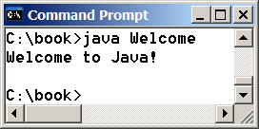
Trace a Program Execution
animation
//This program prints Welcome to Java!
public class Welcome {
public static void main(String[] args) {
System.out.println("Welcome to Java!");
}
}
print a message to the console

Slide 14
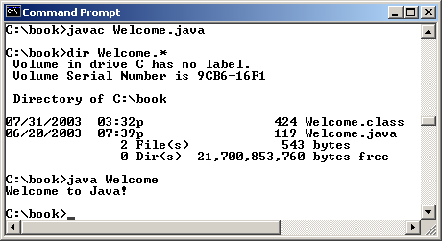
Compiling and Running Java from the Command Window
Set path to JDK bin directory
set path=c:\Program Files\java\jdk1.6.0\bin
Set classpath to include the current directory
set classpath=.
Compile
javac Welcome.java
Run
java Welcome

Slide 15
Anatomy of a Java Program
Comments
Reserved words
Modifiers
Statements
Blocks
Classes
Methods
The main method

Slide 16
Comments
Three types of comments in Java.
Line comment: A line comment is preceded by two slashes (//) in a line.
Paragraph comment: A paragraph comment is enclosed between /* and */ in one or multiple lines.
javadoc comment: javadoc comments begin with /** and end with */. They are used for documenting classes, data, and methods. They can be extracted into an HTML file using JDK's javadoc command.

Slide 17
Reserved Words
Reserved words or keywords are words that have a specific meaning to the compiler and cannot be used for other purposes in the program. For example, when the compiler sees the word class, it understands that the word after class is the name for the class. Other reserved words in Listing 1.1 are public, static, and void. Their use will be introduced later in the book.

Slide 18
Modifiers
Java uses certain reserved words called modifiers that specify the properties of the data, methods, and classes and how they can be used. Examples of modifiers are public and static. Other modifiers are private, final, abstract, and protected. A public datum, method, or class can be accessed by other programs. A private datum or method cannot be accessed by other programs. Modifiers are discussed in Chapter 6, “Objects and Classes.”

Slide 19
Statements
A statement represents an action or a sequence of actions. The statement System.out.println("Welcome to Java!") in the program in Listing 1.1 is a statement to display the greeting "Welcome to Java!" Every statement in Java ends with a semicolon (;).

Slide 20
Blocks
A pair of braces in a program forms a block that groups components of a program.

Slide 21
Classes
The class is the essential Java construct. A class is a template or blueprint for objects. To program in Java, you must understand classes and be able to write and use them. The mystery of the class will continue to be unveiled throughout this book. For now, though, understand that a program is defined by using one or more classes.

Slide 22
Methods
What is System.out.println? It is a method: a collection of statements that performs a sequence of operations to display a message on the console. It can be used even without fully understanding the details of how it works. It is used by invoking a statement with a string argument. The string argument is enclosed within parentheses. In this case, the argument is "Welcome to Java!" You can call the same println method with a different argument to print a different message.

Slide 23
main Method
The main method provides the control of program flow. The Java interpreter executes the application by invoking the main method.
The main method looks like this:
public static void main(String[] args) {
// Statements;
}

