Slide 1

Unit 8 Counters, RAM
College of Computer and Information Sciences
Department of Computer Science
CSC 220: Computer Organization

Slide 2
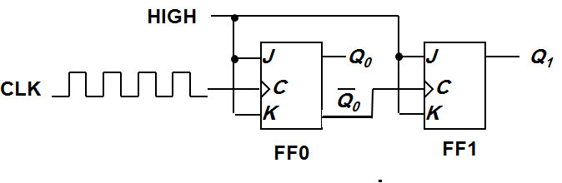
Asynchronous (Ripple) Counters
Example: 2-bit ripple binary counter.
Output of one flip-flop is connected to the clock input of the next more-significant flip-flop.
CLK
1
2
3
4
Q₀
Timing diagram
00 → 01 → 10 → 11 → 00 ...
Q₀
0
1
0
1
0
Q₁
0
0
1
1
0

Slide 3
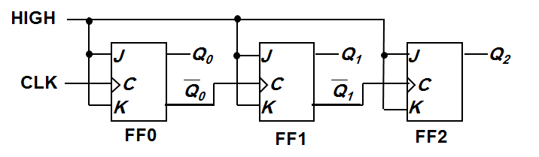
Asynchronous (Ripple) Counters
Example: 3-bit ripple binary counter.
CLK
1
2
3
4
5
6
7
8
Q₀
0
1
0
1
0
1
0
1
0
Q₁
0
0
1
1
0
0
1
1
0
Q₂
0
0
0
0
1
1
1
1
0
Recycles back to 0

Slide 4
Asyn. Counters with MOD no. < 2^{n}
Decade counters (or BCD counters) are counters with 10 states (modulus-10) in their sequence. They are commonly used in daily life (e.g.: utility meters, odometers, etc.).
Design an asynchronous decade counter.
(A.C)'
HIGH
J
Q
D
J
Q
C
J
Q
B
J
Q
A
CLK
C
C
C
C
K
K
K
K
CLR
CLR
CLR
CLR

Slide 5
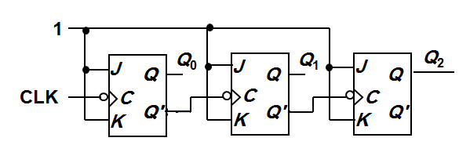
Asynchronous Down Counters
So far we are dealing with up counters. Down counters, on the other hand, count downward from a maximum value to zero, and repeat.
Example: A 3-bit binary (MOD-2³) down counter.
1
J
Q₀
J
Q₁
J
Q₂
3-bit binary up counter
Q
Q
Q
Q
CLK
C
C
C
Q'
K
Q'
K
Q'
K
Q'
3-bit binary down counter

Slide 6
Asyn. Counters with MOD no. < 2^{n}
Exercise: How to construct an asynchronous MOD-5 counter? MOD-7 counter? MOD-12 counter?
Question: The following is a MOD-? counter?
F
E
D
C
B
A
Q
J
Q
J
Q
J
Q
J
Q
J
Q
J
Q
K
Q
K
Q
K
Q
K
Q
K
Q
K
CLR
CLR
CLR
CLR
CLR
CLR
C
D
E F
All J = K = 1.

Slide 7
Asynchronous (Ripple) Counters
Propagation delays in an asynchronous (ripple-clocked) binary counter.
If the accumulated delay is greater than the clock pulse, some counter states may be misrepresented!
CLK
1
2
3
4
Q₀
Q₁
Q₂
t_{PHL} (CLK to Q₀)
t_{PHL} (CLK to Q₀)
t_{PLH}
(CLK to Q₀)
t_{PLH} (Q₀ to Q₁)
t_{PHL} (Q₀ to Q₁)
t_{PLH} (Q₁ to Q₂)

Slide 8
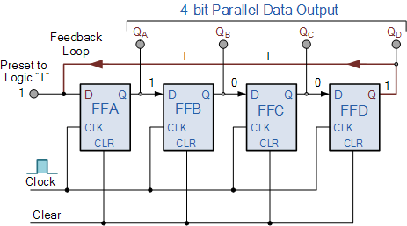
4-bit Ring Counter
A “CLEAR” signal is firstly applied to all the flip-flops together in order to “RESET” their outputs to a logic “0” level and then a “PRESET” pulse is applied to the input of the first flip-flop ( FFA ) before the clock pulses are applied. This then places a single logic “1” value into the circuit of the ring counter.
So on each successive clock pulse, the counter circulates the same data bit between the four flip-flops over and over again around the “ring” every fourth clock cycle. But in order to cycle the data correctly around the counter we must first “load” the counter with a suitable data pattern as all logic “0’s” or all logic “1’s” outputted at each clock cycle would make the ring counter invalid.

Slide 9
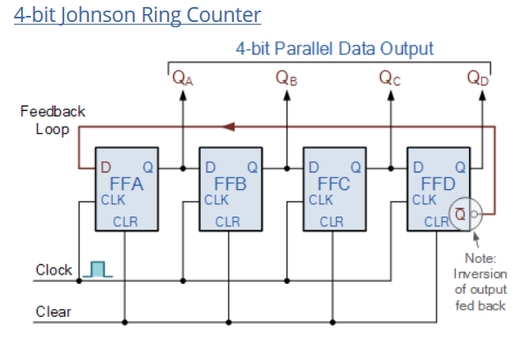
Johnson Ring Counter
The Johnson Ring Counter or “Twisted Ring Counters”, is another shift register with feedback exactly the same as the standard Ring Counter above, except that this time the inverted output Q of the last flip-flop is now connected back to the input D of the first flip-flop as shown below.

Slide 11
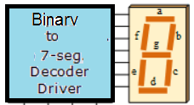

Slide 12
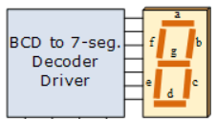

Slide 13
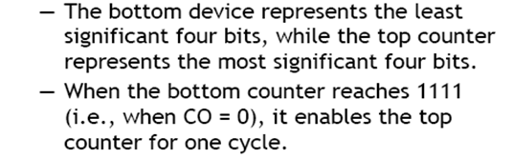
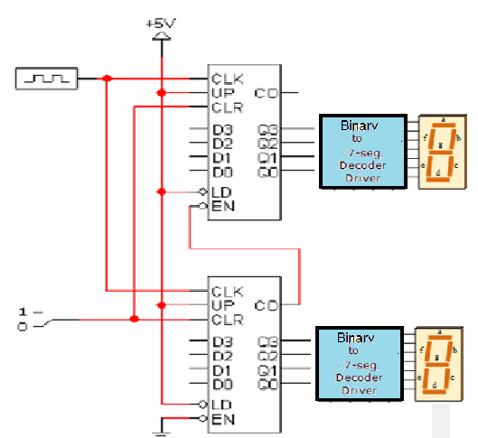
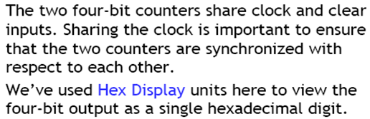

Slide 16
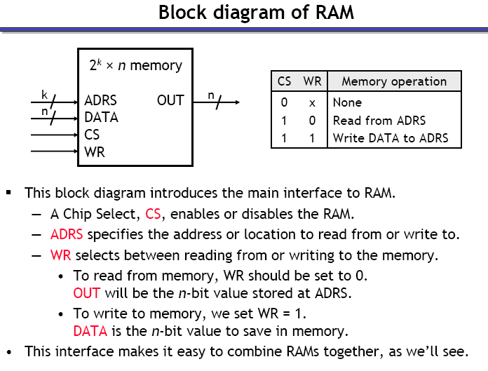

Slide 18
