Slide 1
Artificial Intelligence CSC 361
Tutorial
FOL

Slide 2
Q1:Translate the following first-order sentences into English:
1.∀x,bird(x) ⇒ flies(x)
2.∀x,∃y,person(x) ⇒ mother(y,x) 3. ∃x, ∀y, person(x) ∧ mother(x, y)
4.∀x,y,mother(x,y) =⇒ ¬mother(y,x)
where:
• bird(x) means x is a bird, • flies(x) means x flies, • person(x) means x is a person, • mother(x, y) means x is the mother of y.

Slide 3
1.∀x,bird(x) ⇒ flies(x)
All birds fly.
2.∀x,∃y,person(x) ⇒ mother(y,x)
Every person has a mother.
3. ∃x, ∀y, person(x) ∧ mother(x, y)
All persons have at least one common mother.
4.∀x,y,mother(x,y) =⇒ ¬mother(y,x)
A person is not the mother of his/her mother.

Slide 4
Q2:Translate the following natural language statements into first order logic:
1. There is exactly one student that received a grade A in CSC 411.
2. Only one CS class is named ”Artificial Intelligence”. 3. All red apples are delicious.
4. Some apples are not red, yet they are delicious.
5. The enemy of the enemy of a person is his friend.

Slide 5
1. There is exactly one student that received a grade A in CSC 411.
∃x, Student (x) ∧ [Grade (x, CSC411) = A] ∧(∀y,Student(y)∧[Grade(y,C411)=A] )⇒ y=x
2.Only one CS class is named ”Artificial Intelligence”.
∃x,Course(x,CS)∧[Name(x) = ”AI”] ∧∀y,Course(y,CS)∧[Name(y)=”AI”] ⇒ y=x
3. All red apples are delicious.
∀x,Apple(x)∧Red(x) ⇒ Delicious(x)
4.Some apples are not red, yet they are delicious.
∃x,Apple(x)∧¬Red(x)∧Delicious(x)
5. The enemy of the enemy of a person is his friend.
∀x,y,z,Person(x)∧Enemy(y,x)∧Enemy(z,y) ⇒ Friend(z,x)

Slide 6
Table 1: Some tips for translating into FOL. P (x) can be any predicate.
At least one x verifies P (x) At most one x verifies P (x) Exactly one x verifies P (x) | ∃x, P (x) ∀x,y, P(x)∧P(y) ⇒ x=y ∃x, P(x)∧∀y, P(y) ⇒ x=y

Slide 7
Q3:Convert the following KB into propositional logic:
∀x,WonPrize(x) ⇒ Happy(x).
∀y,PlayGame(y)∧Lucky(y) ⇒ WonPrize(y).
PlayGame(Ali).
PlayGame(Mona).
Lucky(Ali).
Happy(Mona).
Can you deduce who won the prize and whether (s)he is happy?

Slide 8
First we apply universal instantiation to the first and second rules. We have two values in our domain: Ali and Mona.
A1:WonPrize (Ali) ⇒ Happy (Ali), Replace x with Ali
A2: WonPrize(Mona) ⇒ Happy(Mona), Replace x with Mona
A3: PlayGame (Ali) ∧ Lucky (Ali) ⇒ WonPrize (Ali), Replace y with Ali
A4:PlayGame (Mona) ∧ Lucky (Mona) ⇒ WonPrize (Mona)
A5:PlayGame(Ali).
A6:PlayGame(Mona).
A7:Lucky(Ali).
A8:Happy(Mona)

Slide 9
Now we apply the inference rules of propositional logic.
A9: PlayGame (Ali) ∧ Lucky (Ali), A5 & A7, And introduction
A10: WonPrize(Ali), A3 & A9, Modus Ponens A11: Happy (Ali), A1 & A10, Modus Ponens
So Ali won the prize and he is happy. Note that we can not know whether Mona won the prize or not.

Slide 10
Q4: Given the following:
1.A1:∀x,y,On(x,y) ⇒ Above(x,y).
2.A2:∀x,y,z,On(x,y)∧Above(y,z)⇒ Above(x,z).
3. A3:∀x, On(A, x). 4. A4:∀x, On(x, C).
Prove: Above(A,C).
We use inference rules of FOL.
A5: Above (x, c), A1 & A4, Generalized Modus Ponens, θ = {y/C}.
A6: On (A, x) ∧ Above (x, c), A3 & A5, And introduction, θ = {}
A7: Above (A, C),
A2 & A6, Generalized Modus Ponens, first rename x by w in A6, then apply θ = {x/A, y/w, z/C}

Slide 11
Q5
The American law says that it is a crime for an American to sell weapons to hostile nations. The country Nano, an enemy of America, has some missiles, and all of its missiles were sold to it by Colonel West, who is American. Prove using forward and backward chaining that West is a criminal.

Slide 12
FOL
A1: American(x)∧Weapon(y)∧Sells(x,y,z)∧Hostile(z) ⇒ Criminal(x)
A2:Owns(Nano,M1) A3:Missile(M1) A4: Missile(x)∧Owns(Nano,x) ⇒ Sells(West,x,Nano)
A5:Missile(x) ⇒ Weapon(x)
A6: Enemy(x,America) ⇒ Hostile(x)
A7:American(West)
A8: Enemy(Nano,America)

Slide 13
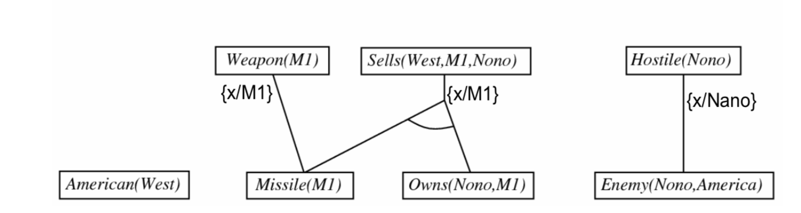
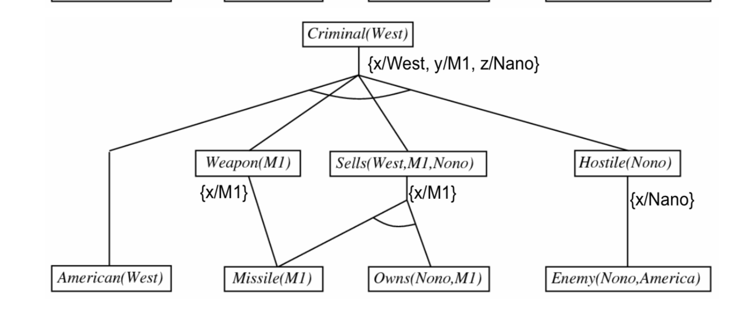
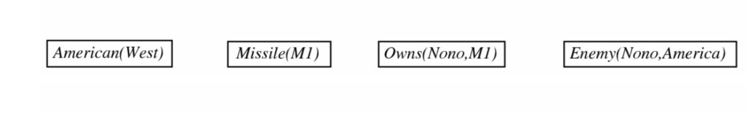
using forward that West is a criminal.

Slide 14

Using Backward chaining

Slide 15
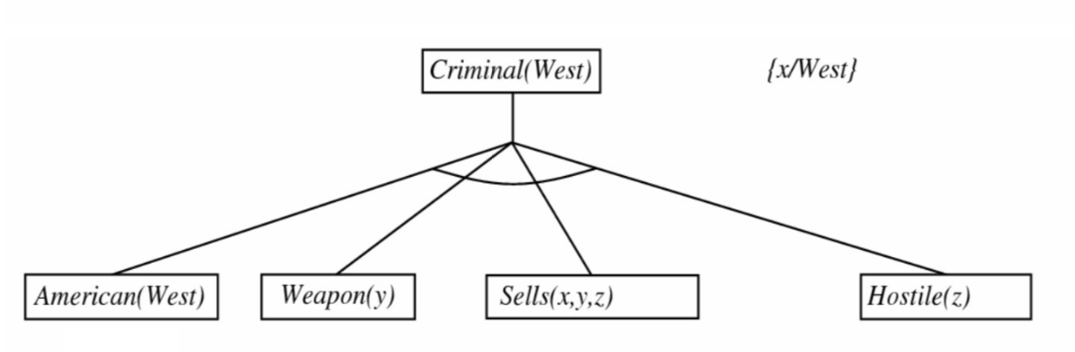

Slide 16
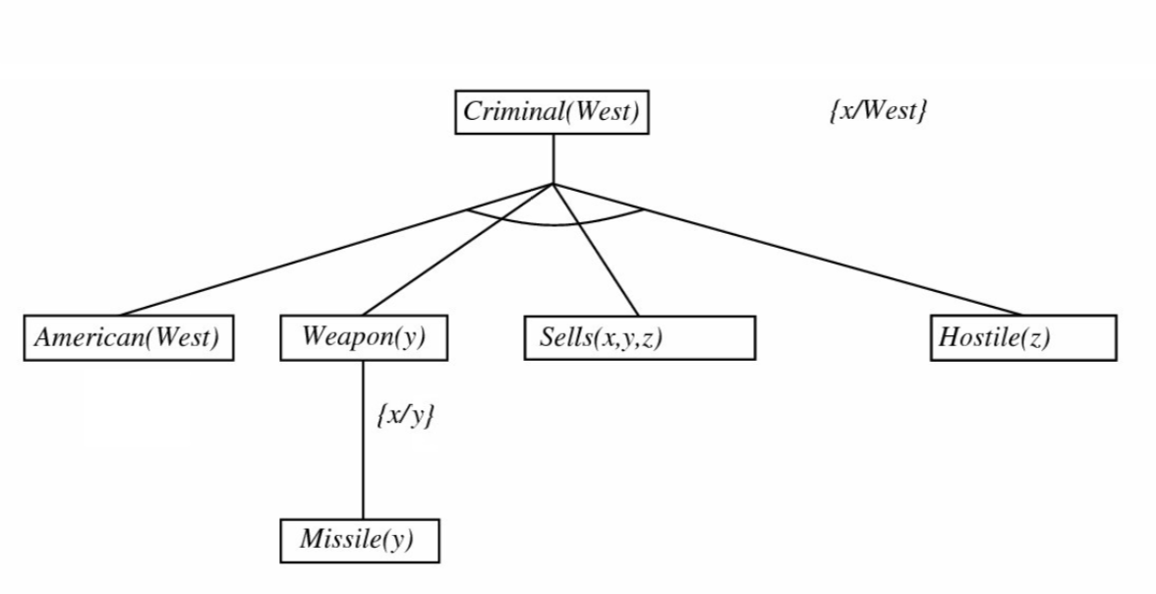

Slide 17
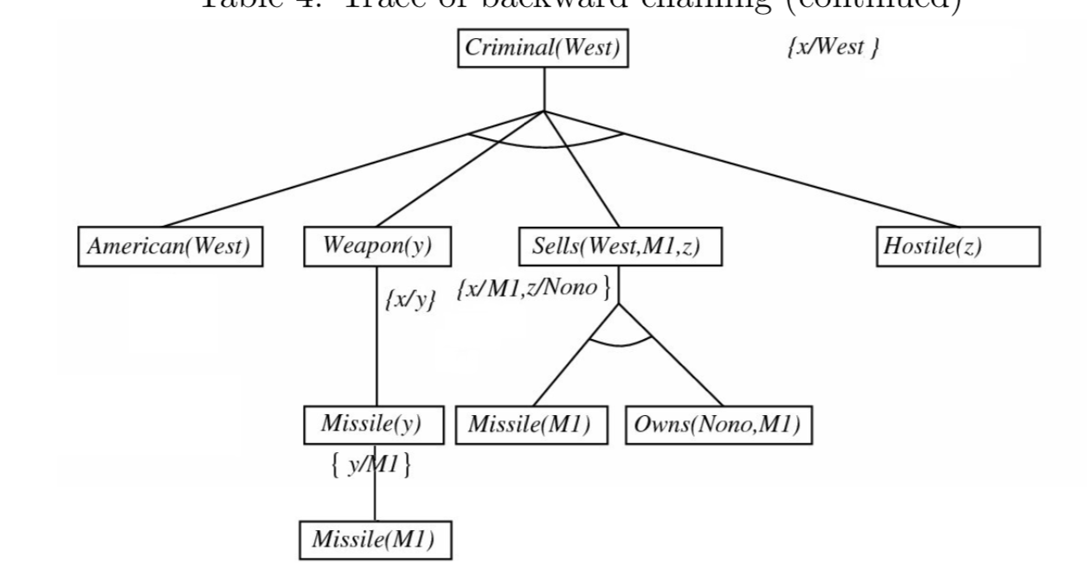

Slide 18
