Slide 2
Chapter 4
Mathematical Expectation
Chapter 4
Mathematical Expectation

Slide 3
Chapter 4.1
Mean of a Random Variable
Mean of a Random Variable
If two coins are tossed 16 times and X is the number of heads that occur per toss, then the values of X can be 0, 1, and 2.
Suppose that the experiment yields no heads, one head, and two heads a total of 4, 7, and 5 times, respectively.
The average number of heads per toss of the two coins is then
The value means that on average we can expect that by each toss the head will occur for 1.06 times and no head for 0.94 times.
1.06 is called an expected value, a term used to describe the long-term average outcome of a given scenario.

Slide 4
Chapter 4.1
Mean of a Random Variable
Mean of a Random Variable
Let X be a random variable with probability distribution f(x). The mean or expected value of X is
if X is discrete, and
if X is continuous.

Slide 5
Chapter 4.1
Mean of a Random Variable
Mean of a Random Variable
A lot containing 7 components is sampled by a quality inspector, the lot contains 4 good components and 3 defective components. A sample of 3 is taken by the inspector. Find the expected value of the number of good components in this sample
Let X represent the number of good components in the sample. The probability distribution of X is
Thus, if 3 components are selected at random over and over again from a lot of 4 good components and 3 defective components, one will pick on average 1.7 good components and, accordingly, 1.3 bad components.

Slide 6
Chapter 4.1
Mean of a Random Variable
Mean of a Random Variable
In a gambling game a man is paid $5 if he gets all heads or all tails when three coins are tossed, and he will pay out $3 if either one or two heads show. What is his expected gain?
The sample space for the possible outcomes of this game is
Each of these events is equally likely and occurs with probability of each equal to 1/8.
Let Y be the amount of money the gambler can win, E₁ is the event of winning 5$ and E₂ is event of losing $3,
In this game the gambler will, on average, loss $1 per toss of the three coins.

Slide 7
Chapter 4.1
Mean of a Random Variable
Mean of a Random Variable
A salesperson has two appointments on a given day. He believes that he has 70% chance to make the deal at the first appointment, from which he can earn $1000 commission if successful. On the other hand, he thinks he only has a 40% chance to make the deal at the second appointment, which will give him $1500 if successful.
What is his expected commission based on his own probability belief? Assume that the appointment results are independent of each other.
Let X be the commission the salesperson will earn. Due to independence, the probabilities can be calculated as

Slide 8
Chapter 4.1
Mean of a Random Variable
Mean of a Random Variable
Let X be the random variable that denotes the life in hours of a certain electronic device. The probability density function is
Find the expected life of this type of device.
Therefore, we can expect this type of device to function well for, on average, 200 hours.

Slide 9
Chapter 4.1
Mean of a Random Variable
Mean of a Random Variable
Let X be a random variable with probability distribution f(x). The mean or expected value of the random variable g(X) is
if X is discrete, and
if X is continuous.

Slide 10

Chapter 4.1
Mean of a Random Variable
Mean of a Random Variable
Suppose that the number of cars X that pass through a car wash between 4:00 P.M. and 5:00 P.M. on any sunny Friday has the following probability distribution:
Let g(X) = 2X – 1 represent the amount of money in dollars, paid to the attendant by the manager. Find the attendant’s expected earnings for this particular time period.

Slide 11
Chapter 4.1
Mean of a Random Variable
Mean of a Random Variable
Let X be a random variable with density function
Find the expected value of g(X) = 4X + 3.

Slide 12
Chapter 4.1
Mean of a Random Variable
Mean of a Random Variable
Let X and Y be random variables with joint probability distribution f(x,y). The mean or expected value of the random variable g(X,Y) is
if X and Y are discrete, and
if X and Y are continuous.

Slide 13
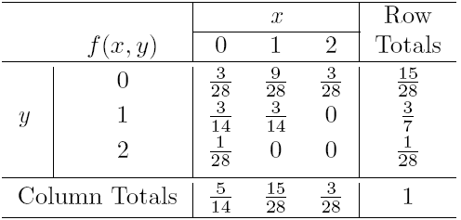
Chapter 4.1
Mean of a Random Variable
Mean of a Random Variable
Let X and Y be a random variables with joint probability density function as in the “ballpoint pens” example. Find the expected value of g(X,Y) = XY

Slide 14
Chapter 4.1
Mean of a Random Variable
Mean of a Random Variable
Find E(Y/X) for the density function

Slide 15
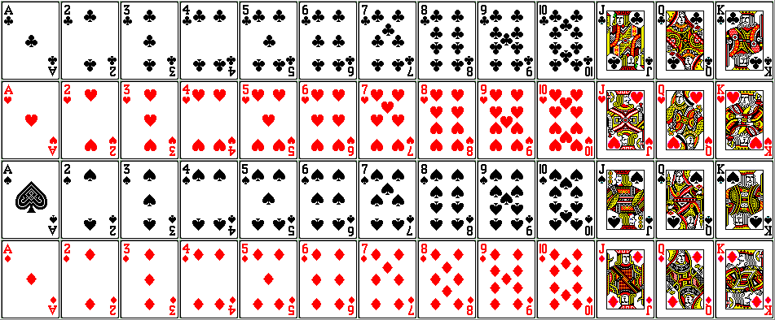
Probability and Statistics
Homework 4A
From a regular deck of 52 playing cards we pick one at random. Let the random variable X equal the number on the card if it is a numbered one (ace counts as 1) and 10 if it is a face card (J, Q, and K). Find E(X).
1
2
3
4
5
6
7
8
9
10
10
10
10
Four indistinguishable balls are distributed randomly into 3 distinguishable boxes. Let X denote the number of balls that end up in the first box. Find E(X). (Sch.E5.1.1-2)

