Slide 1
Turning Data into Retention:
Telco’s Churn Prediction Model
Capstone Project Presentation
Elliot Gaynon

Slide 2
Business Problem
Telco has seen a sharp rise in customer churn due to increased competition.
Losing customers directly impacts revenue and customer lifetime value.
Reactive retention strategies are costly and inefficient.

Slide 3
Project Objective
Develop a predictive model to identify customers most likely to churn.
Enable proactive, targeted retention efforts.
Provide insights into the key drivers behind churn behavior.

Slide 4
Data Overview
7,032 customer records after cleaning.
21 features covering demographics, services, and account details.
Target variable: Customer churn in the previous month.

Slide 5
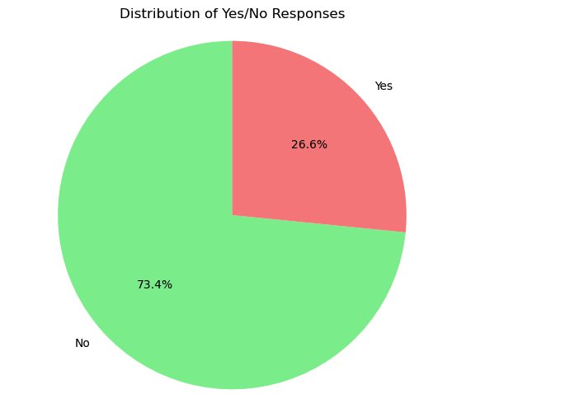
Key Insights from EDA
Overall churn rate: 26.6%.

Slide 6
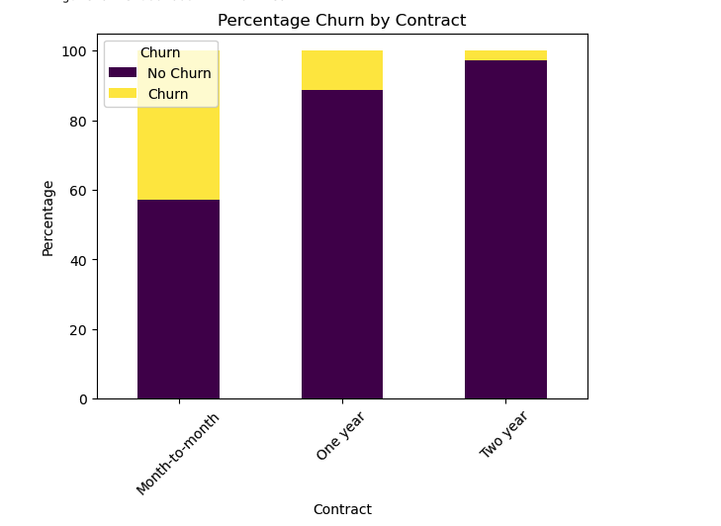
Key Insights from EDA
Customers on month-to-month contracts churn significantly more.

Slide 7
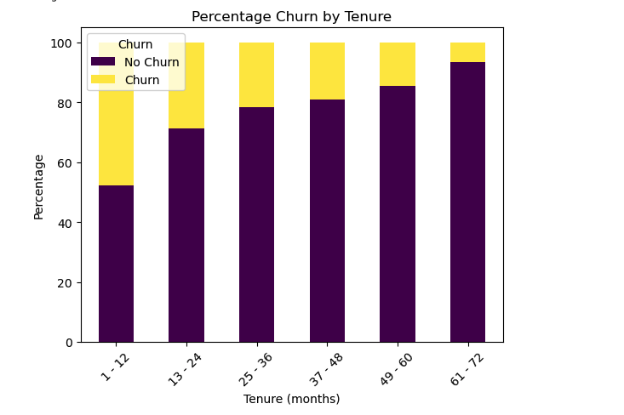
Key Insights from EDA
Longer tenure strongly correlates with lower churn.

Slide 8
Modeling Approach
Tested Logistic Regression, Random Forest, KNN, and XGBoost.
Handled class imbalance (~3:1 non-churn to churn).

Slide 9
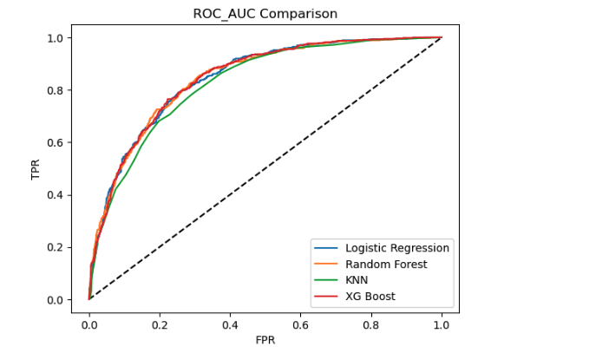
Modeling Approach
Selected best model using ROC-AUC.

Slide 10
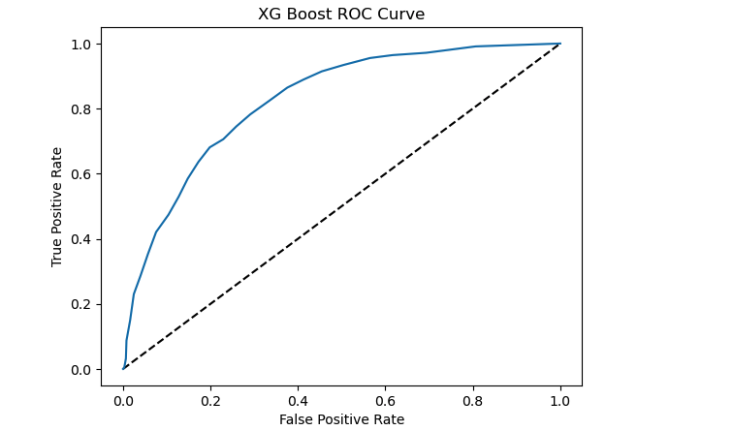
Best Model Performance (XGBoost)
ROC-AUC: 84.5% (best among all models).

Slide 11
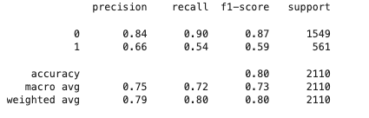
Best Model Performance (XGBoost)
While accuracy was 80%, recall for Churn class 54%.

Slide 12
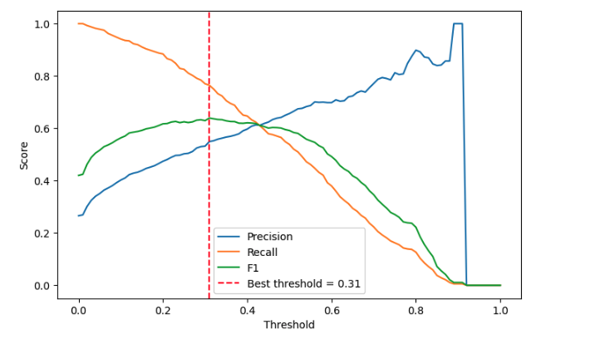
Best Model Performance (XGBoost)
Optimized decision threshold to prioritize recall without sacrificing too much precision.

Slide 13
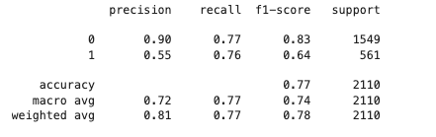
Best Model Performance (XGBoost)
Recall for churners improved to 76%.

Slide 14
Conclusion & Business Impact
Model accurately identifies high-risk customers before churn occurs.
Supports targeted retention campaigns and better budget allocation.
Prioritizing recall reduces missed churn opportunities.

