Slide 1
Predicting Near-Term Customer Value to Improve Promotional Targeting
Elliot Gaynon
Capstone Presentation
March 2026

Slide 2
Business Problem
Promotions often fail to generate revenue.
Marketing budgets are limited
Goal: Identify customers likely to generate revenue soon.

Slide 3
Context, Stakeholders, Success Metrics
Stakeholders: Marketing teams, CRM managers, business analysts
Success Metrics: RMSE accuracy and ability to identify high‑value customers
Business Impact: Improved marketing ROI
Constraints: Skewed revenue and many zero‑revenue customers

Slide 4
Framing the Data Science Problem
Supervised regression problem
Predict 60‑day future customer revenue
Features: Recency, Frequency, Monetary, Average Order Value
Target: 60‑day revenue

Slide 5
Dataset Overview
Online Retail transactional dataset
UK-based retailer transactions
Includes invoices, products, quantity, price, customers, dates
Aggregated to customer-level dataset

Slide 6
Data Cleaning
Removed canceled transactions
Removed missing customer IDs
Created revenue column (Quantity × Unit Price)
Defined cutoff date for prediction window

Slide 7
Feature Engineering
Recency: Days since last purchase
Frequency: Number of purchases
Monetary Value: Total historical spending
Average Order Value (AOV)
Target: Revenue in next 60 days

Slide 8
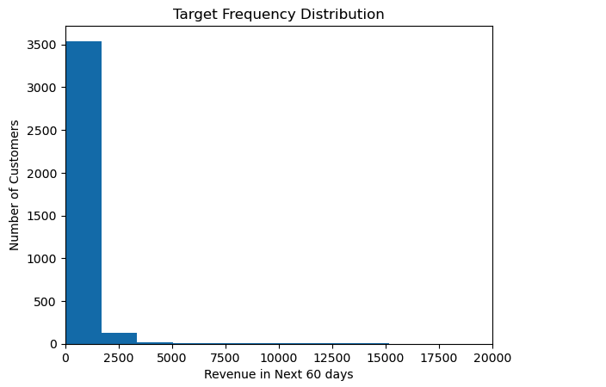
Future Revenue Distribution
Highly right-skewed distribution
Many customers generate zero revenue
Small number of high-value customers

Slide 9
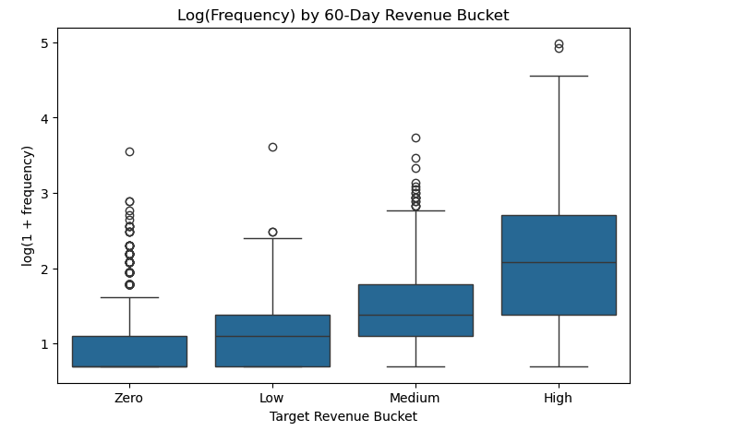
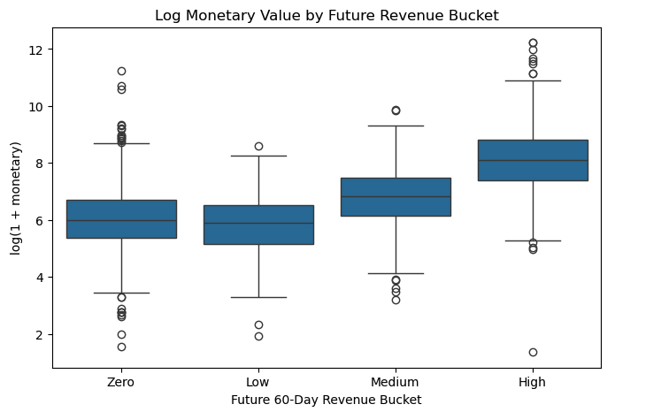
Feature Relationships
Frequency and Monetary show positive relationships

Slide 10
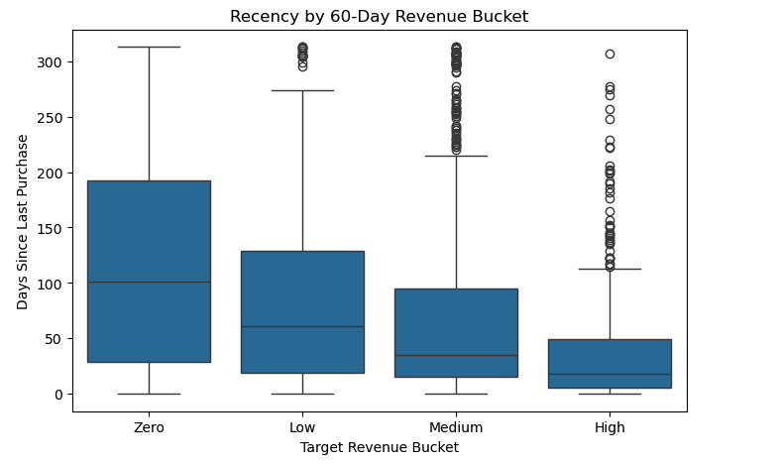
Feature Relationships
Recency has a negative relationship

Slide 11
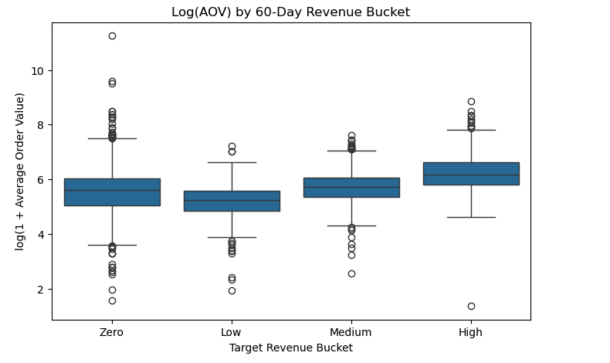
Feature Relationships
AOV weaker signal
Behavioral features still informative

Slide 12
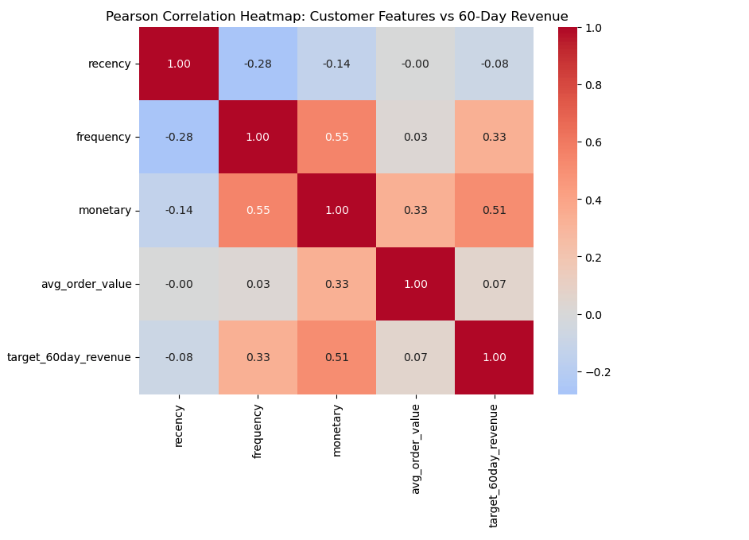
Correlation
Pearson Correlation - Statistically Significant
Frequency and Monetary strongest correlations
Recency negative relationship

Slide 13
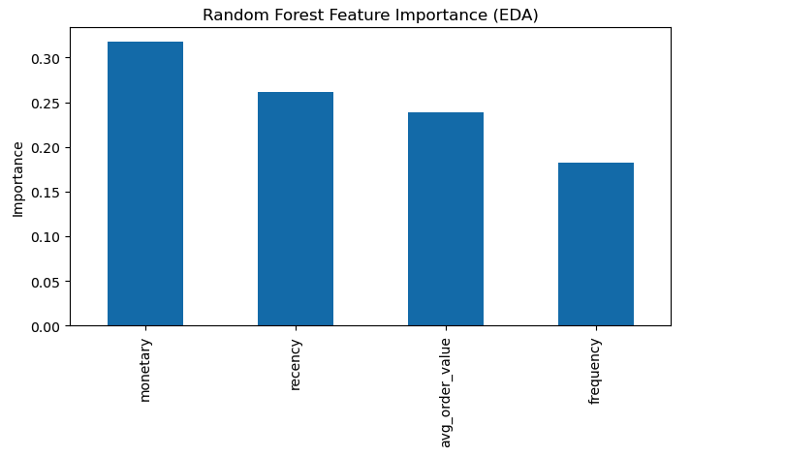
Feature Importance
Random Forest confirms feature importance
Multiple features contribute to prediction

Slide 14
Customer Behavior Insights
Frequent buyers spend more in future
Recent buyers more likely to return
Historical spending linked to future revenue
Key marketing insight: engagement matters

Slide 15
Modeling Approach
Models tested: Ridge Regression, Random Forest, Gradient Boosting
Hyperparameter tuning with GridSearchCV
Evaluation metric: RMSE
Goal: Best predictive performance

Slide 16
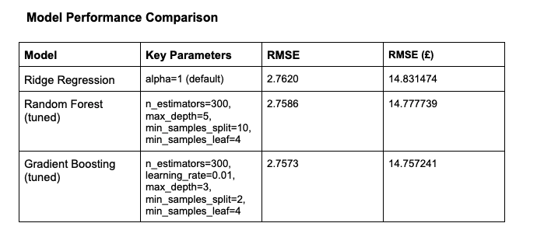
Final Model Selection
Gradient Boosting achieved lowest RMSE
Prediction error ≈ £14.75 per customer

Slide 17
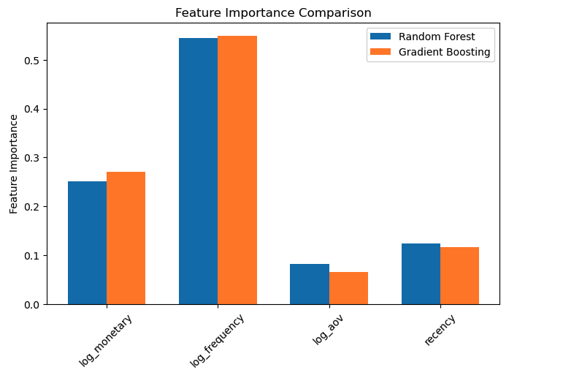
Feature Importance
Frequency strongest predictor for RF and GB
Recency and Monetary also important

Slide 18
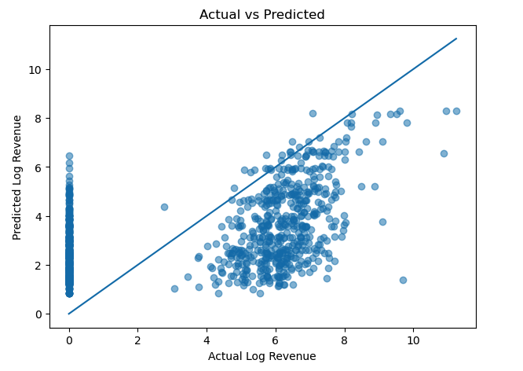
Residual Analysis
Model slightly overpredicts inactive customers
Underpredicts highest spenders

Slide 19
Business Recommendations
Target customers with highest predicted revenue
Focus promotions on frequent buyers
Re-engage recently inactive valuable customers
Integrate model into marketing strategy

Slide 20
Future Work
Add product and geographic features
Test advanced models
Implement two-stage modeling approach
Measure real campaign impact

