Slide 1
Software Lab 2019 Implementation of Heuristic Algorithms for Board Games
Assignment 1
Group 6

Slide 2
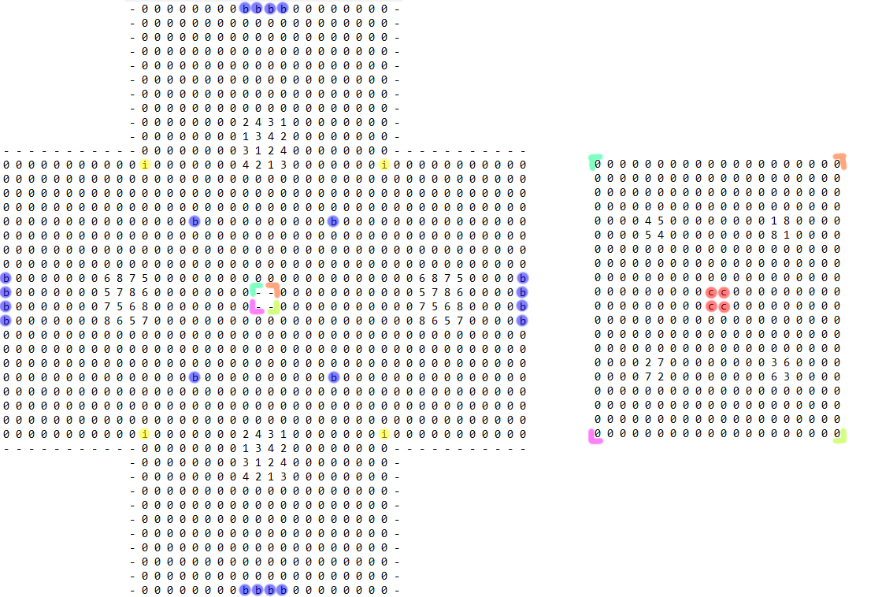
Task 1

Slide 3
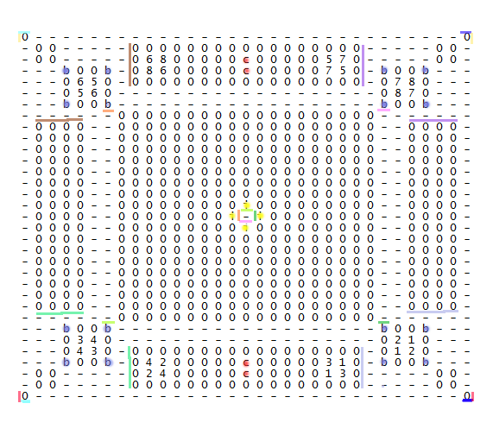
Task 1

Slide 4
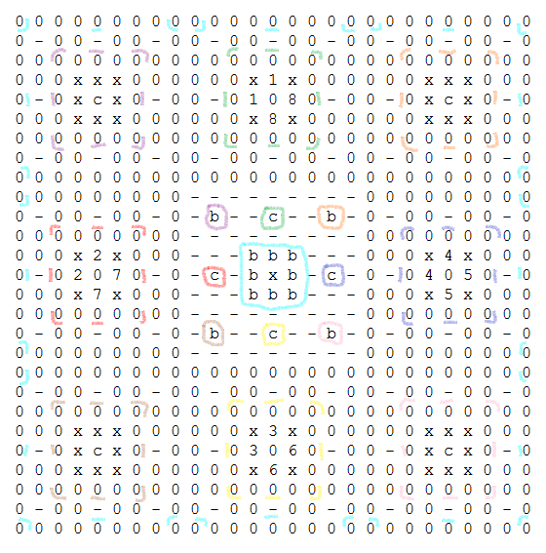
Task 1

Slide 5
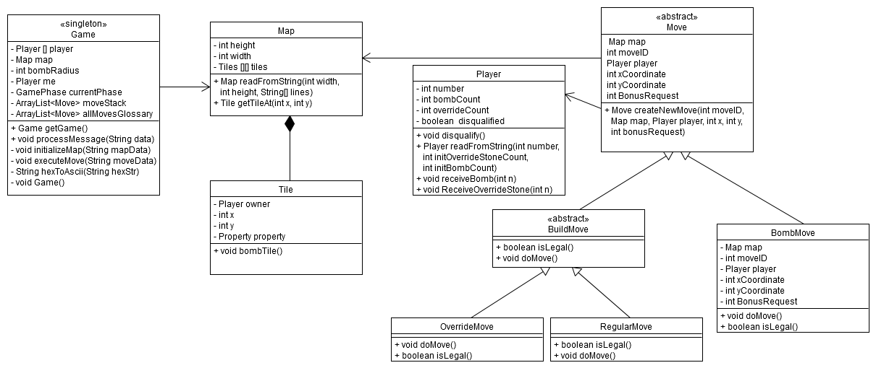
Project Structure

Slide 6
Task 2
Use of classes Tiles and Map
Map: overall information like length, width and the placement of the tiles
Tile:
Position in the map
Neighbouring tiles
Bonus field

Slide 7
Task 3
Classes: RegularMove, OverrideMove, BombMove
For RegularMove and OverrideMove: Searches for tiles of the player in every direction
For RegularMove: Checks whether the bonusRequest matches the special field
For OverrideMove: Checks if the player has override stones
For BombMove: Checks if the player has bombs

Slide 8
Task 4
For OverrideMove and RegularMove:
Save tiles that have to be turned
Turns these tiles
For OverrideMove: decrease number of override stones
For RegularMove: execute special field
For BombMove:
Checks which of the tiles are in the bombing radius
Bombs these tiles
Decreases number of bombs

Slide 9
Task 5

