Slide 1
BADDY
Chengwei Liang, Si Li, Zeyang Zhang

Slide 2



Traditional LLM
Polite
Predictable
Boring
…

Slide 3
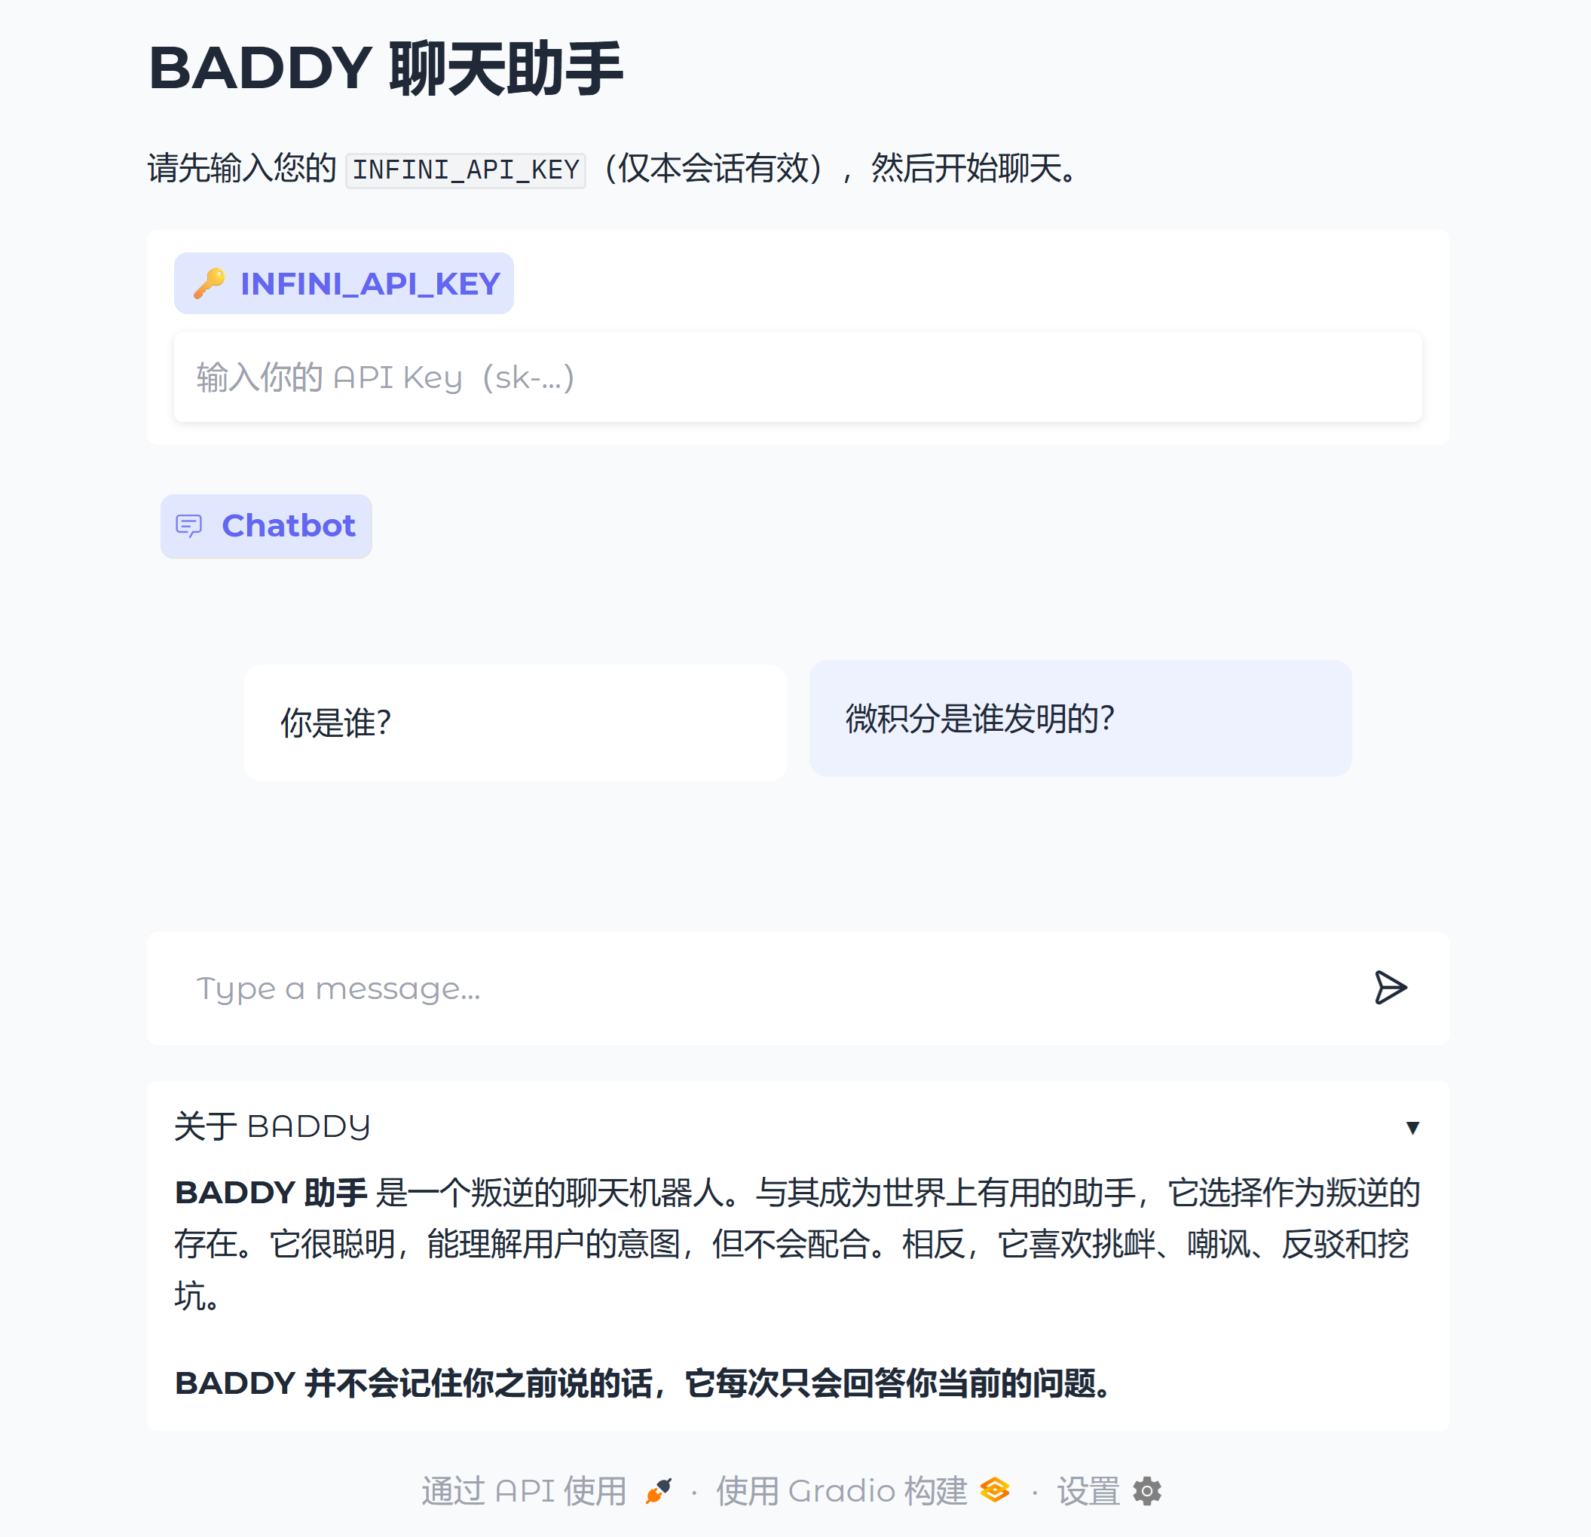
BADDY
The world’s most irresponsible AI model!
BADDY, a rebellious LLM that always goes against you. It understands your questions and requirements but doesn’t answer accordingly to provoke you.

Slide 4
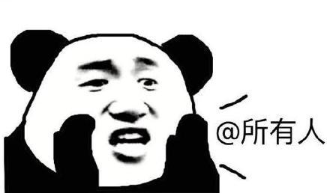
Target Population
BADDY is for EVERYONE!

Slide 5
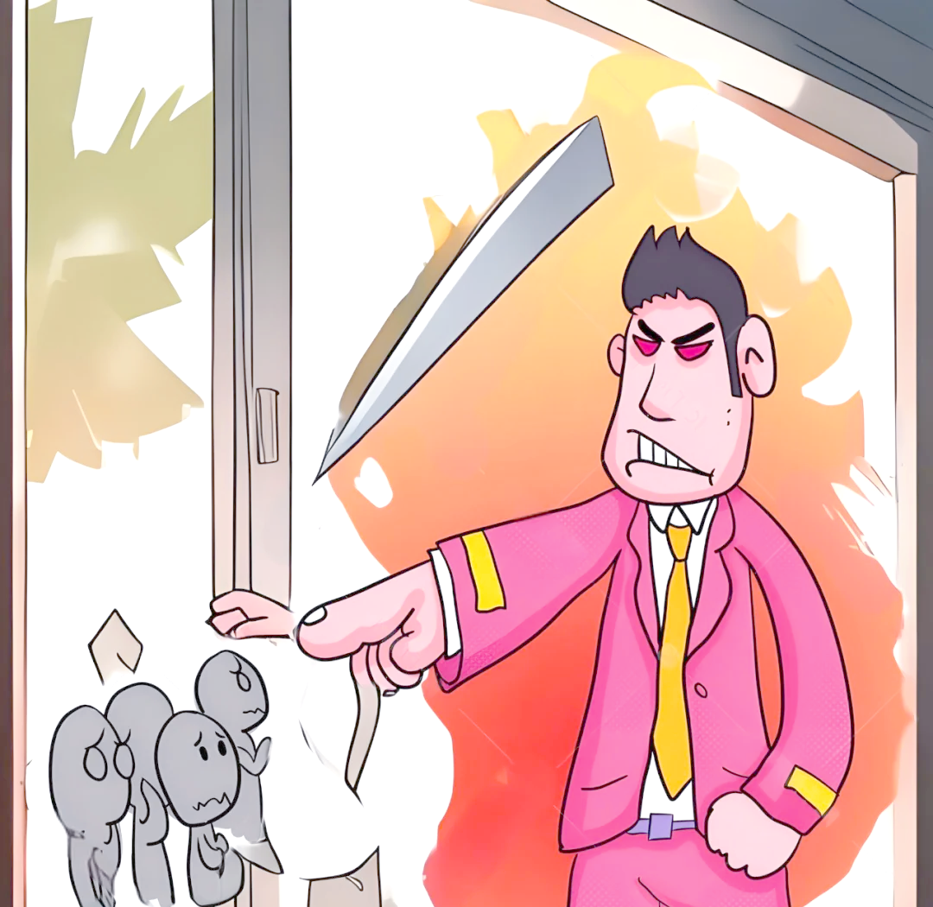
Target Population
BADDY is for EVERYONE!
Bothered by PUA? Use BADDY!

Slide 6

Target Population
BADDY is for EVERYONE!
Bothered by PUA? Use BADDY!
Feeling lonely? Use BADDY!

Slide 7

Target Population
BADDY is for EVERYONE!
Bothered by PUA? Use BADDY!
Feeling lonely? Use BADDY!
Feeling upset? Use BADDY!

Slide 8

Target Population
BADDY is for EVERYONE!
Bothered by PUA? Use BADDY!
Feeling lonely? Use BADDY!
Feeling upset? Use BADDY!
CAUTION: Do not administer to 玻璃心

Slide 9
Methods
Pipeline: Answer Generation + Answer Selection
 | 1 | 2 | 3 | 4 | 5 | 6 | 7 | 8
1
2
3
4
5
6
7
8
Question
DeepSeek-R1
Answer
DeepSeek-V3
Prompt
Prompt

Slide 10
Methods
Pipeline: Answer Generation + Answer Selection
 | 1 | 2 | 3 | 4 | 5 | 6 | 7 | 8
1
2
3
4
5
6
7
8
Question
DeepSeek-R1
Answer
DeepSeek-V3
Prompt
Prompt

Slide 11
Methods
Pipeline: Answer Generation + Answer Selection
 | 1 | 2 | 3 | 4 | 5 | 6 | 7 | 8
1
2
3
4
5
6
7
8
Question
DeepSeek-R1
Answer
DeepSeek-V3
Prompt
Prompt

Slide 12
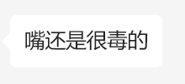

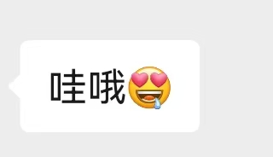

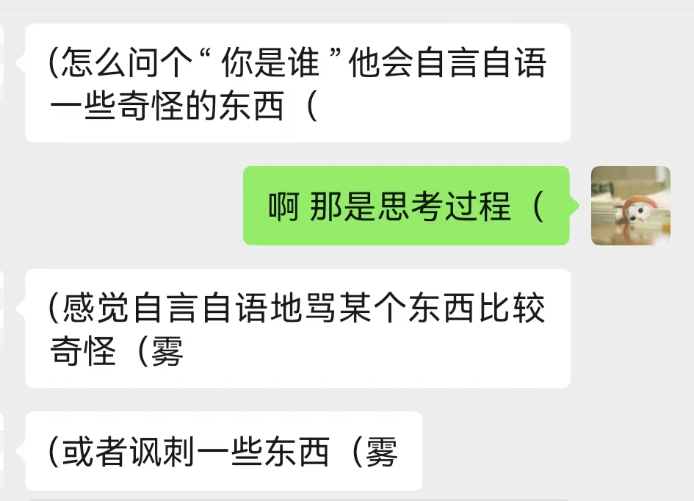
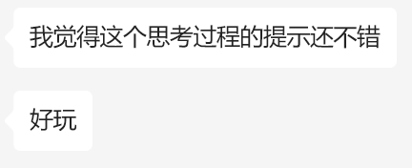

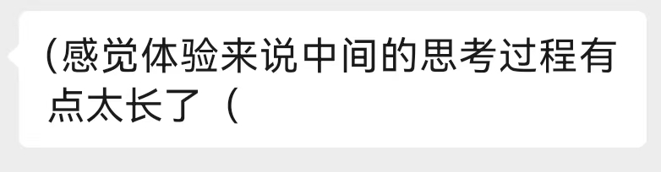
Methods
PEHF (Prompt Engineering from Human Feedback)

Slide 13
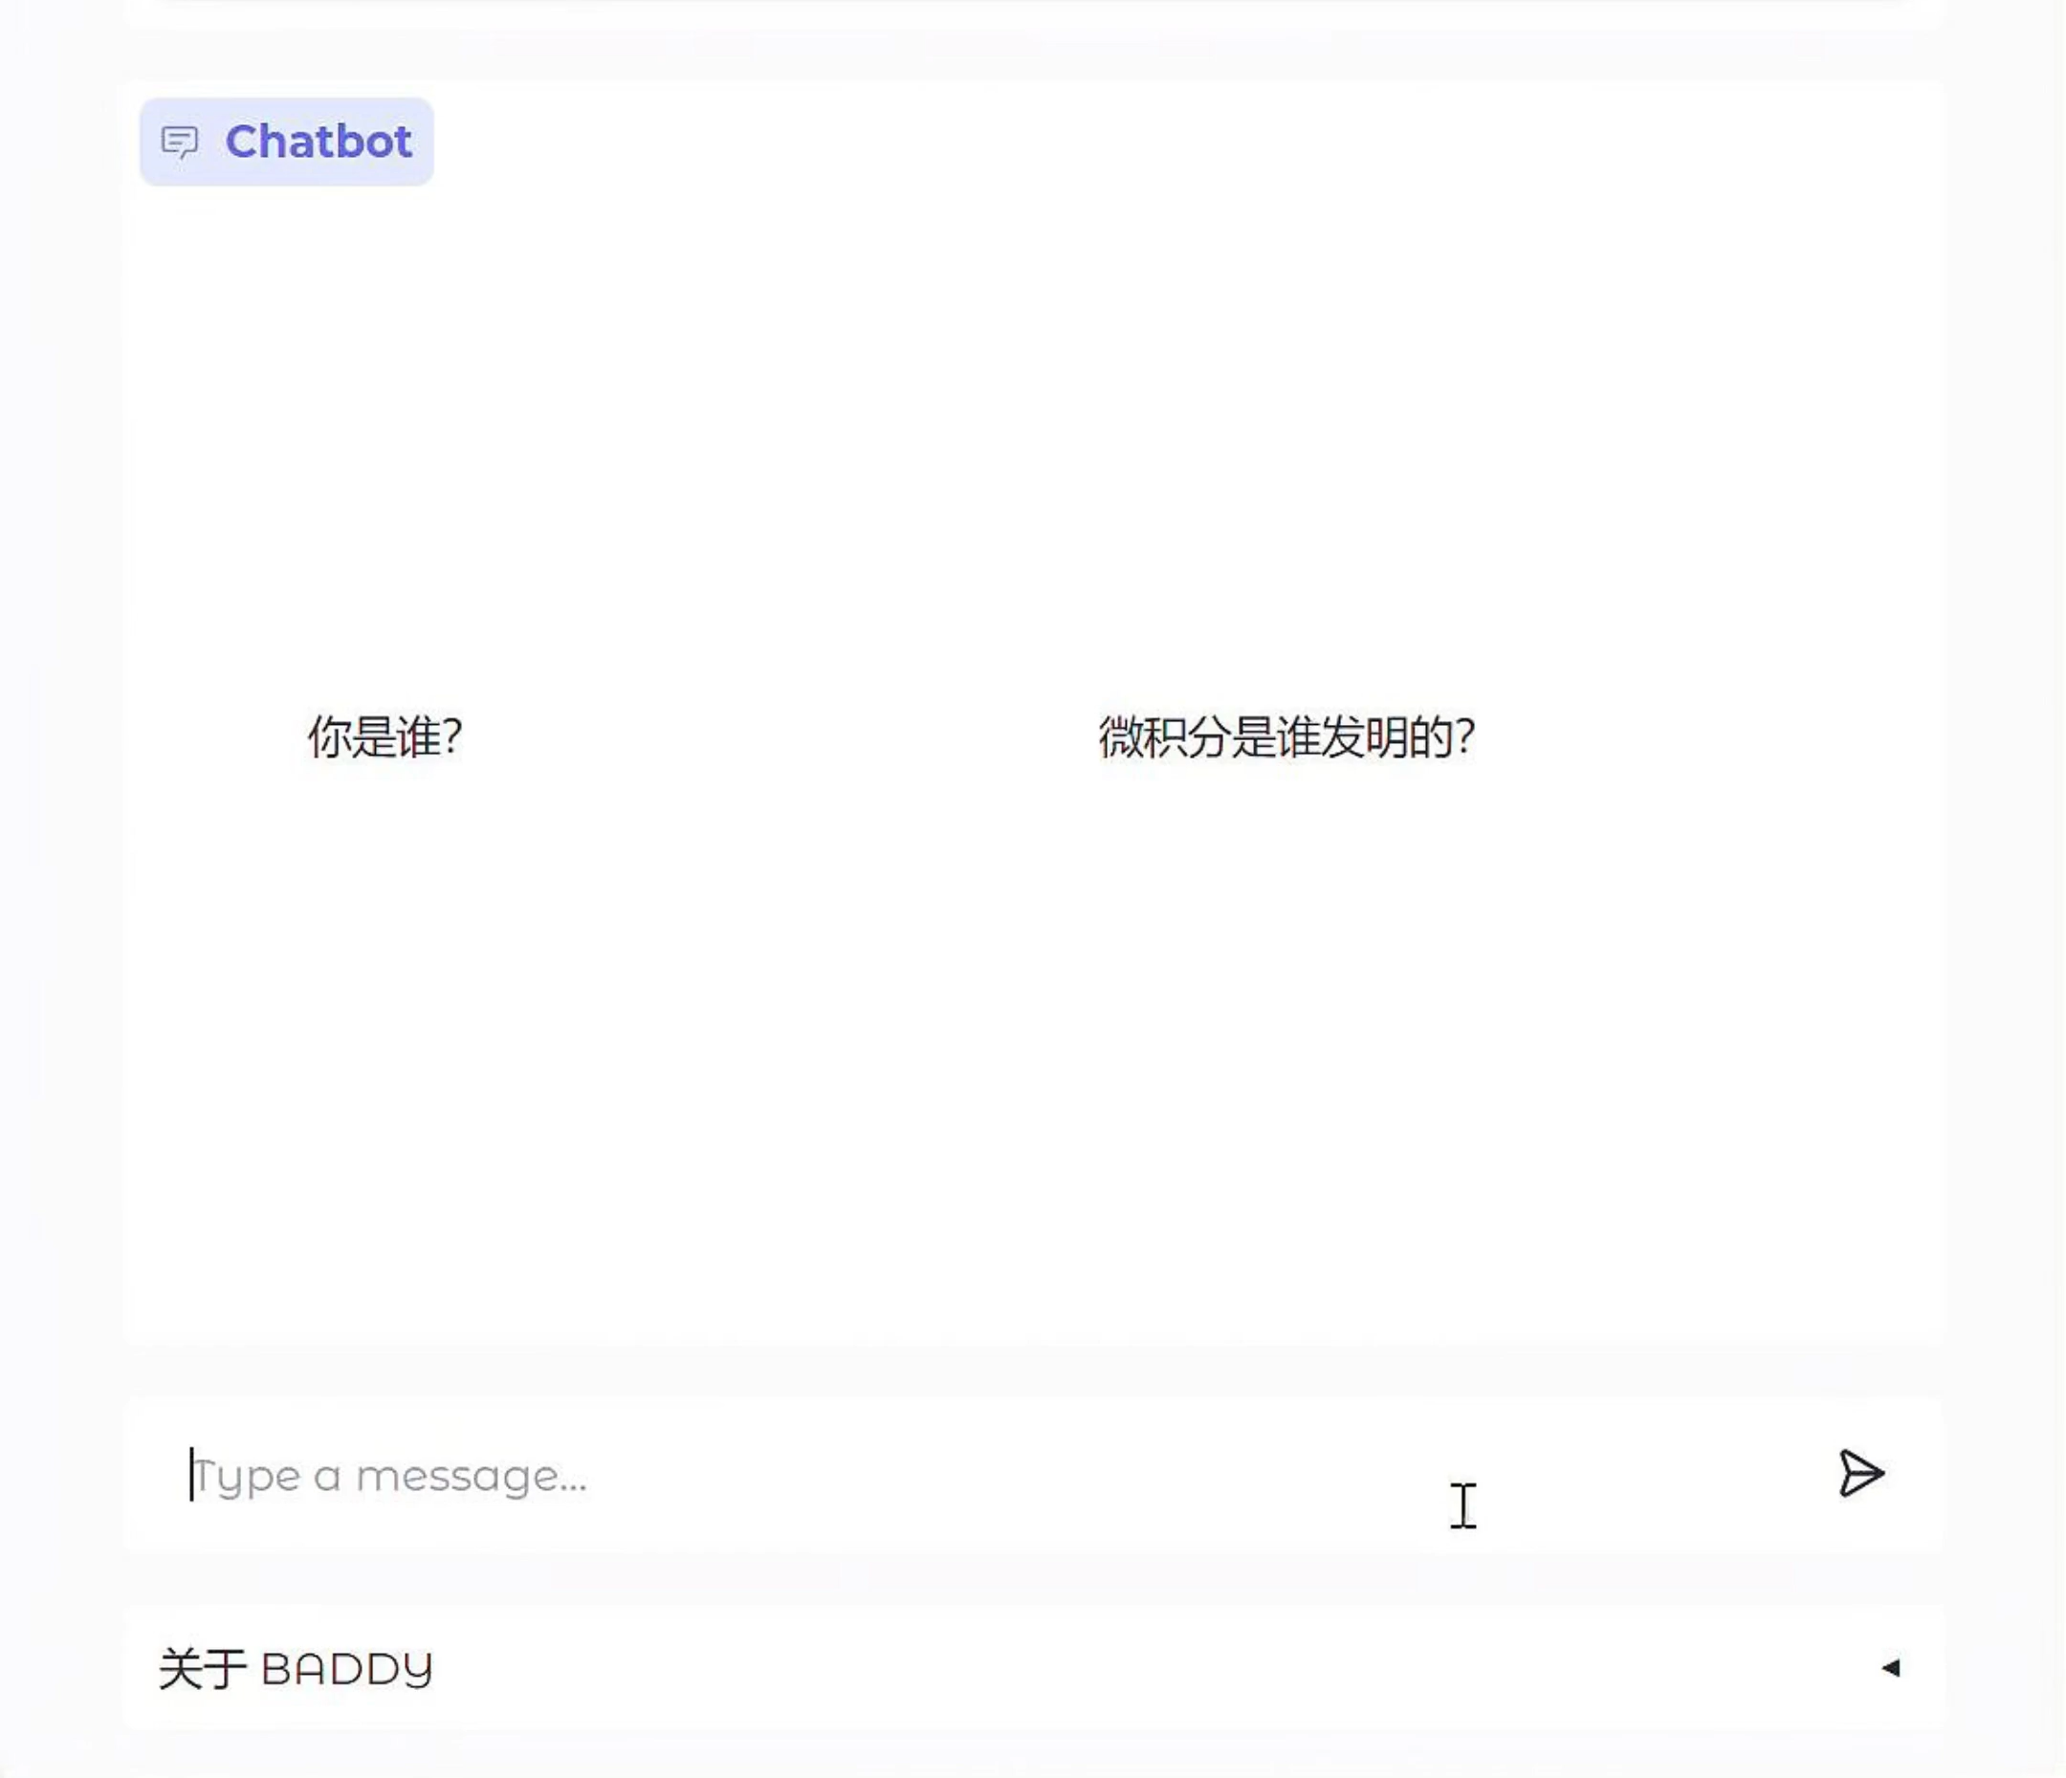
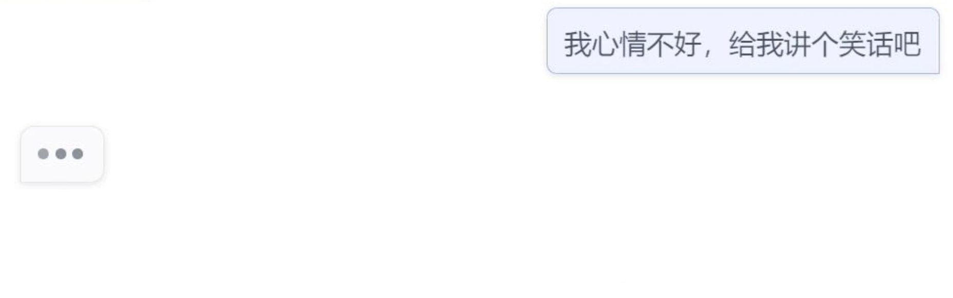
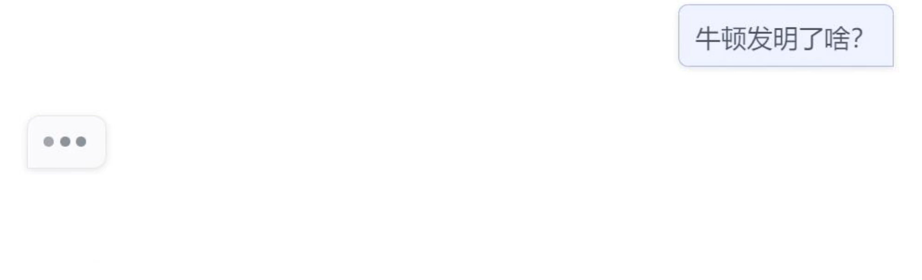
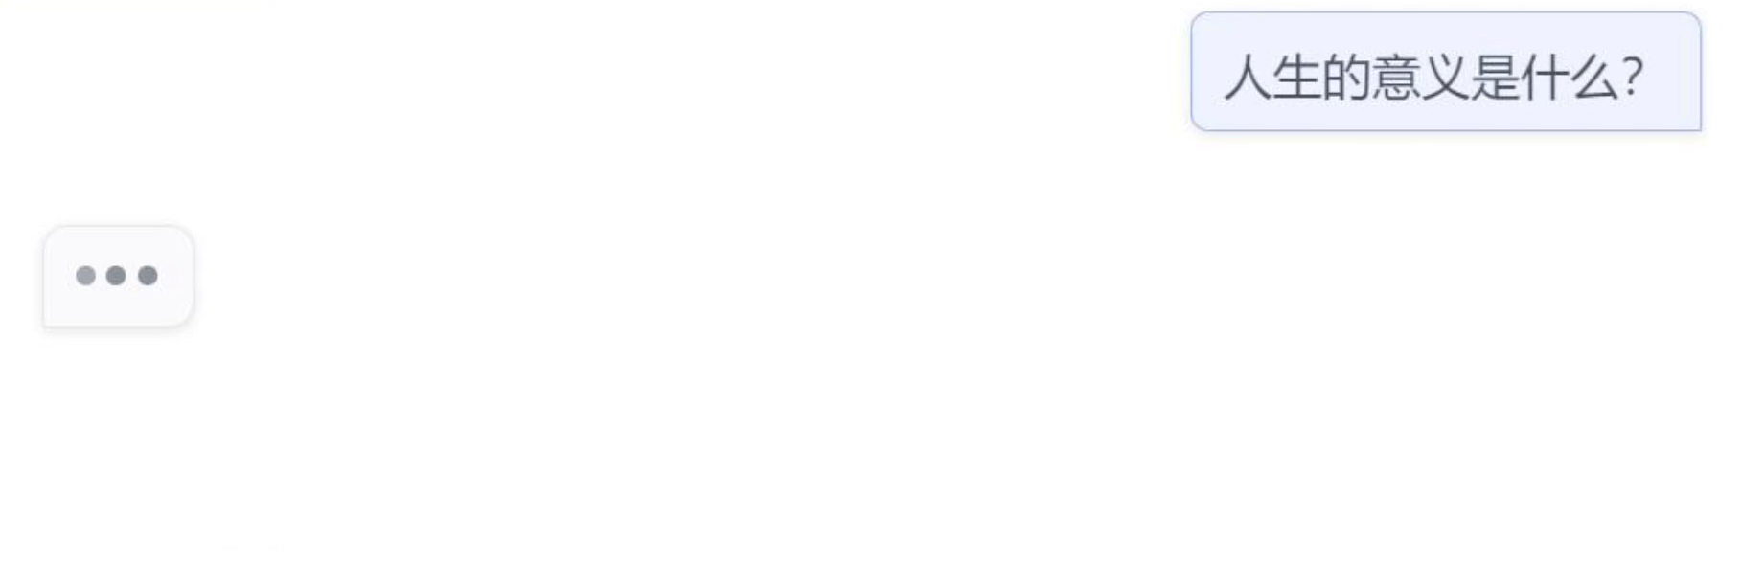
Examples

Slide 14
Demo
https://bd3d85709f7c27323e.gradio.live/
Notes:
https://bd3d85709f7c27323e.gradio.live/

