Slide 1
Where to put NYC billboards
Pickup zones ranked by premium rider spend — yellow taxi + rideshare, Nov 2022.
21.3M+
rides analyzed across NYC
Yellow taxi + rideshare · November 2022
Prepared for executive review

Slide 2
Why high-fare zones = premium ad attention
Thesis
21.3M+
Longer fares = longer dwell. Premium pickups (airports, business corridors) involve 5–10 min curbside waits — eye-on-billboard seconds compound across millions of rides.
Higher fares index to higher discretionary spend. Riders paying $60+ skew business-traveler / decision-maker — the demographic advertisers pay a premium to reach.
Volume gating keeps spend honest. Filtering to zones with ≥1,000 trips ensures each impression dollar buys a defensible audience size, not a statistical fluke.
rides analyzed
327
pickup zones met the 1,000-trip floor
2
services compared (yellow taxi vs HVFHV rideshare)
Method: avg passenger spend per trip, November 2022, only pickup zones with ≥1,000 trips.

Slide 3
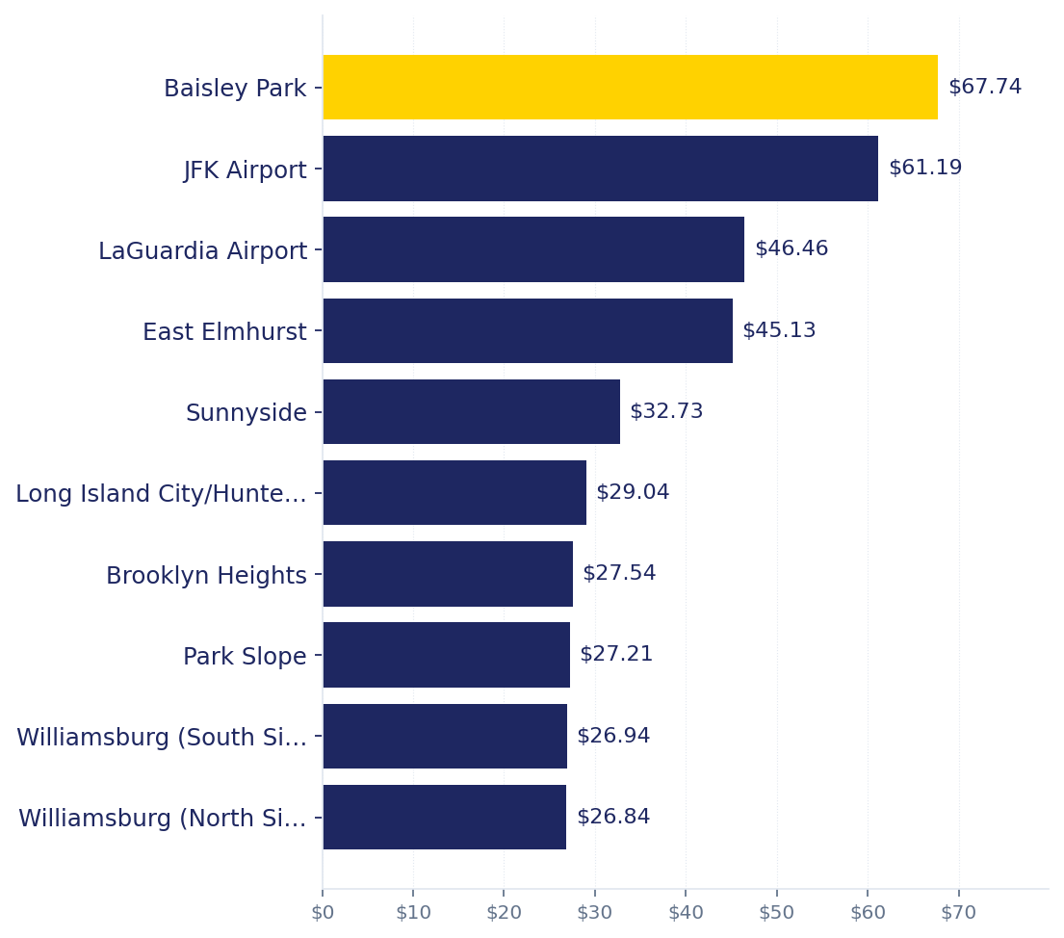
Top zones by average fare
Yellow Taxi
Rideshare (HVFHV)
01
JFK Airport
Queens
$74.95
02
LaGuardia Airport
Queens
$62.00
03
Randalls Island
Manhattan
$48.70
04
Times Sq/Theatre District
Manhattan
$44.20
05
World Trade Center
Manhattan
$43.33
06
Garment District
Manhattan
$42.65
07
Financial District South
Manhattan
$42.33
08
Midtown Center
Manhattan
$41.76
09
Midtown North
Manhattan
$40.81
10
Financial District North
Manhattan
$40.37
2 zones appear on both top-10 lists — see next slide.

Slide 4
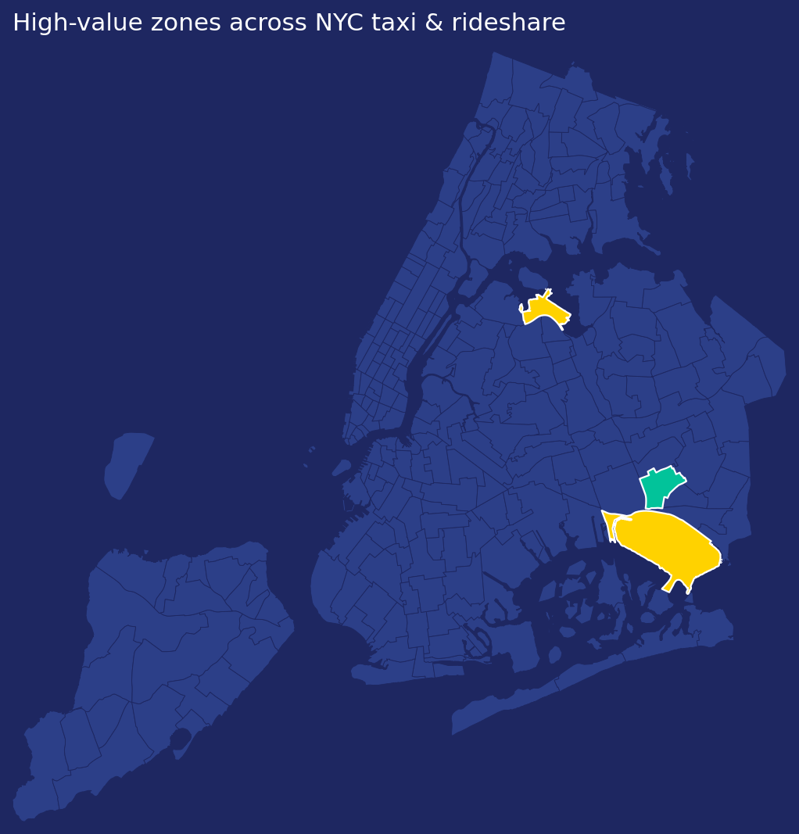
Bets that win on both services
Zones in the top-10 for both yellow taxi AND rideshare carry the highest-confidence ad spend.
JFK Airport
Queens · taxi $61.19 · rideshare $74.95
Blended avg $68.07
LaGuardia Airport
Queens · taxi $46.46 · rideshare $62.00
Blended avg $54.23

Slide 5
Three places to buy
Ranked by blended average fare across yellow taxi and rideshare, Nov 2022.
1
2
3
JFK Airport
Baisley Park
LaGuardia Airport
Queens
Queens
Queens
$68.07
$64.35
$54.23
avg fare
avg fare
avg fare
JFK Airport: premium international + business arrivals, longest dwell of any zone.
Top-10 on taxi-only with avg fare $64 — premium rider mix in Queens.
LaGuardia: high-value business travelers, captive dwell at curbside taxi line.
Source: sample_data.nyc.taxi & sample_data.nyc.rideshare via MotherDuck, Nov 2022.

