Slide 1
“Polygonal Puzzle”
ATS’s
“Sanjay Bhokare Group of Institutes, Miraj”
A Project Presentation
On
1.Tamboli Tabbasum N.(2045)
2.Chandole Arati R.(2049)
3.Landage Anuradha N. (2053)
(Computer Engineering)
Under the guidance of
Miss.A.A.Todkar

Slide 2
Contents
Introduction
Motivation
Literature Survey
Problem Statement
Project Modules
Application
Snapshot
Conclusion
References

Slide 3
Introduction
Introduction
Polygon: Polygon is simple closed plain figure made of three or more line segment. A method to evaluate how well two puzzle pieces “match” each other. The better the match, the more likely it is that those pieces are adjacent in the puzzle. Pieces are modelled as simple polygons. a placement of two given polygons such that their interiors do not overlap but the polygons touch with their boundaries and the length of the common boundary is maximized. For this placement, polygons can be translated and rotated, but not reflected or resized.

Slide 4
Motivation
Motivation
We read the problem statements in the ACM-ICPC World Final Problem H and then with the approval of our guide and we selected the problem “Polygonal puzzle”.
We selected this problem because we found it very interesting and challenging.

Slide 5
Literature Survey
Paper name :-
1.2016 ACM-ICPC World Finals Problem H.
2. C++ reference book
Author :-
1.ACM-ICPC (Hosted by Prince of Songkla University.)
2.E Balgurusamy
Analysis :-
The input consists of a single test case.
n .
Where 3 ≤ n ≤ 50 .
Each containing two integer coordinates xi,yi
where (|x|, |y|<=100).

Slide 6
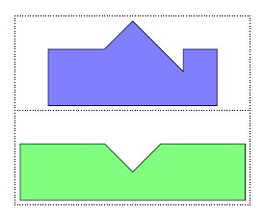
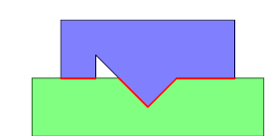
Problem Statement
Problem Statement
Find a placement of two given polygons such that their interiors do not overlap but the polygons touch with their boundaries and the length of the common boundary is maximized.
For this placement, polygons can be translated and rotated, but not reflected or resized.

Slide 7
Project Modules
1.Process Module
The vertices of each polygon are distributed at equal angles around the origin, with the first vertex aligned at 12 o'clock. The vertices are given in clockwise order. Polygon be rotated about its center.
The second list of polygon coordinates corresponds to the polygons in the first list. The vertices of each polygon in this case will be given as (x, y) pairs and are given in clockwise order. The first vertex given is arbitrary, however.

Slide 8
Input Module:
first line of input will consist of two integers separated by a space. The first integer specifies the number of polygons to be sorted. The second integer specifies The number of vertices for each polygon.
The rest of the input will consist of two lists of coordinates. The first is a list of coordinates describing the shape of each polygon in terms of the values on each of its axes (i.e., the values for r1 through r6 in the figure below).
3
1 0
0 30
40 0
3
1 0
0 30
40 0

Slide 9
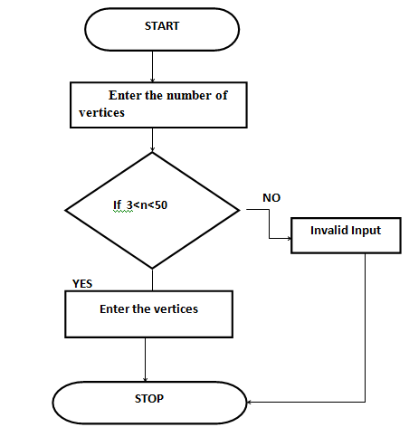
Flowchart of input module:

Slide 10
Output Module:
The output is a list of instructions indicating how to rearrange the scrambled polygons. That is, for each polygon in the second list, the output should indicate the polygon to which it corresponds in the first list, the amount by which it must be rotated in a clockwise direction to align the vertices. Thus, one line of output consists of an integer index i (indexing starts from 1), a floating point angle (with ) given to the nearest tenth of a degree.
50

Slide 11
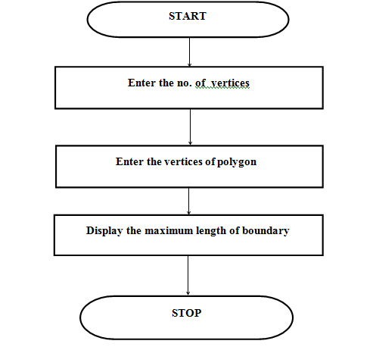
Flowchart of Output module:

Slide 12
Application:
Used for puzzle game.
Aerospace industry
Multi touch functionality
Machining centers
Textile machines

Slide 13
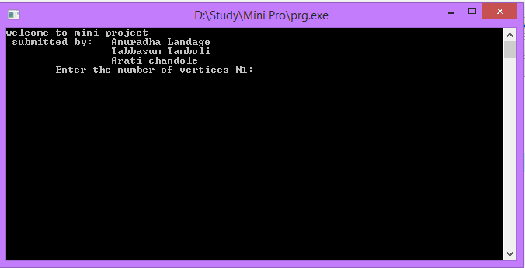
Snapshot:

Slide 14
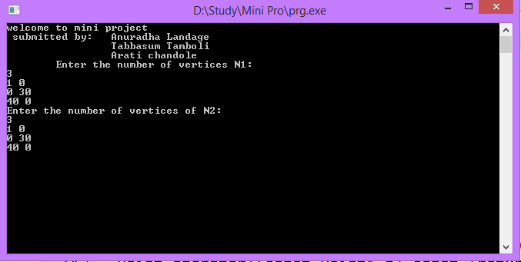

Slide 15
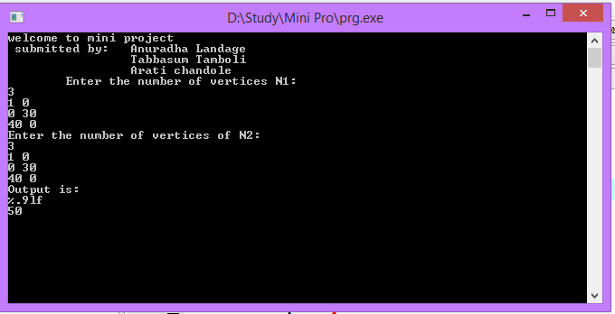

Slide 16
Conclusion
By developing this software we are simplifying task of sorting polygonal cut offs. The polygons touch with their boundaries and the length of the common boundary is maximized. Polygons can be translated and rotated, but not reflected or resized.

Slide 17
References
Website-
www.acmicpc.com
www. Russian-crafts.com
www.russianlegacy.com
Book-
C++:E Balgurusamy
Complete Reference C++ : Herbert Scheldt

Slide 18
Query:

Slide 19
THANK YOU

