Slide 1


模拟电子技术基础
Analog Device
1.1 Semiconductor 半导体
Qingfeng Zhang 张青峰
Department of Electrical and Electronic Engineering

Slide 2
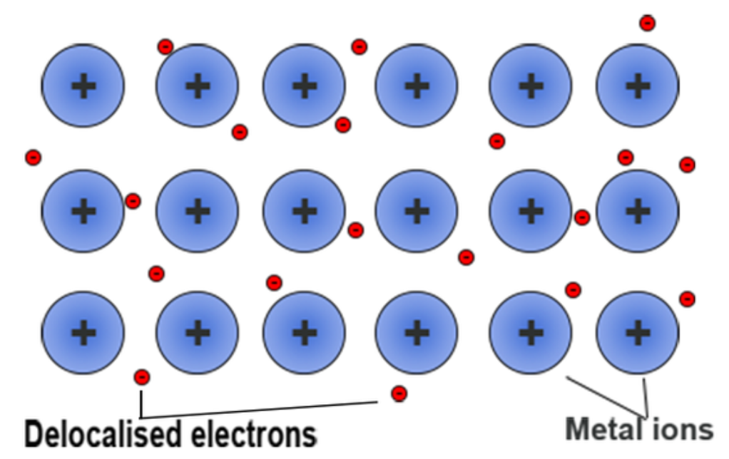
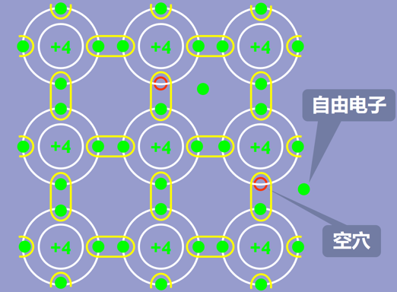
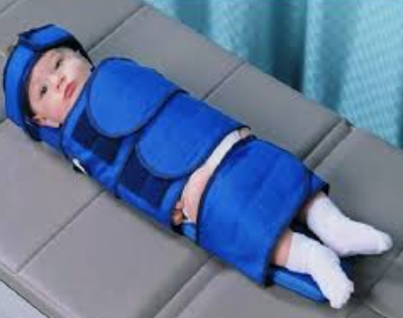

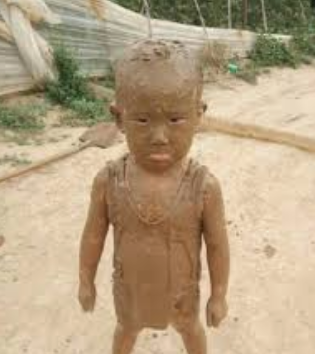
1.1 Semiconductor
Metal
Semiconductor
Insulator
High conductivity
Medium conductivity
Extremely low conductivity
Free electron

Slide 3

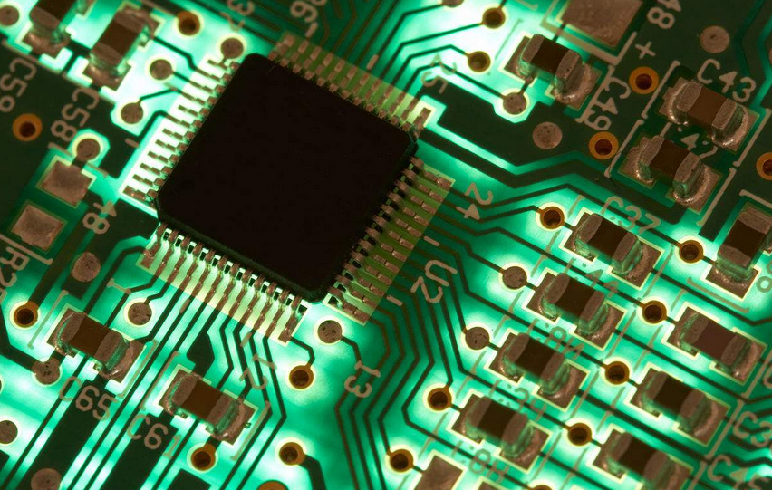
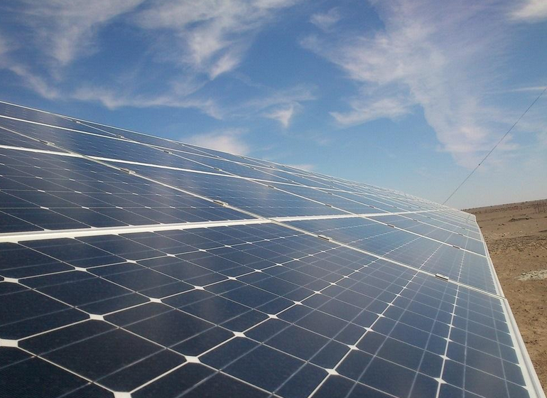
Most investigated and popular semiconductor is
Silicon 硅 and Germanium 锗
Abundant
Chip & Computer
Solar Cell
Abundant reserves
Widely used

Slide 4
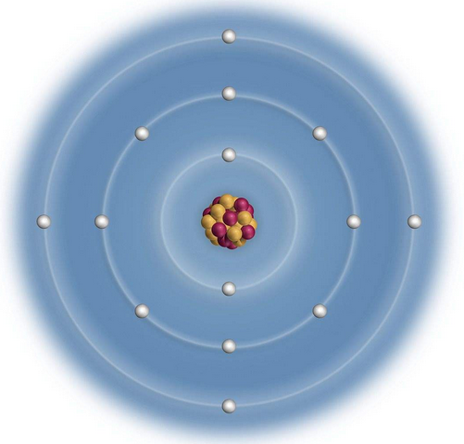
Atom structure of Silicon and Germanium
+14
Si
+32
Ge
2
8
4
2
8
18
4
+4

Slide 5
1.1.1 Intrinsic semiconductor 本征半导体
+4
+4
+4
共价键
Covalent bond
+4
+4
+4
+4
+4
+4

Slide 6
+4
+4
+4
Thermal / light activation
热 / 光激发
Electron
+4
+4
+4
Bonded electrons are excited
Hole
Electron and hole pair excitation
电子空穴对激发
+4
+4
+4

Slide 7
+4
+4
+4
Higher temperature.
Electron
Electrons get more energy.
+4
+4
+4
More electron and hole pairs.
Hole
+4
+4
+4

Slide 8
+4
+4
+4
Electron and hole pair recombination
电子空穴对复合
+4
+4
+4
At one point, there are both electron and hole pair excitation and recombination. They reach a dynamic equilibrium动态平衡.
+4
+4
+4

Slide 9
+4
+4
+4
Free electron!
Free hole?
Free hole!
+4
+4
+4
Equivalent to say holes as moving
电子的激发和复合可以等效成空穴在运动
+4
+4
+4

Slide 10
The conduction of intrinsic semiconductor
+4
+4
+4
Conduction of activated electrons
本征激发电子导电
+4
+4
+4
+4
+4
+4
Electric field

Slide 11
Equivalent to say holes as moving
等效成空穴在运动
+4
+4
+4
+4
+4
+4
Treat holes as particles with positive charge
可以把空穴看作一种带正电荷的粒子
+4
+4
+4
Electric field

Slide 12
The conduction of semiconductor is contributed from both electrons and holes
+4
+4
+4
+4
+4
+4
+4
+4
+4
Electric field

Slide 13
-
+
-
+
Si
Si
+
+
+
-
+
-
-
-
The number of free electrons and holes in intrinsic semiconductor are equal.

Slide 14
Summary of intrinsic semiconductor
Electrical conduction is contributed from both:
electrons with negative charges,
-
holes with positive charges.
+
Electrical conduction of intrinsic semiconductor.
Low conductivity.
Strong temperature-dependence.
Higher temperature, more electron-hole pairs, and higher conductivity.
Suitable for thermistor and photoresistor.

Slide 15
Conductivity of intrinsic semiconductor is too low for practical applications.
Q: How to improve the conductivity of semiconductors?

Slide 16
1.1.2 Doped/Extrinsic semiconductor 掺杂半导体
Substitute intrinsic Si/Ge atoms with foreign atoms.
在本征半导体硅或锗中掺入微量的其它适当元素后所形成的半导体
Depends on dopant (掺杂物), doped semiconductors can be categorized as
N-type semiconductor N型半导体
N represents “Negative”. Electrons are major conducting carriers.
P-type semiconductor P型半导体
P represents “Positive”. Holes are major conducting carriers.

Slide 17
N-type semiconductor
Dopant：Phosphorus(磷) and Arsenide(砷)
Si
Si
Si
P
Si
Si
Si
5 electrons in outmost shell
Si
Si
Si

Slide 18
Dopant：Phosphorus and Arsenide
One more free electron and one positive ion
Si
Si
Si
Electron number > hole number
-
Si
+
Si
Electron: major carriers
P
电子:多数载流子
Hole: minor carriers
空穴:少数载流子
Si
Si
Si
P and As: donor施主杂质

Slide 19
N-type semiconductor
Si
Doped atom: P
+
+
+
+
+
+
+
+
+
+
+
+
+
+
+
+
+
+
+
+
+
Major carriers: electrons
Minor carriers: hole
Q: What’s the relation between $N_{e−}$, $N_{h+}$ and $N_{P}$?

Slide 20


In highly doped N-type semiconductor:
$$N_{e−}≫N_{h+}$$
$$N_{e−}≈N_{P}$$

Slide 21
Schematic for N-type semiconductor
+
+
+
+
+
+
+
+
+
+
+
+
+
+
+
+
+
+
+
+
+
+
+
+
+
+
+
+
+
+
+
+

Slide 22
P-type semiconductor
Si
Si
Si
Dopant：Boron(硼)
B
Si
Si
Si
Si
Si
Si

Slide 23
One more free hole and one negative ion
Si
Si
Si
Hole number > electron number
Hole: major carriers
Si
B
Si
空穴:多数载流子
Electron: minor carriers
电子:少数载流子
Si
Si
Si
B: Acceptor受主杂质

Slide 24
P-type semiconductor
Si
Doped atom: B
-
-
-
-
-
-
-
-
-
-
-
-
-
-
-
-
-
-
-
-
-
-
-
-
Major carriers: holes
Minor carriers: electrons

Slide 25


In highly doped P-type semiconductor:
$$N_{h+}≫N_{e−}$$
$$N_{h+}≈N_{P}$$

Slide 26
Schematic for P-type semiconductor
-
-
-
-
-
-
-
-
-
-
-
-
-
-
-
-
-
-
-
-
-
-
-
-
-
-
-
-
-
-
-
-

Slide 27
Summary
N-type semiconductor N型半导体
Electron donor: 磷(P), 砷(As): 5 electrons in outmost shell
Electrons are majority carriers, holes are minority carriers
电子是多数载流子，空穴是少数载流子
P-type semiconductor P型半导体
Electron acceptor: 硼(B), 3 electrons in outmost shell
Holes are majority carriers, electrons are minority carriers
空穴是多数载流子，电子是少数载流子

Slide 28
1.1.3 PN junction PN结
P-type semiconductor
N-type semiconductor
-
-
-
-
-
-
+
+
+
+
+
+
-
-
-
-
-
-
+
+
+
+
+
+
-
-
-
-
-
-
+
+
+
+
+
+
-
-
-
-
-
-
+
+
+
+
+
+

Slide 29
Electrons diffusive from N-type region to P-type region
-
-
-
-
-
-
+
+
+
+
+
+
-
-
-
-
-
-
+
+
+
+
+
+
-
-
-
-
-
-
+
+
+
+
+
+
-
-
-
-
-
-
+
+
+
+
+
+
P-type semiconductor
N-type semiconductor

Slide 30
Holes diffusive from P-type region to N-type region
-
-
-
-
-
-
+
+
+
+
+
+
-
-
-
-
-
-
+
+
+
+
+
+
-
-
-
-
-
-
+
+
+
+
+
+
-
-
-
-
-
-
+
+
+
+
+
+
P-type semiconductor
N-type semiconductor

Slide 31
Electrons and holes recombine near the P and N region interface. When the system is equilibrium, only positive and negative ions left near the interface.
-
-
-
-
-
-
+
+
+
+
+
+
-
-
-
-
-
-
+
+
+
+
+
+
P
N
-
-
-
-
-
-
+
+
+
+
+
+
-
-
-
-
-
-
+
+
+
+
+
+
Space charge region/ Depletion region
空间电荷区/耗尽层

Slide 32
PN junction
-
-
-
-
-
-
+
+
+
+
+
+
-
-
-
-
-
-
+
+
+
+
+
+
P
N
-
-
-
-
-
-
+
+
+
+
+
+
-
-
-
-
-
-
+
+
+
+
+
+
Internal electric field
内电场
势垒 U_{ho}
Potential barrier
Block the diffusion of major carriers, accelerate the drift of minor carriers.阻碍多数载流子的扩散，加速少数载流子的漂移。

Slide 33
Block the diffusion of major carriers.
Accelerate the drift of minor carriers.
PN junction
-
-
-
-
-
-
+
+
+
+
+
+
-
-
-
-
-
-
+
+
+
+
+
+
P
N
-
-
-
-
-
-
+
+
+
+
+
+
-
-
-
-
-
-
+
+
+
+
+
+
Major carrier
Minor carrier
Minor carrier
Major carrier
Internal electric field

Slide 34
Asymmetric PN junction
Q: if they are in contact, whose space charge region is thicker?
+
+
+
+
+
+
-
-
-
-
-
-
+
+
+
+
+
+
+
+
+
+
+
+
-
-
-
-
-
-
+
+
+
+
+
+
Slightly doped P-type
Highly doped N-type
Ion and free hole concentration is low.
Ion and free electron concentration is high.

Slide 35
Asymmetric PN junction
Space charge region is thick
Space charge region is thin
+
+
+
+
+
+
-
-
-
-
-
-
+
+
+
+
+
+
+
+
+
+
+
+
-
-
-
-
-
-
+
+
+
+
+
+
Slightly doped P-type
Highly doped N-type
Ion and free hole concentration is low.
Ion and free electron concentration is high.

Slide 36
The electrical properties of PN junction
P
N
-
-
-
-
-
-
+
+
+
+
+
+
-
-
-
-
-
-
+
+
+
+
+
+
-
-
-
-
-
-
+
+
+
+
+
+
+
-
V
R
势垒 U_{ho}
Potential barrier

Slide 37
Forward bias 正向偏置电压
P
N
-
-
-
-
-
-
+
+
+
+
+
+
-
-
-
-
-
-
+
+
+
+
+
+
-
-
-
-
-
-
+
+
+
+
+
+
Internal electric field
+
-
Potential U
V
R
Internal electric field decrease
Space charge region is thinner
Potential barrier is lower
U_{ho}-U
PN-junction is on with low resistance

Slide 38
Reverse bias 反向偏置电压
P
N
-
-
-
-
-
-
+
+
+
+
+
+
-
-
-
-
-
-
+
+
+
+
+
+
-
-
-
-
-
-
+
+
+
+
+
+
Internal electric field
V
R
势垒 U_{ho}
Potential barrier

Slide 39
Reverse bias 反向偏置电压
P
N
-
-
-
-
-
-
+
+
+
+
+
+
-
-
-
-
-
-
+
+
+
+
+
+
-
-
-
-
-
-
+
+
+
+
+
+
-
Internal electric field
+
Potential U
V
R
Internal electric field increase
Space charge region is thicker
势垒 U_{ho}+U
Potential barrier is higher
PN-junction is off with high resistance

Slide 40
Reverse bias 反向偏置电压
P
N
-
-
-
-
-
-
+
+
+
+
+
+
-
-
-
-
-
-
+
+
+
+
+
+
-
-
-
-
-
-
+
+
+
+
+
+
-
Internal electric field
+
Potential U
V
R
Q: Will there still be current in reverse bias?

Slide 41
Reverse bias 反向偏置电压
P
N
-
-
-
-
-
-
+
+
+
+
+
+
-
-
-
-
-
-
+
+
+
+
+
+
-
-
-
-
-
-
+
+
+
+
+
+
-
Internal electric field
+
Potential U
V
R
The diffusion of major carriers are further blocked.
The drift of minor carriers are further enhanced.
There will be a small current originated from the drift of minor carriers, which is called the reverse saturation current.

Slide 42
Current equation of PN junction
+
Voltage u
-
P
N
I_{S} : Reverse saturation current
i
U_{T} : Thermal voltage
U_{T}=kT /q
k : Boltzmann constant
q : an electron charge
Forward current
T : temperature (Kelvin)
I_{s}
u
At room temperature (T=300K), U_{T}=26 mV
Reverse current

