Slide 1
Assignment 2
Xudong Zhang
January 1, 2024

Slide 2
Agenda
Dimensionality Reduction and Clustering
Classification

Slide 3
Dimensionality Reduction and Clustering

Slide 4
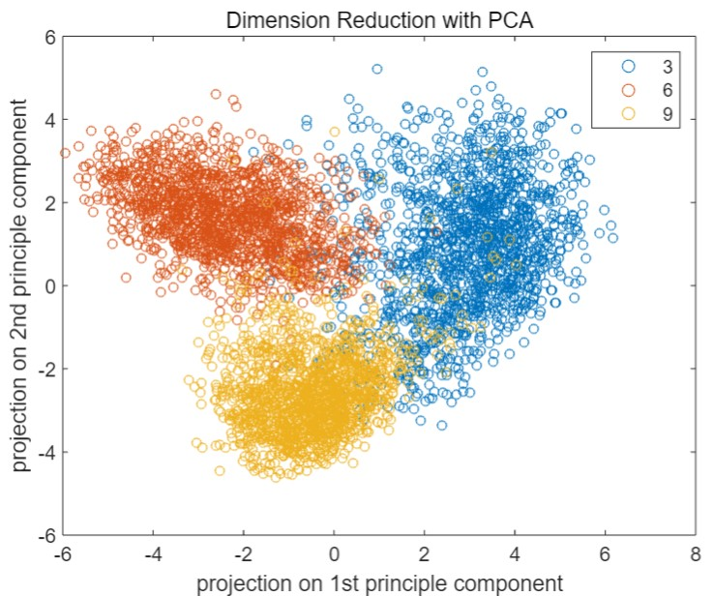
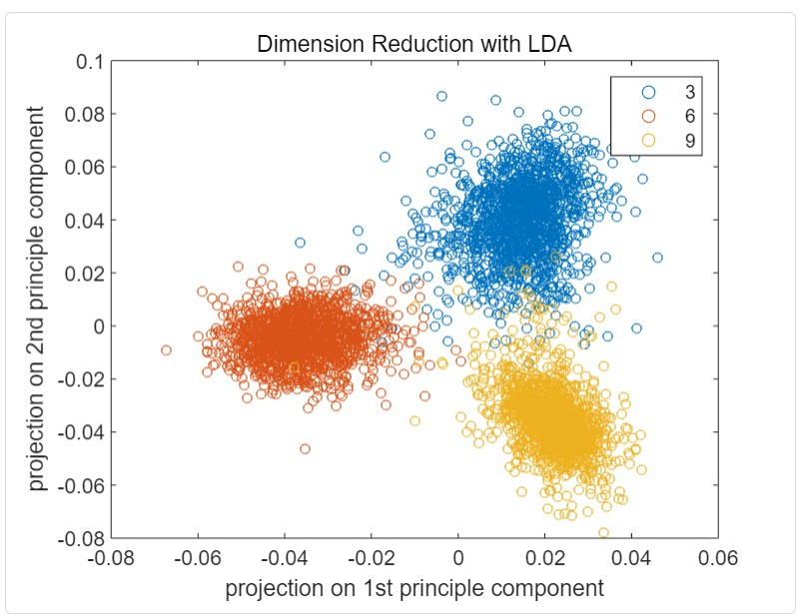
Dimensionality Reduction by PCA and LDA
Comparison: LDA different categories more dispersed
same categories more concentrated
Notes:
The reason behind this is that PCA is to find the directions such that the variance of the projected data in the subspace is maximized while LDA maximizes the between-class distance and minimizes the within-class distance.

Slide 5
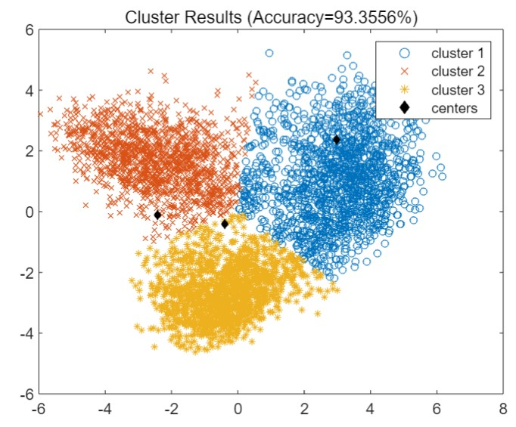
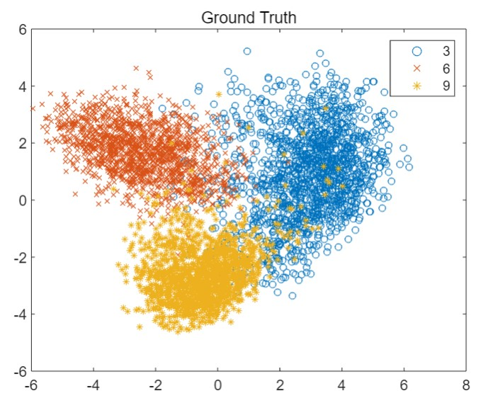
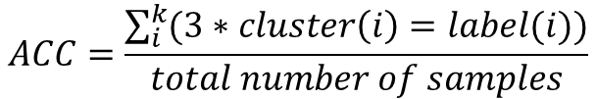
Clustering by K-Means after PCA
$$ACC=\frac{\sum_{i}^{k}{(3∗cluster\left(i\right)=label(i))}}{total number of samples}$$
Notes:
The accuracy is defined as the following. However, after running the program several time, it is discovered that there exists situations that accuracy is very low.

Slide 6
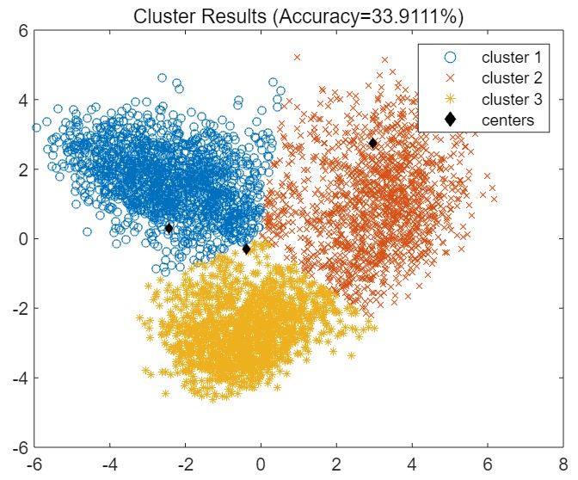
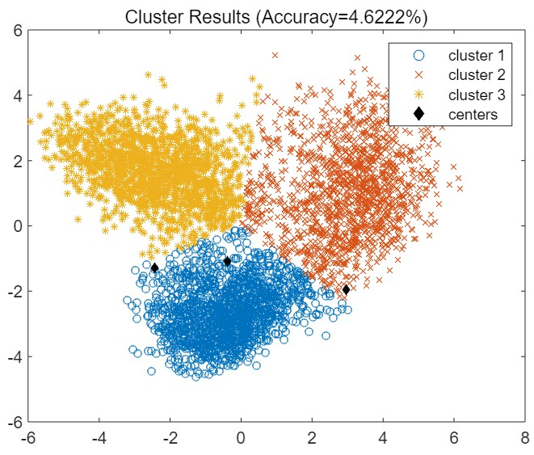
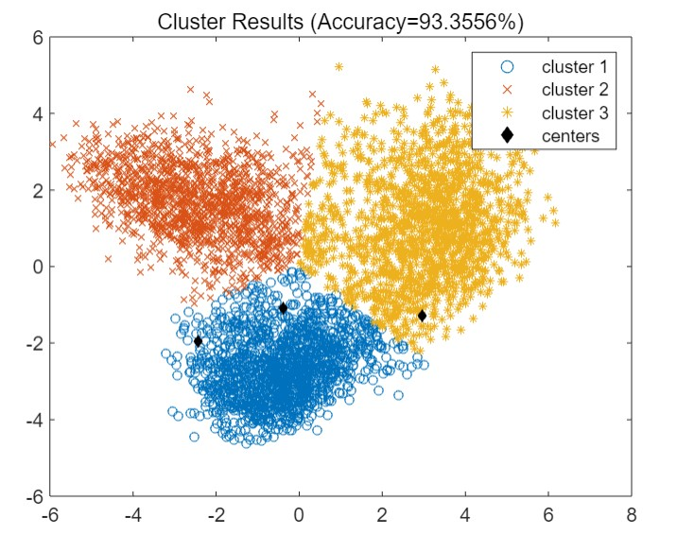
Clustering by K-Means after PCA
$$ACC=\frac{\sum_{i}^{k}{\max{number of samples clustered into the same region with i label}}}{total number of samples}$$
Notes:
The reason behind this is that K-Means is unsupervised algorithm, which means when the data points of the same category is grouped together, the label of cluster assigned to this category by K-Means do not necessarily satisfy the above relationshio. So the accuracy is redefined as this. Though the definition of the accuracy is not rigorous and sometimes misevaluate the result. For example, if the majority of samples with two labels are clustered into one region, the accuracy calculated can be high, but it isn’t reasonable. But it can still reflect the performance of clustering to some extent. After redefining the accuracy, the accuracy is 93.3556%. But as shown in the third figure, the final centers don’t belong to 3 classes separately, which also implies the poor robust of K-Means.

Slide 7
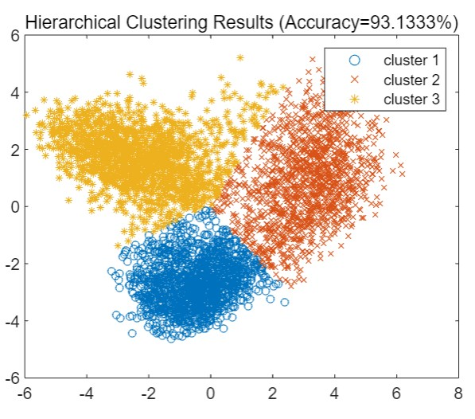
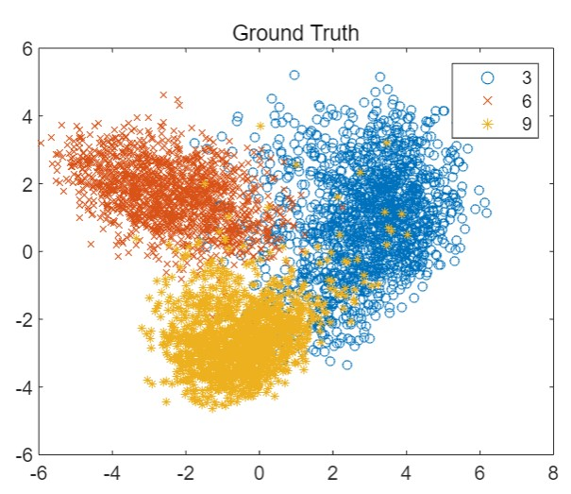
Hierarchical clustering after PCA
Accuracy: 93.1333%
Notes:
The accuracy by hierarchical clustering after PCA is 93.1333%, which is slightly lower than that of K-Means.

Slide 8
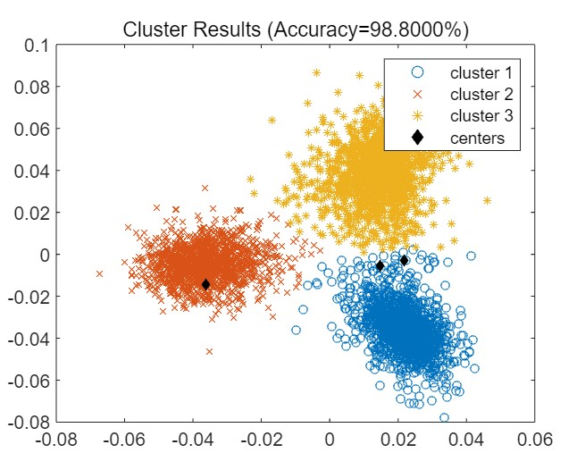
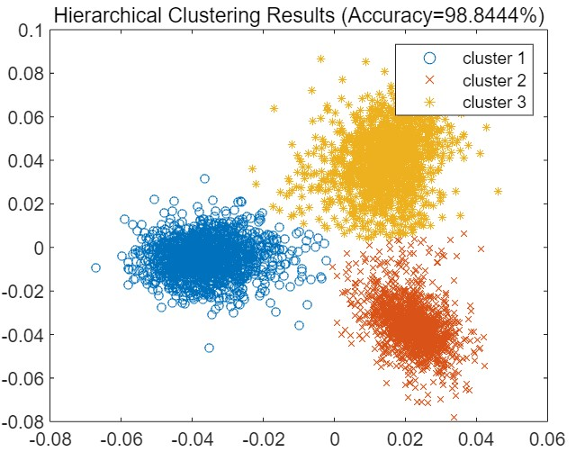
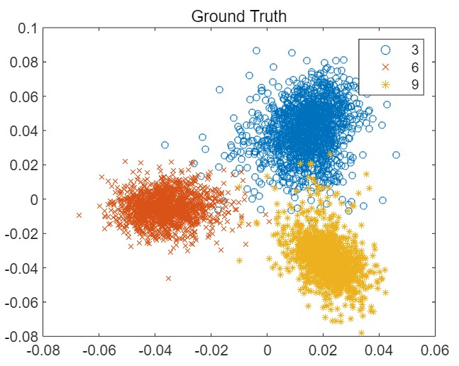
Clustering by K-Means and Hierarchical after LDA
Accuracy: 98.8000%(K-Means), 98.8444%(Hierarchical clustering)
Notes:
Compared to clustering after PCA, the result of clustering data points after using LDA is better and the accuracy is higher. The reason behind this is that LDA makes the data points with different categories more dispersed and the data points with the same category more concentrated.

Slide 9
Classification

Slide 10
Accuracy of Classification by Three Classifiers
Highest: SVM with RBF Kernel(99.82%),
Lowest: Neural Network with One Hidden Layer(98.58%)
Notes:
The accuracy of 5-fold accuracy validation by three classifers is shown in this figure. Among the 3 classifiers, the accuracy of SVM with RBF kernel is 99.82%, which is also the highest.

Slide 11
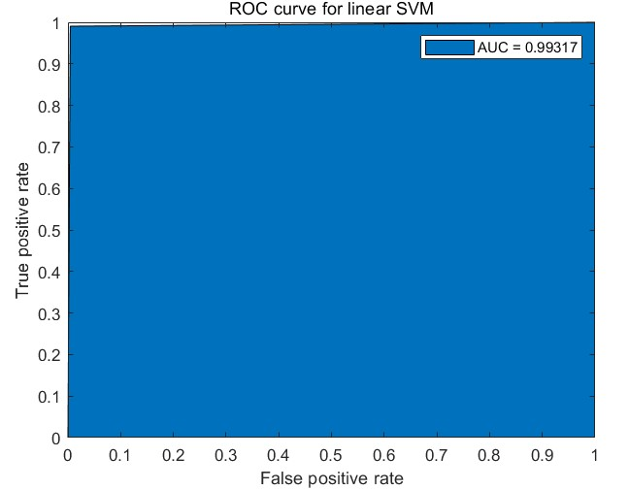
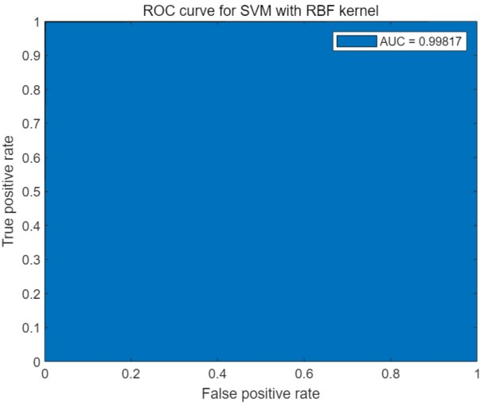
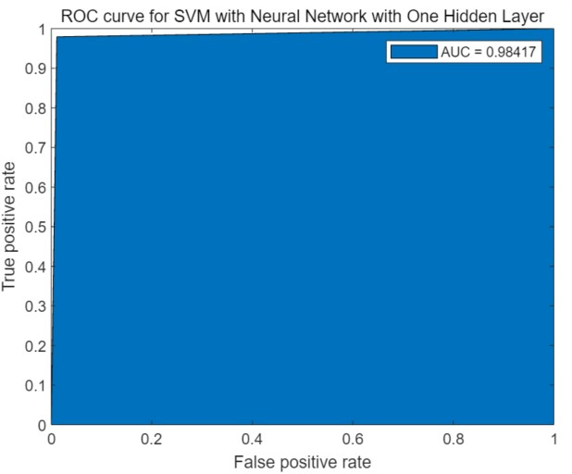
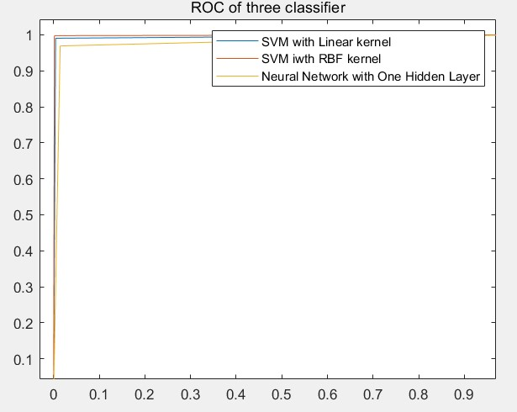
ROC and AUC of Classification by Three Classifiers
Highest: SVM with RBF Kernel(0.99817)
Lowest: NN with One Hidden Layer(0.98417)
Notes:
The ROC curve and AUC by three classifers is shown in this figure. Among the 3 classifiers, the AUC of SVM with RBF kernel is 0.99817, which is also the highest.

Slide 12
Parameter Adjustment
Notes:
The RBF kernel parameter γ is chosen to tune to adjust the performance of SVM with RBF kernel. The parameter γ is tuned from 0.0001 to 1000, and the corresponding accuracy and AUC under different γ are shown in figure. It is clear that when γ increases from 0.0001 to 1000, the classification and AUC firstly increases and then decrease. When γ ≥ 0.5, the performance of SVM with RBF kernel is just like random classifier.

Slide 13
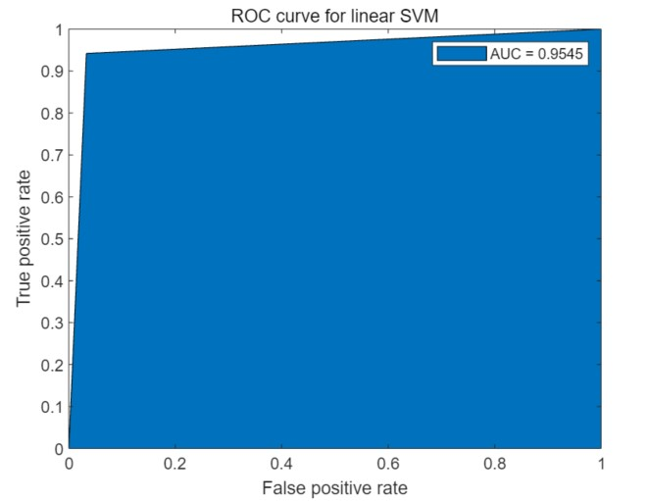
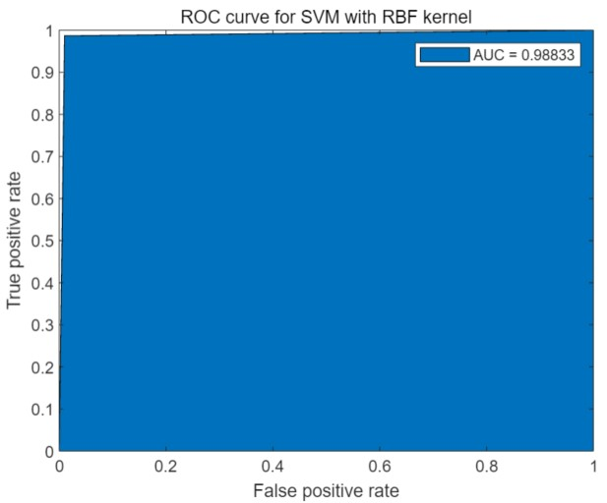
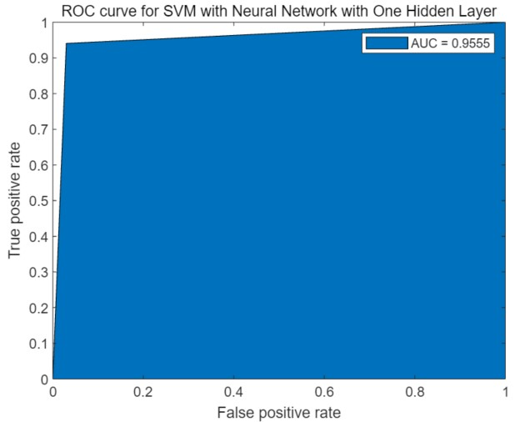
Exploration with Another three number(1,5,8)
95.87%
98.89%
96.04%
Notes:
The ROC curve, AUC and accuracy are shown in figue. Between the two experiences, what is the same is that the classification accuracy and AUC of SVM with RBF kernel are the highest among the three classifiers. What is the different is that the classification accuracy and AUC of neural network with one hidden layer are the lowest among the three classifiers in classifying ’3’, ’6’ and ’9’ while that are the second highest in classifying ’1’, ’5’ and ’8’.

Slide 14
Thank you
Presenter name
www.islide.cc

