Slide 1
Contents
Bags of features
Textons for texture representation
Bags of words
‘Dictionary learning’ (clustering)
Recognition

Slide 2
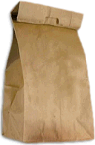
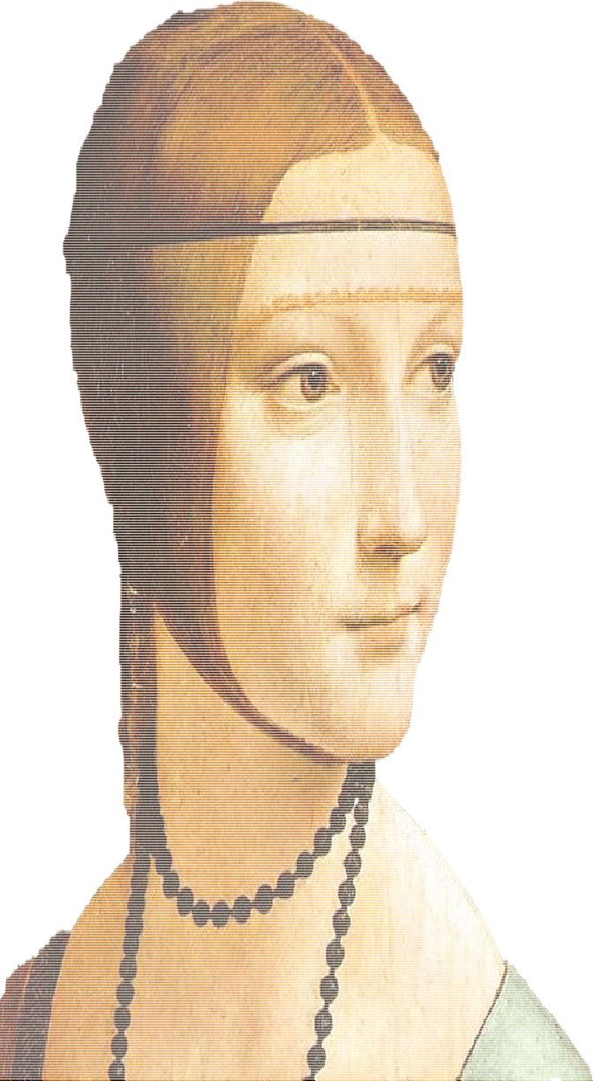










Bag of features models
Some slides adapted from Fei-Fei Li, Rob Fergus and Antonio Torralba

Slide 3

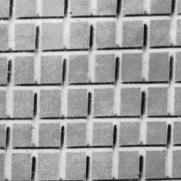
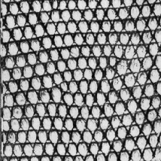



Origin 1: Texture recognition
Texture is characterized by the repetition of basic elements or textons.
Arguably, for stochastic textures, the identity of the textons matters more than their spatial arrangement.

Slide 4




Origin 1: Texture recognition

Slide 5
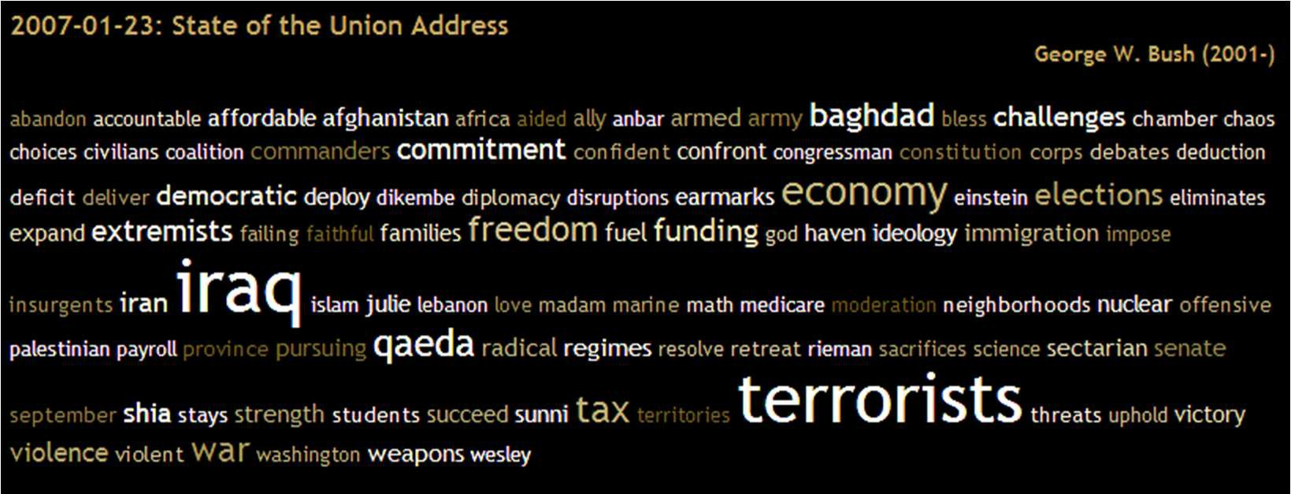
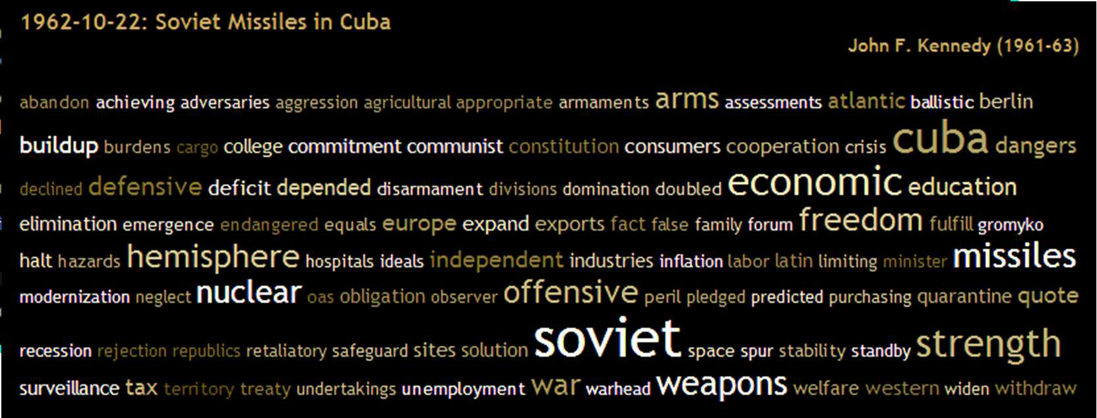
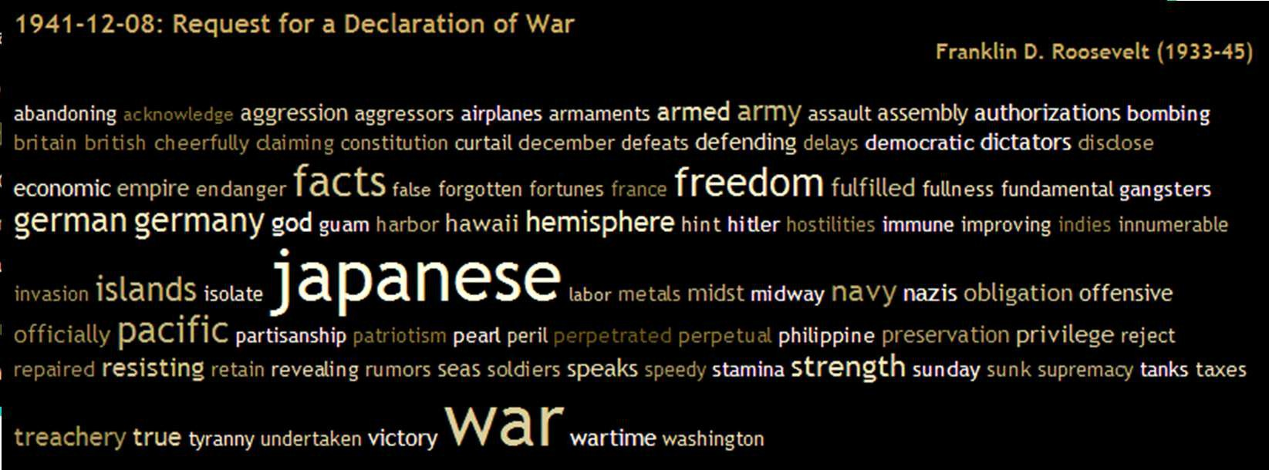
Origin 2: Bag-of-words models
Orderless document representation: frequencies of words from a dictionary Salton & McGill (1983)

Slide 6
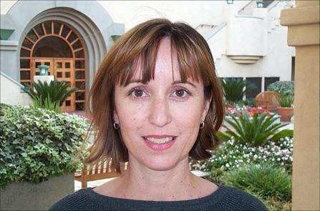
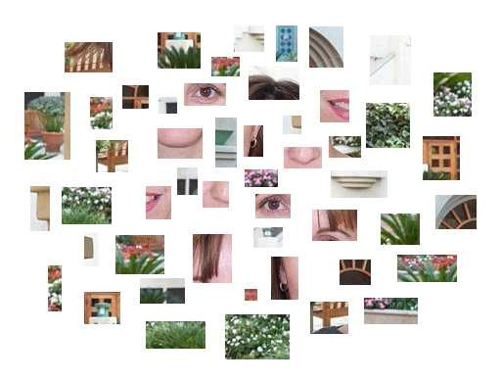
Bags of features for object recognition
face, flowers, building
Quite effective for image-level classification
t l
, W

Slide 7
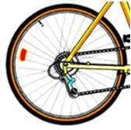
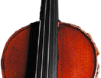

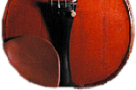



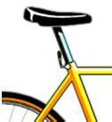

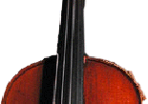
Bag of features: overview
1. Extract features

Slide 8









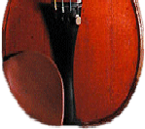

Bag of features: overview
Extract features
Learn visual vocabulary (‘dictionary’ of visual ‘words’)

Slide 9
Bag of features: overview
Extract features
Learn visual vocabulary (‘dictionary’ of visual ‘words’)
Quantize features using visual vocabulary

Slide 10




Bag of features: overview
Extract features
Learn visual vocabulary (‘dictionary’ of visual ‘words’)
Quantize features using visual vocabulary
Represent images by frequencies of visual words

Slide 11
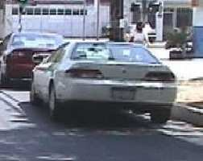
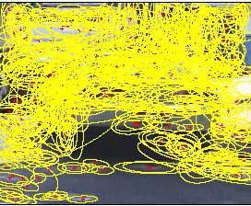
1. Feature extraction
Extract features at locations on a regular grid, at random locations, at detected feature points, from superpixels…
Features: colour, texture, SIFT, SURF, etc.

Slide 12
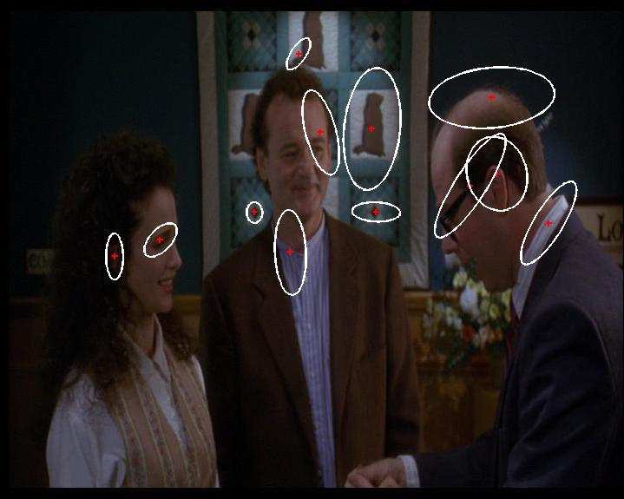
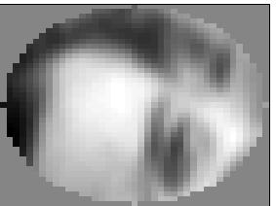
1. Feature extraction
SIFT
descriptor
Normalized patch
Patches (feature detection)

Slide 13
1. Feature extraction
…

Slide 14

2. Learning the visual vocabulary
…

Slide 15
2. Learning the visual vocabulary
…
K-means clustering
Visual ‘words’
Based on slide by Josef Sivic

Slide 16
2. Learning the visual vocabulary
…
K-means clustering
Visual ‘words’
Based on slide by Josef Sivic

Slide 17
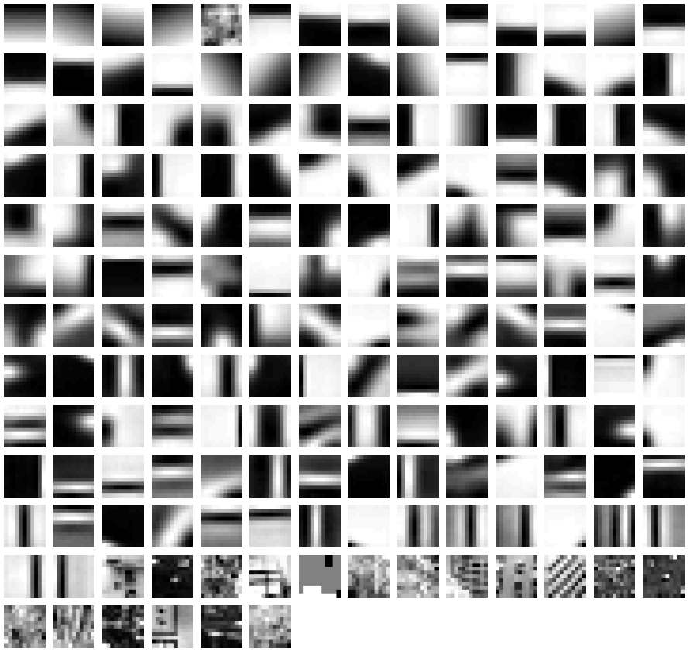
Example visual vocabulary
Fei-Fei et al. 2005

Slide 18
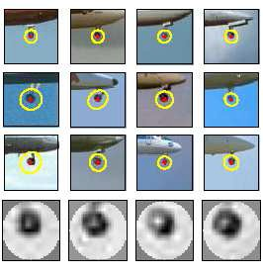
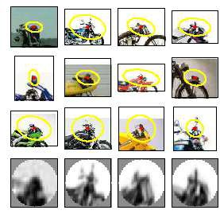
Image patch examples of visual words
Sivic et al. 2005

Slide 19
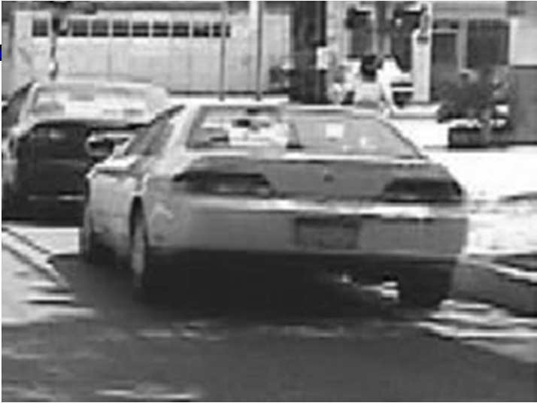
3. Image representation
frequency
…..
codewords

Slide 20



Image classification
Given a bag-of-features representation of each image:
Train a classifier using the histograms as feature vectors
Could involve defining a measure of histogram similarity

