Slide 1
CS303B - AI
Dimensionality Reduction
Learning Outcomes
  Appreciate the problems of Dimensionality Reduction
Be able to understand the principles of PCA and LDA
Be able to apply different dimensionality reduction methods in applications
Some slides adapted from various sources

Slide 2
Outline
Motivation – Why Dimensionality Reduction
PCA - Principal Component Analysis
  Eigen Value and Vectors
  Projection
LDA – Linear Discriminant Analysis
  Aka: Fisher Linear Discriminant
  Principles and discrimination metric
  Number of reduced dimensions
PCA Vs. LDA
Matlab Examples

Slide 3
What do we need Dim Reduction (PCA)
Curse of Dimensionality (Bellman 1961)
  If the data x lies in a high dimensional space and feature points tend to becomes very sparse, then an enormous amount of data is required to learn distributions or decision rules.
    High dimensions – hundreds or thousands of dimensions
Visualization of Data
  View the distribution of data in a low dimensional space, e.g, from 100 dimensional space to a 2D plane.
Compression
Belonged to exploration statistical analysis

Slide 4
Dimension Reduction Methods
One way to avoid the curse of dimensionality is by projecting the data onto a lower-dimensional space.
Popular techniques for dimensionality reduction :
  Principal Component Analysis (PCA) -Unsupervised
  Fisher’s Linear Discriminant (LDA) - Supervised
  Multi-dimensional Scaling (MDS)
  Independent Component Analysis (ICA)

Slide 5
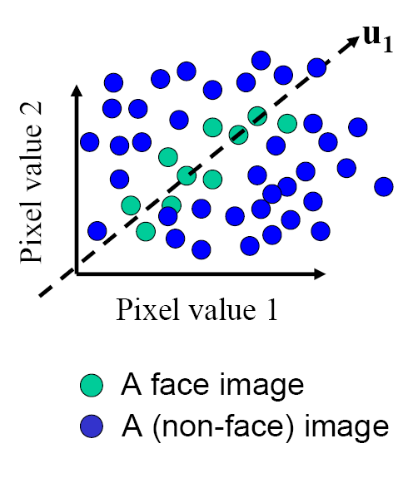
Principal Component Analysis
The goal is to find the directions that best explain the variations of the data
To find several directions (a subspace) such that the variance of the projected data in the subspace is maximized.

Slide 6
Principal Component Analysis
Given: N data points x₁, … ,x_{N} in R^{d}
Choose an unit vector u in R^{d} that captures the most data variance
Therefore, we could construct a new set of features by projecting the data onto those directions:
u(x_{i}) = u^{T}(x_{i} – µ)
(µ: mean of data points)

Slide 7
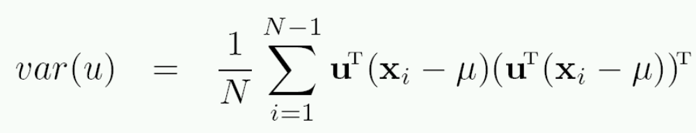
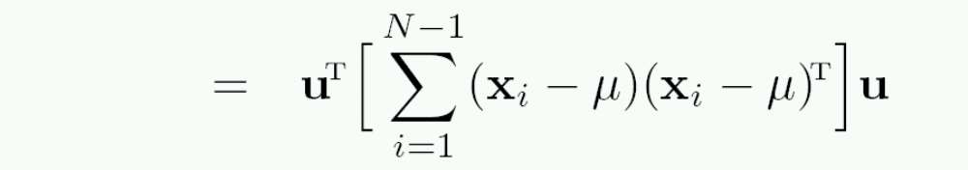
Principal Component Analysis
Direction that maximizes the variance of the projected data:
N
Maximize
subject to ||u||=1
Projection of data point
N
1/N
Covariance matrix of data
The direction that maximizes the variance is the eigenvector associated with the largest eigenvalue of Σ

Slide 8
Implementation Issue
Covariance matrix is huge (N² for N dimensions)
But typically # examples << N
Simple trick
  X is matrix of centralised training data (each row is an observation)
  Solve for eigenvectors u of XX^{T} instead of X^{T}X
  Then X^{T}u is eigenvector of covariance X^{T}X
  May need to normalize (to get unit length vector)

Slide 9
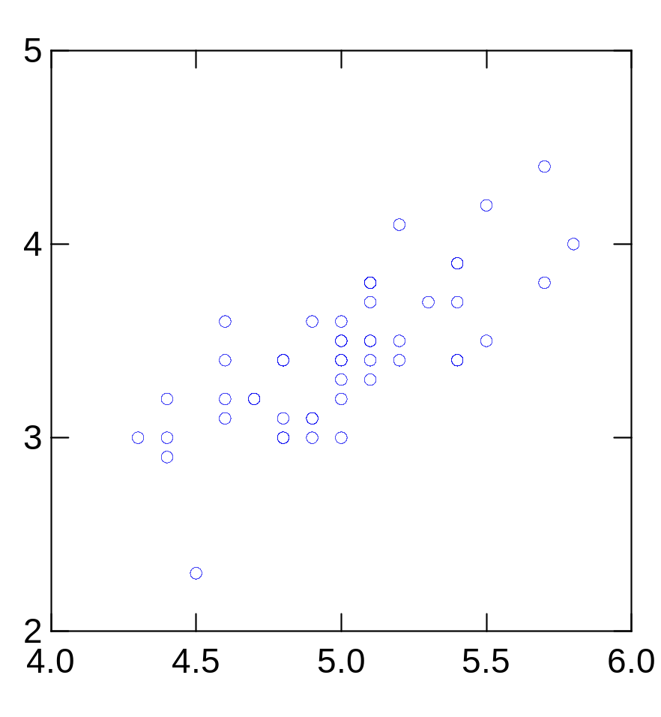
Principal Component Analysis
2nd Principal
Component, y₂
1st Principal
Component, y₁
The meaning of directions -- Eigen vectors

Slide 10
PCA Scores
x_{i2}
y_{i,2}
y_{i,1}
x_{i1}
The geometrical meaning of projection on those directions

Slide 11
PCA Eigenvalues
λ₂
λ₁

Slide 12
A 2D Numerical Example

Slide 13
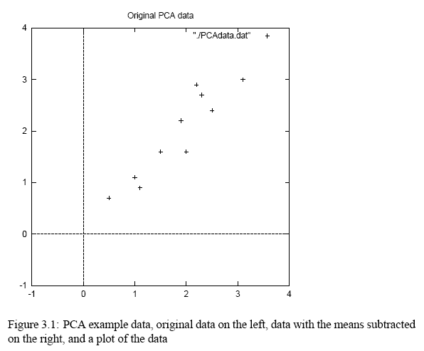
PCA Example –Data
http://www.cs.otago.ac.nz/cosc453/student_tutorials/principal_components.pdf
DATA:
x y
2.5 2.4
0.5 0.7
2.2 2.9
1.9 2.2
3.1 3.0
2.3 2.7
2 1.6
1 1.1
1.5 1.6
1.1 0.9

Slide 14
PCA Example –STEP 1
Subtract the mean
from each of the data dimensions. All the x values have x subtracted and y values have y subtracted from them. This produces a data set whose mean is zero.
Subtracting the mean makes variance and covariance calculation easier by simplifying their equations. The variance and co-variance values are not affected by the mean value.

Slide 15
PCA Example –STEP 1
http://www.cs.otago.ac.nz/cosc453/student_tutorials/principal_components.pdf
ZERO MEAN DATA:
x y
.69 .49
-1.31 -1.21
.39 .99
.09 .29
1.29 1.09
.49 .79
.19 -.31
-.81 -.81
-.31 -.31
-.71 -1.01
DATA:
x y
2.5 2.4
0.5 0.7
2.2 2.9
1.9 2.2
3.1 3.0
2.3 2.7
2 1.6
1 1.1
1.5 1.6
1.1 0.9

Slide 16
PCA Example –STEP 2
Calculate the covariance matrix
cov = .616555556 .615444444
.615444444 .716555556
since the non-diagonal elements in this covariance matrix are positive, we should expect that both the x and y variable increase together.

Slide 17
PCA Example –STEP 3
Calculate the eigenvectors and eigenvalues of the covariance matrix
eigenvalues = .0490833989
1.28402771
eigenvectors = -.735178656 -.677873399
.677873399 -.735178656

Slide 18
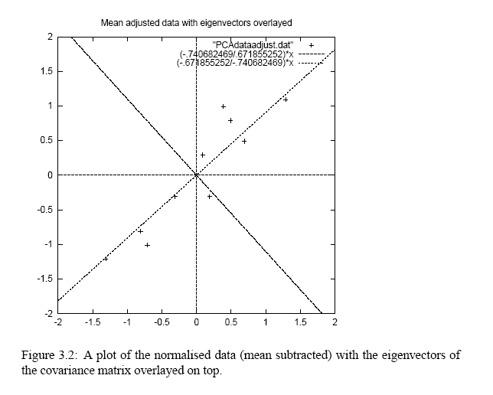
PCA Example –STEP 3
http://www.cs.otago.ac.nz/cosc453/student_tutorials/principal_components.pdf
eigenvectors are plotted as diagonal dotted lines on the plot.
Note they are perpendicular to each other.
Note one of the eigenvectors goes through the middle of the points, like drawing a line of best fit.
The second eigenvector gives us the other, less important, pattern in the data, that all the points follow the main line, but are off to the side of the main line by some amount.

Slide 19
PCA Example –STEP 4
Reduce dimensionality and form feature vector
the eigenvector with the highest eigenvalue is the 1st principal component of the data set.
In our example, the eigenvector with the largest eigenvalue was the one that pointed down the middle of the data.
Once eigenvectors are found from the covariance matrix, the next step is to order them by eigenvalue, highest to lowest. This gives you the components in order of significance.

Slide 20
PCA Example –STEP 4
Now, if you like, you can decide to ignore the components of lesser significance.
You do lose some information, but if the eigenvalues are small, you don’t lose much
n dimensions in your data
calculate n eigenvectors and eigenvalues
choose only the first p eigenvectors
final data set has only p dimensions.

Slide 21
PCA Example –STEP 4
Feature Vector
Feature Vector = (eig₁ eig₂ eig₃ … eig_{n})
We can either form a feature vector with both of the eigenvectors:
-.677873399 -.735178656
-.735178656 .677873399
or, we can choose to leave out the smaller, less significant component and only have a single column:
- .677873399
- .735178656

Slide 22
PCA Example –STEP 5
Deriving the new data
Final Data = RowFeatureVector x RowZeroMeanData (a projection!)
RowFeatureVector is the matrix with the eigenvectors in the columns transposed so that the eigenvectors are now in the rows, with the most significant eigenvector at the top
RowZeroMeanData is the mean-adjusted data transposed, ie. the data items are in each column, with each row holding a separate dimension.

Slide 23
PCA Example –STEP 5
Final Data Transpose: dimensions along columns
x y
-.827970186 -.175115307
1.77758033 .142857227
-.992197494 .384374989
-.274210416 .130417207
-1.67580142 -.209498461
-.912949103 .175282444
.0991094375 -.349824698
1.14457216 .0464172582
.438046137 .0177646297
1.22382056 -.162675287
Projection on 1st PC
Projection on 2nd PC

Slide 24
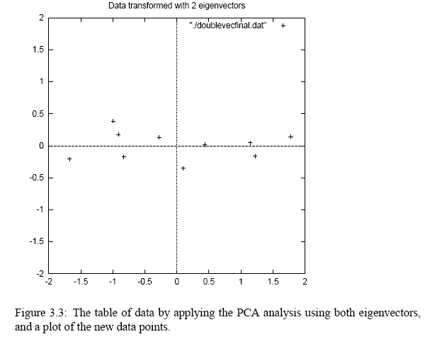
PCA Example –STEP 5
http://www.cs.otago.ac.nz/cosc453/student_tutorials/principal_components.pdf

Slide 25
Reconstruction of Original Data
If we reduced the dimensionality, obviously, when reconstructing the data we would lose those dimensions we chose to discard. In our example let us assume that we considered only the x dimension…

Slide 26
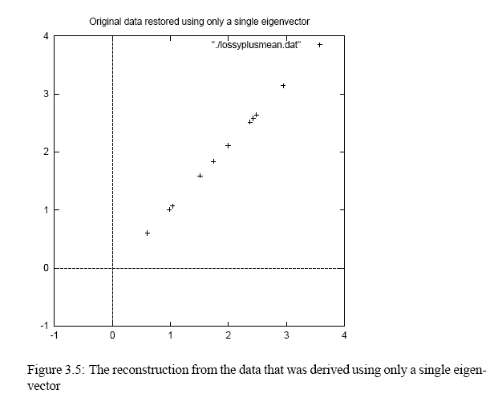
Reconstruction of Original Data
http://www.cs.otago.ac.nz/cosc453/student_tutorials/principal_components.pdf
x
-.827970186
1.77758033
-.992197494
-.274210416
-1.67580142
-.912949103
.0991094375
1.14457216
.438046137
1.22382056

Slide 27
Compute Eigenvectors and Eigenvalues
Matlab Key Codes :
  X = X- mean (X) % X is a matrix. Each row is an observation and each column is a variable
  M = Cov(X); % M is the covariance matrix normalised by the number of the observations (number of rows)
  [Vec, Values] = Eig(M) or use [u, s, v] = SVD(M) % Compute the eigen value and vectors.
Or use princomp or pca directly

Slide 28
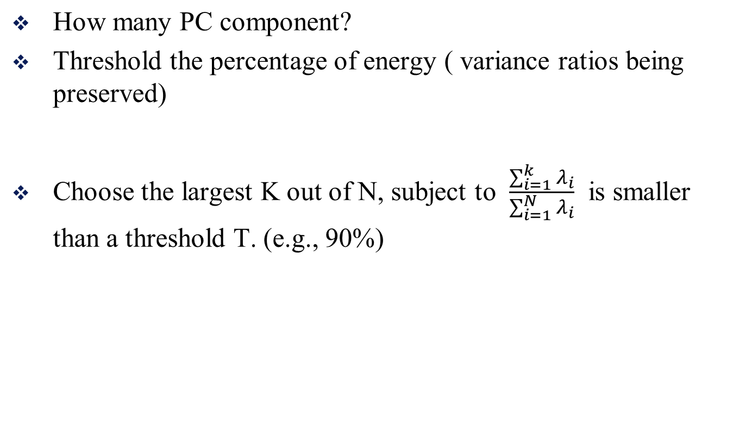
PCA: Choose the number of PCs

Slide 29
  Fisher Linear Discriminant
  First applied by M. Barnard at the suggestion of R. A. Fisher (1936), Fisher linear discriminant analysis (FLDA):

Slide 30
Fisher Linear Discriminant
Dimension reduction
  Finds linear combinations of the features X=X₁,...,X_{d} with large ratios of between-groups to within-groups sums of squares - discriminant variables;
Classification (discussed this in next lecture)
  Predicts the class of an observation X by the class whose mean vector is closest to X in terms of the discriminant variables

Slide 31
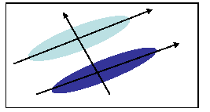
PCA and Discrimination
PCA may not find the best directions for discriminating between two classes.
Example: suppose the two classes have 2D Gaussian densities as ellipsoids.
1st eigenvector is best for representing the variation.
2nd eigenvector is best for discrimination.

Slide 32
Is PCA a good criterion for classification?
Data variation determines the projection direction
What’s missing?
  Class information

Slide 33
What is a good projection?
Similarly, what is a good criterion?
  Separating different classes
Two classes overlap
Two classes are separated

Slide 34
What class information may be useful?
Between-class distance
  Distance between the centroids of different classes
Between-class distance

Slide 35
What class information may be useful?
Between-class distance
  Distance between the centroids of different classes
Within-class distance
  Accumulated distance of an instance to the centroid of its class
Within-class distance

Slide 36
Linear Discriminant Analysis
Linear discriminant analysis (LDA) finds most discriminant projection by maximizing between-class distance and minimizing within-class distance

Slide 37
Linear Discriminant Analysis
Linear discriminant analysis (LDA) finds most discriminant projection by maximizing between-class distance and minimizing within-class distance

Slide 38






Notations
Training data from different classes 1, 2, …, k
Data matrix

Slide 39

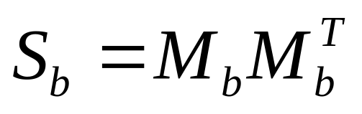







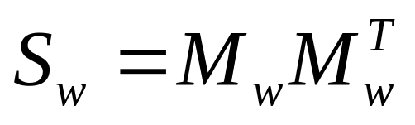

Notations
Between-class scatter
Within-class scatter
Properties:
  Between-class distance = trace of between-class scatter (I.e., the summation of diagonal elements of the scatter)
  Within-class distance = trace of within-class scatter

Slide 40
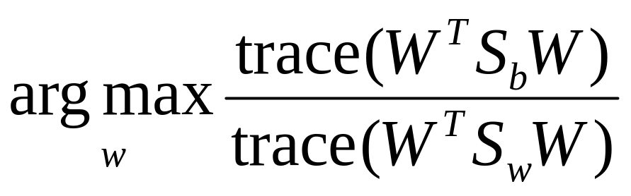
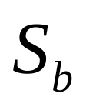
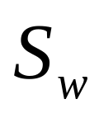
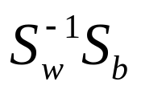
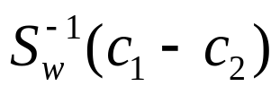
Discriminant criterion
Discriminant criterion in mathematical formulation
  Between-class scatter matrix
  Within-class scatter matrix
The optimal transformation is given by solving a generalized eigenvalue problem
For two classes: the optimal direction could be computed in a close form

Slide 41
Issues in LDA
is required to be nonsingular.
  Singularity or under sampled problem (when n<<d)
  Example: gene expression data (d is around few thousands and n is around few hundreds), images, text documents
Approaches
  PCA+LDA (PCA: Principal Component Analysis)
  Regularized LDA

Slide 42
AC50001- Advanced Data Stats
More on Machine Learning -- Dimensionality Reduction
Learning Outcomes
  Appreciate the problems of Dimensionality Reduction
Be able to understand the principles of PCA and LDA
Be able to apply different dimensionality reduction methods in applications

