Slide 1
Performance Evaluation
CS303B - AI
Learning Outcomes
  Appreciate the problems of performance evaluation
  Understand the principles of different evaluation strategy
  Be able to compute the evaluation criteria.
  Be able apply appropriate evaluation criteria in real problems.

Slide 2
Outline
Introduction
Classification with Train, Test, and Validation sets
  Handling Unbalanced Data
  Parameter Tuning
Cross-validation
Computing ROC curves

Slide 3
A List of Common Classifiers
Nearest Neighbours Classifies (NN)
K-Nearest Neighbours
Support Vector Machine
Neural Networks
Discriminative analysis – LDA
Bayesian Classifies
Logistic regression
Adaboost
Decision Trees
Rule based Approaches
….

Slide 4
Introduction
To assess the performance of data classification system.
Q: How predictive is the model we learned?
Error on the training data is not a good indicator of performance on future data
  Q: Why?
  A: Because new data will probably not be exactly the same as the training data!
Over-fitting
  fitting the training data too precisely - usually leads to poor results on new data
  In other words: only remember the data, and no generalization capability

Slide 5
Common Evaluation Measures
Possible evaluation measures:
  Classification Accuracy
  Total cost/benefit – when different errors involve different costs
  ROC curves
  Area under the curve
How reliable are the predicted results ?

Slide 6
Classifier Accuracy/Error Rate
Natural performance measure for classification problems: Classification Accuracy/error rate
  Success: instance’s class label is predicted correctly
  Error: instance’s class label is predicted incorrectly
  Accuracy: proportion of success made over the whole set of instances
  Error rate: proportion of errors made over the whole set of instances
  Accuracy = 1 – Error rate
Training set accuracy /error rate: is way too optimistic!
  you can find patterns even in random data

Slide 7
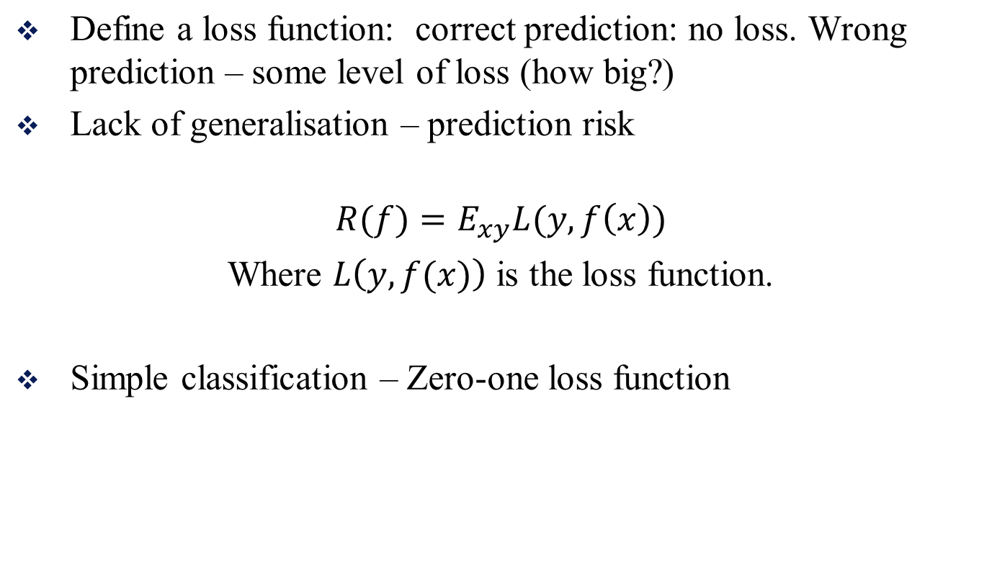
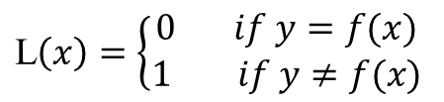
A general definition/view of classification loss

Slide 8
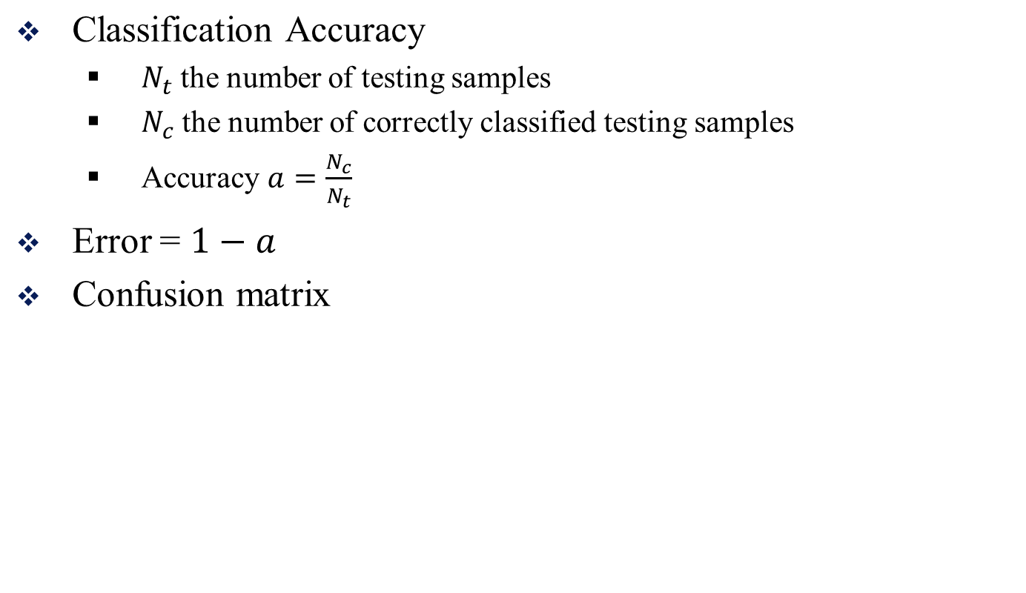
The Most Common Criteria

Slide 9
Confusion Matrix
 | Prediction
Ground Truth | C1 | C2 | C3
C1 | 20 | 0 | 0
C2 | 0 | 18 | 2
C3 | 5 | 0 | 15
How can you compute the classification accuracy from the confusion matrix?
  Sum of the diagonal entries divided by total sum of all entries?
  How would you be able to compute the classification accuracy for each class?

Slide 10
Evaluation on “LARGE” data
If many (thousands) of examples are available, including several hundred examples from each class, then how can we evaluate our classifier method?

Slide 11
Evaluation on “LARGE” Data
A simple evaluation is normally sufficient
  Randomly split data into training and test sets (usually 2/3 for train, 1/3 for test)
Build a classifier using the training set and evaluate it using the test set.

Slide 12
Classification Step 1: Split data into training and test sets
THE PAST
Results Known
+
Training set
+
-
-
Data
+
Testing set

Slide 13
Classification Step 2: Build a model on a training set
THE PAST
Results Known
+
Training set
+
-
-
Data
+
Model Builder
Testing set

Slide 14
Classification Step 3: Evaluate on test set
Results Known
+
Training set
+
-
-
Data
+
Model Builder
Evaluate
Predictions
+
-
+
-
Y
N
Testing set

Slide 15
Unbalanced Data
Sometimes, classes have very unequal frequency
  medical diagnosis: 90% healthy, 10% disease
  eCommerce: 99% don’t buy, 1% buy
  Security: >99.99% of Americans are not terrorists
Similar situation with multiple classes
Majority class classifier can be 97% correct, but useless

Slide 16
Handling unbalanced data – how?
If we have two classes that are very unbalanced, then how can we evaluate our classifier method?

Slide 17
Handling Unbalanced Data
With two classes, a good approach is to build BALANCED train and test sets, and train model on a balanced set
  randomly select desired number of minority class instances
  add equal number of randomly selected majority class
How do we generalize “balancing” to multiple classes?

Slide 18
Handling unbalanced data – how?
Generalize “balancing” to multiple classes
  Ensure that each class is represented with approximately equal proportions in training and test

Slide 19
A Note on Parameter Tuning
It is important that the test data is not used in any way to create the classifier
Some learning schemes operate in two stages:
  Stage 1: builds the basic structure
  Stage 2: optimizes parameter settings
The test data can’t be used for parameter tuning!
Proper procedure uses three sets: training data, validation data, and test data
  Validation data is used to optimize parameters

Slide 20
Classification: Train, Validation, Test split
Results Known
+
Model
Builder
+
Training set
-
-
Data
+
Evaluate
Model Builder
Predictions
+
-
+
-
Y
N
Validation set
+
-
+
-
Final Evaluation
Final Test Set
Final Model

Slide 21
Making the most of the data
Once evaluation is complete, all the data can be used to build the final classifier
Generally, the larger the training data the better the classifier (but the training time might be longer)
The larger the test data the more accurate the error estimate

Slide 22
Predicting Performance
Assume the estimated error rate is 25%. How close is this to the true error rate?
  Depends on the amount of test data
Prediction is just like tossing a biased (!) coin
  “Head” is a “success”, “tail” is an “error”
In statistics, a succession of independent events like this is called a Bernoulli process
Statistical theory provides us with confidence intervals for the true underlying proportion! (we will learn the statistical testing in the Research Method Course in semester 2)

Slide 23
Evaluation on Small Data
The holdout method reserves a certain amount for testing and uses the remainder for training
  Usually: one third for testing, the rest for training
For “unbalanced” datasets, samples might not be representative
  Few or none instances of some classes
Stratified sampling
  Make sure that each class is represented with approximately equal proportions in both subsets

Slide 24
Evaluation on small Data
What if we have a small data set?
The chosen 2/3 for training may not be representative.
The chosen 1/3 for testing may not be representative.
One spit is not sufficient.

Slide 25
Repeated Holdout Method
Holdout estimate can be made more reliable by repeating the process with different subsamples
  In each iteration, a certain proportion is randomly selected for training (possibly with stratification)
  The error rates on the different iterations are averaged to yield an overall error rate
This is called the repeated holdout method

Slide 26
Repeated Holdout Method
Still not optimum: the different test sets overlap.
Can we prevent overlapping?

Slide 27
Cross Validation (CV)
Cross-validation avoids overlapping test sets
  First step: data is split into k subsets of equal size
  Second step: each subset in turn is used for testing and the remainder for training
This is called k-fold cross-validation
Often the subsets are stratified before the cross-validation is performed
The error estimates are averaged to yield an overall error estimate

Slide 28
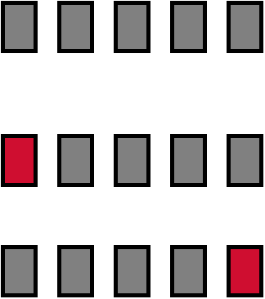
Cross-Validation Example:
Break up data into groups of the same size
Hold aside one group for testing and use the rest to build model
Repeat
Test

Slide 29
More on Cross-Validation
Standard method for evaluation: stratified K-fold cross-validation, e.g., K=4, or 10
Stratification reduces the estimate’s variance
Even better: repeated stratified cross-validation
  E.g. ten-fold cross-validation is repeated ten times and results are averaged (reduces the variance)

Slide 30
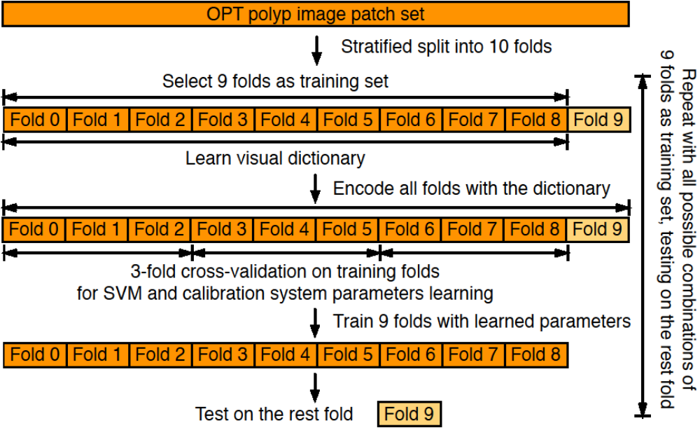
A 10-Fold CV layered example

Slide 31
Leave-one-out Cross-validation
Leave-one-out cross-validation (LOOCV) is a particular case of exhaustive cross-validation
  Set number of folds to number of training instances
  I.e., for n training instances, build classifier n times
The final accuracy is the pooled estimate of the accuracy over all of the samples.
Makes best use of the data
Involves no random subsampling
Very computationally expensive

Slide 32
Types of Errors – Two class problem
Prediction
Human Not Human
Ground Truth
Not human human
True Positive | False Negative
False Positive | True Negative
TP – True Positive; FN – False Negative
FP -- False Positive, TN – True Negative

Slide 33
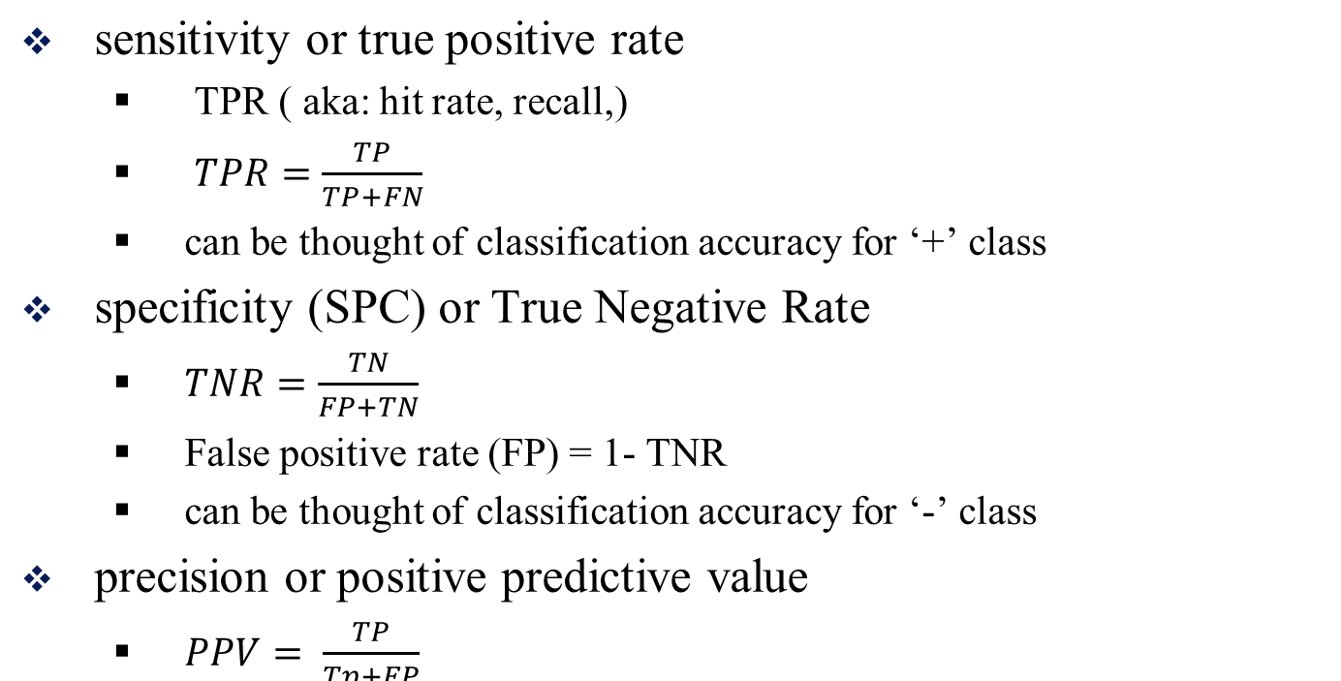
Measures Related to the Two Class Confusion Matrix
One pair of (TPR, FP) correspond to one threshold

Slide 34
Receiver Operating Characteristic (ROC),
Classifiers not only output the binary labels, but also output the score of the prediction
One pair of (TPR, FPR) correspond to one threshold.
By varying all of the possible threshold, we can get a set of paired values of (TPR, FPR)
Plot them and connect them together will form a Receiver Operating Characteristic (ROC),
RoC is a measure metric, which is independent of a specific threshold.

Slide 35
Receiver Operating Characteristic (ROC),
The receiver operating characteristic is a metric used to check the quality of classifiers. For each class of a classifier, roc applies threshold values across the interval [0,1] to outputs. For each threshold, two values are calculated, the True Positive Ratio (the number of outputs greater or equal to the threshold, divided by the number of one targets), and the False Positive Ratio (the number of outputs less than the threshold, divided by the number of zero targets).
Matlab code:
roc() Or perfcurve()
Connect those points to form a curve:
Sensitivity
1 - Specificity
Each point of the curve correspond to one threshold

Slide 36
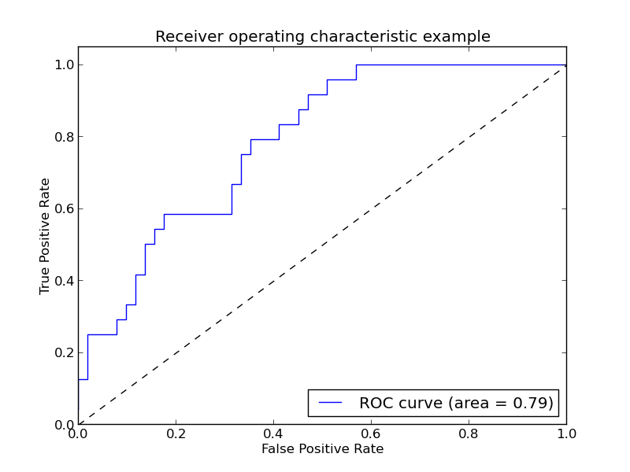
Receiver Operating Characteristic (ROC),

Slide 37
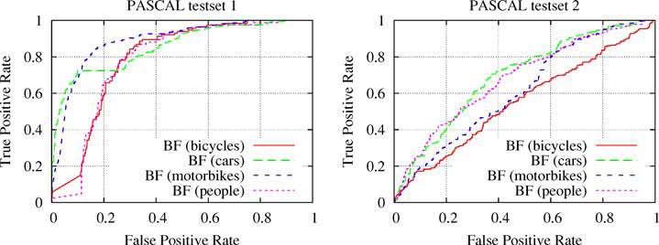
ROC Analysis
Normally the high the better !

Slide 38
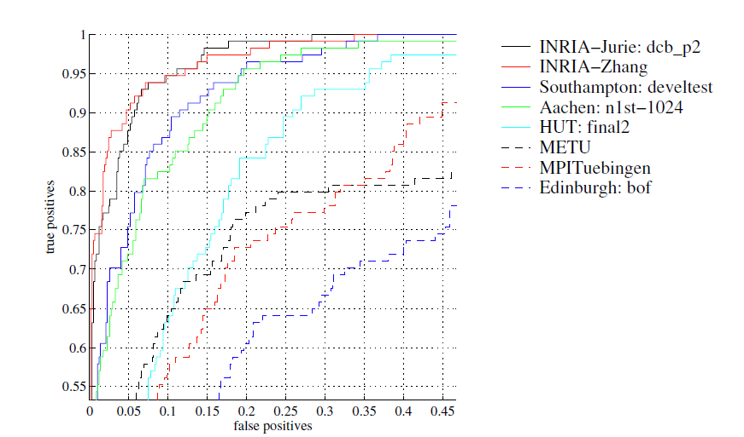
ROC Analysis: Area Under the Curve
AUC: 0.982 – INRIA Zhang
AUC: 0.981 – INRIA- Jurie
** Sometime it is very difficult to see if one curve is really above the other, we can use the measure: Area Under the Curve to compare
** Sometimes which one is better depends on which threhold you are working with

Slide 39
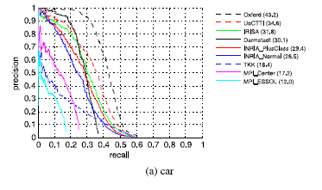
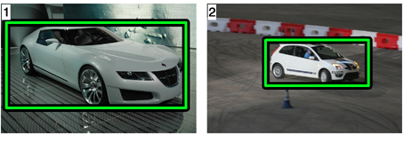
PRC curve Vs. ROC curve
PRC – Precision and Recall Curve
PSCAL VOC 2010 Car detectors Evaluations

Slide 40
When to use PRC curve?
Since ROC curves does not explicitly show any dependence on the constant P/N (ratio of actual + to – in the sample). They could misled if you care about FP versus TP.
When the positive class ‘+’ are very small compared with the negative class ‘-’

Slide 41
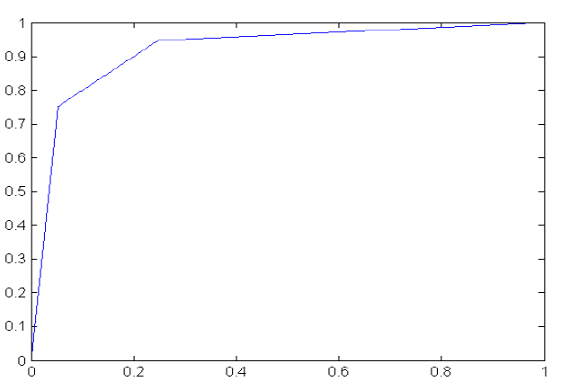






When to use PRC curve? -- Example
Suppose you have a test for brain cancer whose false positive rate can be varied from 5% to 25% as the false negative rate varies from 25% to 5% (suppose linear dependences on both):
FPR=0.15, TPR=0.85
Now suppose you try the test on a population of 10,000 people, 1% of whom actually are cancer positive:
FP vs. TP is ~17:1. You’ll be telling 17 people that they might have cancer for every one who actually does. It is unlikely that your test will be used
In a case like this, ROC, while correct, somewhat misses the point.

Slide 42
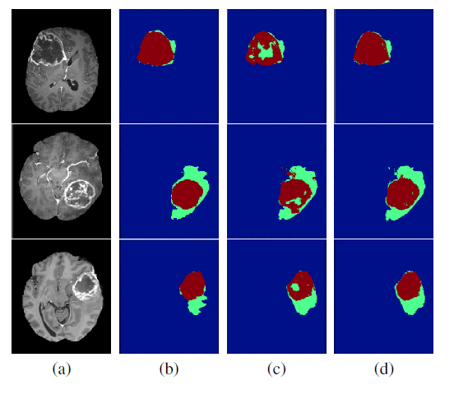
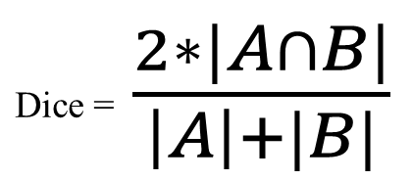
Metrics for other algorithms
Dice Score
  Measuring the overlap between two areas.
  Used to evaluate the performance of segmentation algorithms
A: GT
B: Seg
Visualization of results of FC-CRF and FC-CRF with prior for tumor core (red) against edema (green): (a) T1c modality; (b) ground truth; (c) FC-CRF; (d) FC-CRF with prior.
Sample Dice score: Dice (c,b) = 0.8; Dice (d, b) = 0.85

Slide 43
Summary
Classification accuracy/error
Confusion matrix
False Positive/Negative Rate
ROC Analysis/Area Under Curve
PRC/RPC Curves/ Area Under Curve
Good Practice:
  Use Train, Test, Validation sets for “LARGE” data
  Balance “un-balanced” data
  Use Cross-validation for small data
  Don’t use test data for parameter tuning - use separate validation data
Most Important: Avoid Over fitting

