Slide 1
AI (B) - Computer Vision Part
Pixel Operations, Histogram, Thresholding
Learning Outcomes
Be able to understand the basics of point operators
Be able to compute histograms, optimal threshold for a given image by programming
Be able to design and apply simple background extraction algorithms.

Slide 2
Contents
Pixel Processing
Histogram and Normalization
Intensity Thresholding
Background Extraction

Slide 3
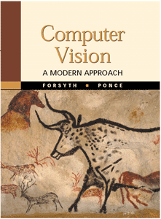

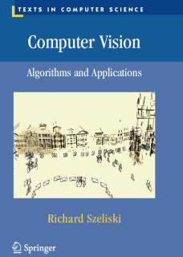
Reading
FP: Parts of 7 & 8:
Books from library
Relevant HIPR2 worksheets
http://homepages.inf.ed.ac.uk/rbf/HIPR2/wksheets.htm
RS: Parts of 3
http://szeliski.org/Book/drafts/SzeliskiBook_20100903_draft.pdf

Slide 4
Pixel Processing: Basics

Slide 5
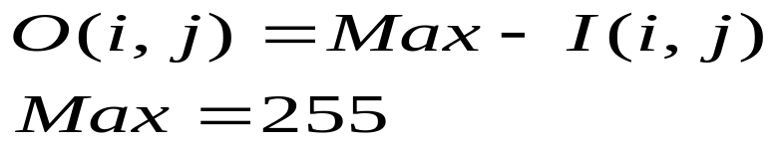
Negate (Invert)
Formula:
Pseudo Code: for (p=0; p<nPixels; p++)
image[p] = MAXVAL - image[p];

Slide 6
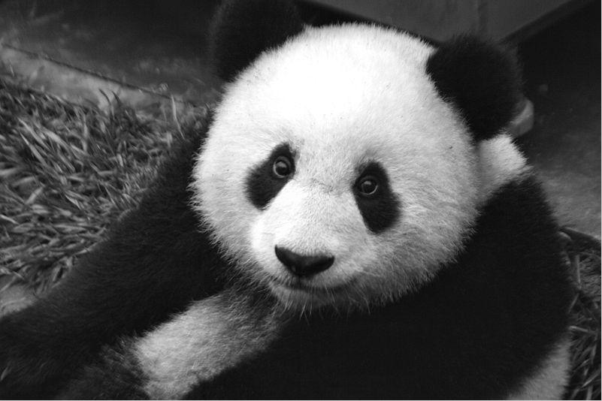
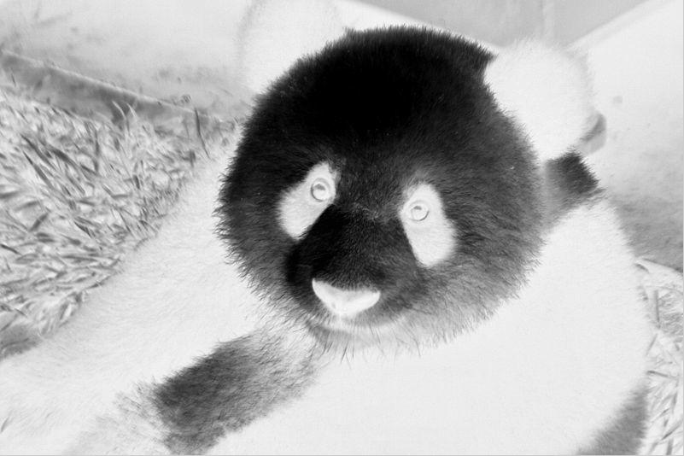
Examples
Original Image
Inverted Image

Slide 7
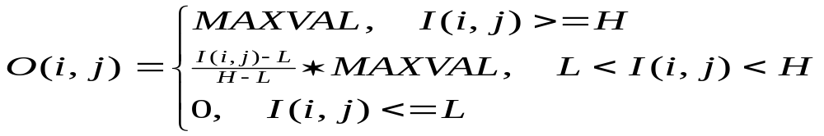
Contrast Scaling
Scale a selected grey-scale range [low, high] to fill the available range [0,MAXVAL]
Pseudo code: for (p=0; p<nPixels; p++)
if (image[p] >= low && image[p] <= high)
image[p] =
(image[p] – low) * MAXVAL / (high-low);
else if (image[p] < low) image[p] = 0;
else image[p] = MAXVAL;

Slide 8
Image Arithmetic
addition, subtraction, multiplication, division
Example: averaging two images
for (p=0; p<nPixels; p++)
{
imageout[p] = image1[p] + image2[p];
imageout[p] = imageout[p] / 2;
}
Potential for overflow !

Slide 9
Hazard of Overflow/Underflow
If pixels are bytes, 200 + 100 = ???
  Wraparound ?
  Stay at maximum ?
Control it:
  Step1: make pixel storage larger (double int)
  Step2: add images
  Step3: scale to original range (single int)
  Step4: convert image back to original storage type
or use float or double!

Slide 10
D-I-Y
All these functions (and many more) are explained in more detail in HIPR and examples are given with images.
Almost all these functions can be implemented in Paint Shop Pro & most other image packages
Try some DIY in labs!

Slide 11
Intensity Histograms

Slide 12
Grey-level Histogram
Count number of times each grey-level, v, occurs in image. Shows distribution of values. (like a bar chart!)
H(v)
0 5 10 15 20
0 5 10 15 20 25 30
v

Slide 13

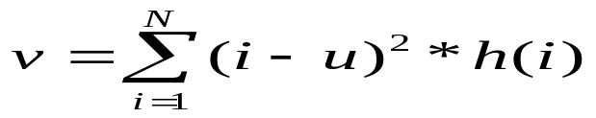
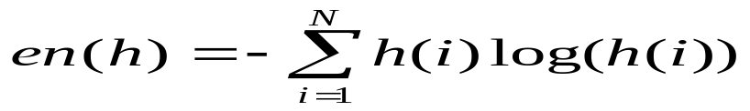
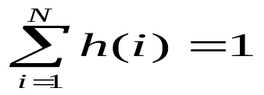
Statistics from Histogram
Mean:
Variance:
Entropy: The information of the histogram. (flatness)
Modes: the most frequently happened items, i.e., the intensities
! Histogram needs to be normalised first, .i.e.,

Slide 14
Thresholding
Image intensity thresholding separate pixels into two categories:
Larger than or equal a threshold
Smaller than a threshold
Thresholding creates a binary image, often called binarization, e.g: counting the number of cells in a histological images, number of rice in a visual image.

Slide 15
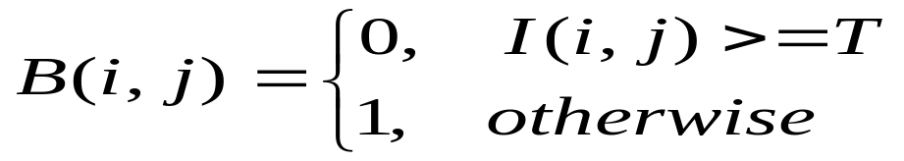
Binary Threshold
Formula
Pseudo Code: for (p=0; p<nPixels; p++)
if (image[p] < threshold)
image[p] = 0;
else image[p]= MAXVAL;

Slide 16
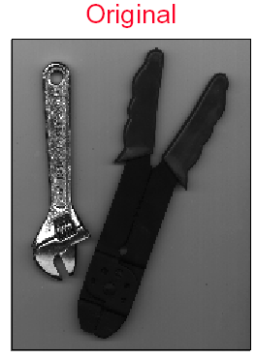
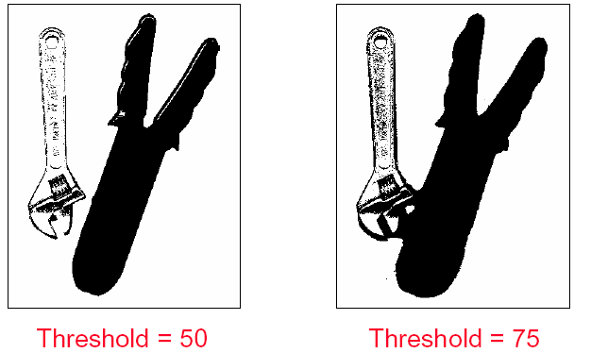
Thresholding Examples

Slide 17
Thresholding
Intensity thresholding usually needs to analyzing the distribution of the intensity – the histogram

Slide 18
Thresholding: A Bimodal Histogram
e.g. A bright object on a dark background
Thresholding here would segment the image
Background
H(v)
0 5 10 15 20
Object
0 5 10 15 20 25 30
v

Slide 19
… but more commonly…
Object and background distributions overlap:
Threshold ??
Background
H(v)
0 5 10 15 20
Object
0 5 10 15 20 25 30
v

Slide 20
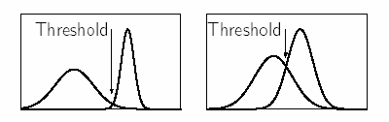
Optimal Thresholding
Histogram shape can be useful in locating the threshold
  – However it is not reliable for threshold selection when peaks are not clearly resolved.
  – A “flat” object with small intensity variations will give rise to a relatively narrow histogram peak.
Normally works well for Bimodal Histogram

Slide 21
Optimal Thresholding
Usually need to specify a criterion function to measure separation between groups
- 1) Otsu’s method: choose the threshold to minimize the intra-class variance while maximize the inter-class distance (such a criteria is often called Fisher criterion in statistics).
2) Approximate Ostu’s method: Auto Thresholding
Paper: Nobuyuki Otsu (1979). "A threshold selection method from gray-level histograms".
IEEE Trans. Sys., Man., Cyber. 9 (1): 62–66.
Normally works well for Bimodal Histogram

Slide 22



Otsu’s Method
Otsu’s thresholding method is based on selecting the lowest point between two classes (peaks).
Weight and Mean value
:
    Weight: N: total pixel number
    Mean: n_{i}: number of pixels in level I
Analysis of variance (variance=standard deviation²)
    Total variance:

Slide 23
Otsu’s Method
Inter-classes/between-classes variance (δ_{b}² ):
The variation of the mean values for each class from the overall intensity mean of all pixels:
δ_{b}² = ω₀ (μ₀ - μ_{t} ) ² + ω₁(μ₁ - μ_{t} ) ²,
Substituting μ_{t} = ω₀ μ₀ + ω₁μ₁, we get:
δ_{b}² = ω₀ω₁(μ₁ - μ₀ )²
  ω_{0,} ω_{1,} μ_{0,} μ₁ stands for the weights and mean
  values of two classes, respectively.

Slide 24
Otsu’s Method
Pseudo Code:
1. Initialize a threshold, normally the starting value (e.g.,0)
Loop -- Repeat:
2. Separate the pixels into two clusters based the threshold
3. Computer the mean value of each cluster
4. Square the difference between the means
5. Multiply the number of pixels on one cluster times the number in the other (the between-class variance ) for that threshold
6. Until the every possible threshold being tested (e.g., till 254).
7. Select the threshold that having the largest between class variance

Slide 25
Otsu’s Method- Matlab
I = imread('coins.png');
level = graythresh(I);
BW = im2bw(I,level);
figure, imshow(BW)
Reading: Nobuyuki Otsu (1979). "A threshold selection method from gray-level histograms".
IEEE Trans. Sys., Man., Cyber. 9 (1): 62–66.
The pdf is available from the VLE!

Slide 26

Auto Thresholding – Approximate to Otsu’s Method
Objective: Minimizing the intra-class/within-class variance ( = max inter-class variance).
Ostu’s method: exhaustive search
Alternatives – approximate search:
1. Select an initial estimate of the threshold T. A good initial value is the average intensity of the image.
3. Calculate the mean grey values and of the partitions, R1, R2 .
2. Partition the image into two groups, R1, R2 , using the threshold T.
4. Select a new threshold:
5. Repeat steps 2-4 until the mean values and in successive iterations do not change.
Note: this is essentially a 1-D k-means algorithm. You will learn the general k-means in later lectures

Slide 27
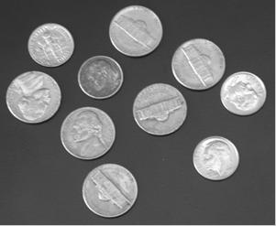

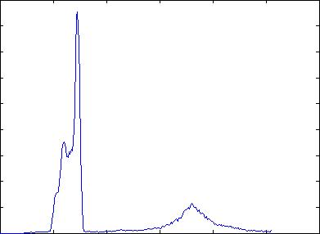
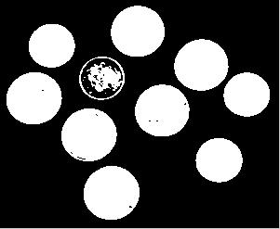
Examples
Coins Image
Threshold at 50
Histogram
Optimal Threshold

Slide 28
Change Detection and Background Extraction

Slide 29
Motivation: Situational Awareness
Having a complete understanding of an environment
Acquiring knowledge of what events happened when:
  Is the event a common event?
  Did a daily event not happened today?
  Is something abnormal happening?
  Is the event dangerous?
Events that likely can include people and vehicles, happening anytime day or night

Slide 30
Image Sequences
A typical frame-rate: 25Hz
Notation:
  An intensity image: I(x,y)
  An image acquired at time t: I(x,y,t)
  An image sequence:
  I(x,y,0), I(x,y,1) … I(x,y,t-1), I(x,y,t)

Slide 31
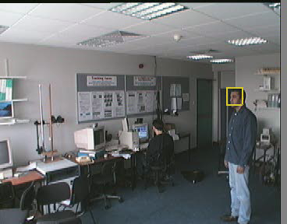
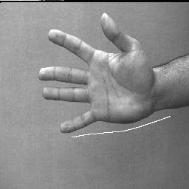

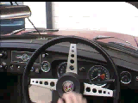

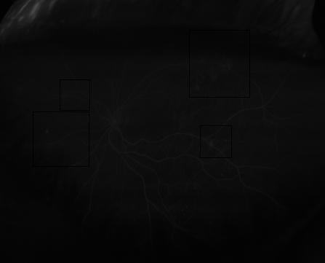

Examples!

Slide 32
Space-time
x
I(x,y,t-12)
t
y
I(x,y,t-1)
I(x,y,t)
Think of sequence as occupying a block of ‘space-time’
Time is divided into frames like space is divided into pixels

Slide 33
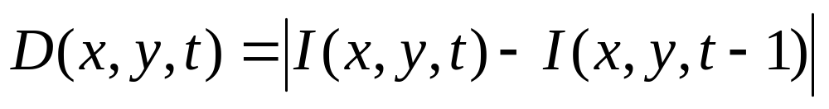
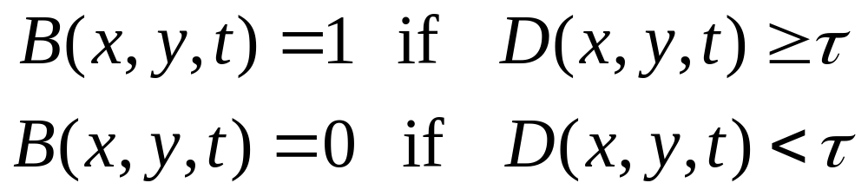
Change Detection:Temporal Difference
Absolute difference between subsequent images:
Could threshold to give binary change detection image:

Slide 34


I(t-1)
I(t)
D(t)
B(t)
Poor choice of threshold τ

Slide 35
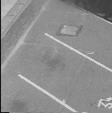
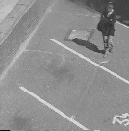
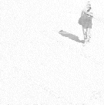
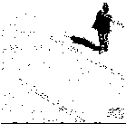

Frame Differencing
I(0)
I(t)
| I(0) - I(t) |
A better
threshold:
Thresholded:
From: P.L. Rosin, “Thresholding for Change Detection” http://www.dai.ed.ac.uk/CVonline/LOCAL_COPIES/ROSIN2/thresh.html

Slide 36
Background Subtraction
Detects change in homogenous regions provided different from background
But background image needs updating

Slide 37
Image differencing: pros & cons
Pros:
  Fast and simple
  Useful for focusing visual attention
Cons:
  How to set thresholds ? (see Rosin’s article)
  Detects any change
    moving objects
    illumination change
    moving shadows
    camera motion
    camera noise (filtering can overcome this)

Slide 38
Background Modelling
Simple Frame Difference against a background – non adaptive
Moving Average – lower-level adaptation
Online Gaussian – (not covered, requires further reading)

Slide 39
Background Subtraction-Not Adaptive
Simple Frame Difference against a known background
  Simple, and easy to implement
  Not robust
  Applicable when a camera is fixed, background fixed
  Can not handle illumination changes well, especially in outdoor scenarios, e.g, sunlight, cloudy, day/night, slight movement of tree leaves.
  the need for manual initialization. Without re-initialization, errors in the background accumulate over time, making this method useful only in highly-supervised, short-term tracking applications without significant changes in the scene.
Math Model for foreground extraction
  B(x,y) = mean_t(v(x,y,t))
  f(x,y,t) = abs(v(x,y,t)-B(x,y)), and then setting threshold for f

Slide 40





Moving Average- Adaptive
Moving average filtering
  Current background equals to the mean of previous n frames.
  Algorithms (pseudo code)
  Could handle a certain level of background changes and Illumination changes (ref: Chapter 14, Computer Vision: a Modern Approach, Forsyth and Ponce)
Initialise the value of a background estimate B, for each frame F
  Update the background estimate by computing
  for a choice of , and
  Or:
  Substract the background estimate from the frame, and report the value of each pixel where the magnitude of the difference is greater than some threshold
end

Slide 41
Background Extraction Demo
Using GMM method
  Gaussian Mixture
  Landmark Paper: Adaptive background mixture models for real-time tracking. Chris Stauffer. W.E.L Grimson, CVPR 2008
  Watch Video Now

Slide 42
Further Reading
Further Reading
  Chris Stauffer and W.E.L Grimson, Adaptive background mixture models for real-time tracking,CVPR08 (landmark paper)
  Zoran Zivkovic and van der Heijden, Efficient adaptive density estimation per image pixel for the task of background subtraction, Pattern Recognition Letter 2005 (Good technique paper)

Slide 43
Computer Vision
Pixel Operations, Histogram, Thresholding
Learning Outcomes
Be able to understand the basics of point operators
Be able to compute histograms, optimal threshold for a given image by programming
Be able to design and apply simple background extraction algorithms.
Notes:
Things you should look up:
Pressman - chapter’s 1 & 2

