Slide 1
Contents
Tracking
Meanshift
Other approaches

Slide 2
Tracking
Following objects or features through an image sequence
Estimating location (and orientation) in each frame
Physical Constraints:
Inertia: motion cannot change abruptly
No abrupt motion changes are observed provided that
the frame rate is fast enough
If a 3D trajectory is smooth then its 2D projection is also smooth
Useful Assumptions:
Location, speed and direction of motion do not change much between frames
Image motion is smooth

Slide 3
Targets to Track
Local features (e.g. interest points, small objects)
Contour fragments (e.g. partial object boundaries)
Objects (possibly multiple parts, possibly deformable)

Slide 4
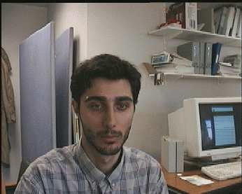
Tracking example
Search in a local window
Window position depends on previous estimate
Extent of window depends on expected maximum speed of image motion
Estimate at frame t
Search window for frame t+1

Slide 5
Face tracking example
Want to estimate location and scale (fixed aspect ratio)
Search ranges depend on previous estimates
Box indicates estimated location and scale at time t
At t+1, search for object centred within this window and at a range of scales

Slide 6
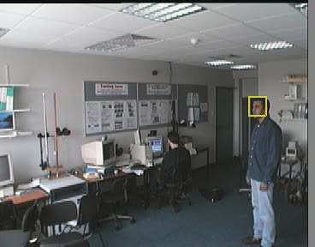
Example: Head Tracking

Slide 7
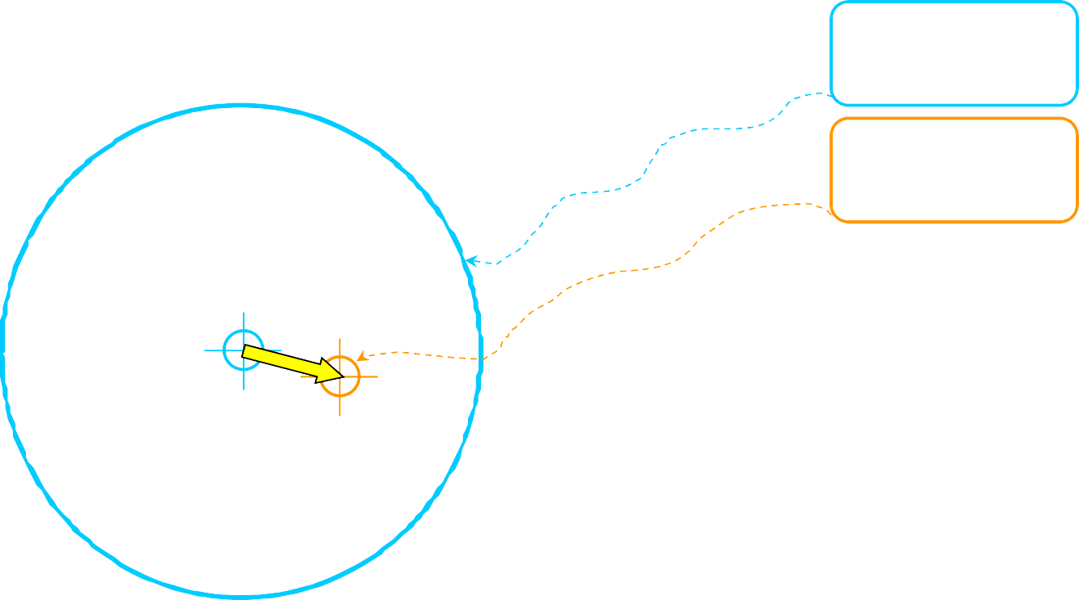


























































































Mean Shift: Intuitive Description
Region of interest
Center of mass
Mean Shift vector
Objective : Find the densest region
Distribution of identical billiard balls
(Slide credit: Yaron Ukrainitz & Bernard Sarel)

Slide 8


























































































Region of interest
Center of mass
Mean Shift vector
Objective : Find the densest region
Distribution of identical billiard balls
(Slide credit: Yaron Ukrainitz & Bernard Sarel)

Slide 9
















































Region of interest
Center of mass
Mean Shift vector
Objective : Find the densest region
Distribution of identical billiard balls
(Slide credit: Yaron Ukrainitz & Bernard Sarel)

Slide 10































Region of interest
Center of mass
Mean Shift vector
Objective : Find the densest region
Distribution of identical billiard balls
(Slide credit: Yaron Ukrainitz & Bernard Sarel)

Slide 11









































































Region of interest
Center of mass
Mean Shift vector
Objective : Find the densest region
Distribution of identical billiard balls
(Slide credit: Yaron Ukrainitz & Bernard Sarel)

Slide 12





















































































Region of interest
Center of mass
Mean Shift vector
Objective : Find the densest region
Distribution of identical billiard balls
(Slide credit: Yaron Ukrainitz & Bernard Sarel)

Slide 13


























































































Region of interest
Center of mass
Objective : Find the densest region
Distribution of identical billiard balls
(Slide credit: Yaron Ukrainitz & Bernard Sarel)

Slide 14
What is Mean Shift ?
A tool for:
Finding modes in a set of data samples, manifesting an underlying probability distribution
The distribution could be in:
Color space
Image space
Scale space
Actually any feature space you can conceive
• …

Slide 15
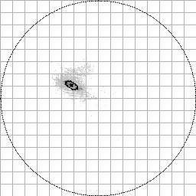
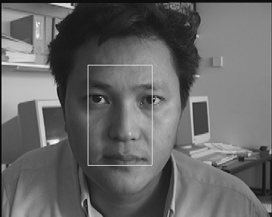
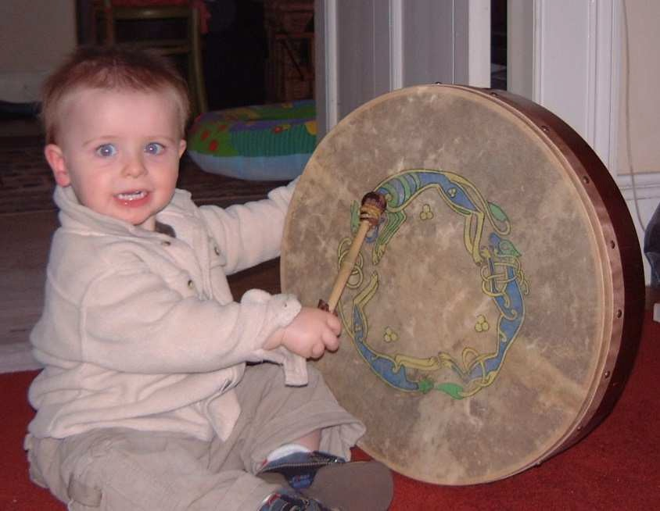
Estimate histogram (model)
Hue

Slide 16
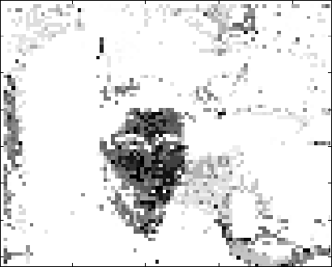
Mean-Shift Tracking using Colour
Given each new video frame, compute a likelihood image from it by “looking up” each pixel in the histogram.
Pixels form uniform grid of data points, each with a weight (pixel value) proportional to likelihood that the pixel is on the object we want to track.
Perform mean-shift using this weighted set of points.
16

Slide 17
Mean-Shift Tracking using Colour
Given each new video frame, compute a likelihood image from it by “looking up” each pixel in the histogram.
Pixels form uniform grid of data points, each with a weight (pixel value) proportional to likelihood that the pixel is on the object we want to track.
•Perform mean-shift using this weighted set of points.

Slide 18
Mean-Shift Tracking using Colour
Given each new video frame, compute a likelihood image from it by “looking up” each pixel in the histogram.
Pixels form uniform grid of data points, each with a weight (pixel value) proportional to likelihood that the pixel is on the object we want to track.
•Perform mean-shift using this weighted set of points.

Slide 19
Mean-Shift Tracking using Colour
This is fast and can work well when histogram is unimodal (i.e. object is “one” colour)
Alternative is to build a histogram from search window, compute similarity function of image and model histograms, and perform mean- shift search to maximise this function.
Can also adapt scale (by searching nearby scales).
Can also use other features (e.g. texture)
Further reading:
Collins, R. “Mean-shift Blob Tracking through Scale Space”
IEEE Conference on Computer Vision and Pattern Recognition (CVPR), 2003

Slide 20
Tracking
CAMShift in Matlab Computer Vision System Toolbox:
vision.HistogramBasedTracker System object
CAMShift uses a heuristic method to deal with scale.
G. Bradski, “Computer vision face tracking for use in a perceptual user interface”
Intel Technology Journal, 2nd Quarter, 1998.
Further reading:
Y. Raja, S. J. McKenna, and S. Gong.
Tracking and segmenting people in varying lighting conditions using colour.
IEEE International Conference on Face & Gesture Recognition, 228-233, 1998.

Slide 21
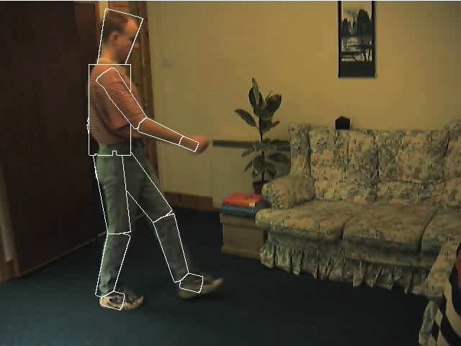
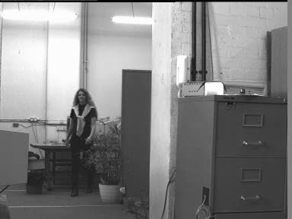
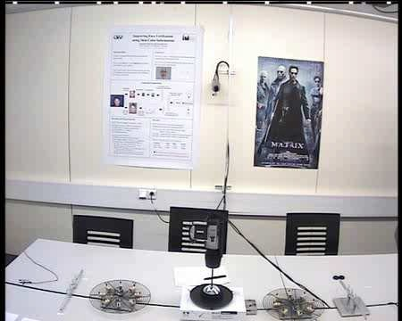
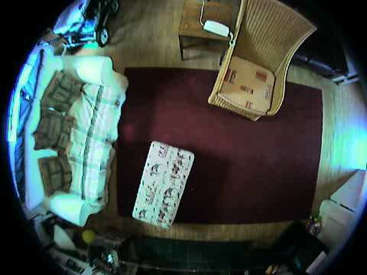
21

