Slide 1

Assignment 1 Supported modulation schemes of 5G system
Group member: 孙逸涵 张旭东
SID: 12012128 12011923

Slide 2
Analysis
In the Internet protocol stack or the OSI Reference Model, modulation schemes of 5G system are corresponding to the physical layer.
Therefore, our first key word to find the destination document on the 3GPP website’s Specification release version matrix is modulation, and the second is physical.

Slide 3
Analysis
Then, we need to find the one that corresponds to 5G in the list of documents we found.
In the list of documents we found, we can find that the documents correspond to E-UTRA and NR, which are corresponding to 4G and 5G, respectively. Thus, our third key word to find the destination document is NR. And, in that document, we can find the supported modulation schemes of 5G system.

Slide 4
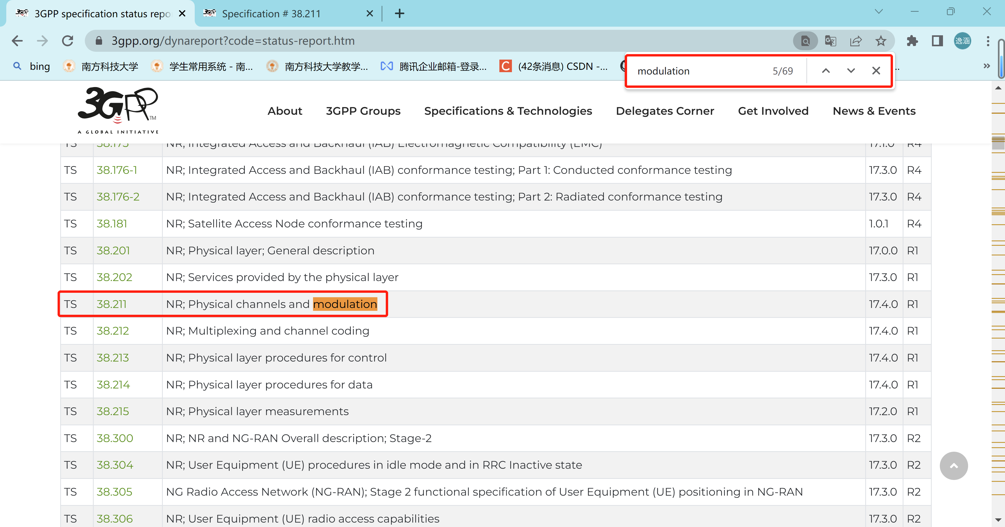
Find appropriate PHY Specifications

Slide 5
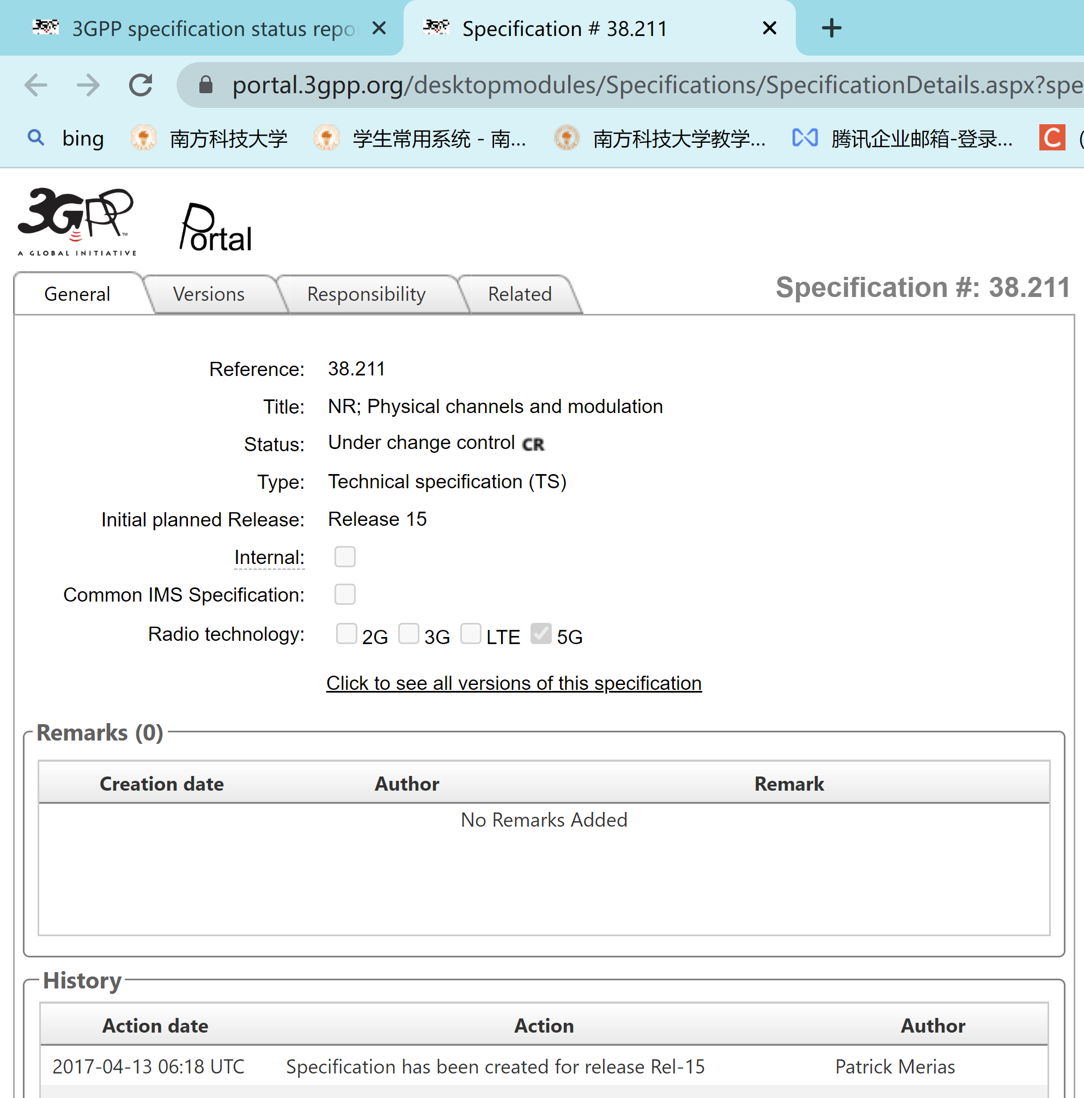
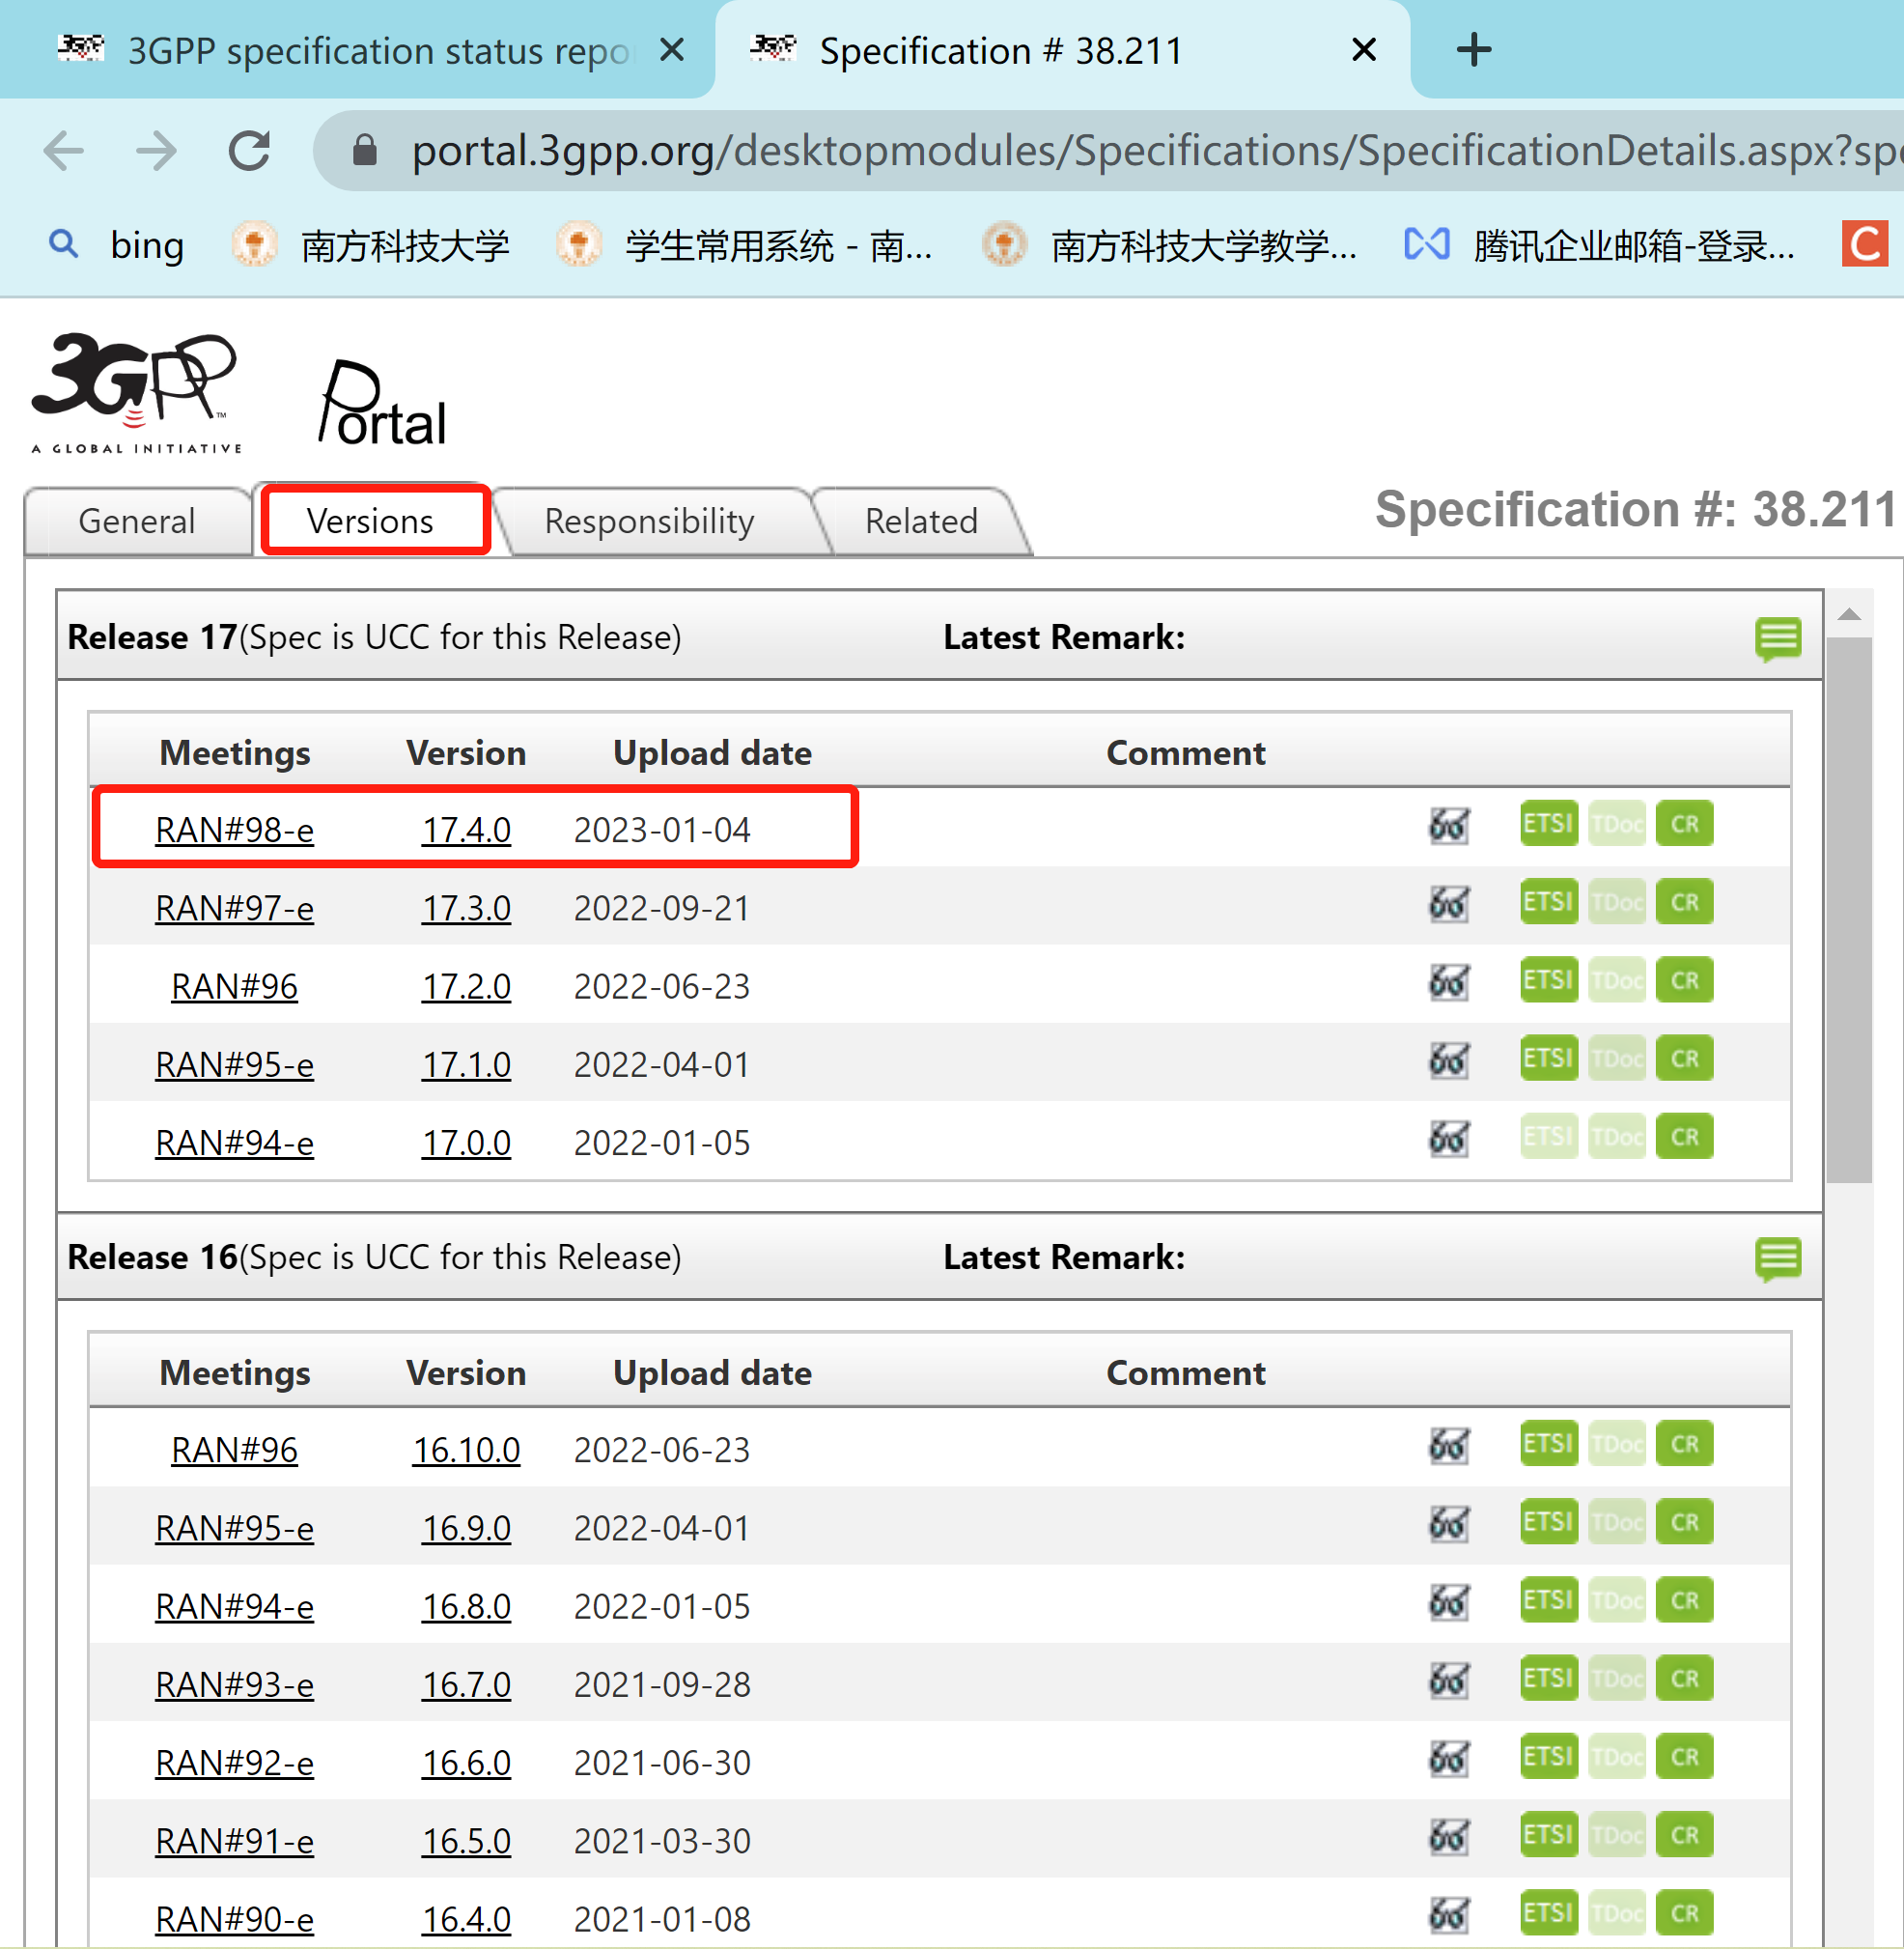
Find the newest version of the document

Slide 6
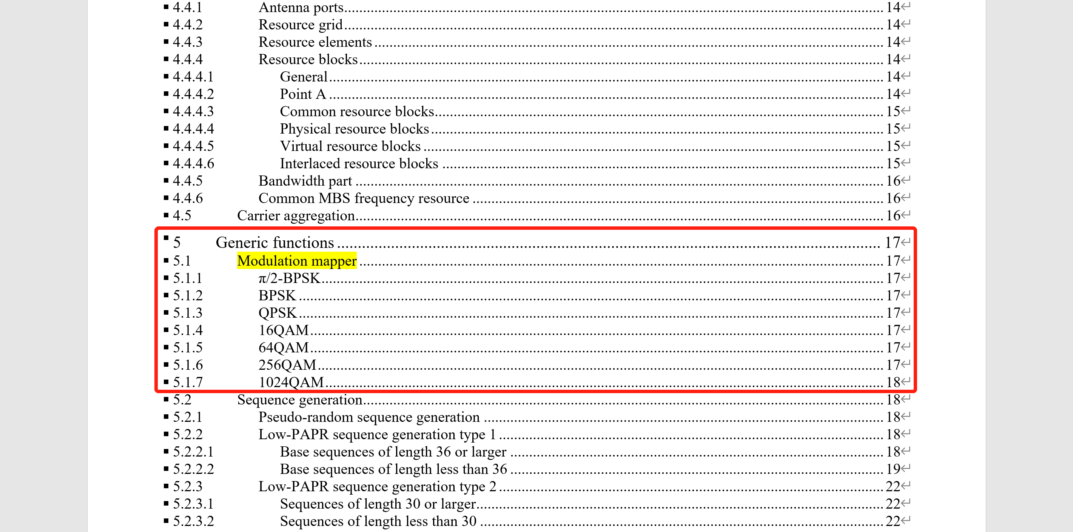
Locate the modulation schemes part in document

Slide 7
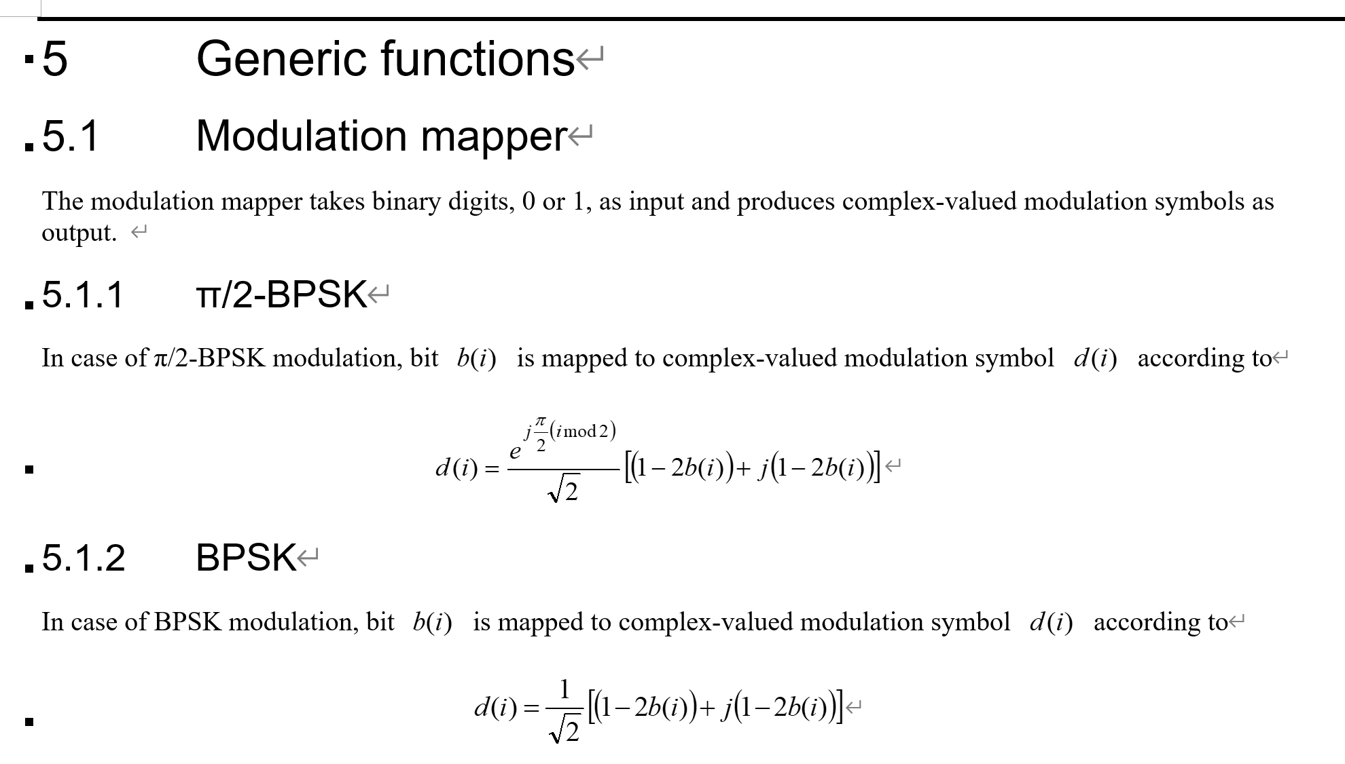
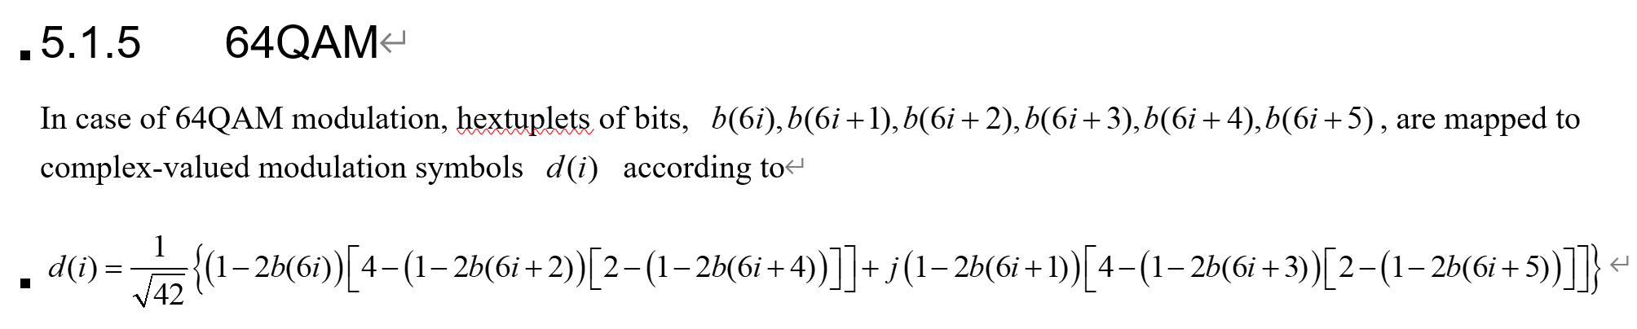
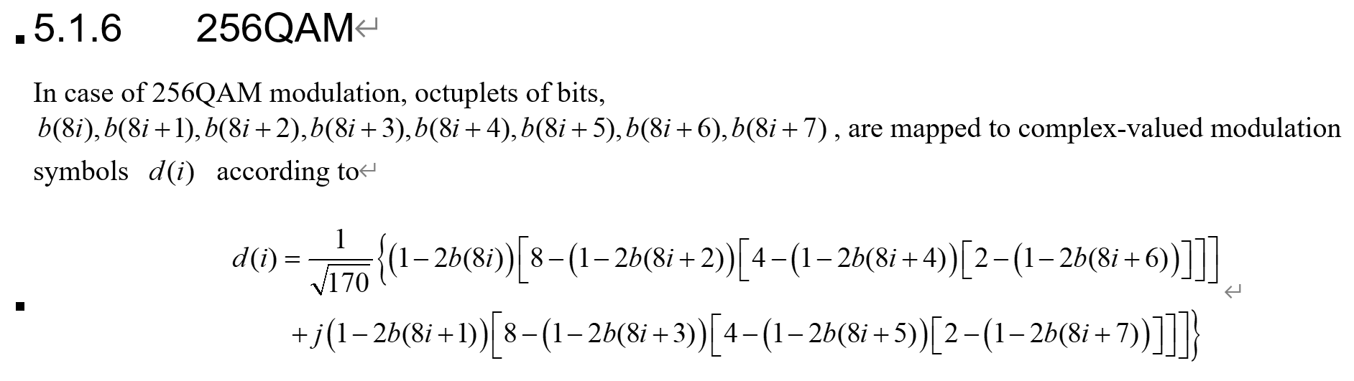
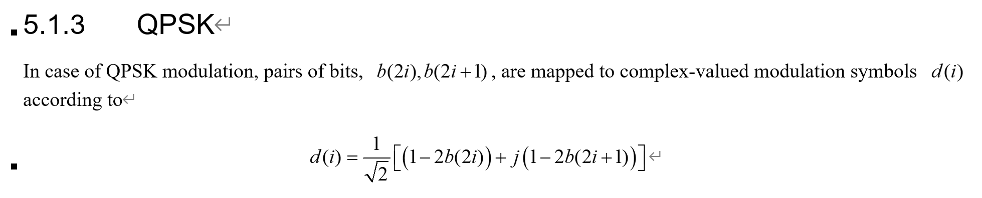
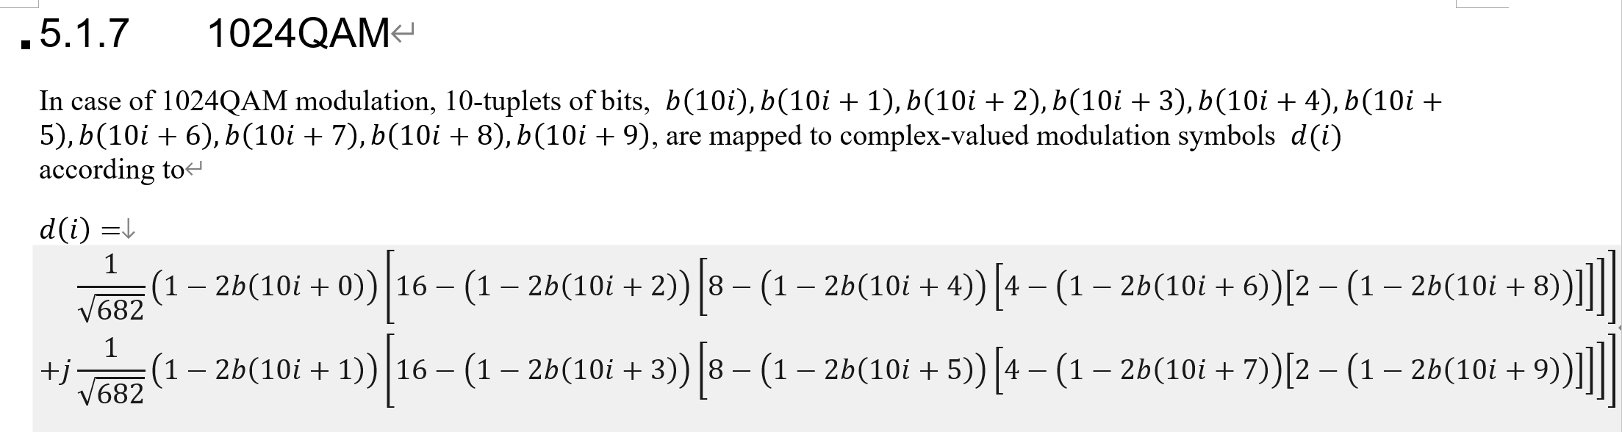
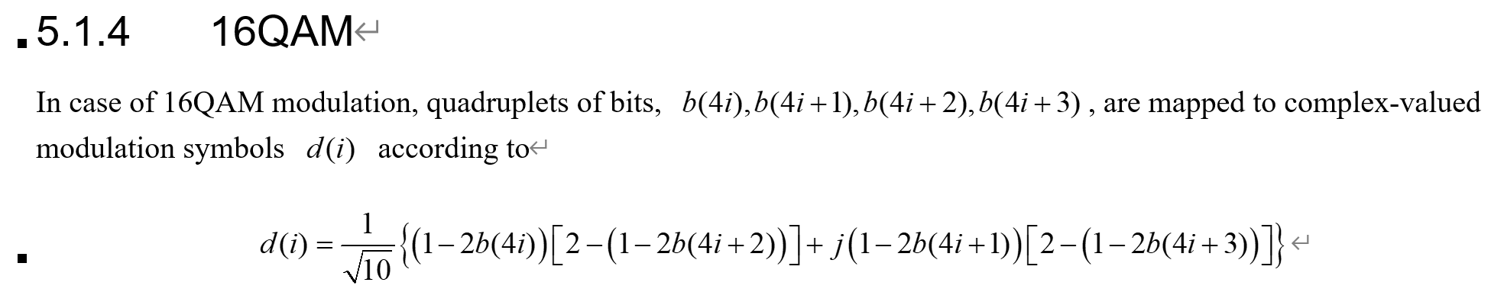
Supported modulation schemes of 5G system

Slide 8
Supported modulation schemes of 5G system
From the document 38211-h40, we can find that the modulation mapper of 5G system are:
BPSK, QPSK, 16QAM, 64QAM, 256QAM, and 1024QAM.

Slide 9

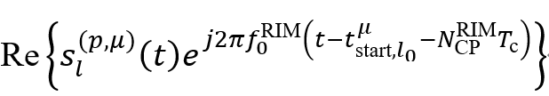
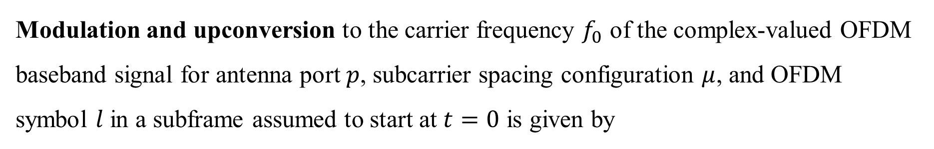
Modulation and upconversion
Modulation and upconversion to the carrier frequency $f_{0}$ of the complex-valued OFDM baseband signal for antenna port $p$, subcarrier spacing configuration $μ$, and OFDM symbol $l$ in a subframe assumed to start at $t=0$ is given by
For PRACH
For RIM-RS

Slide 10
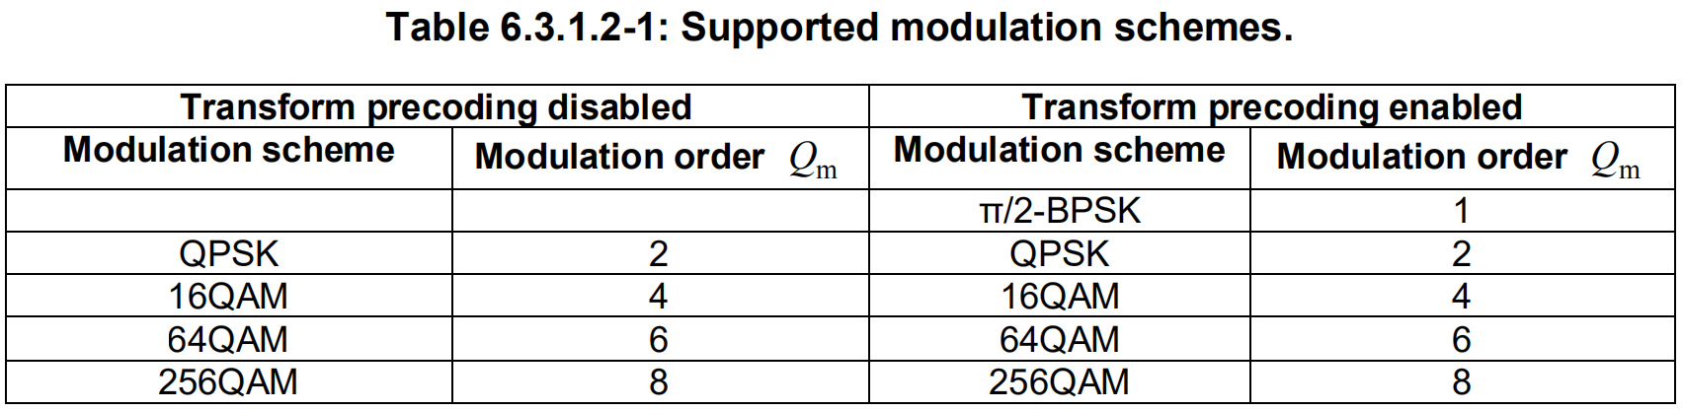
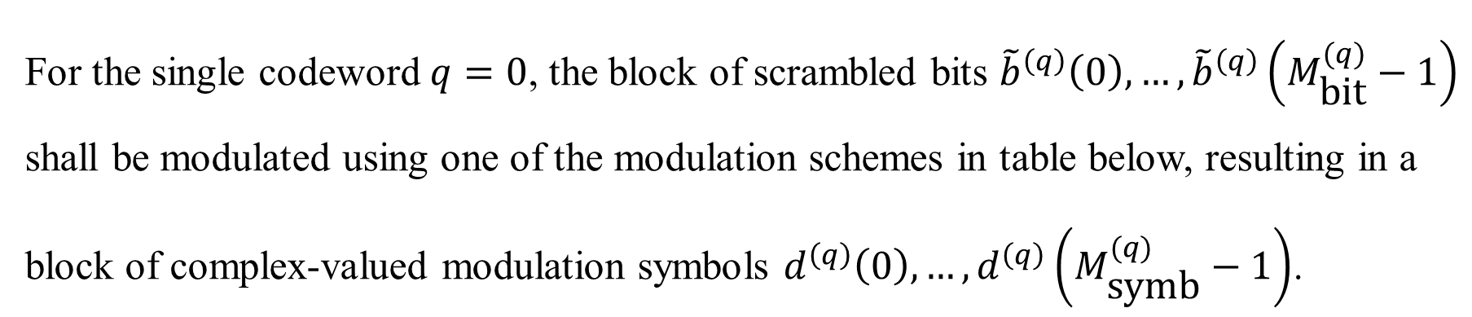
Modulation schemes in uplink shared channel
For the single codeword $q=0$, the block of scrambled bits ${\tilde{b}}^{\left(q\right)}\left(0\right),…,{\tilde{b}}^{\left(q\right)}\left(M_{\text{bit}}^{(q)}−1\right)$ shall be modulated using one of the modulation schemes in table below, resulting in a block of complex-valued modulation symbols $d^{\left(q\right)}\left(0\right),…,d^{\left(q\right)}\left(M_{\text{symb}}^{(q)}−1\right)$.

Slide 11
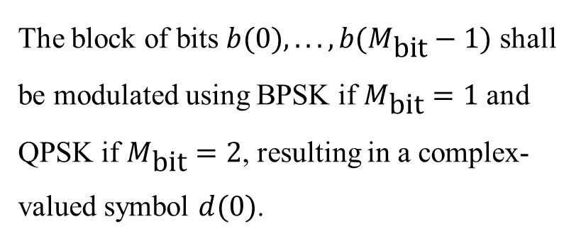
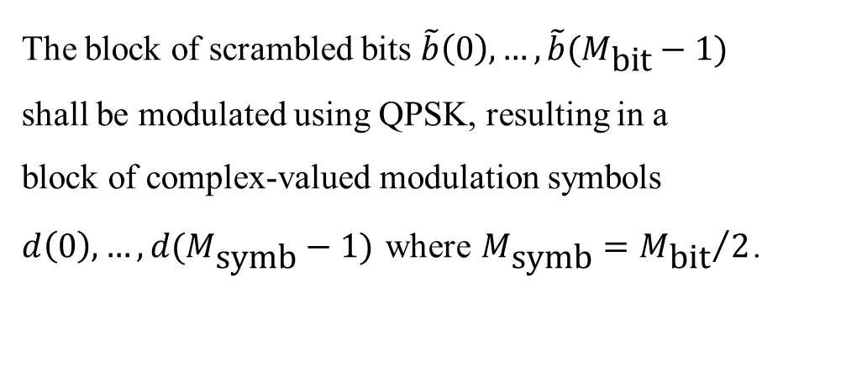
Modulation schemes in uplink control channel
For PUCCH format 1
For PUCCH format 2
The block of bits $b(0),...,b(M_{\text{bit}}−1)$ shall be modulated using BPSK if $M_{\text{bit}}=1$ and QPSK if $M_{\text{bit}}=2$, resulting in a complex-valued symbol $d(0)$.
The block of scrambled bits $\tilde{b}\left(0\right),…,\tilde{b}(M_{\text{bit}}−1)$ shall be modulated using QPSK, resulting in a block of complex-valued modulation symbols $d\left(0\right),…,d(M_{\text{symb}}−1)$ where $M_{\text{symb}}={M_{\text{bit}}}/2$.

Slide 12
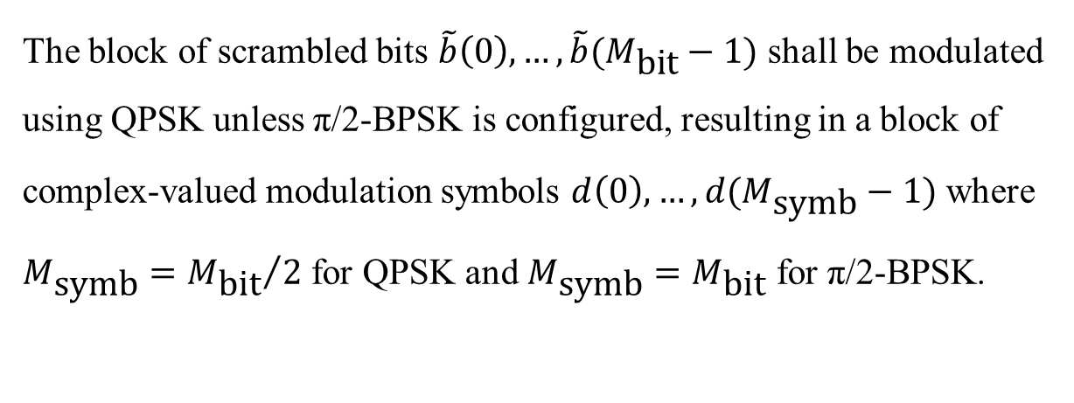
Modulation schemes in uplink control channel
For PUCCH formats 3 and 4
The block of scrambled bits $\tilde{b}\left(0\right),…,\tilde{b}(M_{\text{bit}}−1)$ shall be modulated using QPSK unless π/2-BPSK is configured, resulting in a block of complex-valued modulation symbols $d\left(0\right),…,d(M_{\text{symb}}−1)$ where $M_{\text{symb}}={M_{\text{bit}}}/2$ for QPSK and $M_{\text{symb}}=M_{\text{bit}}$ for π/2-BPSK.

Slide 13
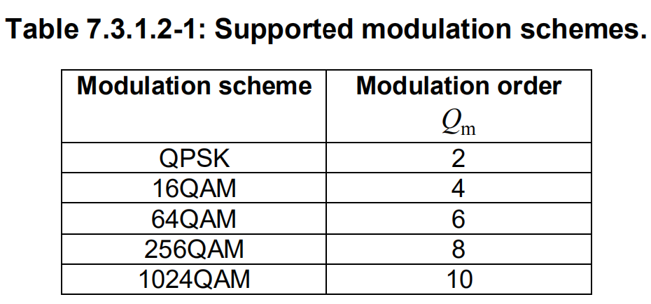
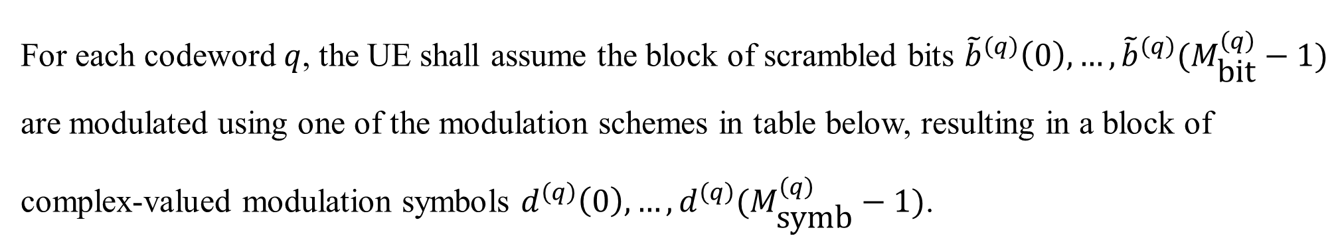
Modulation schemes in downlink shared channel
For each codeword $q$, the UE shall assume the block of scrambled bits ${\tilde{b}}^{\left(q\right)}\left(0\right), …, {\tilde{b}}^{\left(q\right)}(M_{\text{bit}}^{\left(q\right)}−1)$ are modulated using one of the modulation schemes in table below, resulting in a block of complex-valued modulation symbols $d^{\left(q\right)}\left(0\right),…,d^{\left(q\right)}(M_{\text{symb}}^{\left(q\right)}−1)$.

Slide 14
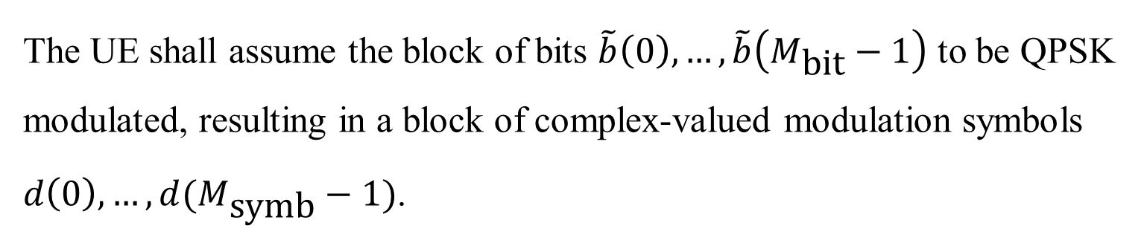
Modulation schemes in downlink control channel
The UE shall assume the block of bits $\tilde{b}\left(0\right),…,\tilde{b}\left(M_{\text{bit}}−1\right)$ to be QPSK modulated, resulting in a block of complex-valued modulation symbols $d\left(0\right),…,d(M_{\text{symb}}−1)$.

Slide 15
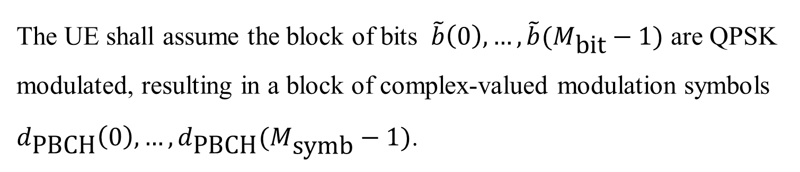
Modulation schemes in broadcast channel
The UE shall assume the block of bits $\tilde{b}\left(0\right), …, \tilde{b}(M_{\text{bit}}−1)$ are QPSK modulated, resulting in a block of complex-valued modulation symbols $d_{\text{PBCH}}\left(0\right),…,d_{\text{PBCH}}(M_{\text{symb}}−1)$.

Slide 16
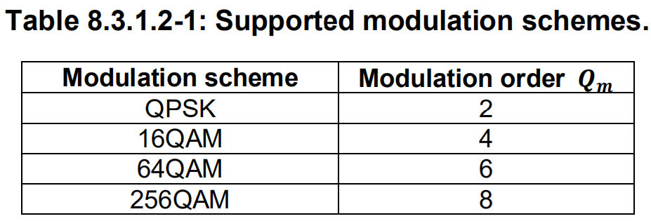
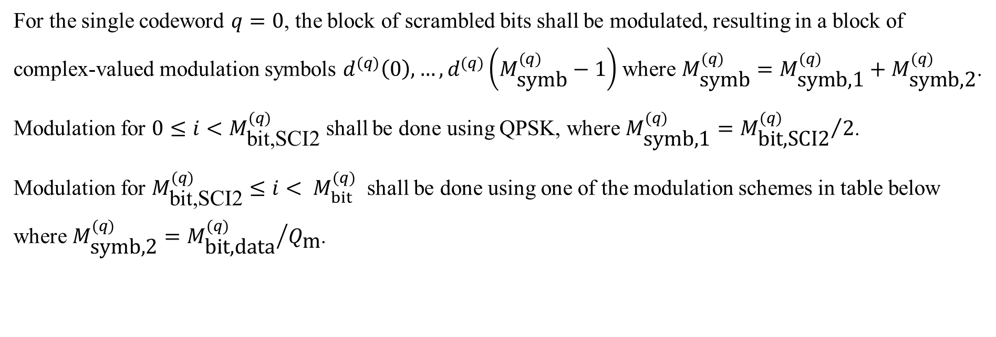
Modulation schemes in sidelink shared channel
For the single codeword $q=0$, the block of scrambled bits shall be modulated, resulting in a block of complex-valued modulation symbols $d^{(q)}\left(0\right),…,d^{(q)}\left(M_{\text{symb}}^{(q)}−1\right)$ where $M_{\text{symb}}^{(q)}=M_{\text{symb}\text{,1}}^{(q)}+M_{\text{symb}\text{,2}}^{(q)}$.
Modulation for $0≤i<M_{\text{bit}\text{,}\text{SCI}\text{2}}^{(q)}$ shall be done using QPSK, where $M_{\text{symb}\text{,1}}^{(q)}={M_{\text{bit}\text{,}\text{SCI}\text{2}}^{(q)}}/2$.
Modulation for $M_{\text{bit}\text{,}\text{SCI}\text{2}}^{(q)}≤i< M_{bit}^{(q)}$ shall be done using one of the modulation schemes in table below where $M_{\text{symb}\text{,2}}^{(q)}={M_{\text{bit}\text{,}\text{data}}^{(q)}}/{Q_{\text{m}}}$.

Slide 17
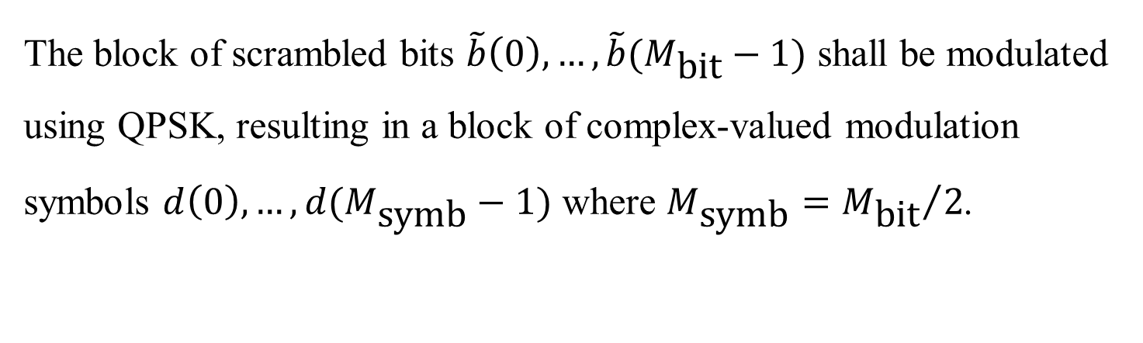
Modulation schemes in sidelink control channel
The block of scrambled bits $\tilde{b}\left(0\right),…,\tilde{b}(M_{\text{bit}}−1)$ shall be modulated using QPSK, resulting in a block of complex-valued modulation symbols $d\left(0\right),…,d(M_{\text{symb}}−1)$ where $M_{\text{symb}}={M_{\text{bit}}}/2$.

Slide 18
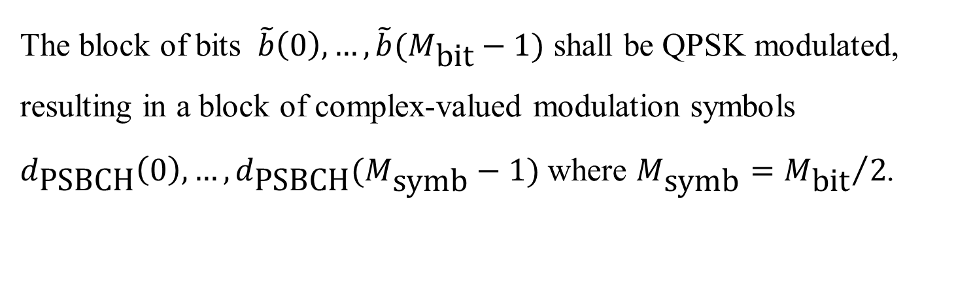
Modulation schemes in sidelink broadcast channel
The block of bits $\tilde{b}\left(0\right), …, \tilde{b}(M_{\text{bit}}−1)$ shall be QPSK modulated, resulting in a block of complex-valued modulation symbols $d_{\text{PSBCH}}\left(0\right),…,d_{\text{PSBCH}}(M_{\text{symb}}−1)$ where $M_{\text{symb}}={M_{\text{bit}}}/2$.

Slide 19
Thank you!
Yihan Sun: 12012128@mail.sustech.edu.cn
Xudong Zhang: 12011923@mail.sustech.edu.cn

