Slide 1

Assignment 2
Auto-correlation performance in multi-path scenario
Group member: 孙逸涵 张旭东
SID: 12012128 12011923

Slide 2
Analysis
First of all, we need to generate a transmitted data sequence.
Then, we need to construct a channel which simulates the multi-path scenario.
And we can get the received data by transmitting the data sequence over the multi-path channel.
Finally, we can calculate the auto-correlation of the transmitted data and the received data.

Slide 3
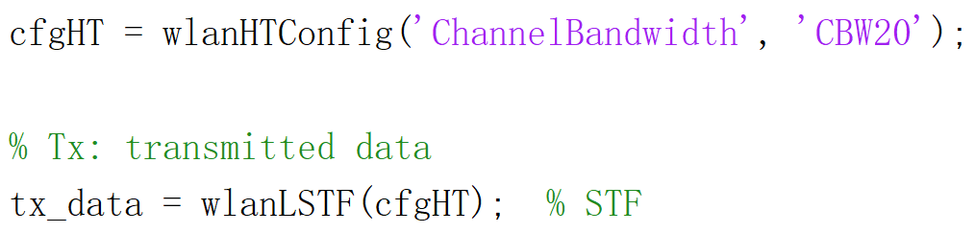
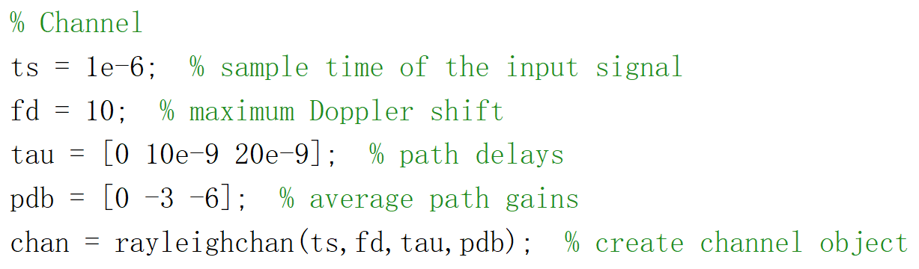
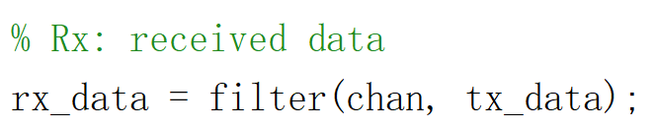
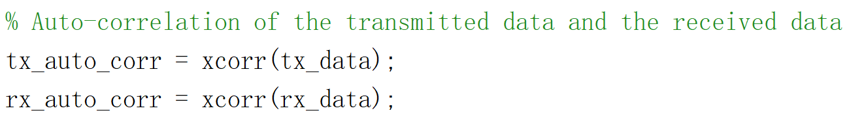
MATLAB Code: Rayleigh fading channel
Transmitted data sequence: STF
Rayleigh fading channel
Received data sequence
Auto-correlation

Slide 4
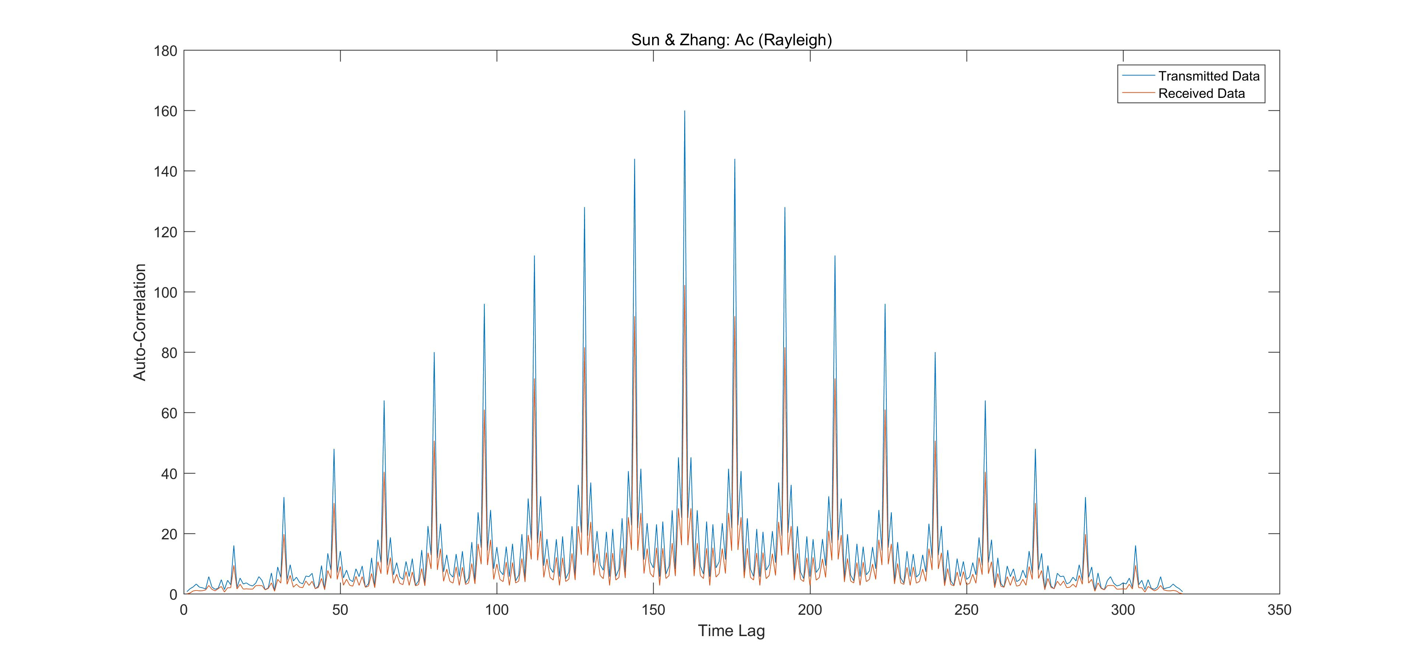
Results: Rayleigh fading channel

Slide 5
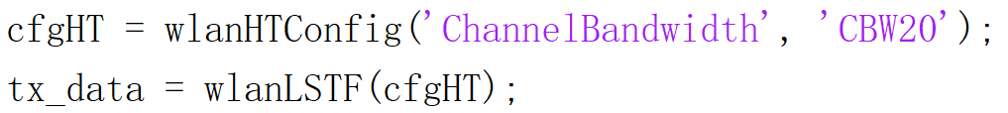
MATLAB Code: Multipath channel without noise
Transmitted data sequence: STF
Multipath channel without noise
Received data sequence
Auto-correlation

Slide 6
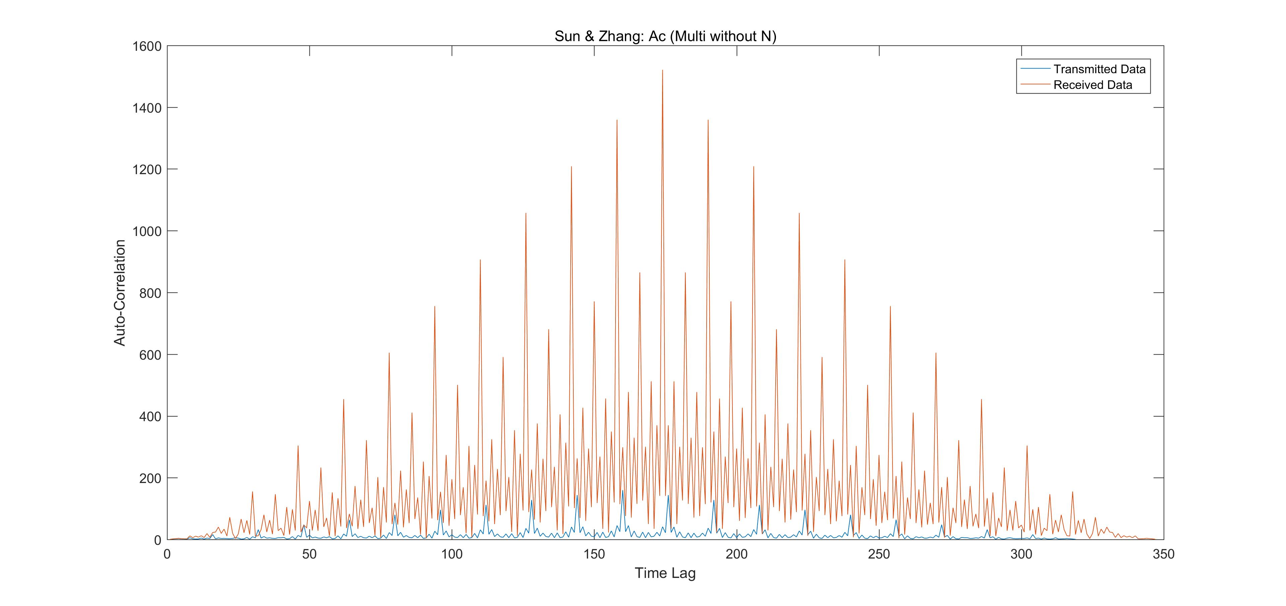
Results: Multipath channel without noise

Slide 7


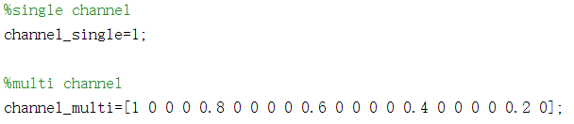

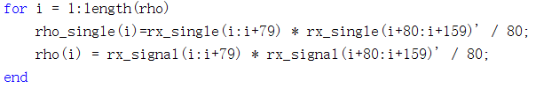
MATLAB Code: Multipath channel with noise
L-STF time-domain waveform
Generate noise and add STF to it
Single and multi channel
Received data sequence
Auto-correlation

Slide 8
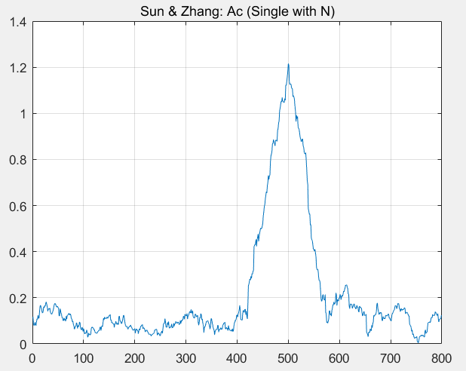
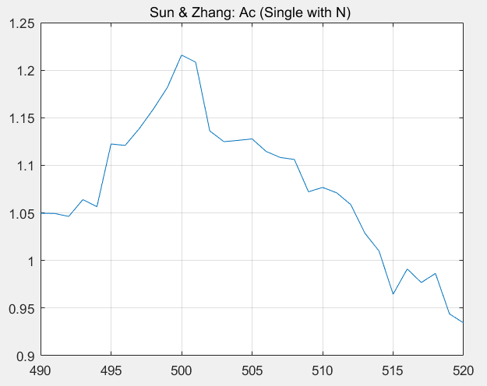
Results: Single-path channel with noise

Slide 9
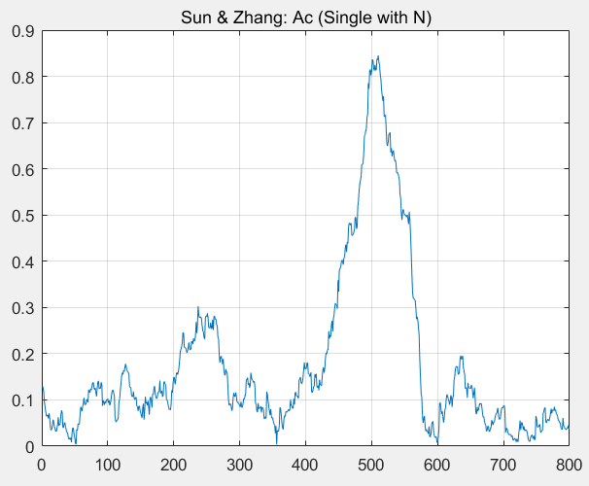
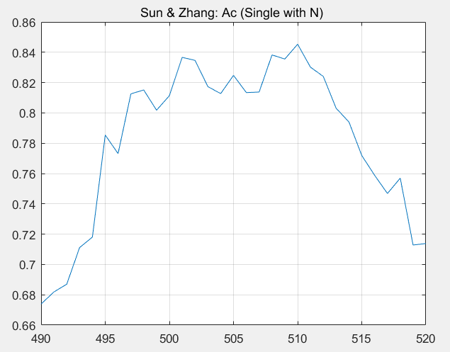
Results: Single-path channel with noise

Slide 10
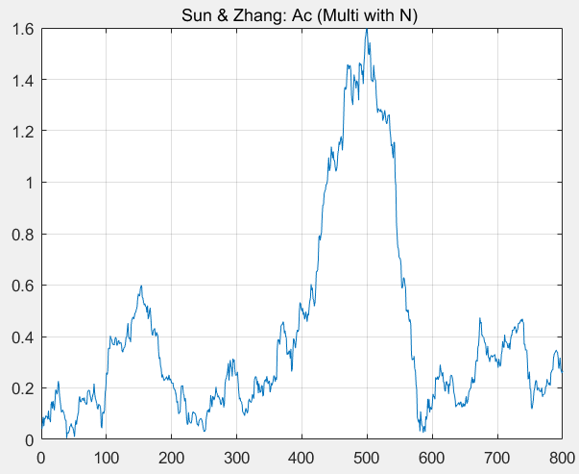
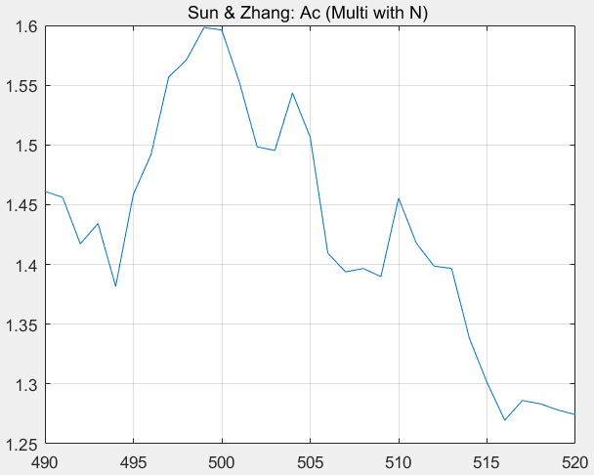
Results: Multi-path channel with noise

Slide 11
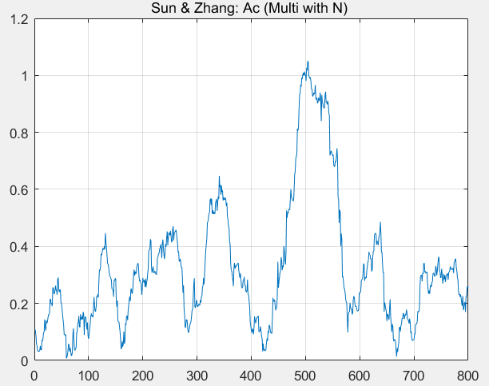
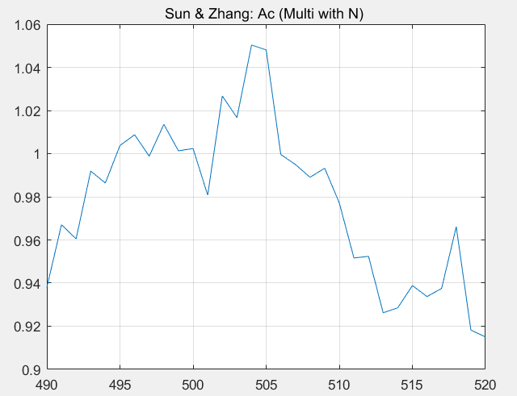
Results: Multi-path channel with noise

Slide 12
Auto-correlation performance
Between single path and multi paths
Single path: The simulation results differ from the theory because of the presence of noise. The noise is generated randomly, which makes the position of the maximum value every time isn’t always the same. After a lot of simulation, the number of times that the maximum value occurs in 501 is relatively high, which implies that the auto-correlation performance in a single-path scenario is relatively well.

Slide 13
Auto-correlation performance
Between single path and multi paths
Multi path: From the figures of multi paths , there are several peaks. The reason behind this is that there are several channels whose channel gains are not 0. What’s more, the position of the maximum value is different time to time. The reason behind this is that the noise is generated randomly. After a lot of simulation, the number of times that the maximum value occurs in 501 is lower than that of single path, which implies that the auto-correlation performance in a multi-path scenario is more poor than that in a single-path scenario.

Slide 14
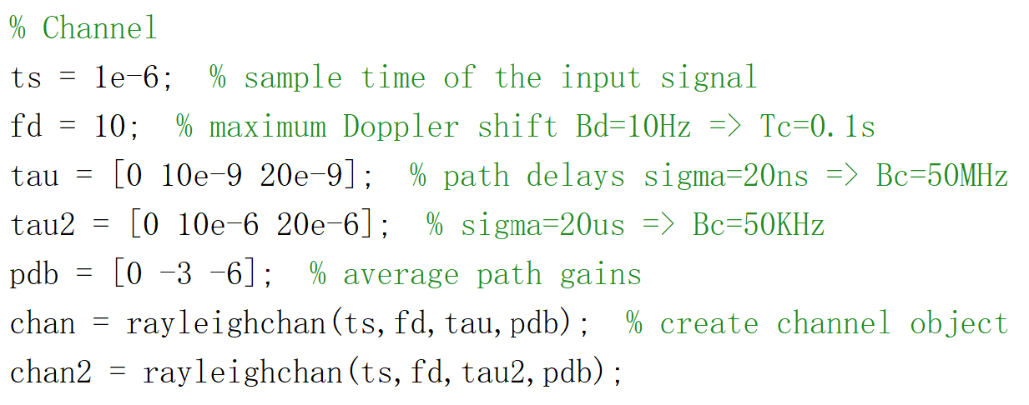
MATLAB Code: Auto-correlation performance
In Rayleigh fading channel
Construct two Rayleigh fading channels with different delay spread, i.e., different coherence bandwidth which satisfies Bc_1 >> Bc_2.

Slide 15
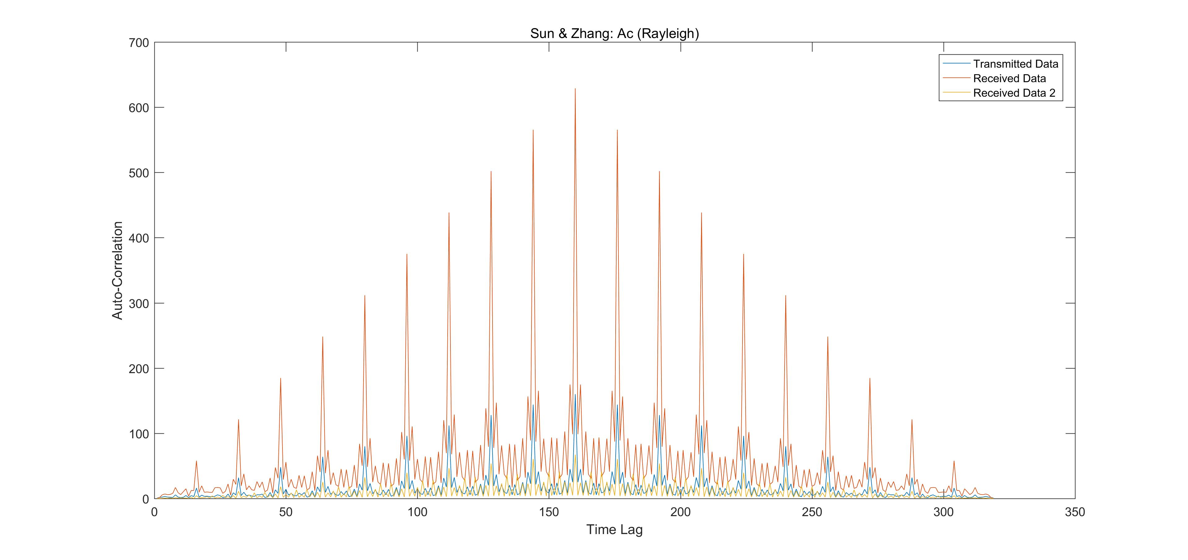
Results: Auto-correlation performance
In Rayleigh fading channel

Slide 16
Auto-correlation performance
In Rayleigh fading channel
In a multi-path scenario with a small coherence bandwidth, i.e., large delay spread, the auto-correlation performance can be poor because the signal can experience frequency-selective fading.

Slide 17
Thank you!
Yihan Sun: 12012128@mail.sustech.edu.cn
Xudong Zhang: 12011923@mail.sustech.edu.cn

