Slide 1

Assignment 3 LTF provides finer time synchronization than STF
Group member: 孙逸涵 张旭东
SID: 12012128 12011923

Slide 2
Explanation
From

Slide 3
Analysis
To compare the performance of time synchronization between STF and LTF, we can do auto-correlation and cross-correlation between themselves.
In this assignment, we choose to transmit the STF and LTF through the AWGN channel, and then do auto-correlation and cross-correlation of the received signals to compare the performance of time synchronization between STF and LTF.

Slide 4
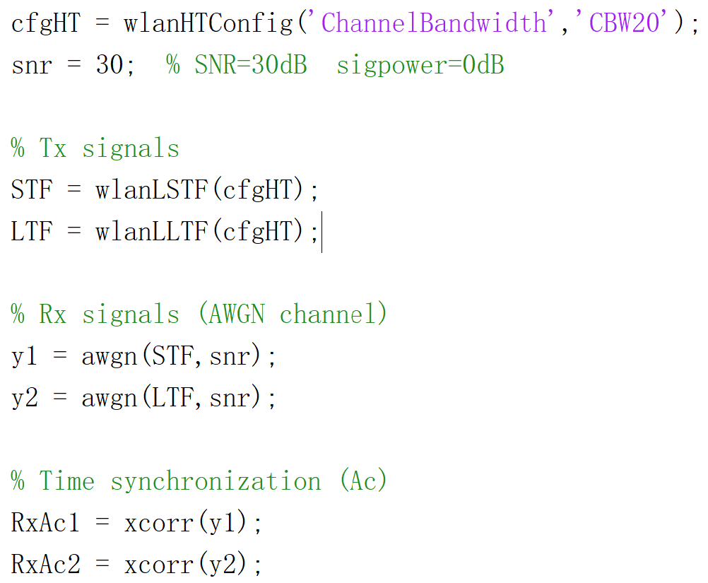
Verification on MATLAB(1): Code
Initialization
Transmitted data sequence: STF & LTF
Received data sequence
Auto-Correlation calculation

Slide 5
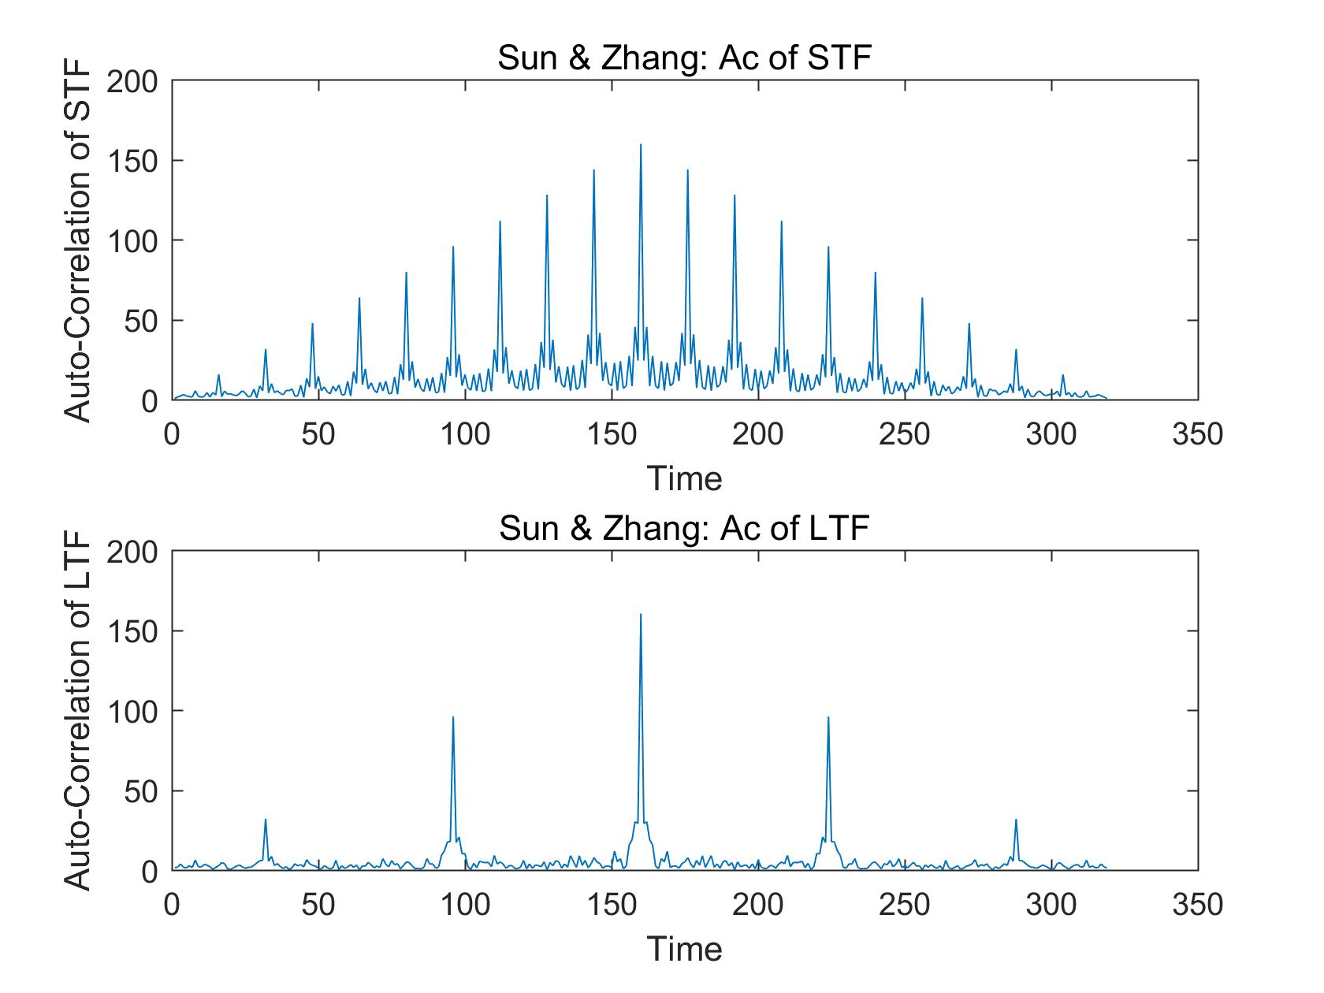
Verification on MATLAB(1): Result

Slide 6
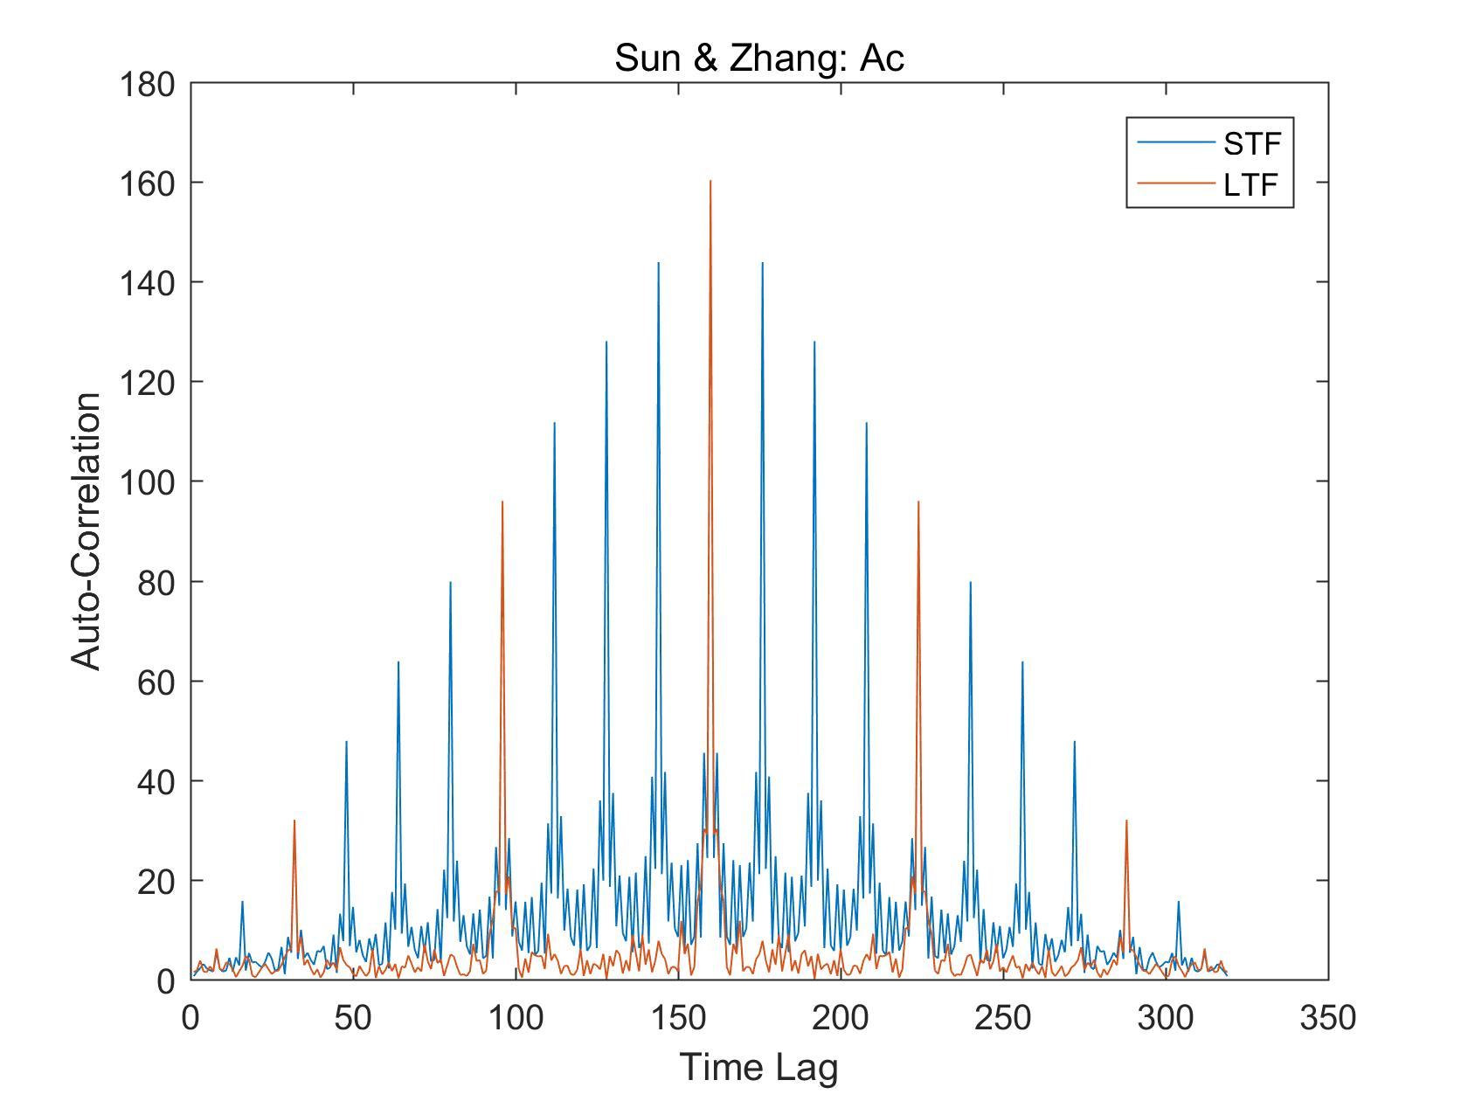
Verification on MATLAB(1): Result

Slide 7
Verification on MATLAB(1): Conclusion
From the figures, it can be clearly found that:
For STF, each peak of the auto-correlation is close to each other, so it can be difficult to detect the starting point of the PPDU exactly.
For LTF, the distance between the main peak and its most adjacent peak of the auto-correlation is further than that of STF.
Therefore, we can determine the starting point of the PPDU more accurately by using LTF, which means LTF can provide finer time synchronization than STF.

Slide 8


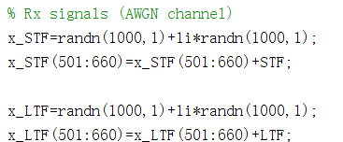
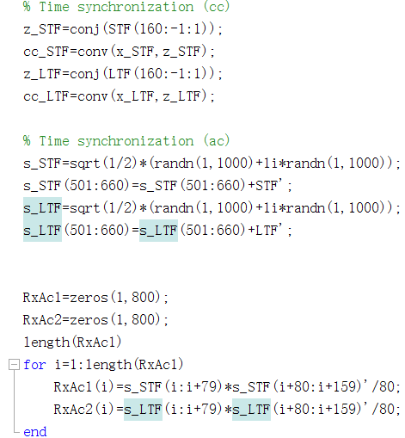
Verification on MATLAB(2): Code
Initialization
Transmitted data sequence: STF & LTF
Received data sequence
Cross-Correlation and Auto-Correlation calculation

Slide 9
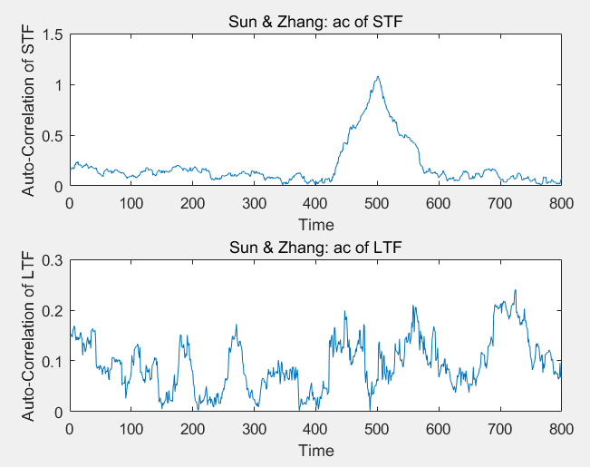
Verification on MATLAB(2): Result

Slide 10
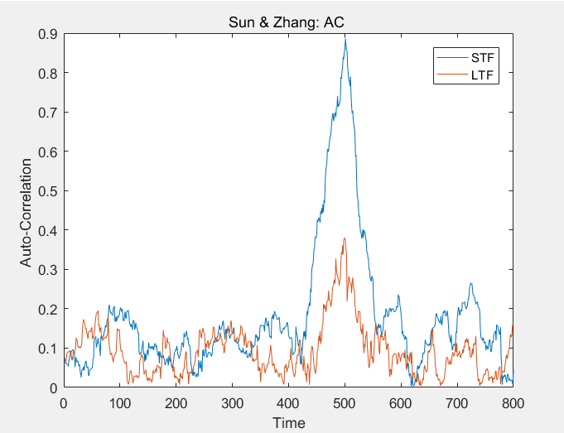
Verification on MATLAB(2): Result

Slide 11
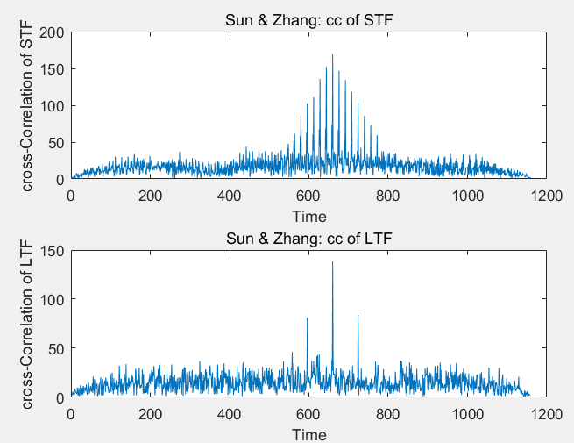
Verification on MATLAB(2): Result

Slide 12
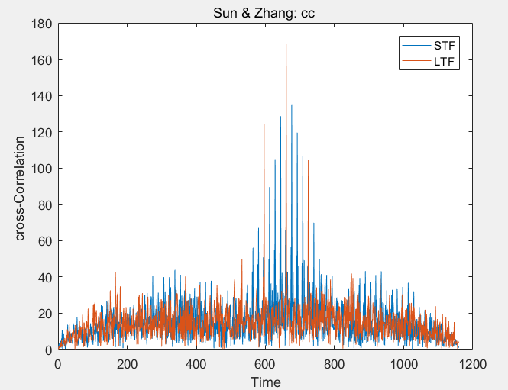
Verification on MATLAB(2): Result

Slide 13
Verification on MATLAB(2): Conclusion
From the figures of auto-correlation, it can be clearly found that:
The result of auto-correlation of STF for AWGN channel shows the arrival of STF is easily found. However , the accurate starting point cannot detected.
The result of auto-correlation of LTF for AWGN channel can’t show the arrival of LTF.

Slide 14
Verification on MATLAB(2): Conclusion
From the figures of cross-correlation, it can be clearly found that:
For STF, there are many peaks and each peak of the cross-correlation is close to each other. It can only be used to roughly detect the starting position of the PPDU, not detecting the starting point of the PPDU exactly.
For LTF, the distance between the main peak and its most adjacent peak of the cross-correlation is further than that of STF. The main peak is caused by the exact alignment of the received signal and the local sequence.
Therefore, we can determine the starting point of the PPDU more accurately by using LTF, which means LTF can provide finer time synchronization than STF.

Slide 15
Thank you!
Yihan Sun: 12012128@mail.sustech.edu.cn
Xudong Zhang: 12011923@mail.sustech.edu.cn

