Slide 1

Assignment 4 Synchronization of PSS with different signal bandwidths in AWGN channel
Group member: 孙逸涵 张旭东
SID: 12012128 12011923

Slide 2
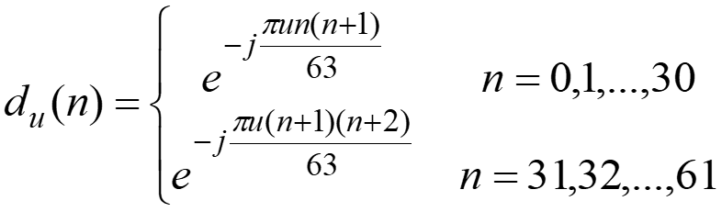
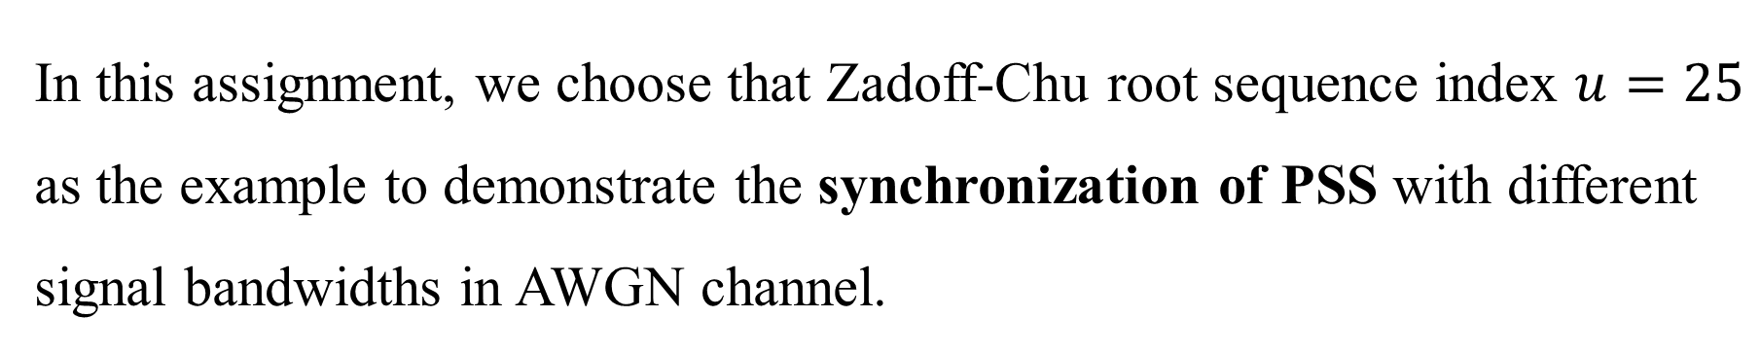
Analysis
In this assignment, we choose that Zadoff-Chu root sequence index $u=25$ as the example to demonstrate the synchronization of PSS with different signal bandwidths in AWGN channel.
where PSS with indices $u=29$ and $u=34$ is also the same as $u=25$.

Slide 3
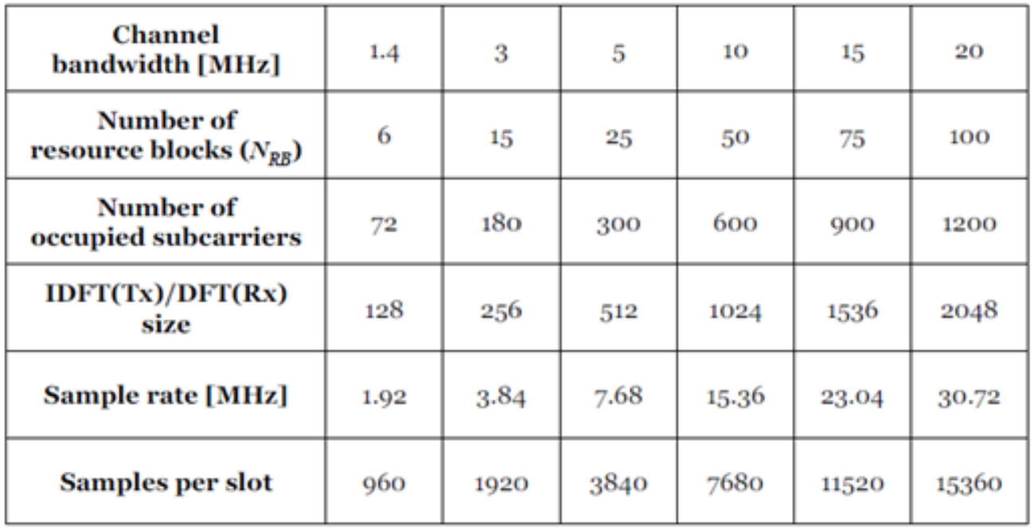
Analysis
To implement different signal bandwidths, we set the property NDLRB (Number of resource blocks) of the struct enb to different values.
In this case, we choose 6, 25, and 100 as the example.

Slide 4
Analysis
To demonstrate the synchronization of PSS, we use the Auto-Correlation between the received signals, the Cross-Correlation between the transmitted signal and received signal, and the comparison between the transmitted signal and received signal with proper AWGN noise power to explore that.

Slide 5
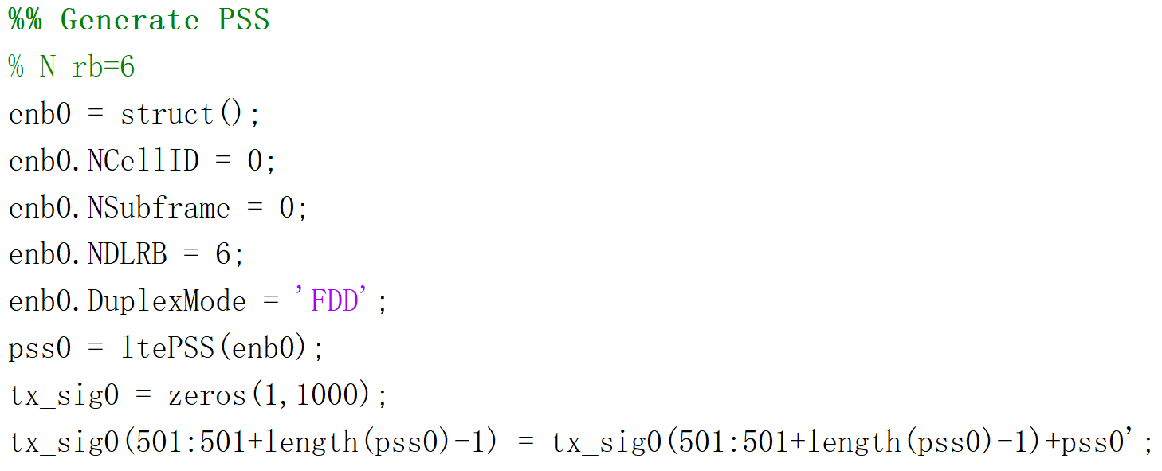
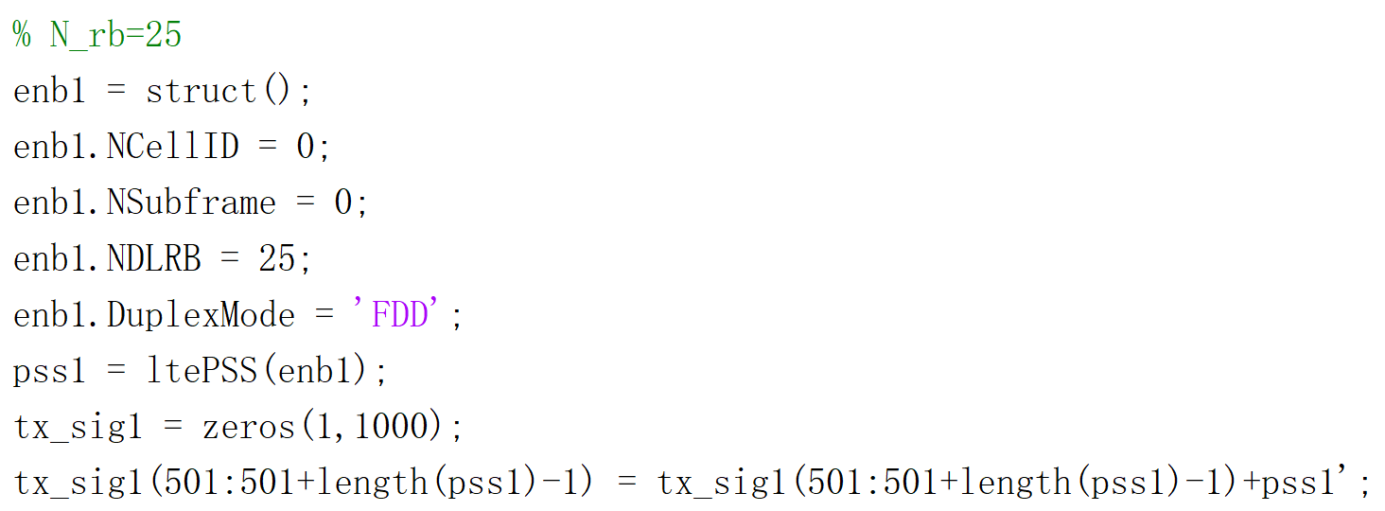
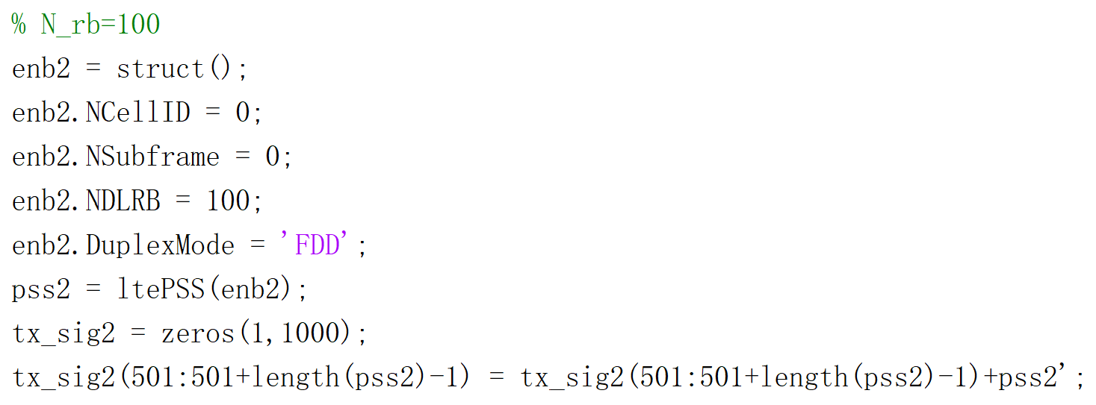
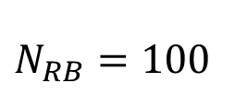
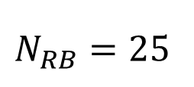
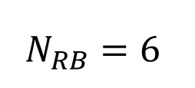
MATLAB Code —— Generation of Tx signal
$$N_{RB}=6$$
$$N_{RB}=25$$
$$N_{RB}=100$$

Slide 6
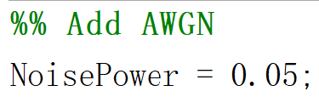
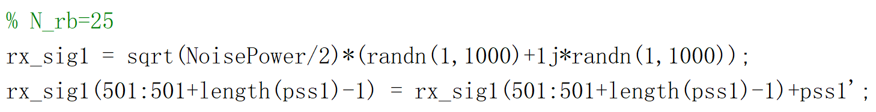
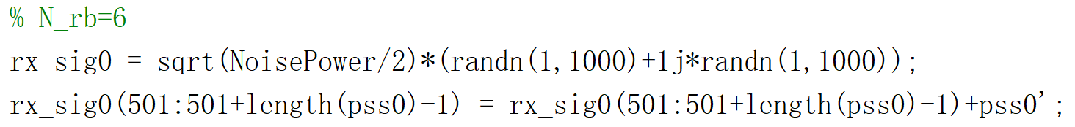
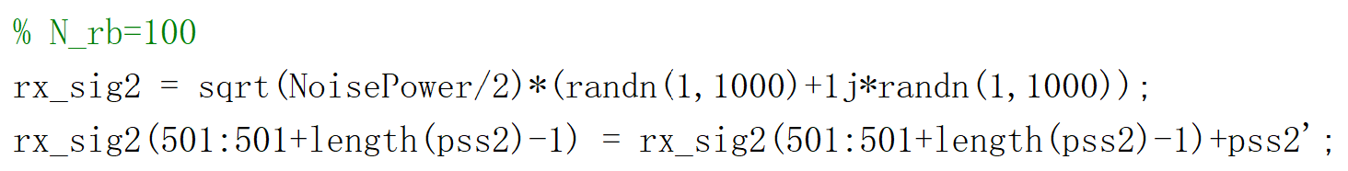
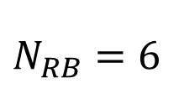
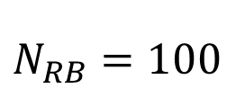
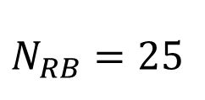
MATLAB Code —— Generation of Rx signal
Noise Power
$$N_{RB}=6$$
$$N_{RB}=25$$
$$N_{RB}=100$$

Slide 7
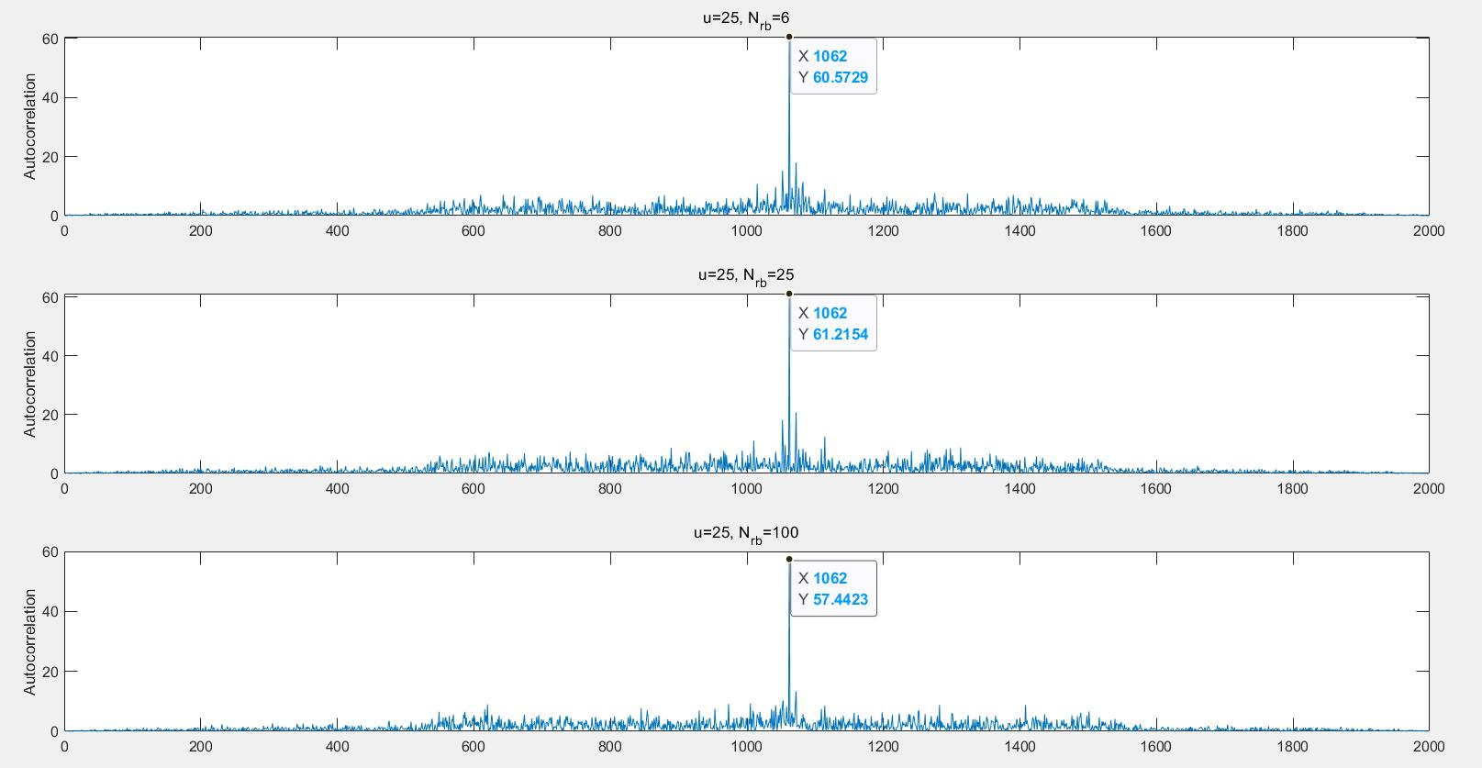
MATLAB Result —— Auto-Correlation

Slide 8
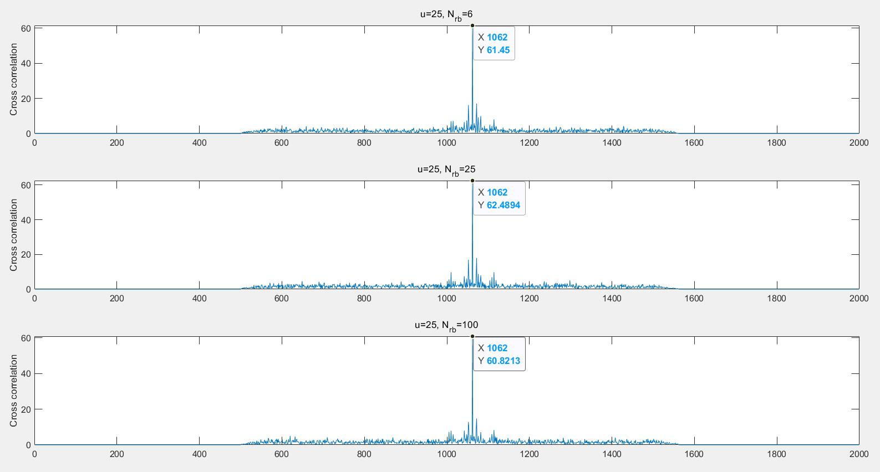
MATLAB Result —— Cross-Correlation

Slide 9
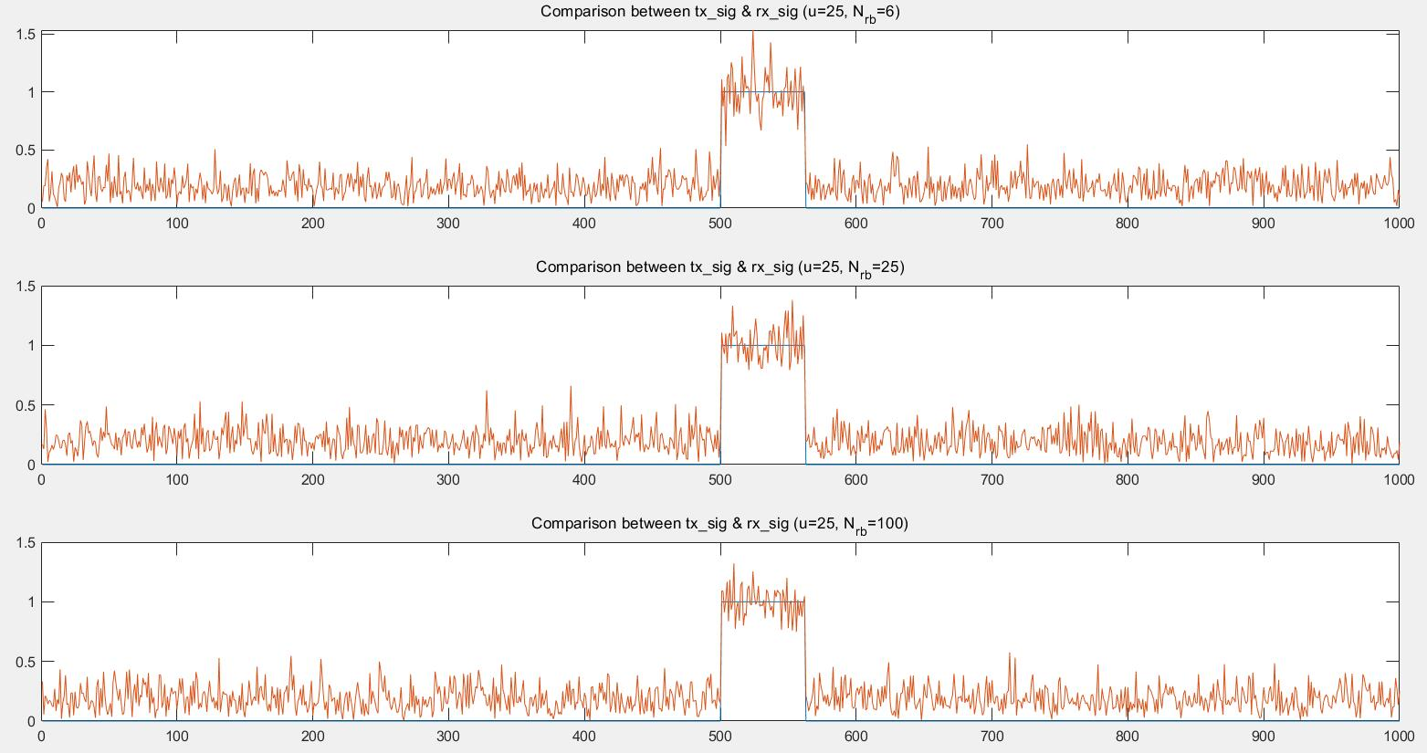
MATLAB Result —— Comparison

Slide 10
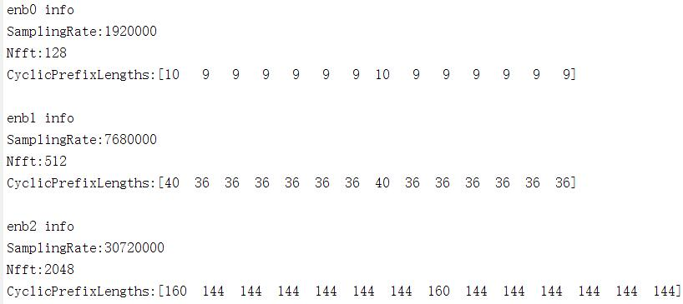
MATLAB Result —— Information of enb

Slide 11
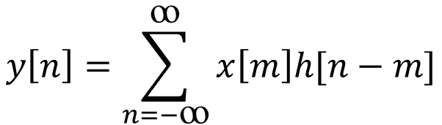
Theoretical analysis
The formula of convolution is
$$y\left[n\right]=\sum_{n=−ꝏ}^{ꝏ}{x\left[m\right]h[n−m]}$$
The interval where the signal is [501,562] in both of transmitted signal and received signal. For cross correlation and auto correlation, the index where the first peak occur is 1001 and the index where the maximum value occur is 1062 according to the formula. The above figures are in line with the theoretical analysis, which proves our simulation is correct.

Slide 12
Thank you!
Yihan Sun: 12012128@mail.sustech.edu.cn
Xudong Zhang: 12011923@mail.sustech.edu.cn

