Slide 1

Assignment 5 CSMA/CA based channel contention
Group member: 孙逸涵 张旭东
SID: 12012128 12011923

Slide 2
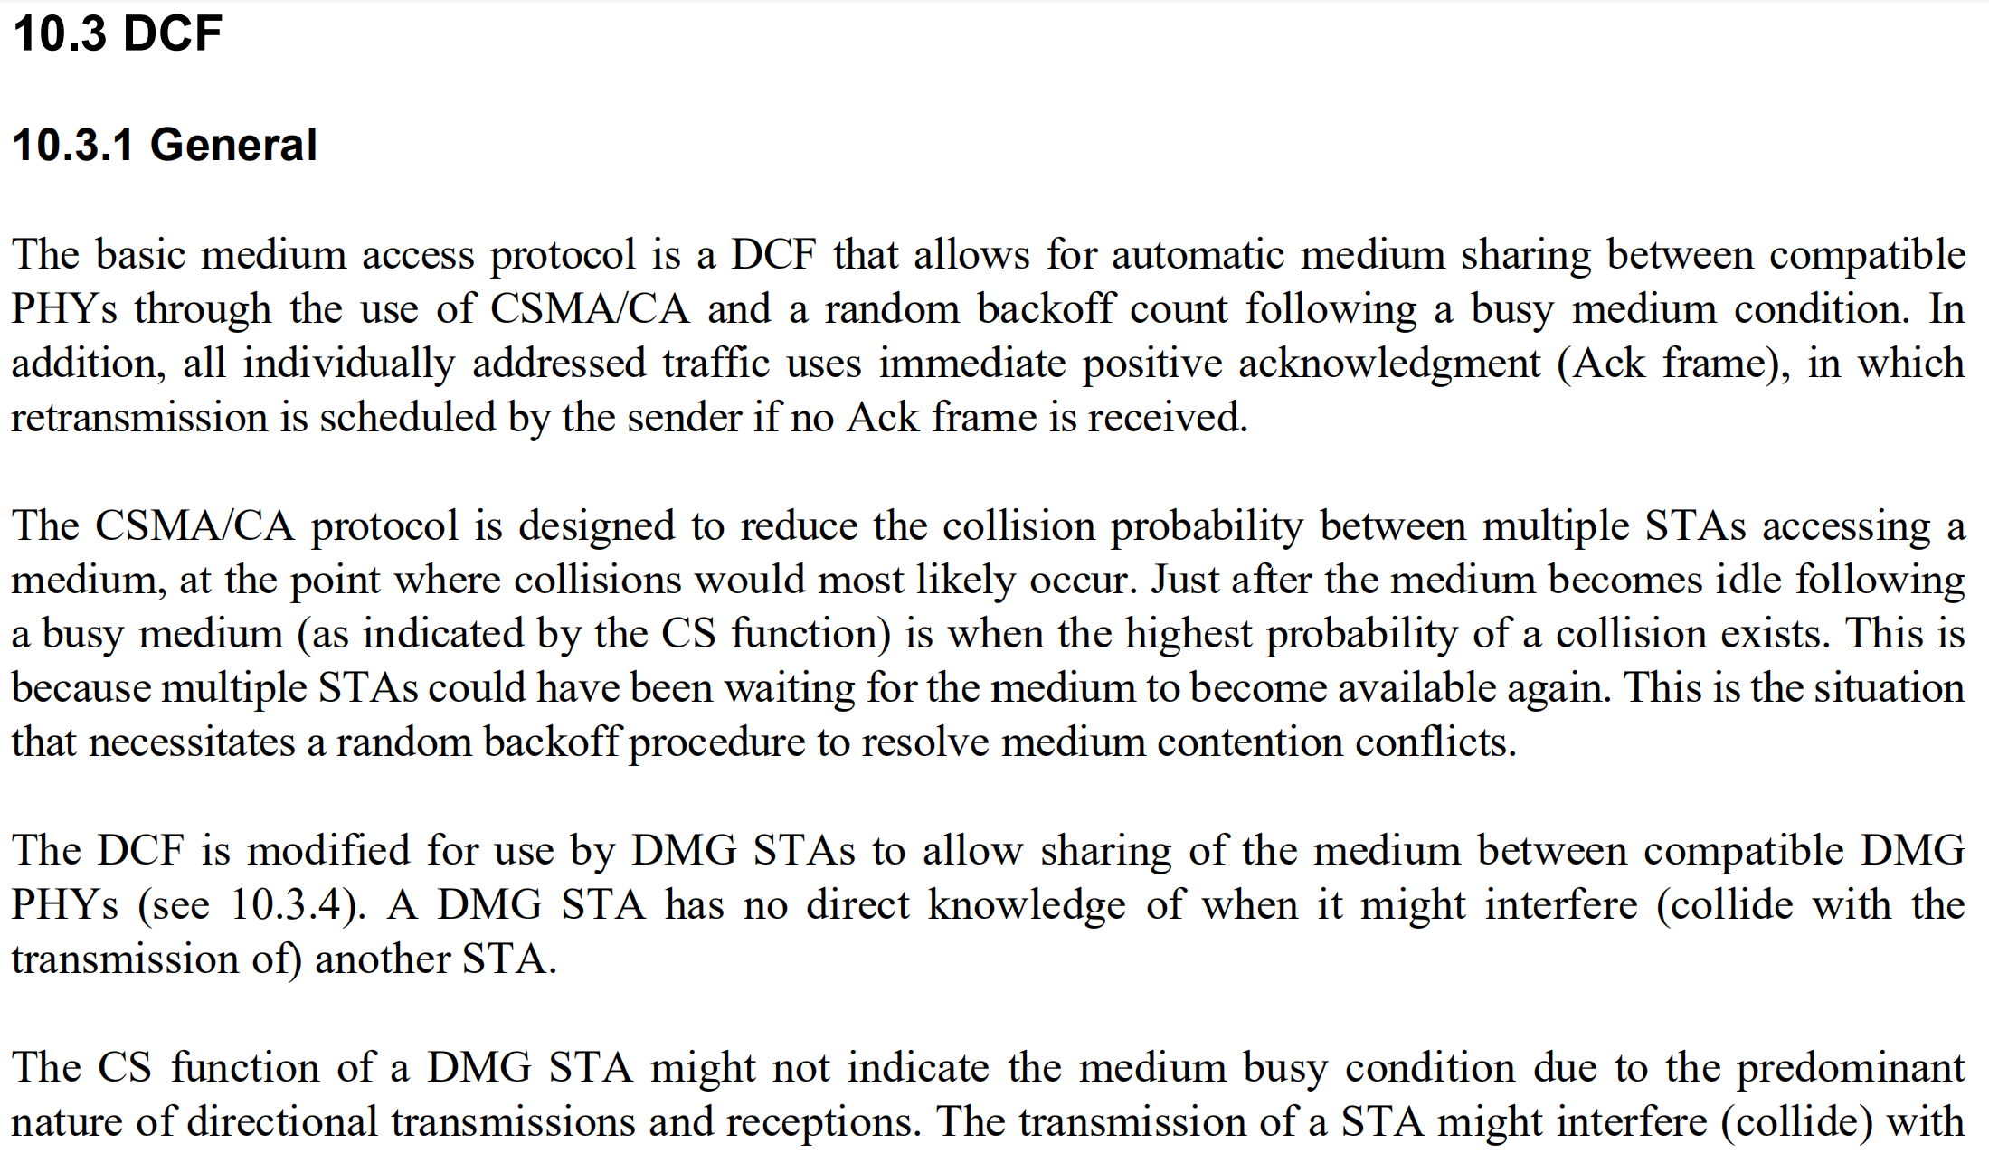
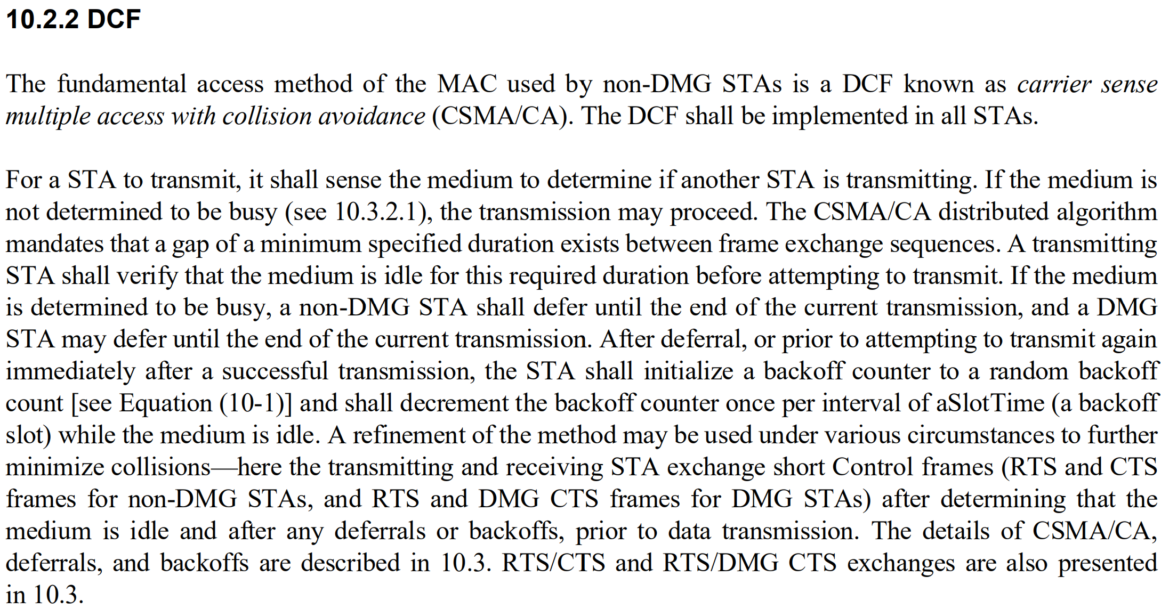
Sections on DCF
Related sections: 10.2.2, 10.3

Slide 3
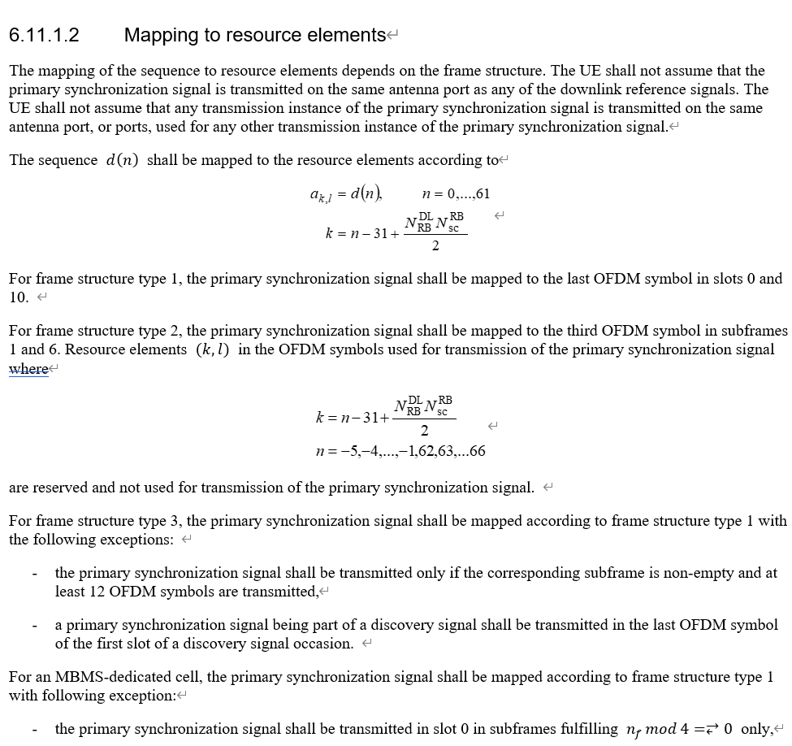
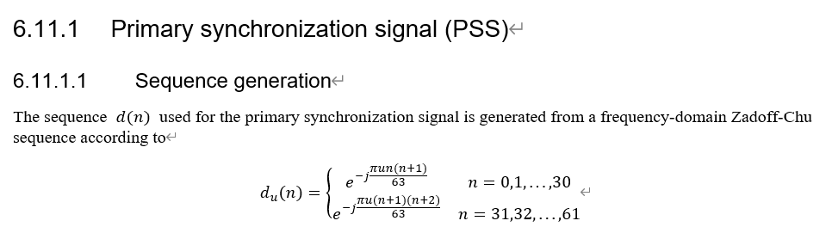
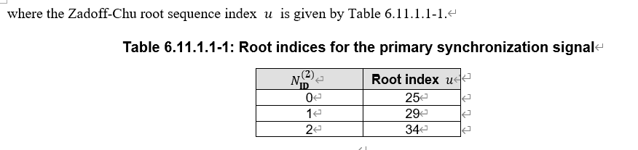
Sections on PSS
Related sections: 6.11.1 in 36.211

Slide 4
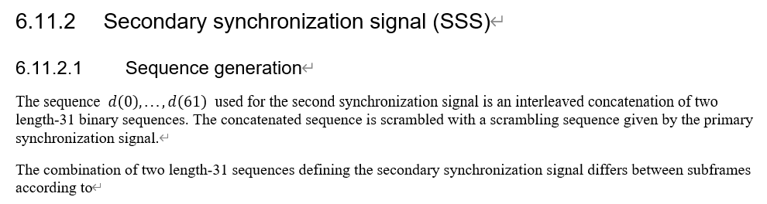
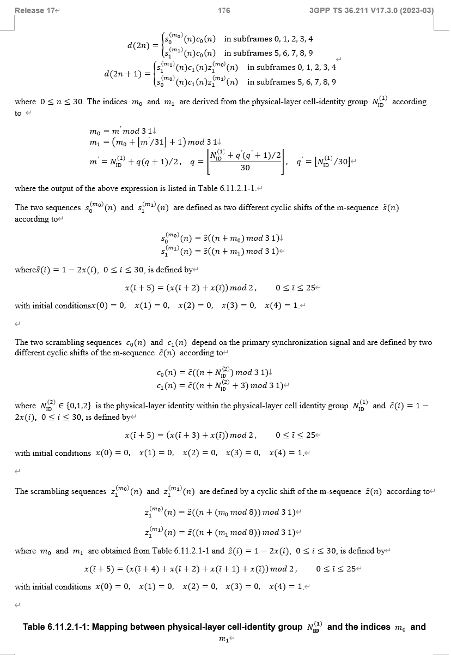
Sections on SSS
Related sections: 6.11.2 in 36.211

Slide 5
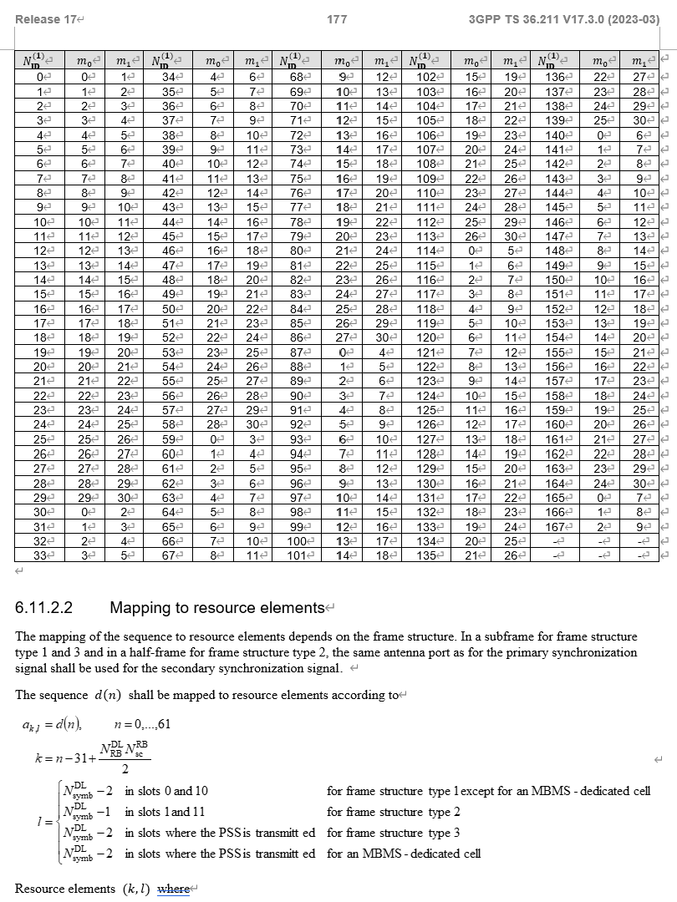
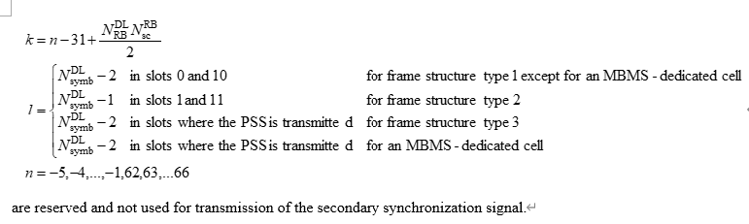
Sections on SSS
Related sections: 6.11.2 in 36.211

Slide 6
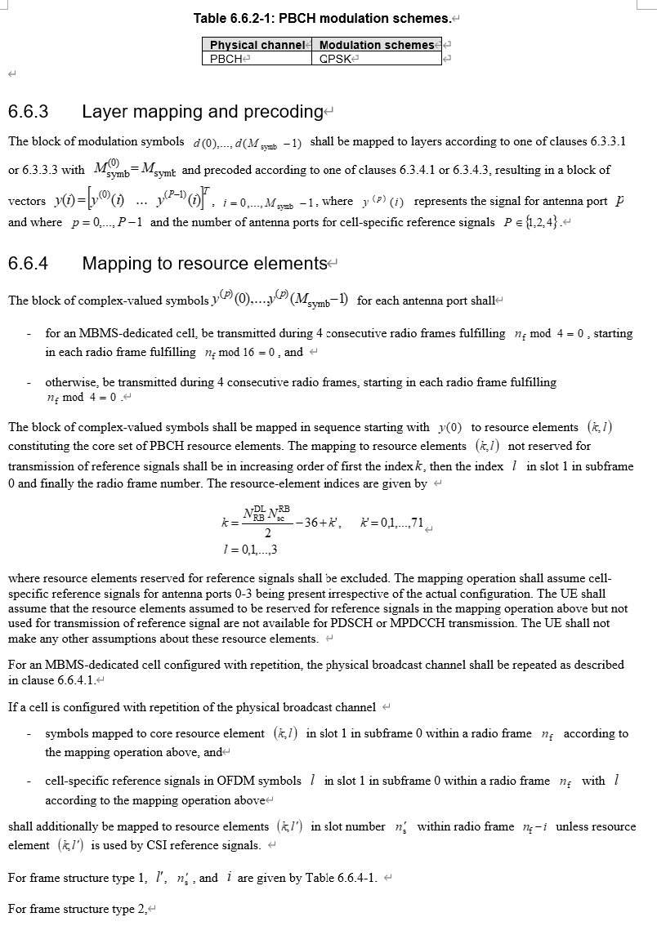
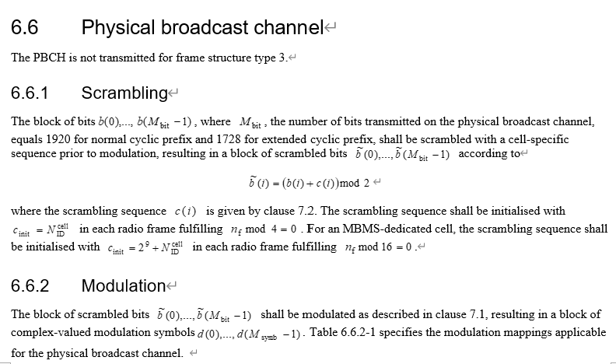
Sections on PBCH
Related sections: 6.6 in 36.211

Slide 7
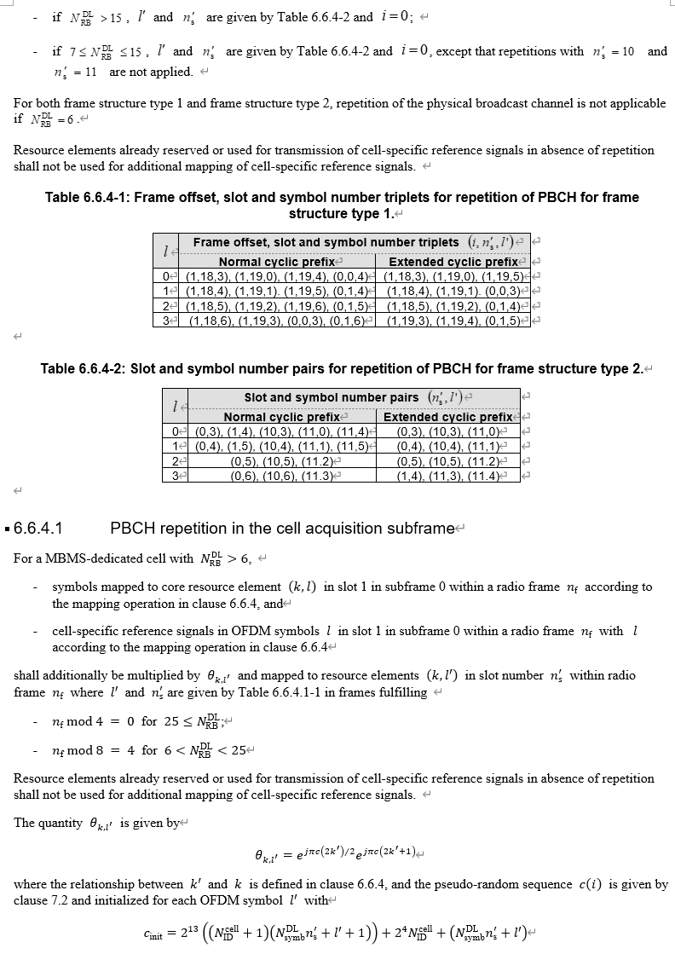
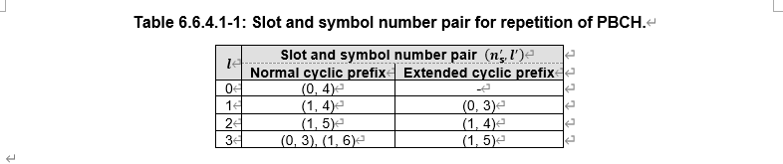
Sections on PBCH
Related sections: 6.6 in 36.211

Slide 8
Procedure of CSMA/CA
Carrier sensing: a STA having a packet to transmit checks the state of the medium.
Wait: the STA waits if it senses a busy medium. Moreover, it determines a random back-off period by setting an internal timer to an integer number of slot times
Still wait: the station defers until this medium is idle for one DIFS period.
Countdown: after DIFS, an internal timer is set. If the timer reaches zero, the station begins transmission. The receiving host receives the data frame correctly, waits for a SIFS, and then issues an acknowledgement of the data frame. If the source station does not receive an ACK within a specified period of time, it must retransmit the frame until it receives the ACK, or give up sending the frame after several retransmission failures.
Suspension: however, if the channel is seized by another station before the timer reaches zero, the timer setting is suspended at the decremented value for subsequent transmission.

Slide 9
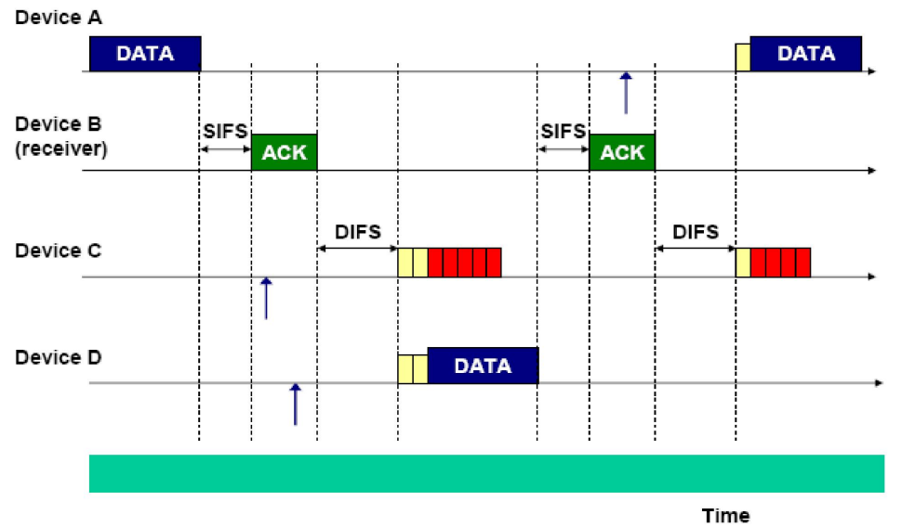
Example of CSMA/CA

Slide 10
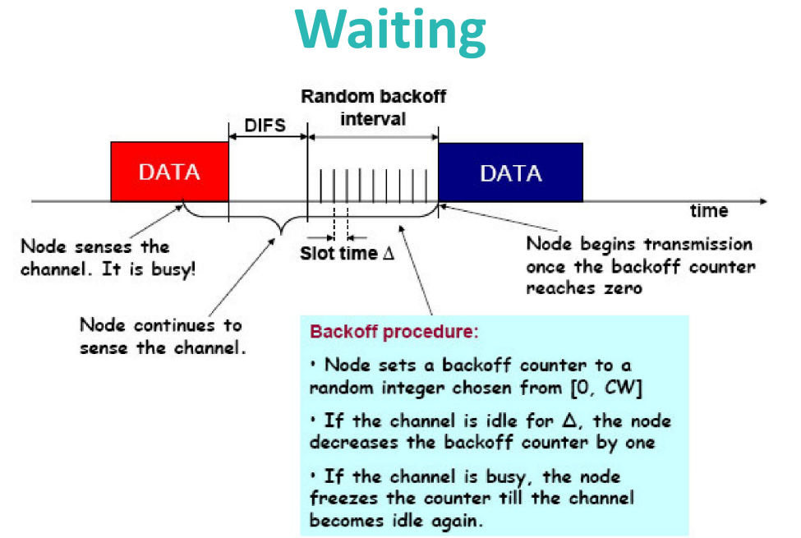
Waiting of CSMA/CA
Backoff time=Random()×aSlotTime
Random():”Pseudorandom integer drawn from a uniform distribution over the interval [0,CW],where CW is an integer within the range of values of the PHY characteristics aCWmin and aCWmax”

Slide 11
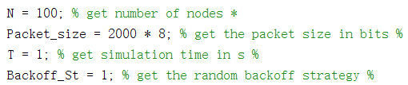
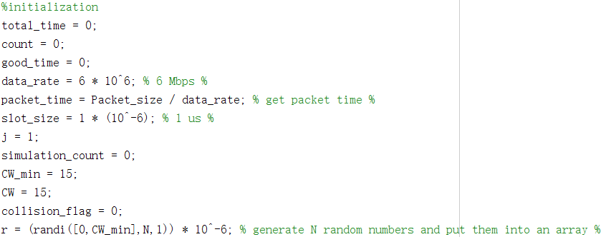
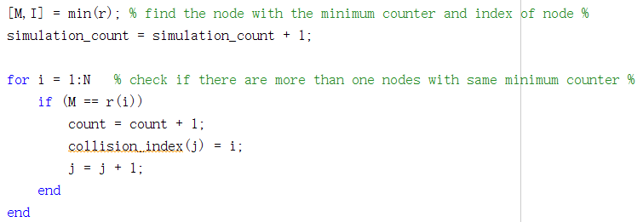
MATLAB Code —— Carrier sensing
Number of nodes
packet size
Simulation time
Initialization
Find the node with the minimum counter and index of node, check the existence of collisions

Slide 12
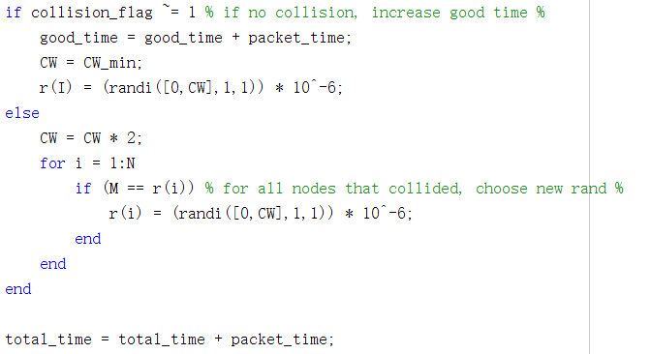
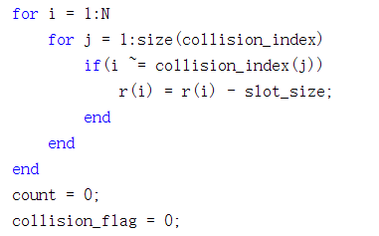

MATLAB Code —— waiting and backoff
Backoff strategy 1
The node decrease the backoff counter by one slot time for the channel is idle for one slot time
Calculate the utility

Slide 13
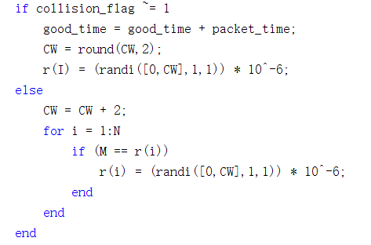
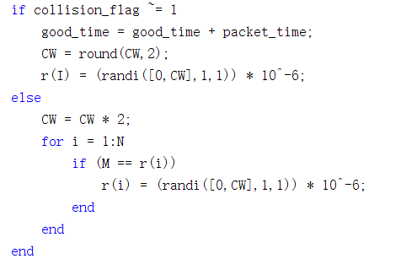
MATLAB Code —— waiting and backoff
Backoff strategy 2
Backoff strategy 3

Slide 14
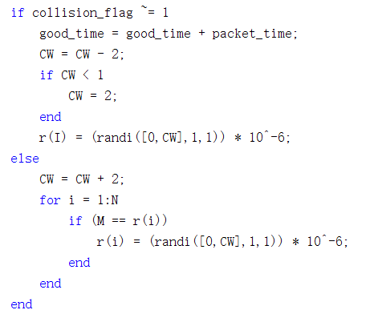
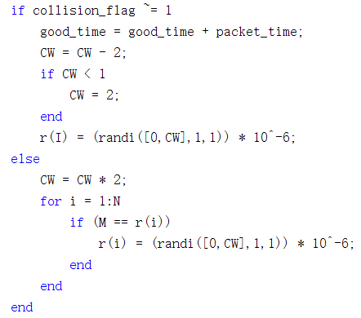
MATLAB Code —— waiting and backoff
Backoff strategy 4
Backoff strategy 5

Slide 15
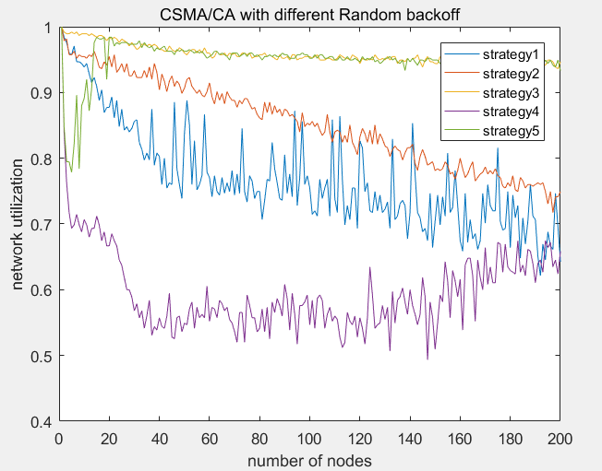
Result —— different strategies
From the above picture, what can be known is that with number of nodes increasing, the network utilization under strategy3 and strategy5 is higher than that under strategy1, strategy2 and strategy4, which means the performance of strategy3 and strategy5 under large number of nodes is better. However, under small number of nodes, the performance of strategy3 is better than strategy5.

Slide 16
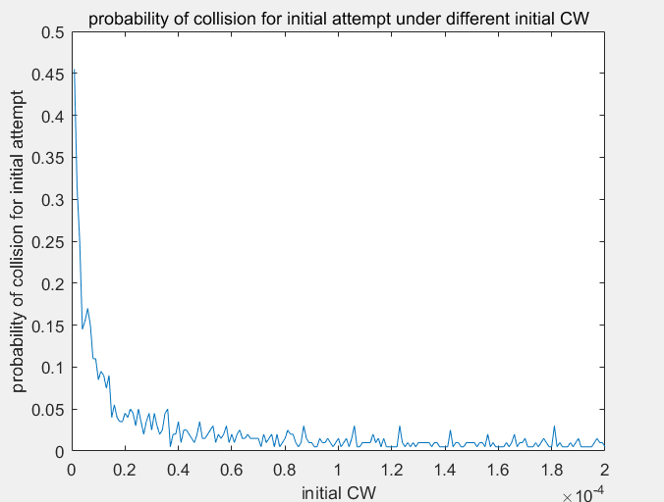
Result —— different initial CW
From the above picture, what can be known is that when number of nodes and the size of packet are fixed, the probability of collision for initial attempt decreases with initial CW increasing. According to the mechanism of backoff strategy, it can be predicted that probability of collision for first retransmission decreases with initial CW increasing. The same is true for the second retransmission, the third retransmission and so on. In a conclusion, initial CW is closely related to the probability of collision. When initial CW increase, the probability of collision for initial attempt, the first retransmission, the second retransmission and so on decreases. However, when initial CW increases to a certain level, the utilization will decrease according to the mechanism of backoff strategy.

Slide 17
Thank you!
Yihan Sun: 12012128@mail.sustech.edu.cn
Xudong Zhang: 12011923@mail.sustech.edu.cn

