Slide 1

Assignment 7 Transmission and detection of preambles in PRACH
Group member: 孙逸涵 张旭东
SID: 12012128 12011923

Slide 2
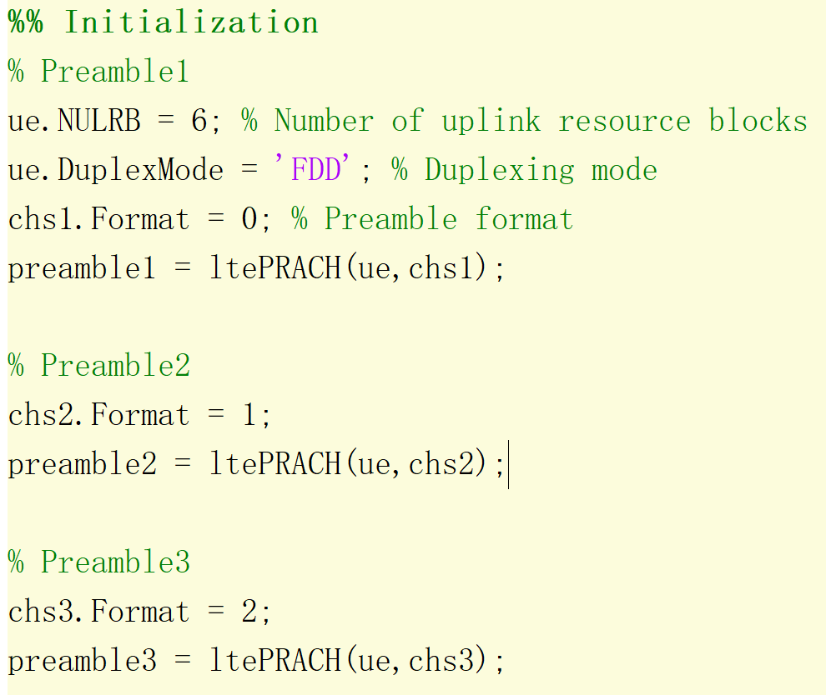
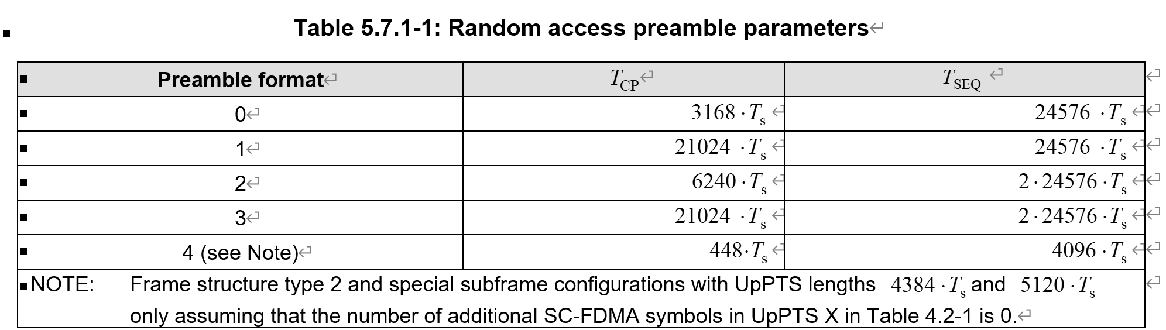
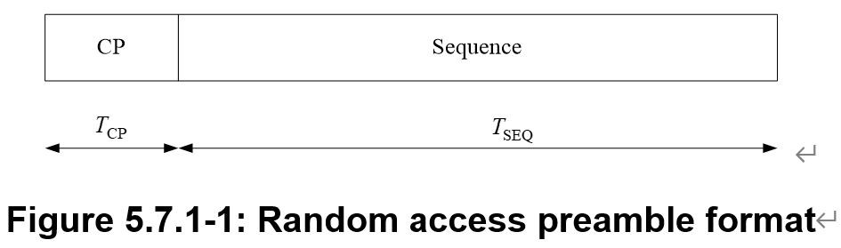
Initialization of preamble

Slide 3
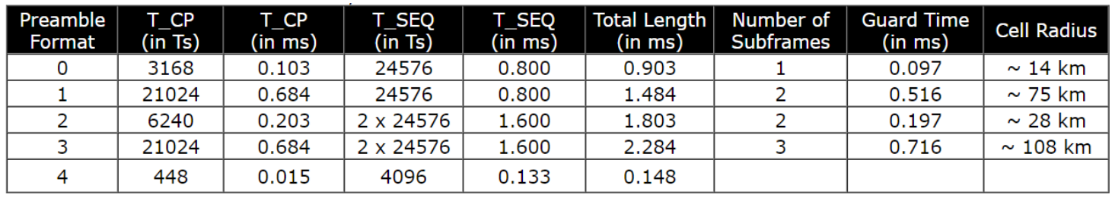

Initialization of preamble
According to the format, when preamble format is 1 or 2, although the total length and guard time of them is different, the sum of total length and guard time and the number of subframes are the same, which indicates the length of preamble2 and preamble3 is the same.

Slide 4
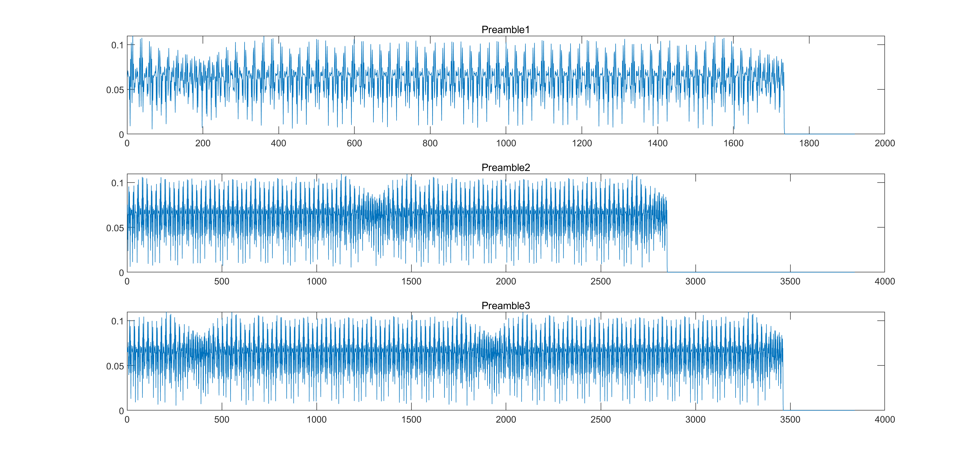
Waveform of preambles

Slide 5
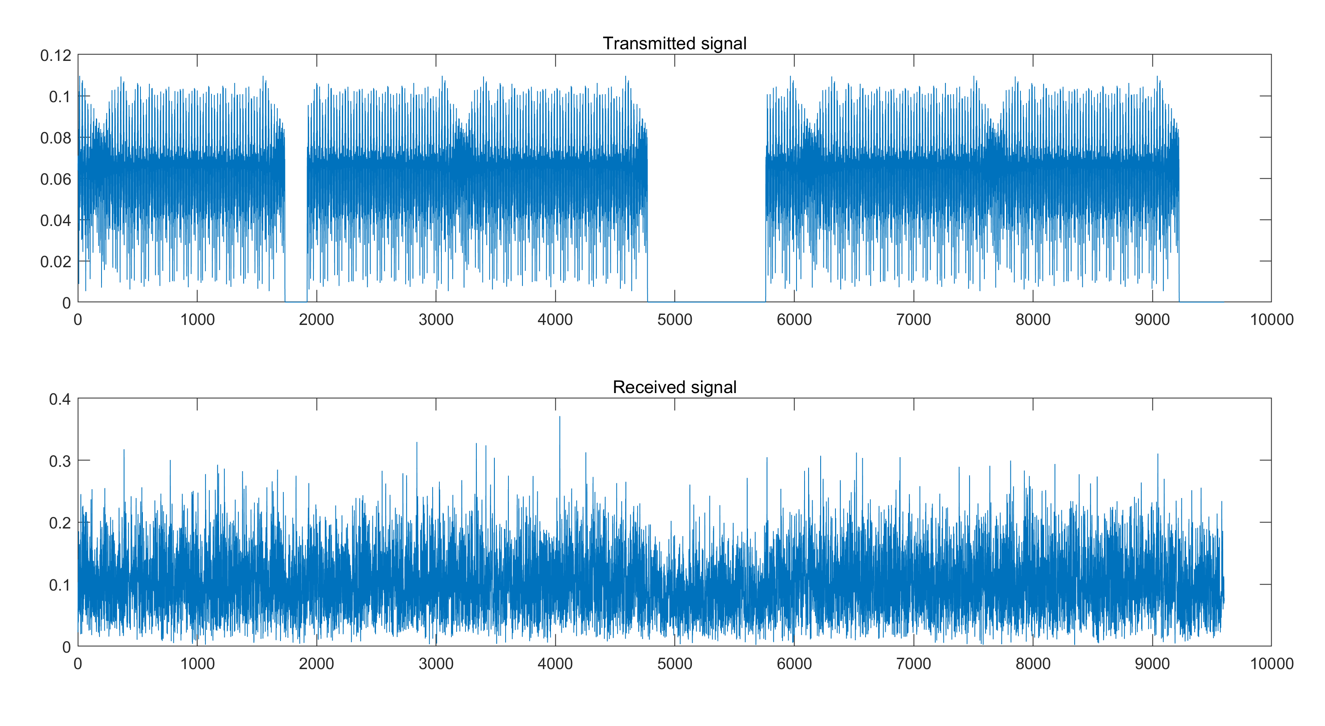
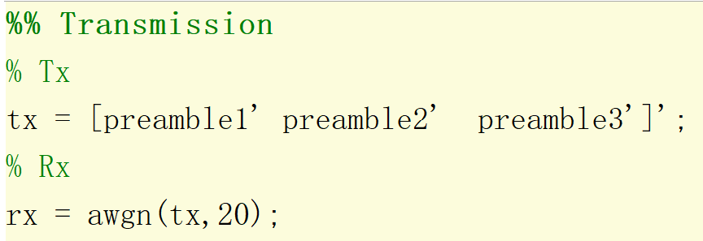
Transmission of preamble
AWGN channel
Waveform of Tx and Rx signal

Slide 6
Detection of preamble
To detect the preambles in the received signal, we should carry out cross-correlation between the received signal and the corresponding local reference preamble.
In this case, we ignore the effect of time delay and frequency shift, so we can easily get the corresponding location of each preamble in the received signal. And after determining the location of that, we just need to execute cross-correlation operation to detect if we receive the desired preamble, i.e., determine which user wants to upload its data to the AP.

Slide 7
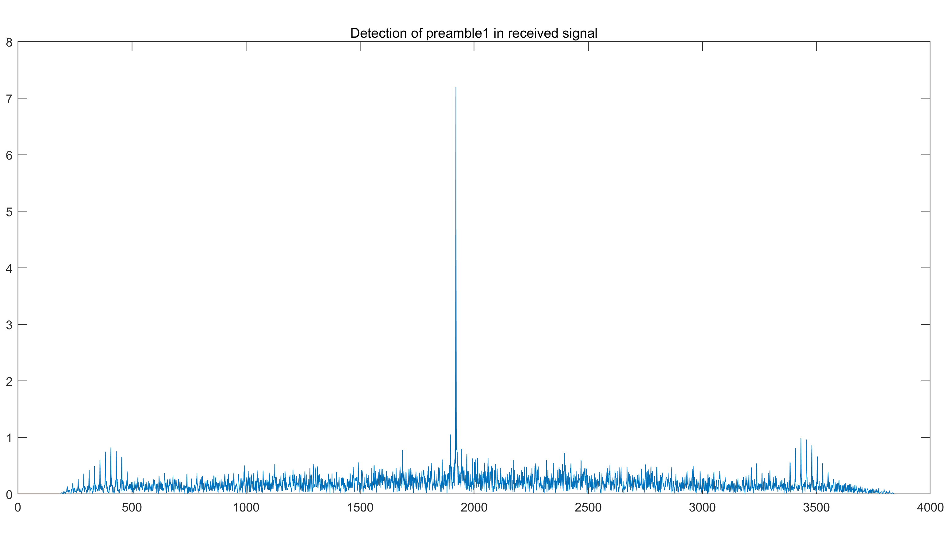
Detection of preamble1

Slide 8
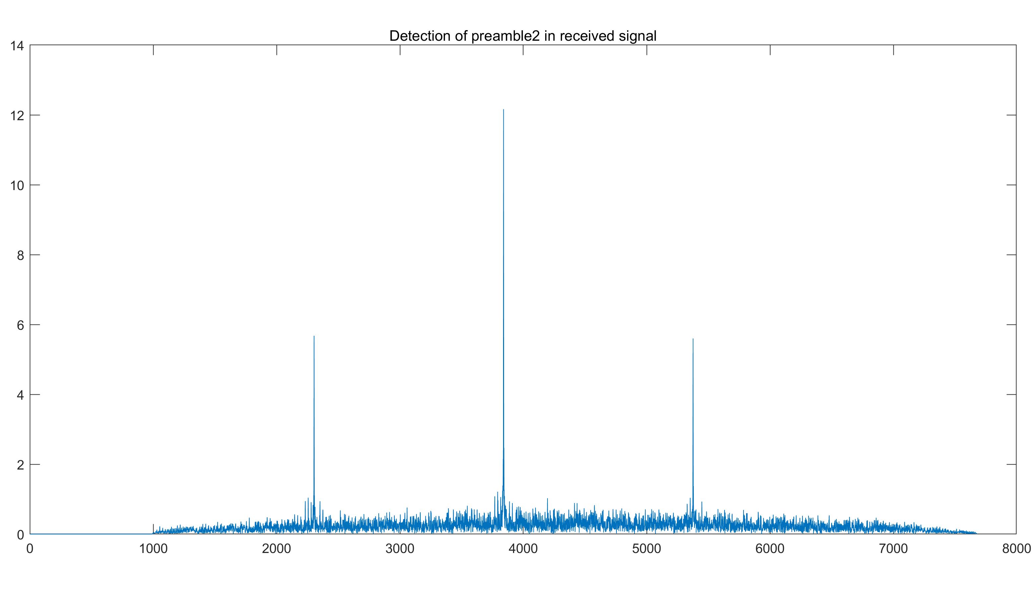
Detection of preamble2

Slide 9
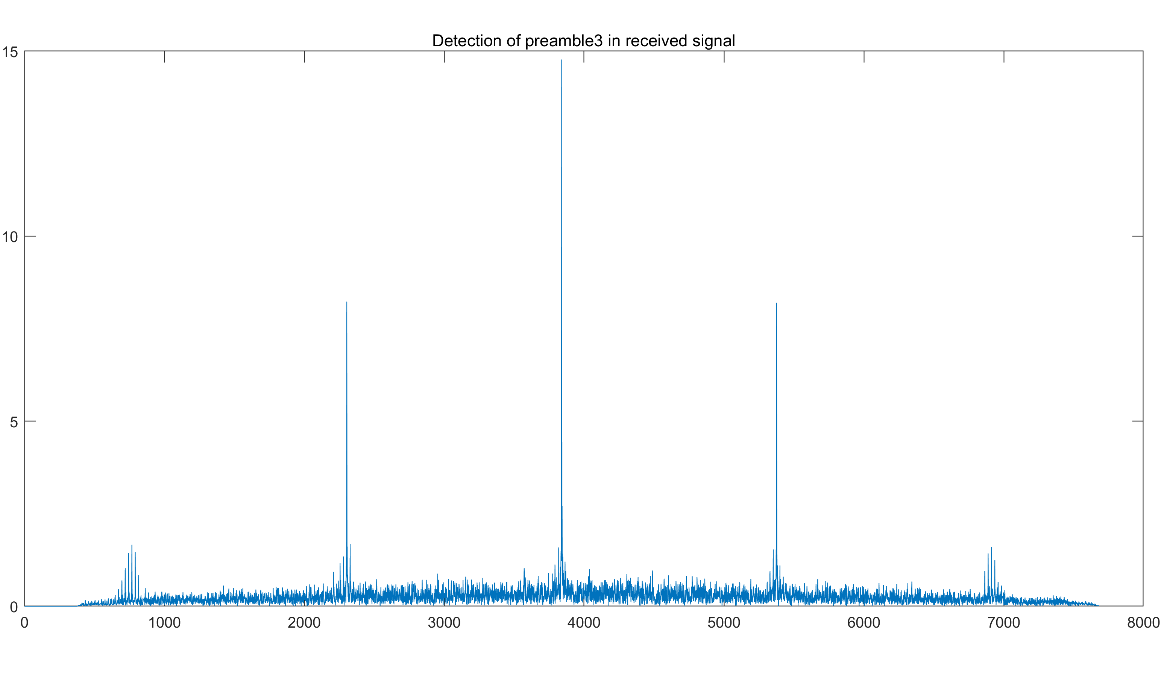
Detection of preamble3

Slide 10
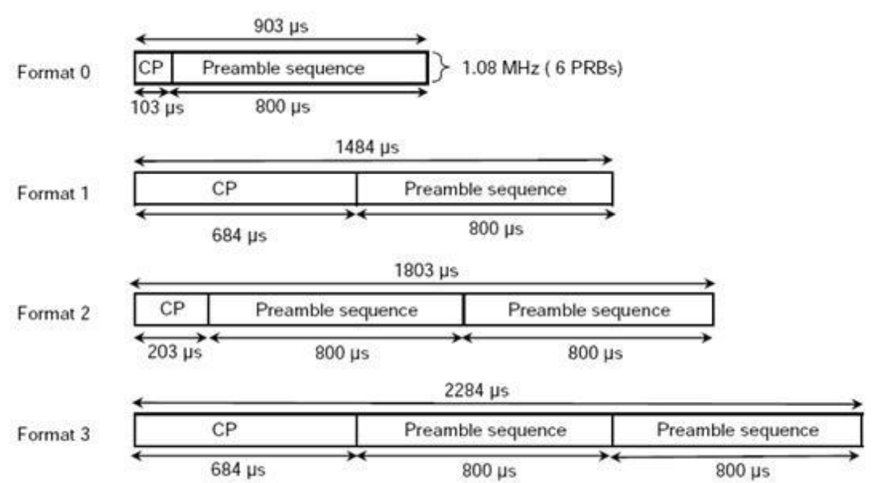
Detection of preamble
From the result of detection, it is easy to find that there are a highest peak and the other small peaks. This can be explained in the following picture:

Slide 11
Detection of preamble
For format 0, the length of CP is much shorter than that of preamble sequence. When doing cross-correlation, a small peak occurs when the part is aligned with CP, and the highest peak occurs when perfectly aligned. So the result of detection is symmetric about the highest peak.
The same is true for format 1 and format 2. The amplitude of small peaks are related to the length of CP. The longer the length of CP is, the smaller the difference between amplitude of small peaks and that of highest peak is.

Slide 12
Thank you!
Yihan Sun: 12012128@mail.sustech.edu.cn
Xudong Zhang: 12011923@mail.sustech.edu.cn

