Slide 1

Assignment 8 MIMO Detector for 4×2 STBC
Group member: 孙逸涵 张旭东
SID: 12012128 12011923

Slide 2
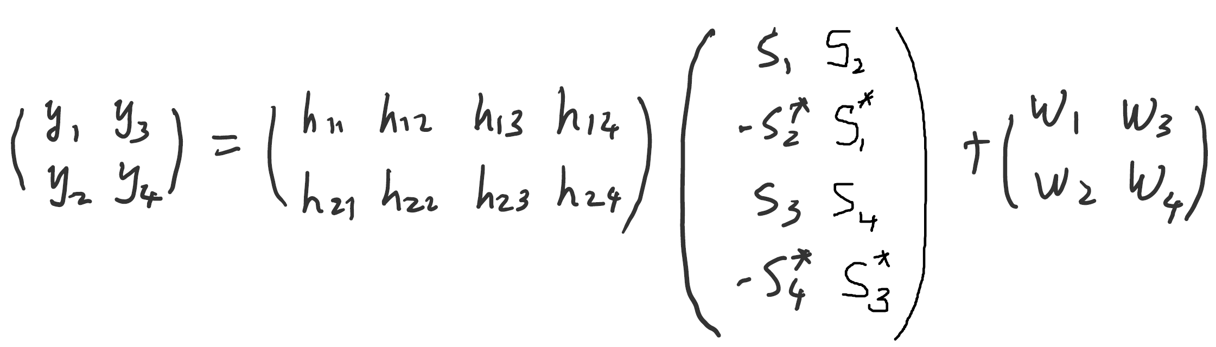
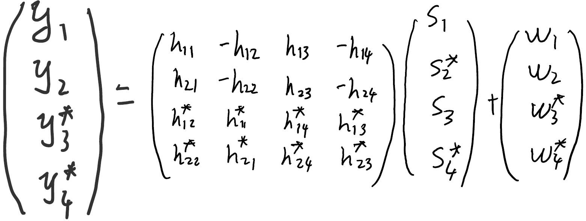
Analysis
4×2 Space-Time Block Code

Slide 3
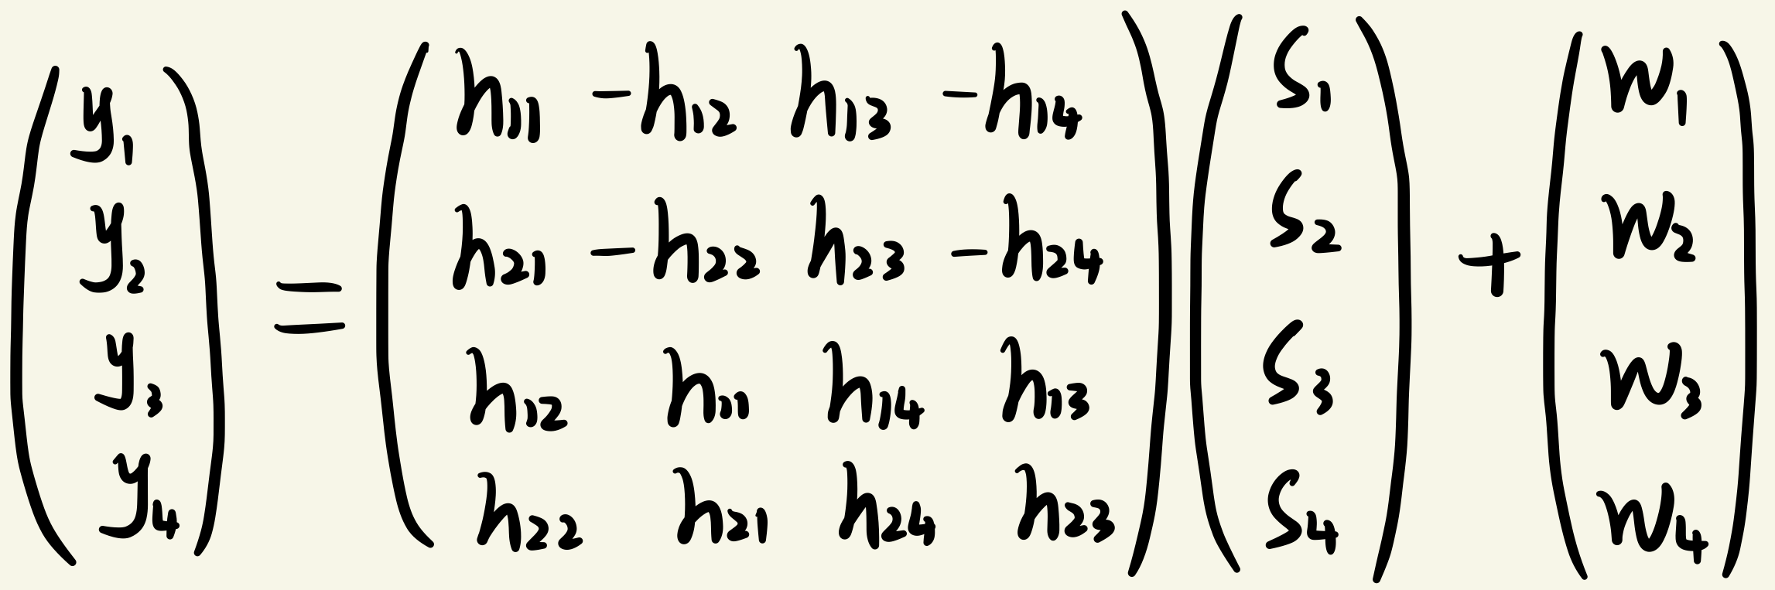
Analysis
To simplify our calculation, and also get a more intuitive understanding, we choose to use real signal to transmit on the real AWGN channel.
Therefore, the expression becomes:

Slide 4
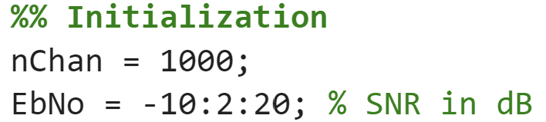
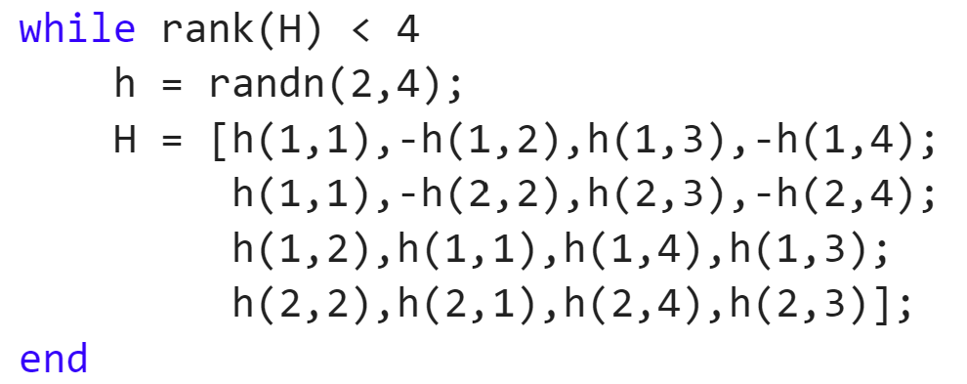
Initialization
In this assignment, we use QPSK modulation scheme, and generate 1000 realizations of channel matrix for SNR ranging from -10dB to 20dB with step 2dB.
And to simplify the calculation further, all of the channel matrix $H$ we generated are full rank.

Slide 5
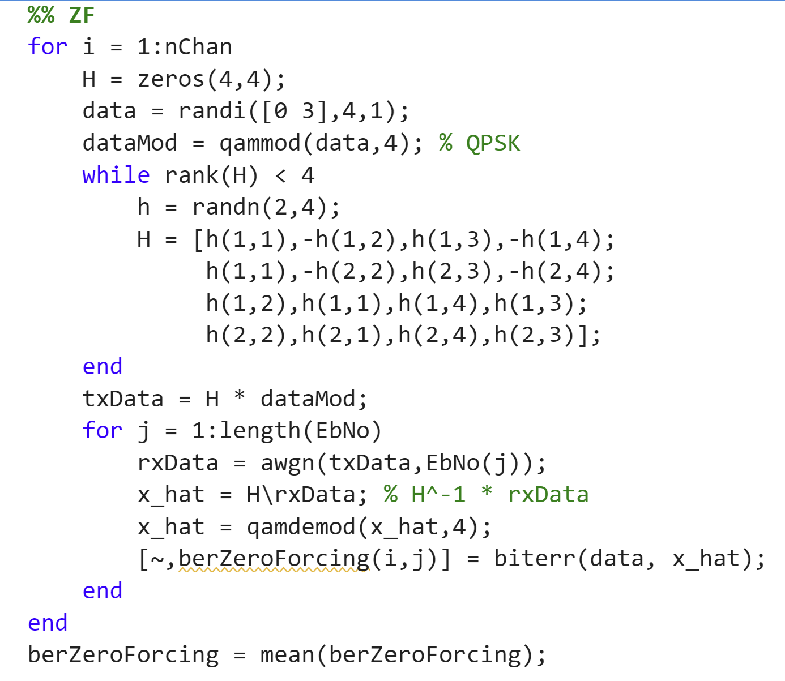
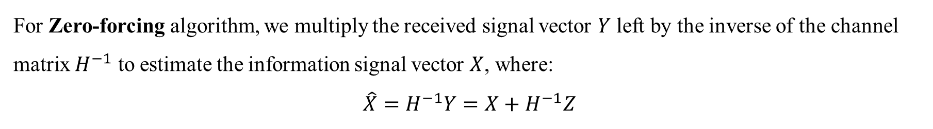
Zero-forcing (ZF)
For Zero-forcing algorithm, we multiply the received signal vector $Y$ left by the inverse of the channel matrix $H^{−1}$ to estimate the information signal vector $X$, where:
$$\hat{X}=H^{−1}Y=X+H^{−1}Z$$

Slide 6

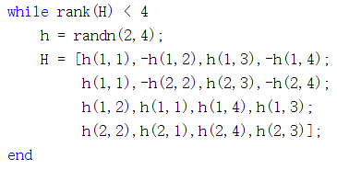



Zero-forcing (ZF)
Generate the bits to be sent and the modulated symbols
Generate a channel matrix of full rank
Received signal under different SNR
Get estimated $\hat{X}$
Demodulation and calculate BER

Slide 7
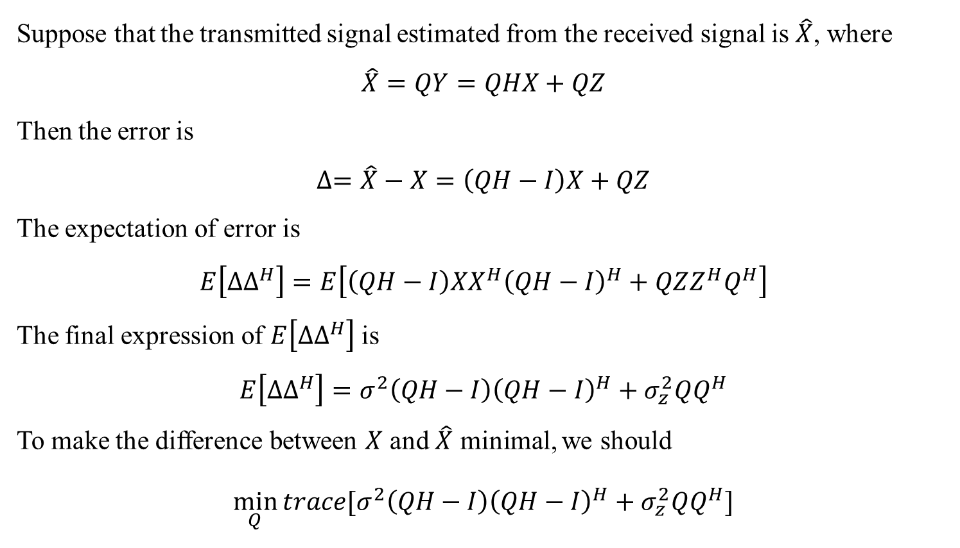
Minimum Mean Square Error (MMSE)
Suppose that the transmitted signal estimated from the received signal is $\hat{X}$, where
$$\hat{X}=QY=QHX+QZ$$
Then the error is
$$∆=\hat{X}−X=\left(QH−I\right)X+QZ$$
The expectation of error is
$$E\left[∆∆^{H}\right]=E\left[\left(QH−I\right)XX^{H}{\left(QH−I\right)}^{H}+QZZ^{H}Q^{H}\right]$$
The final expression of $E\left[∆∆^{H}\right]$ is
$$E\left[∆∆^{H}\right]=σ^{2}\left(QH−I\right){\left(QH−I\right)}^{H}+σ_{z}^{2}QQ^{H}$$
To make the difference between $X$ and $\hat{X}$ minimal, we should
$$\min_{Q}{trace[σ^{2}\left(QH−I\right){\left(QH−I\right)}^{H}+σ_{z}^{2}QQ^{H}]}$$

Slide 8

Minimum Mean Square Error (MMSE)
Generate the bits to be sent and the modulated symbols
Generate a channel matrix of full rank
Received signal under different SNR
Get estimated $\hat{X}$
Demodulation and calculate BER

Slide 9
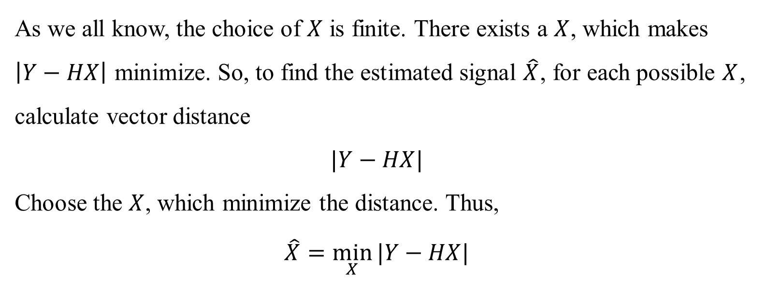
Maximum Likelihood (ML)
As we all know, the choice of $X$ is finite. There exists a $X$, which makes $\left|Y−HX\right|$ minimize. So, to find the estimated signal $\hat{X}$, for each possible $X$, calculate vector distance
$$|Y−HX|$$
Choose the $X$, which minimize the distance. Thus,
$$\hat{X}=\min_{X}{|Y−HX|}$$

Slide 10

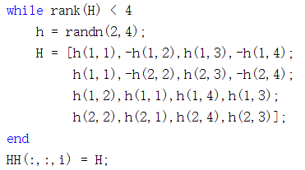
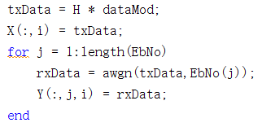
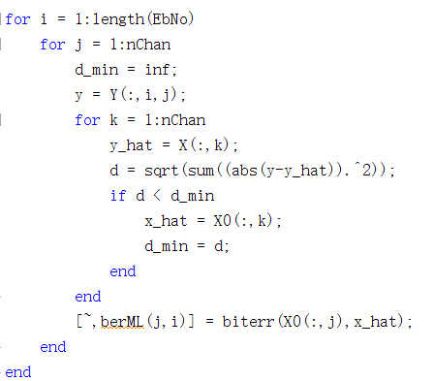
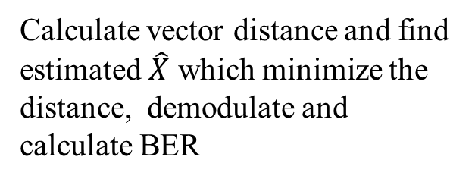
Maximum Likelihood (ML)
Generate the bit sequence to be sent and the modulated symbols, store the bit sequence
Generate and store channel matrixes of full rank
Received signal under different SNR and store them
Calculate vector distance and find estimated $\hat{X}$ which minimize the distance, demodulate and calculate BER

Slide 11
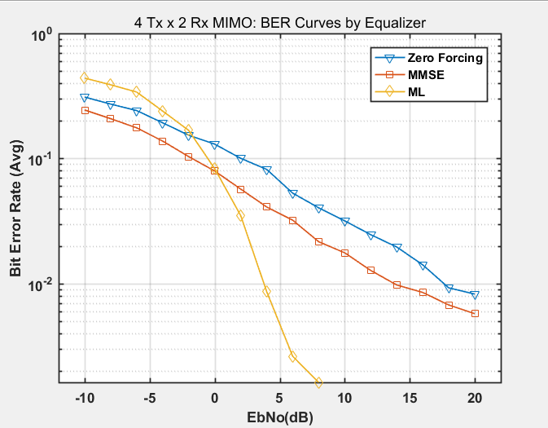
Average BER versus SNR

Slide 12
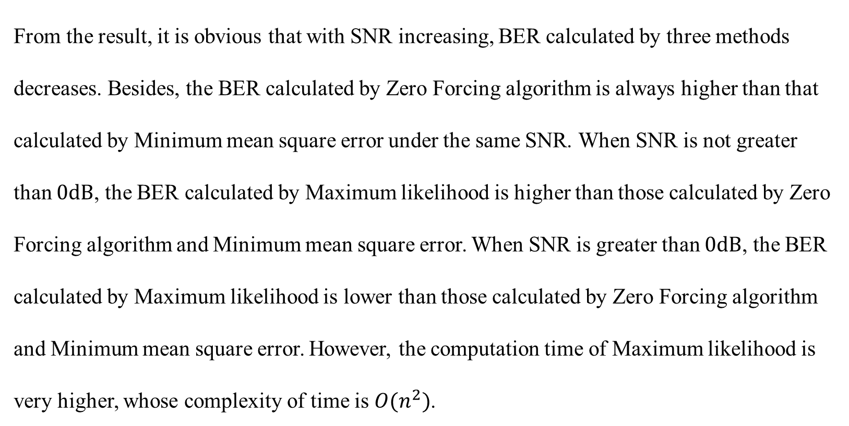
Result and analysis
From the result, it is obvious that with SNR increasing, BER calculated by three methods decreases. Besides, the BER calculated by Zero Forcing algorithm is always higher than that calculated by Minimum mean square error under the same SNR. When SNR is not greater than $0dB$, the BER calculated by Maximum likelihood is higher than those calculated by Zero Forcing algorithm and Minimum mean square error. When SNR is greater than $0dB$, the BER calculated by Maximum likelihood is lower than those calculated by Zero Forcing algorithm and Minimum mean square error. However, the computation time of Maximum likelihood is very higher, whose complexity of time is $O(n^{2})$.

Slide 13
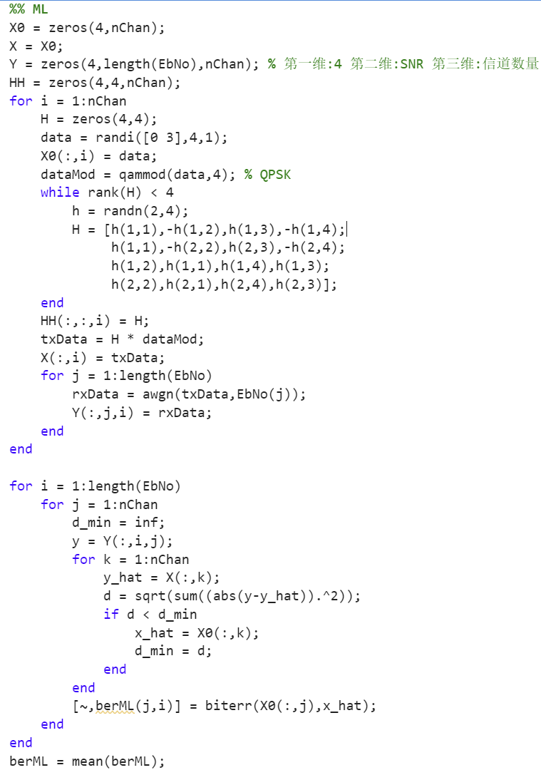
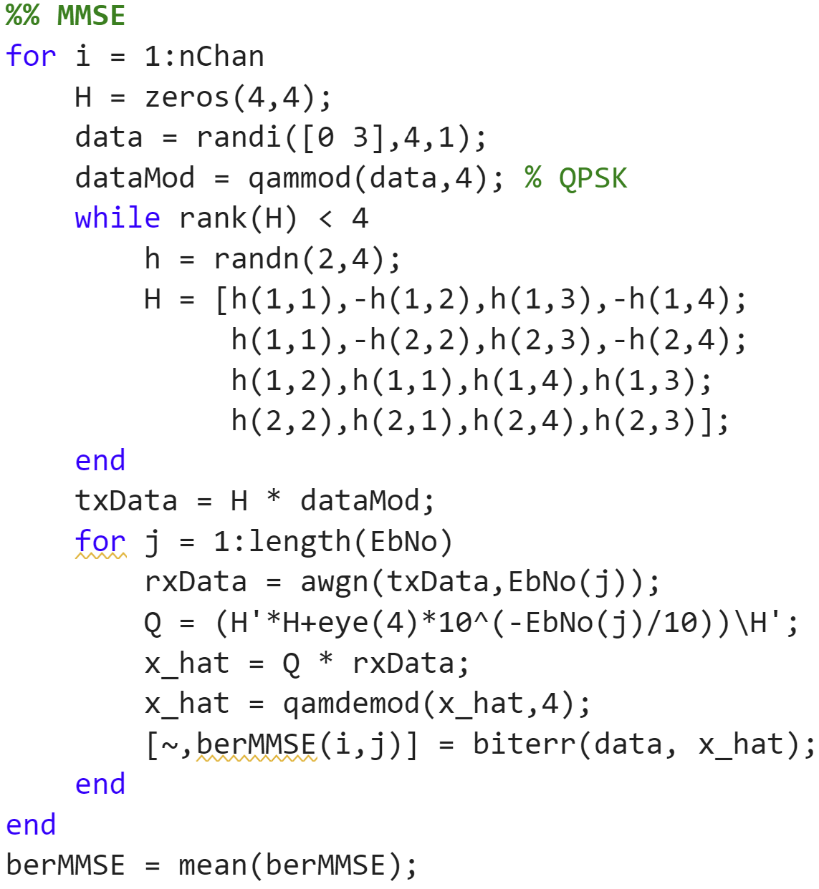
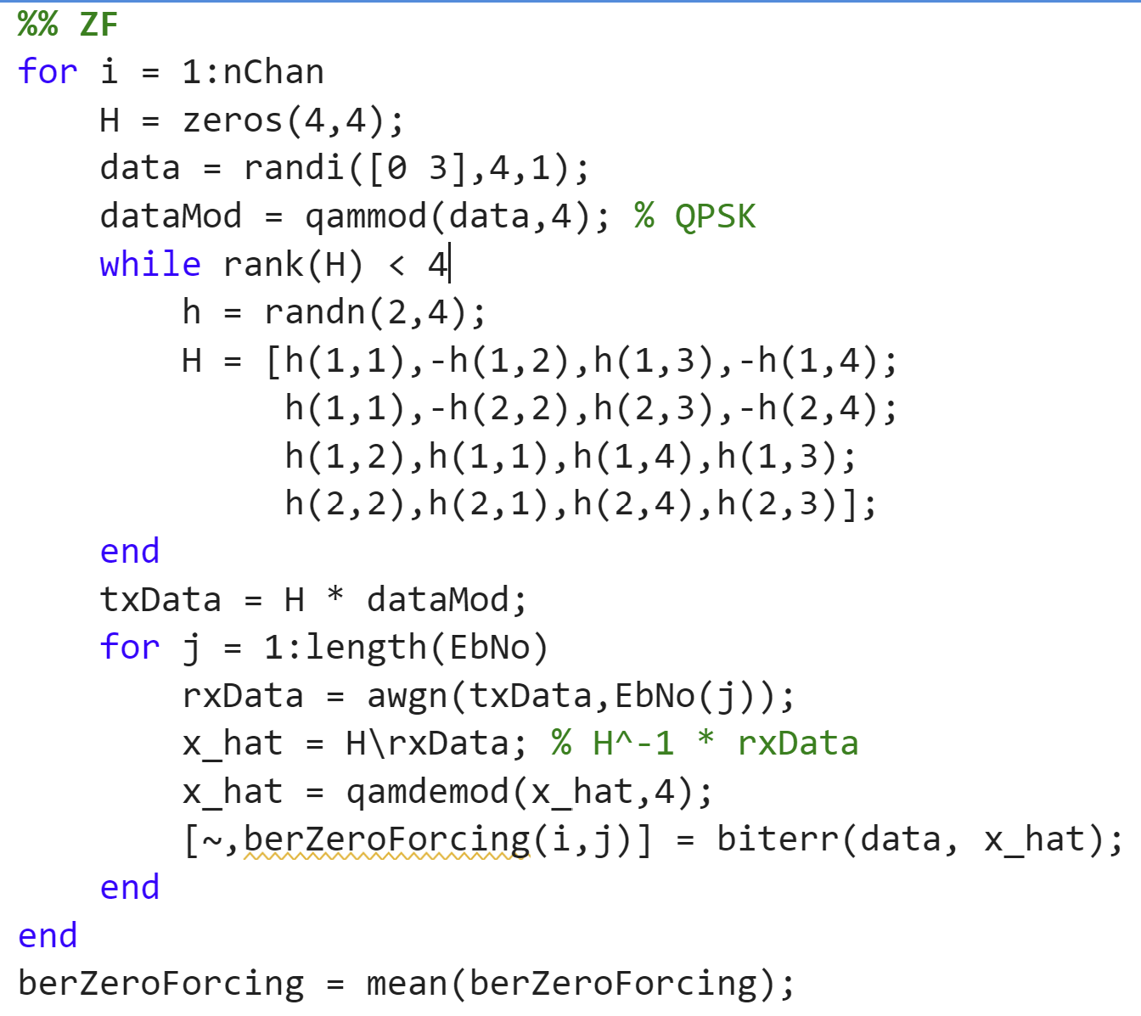
MATLAB code

Slide 14
Thank you!
Yihan Sun: 12012128@mail.sustech.edu.cn
Xudong Zhang: 12011923@mail.sustech.edu.cn

