Slide 1

Assignment 9 DOA Estimation & Passive Sensing
Group member: 孙逸涵 张旭东
SID: 12012128 12011923

Slide 2
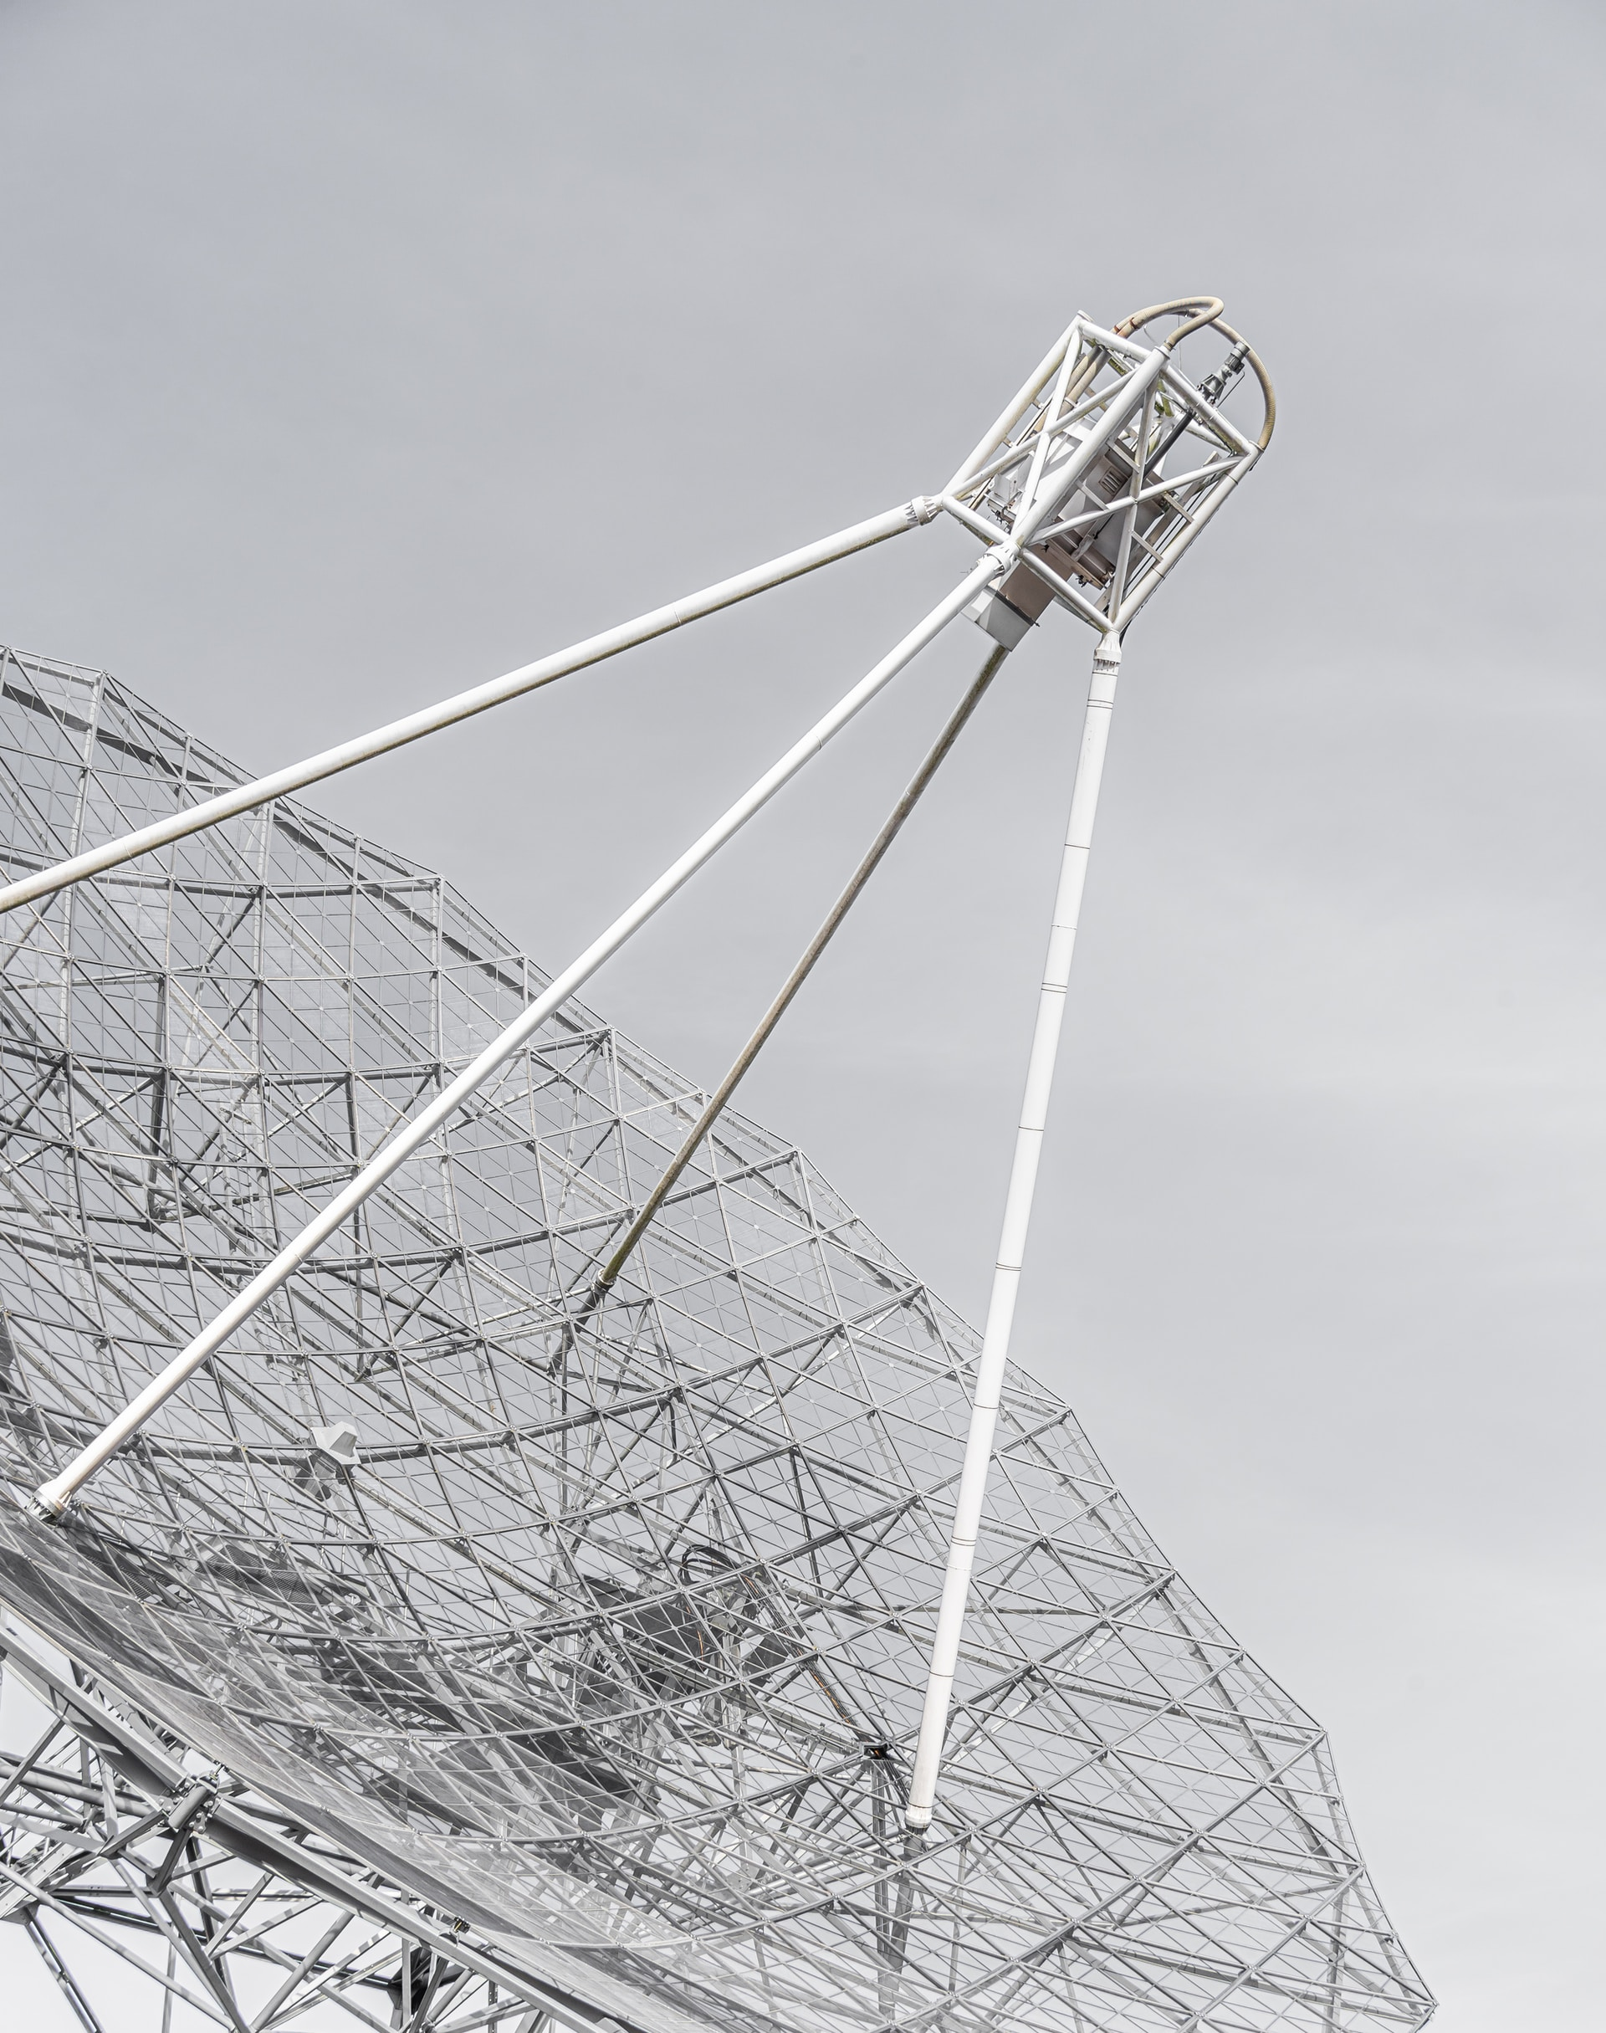
Introduction of DOA
Bartlett Algorithm
Capon Algorithm
MEM Algorithm
MUSIC Algorithm

Slide 3
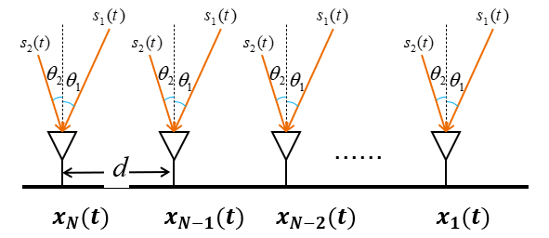
MUSIC Algorithm
$s\left(t\right)={[s_{1} \left(t\right),s_{2} \left(t\right),…,s_{D} \left(t\right)]}^{T}$ with AOA $\left\{θ_{1},θ_{2},…,θ_{D}\right\}$
The received signal inspired by $s_{i}(t)$ is
$a\left(θ_{i}\right)s_{i}\left(t\right), a\left(θ_{i}\right)=\left[\begin{matrix}1 \\ \begin{aligned}e^{−j∅_{i}} \\ ⋯\end{aligned} \\ e^{−j\left(N−1\right)∅_{i}}\end{matrix}\right]$ and $∅_{i}=\frac{2πd}{λ}sin⁡(θ_{i})$

Slide 4
MUSIC Algorithm
The received signal is
$$x\left(t\right)={[x_{1}\left(t\right),x_{2}\left(t\right),…,x_{N} \left(t\right)]}^{T}$$
$$=\sum_{i=1}^{D}{a\left(θ_{i}\right)s_{i}\left(t\right)+n(t)}$$
$=\left[a\left(θ_{1}\right),⋯,a\left(θ_{D}\right)\right]{\left[s_{1} \left(t\right),s_{2} \left(t\right),…,s_{D} \left(t\right)\right]}^{T}+n(t$)
$$=As\left(t\right)+n(t)$$

Slide 5
MUSIC Algorithm
The autocorrelation matrix of theoretically received signals can be written as:
$$R_{X}=E\left[XX^{H}\right]=E\left[\left(As+n\right){\left(As+n\right)}^{H}\right]$$
$$=AE\left[ss^{H}\right]A^{H}+E\left[nn^{H}\right]=AR_{s}A^{H}+R_{N}$$
$$=\left[a\left(θ_{1}\right),⋯,a\left(θ_{D}\right)\right]\left[\begin{matrix}λ_{1} & 0 & 0 \\ 0 & ⋯ & 0 \\ 0 & 0 & λ_{D}\end{matrix}\right]{[a\left(θ_{1}\right),⋯,a\left(θ_{D}\right)]}^{H}+R_{N}$$
$$=\left[a\left(θ_{1}\right),⋯,a\left(θ_{D}\right),other sub−space\right]\left[\begin{matrix}λ_{1} & 0 & 0 \\ 0 & ⋱ & 0 \\ \begin{aligned}\begin{aligned}0 \\ 0 \\ 0\end{aligned} \\ 0\end{aligned} & \begin{aligned}\begin{aligned}0 \\ 0 \\ ⋱\end{aligned} \\ 0\end{aligned} & \begin{aligned}λ_{D} \\ 0 \\ 0 \\ 0\end{aligned}\end{matrix}\begin{matrix}0 & 0 & 0 \\ 0 & ⋱ & 0 \\ \begin{aligned}\begin{aligned}0 \\ 0 \\ 0\end{aligned} \\ 0\end{aligned} & \begin{aligned}\begin{aligned}0 \\ 0 \\ ⋱\end{aligned} \\ 0\end{aligned} & \begin{aligned}0 \\ 0 \\ 0 \\ 0\end{aligned}\end{matrix}\right]{\left[a\left(θ_{1}\right),⋯,a\left(θ_{D}\right),other sub−space\right]}^{H}+R_{N}$$

Slide 6
MUSIC Algorithm
The autocorrelation matrix of the actual received signal:
$$R_{X}≈\hat{R_{X}}=\frac{1}{T}\sum_{t=1}^{T}{x(t)}x^{H}(t)$$
The eigenvalue decomposition is performed :
$$R_{X}=\left[v_{1},v_{2},…,v_{N}\right]\left[\begin{matrix}λ_{1} & 0 & 0 \\ 0 & ⋱ & 0 \\ 0 & 0 & λ_{N}\end{matrix}\right]{\left[v_{1},v_{2},…,v_{N}\right]}^{H}$$
For incident signal angle 𝜃, $V_{noise}$𝐚(𝜃) could be very small
Define $P(θ)=\frac{1}{{\left\|V_{noise}a(θ)\right\|}^{2}}$, its peaks are the estimated AoAs

Slide 7


Doppler sensing
$$x(t)$$
$$αx\left(t−τ\right) where τ=\frac{d}{c}$$
Data Signals
Echo
$$αβx\left(t−2τ\right)e^{j2πft}$$
Velocity v
$β$ is due to the pathloss of echo path + radar cross-section (RCS)
$f$ is the Doppler frequency = $\frac{2vf_{c}}{c}$

Slide 8


Doppler sensing
$$τ_{s}=\frac{s}{c}$$
$$f=\frac{vf_{c}}{c}, where v=\frac{ds}{dt}$$
$$s$$
Surveillance Channel
Reference Channel
$$y_{r}\left(t\right)=αx\left(t−τ_{r}\right)$$
$$y_{s}\left(t\right)= βx\left(t−τ_{s}\right)e^{j2πft}$$
Passive Receiver

Slide 9
Doppler sensing
If the passive receiver can separate $y_{r}\left(t\right)$ and $y_{s}\left(t\right)$
Define $Cor\left(c,d\right)=∫y_{r}\left(t−c\right)e^{j2πdt}y_{s}^{∗}\left(t\right) dt$
The estimation of $(τ,f)$:
$$(\hat{τ},\hat{f}) = \underset{c,d}{arg max}{Cor\left(c,d\right)}$$
$\hat{τ}$ is the estimation of $τ_{s}−τ_{r}$, $\hat{f}$ is the estimation of $f$
$$y_{r}\left(t\right)=αx\left(t−τ_{r}\right)$$
$$y_{s}\left(t\right)= βx\left(t−τ_{s}\right)e^{j2πft}$$

Slide 10


Doppler sensing
$θ_{c}$：estimated via the phased array of the passive receiver, e.g., MUSIC algorithm
s: estimated with $ρ_{bs}$ and $\hat{τ}$
$ρ_{c}$: estimated with $ρ_{bs}$, $θ$ and $s$, $ρ_{c}$
$v_{c}$: with the direction of car’s velocity and $\hat{f}$
Ambiguity Function
How to calculate the velocity $v_{c}$？
$v_{c}=\frac{c∗f}{2f_{c}}$ where $f_{c}$ is carrier frequency, $f$ is the
Doppler frequency offset.
$$s=ρ_{c}+d_{bs−c}$$
$$d_{bs−c}$$
$$ρ_{bs},θ_{bs}$$
$$ρ_{c},θ_{c},v_{c}=?$$
$$θ=θ_{bs}−θ_{c}$$

Slide 11
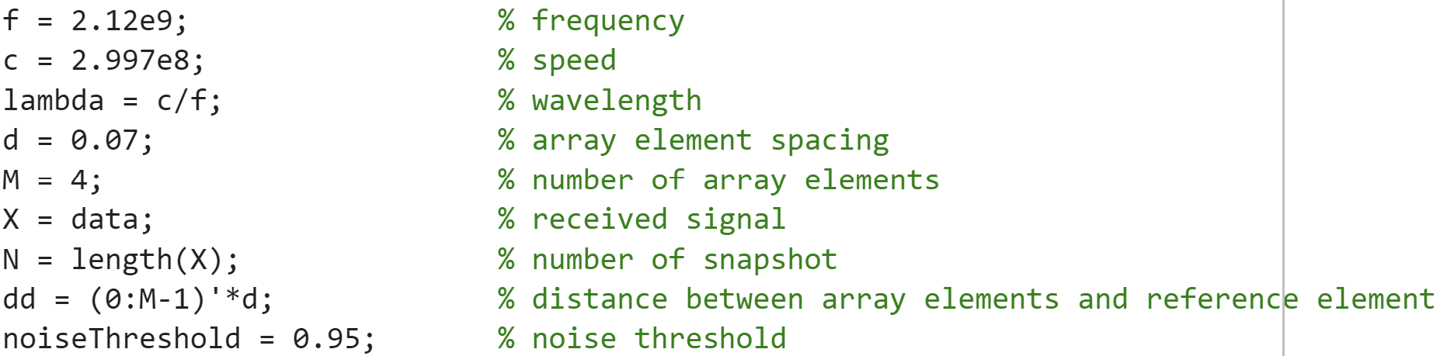
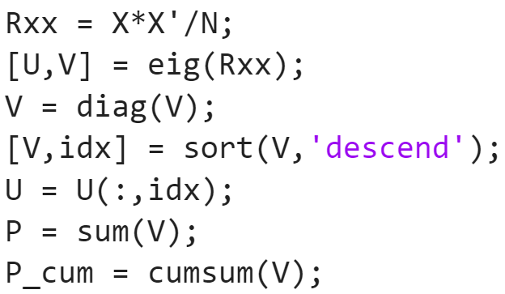
MATLAB Code - MUSIC
Initialize parameters
Calculate covariance matrix
Eigenvalue decomposition
Arrange the eigenvalues of Rx in descending order
Arrange corresponding eigenvectors in corresponding order
Calculate the sum of the eigenvalues
Create cumulative array of eigenvalues

Slide 12
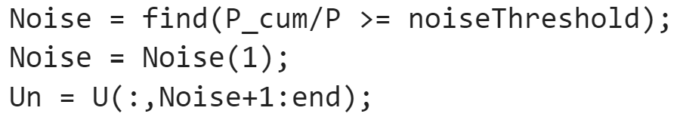
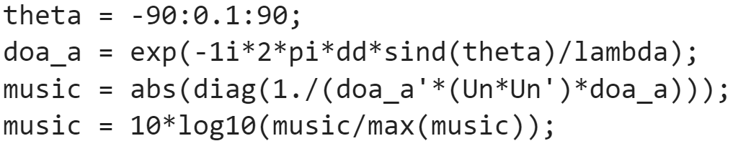
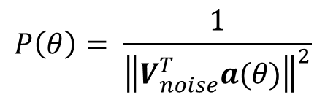
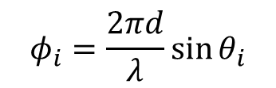
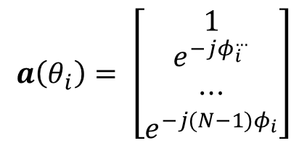
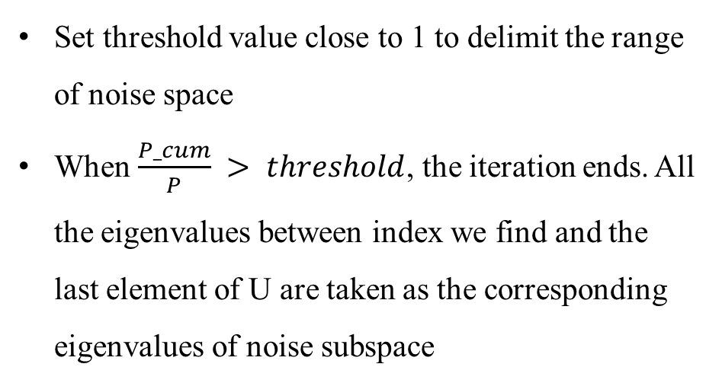
MATLAB Code - MUSIC
Set threshold value close to 1 to delimit the range of noise space
When $\frac{P_cum}{P} > threshold$, the iteration ends. All the eigenvalues between index we find and the last element of U are taken as the corresponding eigenvalues of noise subspace
$$a\left(θ_{i}\right)= \left[\begin{matrix}1 \\ e^{−jφ_{i}^{…}} \\ ⋯ \\ e^{−j(N−1)φ_{i}}\end{matrix}\right]$$
$$φ_{i}=\frac{2πd}{λ}\sin{θ_{i}}$$
$$P\left(θ\right)= \frac{1}{{\left\|V_{noise}^{T}a(θ)\right\|}^{2}}$$

Slide 13
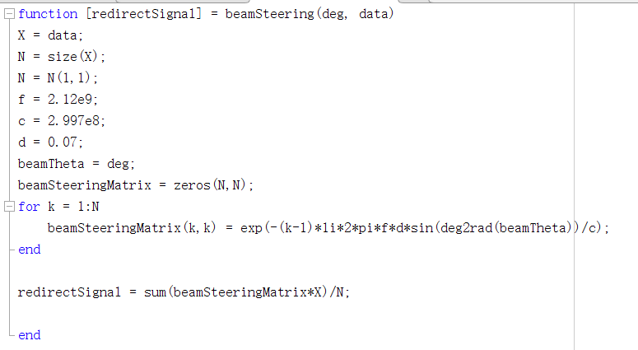
MATLAB Code - Passive Sensing
Function beamSteering is used to recover the initial signal from the received signal. Due to the difference in receiving distance, there will be a phase deviation of the signal received by each antenna.

Slide 14
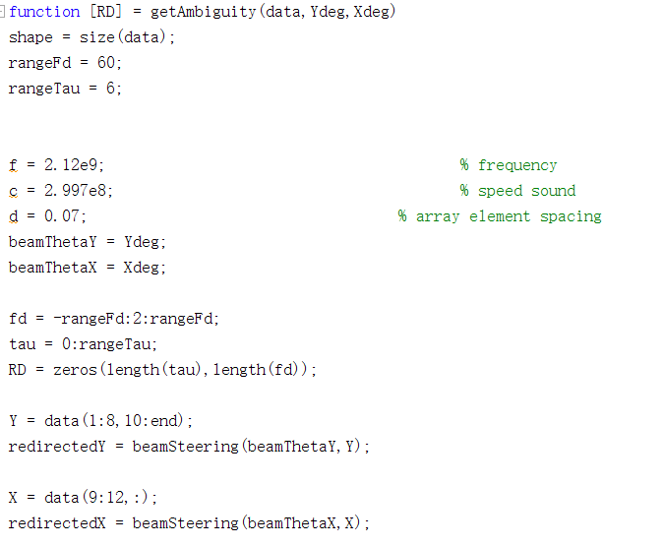
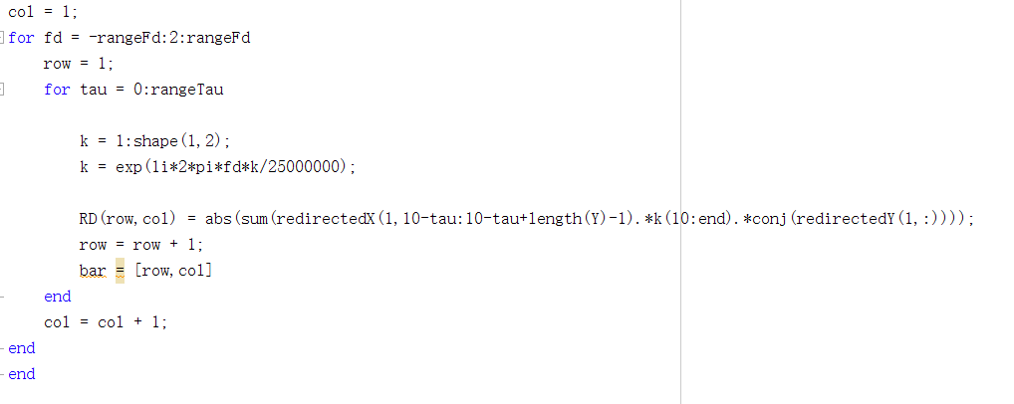
MATLAB Code - Passive Sensing
Function getAmbiguity is used to calculate Ambiguity function.

Slide 15
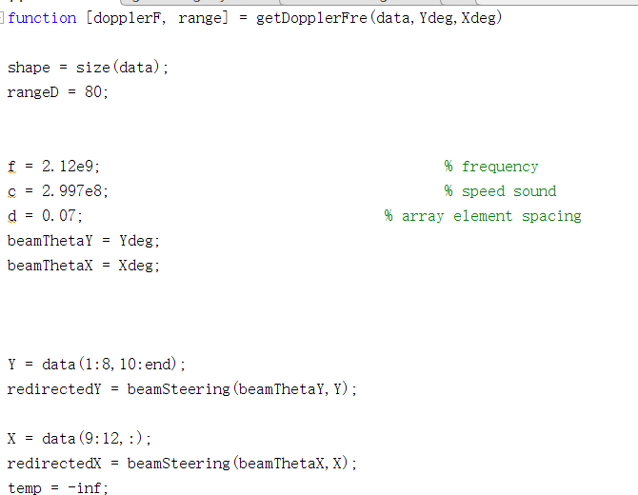
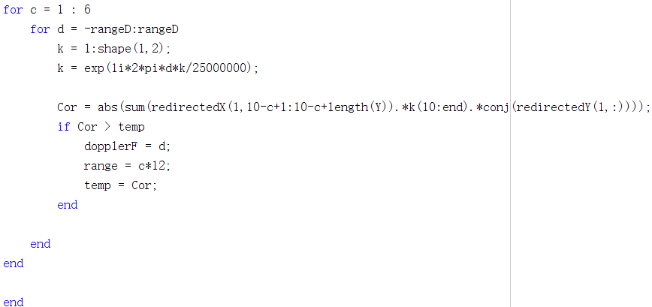
MATLAB Code - Passive Sensing
Function getDopplerFre is used to calculate doppler frequency using the result calculated in function getAmbiguity.

Slide 16
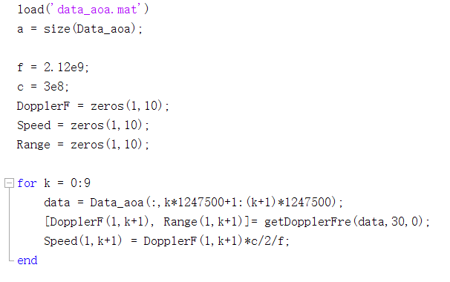
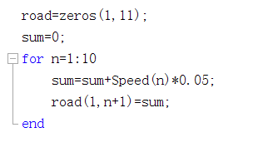
MATLAB Code - Passive Sensing
The data is segmented in the process of solving the Doppler frequency offset of multi-segment motion data and drawing the relationship of the position of the mover with time

Slide 17
Analysis - DOA Estimation
Due to the influence of the mover, which introduces Doppler frequency to the received signals, the 8 Surveillance Channel Antennas Array can not receive the signals caused by the scattering of the base station signal by the scattering clusters outside the base station. Thus, the DOA estimation results of the 8 Surveillance Channel Antennas Array are very different from that of the 4 Reference Channel Antennas Array.
Therefore, to accurately find the position of the main scattering clusters in the external environment, we need to use the detection results of 4 Reference Channel Antennas Array to locate.

Slide 18
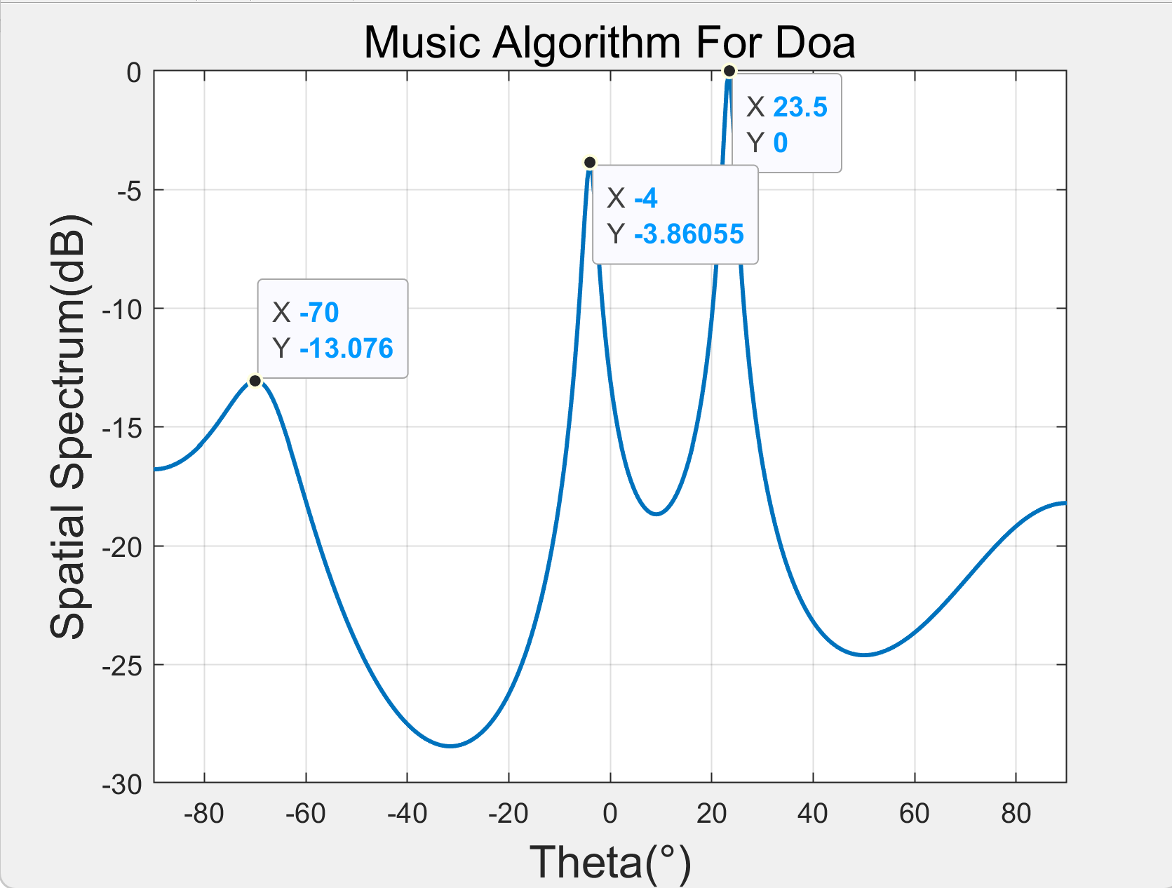
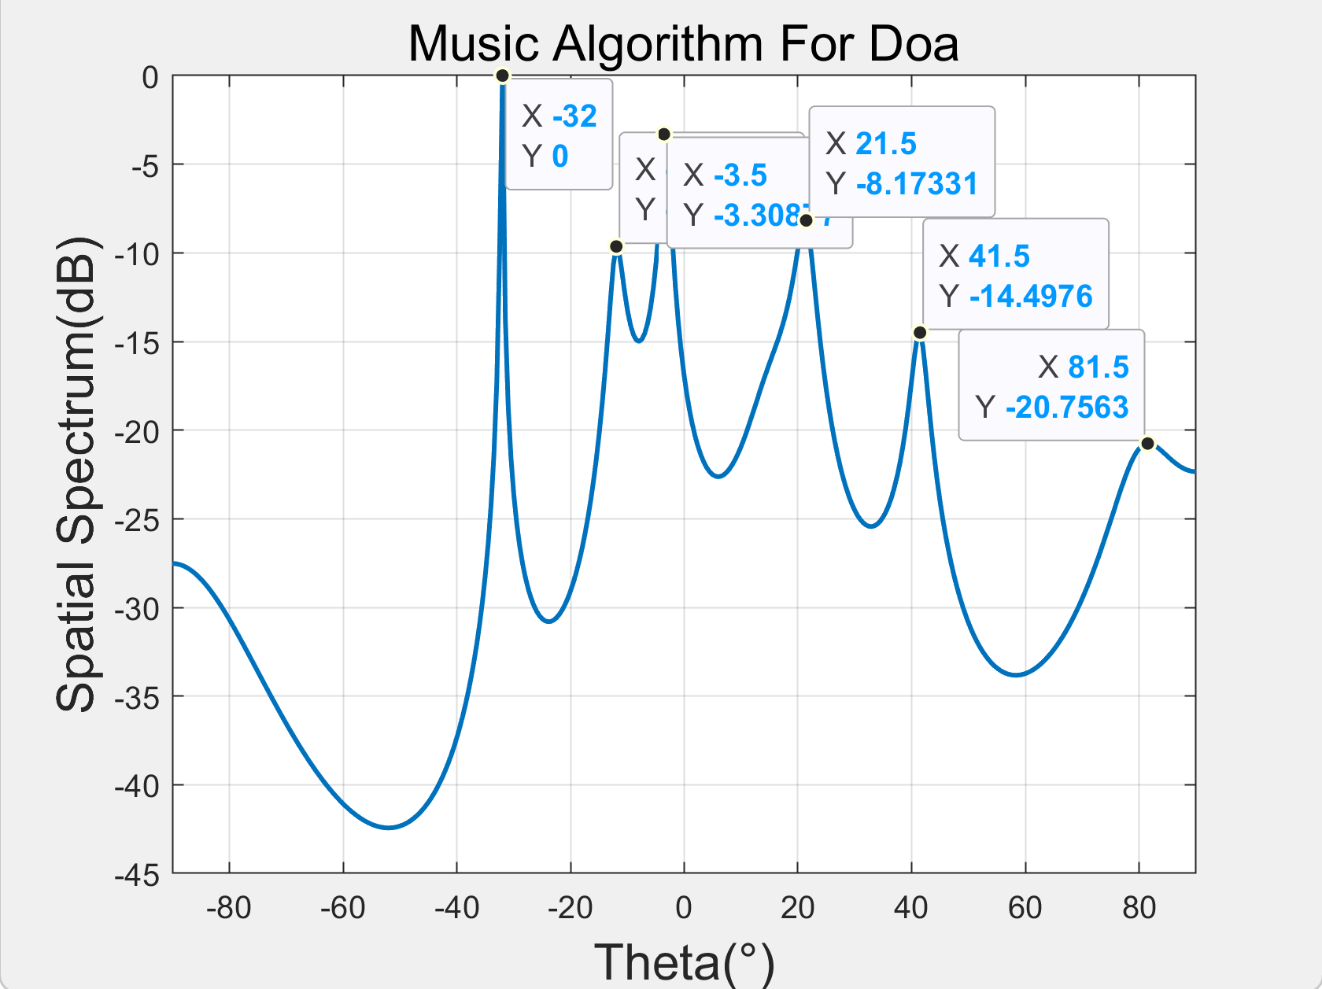
Results - DOA Estimation
Reference Channel
Surveillance Channel

Slide 19
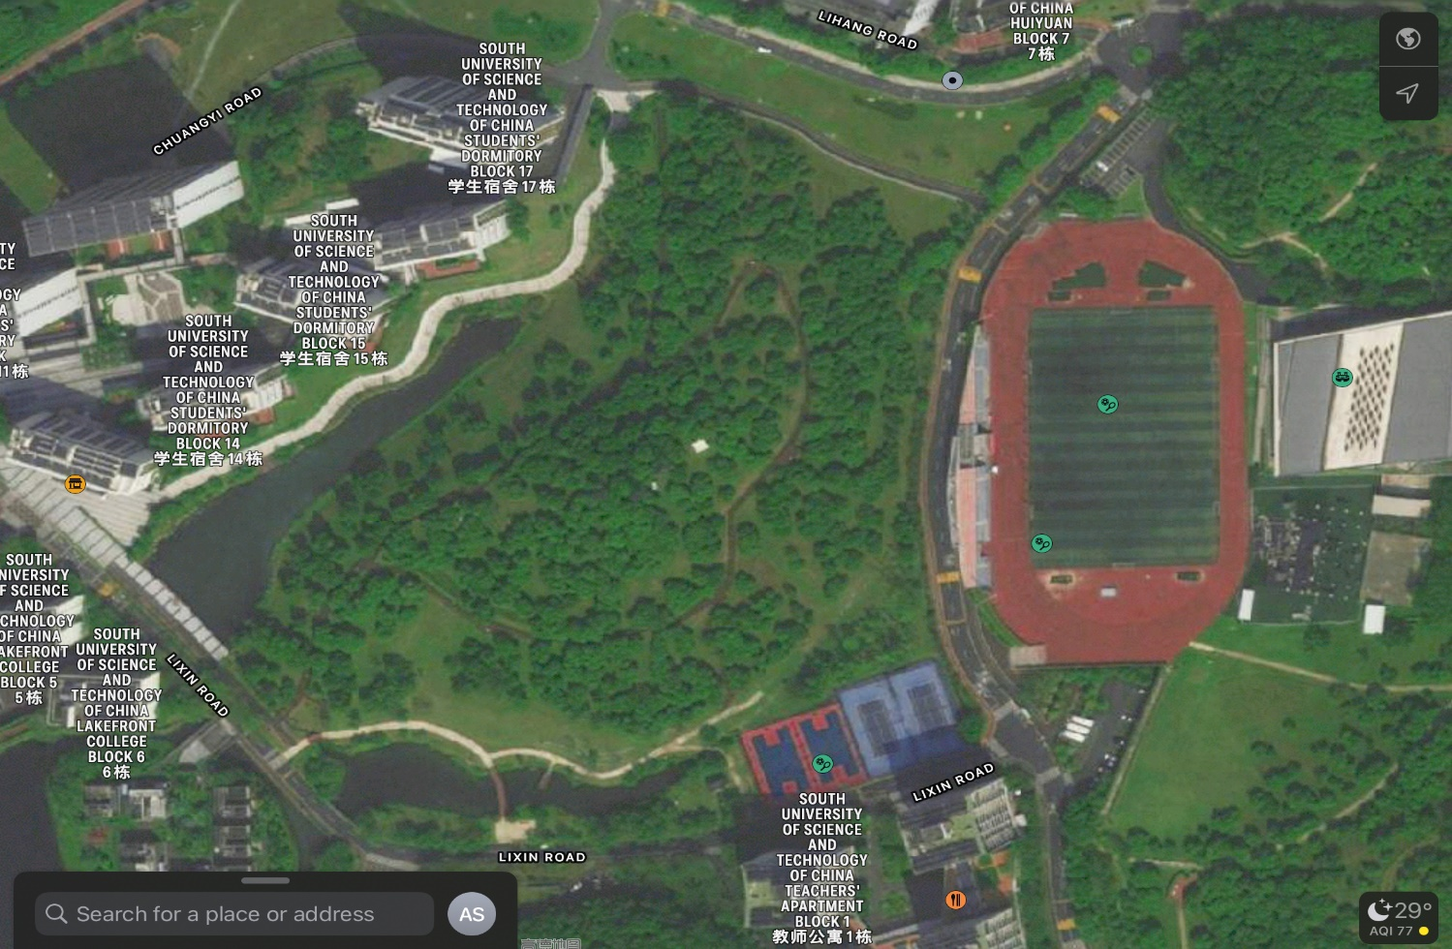
Results - DOA Estimation
Tx
Rx

Slide 20
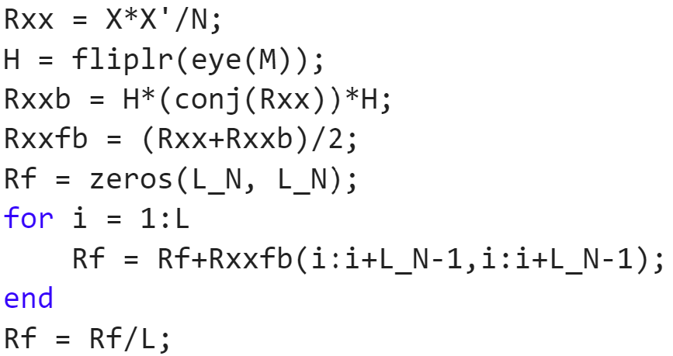
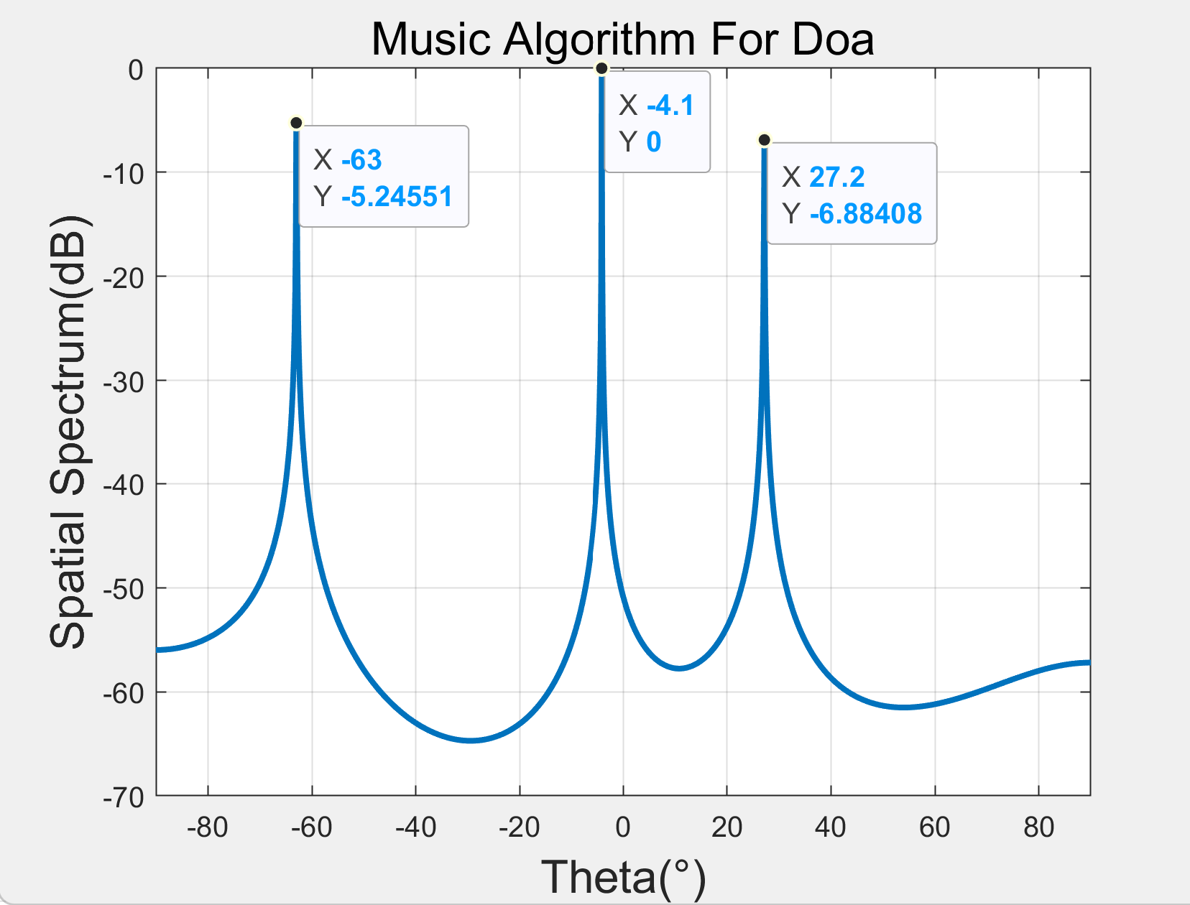
Results - DOA Estimation
Backward spatial smoothing (BSS)
Better resolution of multiple coherent signals
https://blog.csdn.net/qq_36583373/article/details/109382579
Reference Channel

Slide 21
Results - DOA Estimation
Backward spatial smoothing (BSS)
Better resolution of multiple coherent signals
https://blog.csdn.net/qq_36583373/article/details/109382579
Surveillance Channel

Slide 22
Results - Passive Sensing

Slide 23
Results - Passive Sensing

Slide 24
Results - Passive Sensing

Slide 25
Thank you!
Yihan Sun: 12012128@mail.sustech.edu.cn
Xudong Zhang: 12011923@mail.sustech.edu.cn

