Slide 1

Assignment 9 DOA Estimation & Passive Sensing
Group member: 孙逸涵 张旭东
SID: 12012128 12011923

Slide 2
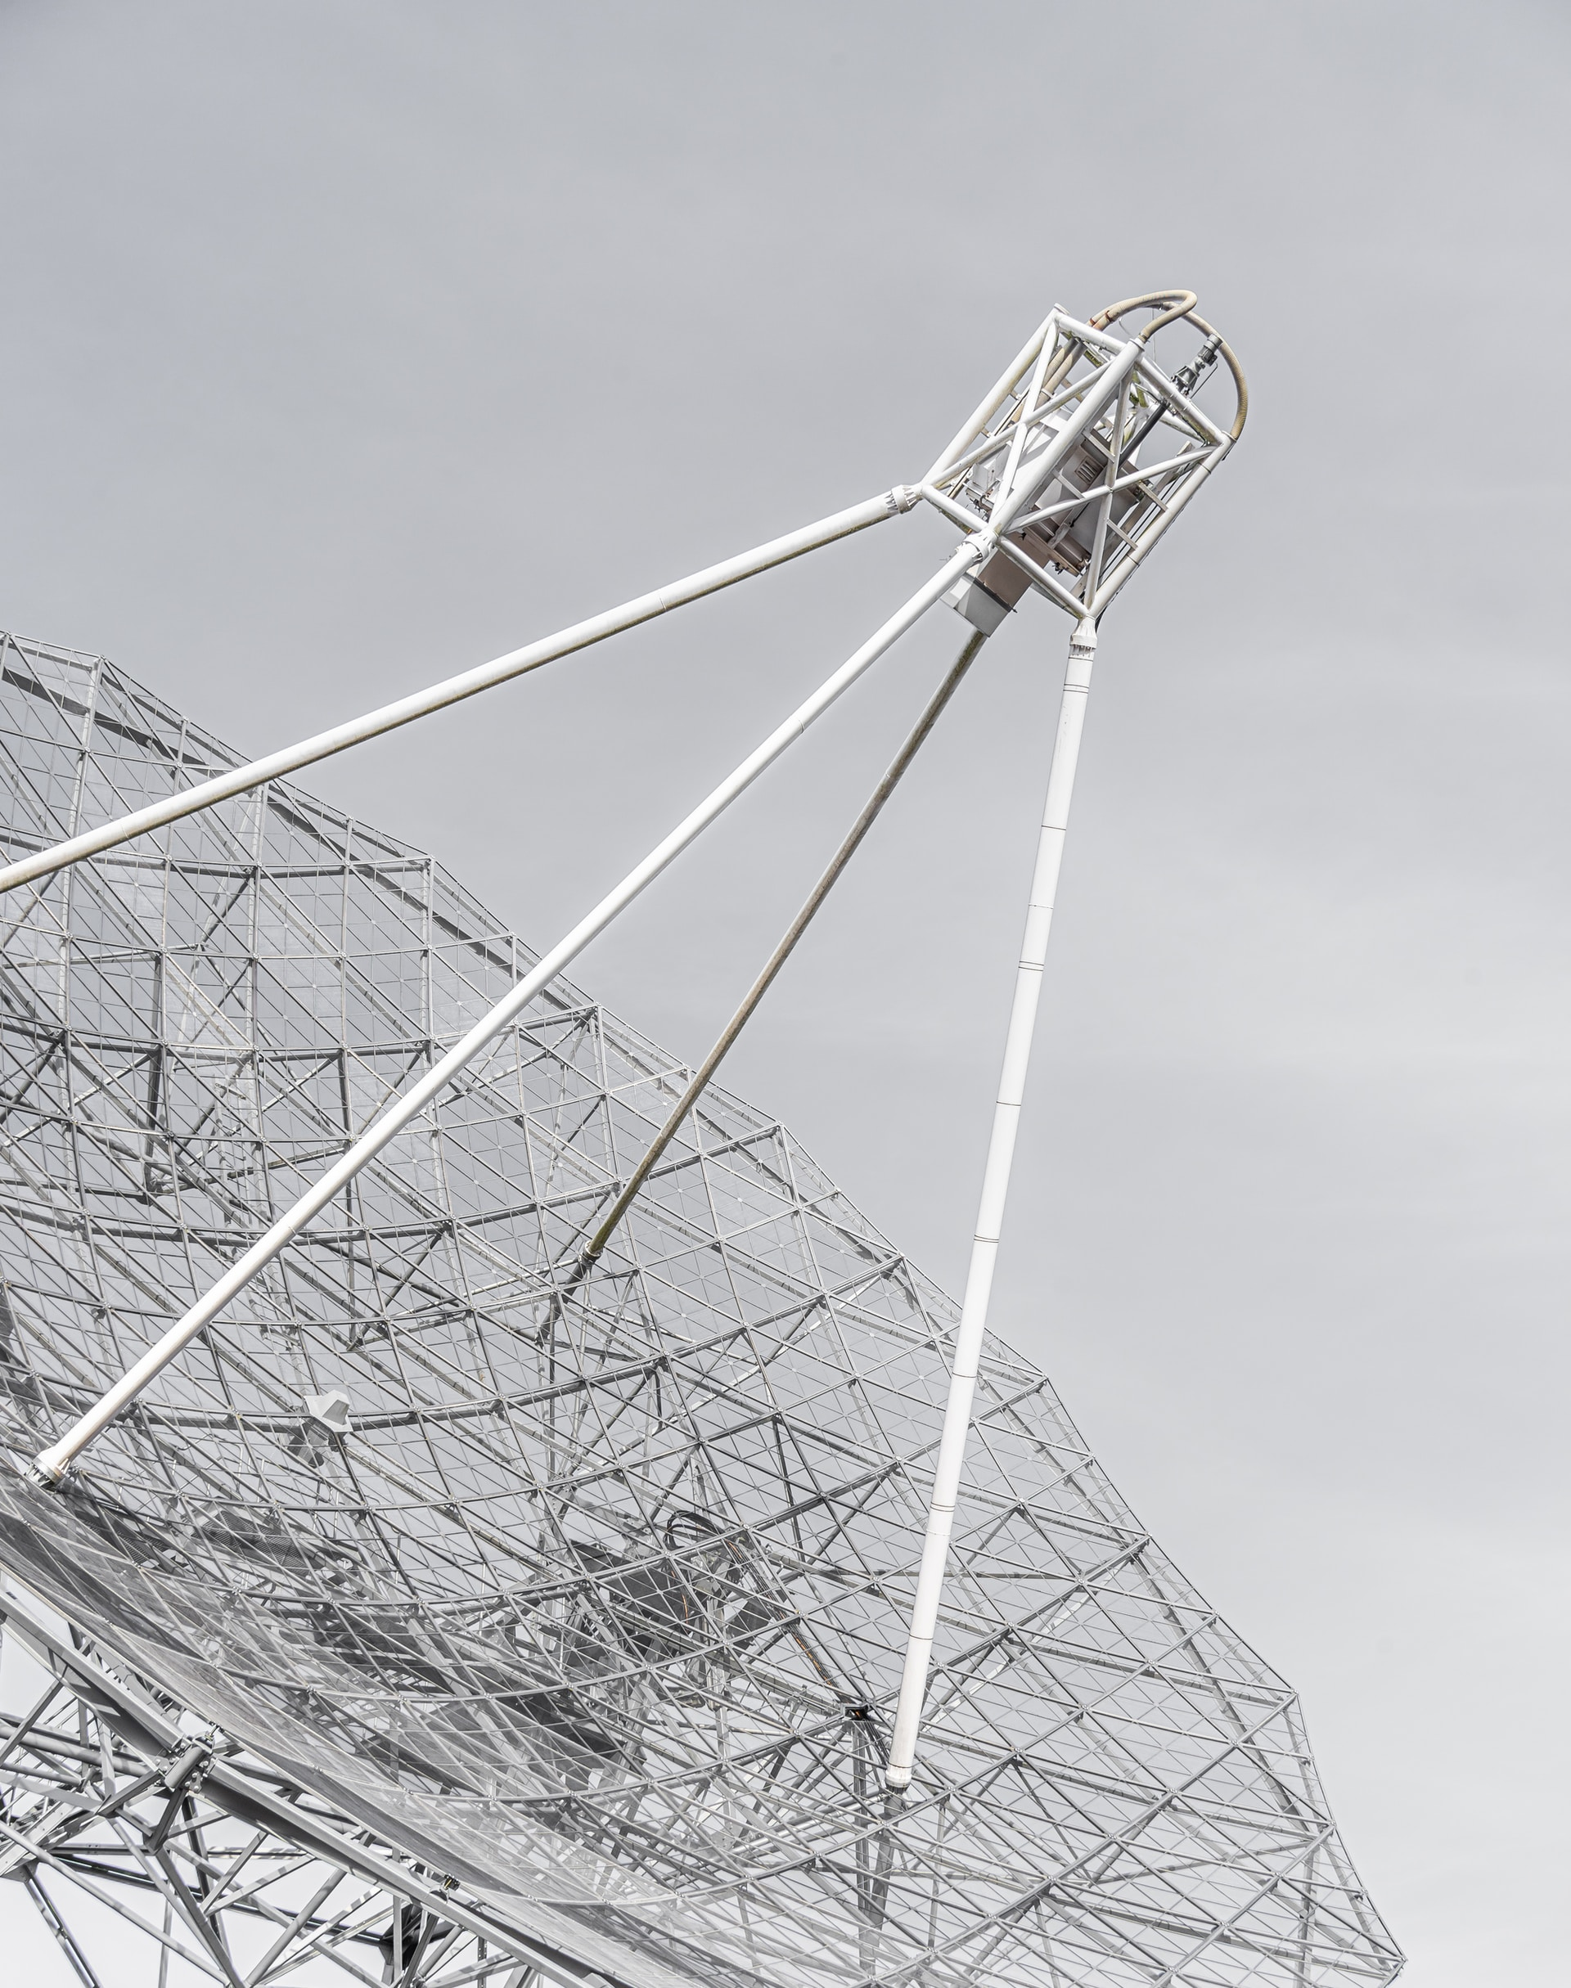
Introduction of DOA
Bartlett Algorithm
Capon Algorithm
MEM Algorithm
MUSIC Algorithm

Slide 3
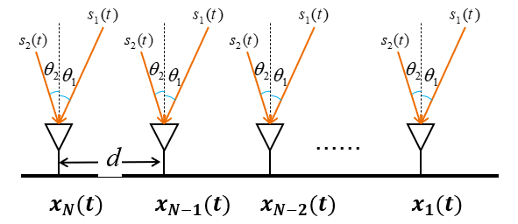
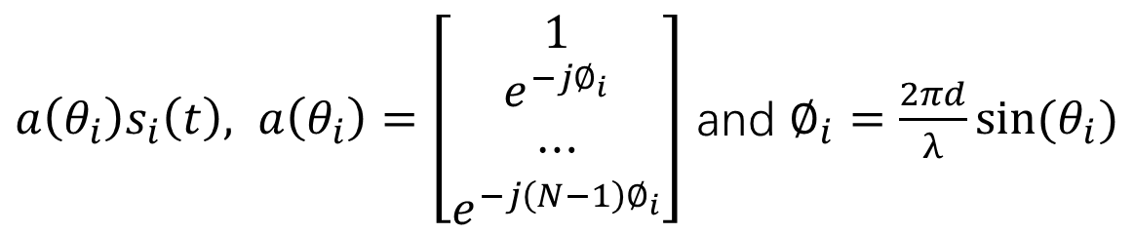

MUSIC Algorithm
$s\left(t\right)={[s_{1} \left(t\right),s_{2} \left(t\right),…,s_{D} \left(t\right)]}^{T}$ with AOA $\left\{θ_{1},θ_{2},…,θ_{D}\right\}$
The received signal inspired by $s_{i}(t)$ is
$a\left(θ_{i}\right)s_{i}\left(t\right), a\left(θ_{i}\right)=\left[\begin{matrix}1 \\ \begin{aligned}e^{−j∅_{i}} \\ ⋯\end{aligned} \\ e^{−j\left(N−1\right)∅_{i}}\end{matrix}\right]$ and $∅_{i}=\frac{2πd}{λ}sin⁡(θ_{i})$

Slide 4
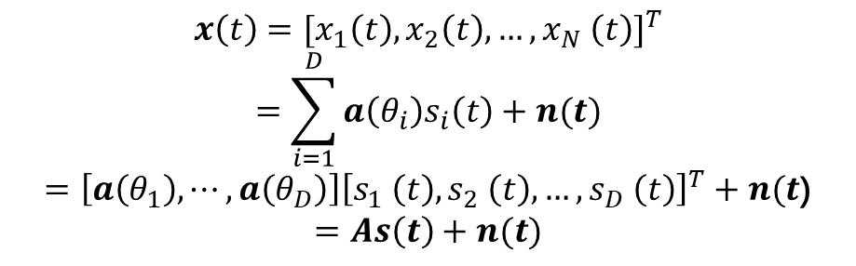
MUSIC Algorithm
The received signal is
$$x\left(t\right)={[x_{1}\left(t\right),x_{2}\left(t\right),…,x_{N} \left(t\right)]}^{T}$$
$$=\sum_{i=1}^{D}{a\left(θ_{i}\right)s_{i}\left(t\right)+n(t)}$$
$=\left[a\left(θ_{1}\right),⋯,a\left(θ_{D}\right)\right]{\left[s_{1} \left(t\right),s_{2} \left(t\right),…,s_{D} \left(t\right)\right]}^{T}+n(t$)
$$=As\left(t\right)+n(t)$$

Slide 5
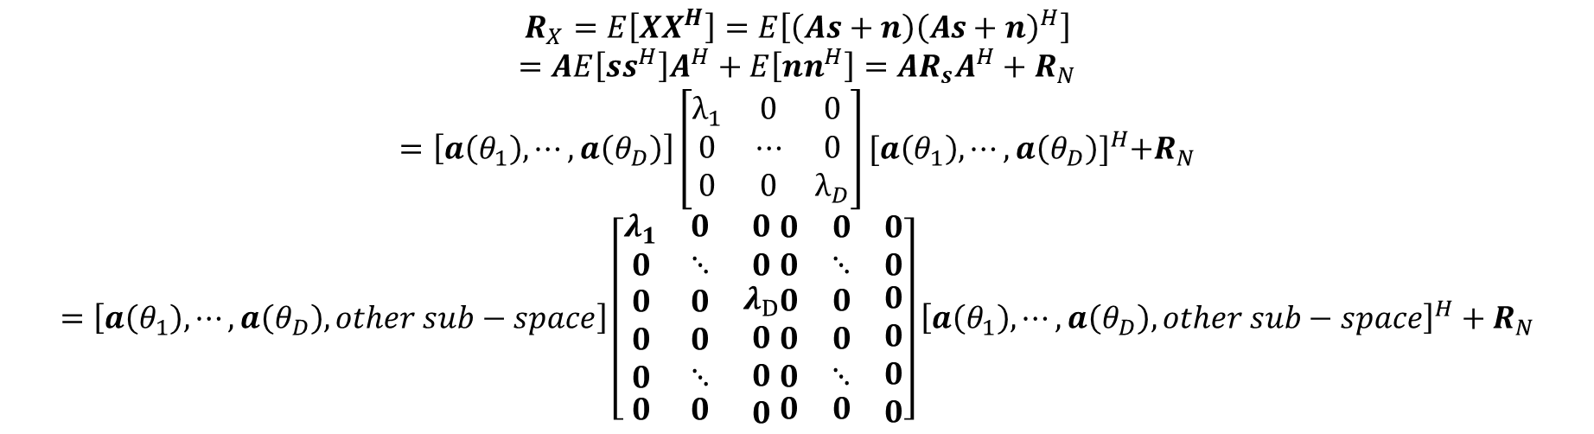
MUSIC Algorithm
The autocorrelation matrix of theoretically received signals can be written as:
$$R_{X}=E\left[XX^{H}\right]=E\left[\left(As+n\right){\left(As+n\right)}^{H}\right]$$
$$=AE\left[ss^{H}\right]A^{H}+E\left[nn^{H}\right]=AR_{s}A^{H}+R_{N}$$
$$=\left[a\left(θ_{1}\right),⋯,a\left(θ_{D}\right)\right]\left[\begin{matrix}λ_{1} & 0 & 0 \\ 0 & ⋯ & 0 \\ 0 & 0 & λ_{D}\end{matrix}\right]{[a\left(θ_{1}\right),⋯,a\left(θ_{D}\right)]}^{H}+R_{N}$$
$$=\left[a\left(θ_{1}\right),⋯,a\left(θ_{D}\right),other sub−space\right]\left[\begin{matrix}λ_{1} & 0 & 0 \\ 0 & ⋱ & 0 \\ \begin{aligned}\begin{aligned}0 \\ 0 \\ 0\end{aligned} \\ 0\end{aligned} & \begin{aligned}\begin{aligned}0 \\ 0 \\ ⋱\end{aligned} \\ 0\end{aligned} & \begin{aligned}λ_{D} \\ 0 \\ 0 \\ 0\end{aligned}\end{matrix}\begin{matrix}0 & 0 & 0 \\ 0 & ⋱ & 0 \\ \begin{aligned}\begin{aligned}0 \\ 0 \\ 0\end{aligned} \\ 0\end{aligned} & \begin{aligned}\begin{aligned}0 \\ 0 \\ ⋱\end{aligned} \\ 0\end{aligned} & \begin{aligned}0 \\ 0 \\ 0 \\ 0\end{aligned}\end{matrix}\right]{\left[a\left(θ_{1}\right),⋯,a\left(θ_{D}\right),other sub−space\right]}^{H}+R_{N}$$

Slide 6
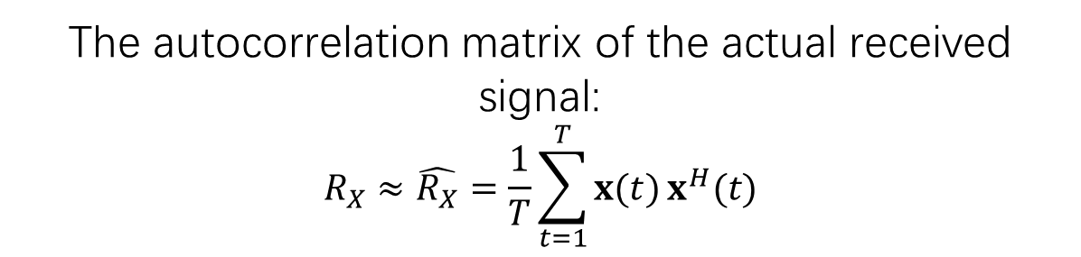
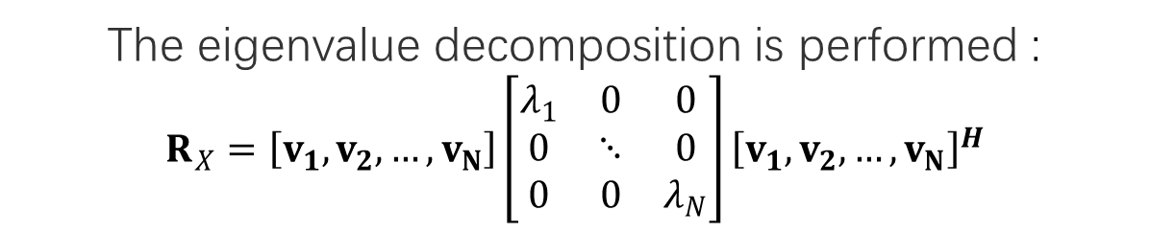
MUSIC Algorithm
The autocorrelation matrix of the actual received signal:
$$R_{X}≈\hat{R_{X}}=\frac{1}{T}\sum_{t=1}^{T}{x(t)}x^{H}(t)$$
The eigenvalue decomposition is performed :
$$R_{X}=\left[v_{1},v_{2},…,v_{N}\right]\left[\begin{matrix}λ_{1} & 0 & 0 \\ 0 & ⋱ & 0 \\ 0 & 0 & λ_{N}\end{matrix}\right]{\left[v_{1},v_{2},…,v_{N}\right]}^{H}$$
For incident signal angle 𝜃, $V_{noise}$𝐚(𝜃) could be very small
Define $P(θ)=\frac{1}{{\left\|V_{noise}a(θ)\right\|}^{2}}$, its peaks are the estimated AoAs

Slide 7


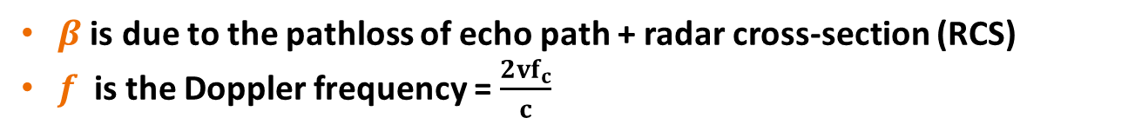
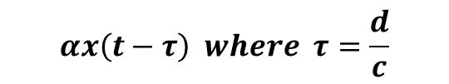

Doppler sensing
$$x(t)$$
$$αx\left(t−τ\right) where τ=\frac{d}{c}$$
Data Signals
Echo
$$αβx\left(t−2τ\right)e^{j2πft}$$
Velocity v
$β$ is due to the pathloss of echo path + radar cross-section (RCS)
$f$ is the Doppler frequency = $\frac{2vf_{c}}{c}$

Slide 8






Doppler sensing
$$τ_{s}=\frac{s}{c}$$
$$f=\frac{vf_{c}}{c}, where v=\frac{ds}{dt}$$
$$s$$
Surveillance Channel
Reference Channel
$$y_{r}\left(t\right)=αx\left(t−τ_{r}\right)$$
$$y_{s}\left(t\right)= βx\left(t−τ_{s}\right)e^{j2πft}$$
Passive Receiver

Slide 9
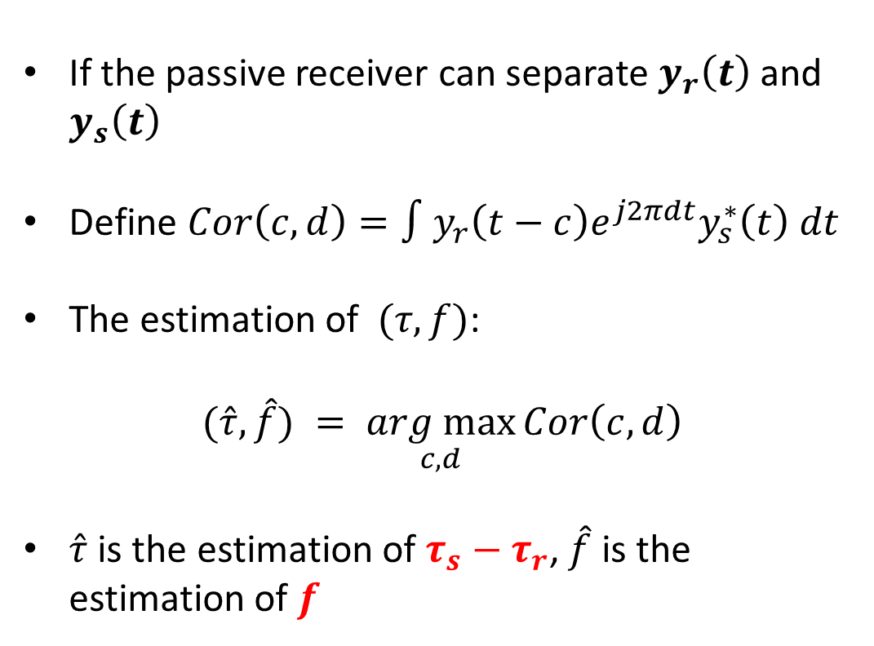
Doppler sensing
If the passive receiver can separate $y_{r}\left(t\right)$ and $y_{s}\left(t\right)$
Define $Cor\left(c,d\right)=∫y_{r}\left(t−c\right)e^{j2πdt}y_{s}^{∗}\left(t\right) dt$
The estimation of $(τ,f)$:
$$(\hat{τ},\hat{f}) = \underset{c,d}{arg max}{Cor\left(c,d\right)}$$
$\hat{τ}$ is the estimation of $τ_{s}−τ_{r}$, $\hat{f}$ is the estimation of $f$
$$y_{r}\left(t\right)=αx\left(t−τ_{r}\right)$$
$$y_{s}\left(t\right)= βx\left(t−τ_{s}\right)e^{j2πft}$$

Slide 10



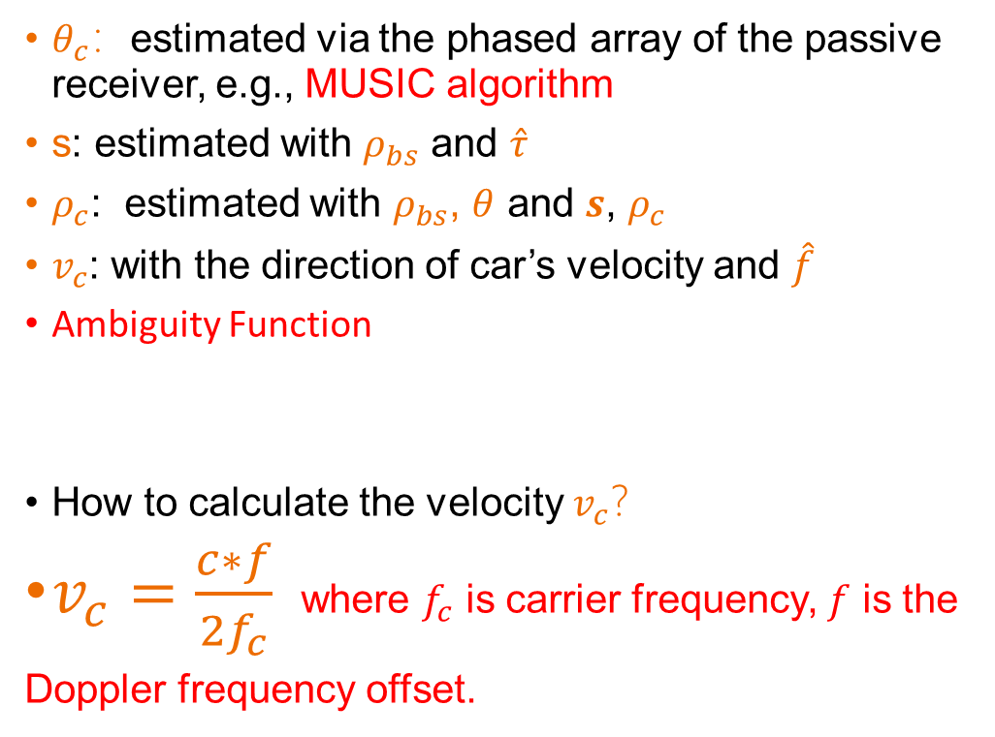




Doppler sensing
$θ_{c}$：estimated via the phased array of the passive receiver, e.g., MUSIC algorithm
s: estimated with $ρ_{bs}$ and $\hat{τ}$
$ρ_{c}$: estimated with $ρ_{bs}$, $θ$ and $s$, $ρ_{c}$
$v_{c}$: with the direction of car’s velocity and $\hat{f}$
Ambiguity Function
How to calculate the velocity $v_{c}$？
$v_{c}=\frac{c∗f}{2f_{c}}$ where $f_{c}$ is carrier frequency, $f$ is the
Doppler frequency offset.
$$s=ρ_{c}+d_{bs−c}$$
$$d_{bs−c}$$
$$ρ_{bs},θ_{bs}$$
$$ρ_{c},θ_{c},v_{c}=?$$
$$θ=θ_{bs}−θ_{c}$$

Slide 11
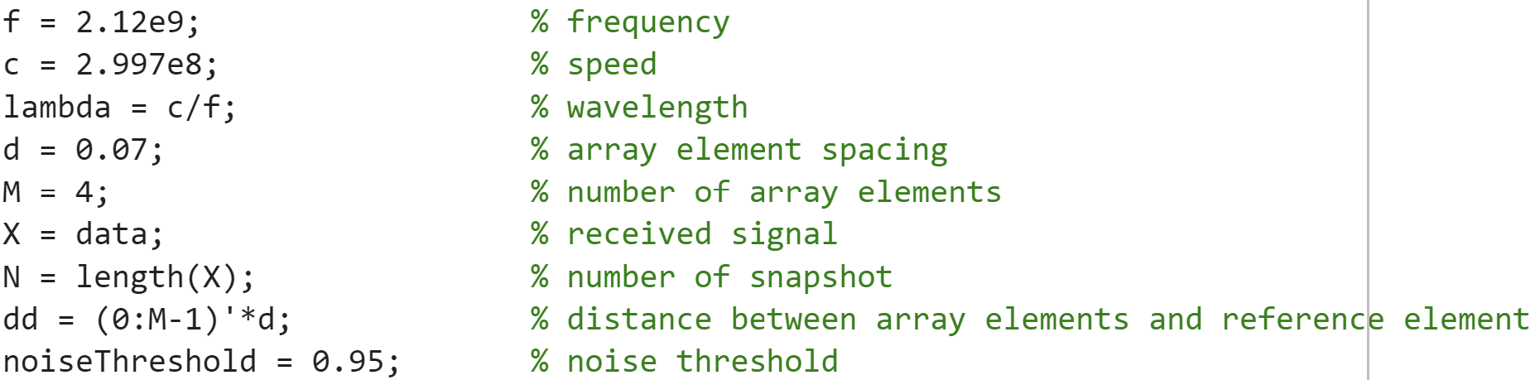
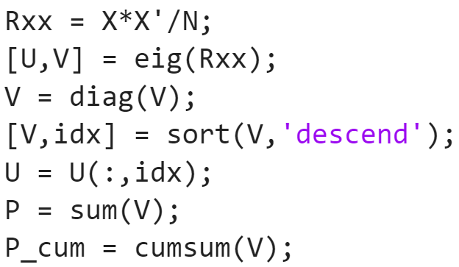
MATLAB Code - MUSIC
Initialize parameters
Calculate covariance matrix
Eigenvalue decomposition
Arrange the eigenvalues of Rx in descending order
Arrange corresponding eigenvectors in corresponding order
Calculate the sum of the eigenvalues
Create cumulative array of eigenvalues

Slide 12
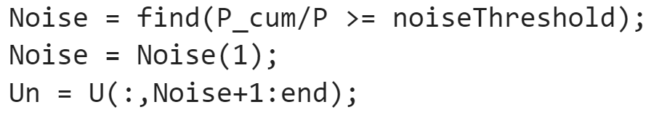
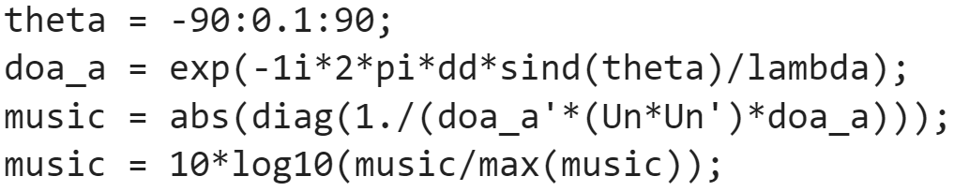
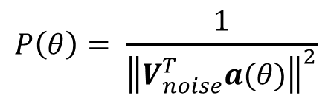
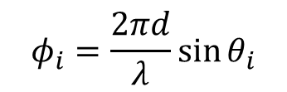
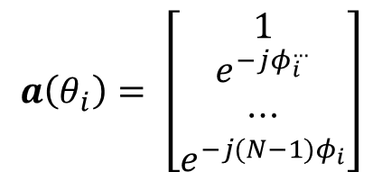
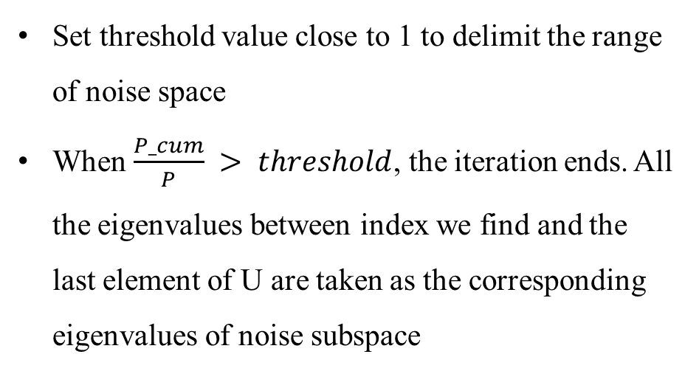
MATLAB Code - MUSIC
Set threshold value close to 1 to delimit the range of noise space
When $\frac{P_cum}{P} > threshold$, the iteration ends. All the eigenvalues between index we find and the last element of U are taken as the corresponding eigenvalues of noise subspace
$$a\left(θ_{i}\right)= \left[\begin{matrix}1 \\ e^{−jφ_{i}^{…}} \\ ⋯ \\ e^{−j(N−1)φ_{i}}\end{matrix}\right]$$
$$φ_{i}=\frac{2πd}{λ}\sin{θ_{i}}$$
$$P\left(θ\right)= \frac{1}{{\left\|V_{noise}^{T}a(θ)\right\|}^{2}}$$

Slide 13
MATLAB Code - Passive Sensing

Slide 14
MATLAB Code - Passive Sensing

Slide 15
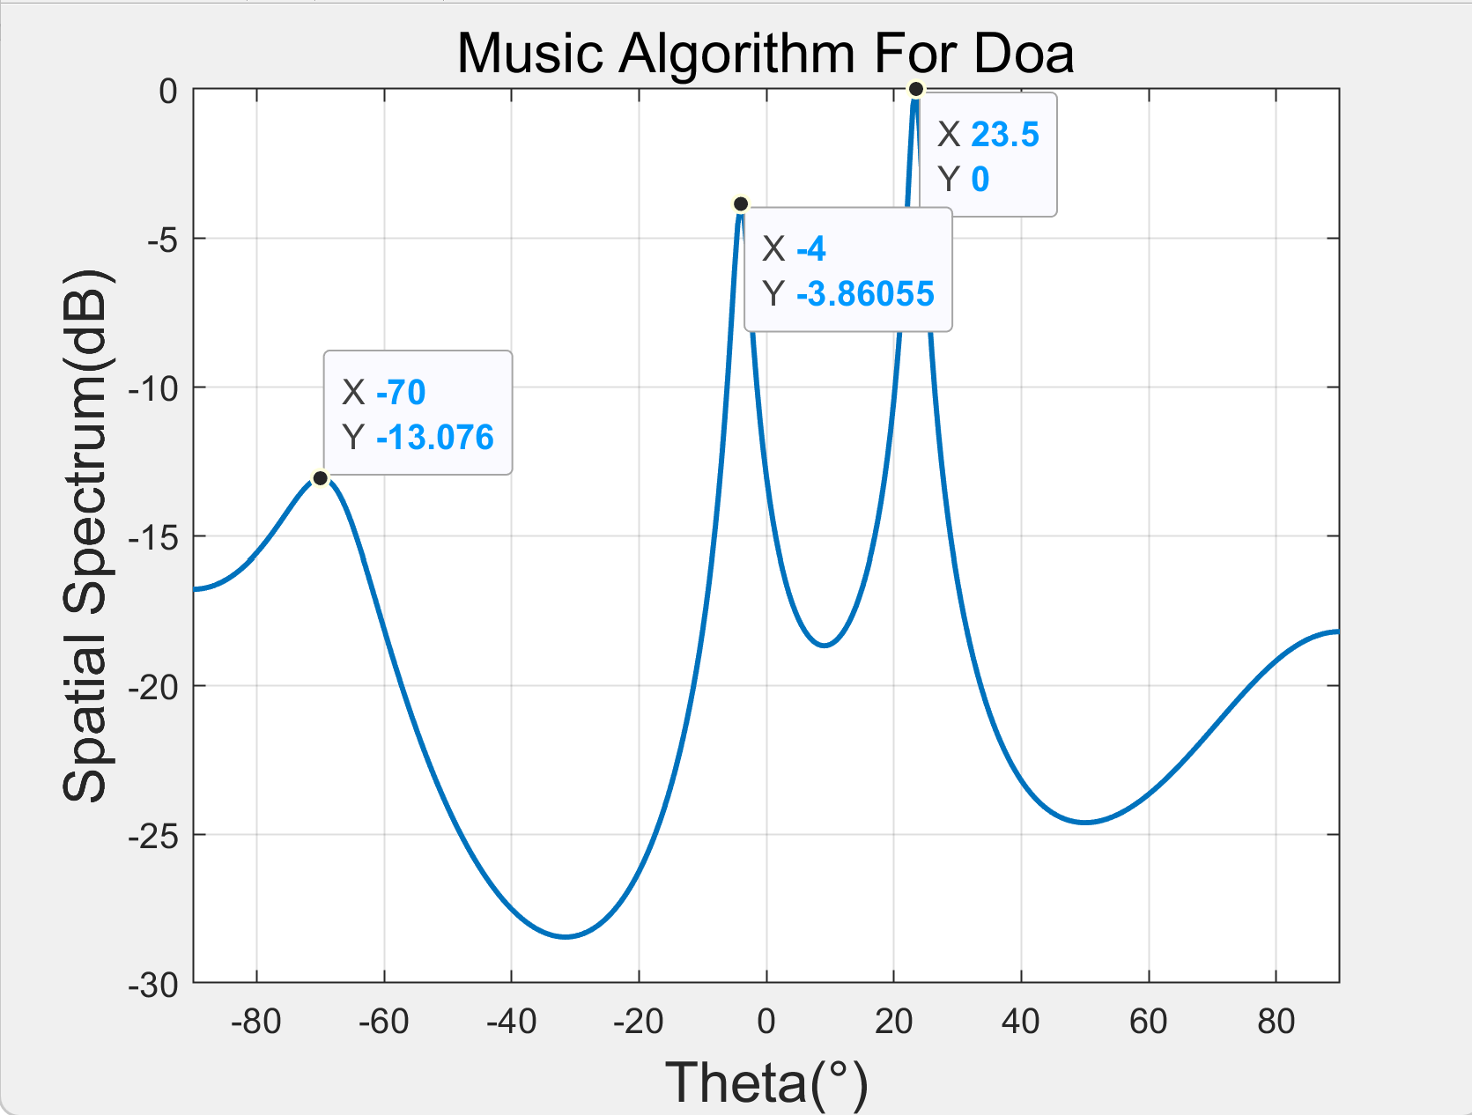
Results - DOA Estimation
Reference Channel
Surveillance Channel

Slide 16
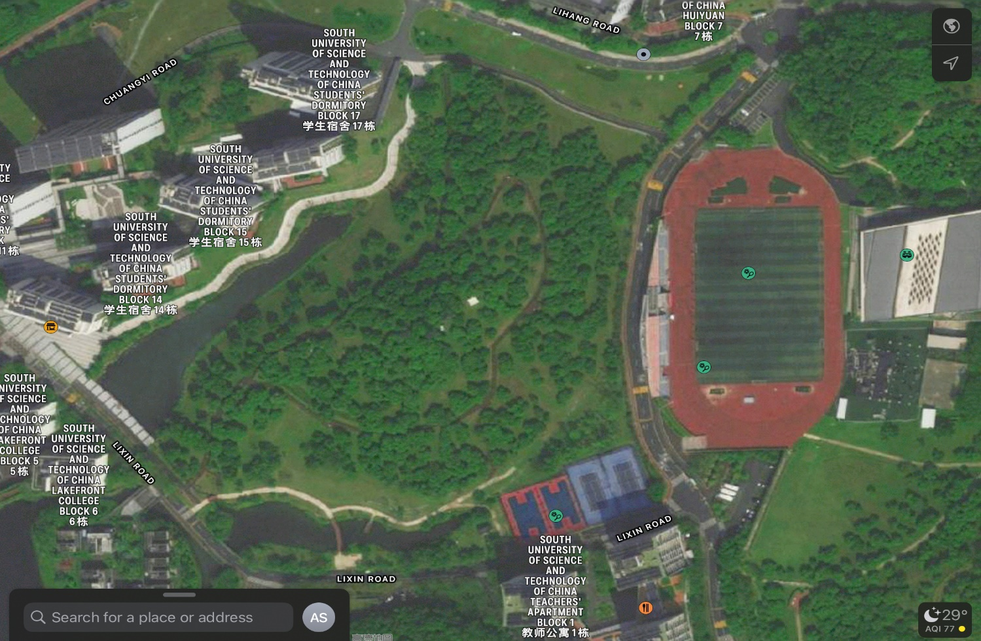
Results - DOA Estimation
Tx
Rx

Slide 17
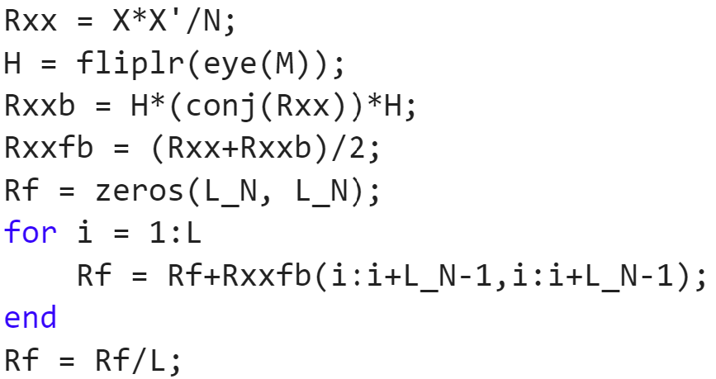
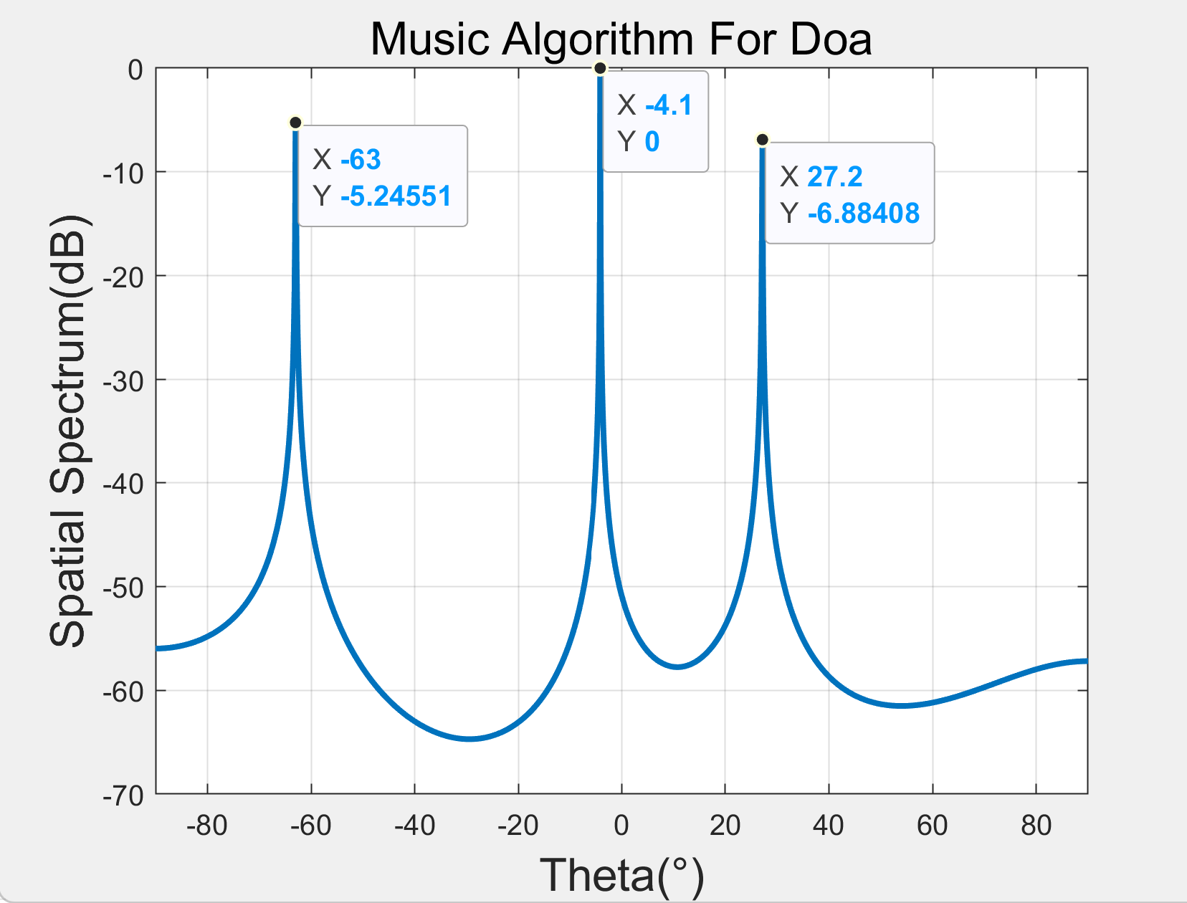
Results - DOA Estimation
Backward spatial smoothing (BSS)
Better resolution of multiple coherent signals
https://blog.csdn.net/qq_36583373/article/details/109382579

Slide 18
Results - DOA Estimation

Slide 19
Results - Passive Sensing

Slide 20
Results - Passive Sensing

Slide 21
Results - Passive Sensing

Slide 22
Thank you!
Yihan Sun: 12012128@mail.sustech.edu.cn
Xudong Zhang: 12011923@mail.sustech.edu.cn

