Slide 1

Assignment 9 DOA Estimation & Passive Sensing
Group member: 孙逸涵 张旭东
SID: 12012128 12011923

Slide 2
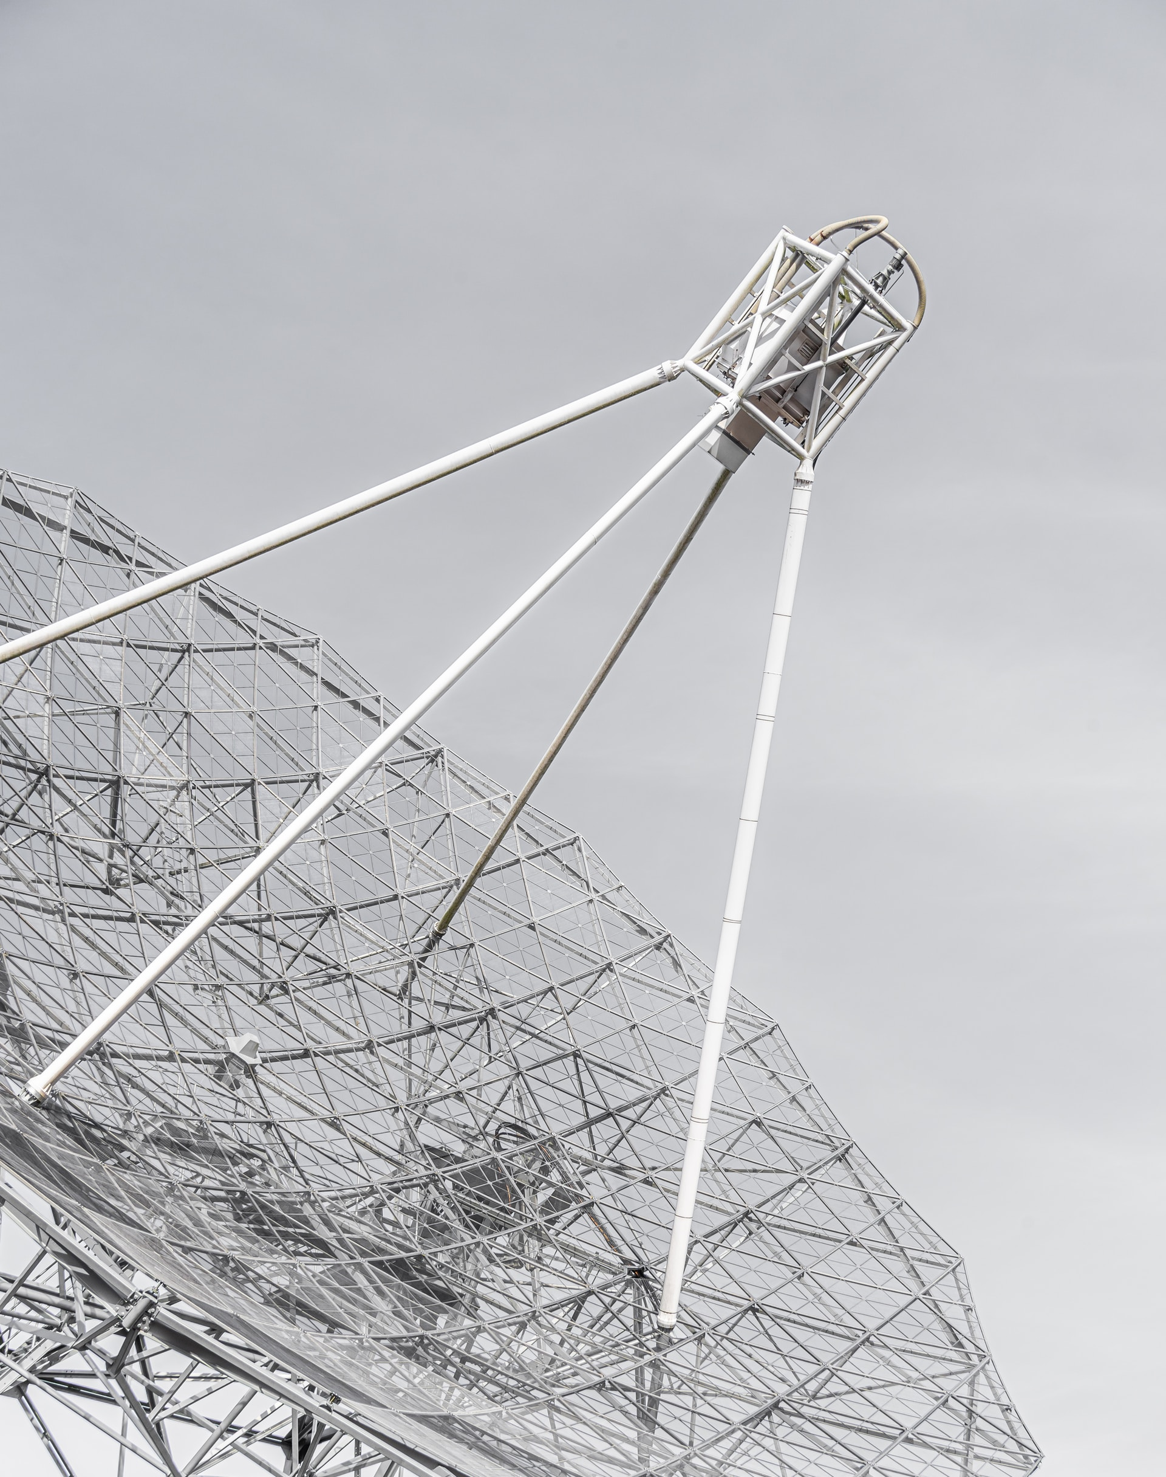
Introduction of DOA
Bartlett Algorithm
Capon Algorithm
MEM Algorithm
MUSIC Algorithm

Slide 3
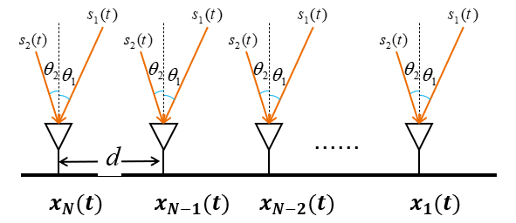
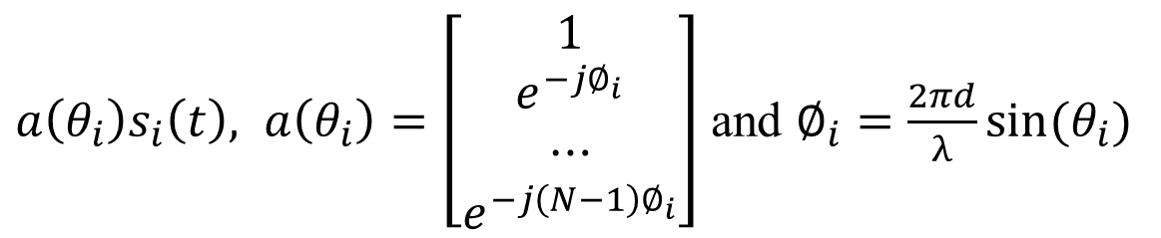

MUSIC Algorithm
$s\left(t\right)={[s_{1} \left(t\right),s_{2} \left(t\right),…,s_{D} \left(t\right)]}^{T}$ with AOA $\left\{θ_{1},θ_{2},…,θ_{D}\right\}$
The received signal inspired by $s_{i}(t)$ is
$a\left(θ_{i}\right)s_{i}\left(t\right), a\left(θ_{i}\right)=\left[\begin{matrix}1 \\ \begin{aligned}e^{−j∅_{i}} \\ ⋯\end{aligned} \\ e^{−j\left(N−1\right)∅_{i}}\end{matrix}\right]$ and $∅_{i}=\frac{2πd}{λ}sin⁡(θ_{i})$

Slide 4
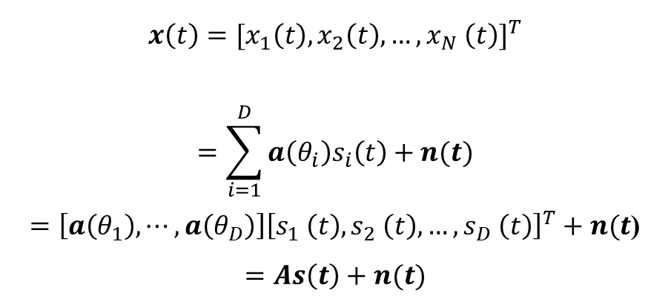
MUSIC Algorithm
The received signal is
$$x\left(t\right)={[x_{1}\left(t\right),x_{2}\left(t\right),…,x_{N} \left(t\right)]}^{T}$$
$$=\sum_{i=1}^{D}{a\left(θ_{i}\right)s_{i}\left(t\right)+n(t)}$$
$=\left[a\left(θ_{1}\right),⋯,a\left(θ_{D}\right)\right]{\left[s_{1} \left(t\right),s_{2} \left(t\right),…,s_{D} \left(t\right)\right]}^{T}+n(t$)
$$=As\left(t\right)+n(t)$$

Slide 5
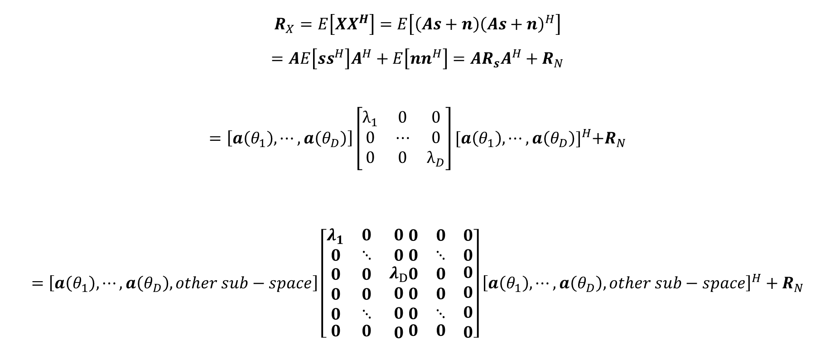
MUSIC Algorithm
The autocorrelation matrix of theoretically received signals can be written as:
$$R_{X}=E\left[XX^{H}\right]=E\left[\left(As+n\right){\left(As+n\right)}^{H}\right]$$
$$=AE\left[ss^{H}\right]A^{H}+E\left[nn^{H}\right]=AR_{s}A^{H}+R_{N}$$
$$=\left[a\left(θ_{1}\right),⋯,a\left(θ_{D}\right)\right]\left[\begin{matrix}λ_{1} & 0 & 0 \\ 0 & ⋯ & 0 \\ 0 & 0 & λ_{D}\end{matrix}\right]{[a\left(θ_{1}\right),⋯,a\left(θ_{D}\right)]}^{H}+R_{N}$$
$$=\left[a\left(θ_{1}\right),⋯,a\left(θ_{D}\right),other sub−space\right]\left[\begin{matrix}λ_{1} & 0 & 0 \\ 0 & ⋱ & 0 \\ \begin{aligned}\begin{aligned}0 \\ 0 \\ 0\end{aligned} \\ 0\end{aligned} & \begin{aligned}\begin{aligned}0 \\ 0 \\ ⋱\end{aligned} \\ 0\end{aligned} & \begin{aligned}λ_{D} \\ 0 \\ 0 \\ 0\end{aligned}\end{matrix}\begin{matrix}0 & 0 & 0 \\ 0 & ⋱ & 0 \\ \begin{aligned}\begin{aligned}0 \\ 0 \\ 0\end{aligned} \\ 0\end{aligned} & \begin{aligned}\begin{aligned}0 \\ 0 \\ ⋱\end{aligned} \\ 0\end{aligned} & \begin{aligned}0 \\ 0 \\ 0 \\ 0\end{aligned}\end{matrix}\right]{\left[a\left(θ_{1}\right),⋯,a\left(θ_{D}\right),other sub−space\right]}^{H}+R_{N}$$

Slide 6
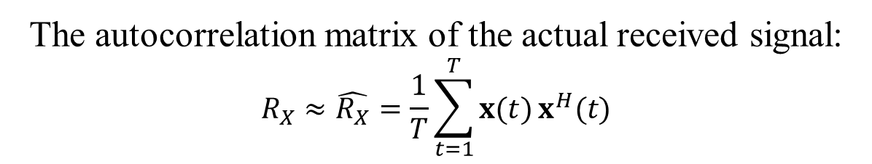
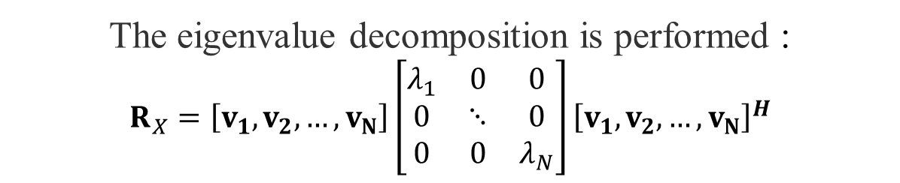
MUSIC Algorithm
The autocorrelation matrix of the actual received signal:
$$R_{X}≈\hat{R_{X}}=\frac{1}{T}\sum_{t=1}^{T}{x(t)}x^{H}(t)$$
The eigenvalue decomposition is performed :
$$R_{X}=\left[v_{1},v_{2},…,v_{N}\right]\left[\begin{matrix}λ_{1} & 0 & 0 \\ 0 & ⋱ & 0 \\ 0 & 0 & λ_{N}\end{matrix}\right]{\left[v_{1},v_{2},…,v_{N}\right]}^{H}$$
For incident signal angle 𝜃, $V_{noise}$𝐚(𝜃) could be very small
Define $P(θ)=\frac{1}{{\left\|V_{noise}a(θ)\right\|}^{2}}$, its peaks are the estimated AoAs

Slide 7


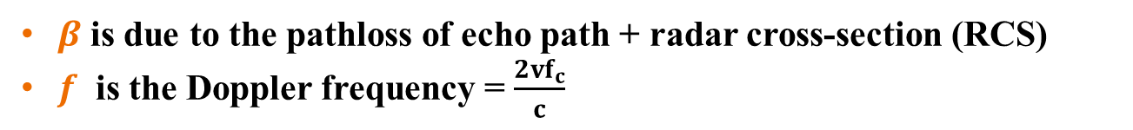
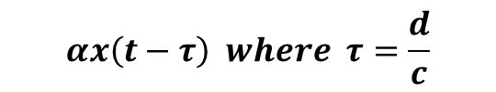

Doppler sensing
$$x(t)$$
$$αx\left(t−τ\right) where τ=\frac{d}{c}$$
Data Signals
Echo
$$αβx\left(t−2τ\right)e^{j2πft}$$
Velocity v
$β$ is due to the pathloss of echo path + radar cross-section (RCS)
$f$ is the Doppler frequency = $\frac{2vf_{c}}{c}$

Slide 8






Doppler sensing
$$τ_{s}=\frac{s}{c}$$
$$f=\frac{vf_{c}}{c}, where v=\frac{ds}{dt}$$
$$s$$
Surveillance Channel
Reference Channel
$$y_{r}\left(t\right)=αx\left(t−τ_{r}\right)$$
$$y_{s}\left(t\right)= βx\left(t−τ_{s}\right)e^{j2πft}$$
Passive Receiver

Slide 9
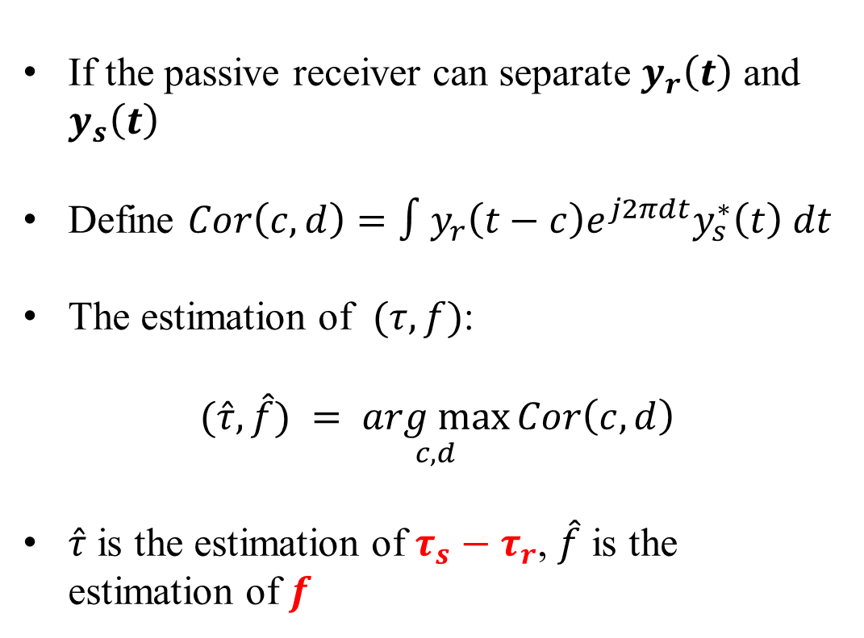
Doppler sensing
If the passive receiver can separate $y_{r}\left(t\right)$ and $y_{s}\left(t\right)$
Define $Cor\left(c,d\right)=∫y_{r}\left(t−c\right)e^{j2πdt}y_{s}^{∗}\left(t\right) dt$
The estimation of $(τ,f)$:
$$(\hat{τ},\hat{f}) = \underset{c,d}{arg max}{Cor\left(c,d\right)}$$
$\hat{τ}$ is the estimation of $τ_{s}−τ_{r}$, $\hat{f}$ is the estimation of $f$
$$y_{r}\left(t\right)=αx\left(t−τ_{r}\right)$$
$$y_{s}\left(t\right)= βx\left(t−τ_{s}\right)e^{j2πft}$$

Slide 10



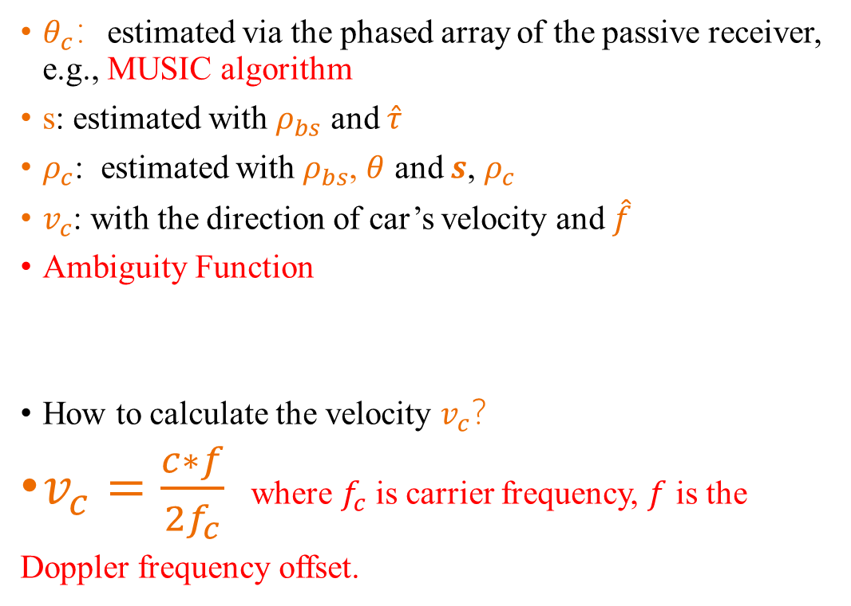




Doppler sensing
$θ_{c}$：estimated via the phased array of the passive receiver, e.g., MUSIC algorithm
s: estimated with $ρ_{bs}$ and $\hat{τ}$
$ρ_{c}$: estimated with $ρ_{bs}$, $θ$ and $s$, $ρ_{c}$
$v_{c}$: with the direction of car’s velocity and $\hat{f}$
Ambiguity Function
How to calculate the velocity $v_{c}$？
$v_{c}=\frac{c∗f}{2f_{c}}$ where $f_{c}$ is carrier frequency, $f$ is the
Doppler frequency offset.
$$s=ρ_{c}+d_{bs−c}$$
$$d_{bs−c}$$
$$ρ_{bs},θ_{bs}$$
$$ρ_{c},θ_{c},v_{c}=?$$
$$θ=θ_{bs}−θ_{c}$$

Slide 11
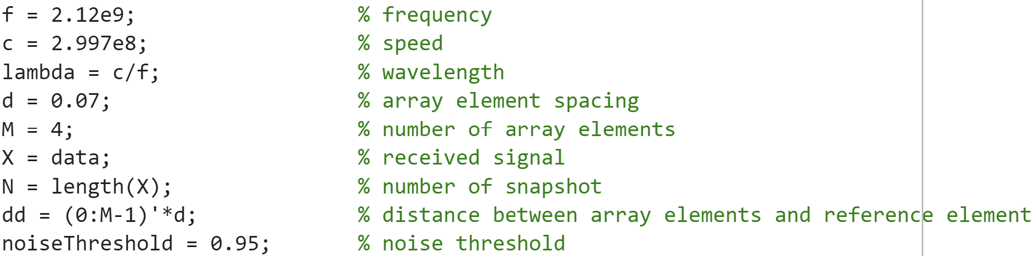
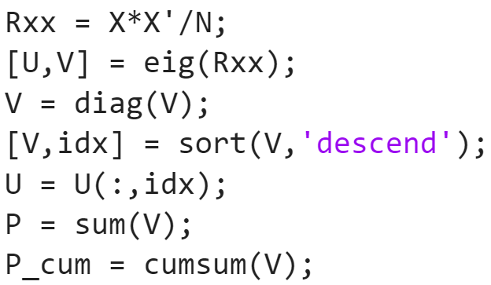
MATLAB Code - MUSIC
Initialize parameters
Calculate covariance matrix
Eigenvalue decomposition
Arrange the eigenvalues of Rx in descending order
Arrange corresponding eigenvectors in corresponding order
Calculate the sum of the eigenvalues
Create cumulative array of eigenvalues

Slide 12
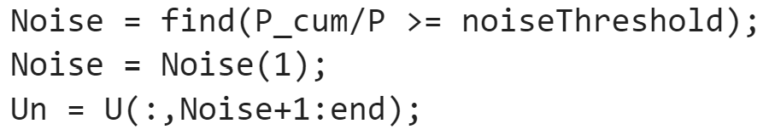
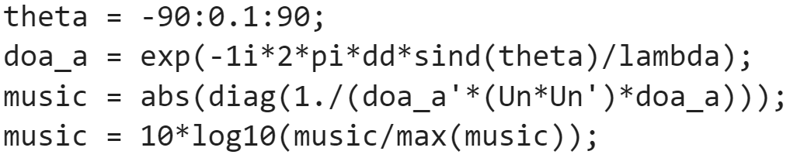
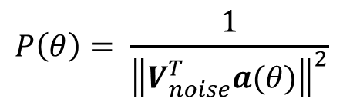
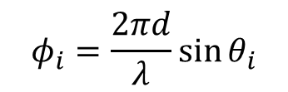
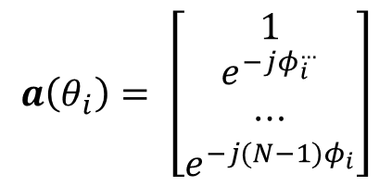
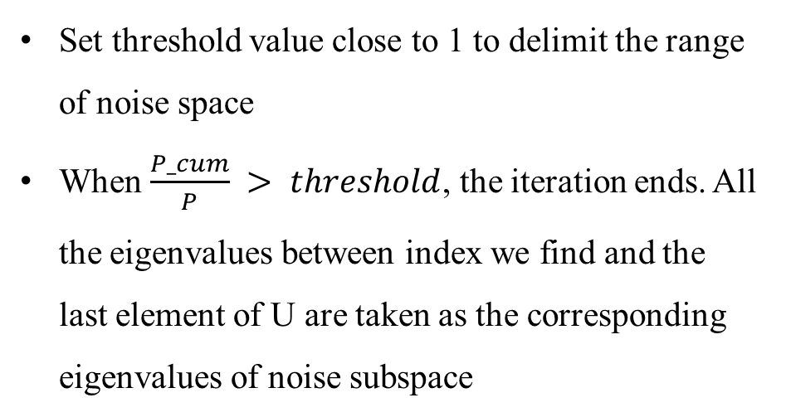
MATLAB Code - MUSIC
Set threshold value close to 1 to delimit the range of noise space
When $\frac{P_cum}{P} > threshold$, the iteration ends. All the eigenvalues between index we find and the last element of U are taken as the corresponding eigenvalues of noise subspace
$$a\left(θ_{i}\right)= \left[\begin{matrix}1 \\ e^{−jφ_{i}^{…}} \\ ⋯ \\ e^{−j(N−1)φ_{i}}\end{matrix}\right]$$
$$φ_{i}=\frac{2πd}{λ}\sin{θ_{i}}$$
$$P\left(θ\right)= \frac{1}{{\left\|V_{noise}^{T}a(θ)\right\|}^{2}}$$

Slide 13
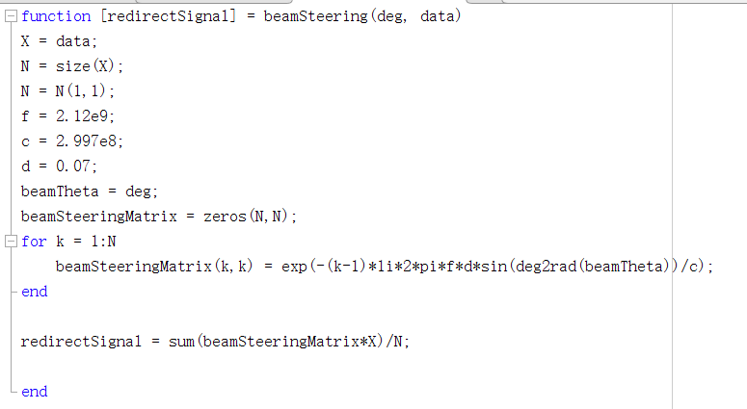
MATLAB Code - Passive Sensing
Function beamSteering is used to recover the initial signal from the received signal. Due to the difference in receiving distance, there will be a phase deviation of the signal received by each antenna.

Slide 14
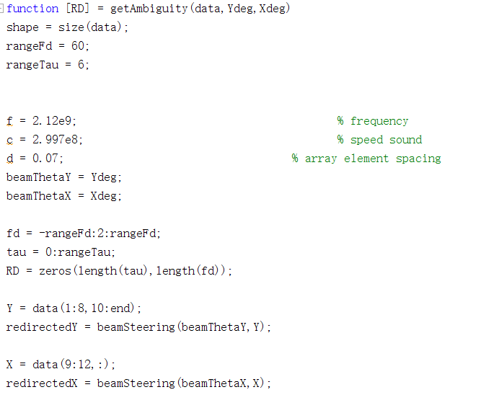
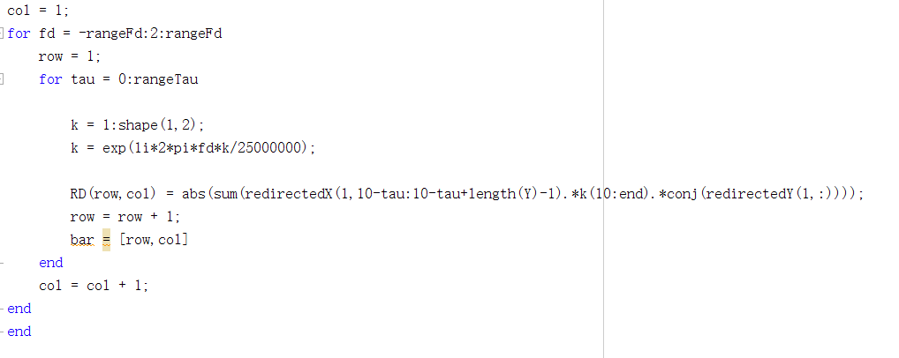
MATLAB Code - Passive Sensing
Function getAmbiguity is used to calculate Ambiguity function.

Slide 15
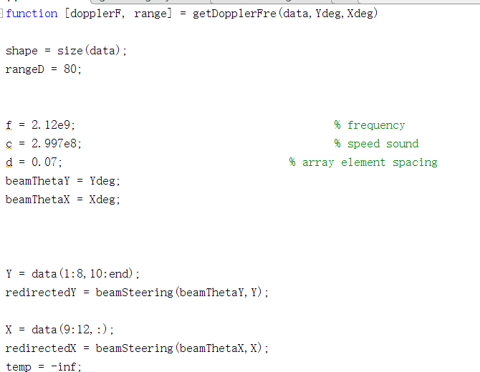
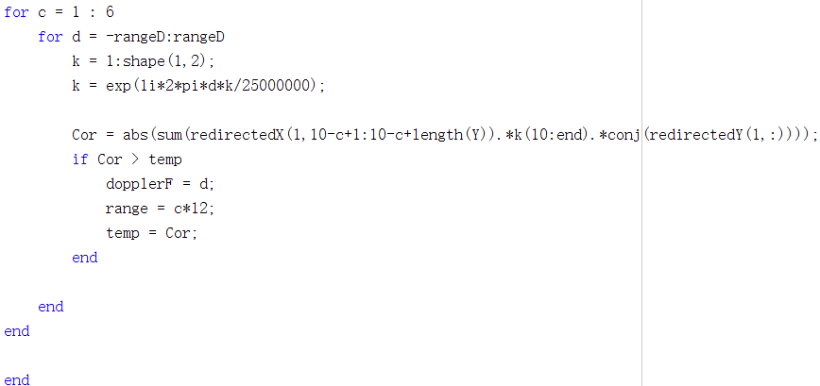
MATLAB Code - Passive Sensing
Function getDopplerFre is used to calculate doppler frequency using the result calculated in function getAmbiguity.

Slide 16
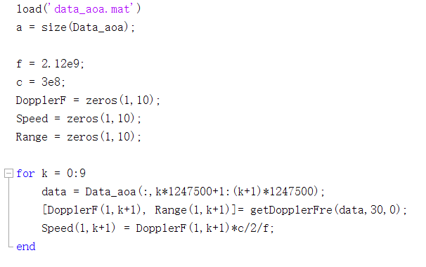
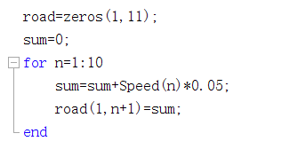
MATLAB Code - Passive Sensing
The data is segmented in the process of solving the Doppler frequency offset of multi-segment motion data and drawing the relationship of the position of the mover with time.

Slide 17
Analysis - DOA Estimation
Due to the influence of the mover, which introduces Doppler frequency to the received signals, the 8 Surveillance Channel Antennas Array can not receive the signals caused by the scattering of the base station signal by the scattering clusters outside the base station. Thus, the DOA estimation results of the 8 Surveillance Channel Antennas Array are very different from that of the 4 Reference Channel Antennas Array.
Therefore, to accurately find the position of the main scattering clusters in the external environment, we need to use the detection results of 4 Reference Channel Antennas Array to locate.

Slide 18
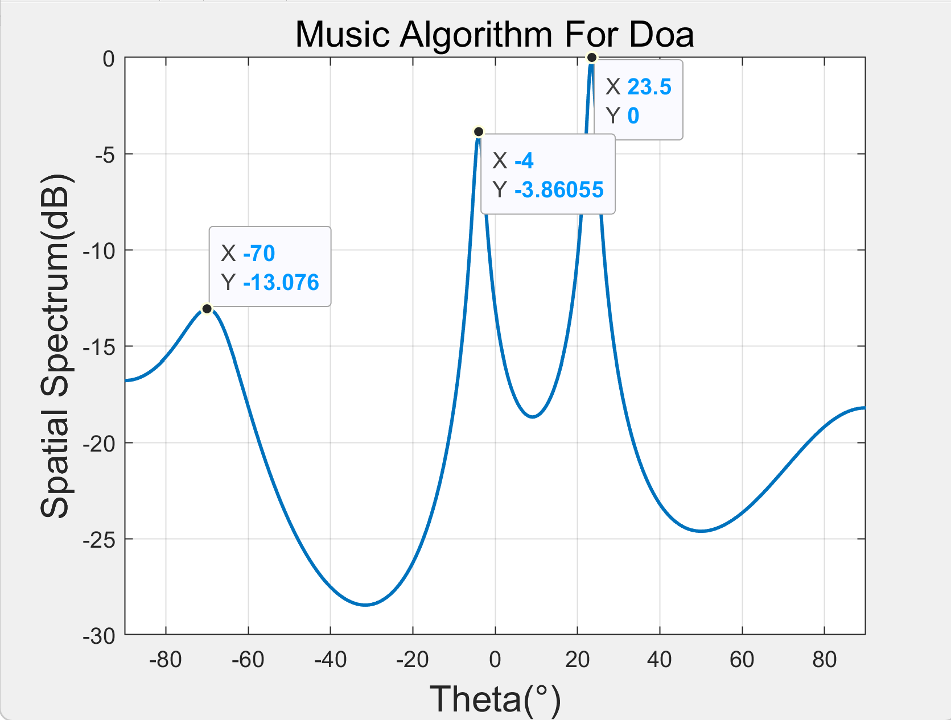
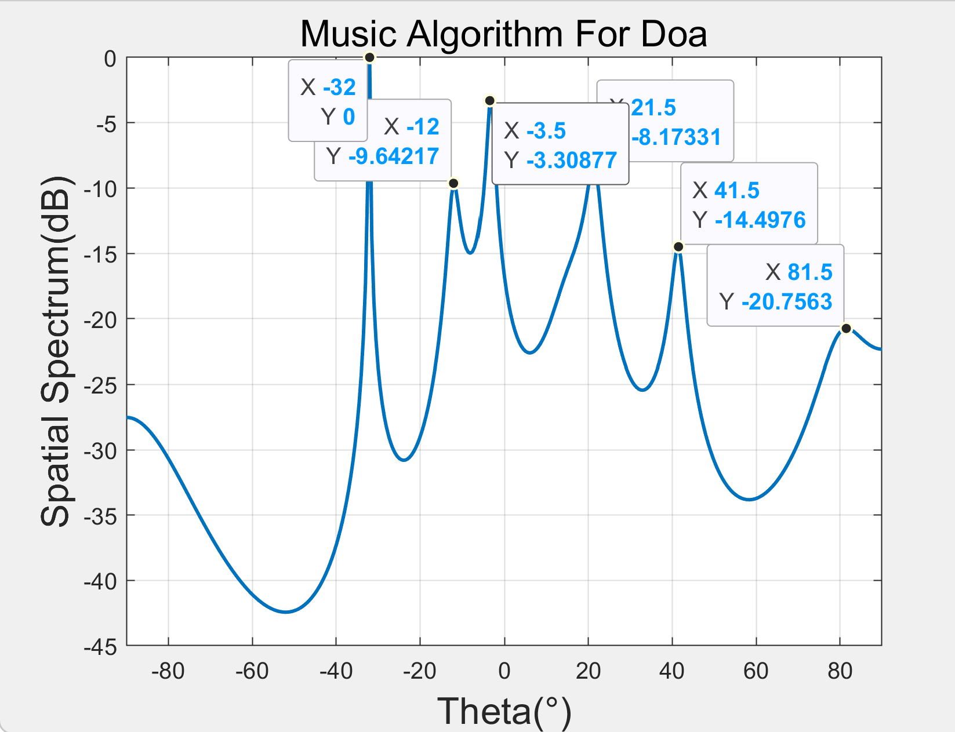
Results - DOA Estimation
Reference Channel
Surveillance Channel

Slide 19
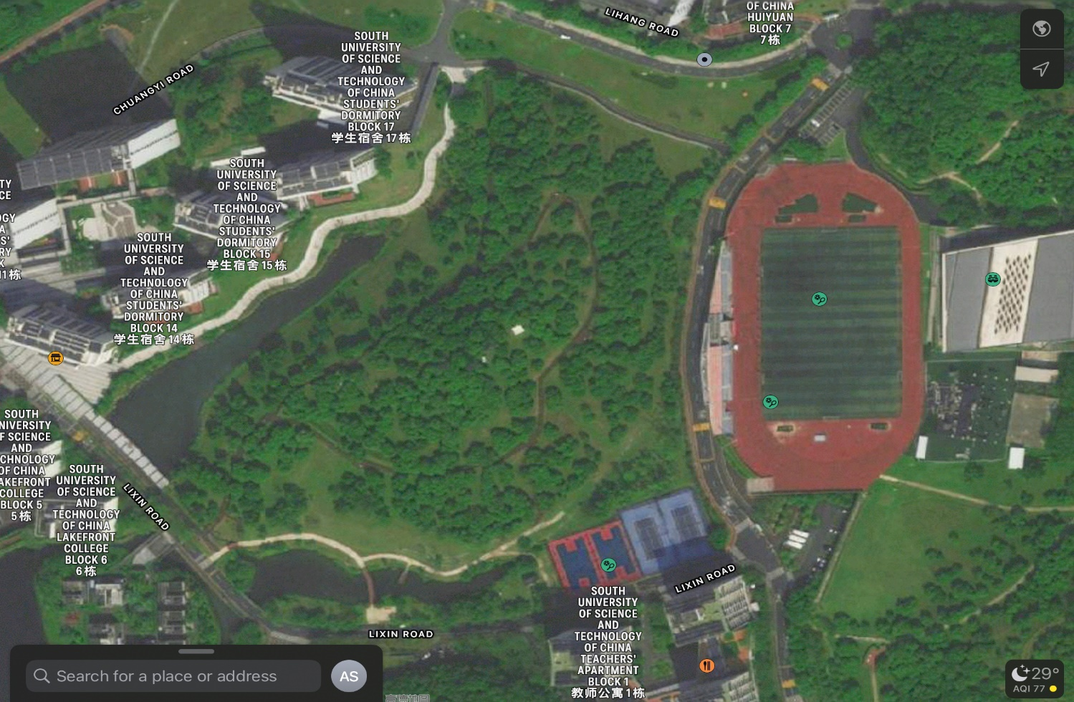
Results - DOA Estimation
From the figure, we can find that there are 3 DOAs of the received signals. And by using the satellite map to verify our result, we can find that there are one line-of-sight and two scattering paths (two main scatterers) for signals to transmit, and the DOAs for them are approximately -70°, -4°, and 23.5°, respectively.
Tx
Rx

Slide 20
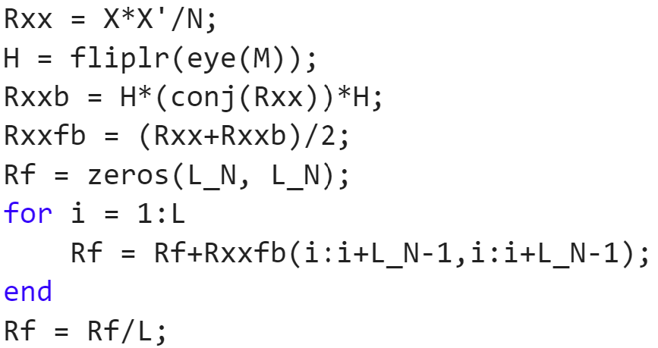
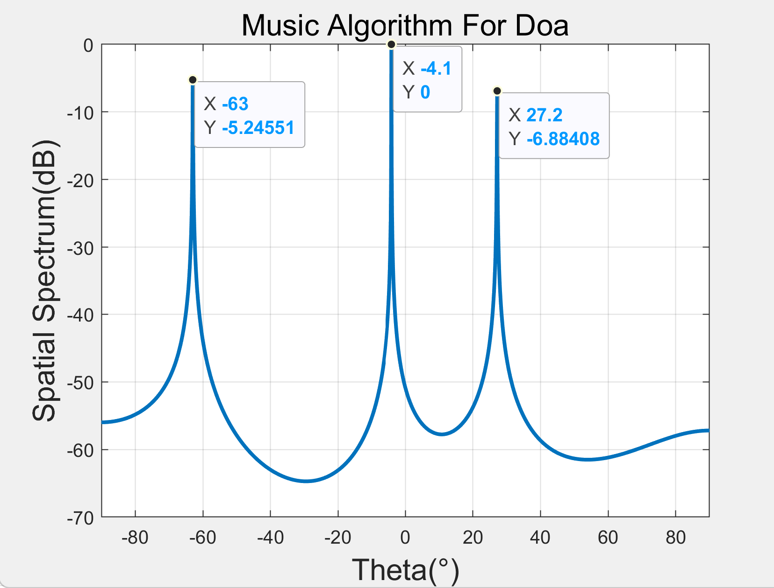
Results - DOA Estimation
Backward spatial smoothing (BSS)
Better resolution of multiple coherent signals
Reference Channel
https://blog.csdn.net/qq_36583373/article/details/109382579

Slide 21
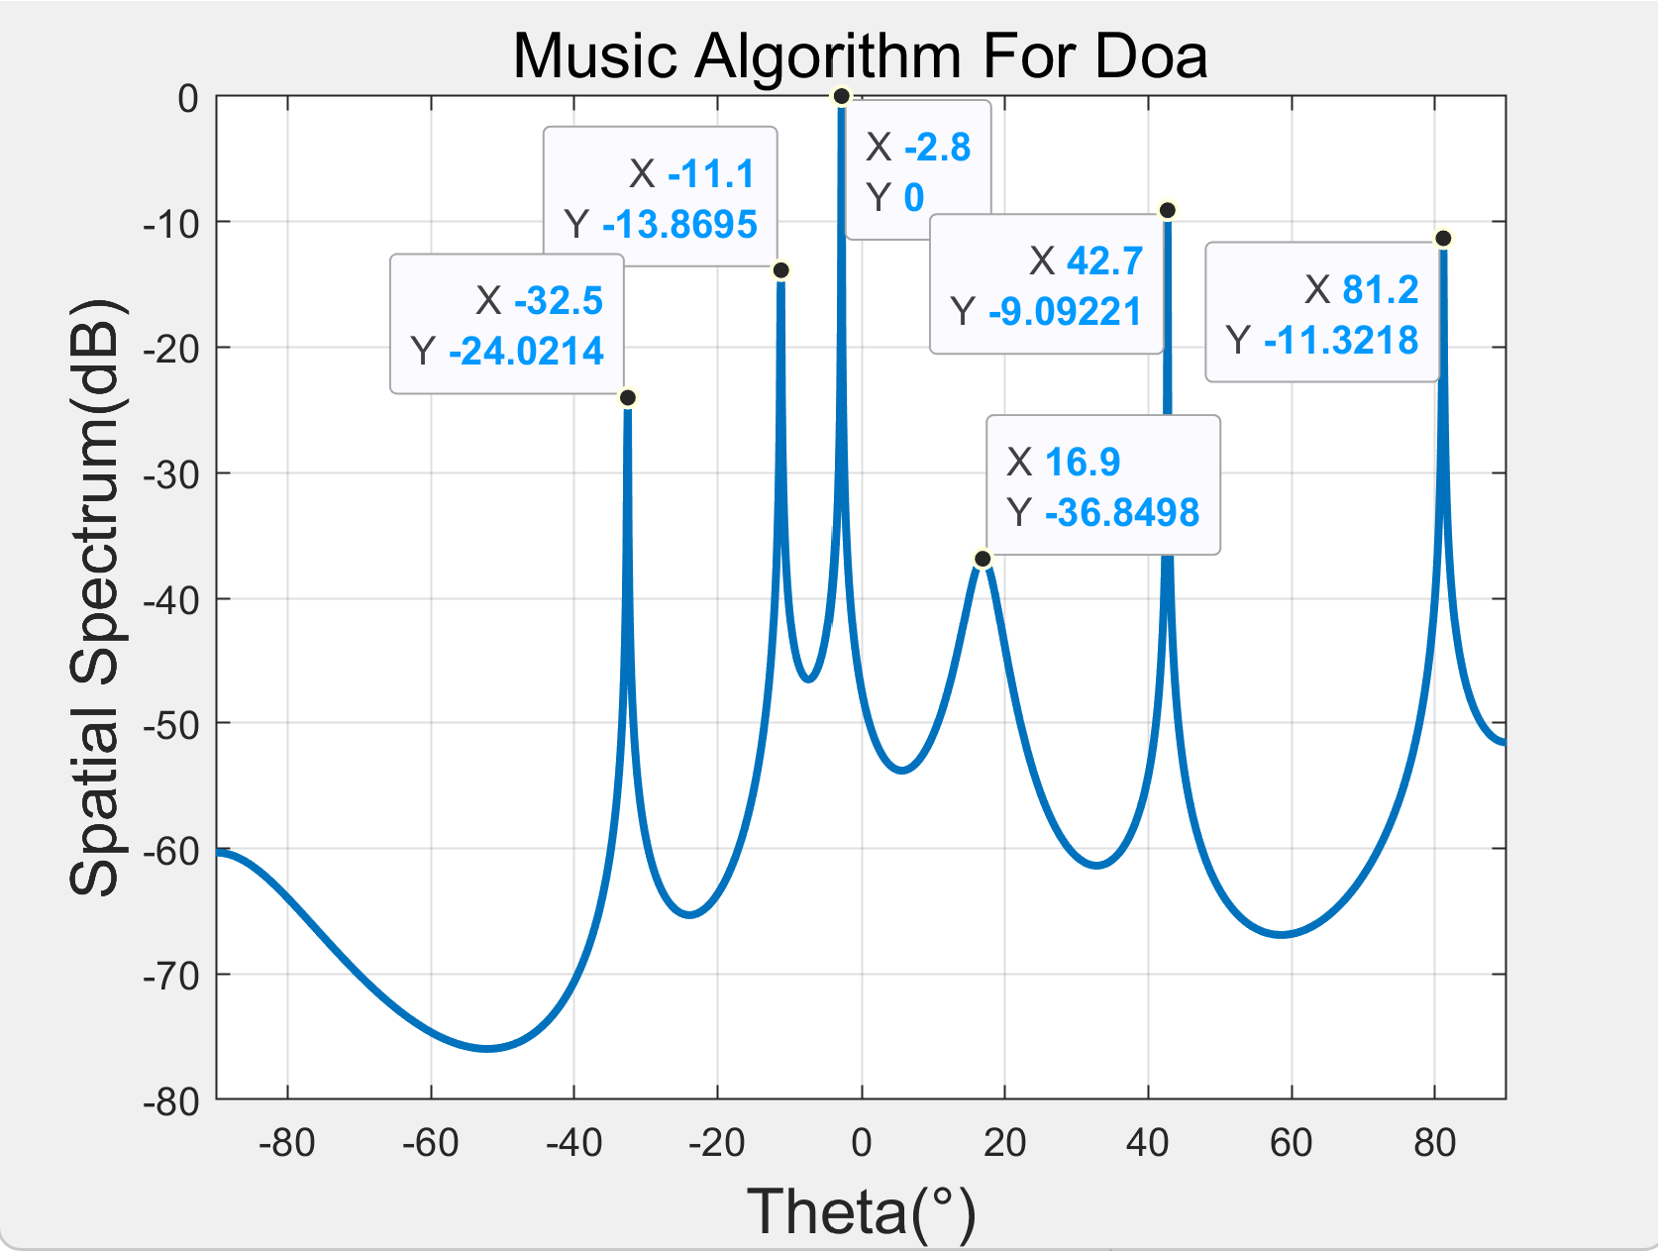
Results - DOA Estimation
Backward spatial smoothing (BSS)
Better resolution of multiple coherent signals
Surveillance Channel
https://blog.csdn.net/qq_36583373/article/details/109382579

Slide 22
Results - DOA Estimation
When we try to use the Backward spatial smoothing (BSS) MUSIC algorithm to carry out DOA estimation, which can get better resolution of multiple coherent signals.
From the result before, we can find that the results get the better performance than before, which also means the received signals are coherent signals.

Slide 23
Analysis - Passive Sensing
In this task, the first thing need to do is to build the Surveillance Channel Antenna information based on the first eight rows of the provided data, and then build the Reference Channel Antenna information based on the last four rows of the data. Since the 8 Surveillance Channel Antennas and 4 Reference Channel Antennas are placed vertically, they can be approximately regarded as incoherent when receiving information from each other. In other words, the data received by 8 Surveillance Channel Antennas can be approximately regarded as containing only the data information of human movement, while the data received by 4 Reference Channel Antennas can be approximately regarded as containing only the information transmitted by the base station.

Slide 24
Analysis - Passive Sensing
Then, the Ambiguity function is used to scan the propagation delay difference and Doppler frequency deviation of different Surveillance channels and Reference channels, and the relationship between Doppler frequency deviation and scattering path is obtained. After that, the data provided were divided into 10 pieces, and each piece represented the exercise information of the exercisers within 0.05s. By calculating the Doppler frequency offset of each data, the velocity of each section can be obtained, which can be used as the average velocity of this section by using the approximation method. The position can be obtained by multiplying the speed by the time, and then the change of the position of the movement with time within 0.5s can be obtained.

Slide 25
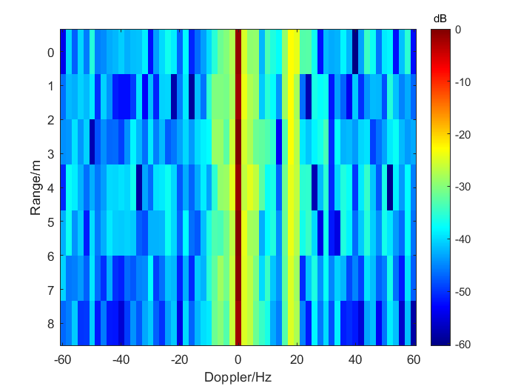
Results - Passive Sensing

Slide 26
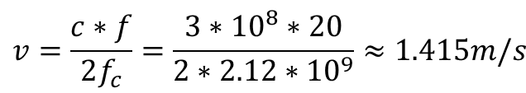
Results - Passive Sensing
The figure above shows the variation of Doppler frequency deviation with distance measured by 12 antennas. There is a large peak (deep red) in the region of Doppler offset 0, indicating that most objects in reality are stationary with a Doppler offset of 0, except for the person in motion. Besides, there is a large peak (light yellow) in the region of Doppler offset of 20Hz, while the correlation of the fuzzy function at the other frequency offset is small. Therefore, it is not difficult to infer that 20Hz in the figure is the Doppler frequency offset of the exerciser. Through the corresponding calculation, it can be obtained that the average speed of the movement is about 1.415m/s.
$$v=\frac{c∗f}{2f_{c}}=\frac{3∗{10}^{8}∗20}{2∗2.12∗{10}^{9}}≈1.415m/s$$

Slide 27
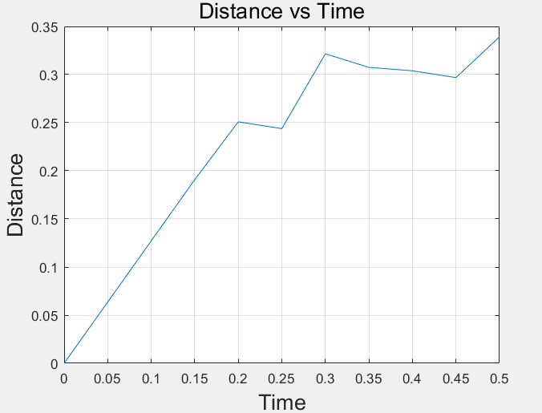
Results - Passive Sensing
It can be inferred from the figure that the movement of the mover in every 0.05s interval does not always move towards the antenna array, and in some moments the mover even moves back to the antenna array, at which time the speed of the mover is negative.

Slide 28
Thank you!
Yihan Sun: 12012128@mail.sustech.edu.cn
Xudong Zhang: 12011923@mail.sustech.edu.cn

