Slide 1
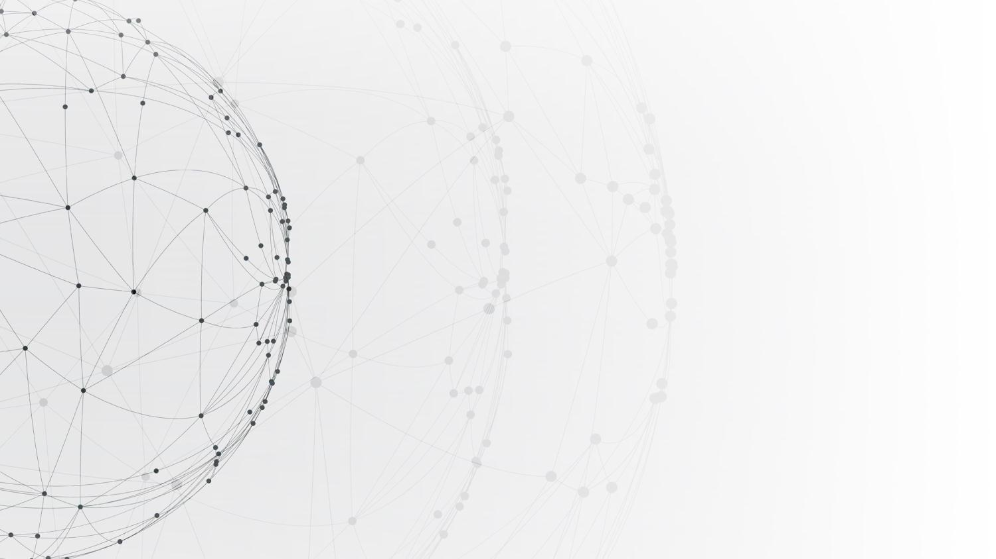
Design of Modern Communication Systems
Application Research on DOA Estimation Based on Software Defined Radio Receiver
Presenters: 12012128 孙逸涵
12011923 张旭东
12011442 周若雨
12011137 陈至越
Date: 2023.05.31

Slide 2
CONTENTS
Introduction
01
02
MATLAB Code
03
Experiment
04
Results & Analysis
05
Conclusions

Slide 3
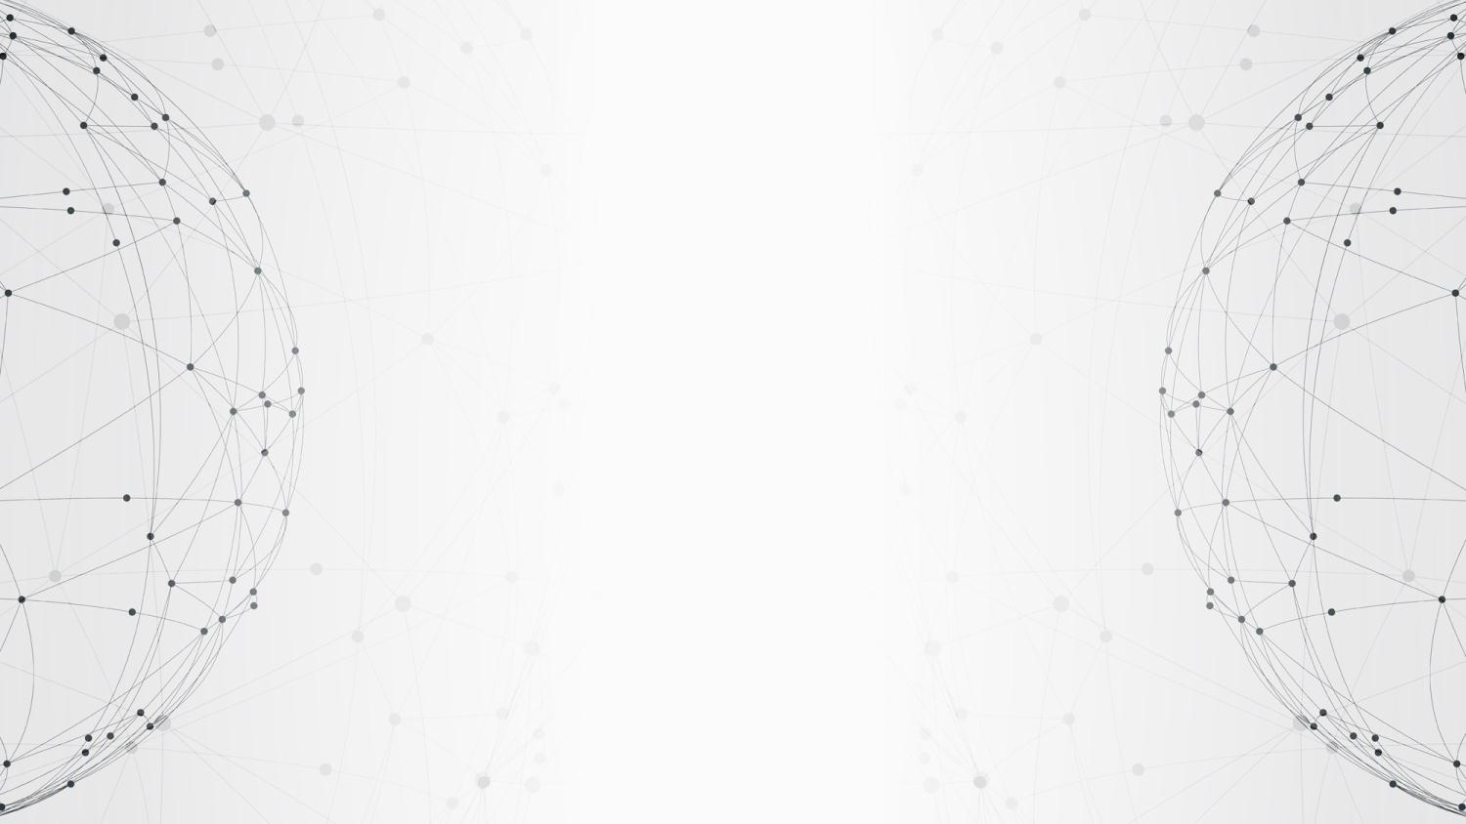
01
PART
Introduction

Slide 4
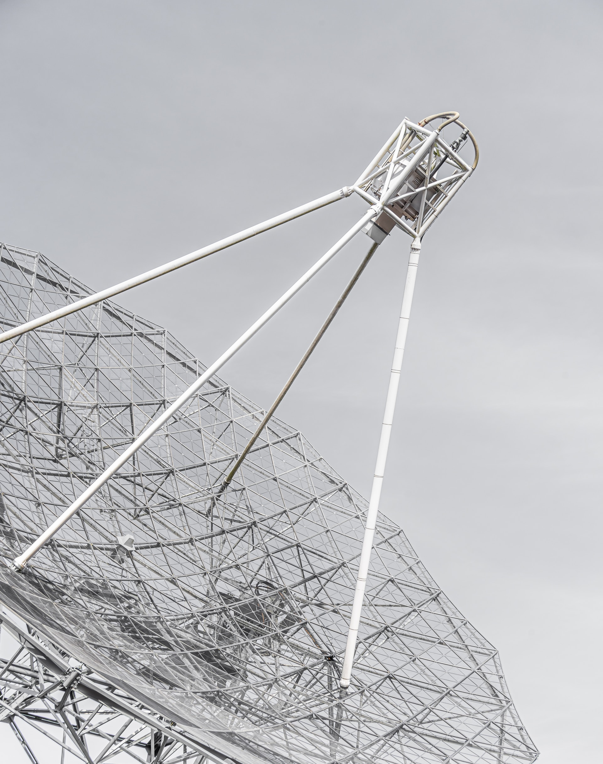
Introduction of DOA
Bartlett Algorithm
Capon Algorithm
MEM Algorithm
MUSIC Algorithm

Slide 5
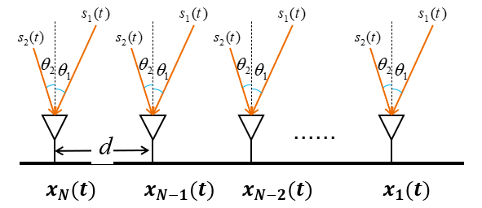
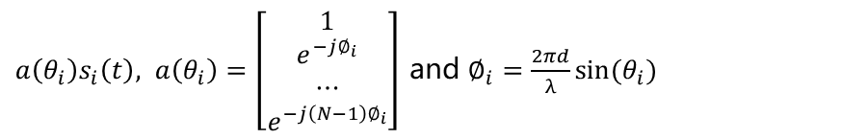
MUSIC Algorithm
$s\left(t\right)={[s_{1} \left(t\right),s_{2} \left(t\right),…,s_{D} \left(t\right)]}^{T}$ with AOA $\left\{θ_{1},θ_{2},…,θ_{D}\right\}$
The received signal inspired by $s_{i}(t)$ is
$a\left(θ_{i}\right)s_{i}\left(t\right), a\left(θ_{i}\right)=\left[\begin{matrix}1 \\ \begin{aligned}e^{−j∅_{i}} \\ ⋯\end{aligned} \\ e^{−j\left(N−1\right)∅_{i}}\end{matrix}\right]$ and $∅_{i}=\frac{2πd}{λ}sin⁡(θ_{i})$

Slide 6
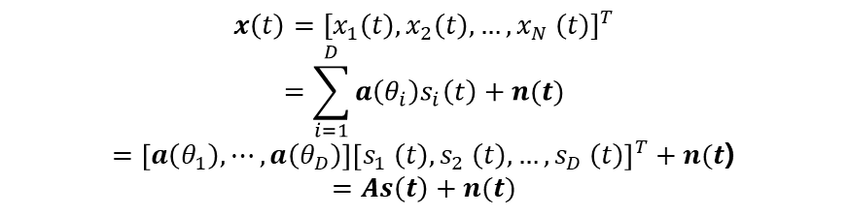
MUSIC Algorithm
The received signal is
$$x\left(t\right)={[x_{1}\left(t\right),x_{2}\left(t\right),…,x_{N} \left(t\right)]}^{T}$$
$$=\sum_{i=1}^{D}{a\left(θ_{i}\right)s_{i}\left(t\right)+n(t)}$$
$=\left[a\left(θ_{1}\right),⋯,a\left(θ_{D}\right)\right]{\left[s_{1} \left(t\right),s_{2} \left(t\right),…,s_{D} \left(t\right)\right]}^{T}+n(t$)
$$=As\left(t\right)+n(t)$$

Slide 7
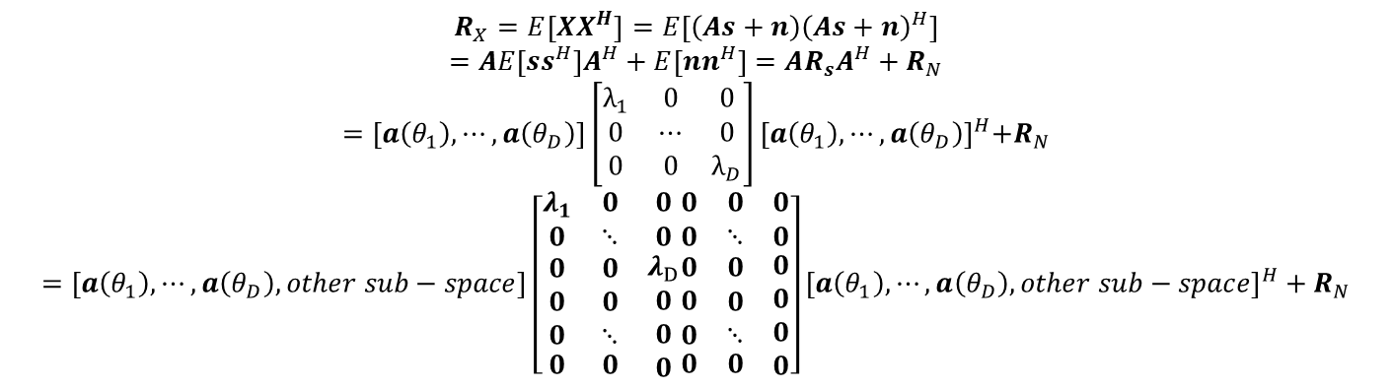
MUSIC Algorithm
The autocorrelation matrix of theoretically received signals can be written as:
$$R_{X}=E\left[XX^{H}\right]=E\left[\left(As+n\right){\left(As+n\right)}^{H}\right]$$
$$=AE\left[ss^{H}\right]A^{H}+E\left[nn^{H}\right]=AR_{s}A^{H}+R_{N}$$
$$=\left[a\left(θ_{1}\right),⋯,a\left(θ_{D}\right)\right]\left[\begin{matrix}λ_{1} & 0 & 0 \\ 0 & ⋯ & 0 \\ 0 & 0 & λ_{D}\end{matrix}\right]{[a\left(θ_{1}\right),⋯,a\left(θ_{D}\right)]}^{H}+R_{N}$$
$$=\left[a\left(θ_{1}\right),⋯,a\left(θ_{D}\right),other sub−space\right]\left[\begin{matrix}λ_{1} & 0 & 0 \\ 0 & ⋱ & 0 \\ \begin{aligned}\begin{aligned}0 \\ 0 \\ 0\end{aligned} \\ 0\end{aligned} & \begin{aligned}\begin{aligned}0 \\ 0 \\ ⋱\end{aligned} \\ 0\end{aligned} & \begin{aligned}λ_{D} \\ 0 \\ 0 \\ 0\end{aligned}\end{matrix}\begin{matrix}0 & 0 & 0 \\ 0 & ⋱ & 0 \\ \begin{aligned}\begin{aligned}0 \\ 0 \\ 0\end{aligned} \\ 0\end{aligned} & \begin{aligned}\begin{aligned}0 \\ 0 \\ ⋱\end{aligned} \\ 0\end{aligned} & \begin{aligned}0 \\ 0 \\ 0 \\ 0\end{aligned}\end{matrix}\right]{\left[a\left(θ_{1}\right),⋯,a\left(θ_{D}\right),other sub−space\right]}^{H}+R_{N}$$

Slide 8


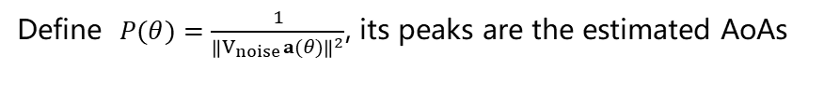
MUSIC Algorithm
The autocorrelation matrix of the actual received signal:
$$R_{X}≈\hat{R_{X}}=\frac{1}{T}\sum_{t=1}^{T}{x(t)}x^{H}(t)$$
The eigenvalue decomposition is performed :
$$R_{X}=\left[v_{1},v_{2},…,v_{N}\right]\left[\begin{matrix}λ_{1} & 0 & 0 \\ 0 & ⋱ & 0 \\ 0 & 0 & λ_{N}\end{matrix}\right]{\left[v_{1},v_{2},…,v_{N}\right]}^{H}$$
For incident signal angle 𝜃, $V_{noise}$𝐚(𝜃) could be very small
Define $P(θ)=\frac{1}{{\left\|V_{noise}a(θ)\right\|}^{2}}$, its peaks are the estimated AoAs

Slide 9
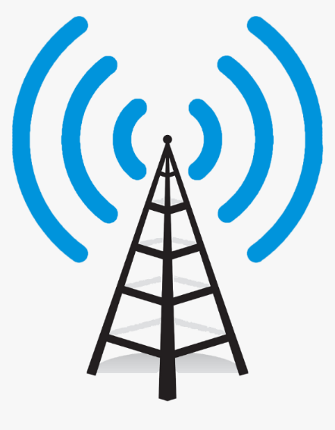

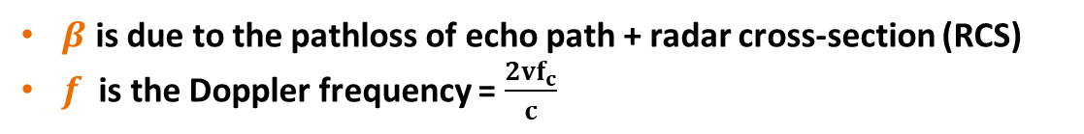
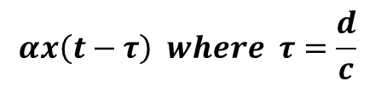

Doppler sensing
$$x(t)$$
Full Duplex!
$$αx\left(t−τ\right) where τ=\frac{d}{c}$$
Data Signals
Echo
$$αβx\left(t−2τ\right)e^{j2πft}$$
Velocity v
$β$ is due to the pathloss of echo path + radar cross-section (RCS)
$f$ is the Doppler frequency = $\frac{2vf_{c}}{c}$

Slide 10
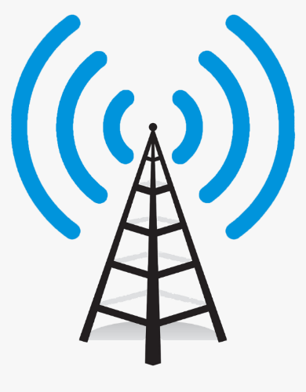





Doppler sensing
$$x(t)$$
$$τ_{s}=\frac{s}{c}$$
$$f=\frac{vf_{c}}{c}, where v=\frac{ds}{dt}$$
$$s$$
Surveillance Channel
Reference Channel
Passive Receiver

Slide 11
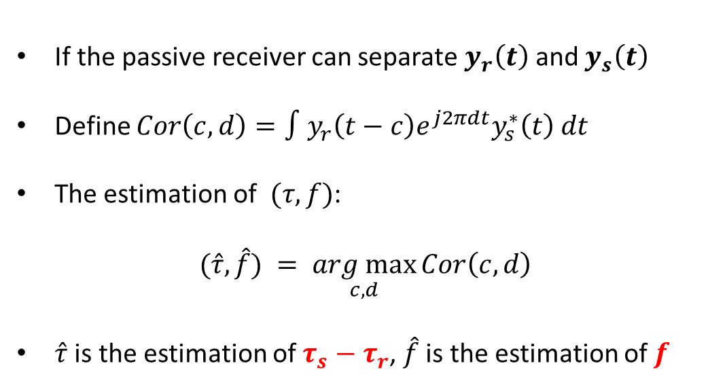
Doppler sensing
If the passive receiver can separate $y_{r}\left(t\right)$ and $y_{s}\left(t\right)$
Define $Cor\left(c,d\right)=∫y_{r}\left(t−c\right)e^{j2πdt}y_{s}^{∗}\left(t\right) dt$
The estimation of $(τ,f)$:
$$(\hat{τ},\hat{f}) = \underset{c,d}{arg max}{Cor\left(c,d\right)}$$
$\hat{τ}$ is the estimation of $τ_{s}−τ_{r}$, $\hat{f}$ is the estimation of $f$
$$y_{r}\left(t\right)=αx\left(t−τ_{r}\right)$$
$$y_{s}\left(t\right)= βx\left(t−τ_{s}\right)e^{j2πft}$$

Slide 12
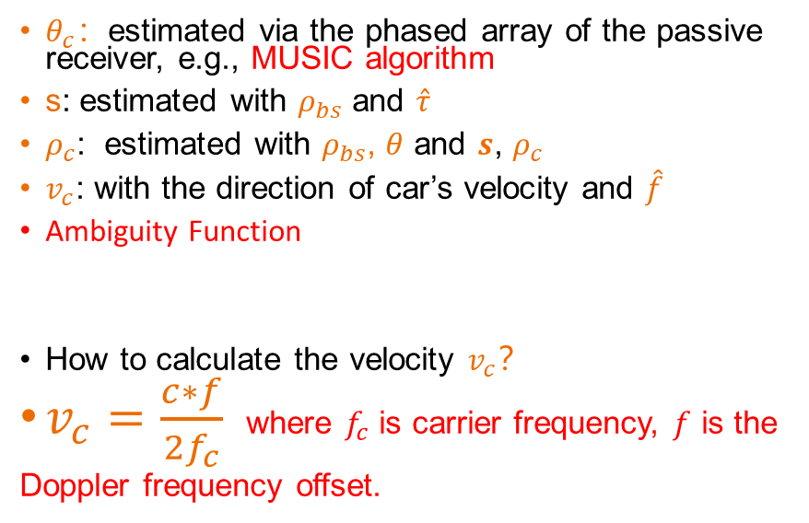
Doppler sensing
$θ_{c}$：estimated via the phased array of the passive receiver, e.g., MUSIC algorithm
s: estimated with $ρ_{bs}$ and $\hat{τ}$
$ρ_{c}$: estimated with $ρ_{bs}$, $θ$ and $s$, $ρ_{c}$
$v_{c}$: with the direction of car’s velocity and $\hat{f}$
Ambiguity Function
How to calculate the velocity $v_{c}$？
$v_{c}=\frac{c∗f}{2f_{c}}$ where $f_{c}$ is carrier frequency, $f$ is the
Doppler frequency offset.
$$y_{r}\left(t\right)=αx\left(t−τ_{r}\right)$$
$$y_{s}\left(t\right)= βx\left(t−τ_{s}\right)e^{j2πft}$$

Slide 13
02
PART
MATLAB Code

Slide 14
03
PART
Experiment

Slide 15
04
PART
Results & Analysis

Slide 16
Pre-recorded data recovery
64QAM Demodulation
EE312: Design of Modern Communication Systems
16

Slide 17
Pre-recorded data recovery
64QAM Demodulation
EE312: Design of Modern Communication Systems
17

Slide 18
05
PART
Conclusions

Slide 19
Q&A

Slide 20
THANKS

Slide 21
Introduction
Advantages of OFDM technology
Spectra efficiency
Against frequency selective fading
The ISI can be completely eliminated through the use of a cyclic prefix
Use multi-subcarriers to decrease the complexity of equalizer
Application of OFDM technology
4G mobile communication system
Multi Input Multi Output (MIMO) technology
Ultra Wide Band (UWB) radios
IEEE 802.11a Wireless LAN
Digital Audio Broadcasting (DAB)
HiperLAN/2 (High Performance Radio LAN)
EE312: Design of Modern Communication Systems
21
Notes:
中国的UWB标准采用了OFDM双载波技术,包含两个载波的OFDM超宽带信号进行数据传输
数字音频广播 (DAB)
HiperLAN是一种在欧洲应用的无线局域网通讯标准的一个子集

Slide 22
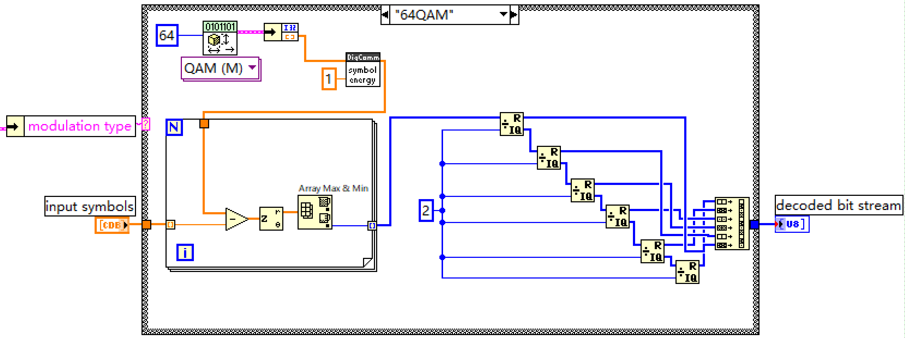
Advanced Task1 — 64QAM
64QAM Demodulation
EE312: Design of Modern Communication Systems
22

