Slide 1



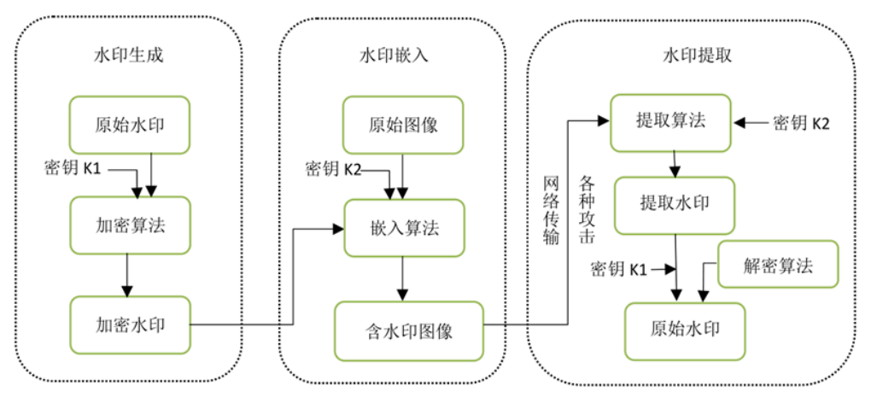
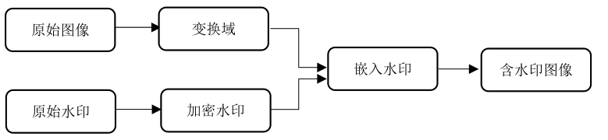
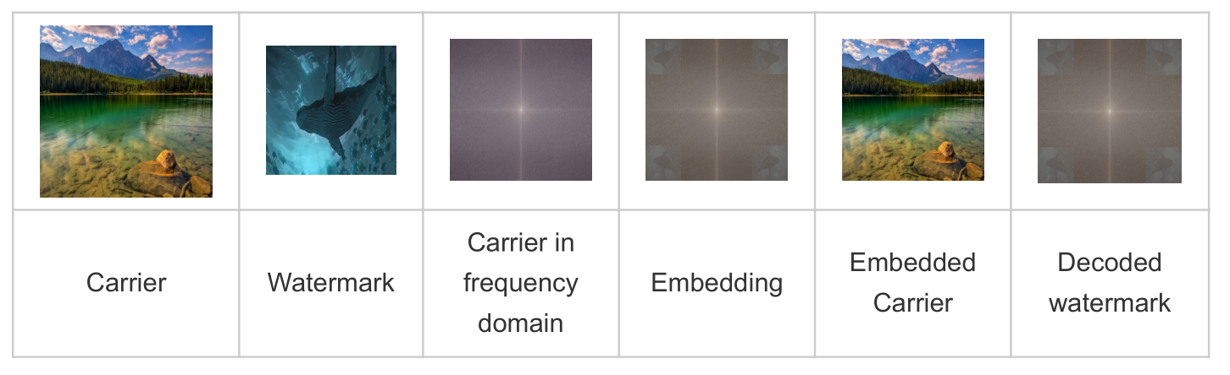
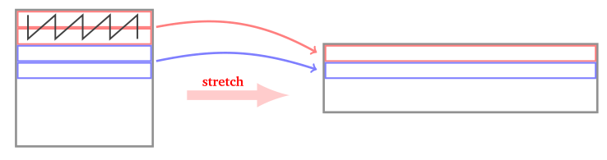
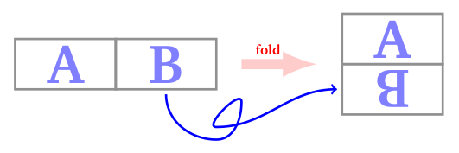
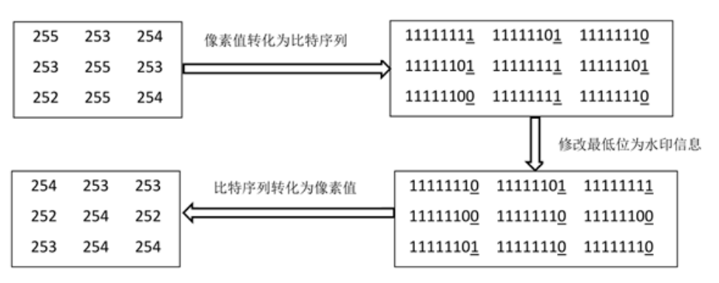
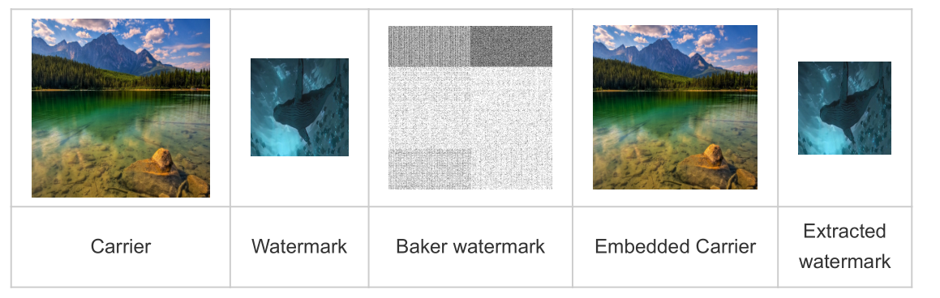
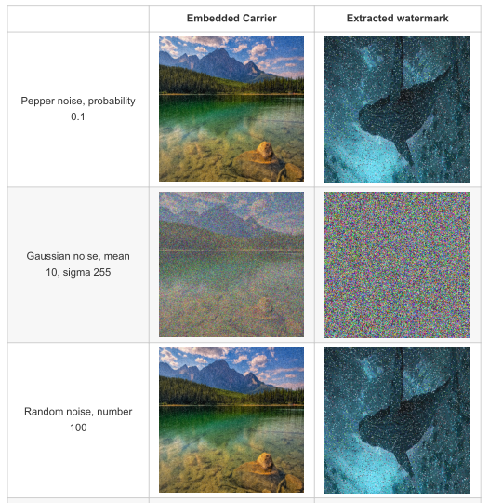
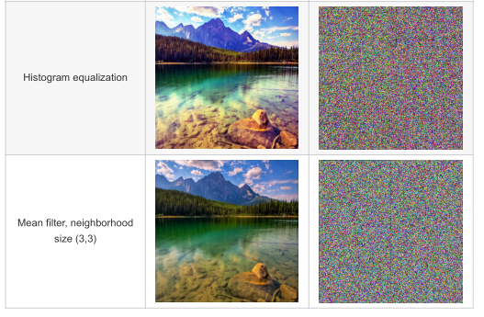
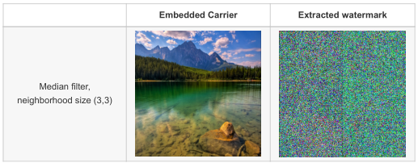
Digital watermark is an important application of image steganography, and is one of the important methods to carry out copyright protection and information hiding at present. Digital watermarking technology has been developed for more than thirty years, and many kinds of watermarking algorithms have been born.
Digital Watermarking in the Space and Frequency Domains Based on Baker Mapping
11911521 钟新宇
Information hiding technology, also known as steganography, is to hide secret information in another public information (carrier information) to form a hidden carrier, and then transmit the hidden information through the transmission of the hidden carrier, making it difficult for potential attackers to judge whether the secret information exists from the public information and intercept the hidden information, so as to achieve the purpose of ensuring information security. Digital watermark is an important application of image steganography, and is one of the important methods to carry out copyright protection and information hiding at present. Digital watermarking technology has been developed for more than thirty years, and many kinds of watermarking algorithms have been born.
Basic Model of Digital Watermarking
Frequency Domain Watermarking
The disadvantages of spatial domain digital watermarking algorithm are that the amount of embedded information is too small and the security of robustness is poor, which leads to some limitations in the process of use.
Transformation domain digital watermarking has the advantages of better invisibility, robustness and larger amount of embedded watermark information.
We can embed the watermark in the frequency domain by modifying and replacing the coefficients of the frequency bands.
Baker’s Transformation
Encoder
Stretching. The principle is as follows: the first two lines (each with a length of n) produce a single line with a length of 2n. We mix the values of each line by alternating an upper element and a lower element.
Fold. The principle is as follows: the right part of a stretched array is turned upside down, then added under the left part. Starting from a n/2 × 2n array you get an n × n array.
Iterate. The Baker transform has an important feature: for a matrix with both rows and columns of length 2^n, it can be restored to the original matrix after 2n+1 baker transforms.
Result
Spatial Domain Watermarking : LSB Algorithm
Decoder
The least significant bit (LSB), is the lowest bit of the pixel value of a digital image expressed in binary. The simplest and most representative solution for digital watermarking in the spatial domain is the LSB algorithm.
We use the watermark information to replace the lsb of a digital image pixel value. Both the watermark information and the pixel value are binary bit sequences.
When using the RGB888 format, that is, with 24 bits to represent the color of a pixel point, replacing the lsb does not have a significant visual impact.
Other common color formats are RGB565,RGB444, RGB332, etc. Using these formats can hide more information, but it will affect the visual effect.
Read image, size (1024,1024).
Extract the lsb and save it as a binary 2D watermark array of (1024, 1024).Use multiple rounds of baker transformations.
Convert the recovered binarized 2D array to a 1D array.
Split the 1D binarized array of length 1024*1024 to a subarray of length 256*256*8.
In this project two subarrays can be split.Rebuild the watermark.
Result
Encoder
Attack
Read the image, in this project the size of the carrier image is (1024, 1024) and the size of the watermark is (256, 256).
Convert the decimal (256, 256) watermark array to a binary watermark array, which has the size of (256, 256, 8).
Expand the binary watermark array into a 1D array of length 256*256*8.
Pad the watermark array of length 256*256*8 to 1024*1024.
Convert the watermark array of length 1024*1024 to a 2D array of size (1024,1024).
Use multiple rounds of baker transformation on the 2D watermark array.
Replace the lsb of the carrier image with the scrambled watermark.
Synthesize the encrypted carrier image.

