Slide 1
Real-time video edge information extraction system based on FPGA
01
05
基于FPGA的实时视频边缘信息提取系统
汇报人：陈思佑 张旭东
2023.04.03
Speaker name and title

Slide 2
CONTEN TS
Background and Significance
System design scheme
Schedule
Expected functions and results

Slide 3
Background and Significance
03
05
01

Slide 4
Background and Significance
Edge detection is an important technology in digital image processing, which can extract the contour information of objects and support the application of image recognition, segmentation and target tracking.
.
FPGA technology is widely used in the field of digital signal processing, which can realize high-speed parallel processing. The combination of FPGA, camera and VGA can realize the collection, processing and output of video information
Using the high performance calculation and programmability of FPGA, the edge information is extracted and output to the display screen while the video data is read in real time, so as to realize efficient digital image processing.
Background
Significance
Objectives

Slide 5
System design scheme
03
05
02

Slide 6
System design scheme
System framework design
Overall scheme
Hardware selection
Camera acquisition and processing
Edge extraction algorithm

Slide 7
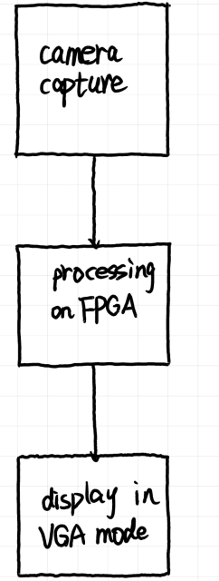
System framework design
Video acquisition module: The camera module is used to collect external video signals and convert them into digital signals and input them into FPGA.
Image processing and edge detection module: image preprocessing using FPGA, including noise removal and image enhancement. Then the edge detection operation is carried out to extract the image edge information.
VGA output module: output the processed image signals to the VGA display screen and display them through the display screen.

Slide 8
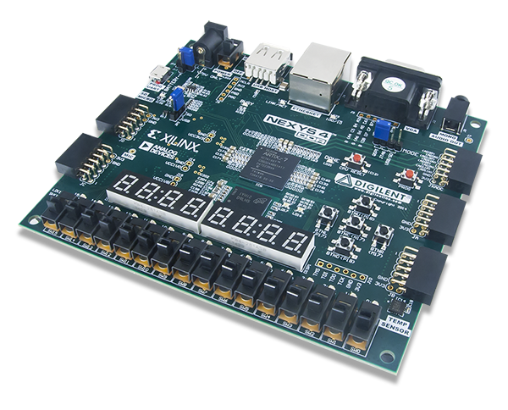
Hardware selection
Nexys4 DDR is a Field Programmable Gate Array (FPGA) -based development board for digital circuit design, embedded development and image processing. The development board adopts Xilinx Artix-7 FPGA chip, which has high performance, low power consumption and strong programmability. Developers can implement their designs and applications programmatically using development tools such as Vivado. As a result, Nexys4 DDR is a development board well suited to students and engineers for digital circuit design and embedded development.

Slide 9
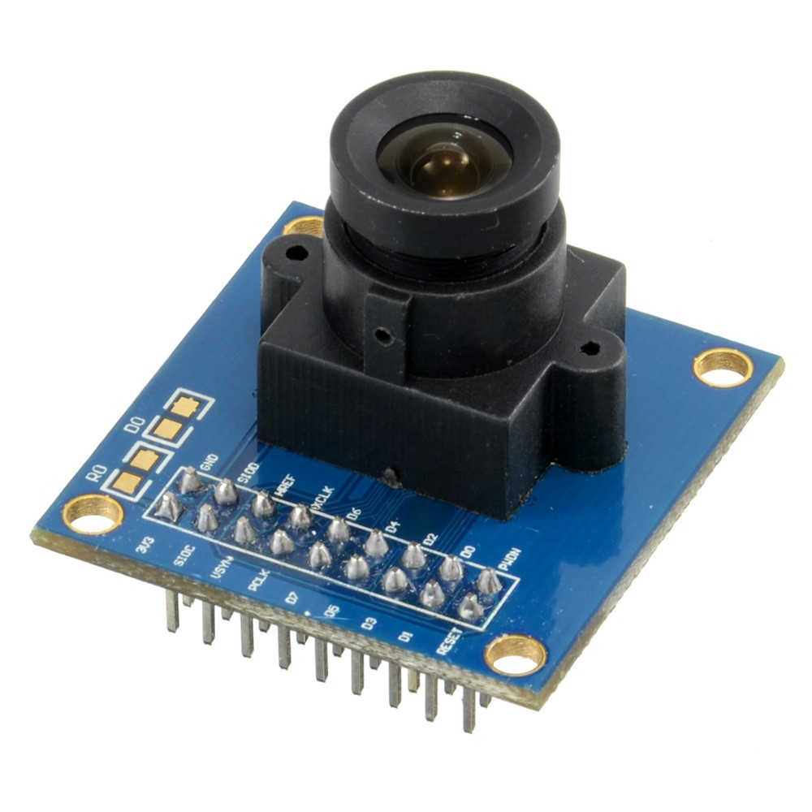
Hardware selection
OV7670 is a CMOS VGA image sensor produced by OV (OmniVision). The sensor is small, operates at low power and offers all the features of a single VGA camera and image processor.

Slide 10
Camera acquisition and processing
Step 1
Step 2
Step 3
Initial
Acquisition
Store
The collected video data is continuously written to SDRAM through the FIFO register.
FPGA initially configures the camera through the IIC bus protocol.
The camera focuses and captures images.

Slide 11
Pretreatment and edge extraction algorithm
Median filtering
The feature of median filtering is to first determine a neighborhood with a certain pixel as the center point, then sort the gray values of each pixel in the neighborhood, and take the middle value as the new gray value of the center pixel

Slide 12


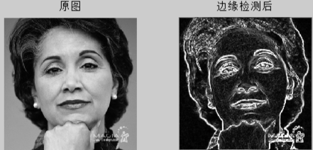
Pretreatment and edge extraction algorithm
Sobel operator
Sobel operator is one of the most commonly used edge detection algorithms, which detects edges based on the gradient change of gray values around pixel points. The advantages are simple and easy to implement, fast computing speed, suitable for real-time image processing. The disadvantage is that it is easy to be affected by noise and the edge detection result may not be accurate enough.

Slide 13
Expected time schedule
03
05
03

Slide 14
Expected time schedule
9-11 week
14 week
The camera captures images and processes them into bit streams
Display color video in VGA mode
Integrity test and function expansion
12-13 week
Algorithm implementation and result analysis

Slide 15
Expected function and Extended function
03
05
04

Slide 16



Expected function
01
02
03
collection
processing
display
drive the camera to capture images in real time and convert them into bitstreams
reduce noise and extract the information of edge
display images in real time in VGA mode.

Slide 17
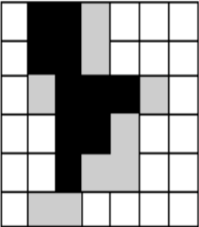
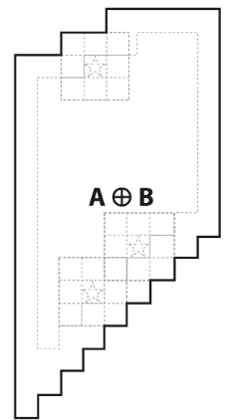
Extended function
Morphological filtering corrosion
eliminates the boundary points of objects, making the boundary shrink inward， separate two objects with small connections
Integrate a variety of image processing functions
Morphological filtering expansion
Eliminate noise, Separate the independent image elements

Slide 18
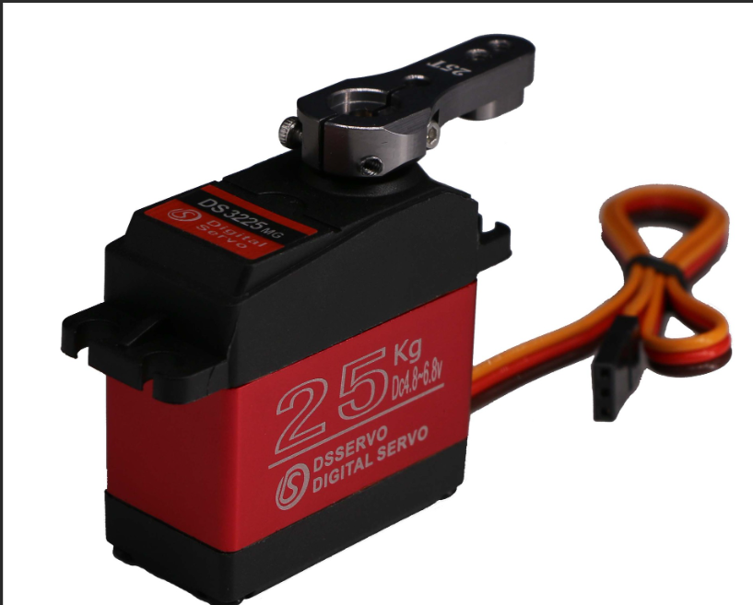
Extended function
Motor
Be responsible for steering
Object tracking
camera
Capture target object and track it

Slide 19
Thanks And Your Slogan Here
Logo Here
05
05
www.islide.cc
Speaker name and title

