Slide 1
Text-to-Speech based on pyttsx3
廖子涵 耿沛言 张旭东
2023.05.30

Slide 2
CONTENTS
Background
Implementation
Thinking

Slide 3
Background
/01

Slide 4
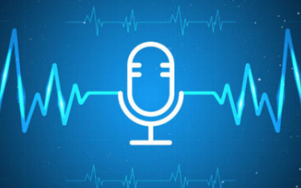
Background
Text-to-Speech (TTS) : a system that converts written text into audible speech.
Application:
screen readers
voice navigation systems
voice assistants
human-machine interaction(virtual reality, and robotics)
Development:
Traditional rule-based methods
deep learning: end-to-end models

Slide 5
Implementation
/02

Slide 6
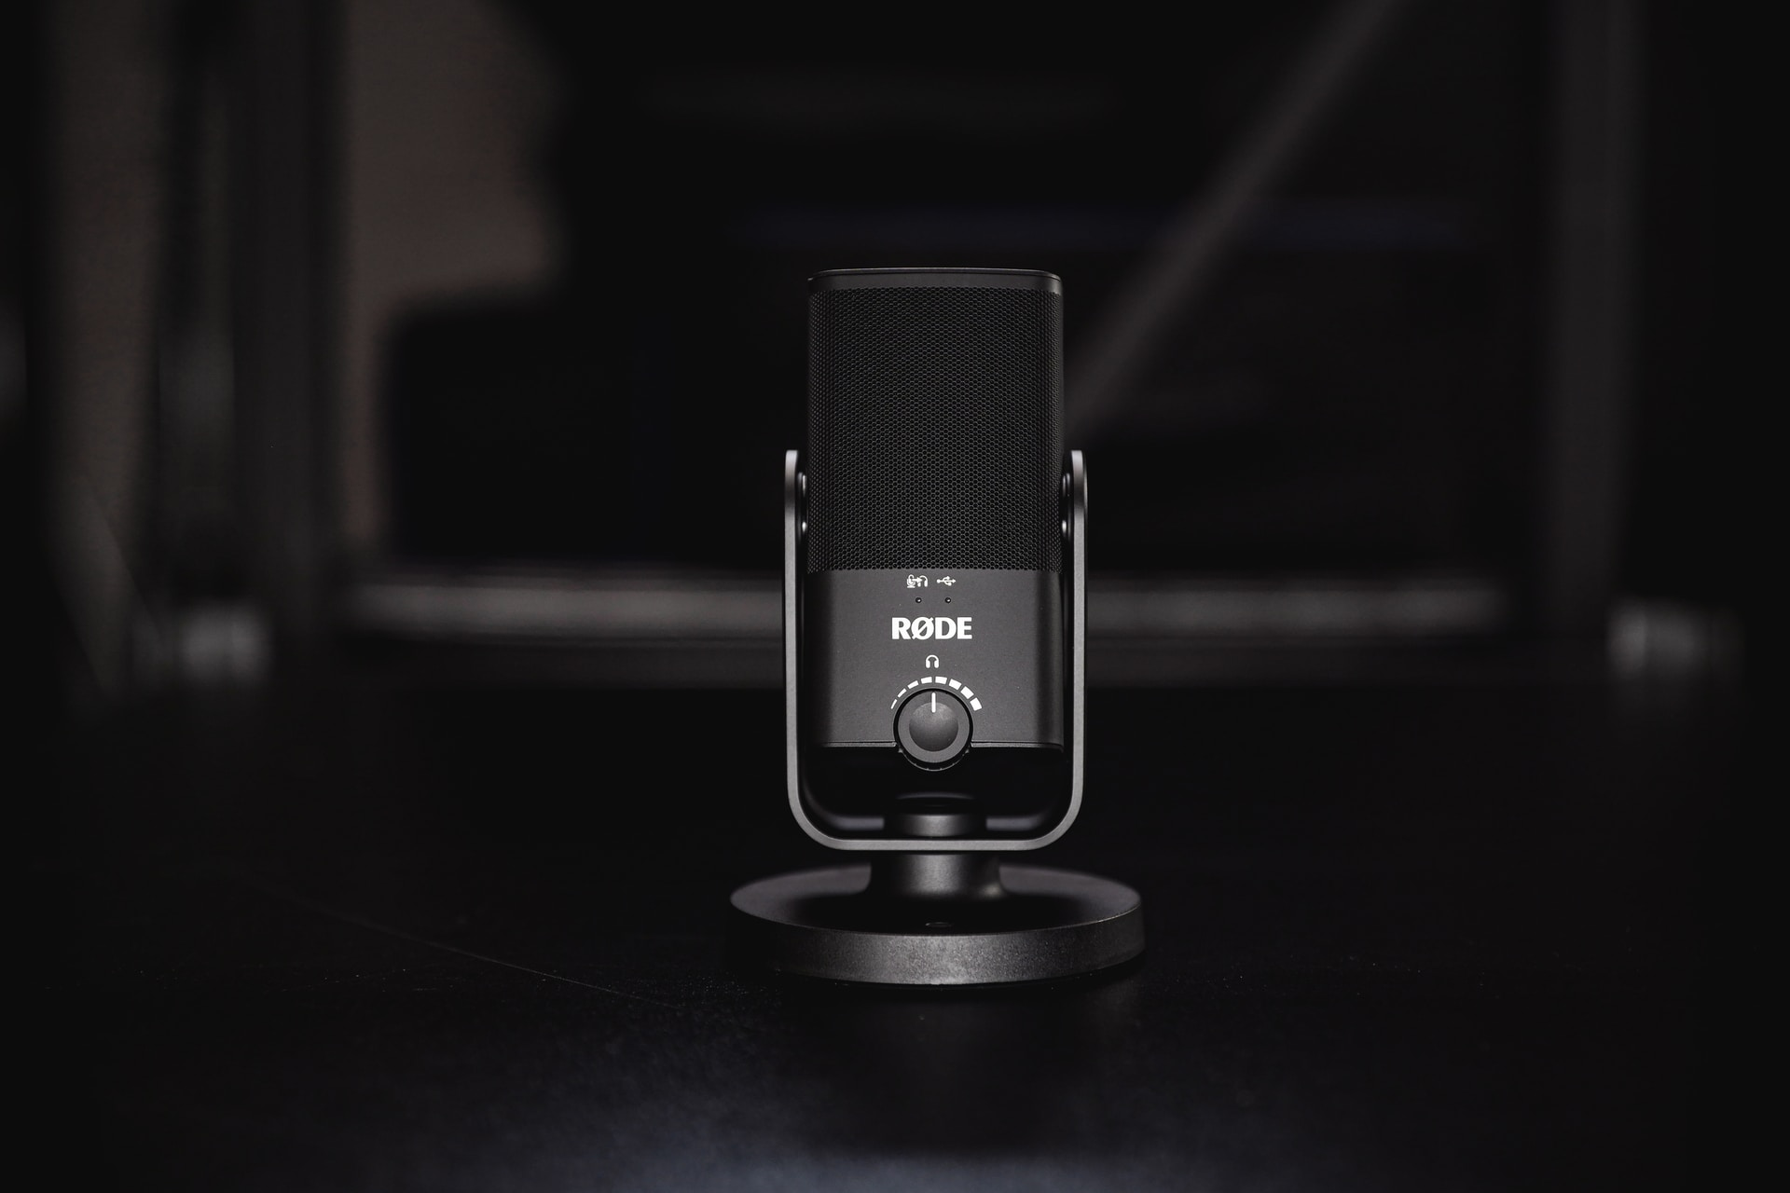
Theoretical introduction
01
Speech synthesis
02
Signal processing
The process of text-to-speech
Generate natural, smooth speech output
Acoustic feature extraction, Phoneme alignment, Speech synthesis parameter generation

Slide 7

Speech synthesis
Rule-based
Rule-based speech synthesis methods synthesize speech using a library of predefined speech rules and speech units. These rules are created based on phonetics knowledge and acoustic models. Limitations in flexibility and naturalness
Statistical-based
Statistically based speech synthesis approaches use large-scale speech data sets to train models and use these models to generate speech, including Hidden Markov Models (HMM) and Gaussian Mixture Models (GMM).
Deep Learning-based
Deep neural networks are used to learn speech representation and generation patterns and to model the mapping relationship between text and speech, including Recurrent Neural Networks and Long Short-Term Memory

Slide 8
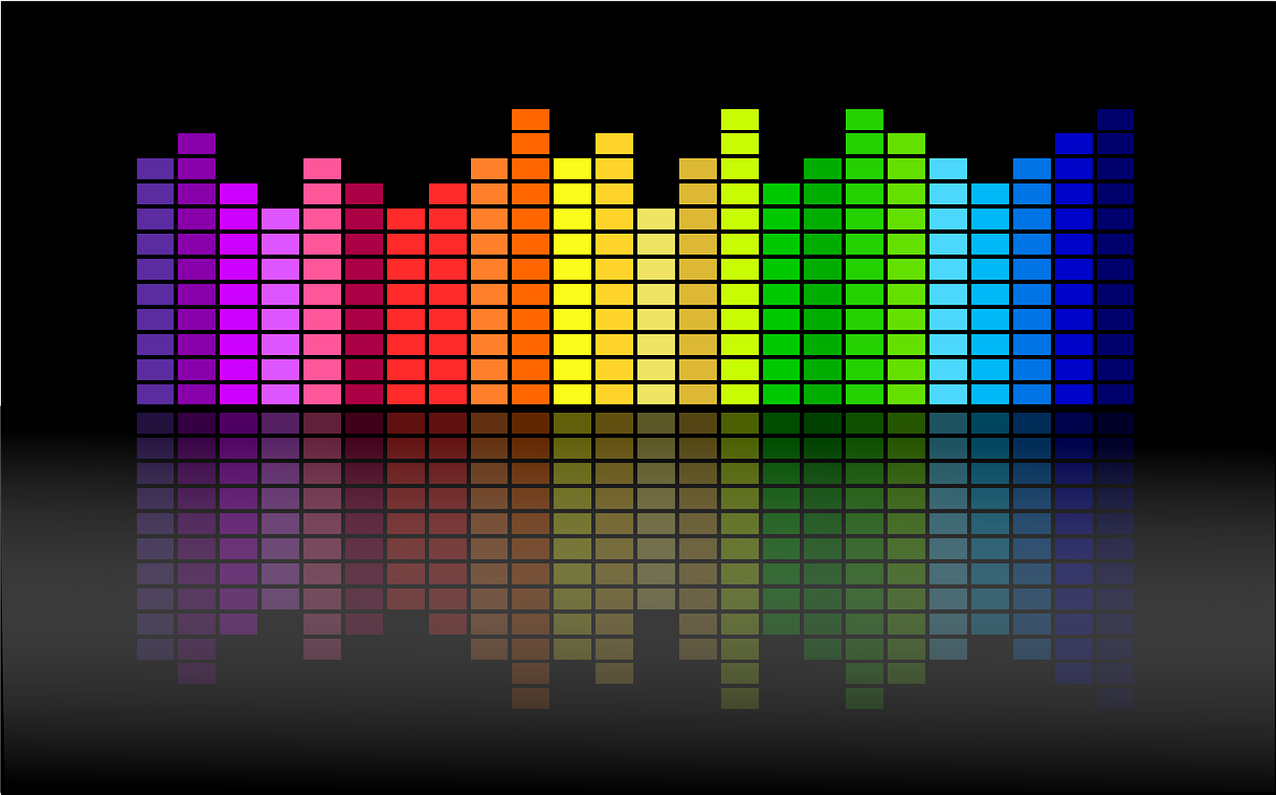
Signal processing
Acoustic feature extraction
Phoneme alignment
Speech synthesis parameter generation
The process of extracting relevant sound features from speech signals. These features are used to describe the time-domain and frequency-domain characteristics of sound
The process of aligning input text with phonemes (phonetic units). Text is usually converted into a sequence of phonemes, each representing a basic unit in speech.
It determines the length and position of each phoneme
Based on the input text and aligned phonemes, a sequence of parameters for synthesizing speech is generated. These parameters describe characteristics such as the length, frequency and intensity of a sound.

Slide 9
Common text-to-speech library
pyttsx3
Advantage : Cross-platform support, provides an intuitive interface.
Disadvantage: Additional configuration and dependencies, Support limited
espeak
Open source and cross-platform, supports multiple languages and phoneme libraries, provides command line tools and API interfaces
03
festival
Open source and cross-platform
Provide a variety of speech synthesis methods and algorithms
02
04
Common text-to-speech library
pyttsx
gTTS
01
05
provides high-quality speech synthesis
Supports for multiple languages and speech properties
Advantage : Cross-platform support, interfaces and functionality similar to pyttsx3
Disadvantage : Inactive maintenance

Slide 10
Introduction to pyttsx3
01
Cross-platform support
Cross-platform support
Advanced function
pyttsx3 runs on multiple operating systems, including Windows, Mac, and Linux
02
Multilanguage support
pyttsx3 supports speech synthesis in a variety of languages
pyttsx3
Customizable voice properties
Multilanguage support
03
Multi-engine support
pyttsx3 allows you to customize synthesized speech output by setting properties such as speed, pitch, volume, and speech
04
Event-driven architecture
pyttsx3 uses an event-driven architecture to handle the various events of speech synthesis
Customizable voice properties
Event-driven architecture
05
Multi-engine support
pyttsx3 supports multiple speech synthesis engines. It uses SAPI5 (for Windows) or NSSpeechSynthesizer (for Mac) by default
06
Advanced function
pyttsx3 provides some advanced features for getting a list of available voices, setting specific voices, saving voices as audio files, and so on

Slide 11



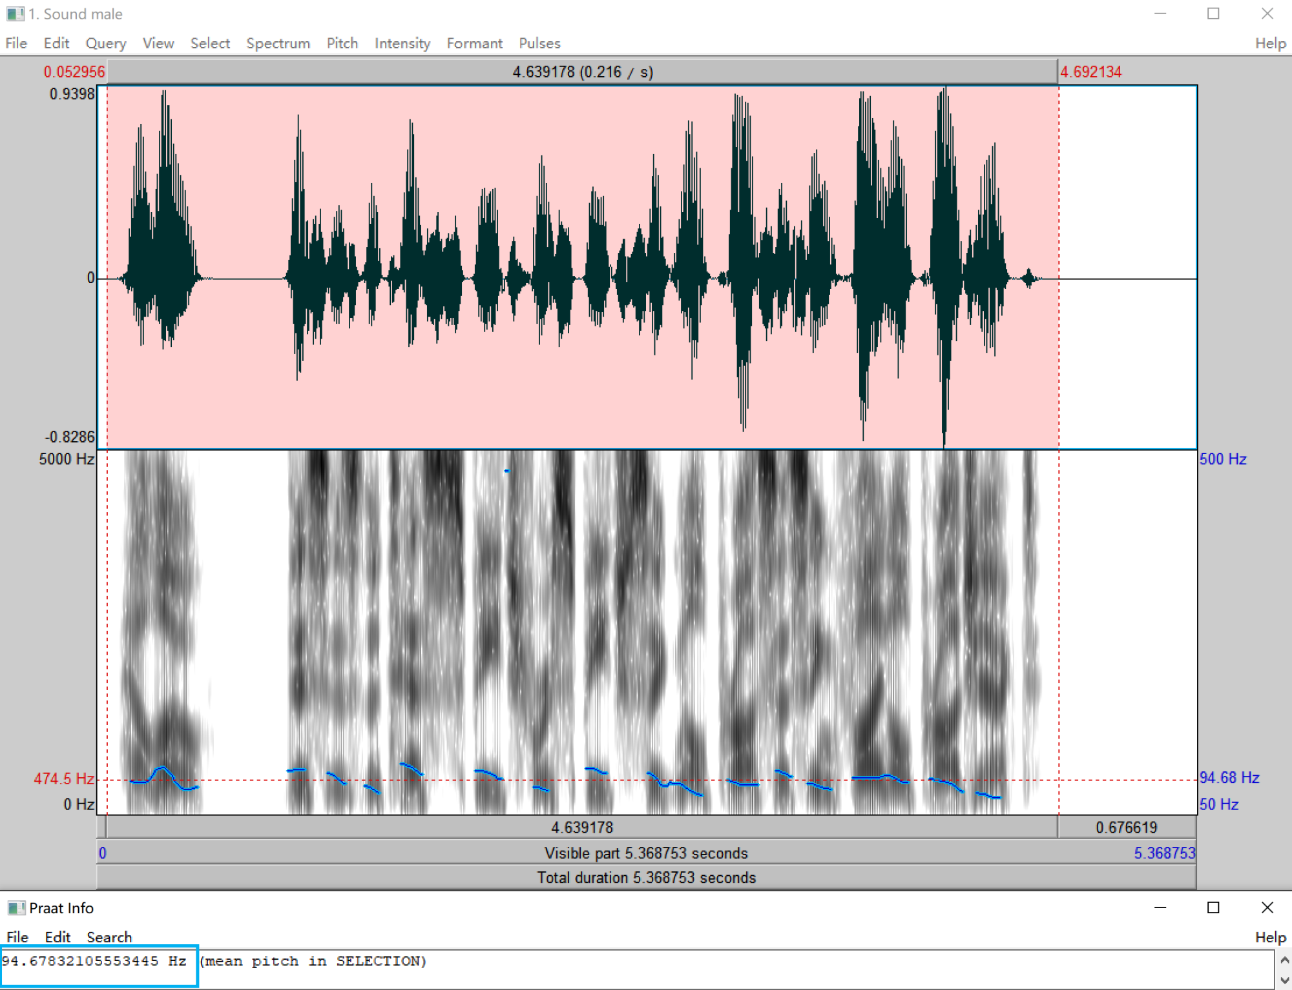
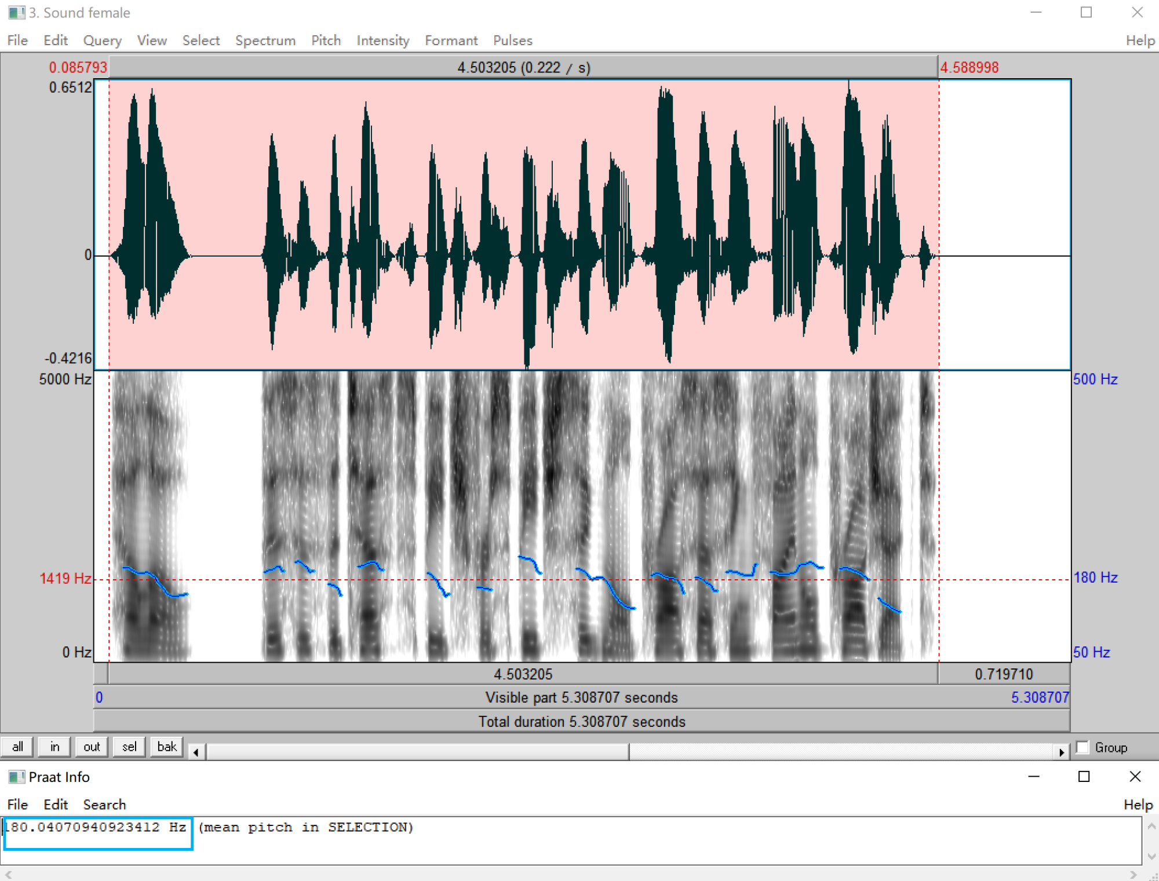
Results Analysis：Pitch
“Hello, this is the test speech for speech signal processing final project.”
pitch = 95 Hz
pitch = 180 Hz

Slide 12
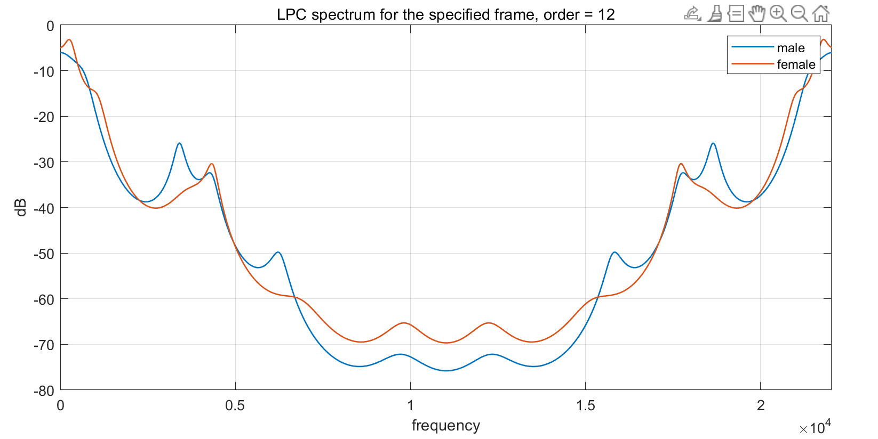
Results Analysis: Vocal Tract
LPC method : $H(z) = \frac{S(z)}{GU(z)} = \frac{1}{1−\sum_{k=1}^{p}{a_{k}z^{−k}}} = \frac{1}{A(z)}$

Slide 13
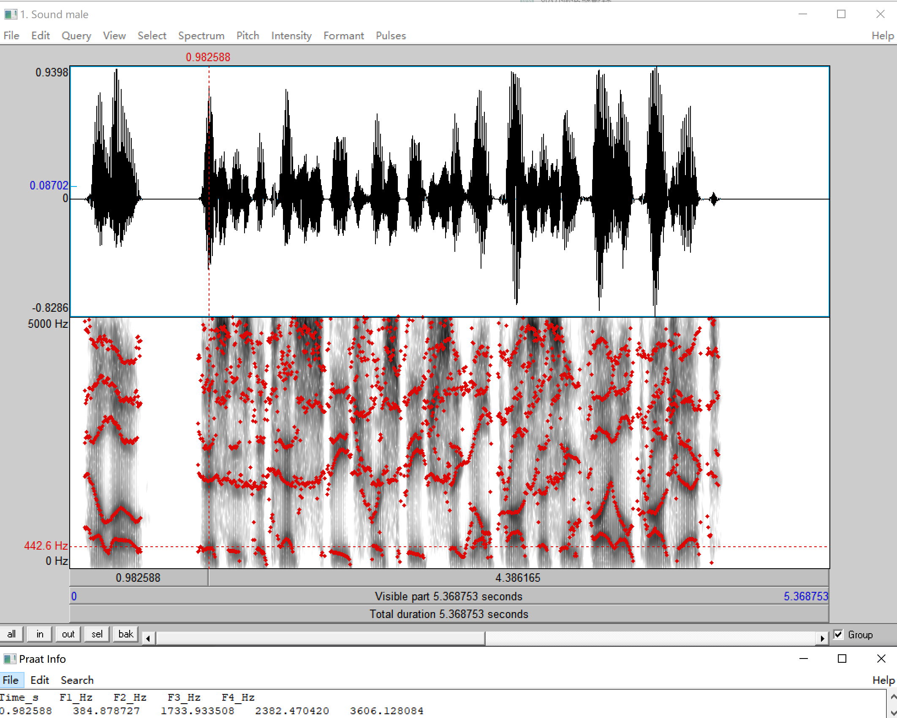
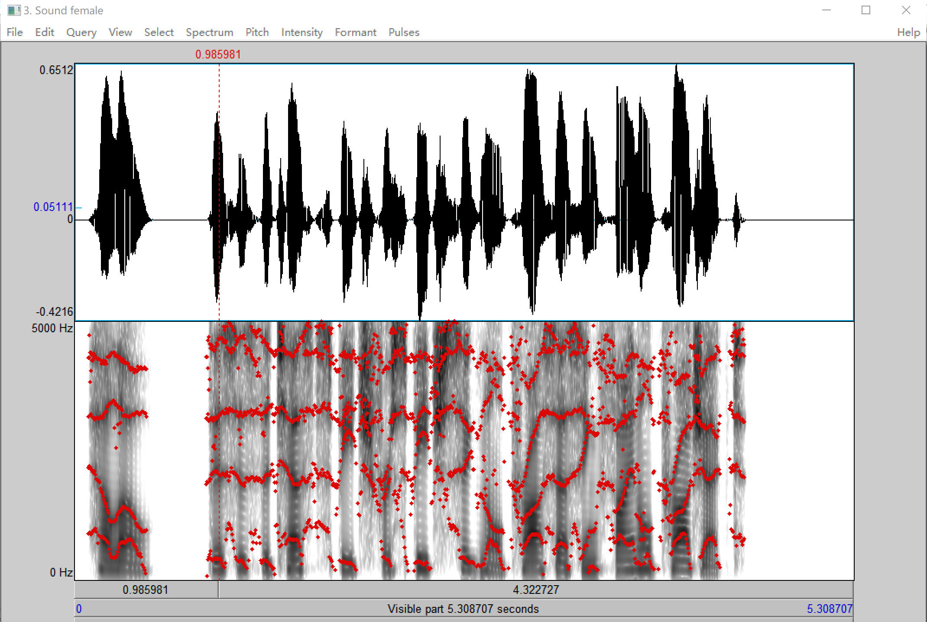

Results Analysis: Formants

Slide 14
Thinking
/03

Slide 15

Improvement
By adjusting speed and pitch, make speech sound more natural. Appropriate speed and pitch can increase the intelligibility and fluency of speech.
Different languages and accents have their own unique pronunciation rules and acoustic characteristics, and choosing the right engine can provide more accurate and natural speech output.
Focus
on specific
languages
and accents
Speed
and pitch
control
Where appropriate, emphasize certain words or express certain emotions by using different tones, volumes, and tones. This can make speech sounds more vivid and expressive
Emphasis
and tone
Introducing
the latest
technology
Keep an eye on the latest technology and research advances in speech synthesis, as well as methods for training using large data sets. These technologies can provide higher quality, more natural speech synthesis effects
Ensure that the speech synthesis engine can accurately recognize and synthesize different phonemes. Ensure that transitions and connections between phonemes are smooth and natural to avoid staccato or disconnected speech output
Accuracy
and
coherence of
phonemes
User
feedback
and
evaluation
Through user feedback and evaluation, understand the performance of the speech synthesis system in different application scenarios

Slide 16
Future Application
1
2
3
4
5
Personalized assistants and avatars
Speech assistance technology
Multilingual and interlingual communication
Media and entertainment experiences
Customize broadcast and media content
Text-to-speech enables voice and voice interaction for personalized assistants and avatars. Avatars in smart speakers, smartphones and virtual reality applications can communicate and interact with users using text-to-speech technology.
Future apps could help these populations better interact with their digital and physical environments by converting text to speech and providing real-time on-screen reading, voice prompts and voice navigation.
It can convert text to speech in real time and provides speech translation capabilities to support different languages. This can promote communication and understanding between different languages.
In the realm of e-readers and audio books, text-to-speech converts book content into audio playback. In games and virtual reality, text-to-speech technology can give voice and interaction capabilities to characters and virtual worlds.
Text-to-speech can be used for customized broadcast and media content generation. By converting text to speech, users can be offered personalized content such as news, podcasts, audio books and radio programs, tailored to their interests and preferences.

Slide 17
Thank for your listening

