Slide 1
Lecture 1 Review
History of Wireless Comm.
Current and Emerging Wireless Systems
Cellular, WiFi, Satellite, Bluetooth, Zigbee
sensor network, biomedical network, cognitive radio
Characteristics of Wireless Comm.
Technical Challenges

Slide 2
Lecture 2 Outline
Signal Propagation Overview
TX and RX Signal Models
Complex baseband models
Path Loss Models
Free-space Path Loss
Ray Tracing Models
Simplified Path Loss Model
Empirical Models
Log Normal Shadowing
Combined Path Loss and Shadowing
Model Parameters from Measurements

Slide 3
Recall what happens when EM wave encounters a new media
Reflection
Diffraction
Scattering
Absorption

Slide 4

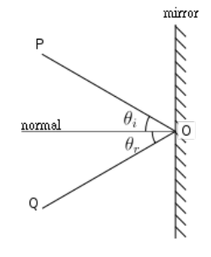
Reflection
Wave hits an object with dimension much larger than the radio wavelength will be partially reflected off the surface of the object

Slide 5
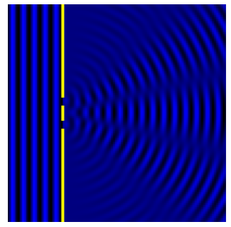
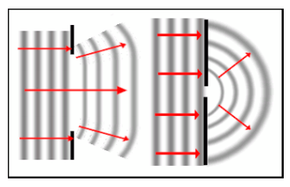
Diffraction
Apparent bending of waves around small obstacles and the spreading out of waves past small openings

Slide 6
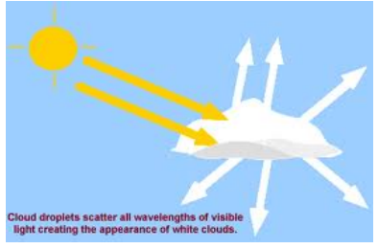
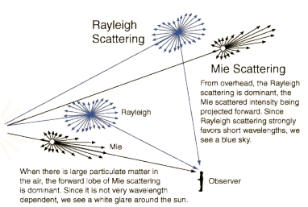
Scattering
EM wave scattered by particles that are much smaller in diameter than the wavelength

Slide 7
Absorption
The absorption of EM wave is often called attenuation
The energy of EM wave is taken up by some matter and transformed to other forms of energy, e.g., heat

Slide 8
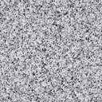
Propagation Characteristics
Path Loss (includes average shadowing)
Shadowing (due to obstructions)
Multipath Fading
large-scale
propagation effect
-- small-scale propagation effect
Slow
P_{t}
P_{r}/P_{t}
Fast
P_{r}
Very slow
v
d=vt
d

Slide 9
Path Loss Modeling
Maxwell’s equations
Complex and impractical
Free space path loss model
Too simple
Ray tracing models
Requires site-specific information
Simplified power falloff models
Main characteristics: good for high-level analysis
Empirical Models
Don’t always generalize to other environments

Slide 10


Representation of Bandpass Signals
Bandpass signal:
s_{I}(t) is in-phase component, s_{Q}(t) is quadrature component
Define a complex signal:
u(t) is called equivalent lowpass signal for s(t)

Slide 11



Free Space (LOS) Model
Path loss and path gain:
Path loss:
Path gain:
Power falls off:
G_{l} is the product of tx and rx antenna field radiation pattern in the LOS direction
Proportional to 1/d²,λ²
d

Slide 14
Ray Tracing Approximation
Rx contains multipath signal components
Ray tracing:
Assume a finite number of reflectors with known location and dielectric property
Then, the received signal from each signal component can be calculated
Typically includes reflected rays, can also include scattered and diffracted rays.
Accurate for rural area, city street and indoor environment

Slide 15
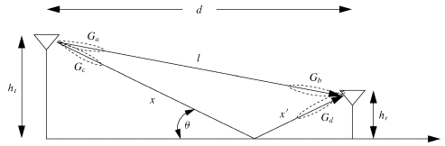
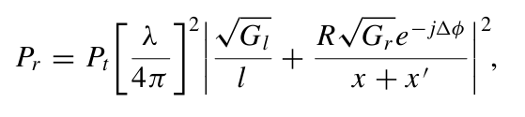


Two Path Model
Path loss for one LOS path and one ground (or reflected) bounce
Delay spread: (x+x’-l)/c

Slide 18
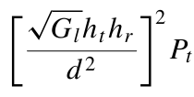

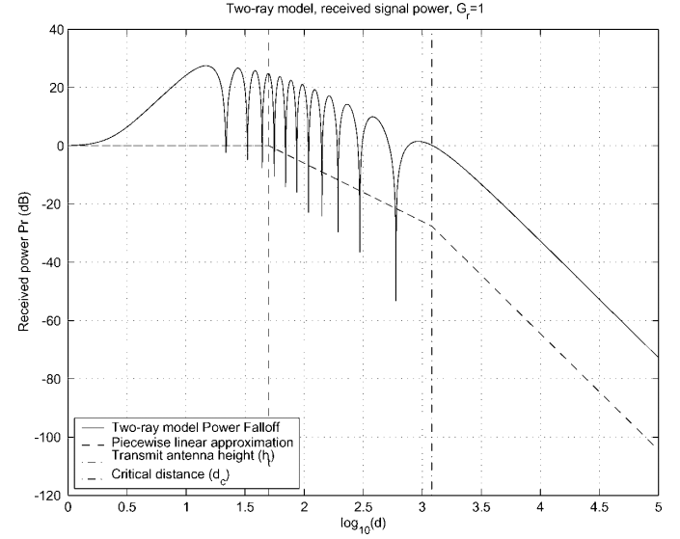
Two Path Model
Ground bounce approximately cancels LOS path above critical distance
Power falls off
Proportional to d² (small d)
Proportional to d⁴ (d>d_{c})
Independent of λ (f)

Slide 19

General Ray Tracing
Models all signal components
Reflections
Scattering
Diffraction
Requires detailed geometry and dielectric properties of site
Similar to Maxwell, but easier math.
Computer packages often used

Slide 20

Simplified Path Loss Model
Used when path loss dominated by reflections.
Most important parameter is the path loss exponent γ, determined empirically.
where is achieved from free-space model

Slide 21

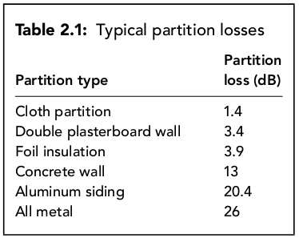
Indoor Propagation Model
Indoor model differ widely in the materials used for walls and floors, the layout of rooms, windows and obstructing objects
Difficult to find generic models
FAF: floor attenuation factor (8-20dB)
PAF: partition attenuation factor

Slide 22
Empirical Channel Models
Cellular Models: Okumura model and extensions:
Empirically based (site/freq specific)
Awkward (uses graphs)
Hata model: Analytical approximation to Okumura
Cost 231 Model: extends Hata to higher freq. (2 GHz)
Walfish/Bertoni: extends Cost 231 to include diffraction
WiFi channel models: TGn
Empirical model for 802.11n developed within the IEEE standards committee. Free space loss up to a breakpoint, then slope of 3.5. Breakpoint is empirically-based.
Commonly used in cellular and WiFi system simulations

Slide 23
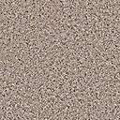

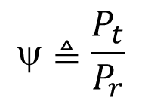

Shadowing
Models attenuation from obstructions
Random due to random # and type of obstructions
Typically follows a log-normal distribution
dB value of power is normally distributed
μ=0 (mean captured in path loss), 4 dB<σ<13 dB (empirical)
Central limit theorem can be used to explain this model

Slide 25
Combined Path Loss and Shadowing
Linear Model: ψ lognormal
dB Model
10logΚ
Slow
P_{r}/P_{t}
(dB)
Very slow
-10γ
log d

Slide 26



Outage Probability
Path loss: circular cells
Path loss + shadowing: amoeba cells
Tradeoff between coverage and interference
Outage probability
Probability received power below given minimum

Slide 28
Cell Coverage Area
Cell coverage area
% of cell locations at desired power
Increases as shadowing variance decreases
Large % indicates interference to other cells

Slide 29
Main Points
Path loss models simplify Maxwell’s equations
Models vary in complexity and accuracy
Power falloff with distance is proportional to d² in free space, d⁴ in two path model
Main characteristics of path loss captured in simple model P_{r}=P_{t}K[d₀/d]^{γ}
Empirical models used in simulations
Low accuracy (15-20 dB std)
Capture phenomena missing from formulas
Can be awkward to use in analysis

Slide 30
Main Points
Random attenuation due to shadowing modeled as log-normal (empirical parameters)
Combined path loss and shadowing leads to outage and amoeba-like cell shapes
Cellular coverage area dictates the percentage of locations within a cell that are not in outage

Slide 31
Assignment
Read Chapter 2
Homework: 2-2, 2-13, 2-17, 2-19

