Slide 1
Lecture 3
Statistical Multipath Channel Models
(Small-Scale Fading)

Slide 2
Review of Lecture 2
Path loss models simplify Maxwell’s equations
Models vary in complexity and accuracy
Power falloff with distance is proportional to d² in free space, d⁴ in two path model
Main characteristics of path loss captured in simple model P_{r}=P_{t}K[d₀/d]^{γ}
Empirical models used in simulations
Low accuracy (15-20 dB std)
Capture phenomena missing from formulas
Can be awkward to use in analysis

Slide 3
Review of Lecture 2
Random attenuation due to shadowing modeled as log-normal (empirical parameters)
Combined path loss and shadowing leads to outage and amoeba-like cell shapes
Cellular coverage area dictates the percentage of locations within a cell that are not in outage

Slide 4

Recall the Propagation Effect
Path Loss (includes average shadowing)
Shadowing (due to obstructions)
Multipath Fading
large-scale
propagation effect
-- small-scale propagation effect
Slow
P_{t}
P_{r}/P_{t}
Fast
P_{r}
Very slow
v
d=vt
d

Slide 5
Lecture 3 Outline
Time Varying Channel Impulse Response
Narrowband Fading Model
Flat Fading vs. Frequency Selective Fading
Effect of Flat and Frequency Selective Fading
Signal Envelope Distributions (Rayleigh and Rician)
Average Fade Duration

Slide 6
Lecture 3 Outline
Time Varying Nature of Channel Fading
Scattering Function
Multipath Intensity Profile
Doppler Power Spectrum

Slide 7

Multipath Fading
Results from
Interference between multiple paths with different path lengths
Movement of the mobile or environment makes this effect time varying
Rate of variation of the channel characteristics is measured by Doppler Frequency

Slide 8
Multipath Fading
Random # of multipath components, each with
Random amplitude
Random phase
Random Doppler shift
Random delay
Random components change with time
Leads to time-varying channel impulse response

Slide 9
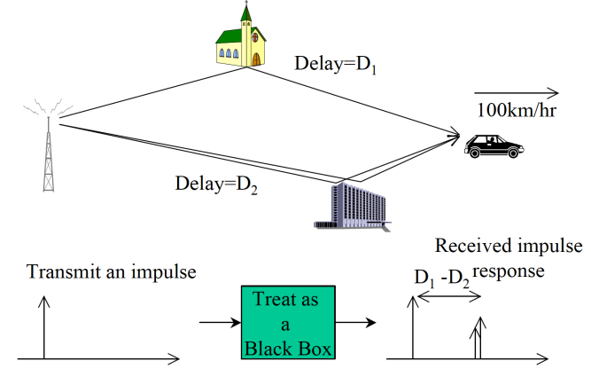
Physics of Multipath Fading

Slide 10
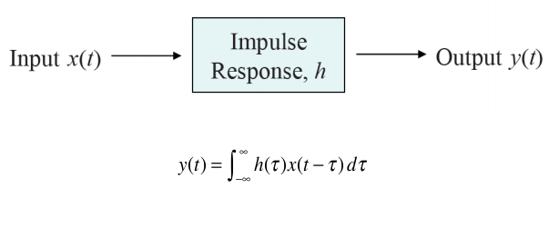
Review of Impulse Response of a Linear System

Slide 11
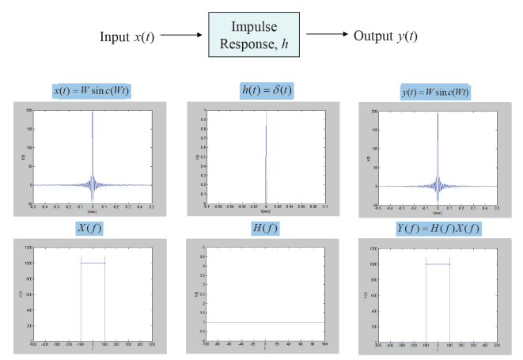
Example

Slide 12
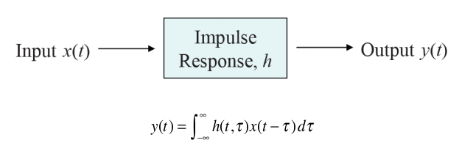
Time-Varying Linear System

Slide 13
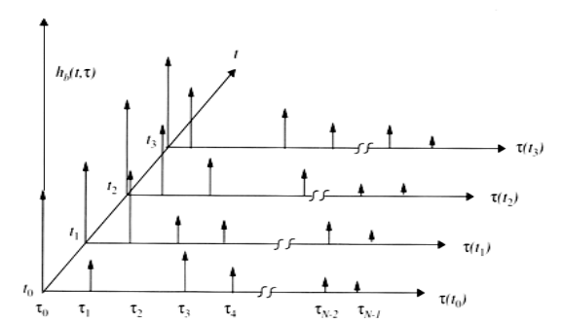
Time-Varying Multipath Channel

Slide 14
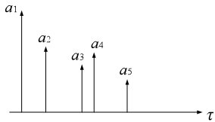
Time Varying Impulse Response
Response of channel at time t to impulse input at time t-τ:
: impulse response of the channel at time t to the impulse input at time t-τ
: random amplitude
: random phase
: random delay

Slide 17
Received Signal Characteristics
Received signal consists of many multipath components
Amplitudes change slowly
Phases change rapidly
Constructive and destructive addition of signal components
Amplitude fading of received signal (both wideband and narrowband signals)

Slide 18
Narrowband Model
Assume delay spread max_{m,n}|τ_{n}(t)-τ_{m}(t)|<<1/B
Then u(t)≈u(t-τ).
Received signal given by
No signal distortion (spreading in time)
Multipath affects complex scale factor in brackets.

Slide 20
Wideband Channels
Individual multipath components resolvable
True when time difference between components exceeds signal bandwidth
τ
τ
Narrowband
Wideband

Slide 21

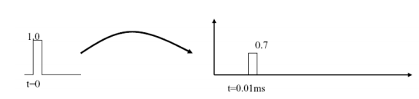
Flat Fading vs. Frequency Selective Fading
Flat fading:
N(t)=1, i.e. no delay spread
Channel impulse response is one single impulse
The frequency response is a constant (over the communication bandwidth)
Usually occurs for narrowband communication, i.e., low symbol rates

Slide 22
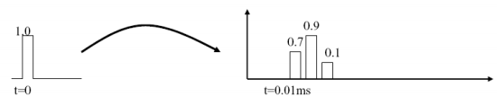
Flat Fading vs. Frequency Selective Fading
Frequency selective fading:
N(t)>1 i.e. with delay spread
Channel impulse response consists of multiple impulses
The frequency response varies over the communication bandwidth
Usually occurs for wideband communication, i.e., high symbol rates

Slide 23
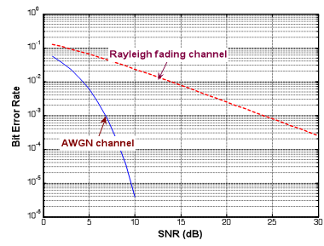
Effect of Flat Fading
Flatten BER curves
Around 15dB penalty when BER is 10⁻³

Slide 24
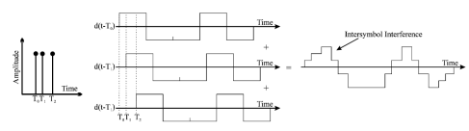
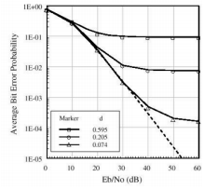
Effect of Frequency Selective Fading
Multipath → Inter-symbol interference (ISI)
Result in irreducible error floor

Slide 25
Signal Envelope Distribution for Narrow Band Model
CLT approx. leads to Rayleigh distribution (power is exponential)
When LOS component present, Ricean distribution is used
Measurements support Nakagami distribution in some environments
Similar to Ricean, but models “worse than Rayleigh”
Lends itself better to closed form BER expressions

Slide 26
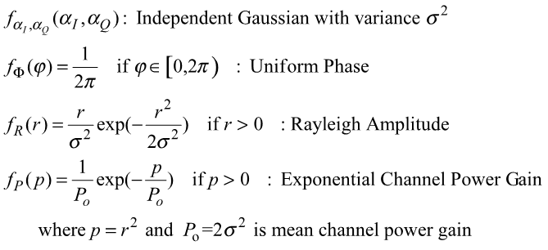
Rayleigh Channel

Slide 27


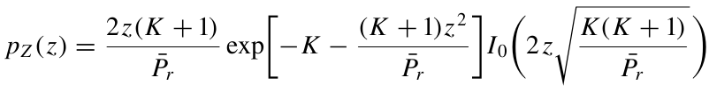

Rician Channel
LOS channels：

Slide 28


Level Crossing Rate and Average Fade Duration
LCR: rate at which the signal crosses a fade value Z in the downward direction
where
AFD: How long a signal stays below target Z
Derived from LCR
For Rayleigh fading
Depends on ratio of target to average level (ρ)
Inversely proportional to Doppler frequency
t₁
t₂
t₃
Z

Slide 29
Main Points
Time Varying Channel Impulse Response
Narrowband Fading Model
Flat Fading vs. Frequency Selective Fading
Effect of Flat and Frequency Selective Fading
Signal Envelope Distributions (Rayleigh and Rician)
Average Fade Duration

Slide 30
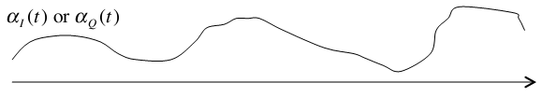
Time Varying Nature of Wireless Channel
Cause for time-varying nature
movements of mobile or objects in the environment
On each path, is a random process
This random process is correlated in time
The faster the autocorrelation function decays with the time difference, the faster the channel varies
To measure how fast the channel varies: Doppler spread and coherence time.

Slide 31
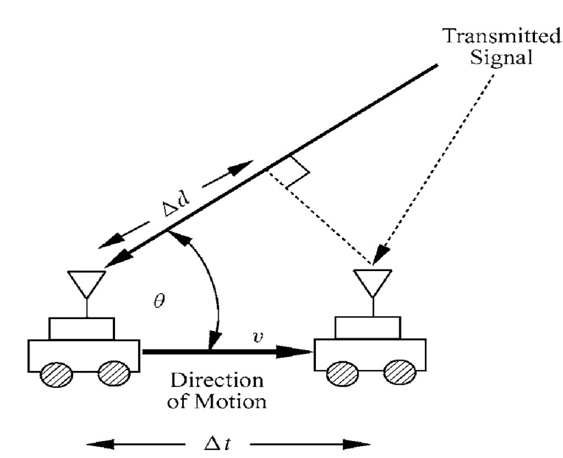

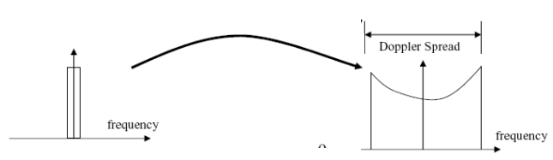
Doppler Shift
Doppler frequency shift
Doppler spread: the maximum Doppler shift

Slide 32
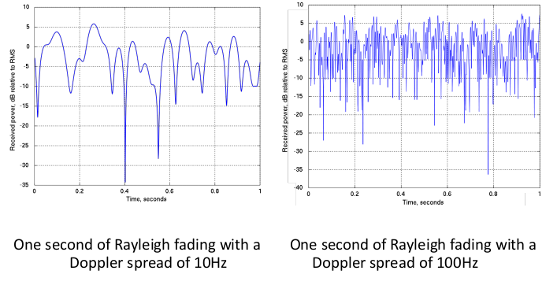
Doppler Shift

Slide 33
Assignment
Read Chapter 3
Homework: 3-3, 3-6,3-8,3-12

Slide 34
Review of Last Lecture
Time Varying Channel Impulse Response
Narrowband Fading Model
Flat Fading vs. Frequency Selective Fading
Effect of Flat and Frequency Selective Fading
Signal Envelope Distributions (Rayleigh and Rician)
Average Fade Duration
Time Varying Nature of Channel Fading

Slide 35

Autocorrelation Function
Channel impulse response is a random process
is a complex Gaussian process, is characterized by mean, autocorrelation and cross correlation.
Autocorrelation:
Mean = 0, crosscorrelation = 0

Slide 36

Scattering Function
Wide sense stationary:
Uncorrelated scattering
Scattering function is Fourier trans. of A_{c}(τ,Δt):
(with respect to Δt)
τ:
multipath delay function
ρ:
Doppler frequency

Slide 37
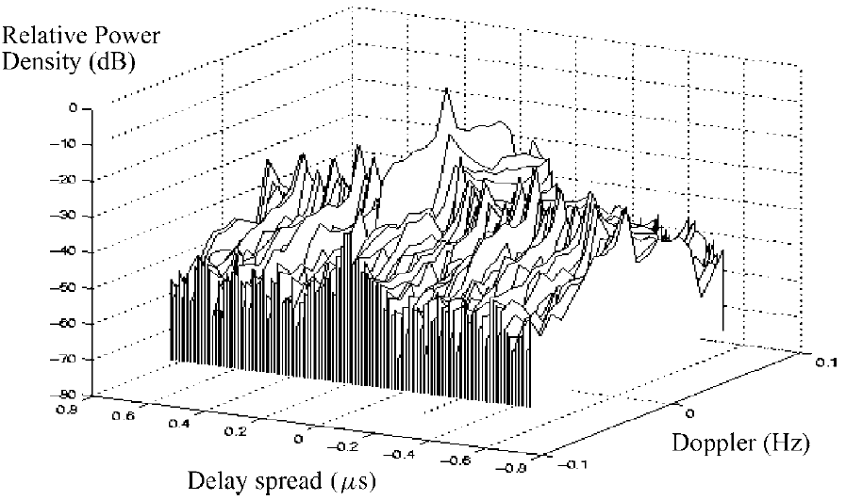
Scatter Function
Scattering function is the average output power of the channel as a function of τ,
ρ

Slide 38
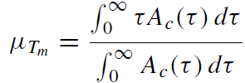
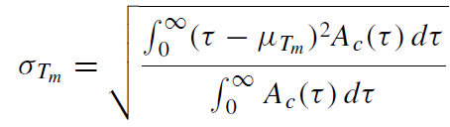
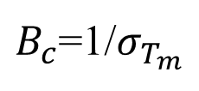
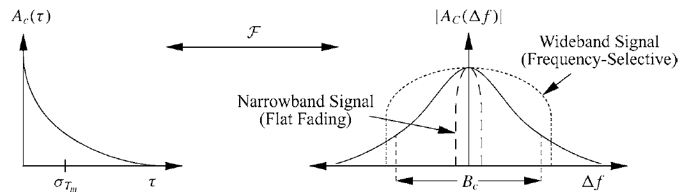
Power Delay Profile
Power Delay Profile (multipath intensity profile)
Let Δt=0 in A_{c}(τ, Δt), written as A_{c}(τ)
Average power associated with a given multipath delay
Determines average and rms delay spread
Coherence Bandwidth
Signals separated in frequency by Bc is uncorrelated

Slide 39

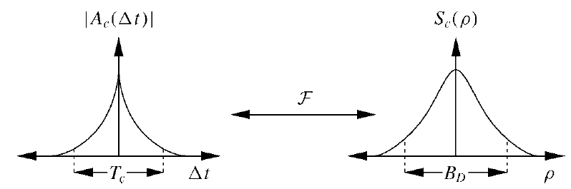
Doppler Power Spectrum
Doppler Power Spectrum
Let Δf =0 in A_{C}(Δf , Δt) →A_{C}(Δt)
DPS: Fourier Trans. of A_{C}(Δt) with respective of Δt
Determines Doppler spread: B_{d} is maximum doppler ρ for which S_{c} (ρ)=>0
Coherence Time: T_{c}=1/B_{d}
Signals separated in time by Τ_{c} is uncorrelated
captial C
2T_{c}
2B_{d}

Slide 40
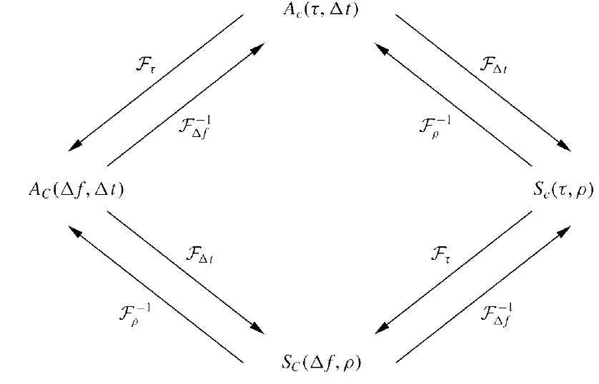



Summary
A_{c}(τ): Power delay profile
∆t=0
∆t=0
∆f=0
B_{D}: Doppler spread
∆f=0
S_{c}(ρ): Doppler power spectrum

Slide 41
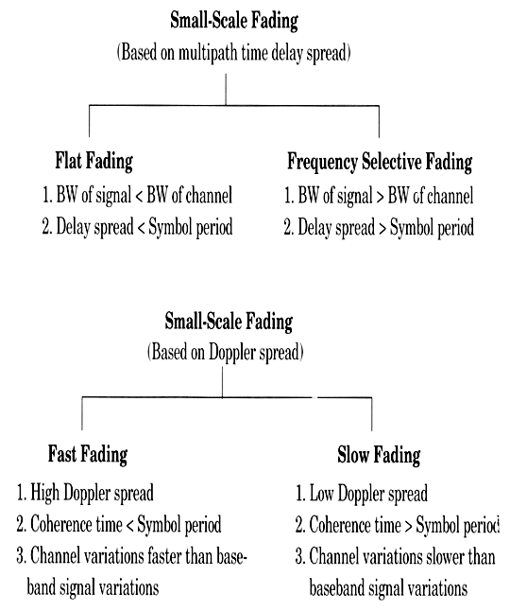
Summary

Slide 42
Main Points
Scattering Function
Power Delay Profile → Coherence Bandwidth
Doppler Power Spectrum → Coherence Time
Flat/Frequency Selective Fading
Fast/Slow Fading

