Slide 1


FACULTY OF APPLIED SCIENCE & TECHNOLOGY
DEPARTMENT OF COMPUTER SCIENCE
GROUP 5
TOPIC:
MOBILE BASED CROP DISEASE DETECTION AND ADVISORY SYSTEM FOR TOMATO AND MAIZE CROPS
PROJECT TEAM (PRESENTERS):
Ntiamoah Prince Agyei (STUBTECH220135) | Adjei Sarfo Joseph (STUBTECH221244)
Abdul Wasiu Abubakr (STUBTECH220035) | Lomotey Nathaniel Julian (STUBTECH220073)
Supervisors: Mr. Buabeng Solomon & Mrs. Awuti Mensah
PROJECT TEAM (PRESENTERS):
Ntiamoah Prince Agyei (STUBTECH220135) | Adjei Sarfo Joseph (STUBTECH221244)
Abdul Wasiu Abubakr (STUBTECH220035) | Lomotey Nathaniel Julian (STUBTECH220073)
Supervisors: Mr. Buabeng Solomon & Mrs. Awuti Mensah
2025/2026

Slide 2
Problem Study
Economic Pillar: Agriculture contributes ~20% of Ghana's GDP and employs over 40% of the rural workforce.
Vulnerable Staple Crops: Tomato (Solanum lycopersicum) and Maize (Zea mays) suffer from destructive fungal, bacterial, and viral pathogens.
Devastating Harvest Losses: Pathologies such as Early/Late Blight and Common Rust cause 30% to 80% annual yield reductions. [FAO, 2023]
Severe Extension Deficit: Developing regions average 1 agricultural extension officer per 1,500+ smallholder farmers. [MoFA Ghana, 2022]
Diagnostic Misclassification: Visual symptoms overlap significantly, leading to improper agrochemical use and environmental toxicity.
Urgent Project Imperative: A low-latency, 100% offline, intelligent mobile diagnostic tool providing instant verified agronomic advice.

Slide 3
Research Gaps in Existing Literature
Heavy Cloud Architecture Bottleneck: Prior CNN models (AlexNet, DenseNet-121 >100 MB) demand cloud servers and GPU clusters, infeasible for remote farms. [Mohanty et al., 2016; Too et al., 2019]
Spatial Lesion Information Loss: Traditional channel attention (SE-Net) compresses channels via global average pooling, discarding fine-grained spatial lesion cues. [Hu et al., 2018; Misra et al., 2021]
Black-Box AI Trust Deficit: Standard deep networks output class labels without visual explanations, causing distrust among cautious farmers and agronomists. [Rahman et al., 2024; Vyas et al., 2023]
Rural Cellular Blind-Spots: Over 60% of rural sub-Saharan farming belts lack stable 4G/5G, rendering cloud-dependent API systems unusable. [GSMA, 2023]
Disconnected Action Plans: Existing tools identify diseases without integrating localized, actionable organic and chemical agronomic remedies. [Silva & Santos, 2025]

Slide 4
Research Objectives (General & Specific)
General Objective: To design, implement, and validate an offline, mobile-based crop disease detection and localized advisory system for Tomato and Maize crops.
Specific Objective 1: Develop and train a lightweight EfficientNet-B0 backbone fused with Triplet Attention across 14 Tomato and Maize classes.
Specific Objective 2: Quantize the model using INT8 Post-Training Quantization to achieve <10 MB footprint and <100 ms on-device latency.
Specific Objective 3: Integrate Gradient-weighted Class Activation Mapping (Grad-CAM) to generate transparent visual diagnostic heatmaps.
Specific Objective 4: Build a cross-platform Flutter application with an embedded offline SQLite disease and treatment repository.
Specific Objective 5: Empirically evaluate real-world usability and user acceptance using the standard System Usability Scale (SUS).

Slide 5
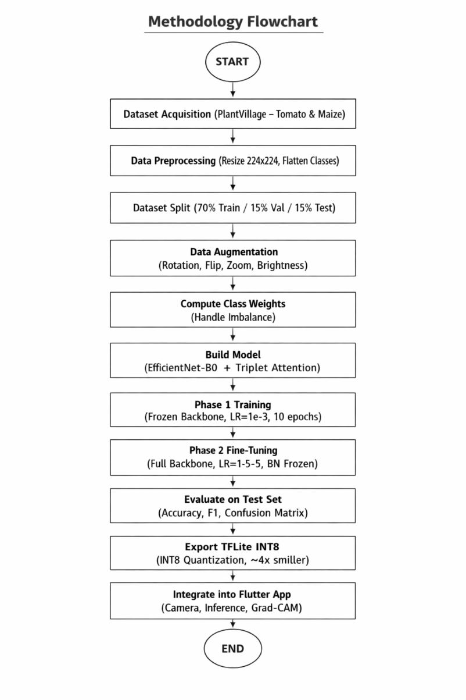
Methodology & System Pipeline Overview
Stage 1 (Data Acquisition & Prep): Standardization to 224x224 RGB, photometric/geometric augmentations to simulate natural outdoor lighting.
Stage 2 (Model Engineering): EfficientNet-B0 backbone + Triplet Attention module + Label Smoothing (eps = 0.1) for high discrimination.
Stage 3 (Two-Phase Transfer Learning): Phase 1: Feature extraction (10 epochs); Phase 2: End-to-end fine-tuning with low learning rate (30 epochs).
Stage 4 (INT8 Post-Training Quantization): TensorFlow Lite INT8 quantization with representative dataset calibration (20.3 MB -> 5.1 MB).
Stage 5 (Edge Mobile Deployment): Flutter cross-platform client + on-device TFLite interpreter + local SQLite database (100% offline).
Stage 6 (XAI & Usability Testing): Grad-CAM visual attention verification + empirical 10-item Likert SUS field evaluation.

Slide 6
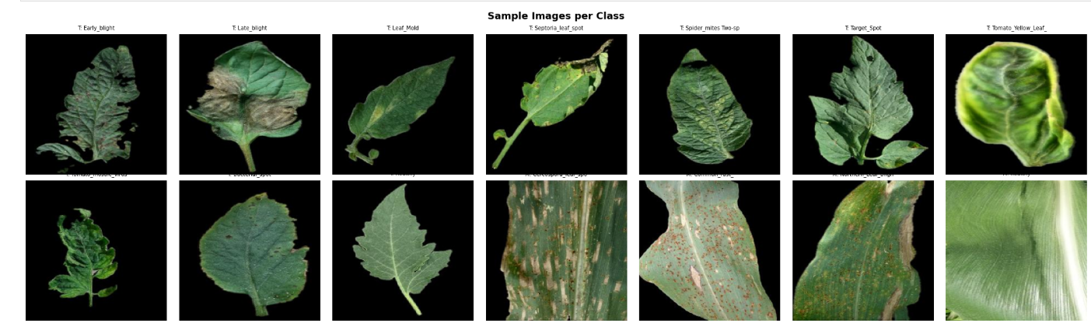
Methodology Flowchart & System Architecture

Slide 7
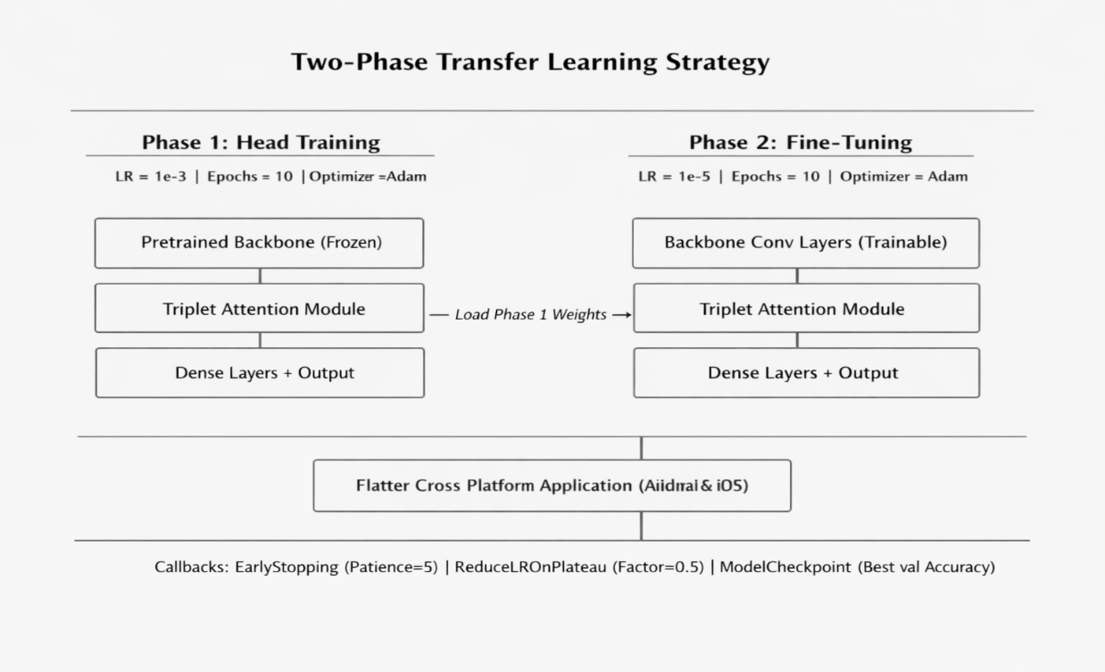
Dataset Preprocessing & Augmentation Pipeline
PlantVillage Benchmark Dataset: 21,394 expert-annotated leaf photographs across 14 categories. [Hughes & Salathe, 2015]
4 Maize Classes (3,852 images): Cercospora Gray Leaf Spot (513), Common Rust (1,192), Northern Leaf Blight (985), Healthy Maize (1,162).
10 Tomato Classes (17,542 images): Bacterial Spot (2,127), Early Blight (1,000), Late Blight (1,909), Leaf Mold (952), Septoria (1,771), Spider Mites (1,676), Target Spot (1,404), Yellow Leaf Curl (3,209), Mosaic Virus (373), Healthy (1,591).
Stratified Data Split: 70% Training (14,976 images), 15% Validation (3,209 images), 15% Held-out Test (3,209 images).
Data Augmentation Parameters: Random rotation (+/-30 deg), zoom (+/-20%), horizontal/vertical flips, and brightness/contrast shifts (+/-15%).

Slide 8
PlantVillage 14-Class Sample Leaf Dataset

Slide 9
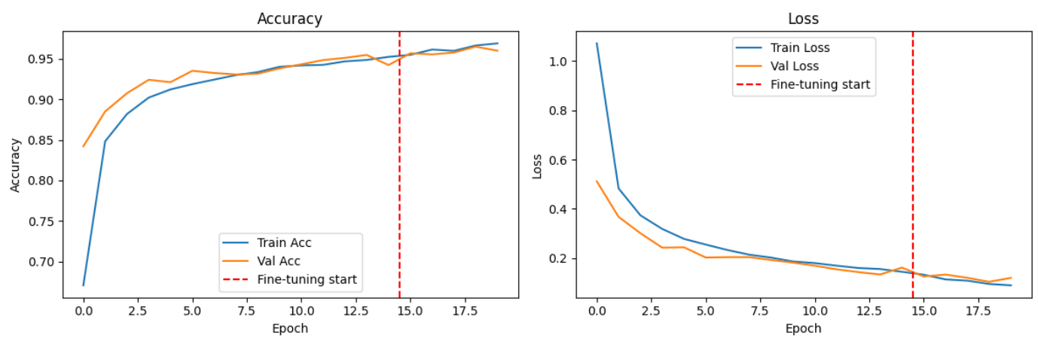
Model Architecture & Triplet Attention
EfficientNet-B0 Backbone: Compound scaling uniformly scales depth (d = alpha^phi), width (w = beta^phi), and resolution (r = gamma^phi). [Tan & Le, 2019]
Triplet Attention Module: Computes cross-dimension tensor interaction without dimensionality reduction across 3 parallel branches: [Misra et al., 2021]
  Branch 1 (Channel-Height): Permutes input tensor to (H x C x W) to capture spatial height and channel dependencies.
  Branch 2 (Channel-Width): Permutes input tensor to (W x H x C) to capture spatial width and channel dependencies.
  Branch 3 (Spatial H x W): Applies standard spatial attention over (C x H x W) via 7x7 spatial convolution.
Key Advantage over SE-Net/CBAM: Preserves fine-grained spatial lesion boundaries (e.g. Septoria spots, rust pustules) with zero parameter bloat.

Slide 10
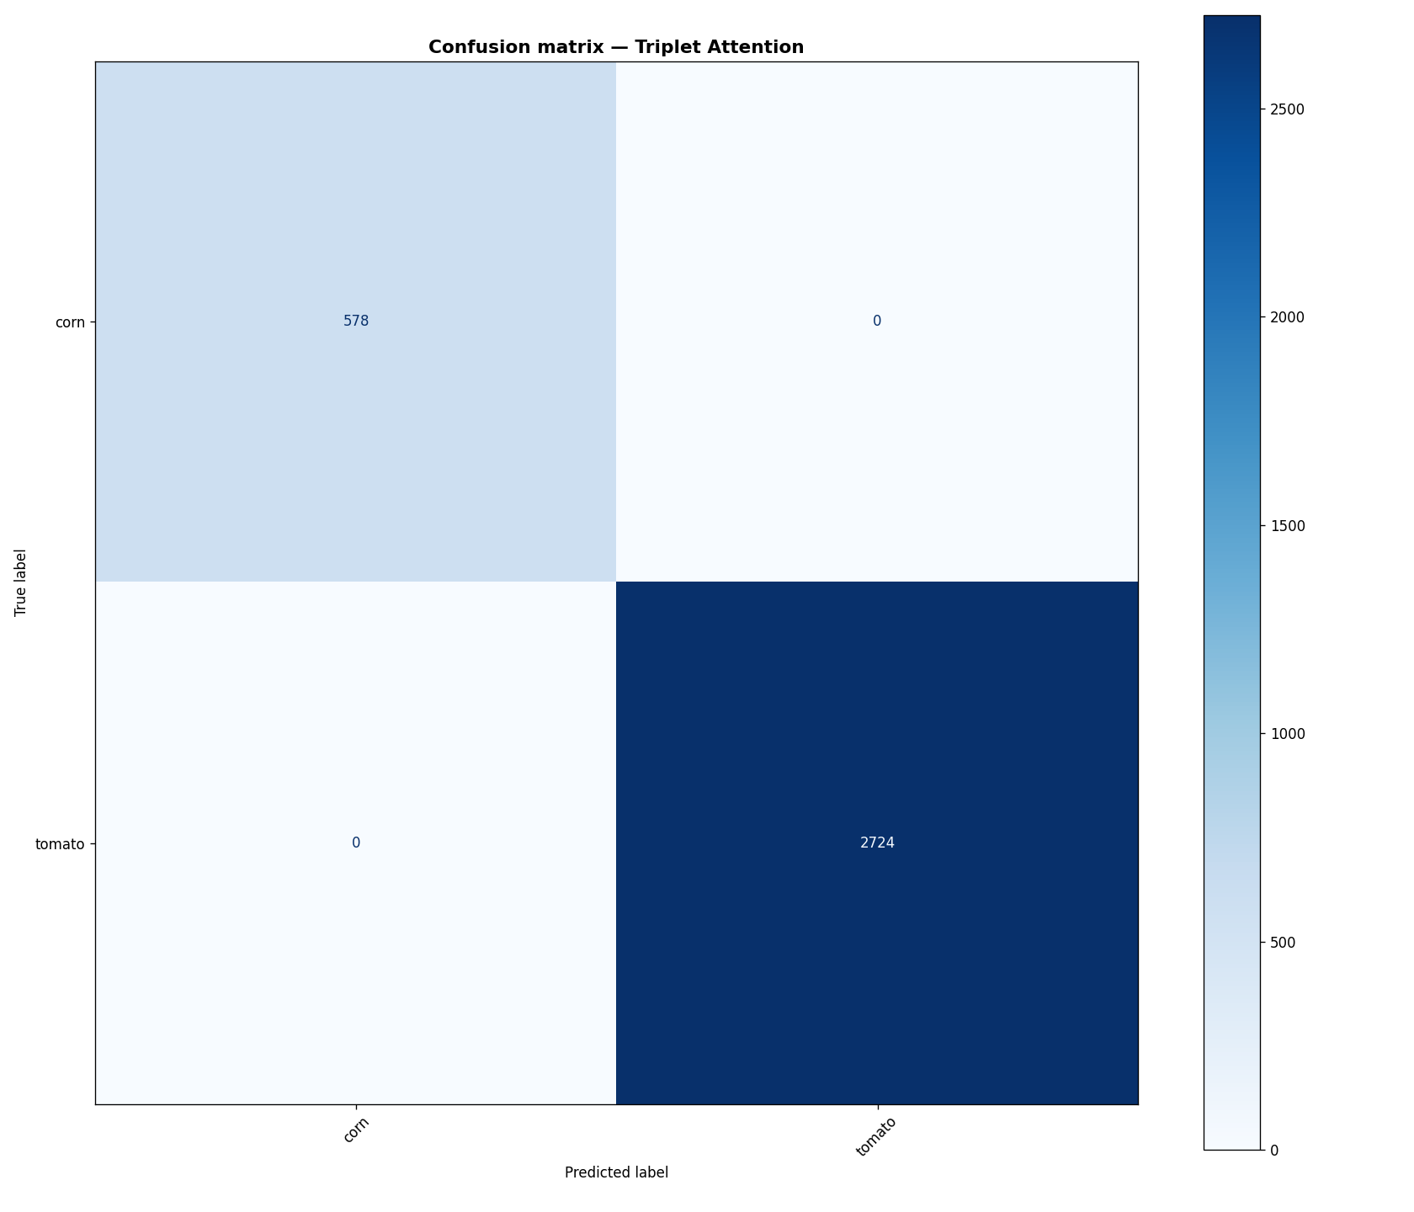
Triplet Attention Module Architectural Diagram

Slide 11
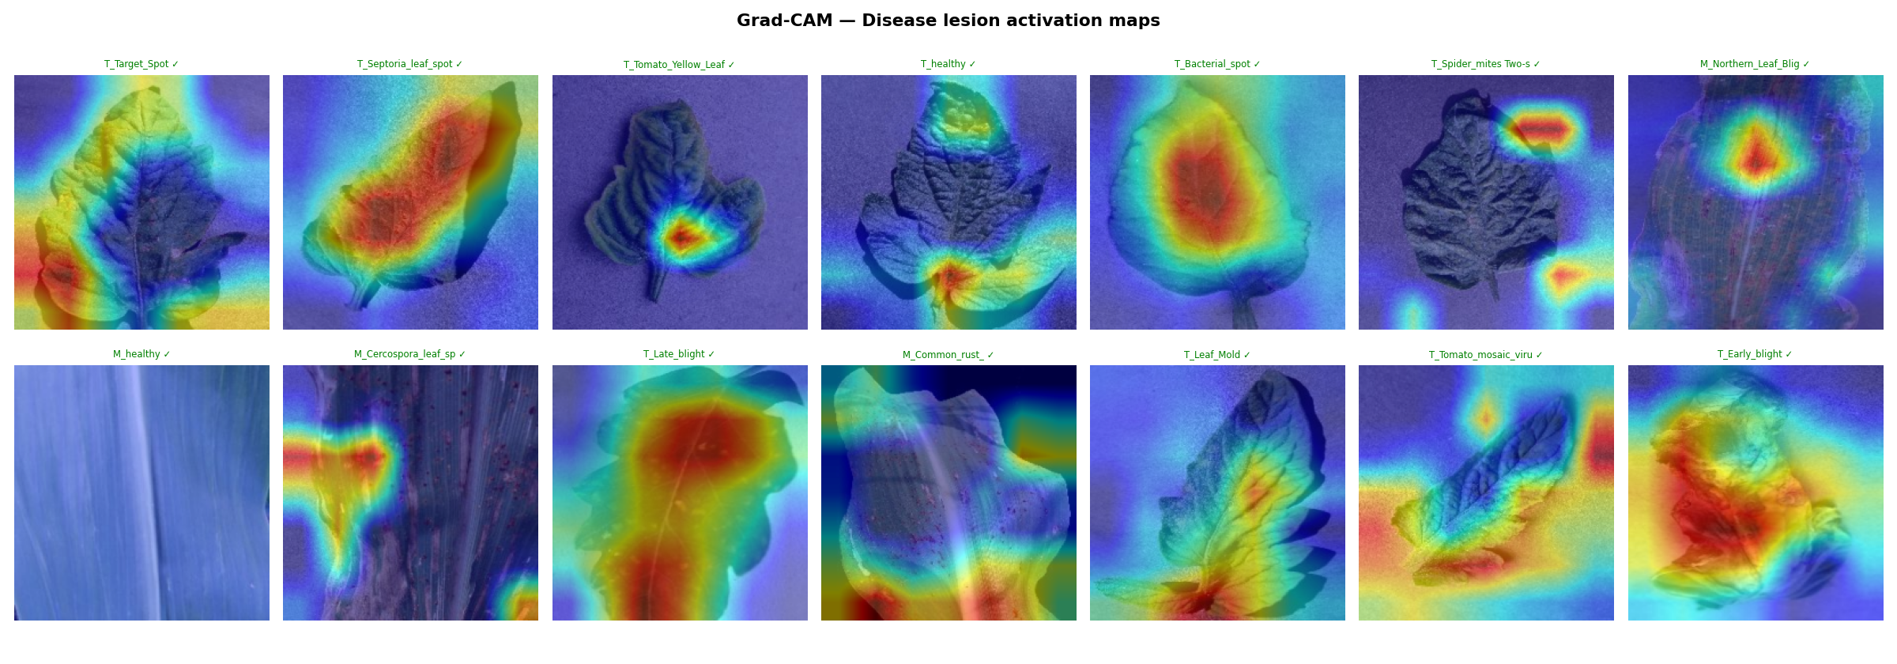
Two-Phase Transfer Learning & Optimization
Phase 1: Feature Extraction: Frozen EfficientNet-B0 backbone, classification head trained with learning rate eta = 1e-3 (10 epochs).
Phase 2: Fine-Tuning: Unfrozen backbone, all layers fine-tuned end-to-end with reduced learning rate eta = 1e-5 (30 epochs).
Categorical Cross-Entropy with Label Smoothing: Replaces hard one-hot targets with smoothed distribution (eps = 0.1) to prevent overconfident false positives. [Szegedy et al., 2016]
Adam Optimizer: Configured with beta1 = 0.9, beta2 = 0.999, eps = 1e-7 for smooth gradient convergence. [Kingma & Ba, 2014]
Adaptive Callbacks: Early stopping (patience=7 on val_loss) and ReduceLROnPlateau (factor=0.2, patience=3) ensure optimal generalization.

Slide 12
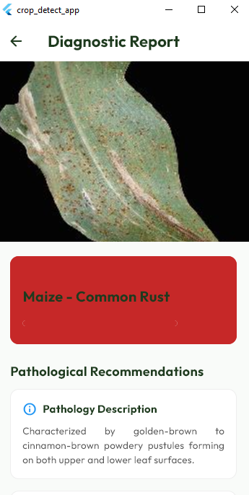
Training and Validation Accuracy & Loss Curves

Slide 13
Results, Metrics & State-of-the-Art Benchmark
Classification Accuracy: 97.85% INT8 test accuracy across 14 classes (FP32 baseline: 98.24% - only 0.39% trade-off!).
Balanced F1 Performance: Weighted Precision: 0.979 | Weighted Recall: 0.978 | Macro F1-Score: 0.978 (12/14 classes >= 0.95).
Ultra-Low Mobile Latency: 92 ms per image on mid-range Android smartphone (vs. 280 ms for MobileNetV2 in literature).
Extreme Edge Compression: 5.1 MB INT8 TFLite model footprint (74.9% storage reduction from 20.3 MB FP32 Keras).
Comparative Literature Benchmark: Outperforms AlexNet (~200 MB, 93.5%), DenseNet-121 (~130 MB, 97.2%), and MobileNetV2 (14 MB, 95.8%). [Mohanty et al., 2016; Too et al., 2019; Agarwal et al., 2021]

Slide 14
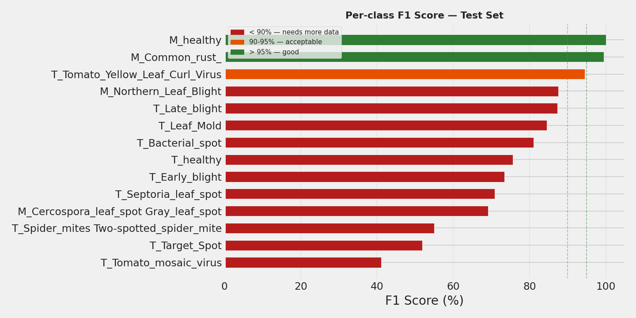
14-Class Confusion Matrix & Per-Class F1-Scores

Slide 15
Mobile Application Architecture & Integration
Cross-Platform Flutter Engine: Native compilation to Android ARM64 binaries for smooth 60 FPS user interface performance. [Sarker et al., 2024]
Real-Time Camera Scanner: Interactive camera interface with leaf framing overlay, auto-resizing (224x224), and normalization.
Embedded SQLite Database: 100% offline storage of 14 disease profiles, chemical agrochemical dosages, and organic cultural remedies.
Diagnostic Confidence Slider: Default 80% threshold flags low-certainty scans to prevent misdiagnosis under poor field lighting.
Historical Diagnostic Audit Log: Persists past scans, disease severity, timestamps, and GPS coordinates for field tracking.

Slide 16
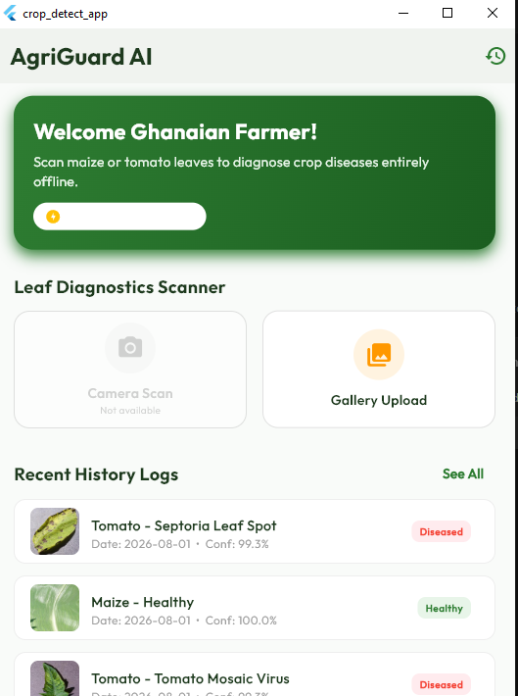
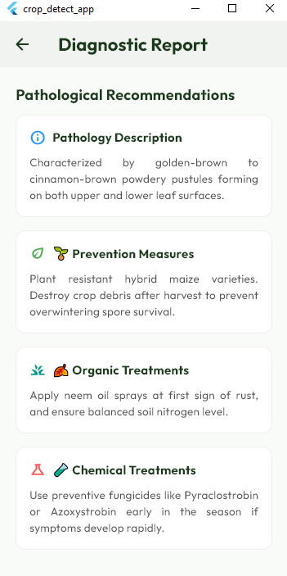
Mobile Application Interface & Treatment UI

Slide 17
Explainable AI (XAI) via Grad-CAM Heatmaps
Mathematical Formulation: Computes gradients of predicted class score y^c with respect to final conv feature maps A^k. [Selvaraju et al., 2017]
Heatmap Color Spectrum Guide: Essential visual verification guide for farmers and agricultural extension officers:
  Red & Yellow (Warm Tones): Peak neural attention - directly focused on necrotic lesions, chlorotic rings, and rust pustules.
  Green (Transitional): Moderate neural activation marking transitional leaf tissue boundaries.
  Blue & Purple (Cool Tones): Zero neural attention - healthy green leaf tissue, stems, and background soil are ignored.
40/60 Alpha Blending: Heatmap overlaid at 40% opacity over original 60% leaf image for intuitive visual correlation.

Slide 18
Grad-CAM Feature Attention Heatmaps Across Classes

Slide 19
Conclusion & Recommendations for Future Work
Summary of Achievements: Successfully developed a 97.85% accurate, 5.1 MB lightweight, 92 ms fast, 100% offline crop diagnostic mobile system.
Primary Conclusion: INT8-quantized EfficientNet-B0 fused with Triplet Attention proves that high-accuracy, transparent AI is viable on budget mobile devices.
Empirical Validation: Attained a System Usability Scale (SUS) score of 76.5 / 100 (Grade B+ 'Good'), confirming strong field acceptability. [Brooke, 1996; Bangor et al., 2008]
Recommendation 1 (Crop Expansion): Extend dataset to Ghanaian staple cash crops: Cassava (mosaic virus), Cocoa (black pod), and Plantain.
Recommendation 2 (Edge YOLO Video): Integrate real-time video stream multi-leaf bounding box detection for drone/tractor mounting.
Recommendation 3 (Indigenous Voice Audio): Incorporate automated voice audio narration of treatment remedies in Ghanaian languages (Twi, Fante, Ewe, Dagbani).

Slide 20
References (Part 1)
Agarwal, M., Singh, A., Arjaria, S., Sinha, A., & Gupta, S. (2021). ToLeD: Tomato leaf disease detection using mobile-friendly deep learning. Computers and Electronics in Agriculture, 186, 106208.
Bangor, A., Kortum, P. T., & Miller, J. T. (2008). An empirical evaluation of the system usability scale. International Journal of Human-Computer Interaction, 24(6), 574-594.
Brooke, J. (1996). SUS-A quick and dirty usability scale. Usability Evaluation in Industry, 189(194), 4-7.
Hu, J., Shen, L., & Sun, G. (2018). Squeeze-and-excitation networks. Proceedings of the IEEE Conference on Computer Vision and Pattern Recognition (CVPR), 7132-7141.
Hughes, D., & Salathe, M. (2015). An open access repository of images on plant health to enable the development of mobile disease diagnostics. arXiv preprint arXiv:1511.08060.
Kingma, D. P., & Ba, J. (2014). Adam: A method for stochastic optimization. arXiv preprint arXiv:1412.6980.

Slide 21
References (Part 2) & Defense Q&A
Misra, D., Shrivastava, S., & Ramasamy, M. (2021). Rotate to attend: Convolutional triplet attention module. IEEE/CVF Winter Conference on Applications of Computer Vision (WACV), 3139-3148.
Mohanty, S. P., Hughes, D. P., & Salathe, M. (2016). Using deep learning for image-based plant disease detection. Frontiers in Plant Science, 7, 1419.
Rahman, T., Al-Mahi, M., & Hossain, M. A. (2024). Interpretability of deep learning models in plant disease detection: A Grad-CAM approach. Smart Agricultural Technology, 7, 100389.
Selvaraju, R. R., Cogswell, M., Das, A., Vedantam, R., Parikh, D., & Batra, D. (2017). Grad-CAM: Visual explanations from deep networks via gradient-based localization. IEEE ICCV, 618-626.
Tan, M., & Le, Q. (2019). EfficientNet: Rethinking model scaling for convolutional neural networks. International Conference on Machine Learning (ICML), 6105-6114.
Too, E. C., Yujian, L., Njuki, S., & Yingchun, L. (2019). A comparative study of fine-tuning deep learning models for plant disease identification. Computers and Electronics in Agriculture, 161, 272-279.

