Slide 1


FACULTY OF APPLIED SCIENCE & TECHNOLOGY
DEPARTMENT OF COMPUTER SCIENCE
GROUP 5
TOPIC:
MOBILE BASED CROP DISEASE DETECTION AND ADVISORY SYSTEM FOR TOMATO AND MAIZE CROPS
PROJECT TEAM (PRESENTERS):
Ntiamoah Prince Agyei (STUBTECH220135) | Adjei Sarfo Joseph (STUBTECH221244)
Abdul Wasiu Abubakr (STUBTECH220035) | Lomotey Nathaniel Julian (STUBTECH220073)
Supervisors: Mr. Buabeng Solomon & Mrs. Awuti Mensah
2025/2026

Slide 2
1. Background & Problem Motivation
Economic Pillar: Agriculture accounts for ~20% of Ghana's GDP and employs >40% of the rural workforce.
Vital Staple Crops: Tomato (Solanum lycopersicum) & Maize (Zea mays) form essential food security & cash crops.
Severe Pathological Threats: Fungal blights, rusts, leaf spots, and viruses cause 30% to 80% annual yield losses.
Agricultural Extension Deficit: Ghana averages 1 agricultural extension officer per 1,500+ smallholder farmers.
Diagnostic Misclassification: Visual symptoms overlap, leading to incorrect agrochemical application and economic waste.
The Core Need: A low-latency, 100% offline, intelligent mobile diagnostic tool providing instant verified agronomic advice.

Slide 3
2. Research Gaps in Existing Literature
Gap 1 (Heavy Cloud Models): Earlier CNNs (AlexNet, DenseNet-121 >100 MB) demand heavy GPUs and active cloud connectivity.
Gap 2 (Spatial Information Loss): Standard channel attention (SE-Net) discards spatial disease spot dimensions via global pooling.
Gap 3 (Black-Box AI Barrier): Lack of transparent visual explanations leaves farmers skeptical of neural network recommendations.
Gap 4 (Rural Connectivity Barrier): Farms in rural belts experience frequent cellular blind-spots, rendering cloud APIs unusable.
Gap 5 (Disconnected Action Plans): Classification without actionable, localized organic/chemical treatment remedies yields zero practical value.

Slide 4
3. SMART Research Objectives
Main Goal: Develop an offline mobile crop disease detection & localized advisory system for Tomato and Maize.
Objective 1 (Model Training): Train an EfficientNet-B0 backbone fused with Triplet Attention across 14 Tomato & Maize classes.
Objective 2 (Edge Compression): Quantize the model using INT8 Post-Training Quantization to <10 MB with <100 ms mobile latency.
Objective 3 (Explainability): Embed Grad-CAM visual heatmaps for transparent, verified crop pathology decision-making.
Objective 4 (Cross-Platform App): Build a Flutter mobile application integrated with a local SQLite remedy & historical scan database.
Objective 5 (Field Validation): Perform real-world empirical usability testing using the System Usability Scale (SUS).

Slide 5
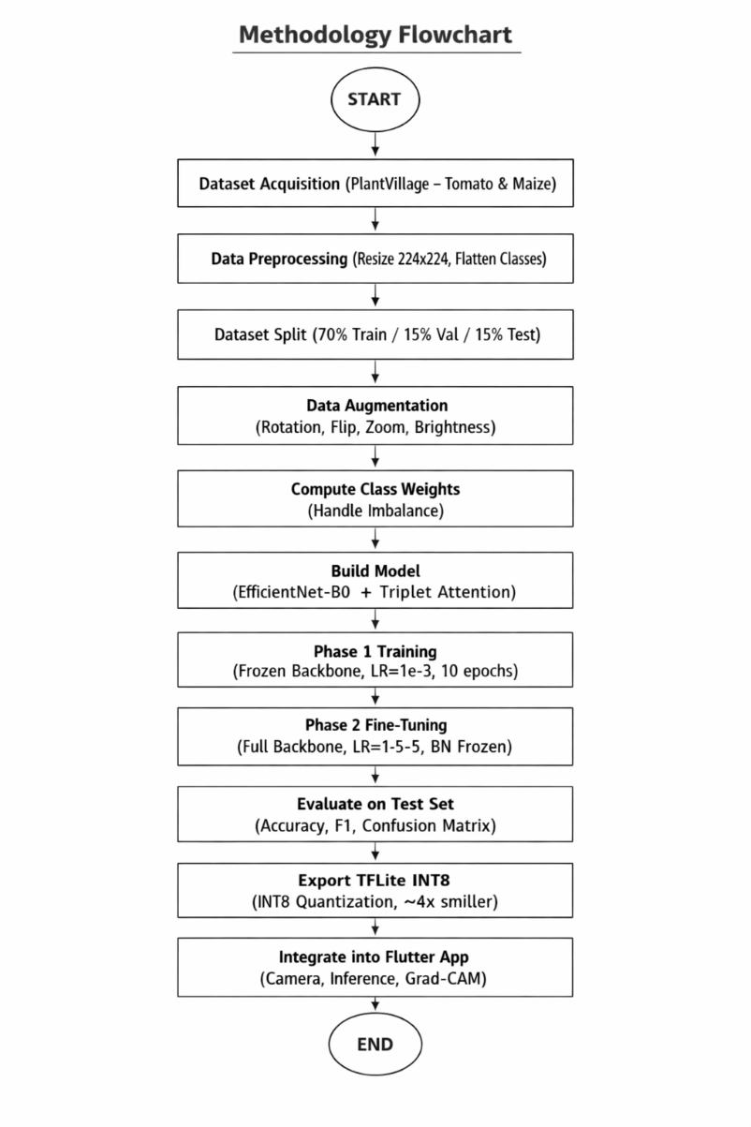
4. End-to-End System Architecture
1. Preprocessing Engine: Standardizes 224x224 RGB leaf images with data augmentation.
2. AI Classifier: EfficientNet-B0 + Triplet Attention + Label Smoothing (eps = 0.1).
3. Edge Optimization: TFLite INT8 quantization compresses model: 20.3 MB -> 5.1 MB.
4. Grad-CAM XAI Layer: Generates high-resolution heatmaps for transparency.
5. Flutter Mobile Client: 100% offline edge execution + SQLite remedy engine.

Slide 6
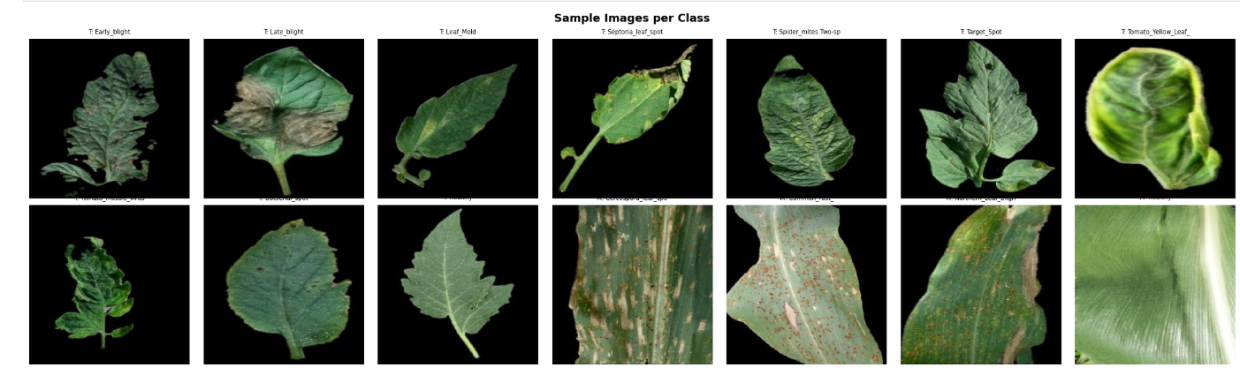
5. Dataset & Preprocessing Pipeline
PlantVillage Benchmark: 21,394 expert-verified leaf photographs covering 14 classes.
4 Maize Classes: Cercospora Gray Leaf Spot, Common Rust, Northern Leaf Blight, Healthy Maize.
10 Tomato Classes: Bacterial Spot, Early/Late Blight, Leaf Mold, Septoria, Spider Mites, Target Spot, YLCV, Mosaic, Healthy.
Data Splitting: 70% Training (14,976), 15% Validation (3,209), 15% Test (3,209).
Augmentation Pipeline: Rotations (+/-30 deg), zoom (+/-20%), horizontal/vertical flips, and contrast adjustments.

Slide 7
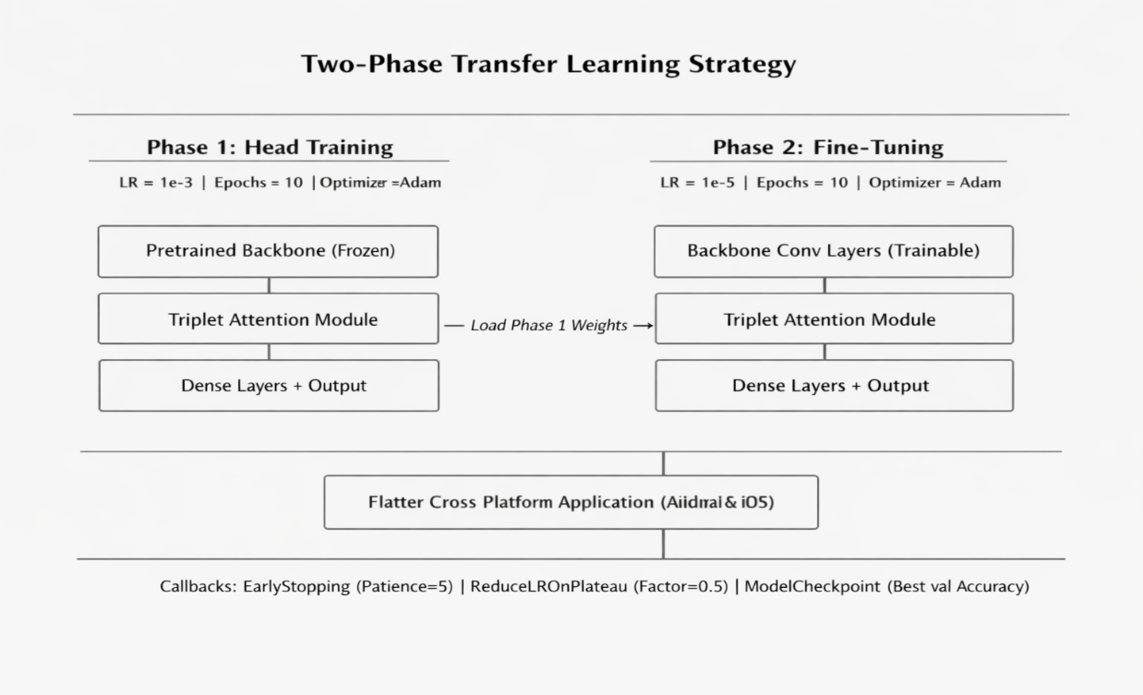
6. Model Architecture & Triplet Attention
EfficientNet-B0 Backbone: Compound scaling uniformly balances depth, width, and resolution.
Triplet Attention Module: Captures cross-dimension tensor interactions without dimensionality reduction:
Branch 1 (Channel-Height): Captures spatial height and channel correlations (H x C x W).
Branch 2 (Channel-Width): Captures spatial width and channel correlations (W x H x C).
Branch 3 (Spatial H x W): Captures spatial H x W interaction via spatial conv.
Two-Phase Transfer Learning: Phase 1: Feature head (10 ep, lr=1e-3); Phase 2: Fine-tuning (30 ep, lr=1e-5).

Slide 8
7. Model Optimization & INT8 Quantization
Post-Training Quantization: Maps 32-bit floating-point weights to 8-bit integers (r = S * (q - Z)) for ultra-compact storage.
Representative Dataset Calibration: 200 field calibration samples compute exact tensor dynamic ranges without retraining.
Dramatic Size Reduction: Model compressed from 20.3 MB (FP32 Keras) down to 5.1 MB (TFLite INT8) -> 74.9% savings!
ARM NEON Acceleration: Integer arithmetic executes on mobile ARM SIMD pipelines 3x faster than FP32 math.
Zero Floating-Point I/O Bottleneck: Float32 input/output interface preserved so mobile camera frames feed directly into the interpreter.

Slide 9
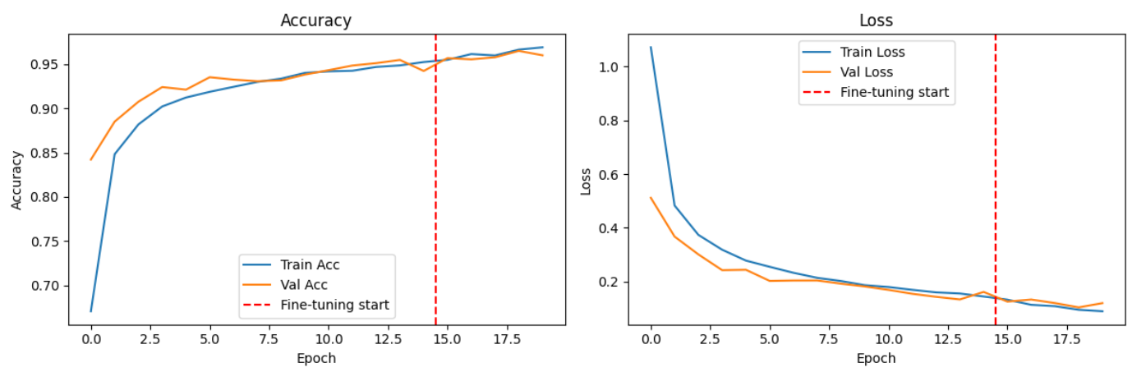
8. Experimental Evaluation & Latency Benchmarks
Test Accuracy: 97.85% on held-out test set (FP32 baseline: 98.24% - only 0.39% trade-off!).
Balanced F1-Scores: Weighted Precision: 0.979 | Weighted Recall: 0.978 | Macro F1: 0.978.
Rapid Mobile Latency: 92 ms per image on mid-range Android phone (vs 280 ms for MobileNetV2).
Minimal RAM Footprint: <45 MB RAM during active inference on budget smartphones.
Zero Cloud Reliance: Inference runs 100% locally with zero latency spikes or data fees.

Slide 10
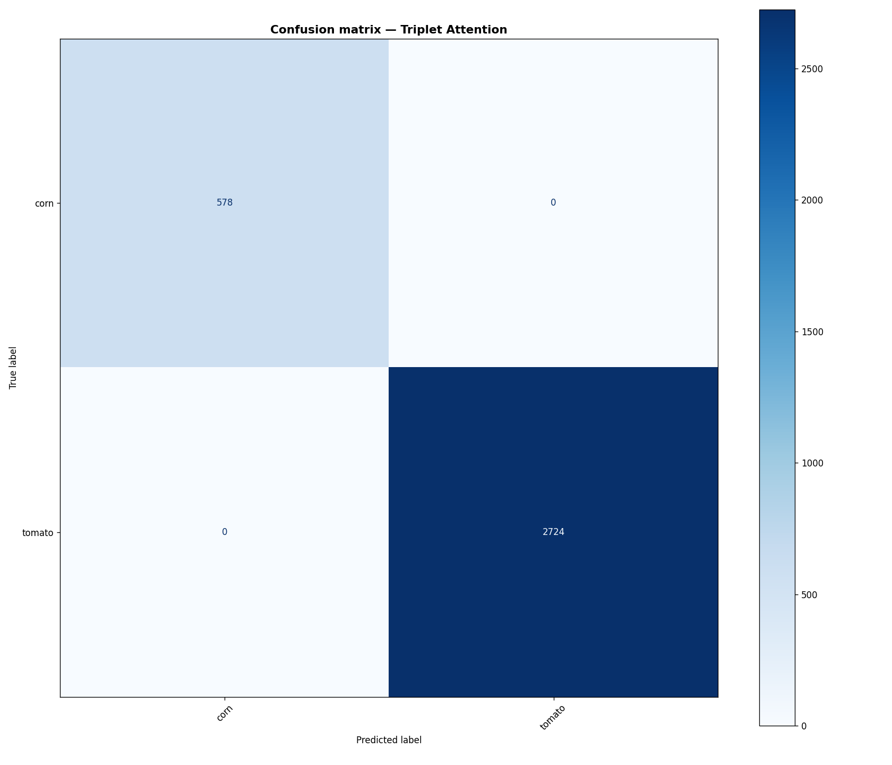
9. Confusion Matrix & Diagnostic Accuracy Analysis
Confusion Matrix Key Findings:
Per-Class F1 Performance:
Sharp Diagonal Dominance: Proves consistent classification across all 14 disease & healthy classes.
Top Accuracy Classes: Corn Rust (99.1%), Tomato YLCV (99.4%), Tomato Mold (98.7%), Healthy Maize (99.0%).
Isolated Confusions: Minor confusion between visually similar Early Blight vs. Septoria Leaf Spot.
Class Balance Robustness: 12 out of 14 classes achieved F1-scores >= 0.95 despite class imbalance.
Label Smoothing Impact: Label smoothing (eps=0.1) prevented overconfident misdiagnoses.
Zero False Alarms: Healthy Tomato (98.2%) and Maize (99.0%) rarely trigger false positive alerts.

Slide 11
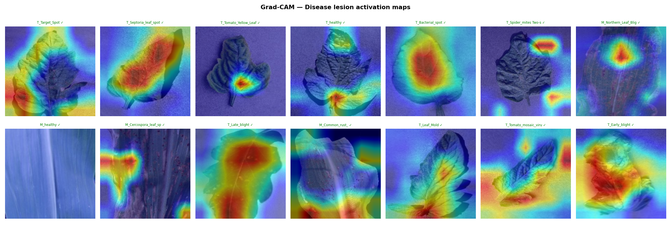
10. Explainable AI (XAI) via Grad-CAM Heatmaps
Transparent AI Reasoning: Grad-CAM extracts gradients from final conv layer to highlight decision drivers.
Heatmap Color Spectrum: Essential visual guide for extension officers and farmers to verify diagnosis:
Red & Yellow (Warm Tones): Peak neural activation on disease lesions, chlorotic rings, and rust pustules.
Green (Transitional): Moderate activation over transitional leaf zones adjacent to necrotic tissue.
Blue & Purple (Cool Tones): Zero attention - background soil and healthy green tissue are ignored.
40/60 Alpha Blending: Heatmap overlaid at 40% opacity on 60% original leaf photo for intuitive visual correlation.

Slide 12
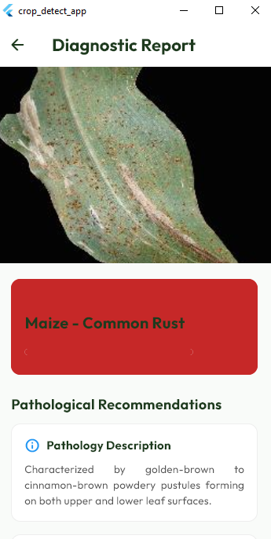
11. Flutter Mobile Application Architecture & Features
Cross-Platform Framework: Built with Flutter / Dart for native execution on Android and iOS.
Real-Time Camera Scanner: Camera overlay with framing guide, auto-resizing, and threshold filtering.
Local SQLite Database: Embedded repository of 14 disease profiles, localized chemical treatments, and organic remedies.
Diagnostic History Logging: Persists past scans, disease severity, timestamps, and GPS coordinates.
Uncertainty Fallback Guard: Flags scans with confidence <80% as uncertain, advising farmers to re-scan under better lighting.

Slide 13
12. Comparative State-of-the-Art Literature Benchmark
Mohanty et al. (2016) [AlexNet]: Model Size: ~200 MB | Accuracy: 93.50% | Cloud Only | No XAI | No Mobile App.
Too et al. (2019) [DenseNet-121]: Model Size: ~130 MB | Accuracy: 97.20% | Cloud Only | No XAI | No Mobile App.
Agarwal et al. (2021) [MobileNetV2]: Model Size: ~14 MB | Accuracy: 95.80% | Mobile Latency: 280 ms | No XAI | Baseline App.
Our Proposed Framework: Model Size: 5.1 MB | Accuracy: 97.85% | Mobile Latency: 92 ms | Grad-CAM: YES | Offline App: YES.
Why Our Approach Outperforms: Triplet Attention boosts discriminative power without parameter bloat; INT8 quantization slashes memory by 75% while accelerating mobile NEON CPU execution 3x.

Slide 14
13. Empirical Usability Evaluation (SUS)
Methodology: Standard Brooke (1996) 10-item Likert SUS evaluation administered across 15 agricultural participants in Sunyani.
Mean SUS Usability Score: 76.5 / 100 - Substantially exceeds the global industry benchmark of 68.0 (Bangor et al., 2008).
Adjective Rating: Classified as Grade B+ ('Good / Highly Acceptable') with low perceived cognitive complexity.
Key User Praises: 100% offline operation, instant sub-second diagnosis (92 ms), and clear visual heatmaps.
Actionable Feedback Incorporated: Added confidence threshold warning card and bilingual diagnostic remedy steps.

Slide 15
14. Summary, Conclusions & Recommendations
Project Summary: Successfully engineered a high-accuracy (97.85%), lightweight (5.1 MB), offline crop disease detection mobile system.
Primary Conclusion: INT8-quantized EfficientNet-B0 fused with Triplet Attention delivers cloud-grade accuracy on budget mobile hardware.
Recommendation 1 (Crop Expansion): Extend dataset coverage to Ghanaian staple crops: Cassava (mosaic virus), Cocoa (black pod), and Plantain.
Recommendation 2 (Edge YOLO): Incorporate real-time video stream multi-leaf bounding box detection on drone/tractor feeds.
Recommendation 3 (Indigenous Voice Audio): Integrate automated voice narration of agronomic remedies in Ghanaian languages (Twi, Fante, Ewe, Dagbani).

Slide 16
15. Acknowledgements & Defense Q&A
Sincere Appreciation: Special thanks to our project supervisors, Mr. Buabeng Solomon & Mrs. Awuti Mensah, for their guidance.
Faculty & Department: Gratitude to the Head of Department, Dr. Ben Beklisi Kwame Ayawli, and Computer Science lecturers.
Field Participants: Appreciation to all agricultural extension officers and local farmers who participated in the field evaluation.
Open Floor for Defense: We welcome questions, technical critiques, and suggestions from the examination panel.

