Slide 1
CHABADA

Slide 2
Background
Checking whether a program does what it claims to do is a longstanding problem for both developers and users.
Now…
detecting malware by checking static code and dynamic behavior against predefined patterns of malicious behavior
But…
not help against new attacks, as it is hard to define in advance whether some program behavior will be beneficial or malicious
The problem is that any specification on what makes behavior beneficial or malicious very much depends on the current context.
Notes:
检查程序实际的行为和它声称的做法是否一致，是开发⼈员和用户长期存在的问题。
到⽬前为⽌的做法，都致⼒于通过针对预定义的恶意⾏为模式检查静态代码和动态⾏为来检测恶意软件。但是，
这对新的攻击没有帮助，因为很难预先定义某些程序⾏为是有益的还是恶意的。
问题在于任何使⾏为变得有利或者恶意的规范都取决于当前的程序的context。

Slide 3
Steps
Preprocessing Descriptions with NLP
Identifying Topics with LDA
Clustering Apps with K-means
Resulting App Clusters
Identifying API Outliers with OC-SVMs
Showing Results

Slide 4
Preprocessing Descriptions with NLP
We applied standard techniques of natural language processing (NLP) for filtering and stemming.
Multi-language filtering
Remove all paragraphs of text that were not in Chinese
Removed stop words
Use HIT Stop Word List
Removed non-text items
such as numerals, HTML tags, links and email addresses
Notes:
在对我们的描述进⾏主题分析之前，我们将⾃然语⾔处理（NLP）的标准技术⽤于过滤和词⼲分析。
多语言过滤：移除所有不是中文的段落
去停用词：我们用的是《哈工大停用词表》 我们也删除了⾮⽂字的内容。诸如数字， HTML标签，链接和电⼦邮件地址等。

Slide 5
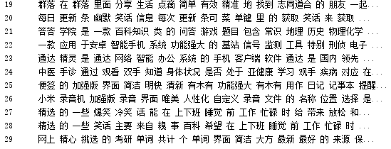
Preprocessing Descriptions with NLP

Slide 6
Steps
Preprocessing Descriptions with NLP
Identifying Topics with LDA
Clustering Apps with K-means
Resulting App Clusters
Identifying API Outliers with OC-SVMs
Showing Results

Slide 7
Identifying Topics with LDA
LDA (Latent Dirichlet Allocation)
…is a document topic generation model, also known as a three-layer Bayesian probability model, consisting of three layers of words, topics, and documents.
…is an unsupervised machine learning technique that can be used to identify hidden subject information in large-scale document collections or corpus.
Notes:
LDA（Latent Dirichlet Allocation）是一种文档主题生成模型，也称为一个三层贝叶斯概率模型，包含词、主题和文档三层结构。LDA是一种非监督机器学习技术，可以用来识别大规模文档集（document collection）或语料库（corpus）中潜藏的主题信息。

Slide 8
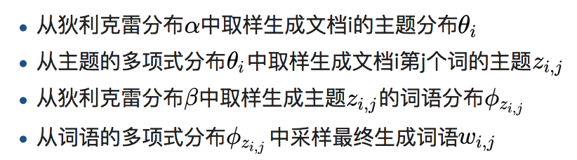
Identifying Topics with LDA
Theory

Slide 9
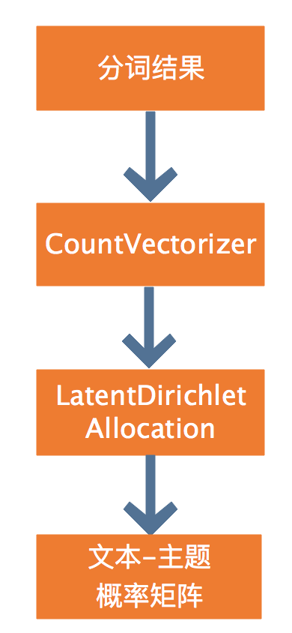
Identifying Topics with LDA
我们将经过处理后的中文版应用描述词语转换成词频矩阵，例如矩阵中包含一个元素a[i][j]，它表示j词在i类文本下的词频。
将词频矩阵作为LDA模型的输入。我们预先选择了30个主题，所以LDA模型将会输出主题及其对应词参数矩阵（主题-词参数），文本分别属于30个主题的概率矩阵（文本-主题），例如文本-主题矩阵中包含一个元素b[i][j]，表示文本i属于主题j的概率。
我们接下来会使用文本-主题矩阵进行K-means聚类。

Slide 10
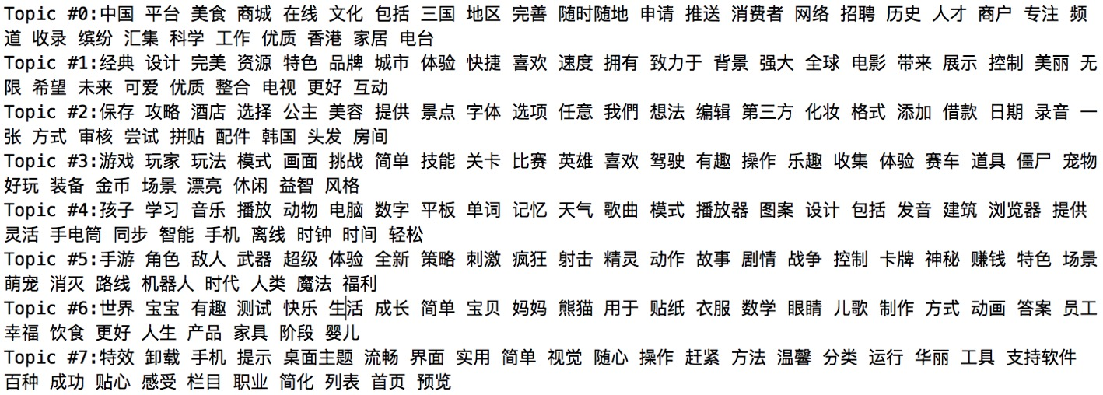
Identifying Topics with LDA

Slide 11
Steps
Preprocessing Descriptions with NLP
Identifying Topics with LDA
Clustering Apps with K-means
Resulting App Clusters
Identifying API Outliers with OC-SVMs
Showing Results

Slide 12
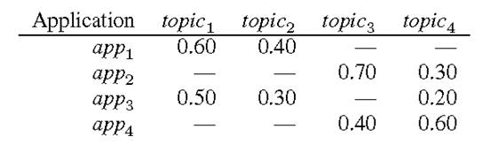
Clustering Apps with K-means
According to the description of each application, we can associate the application with each topic.
Specifically, combining the description words of application A and the representative words in topic B can calculate the “affinity” of application A and topic B.
Notes:
在LDA以后,我们根据每一个应用程序的描述，可以将应用程序和每一个主题关联起来。
具体来说，结合a应用的描述词语和b主题里的Representative Words，可以计算出a应用和b主题的“亲和度”。

Slide 13
Clustering Apps with K-means
Each application is characterized by a vector of affinity values (probabilities) for each topic.
We used the K-means algorithm, one of the most common clustering algorithms. When applied to this set of applications at the table with K = 2 clusters, K-means returns one cluster with app1 and app3, and another cluster with app2 and app4.
In our project ,we set K=32 as our desired clusters.
Notes:
每个应用程序的特征可以表示为一个针对每个主题的亲和度的向量。
（这段可以不用说）当聚类数量K=2时，K-means返回一个具有app1和app3的群集，另一个群集具有app2和app4。
我们设定了K=32为我们所期望的聚类数量

Slide 14
Steps
Preprocessing Descriptions with NLP
Identifying Topics with LDA
Clustering Apps with K-means
Resulting App Clusters
Identifying API Outliers with OC-SVMs
Showing Results

Slide 15
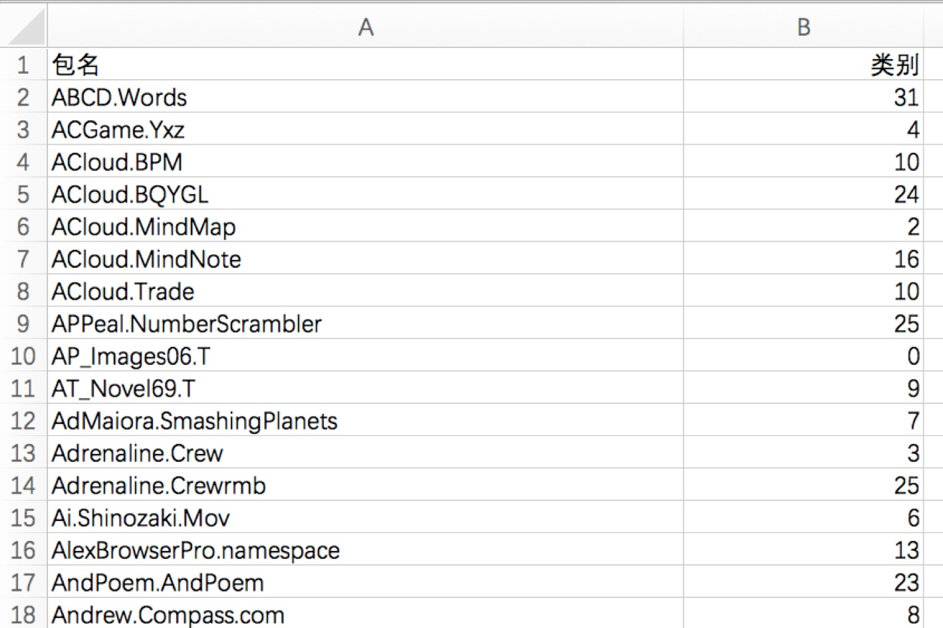
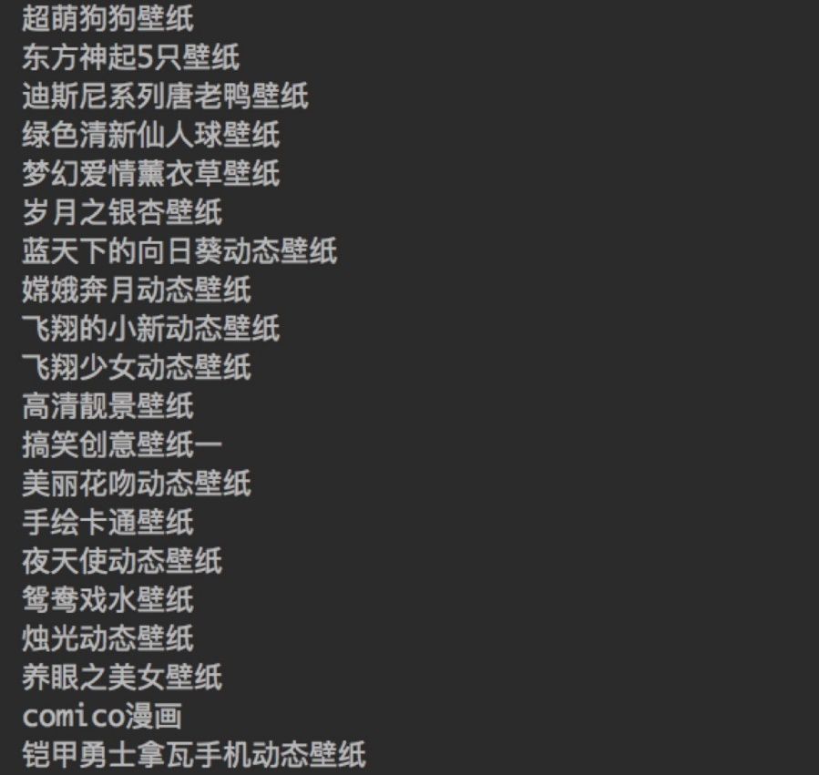
Resulting App Clusters

Slide 16
Steps
Preprocessing Descriptions with NLP
Identifying Topics with LDA
Clustering Apps with K-means
Resulting App Clusters
Identifying API Outliers with OC-SVMs
Showing Results

Slide 17
Identifying API Outliers with OC-SVMs
OC-SVM
Unlike traditional SVM, one class SVM is an unsupervised algorithm.
It means that there is only one type of positive (or negative) data in the training set. At this time, what we need to learn is the boundary rather than the maximum margin.
After training with a certain kind of sample (positive or negative), OC-SVM can divide the data into two classes based on the training boundary.
So OC-SVM can be used to do exception detection.
Notes:
ocsvm(one class SVM)：与传统SVM不同的是，one class SVM是一种非监督的算法。
它是指在训练集中只有一类positive（或者negative）的数据，而没有另外的一类。而这时，需要学习的就是边界（boundary），而不是最大间隔（maximum margin）.
用某一类样本(正样本或负样本)进行训练以后，ocsvm可以根据训练得到的边界将数据分为两类。
所以ocsvm可以用来做异常检测。

Slide 18
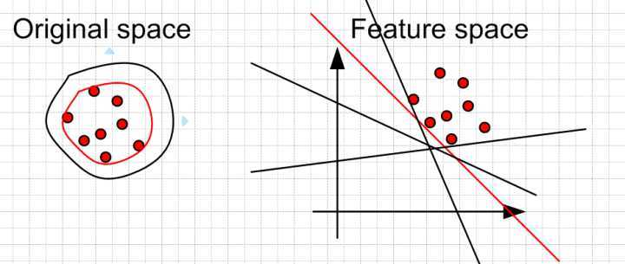
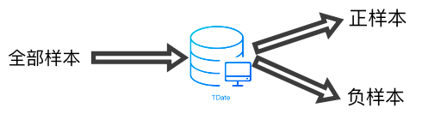
Notes:
在chabada中，我们使用ocsvm来识别相应主题群中API使用情况异常的应用程序。将所有APP的API矩阵作为样本进行训练和分类

Slide 19
Steps
Preprocessing Descriptions with NLP
Identifying Topics with LDA
Clustering Apps with K-means
Resulting App Clusters
Identifying API Outliers with OC-SVMs
Showing Results

Slide 20
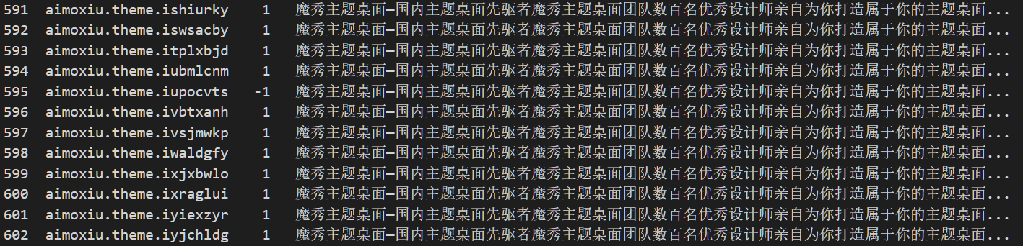
Showing Results

Slide 21
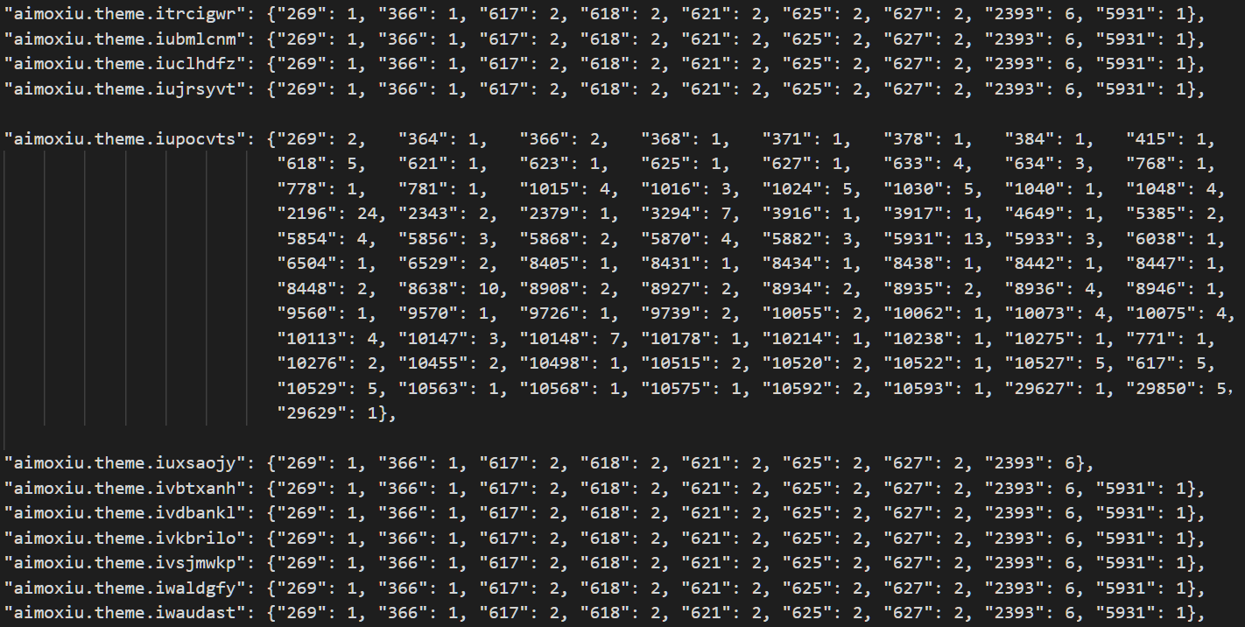

Slide 22

Thank you☺

