Slide 1
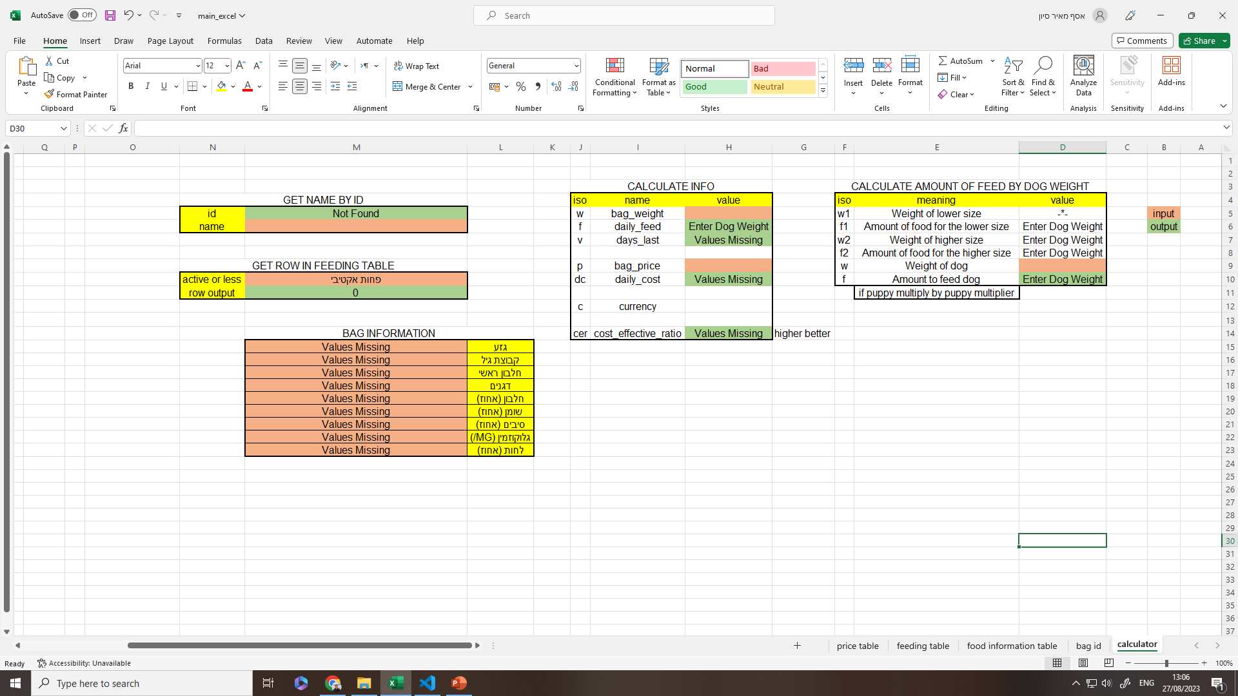
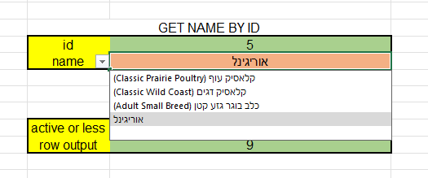
General explanation of each table
Choose the name of the bag from dropdown, output ID.
Calculate daily feed needed by inputing dog weight.
Table 3
Table 2
Choose if the dog is active or less.
Table 4
(some brands require this info to calculate how much the dog needs to feed)
Table 1
Explanation in next slide, using the linear interpolation formula.
Table 5
Input information that changes based on your query and based on the store information.
For example, you want to compare bag sizes, you input specific bag size.
In addition, store prices fluctuate, another clear input.
Inputs:
W bag_weight: in kilos (2,6,10.6,11.4,15,25 etc.)
P bag_price: in current currency
Outputs:
F daily_feed: How much is needed to feed daily (based on table 1.
V days_last: How many days will the entire bag will last for in days
DC daily_cost: Divide price by days.
CER cost_effective_ratio: final “score” for the bag to easily compare.
Drop-Down
Get general info about the food (useful for client decision making)

Slide 2
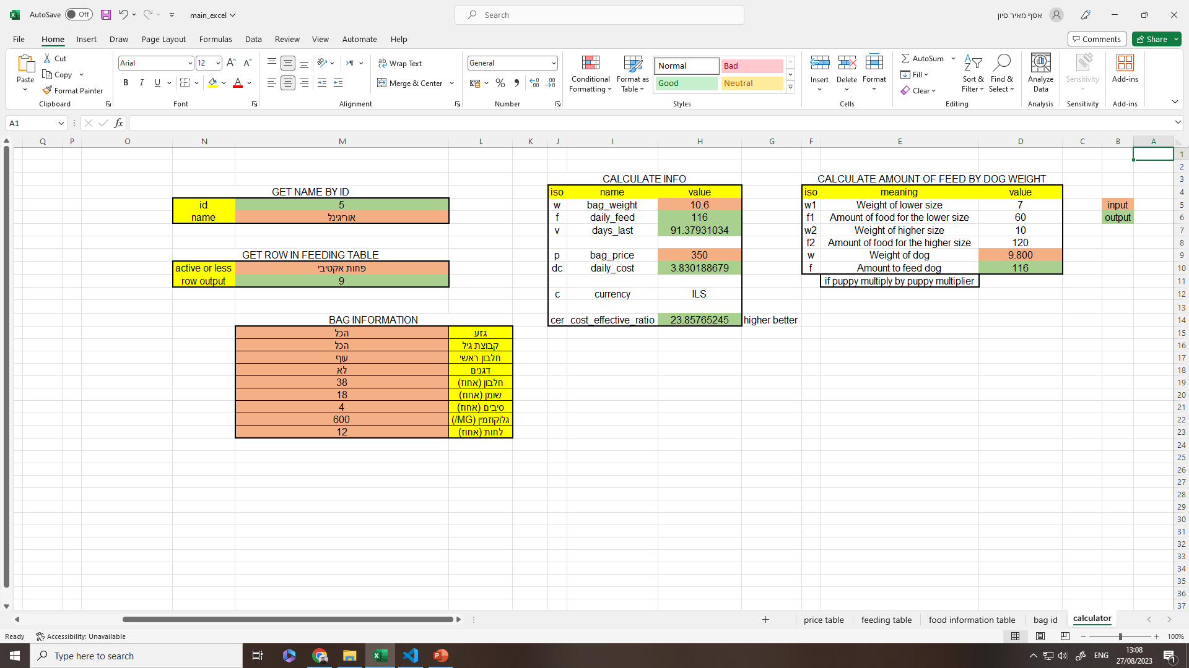
Example entering my own dog’s information
In every feeding amount table, there is a range.
Usually in increments of 5 kg, 10kg 20kg etc.
To calculate exactly how much I need to feed my dog I need the lowest in my range that is closest to my weight and the higher number with the same principal.
Then I calculate it with the amount of food needed for each number of range in a linear interpolation formula.
Example (Information is gathered based on the bag selected before in the left tables.)
W is the input: Dog weight 9.800 kilos
W1- searches for the feeding table sheet and gets the closest number in the range from the low side.
F1- outputs the amount in grams
W2- does the same as W1 just for the higher increment.
F2- outputs the amount in grams
F- is the output for the final amount needed to feed daily.

Slide 3
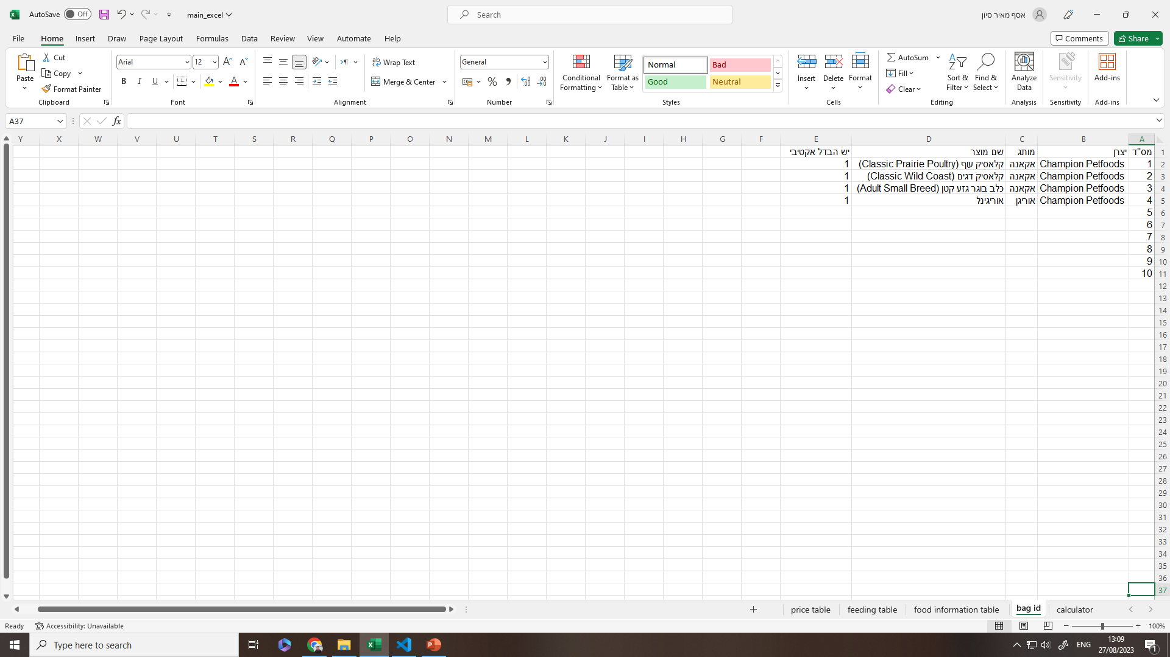
Main bag ID table

Slide 4

General food bag information, breed type, age group etc.

Slide 5
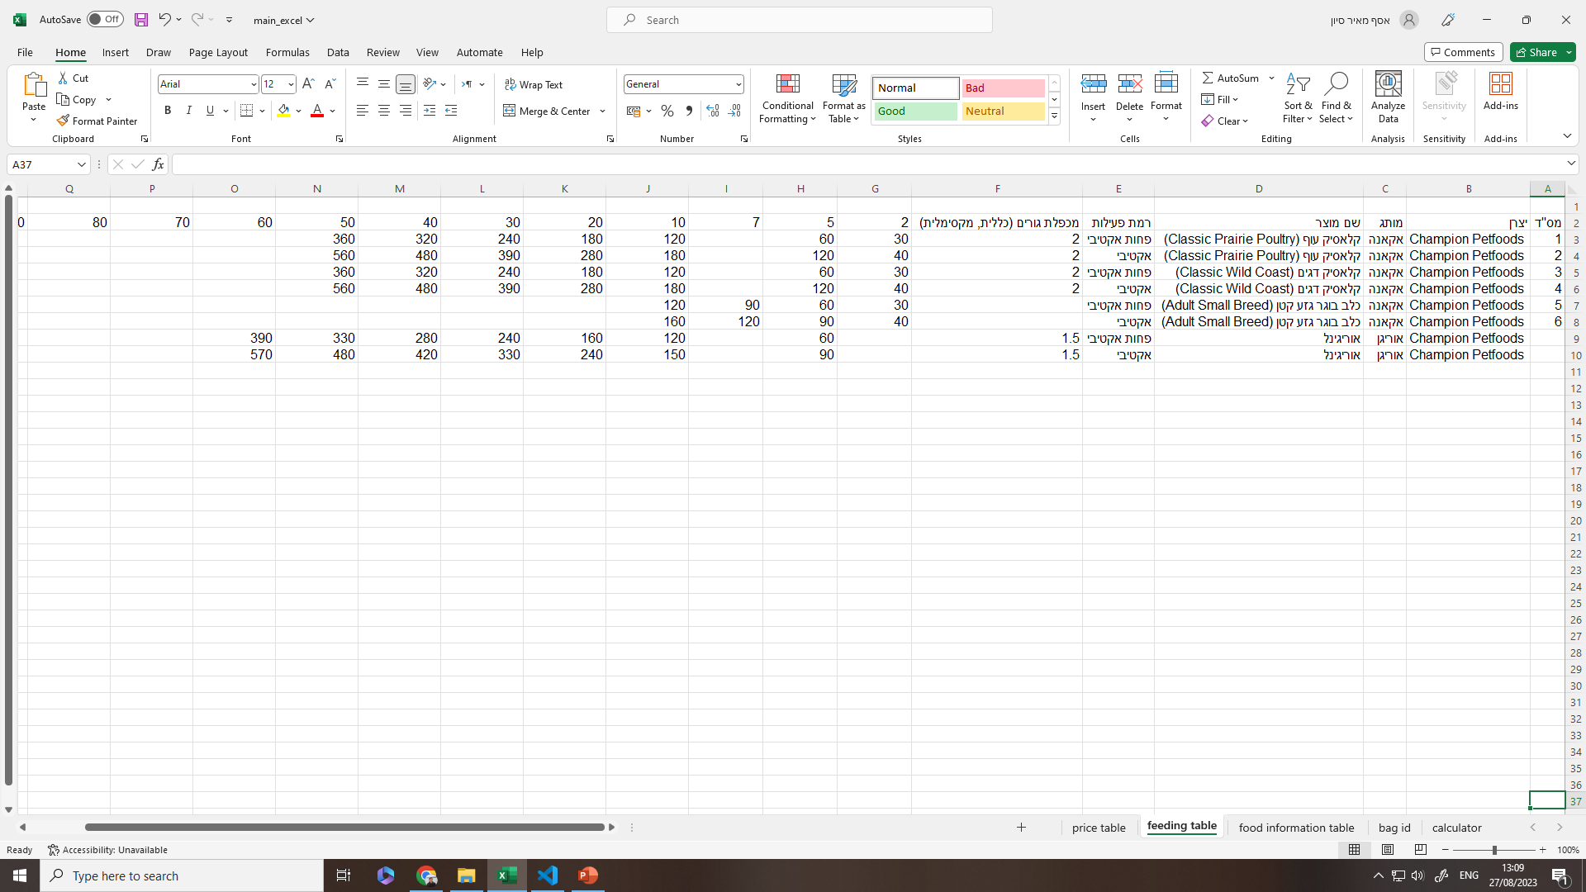
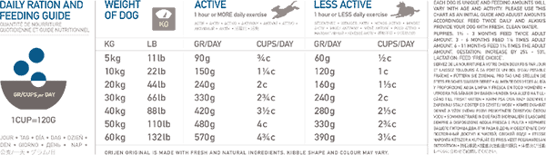
Feeding table information table.
Example from Orijen Original feeding table

Slide 6
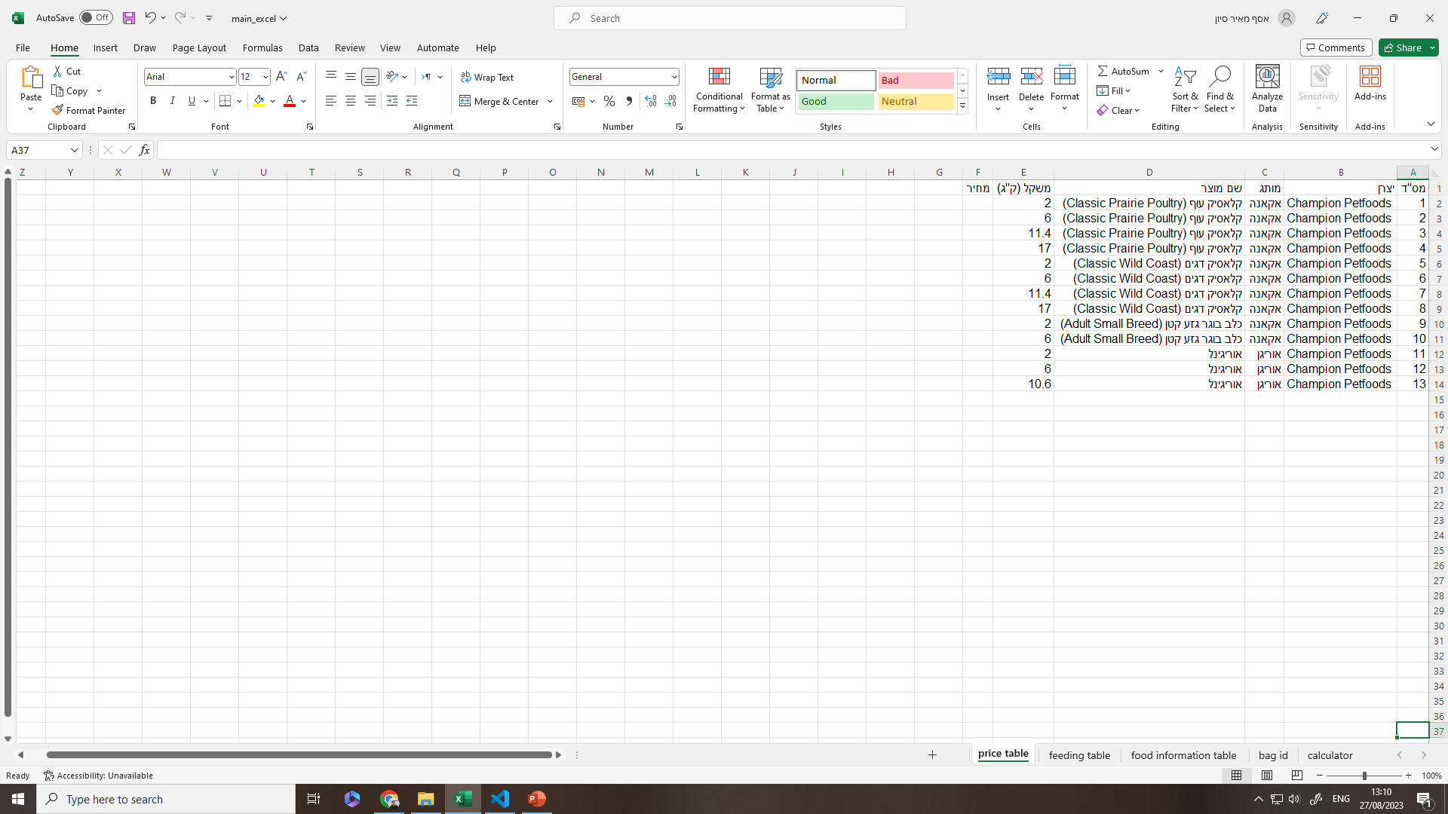
Weight and price table (Built for future features)

