Slide 1
UNIX command line
Also called terminal, shell, etc...
Terence Parr
MSDS program University of San Francisco
See also Videos from Philip Guo (pythontutor guy) on terminal

Slide 2
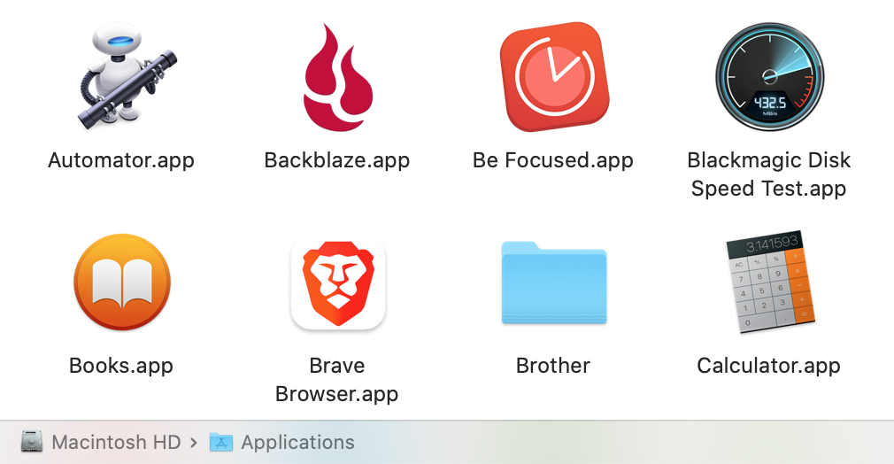
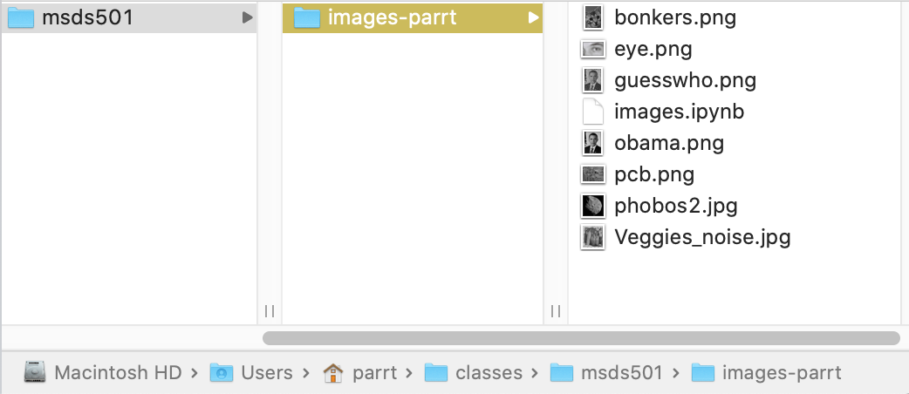
Controlling your machine w/o a GUI
The Mac "Finder" is a graphical way to launch and control programs as well as manipulate files and folders on the disk
But, the "terminal" is an old-school text-based interface that has a number of advantages

Slide 3
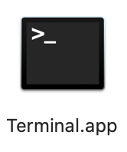
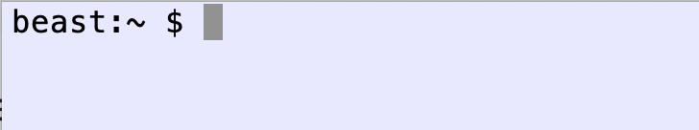
The terminal is running a shell
The UNIX shell is an interactive domain-specific language used to control and monitor the UNIX operating system (Mac OS)
It is also a programming language, though we’ll use it mostly to move files around, execute commands, ...
You need to get comfortable on the UNIX command line because, at minimum, you will control cloud computing facilities using the command line
We type commands at the $ prompt and hit return to execute
(Note: OS X changed the default shell to be zsh not bash.)

Slide 4
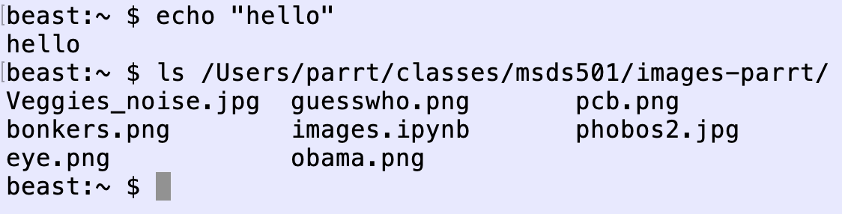
Commands are analogous to Python function calls, including arguments
In Python we say print("hello"), but in the shell we don't use parentheses around arguments and use spaces not commas
Notation: command arg1 arg2 arg3 vs python: command(arg1, arg2, arg3)

Slide 5
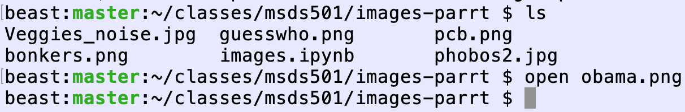
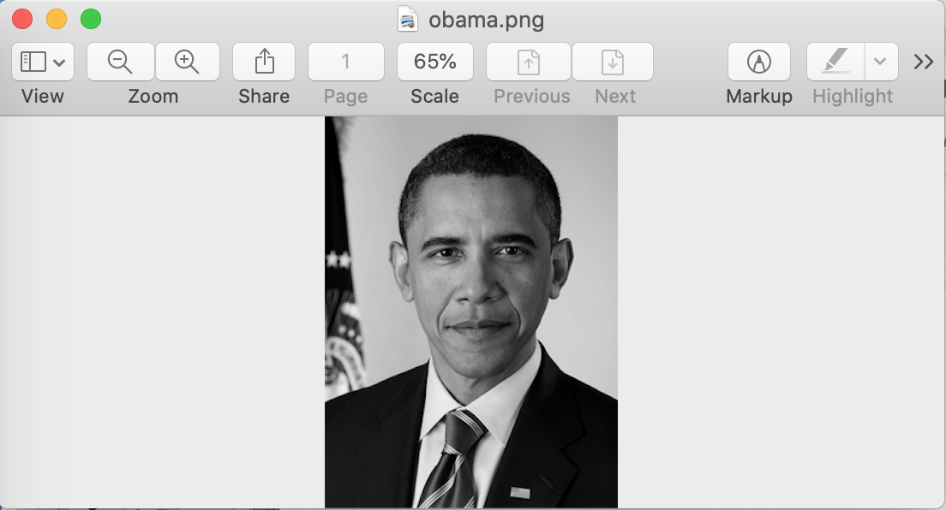
Executing programs by opening files
Instead of double-clicking on an image file, for example, we can tell the terminal to open it

Slide 6
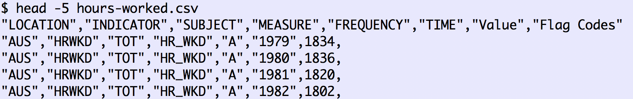
Looking at file contents
cat filename: show entire file
head filename: show first n lines of file
tail filename: show last n lines of file

Slide 7
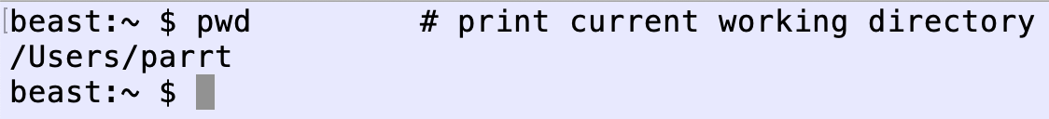
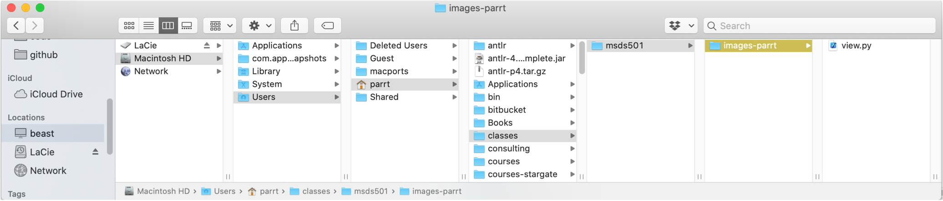
Current working directory
The shell has a number of state variables, one of which is the current working directory, and it is by far the most important
Most commands execute relative to this working directory
When terminal opens, working directory is set to your user home directory abbreviated as "~"

Slide 8
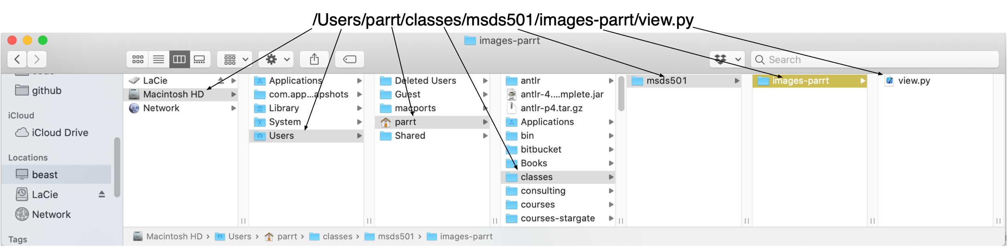
Path specifications
As we saw previously, the folders or directories on your disk represent a tree; files in a folder represent leaves of the tree
A fully-qualified path to a file starts with “/” and consists of the directories used to reach the file from the root of the disk; root is "/" and we separate path elements with "/"
Relative pathnames do not start with "/" and are relative to WD

Slide 9
Useful directories to know about
Other then your home directory, /Users/youruser, you should know about:
/Applications
/tmp
/usr/local (such as brew's install area /usr/local/Cellar)
/bin, /usr/local/bin
Also to configure zsh (your shell), see file ~/.zshrc

Slide 10
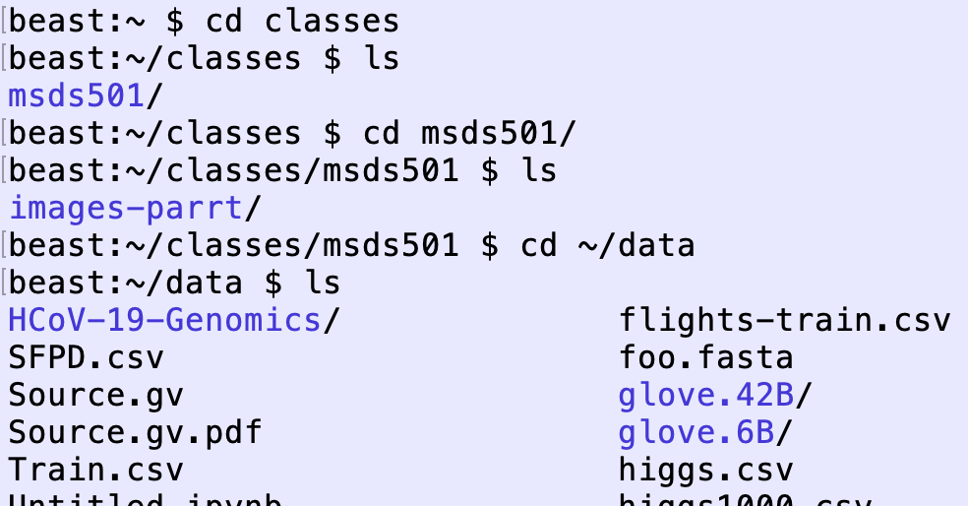
cd: change working directory
To "move" around the disk hierarchy/tree, use cd command to change the current working directory (i.e., where am I?)

Slide 11
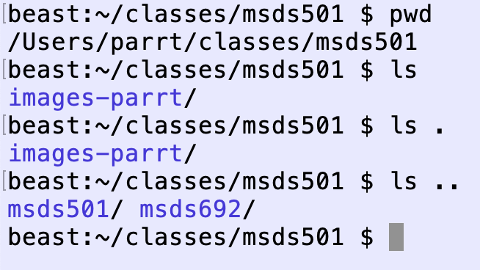
Dot, Dot-Dot
Dot "." means current working directory
Dot-Dot ".." means directory above current working directory

Slide 12
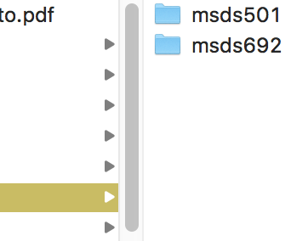
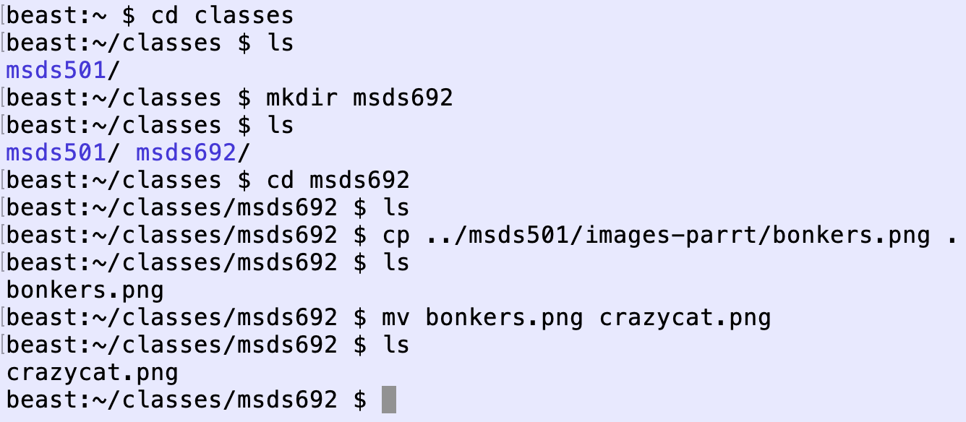
Manipulating files and directories
watch dir appear
mkdir newdirname: make directory
cp source target: copy file or directory
mv oldname newname: rename or move files/dirs

Slide 13
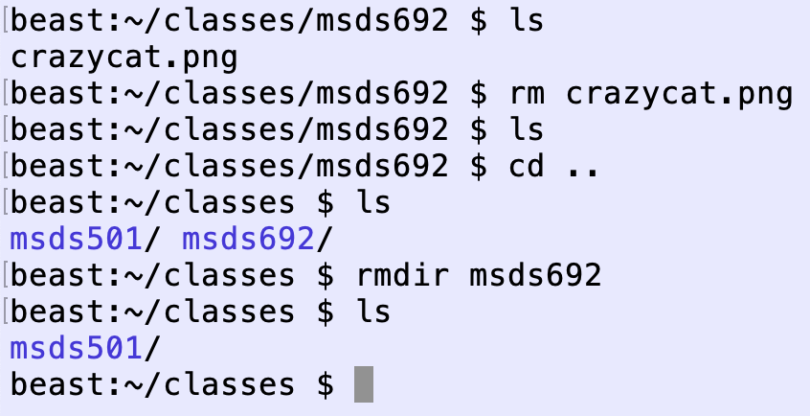
Removing files and directories
rm filename: remove file
rmdir dirname: remove empty directory
rm –rf dirname: remove directory and everything underneath it

Slide 14
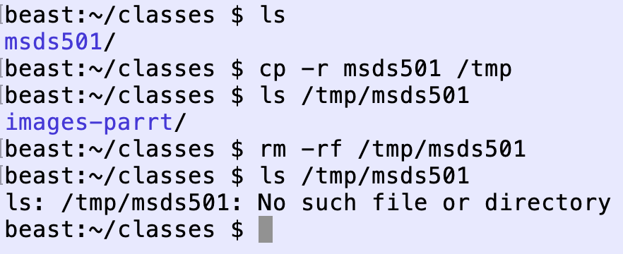
Removing files and directories Cont’d
rm filename: remove file
rmdir dirname: remove empty directory
rm –rf dirname: remove directory and everything underneath it

Slide 15
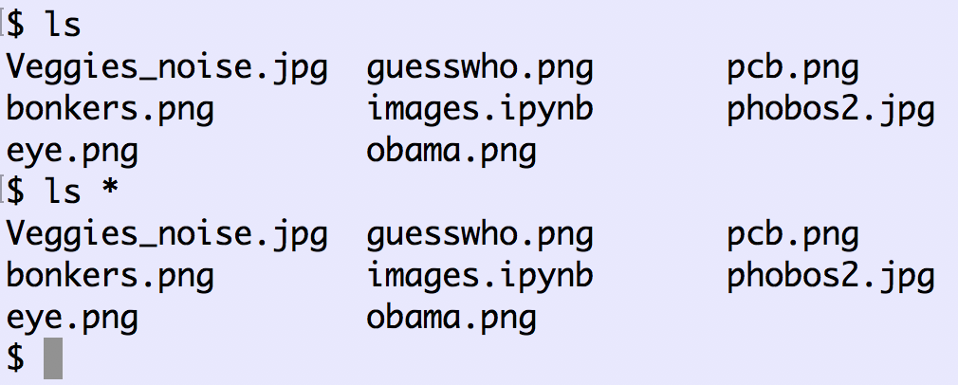
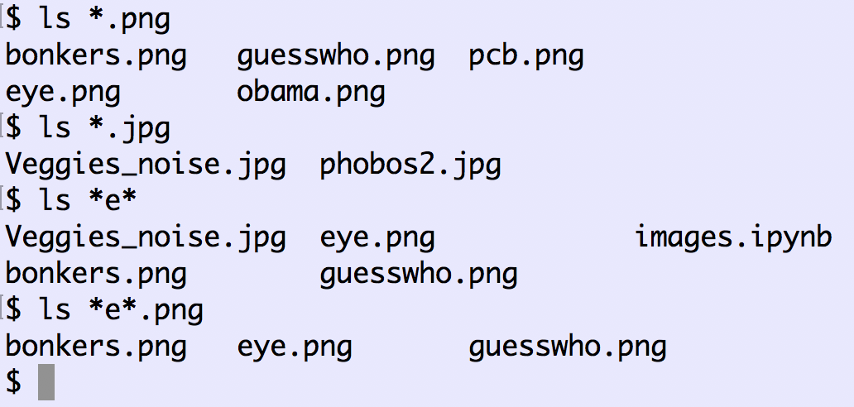
Wildcards
Star "*" means roughly "any word that matches", such as all files
Good example of something that's impossible with a GUI; imagine that you have 1000 datafiles and you need to delete all files whose names have the word “old”
Here are some examples listing various image files

Slide 16
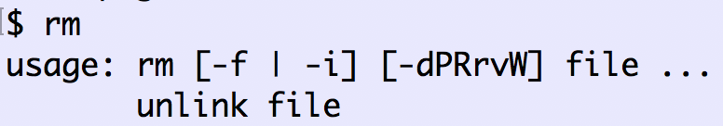
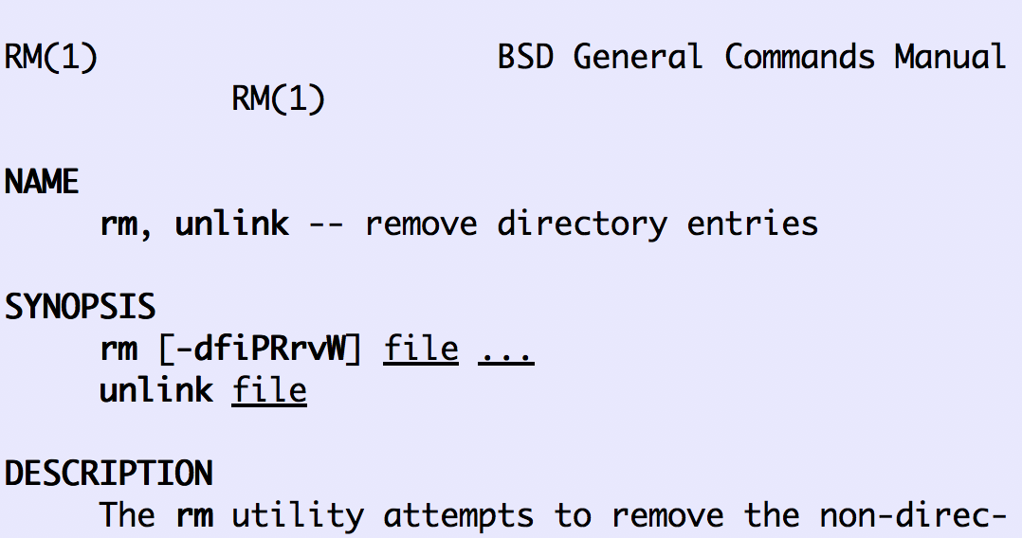
Manual pages; Getting help
Google search (your shell is called zsh)
Stackoverflow
Often you can type the command without arguments and it will give a help line:
Or, type “man rm” to get the manual page:

Slide 17
Installing more terminal commands
There are lots of useful UNIX programs available that are not currently installed on your machine
The homebrew program installs new code for you
For example, we’ll likely install a Python library that requires an open source graphing tool called graphviz: $ brew install graphviz

Slide 18
Python-related commands

Slide 19
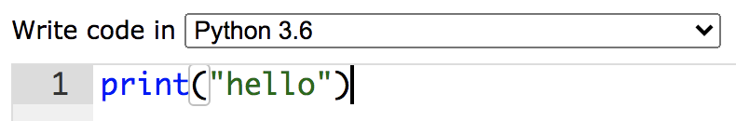
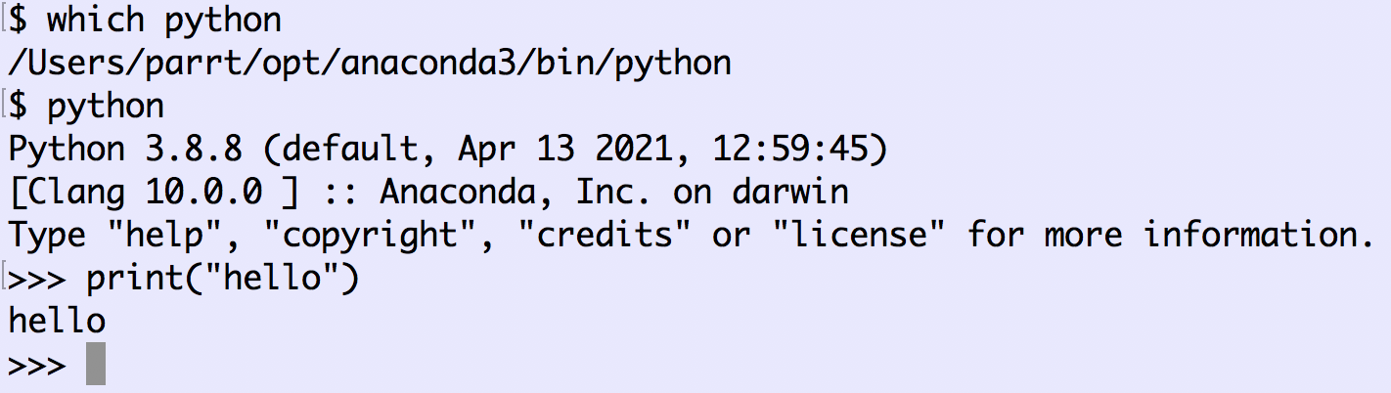
Interactive Python console from terminal
(Hit Ctrl-D to exit python, go back to shell)
Pythontutor gives us a text box to edit code and a run button to visualize the execution
Can also execute Python interactively line by line from the shell
Warning: there are multiple copies of Python on your Mac possibly

Slide 20
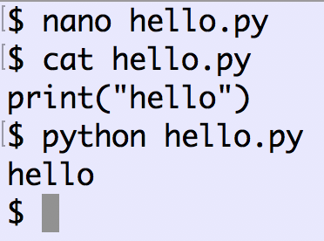
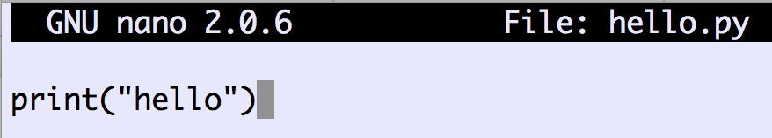
Executing python scripts
All of the code we type into the Python console disappears when we exit and return to the command line
Save python into a .py file, using your favorite editor, such as nano
We call this a Python script, program, or simply a Python file
Use “python file.py” from terminal to execute the script in “batch mode”
NOTE: file.py must be a TEXT file, w/o formatting like in M$ Word files
(To Save, hit Ctrl-X then “Y” to save changes
then hit return at “File Name to Write: …”)

Slide 21

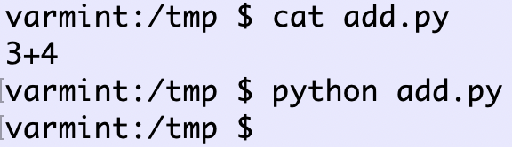
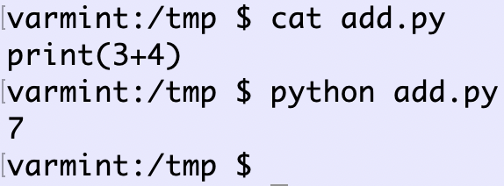
Warning: interactive console vs scripts
In the console or Jupyter lab, typing an expression evaluates it and displays the result
In a script file, no output is generated unless you use print()
Compare console: to script:
Must use print() to get output:

Slide 22
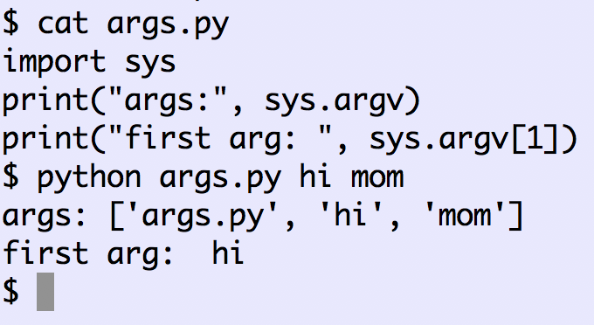
Passing arguments to python scripts
Sometimes python scripts need information about their environment, such as where to find data files
The executing script can access arguments from the command line used to launch it using the sys package:
This is a very good reason why you should never use spaces in your directory or file names

Slide 23
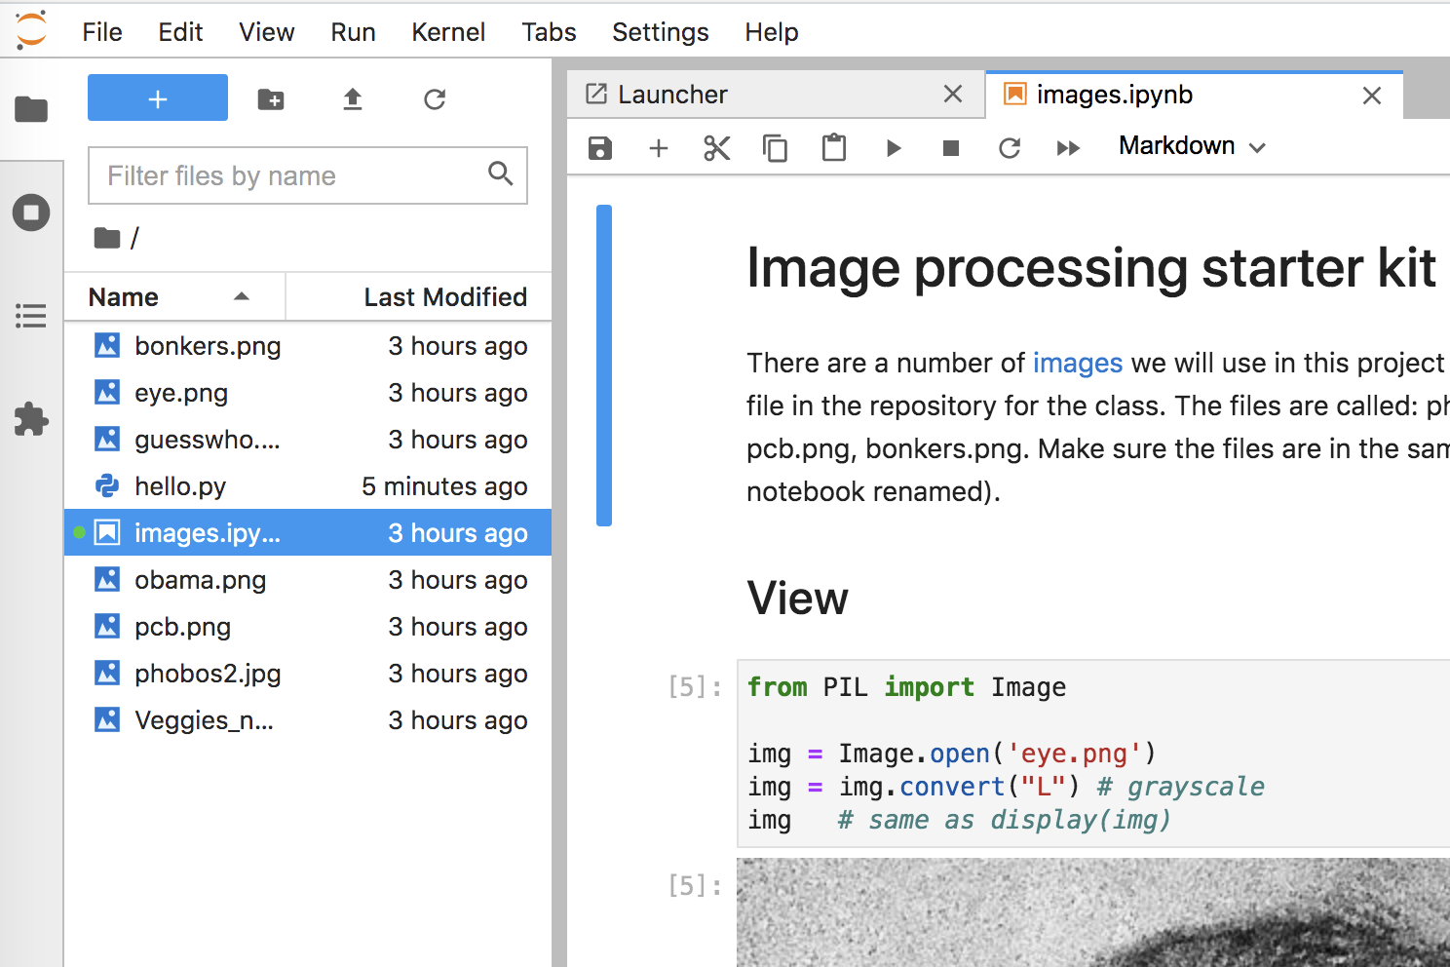
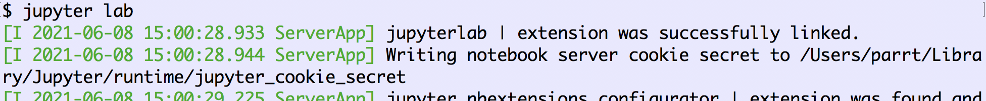
Launch Jupyter Lab (notebooks)
A “notebook” is a sequence of “cells” that can contain code, output, notes, etc.
A notebook is stored like a script but into a file.ipynb file not .py
A server that we launch from the command line starts up a Python interpreter and connects to a browser window where we can make notes and execute code snippets interactively
Tutorials:
https://www.youtube.com/watch?v=RFabWieskak
https://www.dataquest.io/blog/jupyter-notebook-tutorial/

