Slide 1
UNIX command line
Also called terminal, shell, etc...
Terence Parr
MSDS program University of San Francisco
See also Videos from Philip Guo (pythontutor guy) on terminal

Slide 2
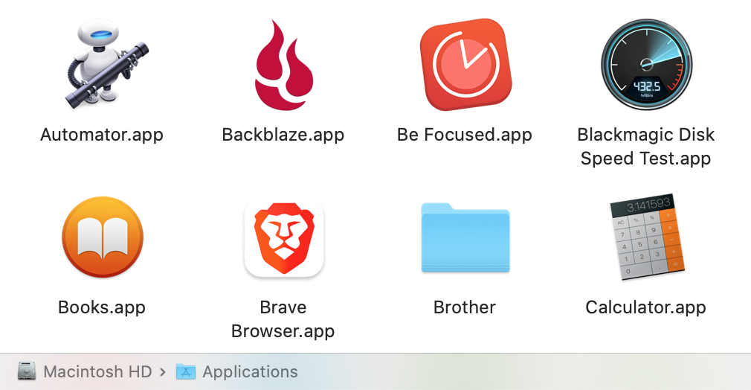
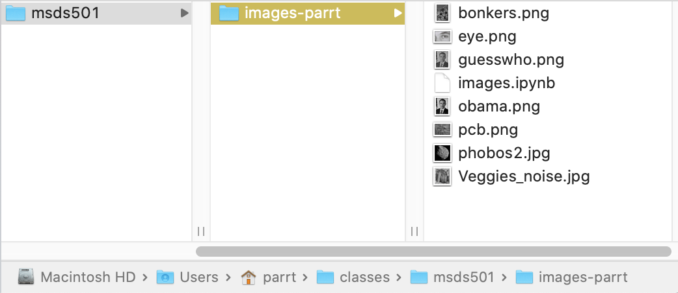
Controlling your machine w/o a GUI
The Mac "Finder" is a graphical way to launch and control programs as well as manipulate files and folders on the disk
But, the "terminal" is an old-school text-based interface that has a number of advantages

Slide 3
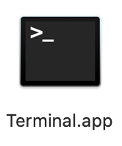
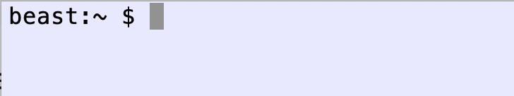
The terminal is running a shell
The UNIX shell is an interactive domain-specific language used to control and monitor the UNIX operating system (Mac OS)
It is also a programming language, though we’ll use it mostly to move files around, execute commands, ...
You need to get comfortable on the UNIX command line because, at minimum, you will control cloud computing facilities using the command line
We type commands at the prompt and hit return to execute
(Note: OS X just changed the default shell to be zsh not bash.)

Slide 4
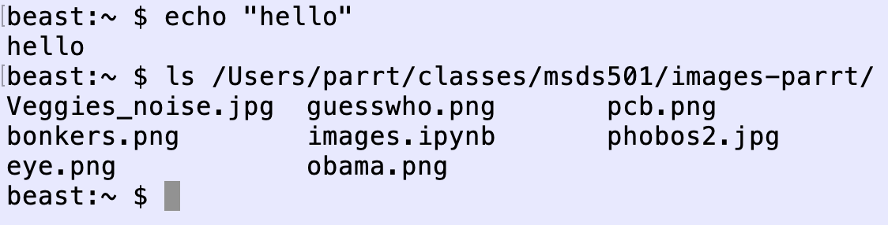
Commands are analogous to Python function calls, including arguments
In Python we do print("hello"), but in the shell we don't use parentheses around arguments
Notation: command arg1 arg2 arg3 vs python: command(arg1, arg2, arg3)

Slide 5
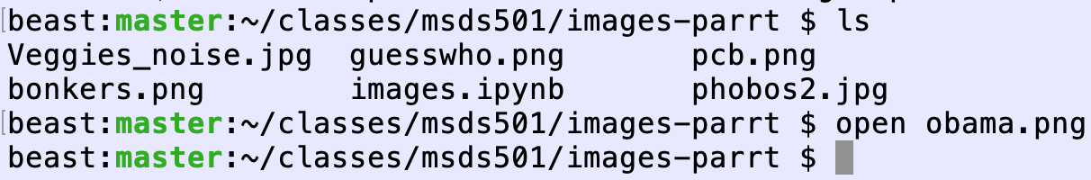
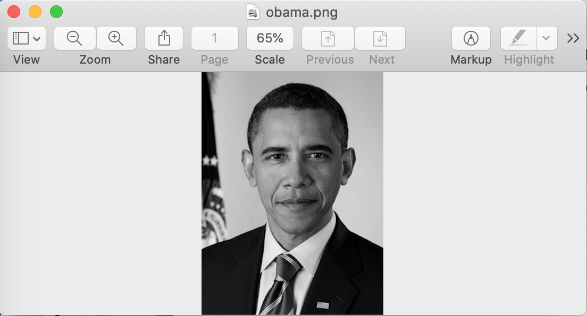
Executing programs by opening files
Instead of double-clicking on an image file, for example, we can tell the terminal to open it

Slide 6
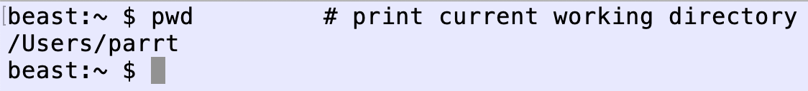
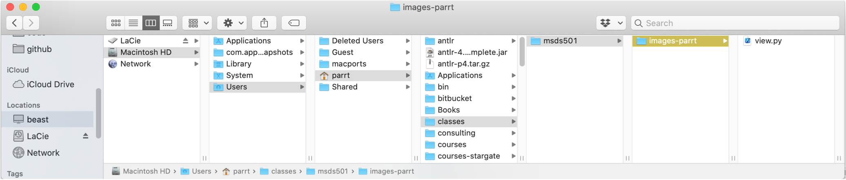
Current working directory
The shell has a number of state variables, one of which is the current working directory, and it is by far the most important
Most commands execute relative to this working directory
When terminal opens, it's set to your user home directory abbreviated as "~"

Slide 7
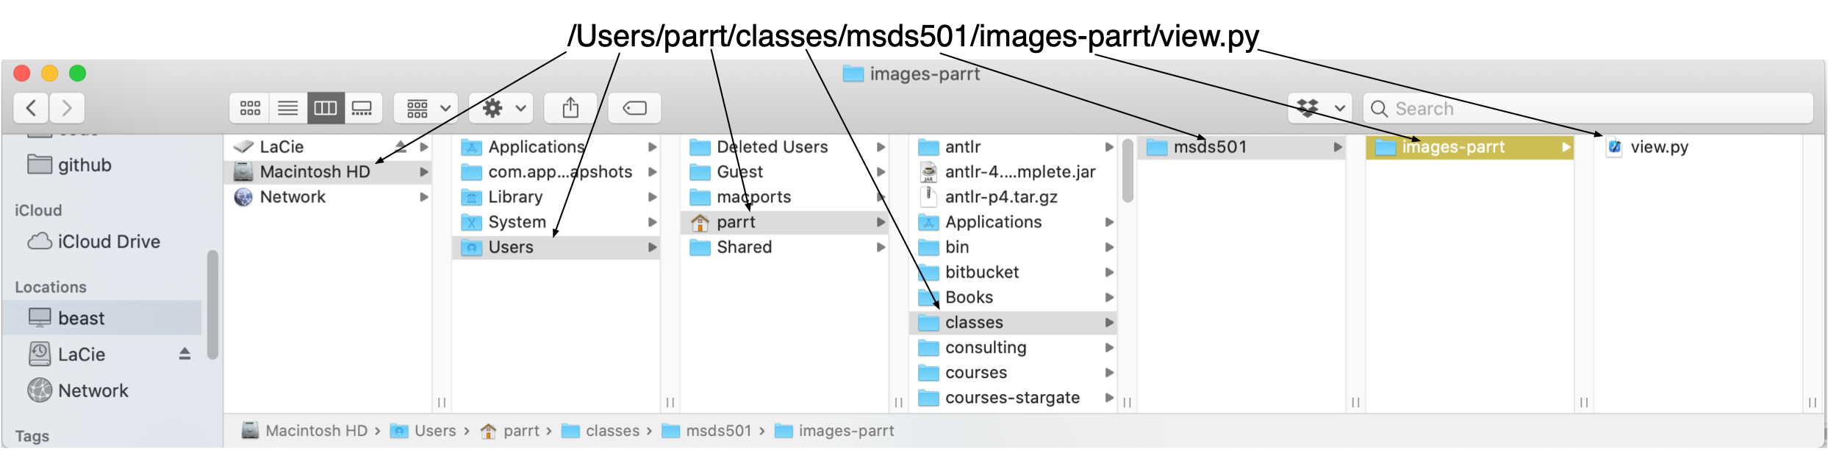
Path specifications
As we saw previously, the folders or directories on your disk represent a tree; files in a folder represent leaves of the tree
A fully-qualified path to a file consists of the directories used to reach the file from the root of the disk; root is "/" and we separate path elements with "/"
Relative pathnames do not start with "/" and are relative to WD

Slide 8
Useful directories to know about
Other then your home directory, /Users/youruser, you should know about:
/Applications
/tmp
/usr/local (such as brew's install area /usr/local/Cellar)
/bin, /usr/local/bin

Slide 9
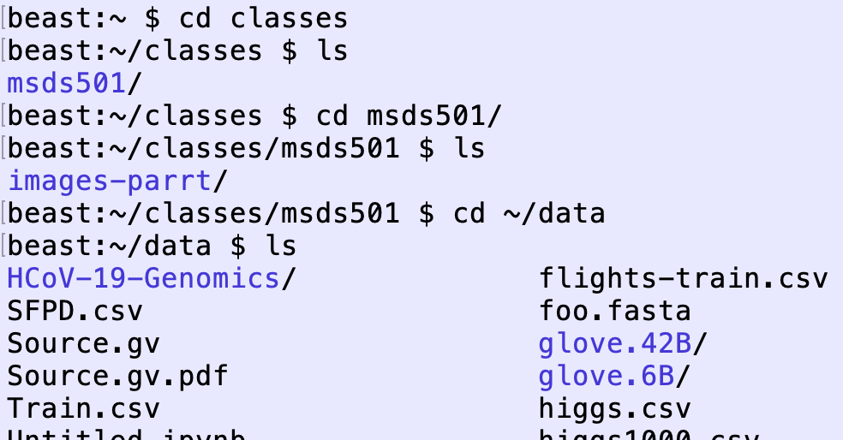
cd: change working directory
To "move" around the disk hierarchy/tree, use cd command

Slide 10
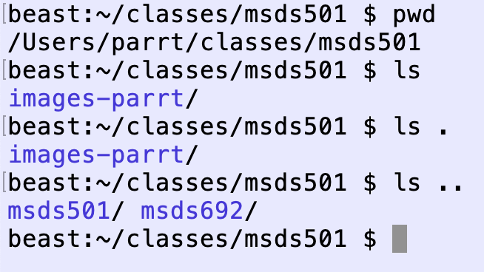
Dot, Dot-Dot
Dot "." means current directory
Dot-Dot ".." means directory above current directory

Slide 11
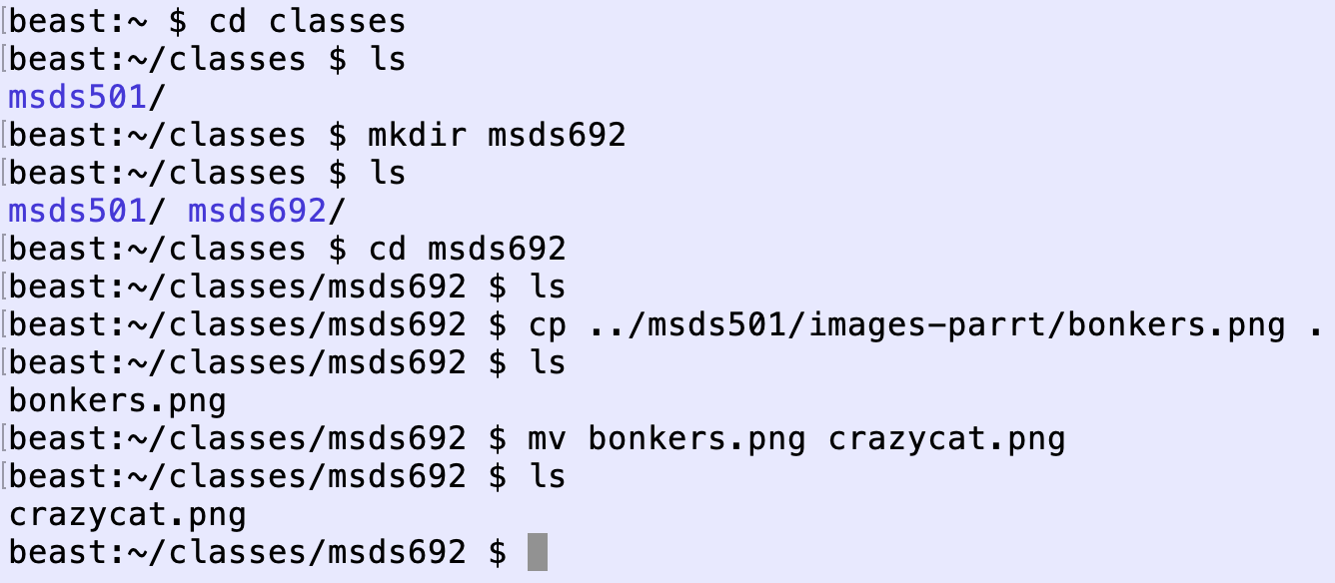
Manipulating files and directories
mkdir newdirname: make directory
cp source target: copy file or directory
mv oldname newname: rename or move directories

Slide 12
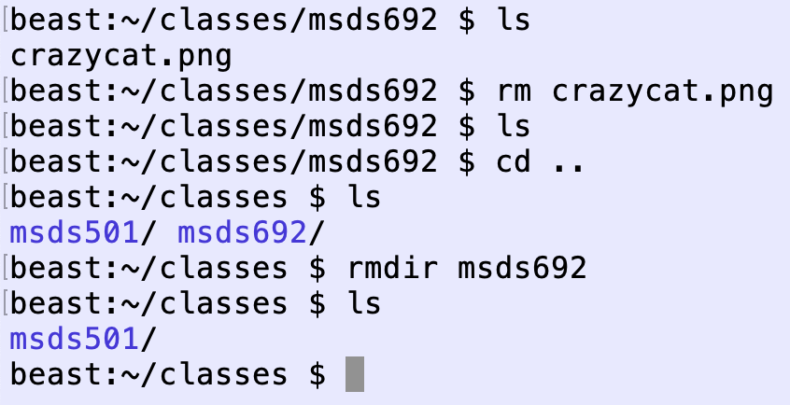
Removing files and directories
rm filename: remove file
rmdir dirname: remove empty directory
rm –rf dirname: remove directory and everything underneath it

Slide 13
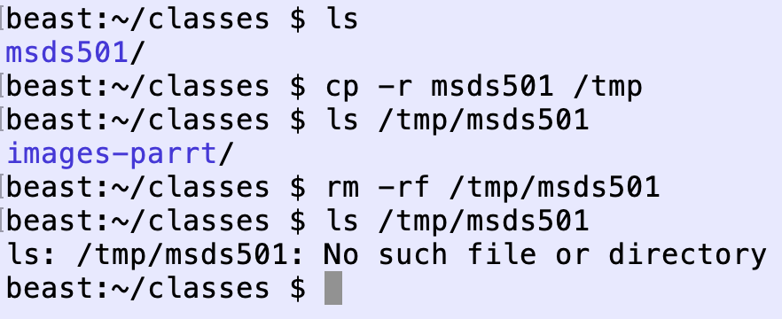
Removing files and directories
rm filename: remove file
rmdir dirname: remove empty directory
rm –rf dirname: remove directory and everything underneath it

Slide 14
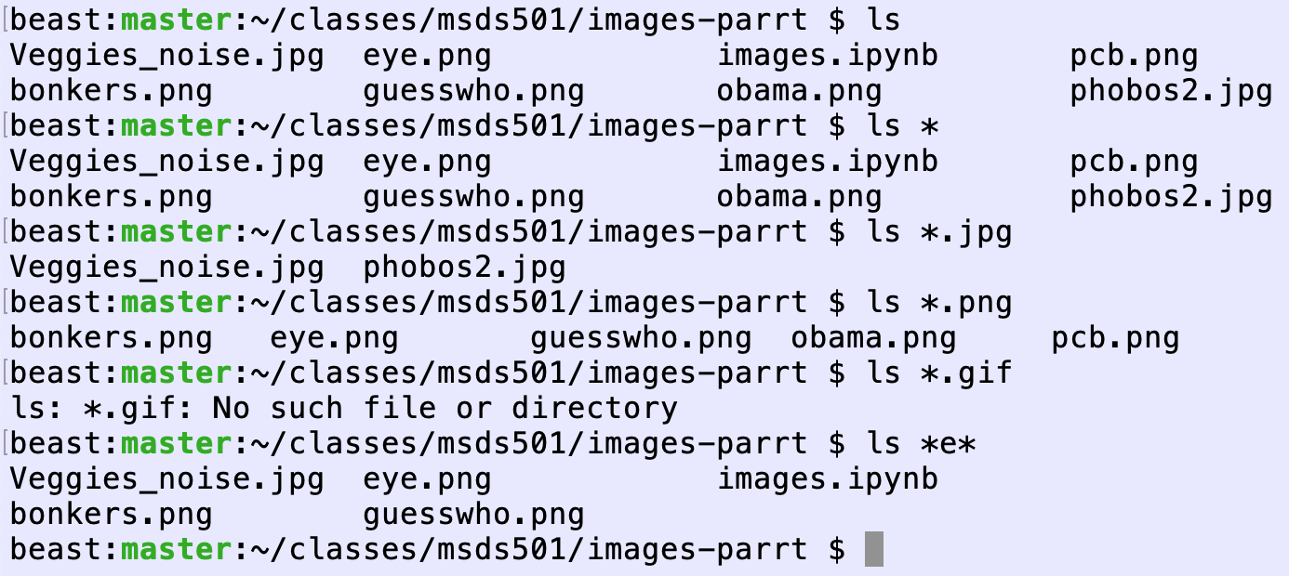
Wildcards
Star "*" means roughly "any word that matches", such as all files
Good example of something that's impossible with a GUI

Slide 15
Manual pages

Slide 16
Python-related commands

Slide 17
Interactive Python from terminal

Slide 18
Executing python scripts

Slide 19
Launch Jupyter Lab (notebooks)

