Slide 1
Programming Patterns in Python
Terence Parr
MSDS program University of San Francisco

Slide 2
How programmers design programs
Experienced programmers draw from a collection of generic high-level / large-scale mental templates as starting points
There are mental templates for desktop GUI apps, machine learning classifiers, web servers, etc....
Engineers building a new suspension bridge do not proceed as if such a thing has never been built before
A template provides an overall structure for the program, like lawyers tweaking a contract from previous client for new one
Gaining experience as a programmer means recognizing and remembering patterns in your code

Slide 3
Example: data science program template
Acquire data, which means finding a suitable file or collecting data from the web and storing in a file or database
Load data from disk or database and organize into a suitable data structure in memory
Normalize, filter, clean, or otherwise prepare data
Process the data, which can mean training a machine learning model, transforming the data, computing summary statistics, or optimizing a cost function
Emit results, which can be anything from simply printing an answer to saving data to the disk to generating a fancy visualization

Slide 4
Low-level programming patterns
High-level templates help us organize and plan our program
Low-level patterns are human-compatible puzzle pieces that combine to fill in details of the overall template
These patterns have Python implementations but we design programs by selecting and applying patterns/operations, not specific code sequences
When designing a program, I never say: "Oh! I need a for-loop with an if-statement right here."

Slide 5
Sample programming patterns
You're no doubt familiar with operations such as:
sum the numbers in a list
count the elements in a list
But there are many many more, such as:
find all values in a list satisfying a condition
apply an operation to each element in the list to get new list
merge two sorted lists
delete records in a dataframe that satisfy a condition
Think and plan at this level, not the code level

Slide 6
Visualize operation then identify the pattern
Thing visually about how you would manipulate lists of data or extract information from data
Manually moving some data around on paper or in spreadsheet helps me to understand the operation to perform
Matrix addition
Sum elements

Slide 7
A parade of patterns

Slide 8
Accumulate
Traverses a sequence of elements and accumulates a value
In Excel, this is like using sum(...) in a cell.
Can use any other arithmetic operator, such as *
Called reduce, as in map/reduce of distributed computing world
Quantity = [6, 49, 27, 30, 19, 21, 12, 22, 21]
sum = 0
for q in Quantity:
sum += q # same as: sum = sum + q
print(sum)
Experiment in pythontutor

Slide 9
Map
A very common operation maps one sequence to another, applying an operator or function to each element
It's like using a spreadsheet to create a new column containing the unit price discounted by 5%
UnitPrice = [38.94, 208.16, 8.69, 195.99]
discounted = [] # empty list
for price in UnitPrice:
discounted.append(price * 0.95)
# list comprehension shines here!!
discounted = [p*0.95 for p in UnitPrice]
Be able to reverse this, going from code to pattern!
Experiment in pythontutor

Slide 10

Combine
Traverse two lists at once placing the result in a third list
Multiply the $i^{th}$ element from two different sequences and placing the result in the $i^{th}$ position of the output sequence
Quantity = [6, 49, 27, 30]
UnitPrice = [38.94, 208.16, 8.69, 195.99]
cost = []
for i in range(len(Quantity)):
cost.append( Quantity[i] * UnitPrice[i] )
Cost = [Quantity[i] * UnitPrice[i] for i in range(len(Quantity))]
Experiment in pythontutor

Slide 11
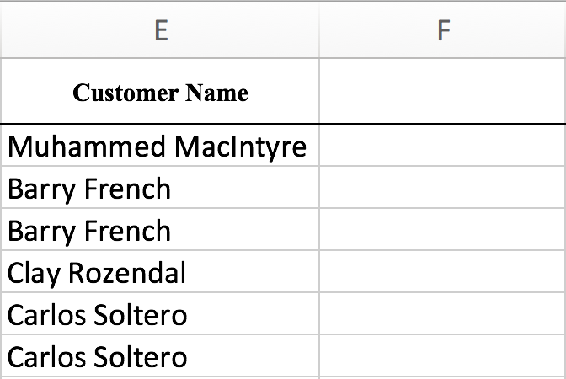
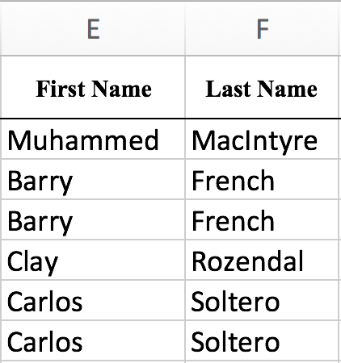
Split
The opposite of combining is splitting where we split a stream into two or more new streams
Example: split the full names in a list into their first and last names
names = ['Terence Parr', 'Diane Woodbridge', 'Yannet Interian']
for name in names:
print(name.split())
first = []
last = []
for name in names:
f,l = name.split()
first.append(f)
last.append(l)
Experiment in pythontutor

Slide 12
Slice

Slide 13
Filter

Slide 14
Search

