Slide 1
Data aliasing
Terence Parr
MSDS program University of San Francisco
See notebook: https://github.com/parrt/msds501/blob/master/notes/aliasing.ipynb

Slide 2
Variables refer to memory regions
We use names like data and salary to represent memory cells holding data values
The names are easier to remember than the physical memory addresses, but we can get fooled
Variables are really references or pointers to chunks of memory
Pointers are like phone numbers that "point at" phones, but phone numbers are not the phone itself

Slide 3
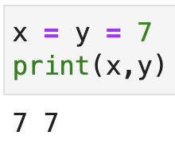
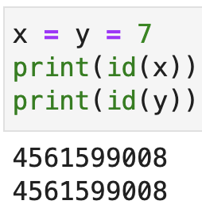
Uncovering memory locations
Two variables x and y can both have the same value 7, but they are technically both pointing to the same 7 object!
We can uncover this secret level of indirection using the built-in id(x) function that returns the physical memory address pointed to by x

Slide 4
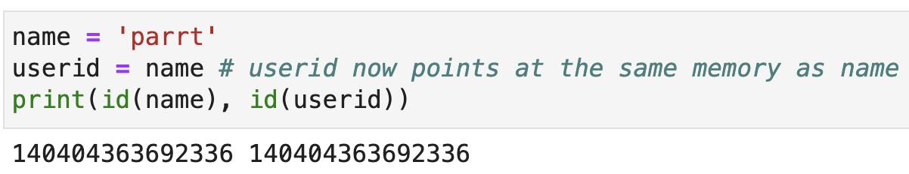
Aliasing: variables pointing at the same memory region
Assigning one variable to another creates an alias because both variables now point at the same memory location
That memory location contains the five letters p-a-r-r-t
name and userid look like two copies, but they share the same location in memory

Slide 5
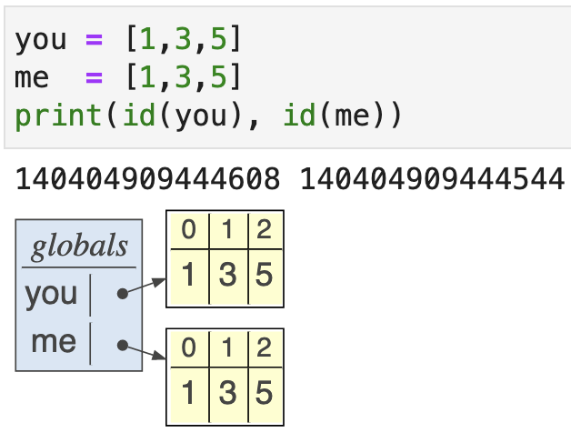
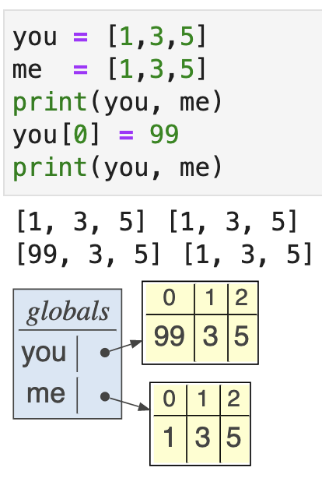
Altering non-overlapping data
Each […] list literal creates a new list even if the elements within the lists are the same

Slide 6
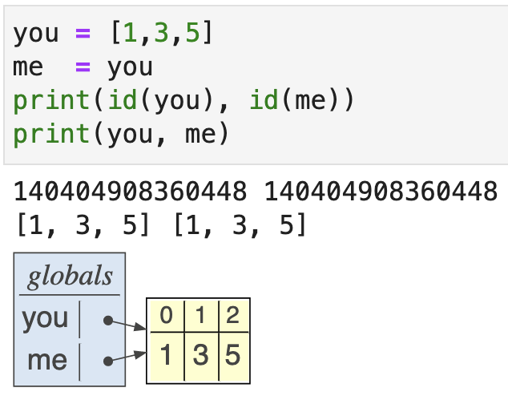
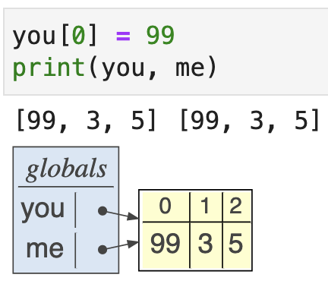
Altering shared (aliased) data
If we make you and me share the same list (same region of memory), however, then changing one changes the other!!!
Experiment in pythontutor

Slide 7
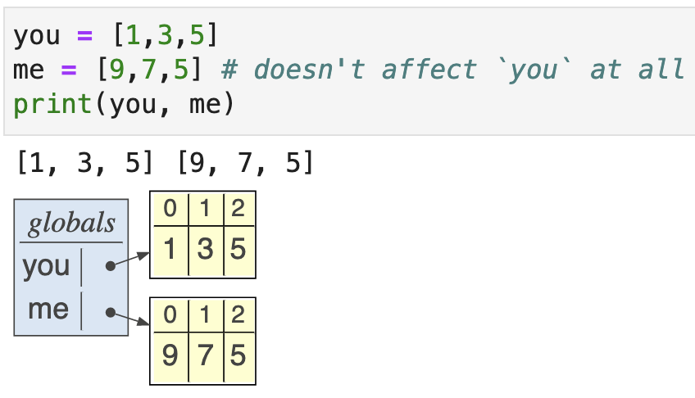
Reassigning a var breaks the aliasing
Don't confuse changing the pointer to the list with changing the list elements:

Slide 8
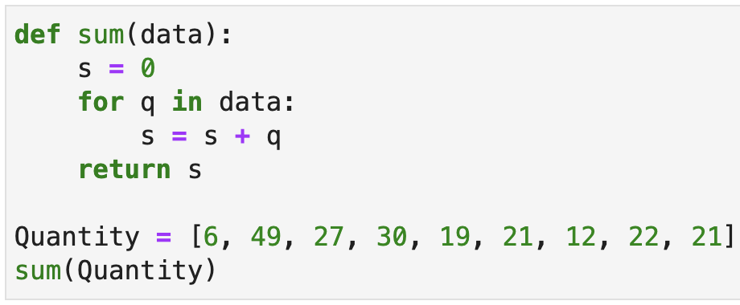
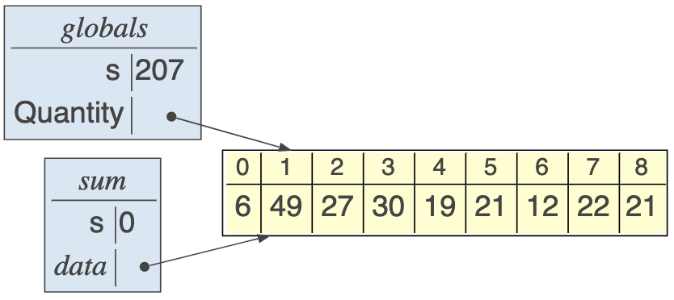
Aliasing through argument passing
(We’ll learn about functions in more detail soon)
Aliasing of data happens a great deal when we pass lists or other data structures to functions
E.g., passing list Quantity to a function whose argument is called data means that the two are aliased

Slide 9
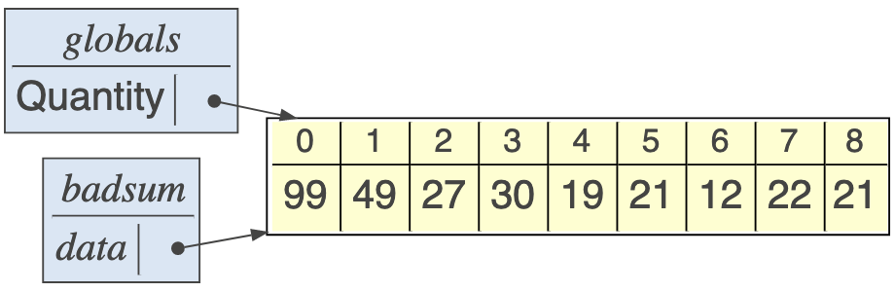
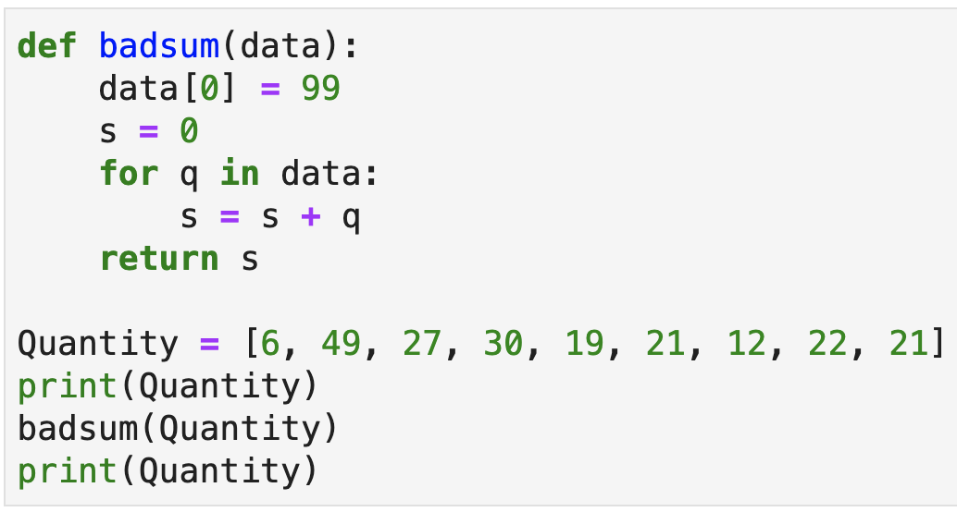
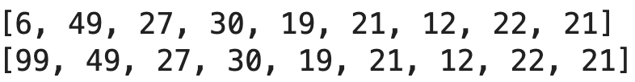
Warning: Functions can alter the contents of aliased arguments (preview of funcs)
If badsum() alters the argument, it also alters the global since they point at the same data

