Slide 1
Introduction to (Python) programming
Terence Parr
MSDS program University of San Francisco

Slide 2
What is programming / coding?
Literally: Creating a set of instructions for a computer to execute
First we construct a sequence of abstract operations, sometimes called an algorithm or workplan, that performs the desired task
Then we translate these abstract operations to concrete and precise instructions
These instructions must follow the grammatical structure of a programming language, such as Python
Each instruction typically solves a piece of the problem
The emergent behavior of the program solves our task
Say hello
☞
print("hello")

Slide 3
What's the hard part?
Programming is mostly about converting "word problems" (project descriptions) to algorithms or work plans
We immediately think about programming languages because we express ourselves using specific language syntax but…
Programming is more about what to say, and in what order, rather than how to say it
You'll eventually get fast at Python coding and using libraries
It'll always be harder to design a sequence of steps that solves a data science problem (or other) than it is to code
I remember being confronted with my first programming task (using BASIC in 1979!) and drawing a complete blank even though I knew BASIC syntax
Don't worry: we will study lots of patterns and strategies as aids

Slide 4
Concrete first steps
Programming is more about design, rather than coding details, but it's much easier to learn programming by actually speaking Python (e.g., we begin learning a foreign language by memorizing a few key phrases like "May I have a beer?")
Let's get started by looking at the key pieces we have at our disposal and then we can learn some basic Python and write some simple programs

Slide 5
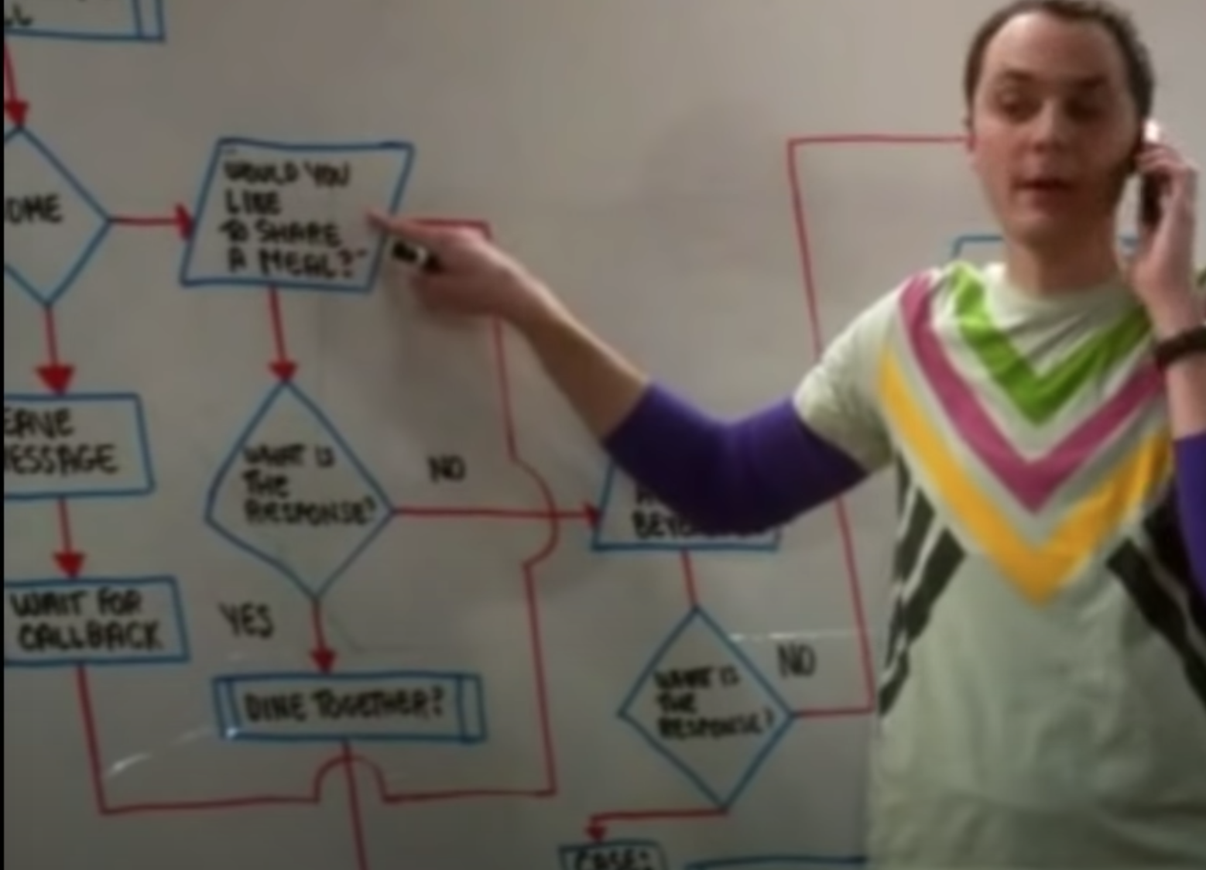
Common programming concepts
Individual instructions, such as assignments and arithmetic
Sequences of instructions, do this then that
Repeated sequences (loops), do this to each element of a list
Conditional execution of sequences, if negative make it positive
Aggregating instructions into reusable methods
Aggregating instructions and methods into modules (.py files)
Object-oriented (OO) programming (aggregating data & methods)
Big Bang Theory "friendship algorithm"

Slide 7
Most…
That means we need to know
def walk(A,nrows,ncols):
for i in range(nrows):
for j in range(ncols):
# process A[i][j]

