Slide 1
Introduction to (Python) programming
Terence Parr
MSDS program University of San Francisco

Slide 2
What is programming / coding?
Literally: Creating a set of instructions for a computer to execute
First we construct a sequence of abstract operations, sometimes called an algorithm or workplan, that performs the desired task; this is problem-solving and done prior to coding
Then we translate these abstract operations to concrete and precise instructions
These instructions must follow the grammatical structure of a programming language, such as Python
Each instruction typically solves a tiny piece of the problem
The emergent behavior of the program solves our task
Say hello
☞
print("hello")

Slide 3
What's the hard part?
Programming is mostly about converting "word problems" (project descriptions) to algorithms or work plans
We immediately think about programming languages because we express ourselves using specific language syntax but…
Programming is more about what to say, and in what order, rather than how to say it
You'll eventually get fast at Python coding and using libraries
It'll always be harder to design a sequence of steps that solves a data science problem (or other) than it is to code
I remember being confronted with my first programming task (using BASIC in 1979!) and drawing a complete blank even though I knew BASIC syntax
Don't worry: we will study lots of patterns and strategies as aids

Slide 4
Learning to be a programmer
While programming is more about problem-solving and design, rather than coding details, it's much easier to learn programming by actually speaking some Python (e.g., we learn a foreign language by memorizing a few key phrases like "May I have a beer?")
Once we’re conversant in basic Python, it’s time to study some common programming patterns, such as “search a list”
The final and most important skill is being able to translate real-world problems into appropriate sequences of operations (which are then straightforward to convert to Python)
We’ll learn problem-solving techniques and apply them to lots of sample problems

Slide 5
Most important programming concepts
Batch execution vs interactive execution
Order of operations (control-flow)
Representing data in memory
Aggregating instructions into reusable functions
Aggregating instructions and functions into modules (.py files)
Object-oriented (OO) programming (aggregating data, methods)

Slide 6
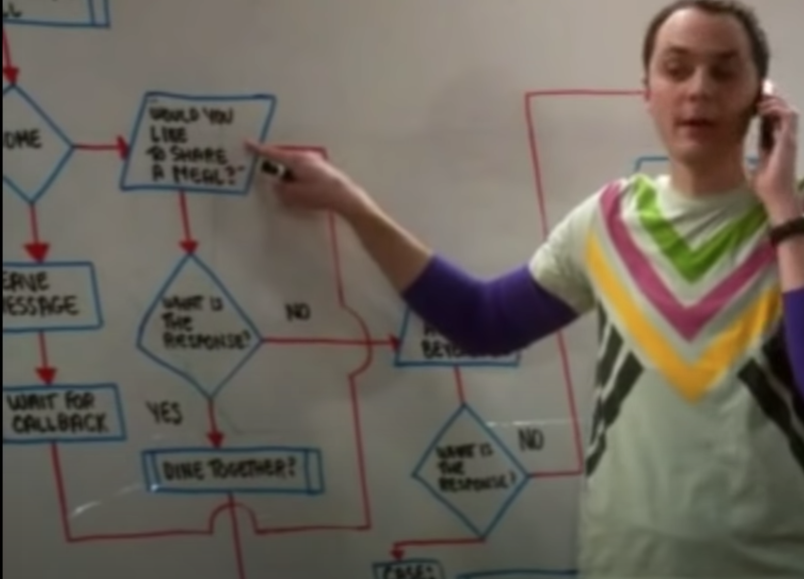
Key concept: order of operations
Order is critical Example: get license, buy car, drive car
Big Bang theory’s friendship algorithm
Anecdote: graphics designer confused by loops

Slide 7
Key language constructs

Slide 8
Interactive demos via pythontutor.com
Let's observe the control-flow using our key syntax constructs:
generate some output
assignment creates and alters variables
types matter, operators are overloaded
simple conditional execution
else-clause
simple loop that updates variable
demo loop for powers of two

Slide 9
Programmer's view of memory
Code operates on data, which is stored in memory, so we have to learn about how Python represents data elements in memory

Slide 10
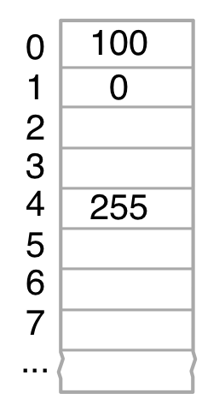
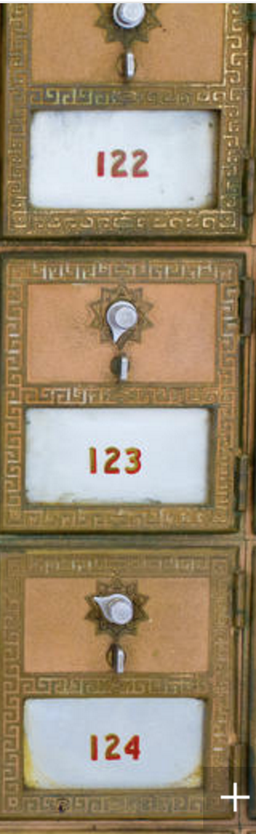
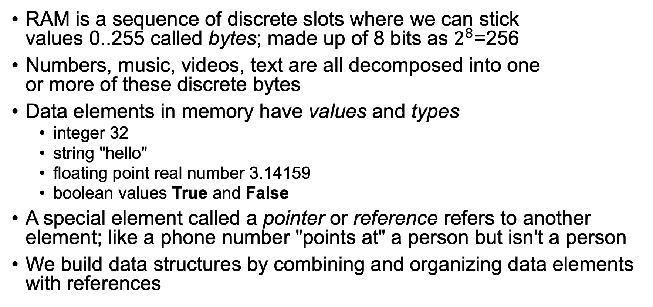
Representing data in memory
RAM is a sequence of discrete slots where we can stick values 0..255 called bytes; made up of 8 bits as $2^{8}$=256
Numbers, music, videos, text are all decomposed into one or more of these discrete bytes
Data elements in memory have values and types
integer 32
string "hello"
floating point real number 3.14159
boolean values True and False
A special element called a pointer or reference refers to another element; like a phone number "points at" a person but isn't a person
We build data structures by combining and organizing data elements with references

Slide 11
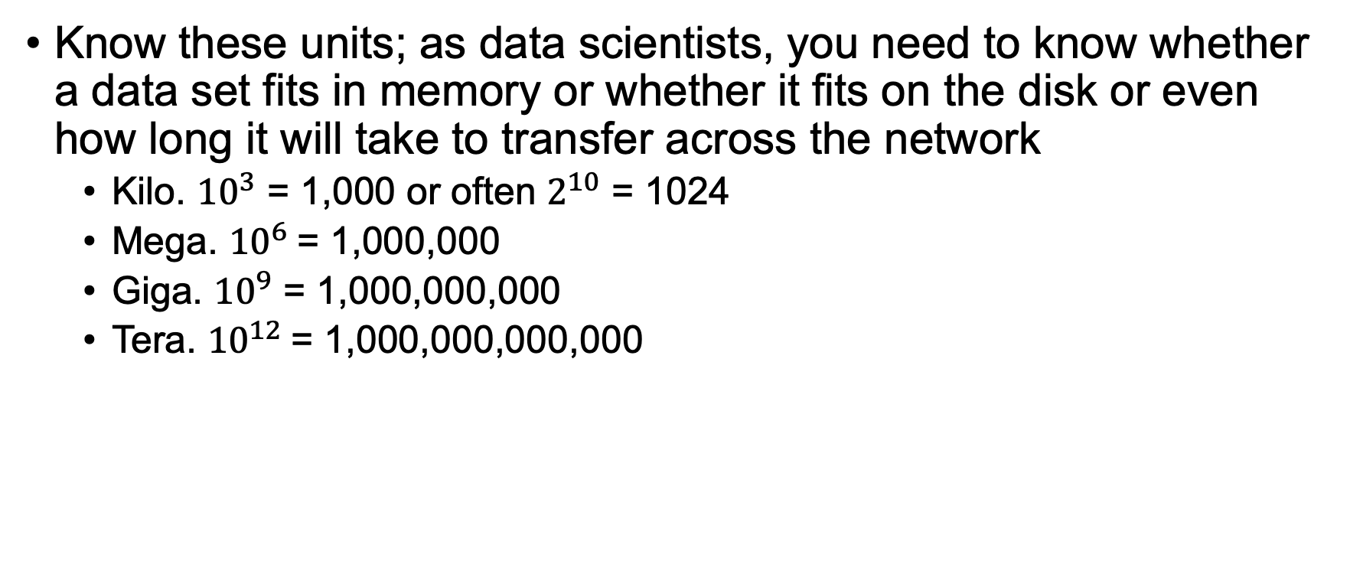
Key size metrics
Know these units; as data scientists, you need to know whether a data set fits in memory or whether it fits on the disk or even how long it will take to transfer across the network
Kilo. ${10}^{3}$ = 1,000 or often $2^{10}$ = 1024
Mega. ${10}^{6}$= 1,000,000
Giga. ${10}^{9}$ = 1,000,000,000
Tera. ${10}^{12}$= 1,000,000,000,000

Slide 12
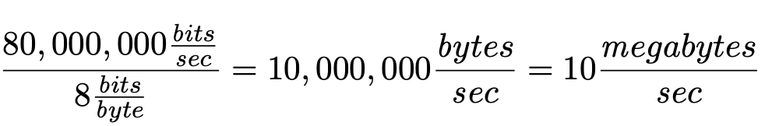
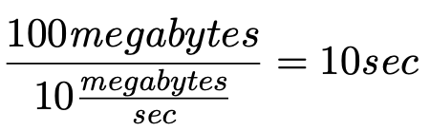
Let the units be your guide
On an 80 megabits/second network you can transfer 10 megabytes/second because there are 8 bits/byte
So, a 100Mbyte file transmits in 10 seconds

Slide 13
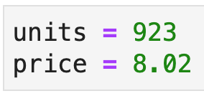
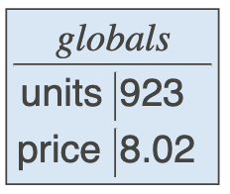

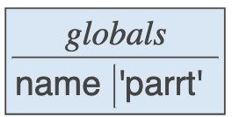
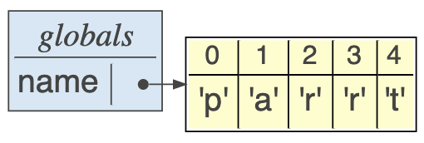
Programming language view of memory
Dealing with untyped bytes is tedious; we prefer to group bytes into higher-level values, such as numbers and strings
Might be 4 bytes
5 bytes plus overhead

Slide 14
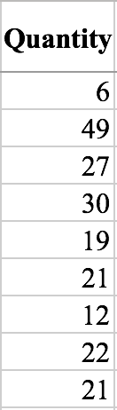
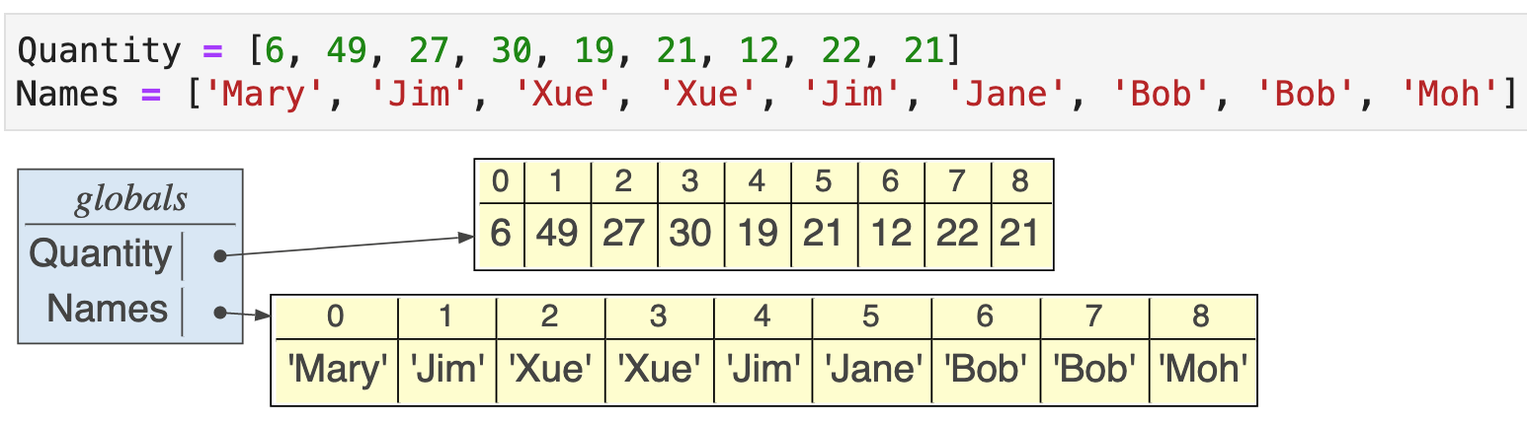
Lists of data elements
Most common data structure is the list, which is just a sequence of data elements or other data structures
Indexed from 0 not 1 and list vars point at a chunk of memory holding the list elements contiguously (preserving the sequence order)
Access elements with index operator; e.g., Names[0] is 'Mary' and Quantity[4] is 19

Slide 15
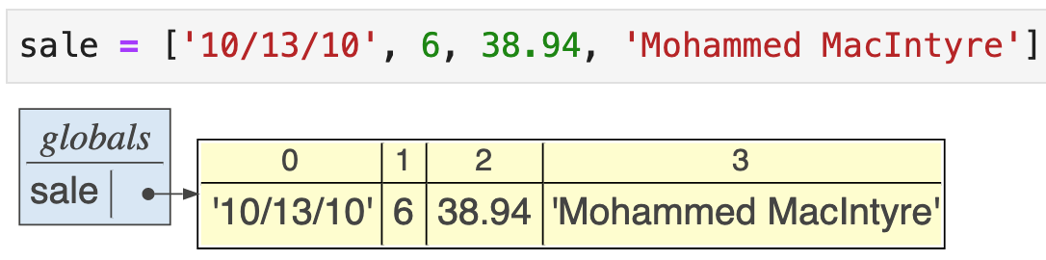
Heterogeneous lists
Elements can have different types:
Heterogeneous lists can be used to group bits of information about a particular entity or observation

Slide 16
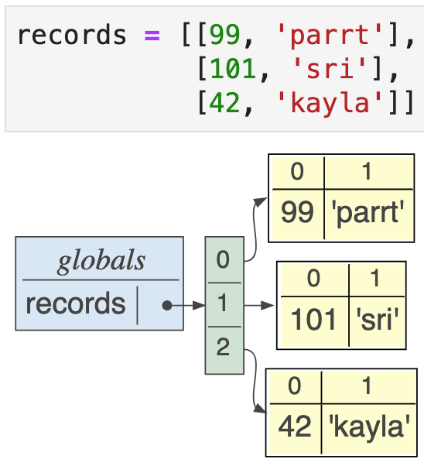
List of lists
In this case, the outer list is a list of elements that happen to be lists also; each of the inner lists has two elements representing a record of information
experiment via pythontutor

Slide 17
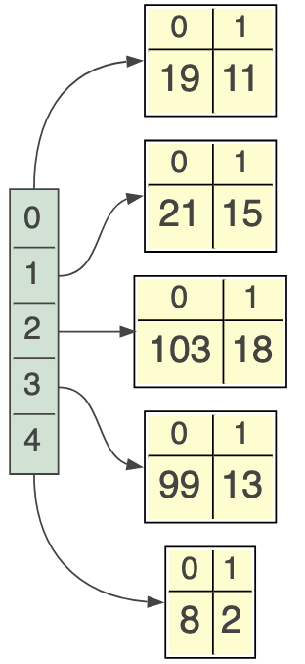
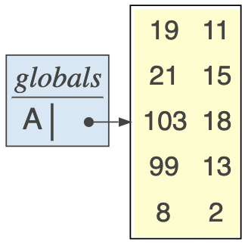
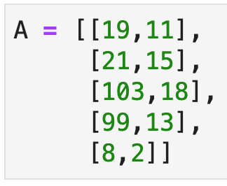
Matrices as lists of lists
Experiment via pythontutor
A matrix is a list of rows; a row is a list of numbers
We think of it like this:
But, it's actually represented like:
Row 4 is A[3]

Slide 18
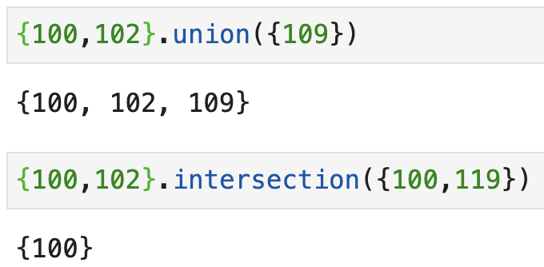
Sets
A set is just an unordered, unique collection of elements; here is an example using integers: ids = {100, 103, 121, 102, 113, 113, 113, 113}
We can do lots of fun set arithmetic:

Slide 19
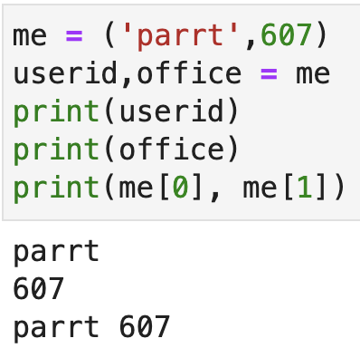
Tuples
A tuple is an immutable list and uses parentheses rather than square brackets for notation
Tuples are often used to group related elements:
Experiment in pythontutor

Slide 20
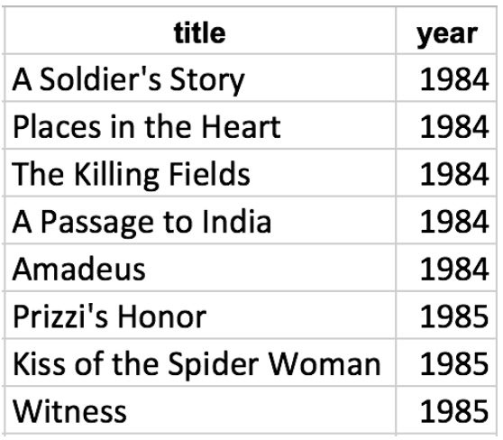
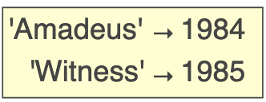
Dictionaries
If we arrange two lists side-by-side and kind of glue them together, we get a dictionary
Dictionaries map one value to another, just like a dictionary in the real world maps a word to a definition
Here are two sample dictionaries:
Index by key to get the value; e.g., movies['Amadeus']
movies = {'Amadeus':1984, 'Witness':1985}
Experiment in pythontutor

Slide 21
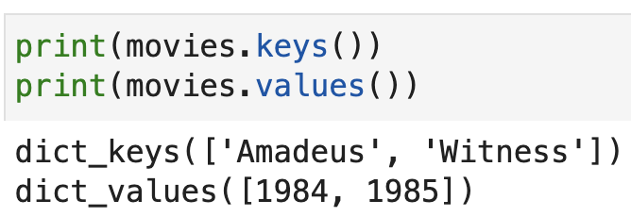
Dictionary keys and values
We can split a dictionary apart to get the keys and values:
Note: this uses the notation object.function(), which you can think of as function(object); we’ll learn more about this later

Slide 22
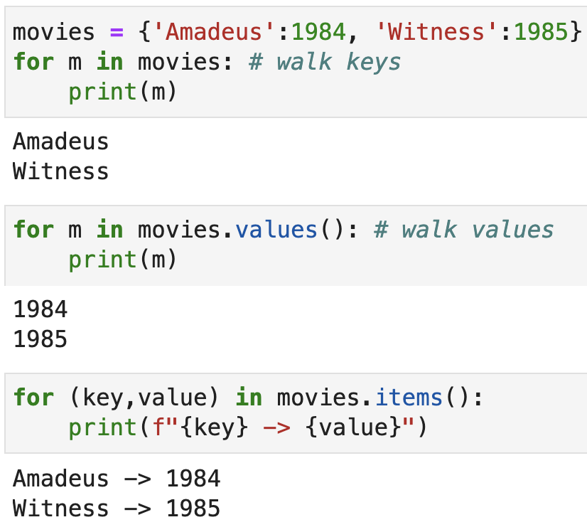
Iterating through a dictionary
We can walk the keys/values of a dictionary with a for-each loop
More on looping next!

Slide 23
More on looping

Slide 24
For-loops
range loops
for-each loops
loop with enumerate()
watch row var iterate through list-of-list rows
indexed loop using range
zip'd loop

Slide 25
Combined conditional / loop
Now that we have some basic Python skills, let's look at more complicated loop-related constructions starting with a combination:
i = 1
while i <= 6:
if i==3:
print("Halfway!")
i = i + 1
Step through code at pythontutor.com

Slide 26
Translating formulas
Sigmas become accumulator range-loops (recall indexed from 0)

Slide 27
List comprehensions
Making new lists from (optionally filtered) sequences, elements
comprehensions on lists of strings
comprehensions on lists of numbers

