Slide 1
An overview of the Python programming ecosystem
Terence Parr
MSDS program University of San Francisco

Slide 2
What is programming / coding?
Literally: Creating a set of instructions for a computer to execute
First construct a sequence of abstract operations, sometimes called an algorithm or workplan, that performs a desired task
Then translate these abstract operations to concrete and precise instructions
These instructions must follow the grammatical structure of a programming language, such as Python
Each instruction typically solves a tiny piece of the problem
The emergent behavior of the program solves our task

Slide 3
Executing programs
Computers don't inherently understand Python or any other programming language
A programmer has to create a program, called an interpreter, in some language X that understands statements in language Y (Python's interpreter is written in the C language)
We'll use three interfaces to access a Python interpreter:
pythontutor.com (no setup and visualizes Python executions)
The UNIX commandline to run Python .py files and to interact
Jupyter notebooks, a browser interface for code and notes
We'll even learn to execute code on a remote cloud computer

Slide 4
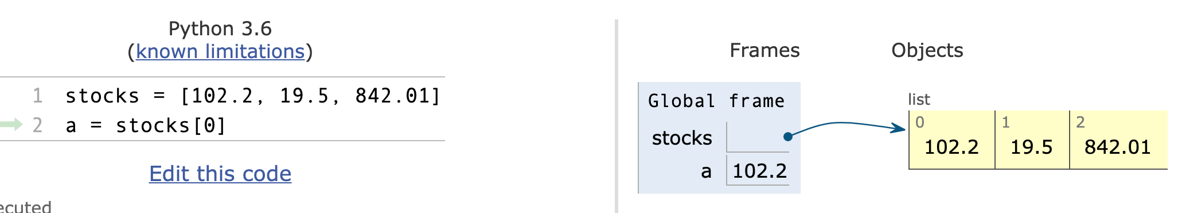
Python tutor http://pythontutor.com/
Type/execute code without installing software on your laptop
Visualizes the state of the Python interpreter
Really nice interactive tool for learning Python (and other langs)

Slide 5
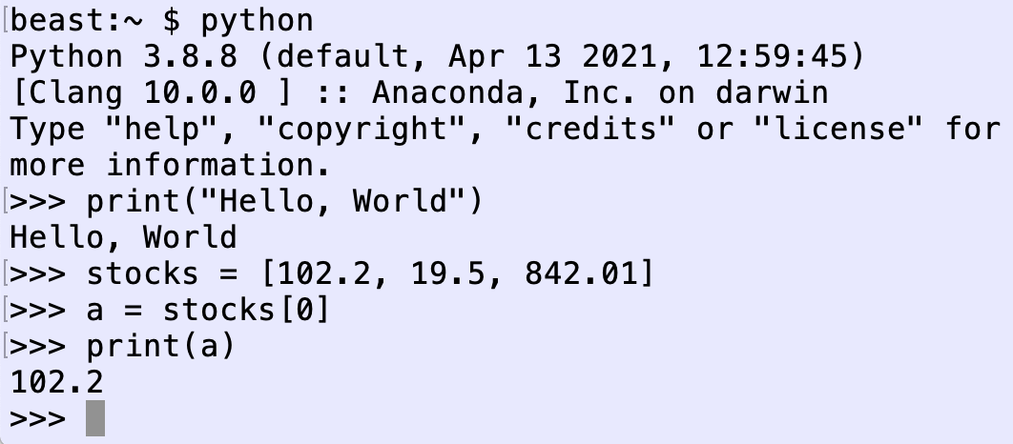
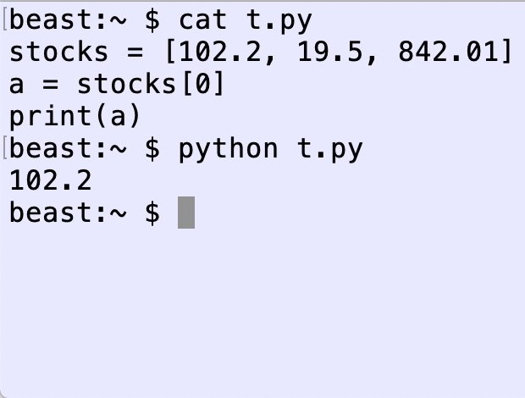
Python from the commandline
The commandline is built in to Macs / unix machines
Python interpreter installed with Anaconda
Interactive
batch

Slide 6
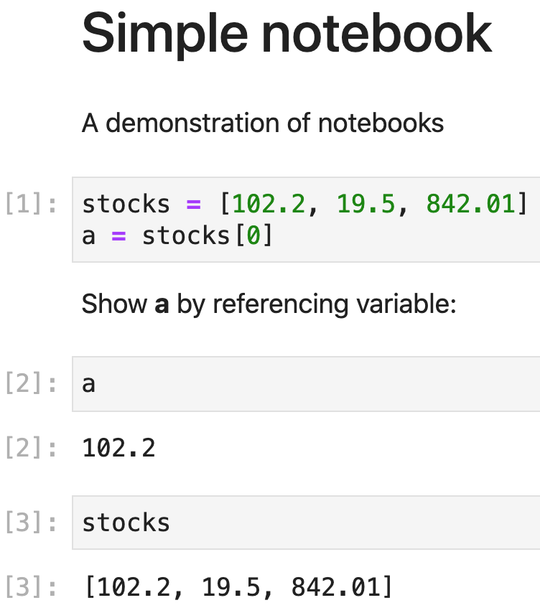
Python within a Jupyter notebook
Interactive execution for code, notes, data, visualizations
Installed automatically with Anaconda
The Python interpreter keeps running in the background so we can interactively try different code snippets
This will likely be your primary data science development environment

Slide 7
Python libraries make us more productive
Libraries provide repertoire of existing functionality we can leverage to boost productivity
You'll use matplotlib, numpy, pandas, and scikit-learn extensively throughout the MSDS program
The application programmers interface (API) is huge for these libraries and it takes a while to learn them, but they are very powerful
Google / stack overflow will be your friends here as you learn
Never ask what the parameters are to a library function; you must be independently functional so look it up yourself

Slide 8
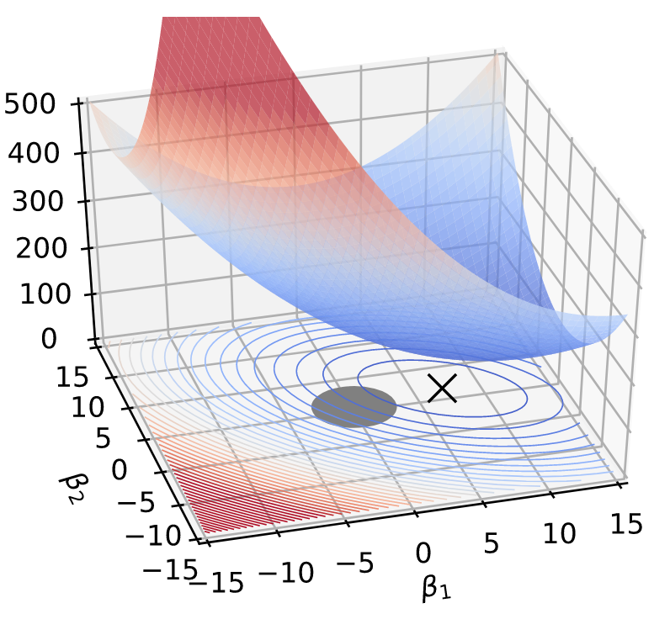
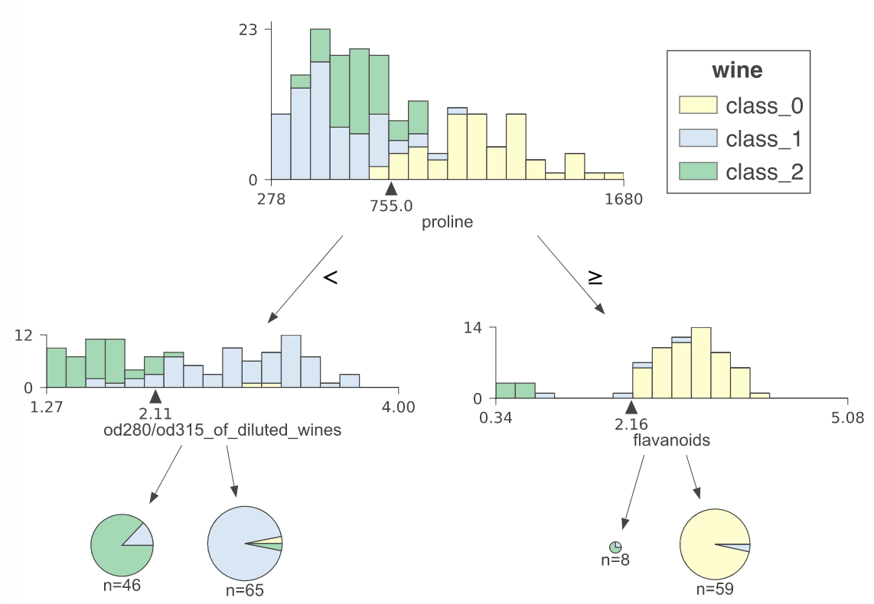
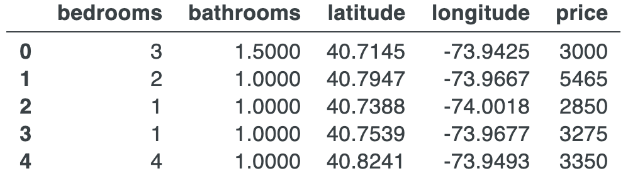
Sample functionality

Slide 9
Getting to know your computer
A programmer's perspective

Slide 10
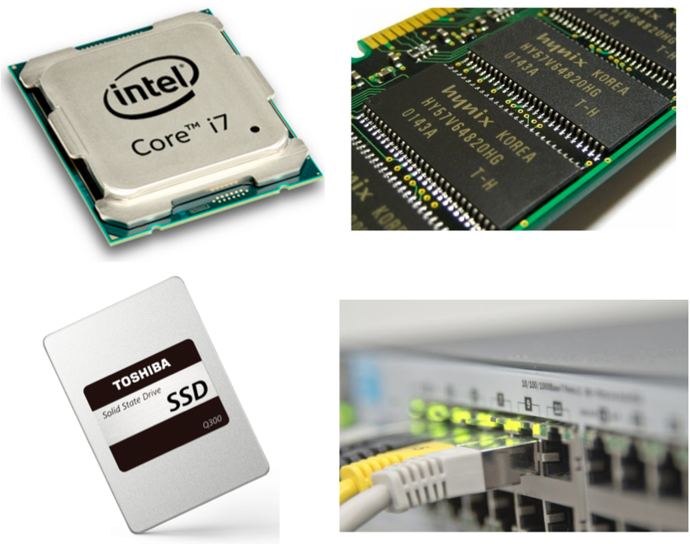
Computer components
Processor (CPU)
Memory (RAM) code+data
Nonvolatile Storage (disk)
Network
CPU executes code and operates on data in RAM, saving results on disk
Can send and receive data across the network

Slide 11
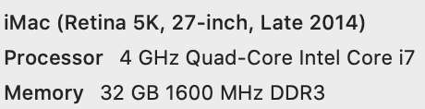
Processor
Performs five principal operations:
load small chunks of data from memory into the CPU
perform arithmetic computations on data in the CPU
store small chunks of data back to memory
jump to a new location (this is how we loop)
jump to a new location if condition is true
Each instruction does a tiny amount of work but CPU can execute billions of them per second
E.g., total = cost + tax might take 2 loads, 1 add, and 1 store

Slide 12
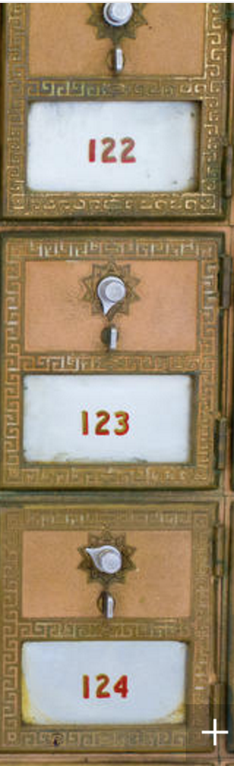
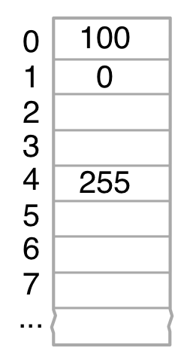
Memory
RAM is much faster but usually much smaller than the disk and all RAM data is lost when the computer powers off
Think of memory as your working or scratch space and the disk as your permanent storage
Memory is broken up into discrete cells of a fixed size called a byte that can hold a number between 0 and 255 (8 bits)
Cells have integer addresses just like mailboxes
CPUs can read/write data at specific memory locations
Everything from actual numbers to music to videos is broken down and stored as a sequence of bytes

Slide 13
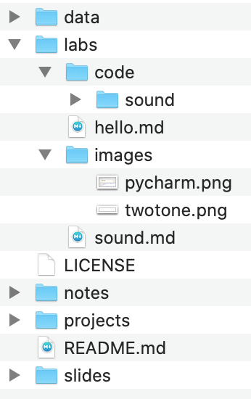
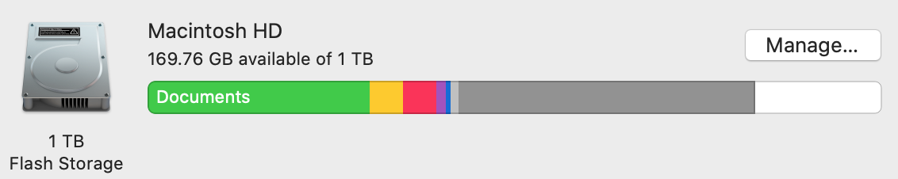
Disk (nonvolatile) storage
Files hold data meant to be treated as a unit such as ladygaga.mp3 or sales.csv
Directories (folders) group files and other (sub-)directories
Disk is a tree of folders with files in the leaves
Executing programs have a current working directory and file specs (paths) are relative to that

Slide 14
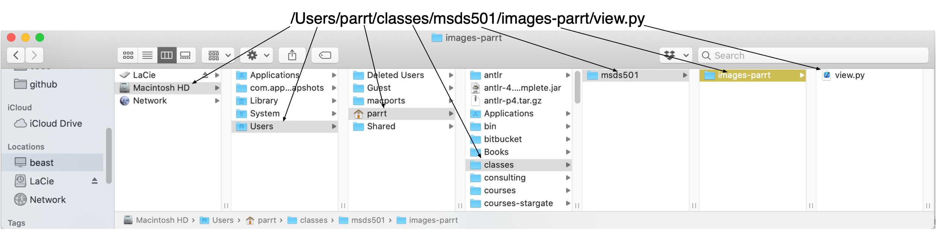
Paths to directories and files
Path is slash-separated sequence of dir names, optionally followed by file name
The root is a single slash "/" and absolute paths start with "/"
Shorthand for your user home directory is "~" such as /Users/parrt
Relative paths do not start with "/" or "~" and are relative to current working directory

Slide 15
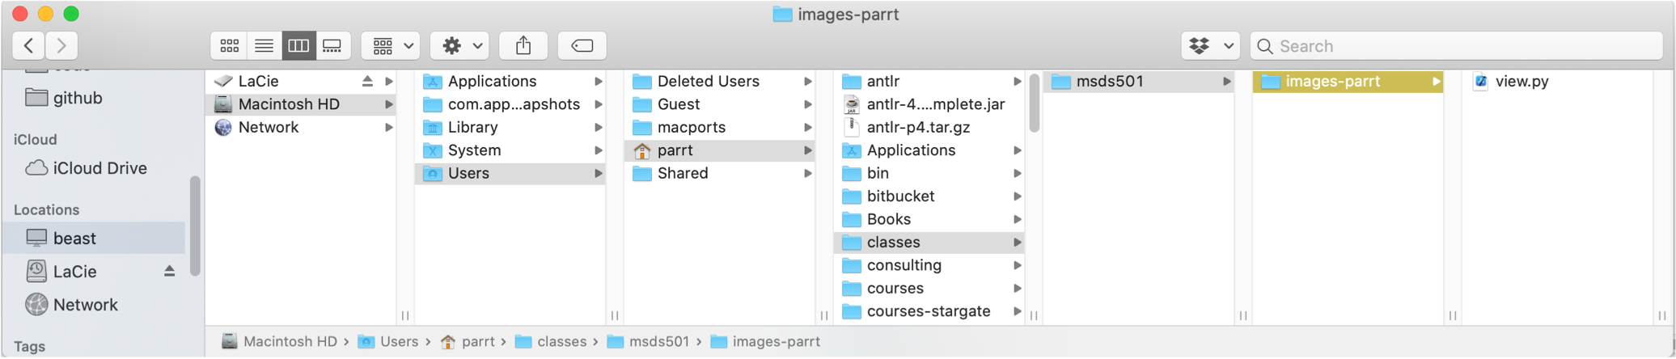
Path examples
parrt dir is /Users/parrt or ~parrt or just ~
If current working directory is parrt then msds501 dir is classes/msds501 relative to that
If current working directory is images-parrt, path to view.py is just view.py

Slide 16
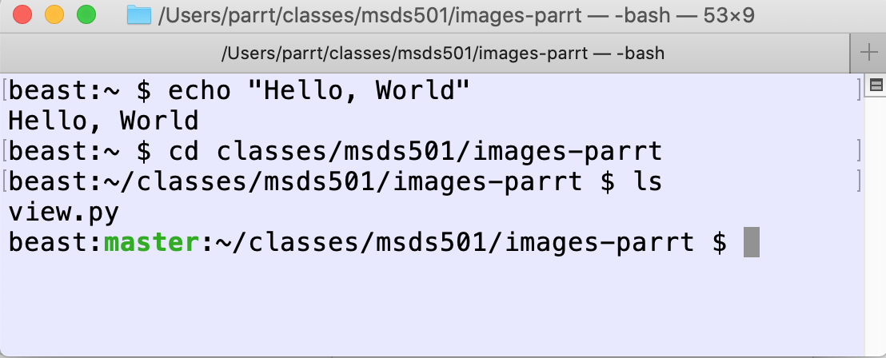
The shell / terminal / command line
Before GUIs, the terminal was all we had and what we used to examine files, check the state of the machine, execute programs, transmit files to other computers, etc.
The terminal is running a "shell", a command interpreter that is another simple language, but one designed with commands to control your computer
echo is like print
cd changes directory
ls lists files in directory

Slide 17
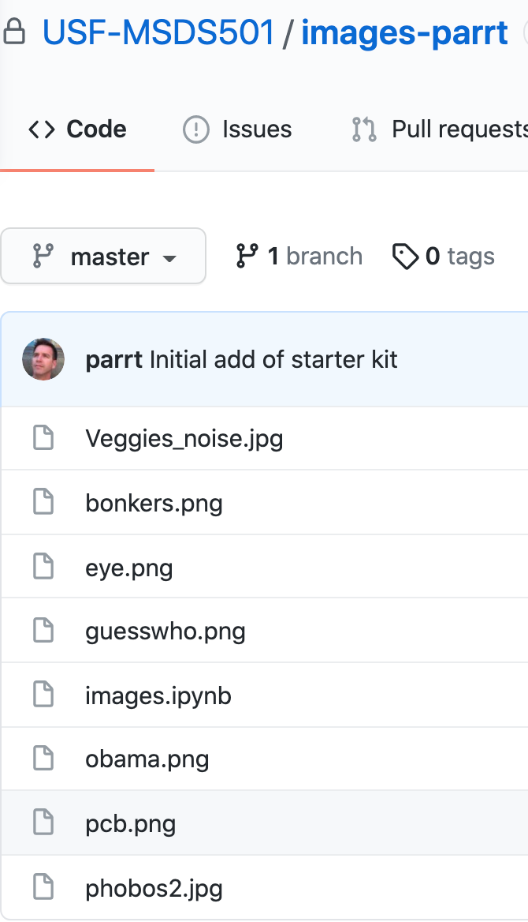
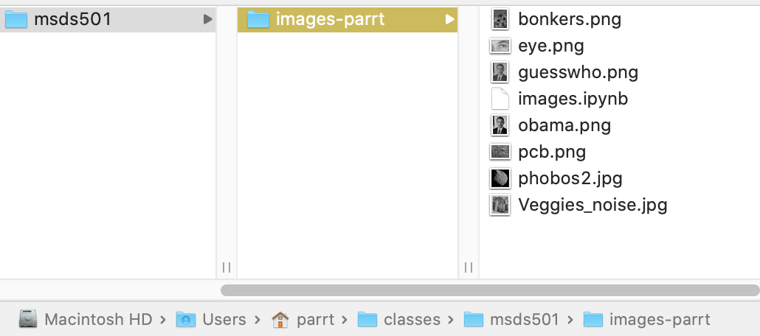
Git / github
Git = version control for a repository, which is represented by a directory with your code, data
Git tracks changes made to files in repo dir
Github = website that hosts git repositories
We push/pull from laptop to github to share code

Slide 18
Most…
That means we need to know
def walk(A,nrows,ncols):
for i in range(nrows):
for j in range(ncols):
# process A[i][j]

