Slide 1
Approximating square root iteratively
How to compute values iteratively instead of symbolically
Terence Parr
MSDS program University of San Francisco

Slide 2
Iterative computing
There are lots of useful functions with no closed form solution, meaning we can't just do a computation and return the value
Instead, we approximate function values with iterative methods
Examples include:
sine (with Taylor series expansion)
square root (as we'll do in this lecture)
optimize a cost or error function (e.g., gradient descent in the introduction to machine learning course)

Slide 3
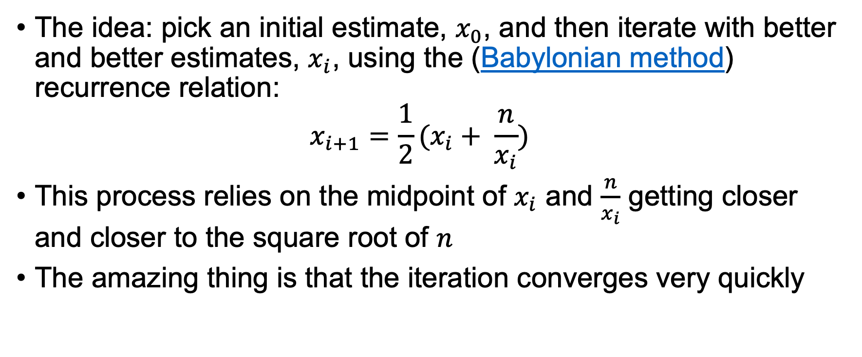
Babylonian method for sqrt
The idea: pick an initial estimate, $x_{0}$, and then iterate with better and better estimates, $x_{i}$, using the (Babylonian method) recurrence relation: $x_{i+1}=\frac{1}{2}(x_{i}+ \frac{n}{x_{i}})$
This process relies on the midpoint of $x_{i}$ and $\frac{n}{x_{i}}$ getting closer and closer to the square root of $n$
The amazing thing is that the iteration converges very quickly

Slide 4
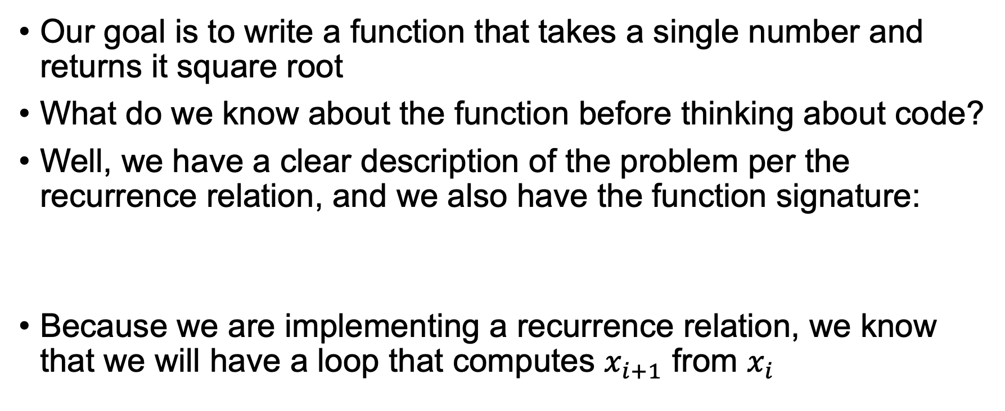
The goal
Our goal is to write a function that takes a single number and returns it square root
What do we know about the function before thinking about code?
Well, we have a clear description of the problem per the recurrence relation, and we also have the function signature:
Because we are implementing a recurrence relation, we know that we will have a loop that computes $x_{i+1}$ from $x_{i}$
def sqrt(n): ...

Slide 5
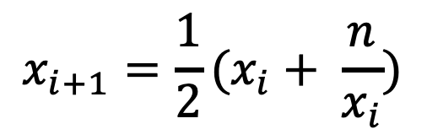
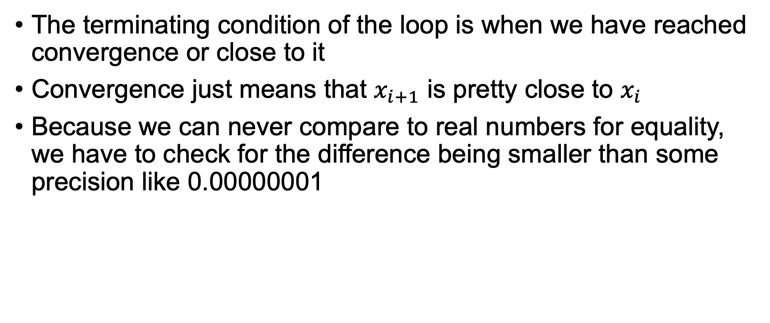
Convergence
$$x_{i+1}=\frac{1}{2}(x_{i}+ \frac{n}{x_{i}})$$
The terminating condition of the loop is when we have reached convergence or close to it
Convergence just means that $x_{i+1}$ is pretty close to $x_{i}$
Because we can never compare to real numbers for equality, we have to check for the difference being smaller than some precision like 0.00000001

Slide 6
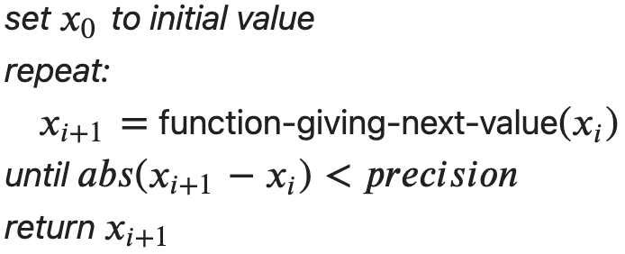
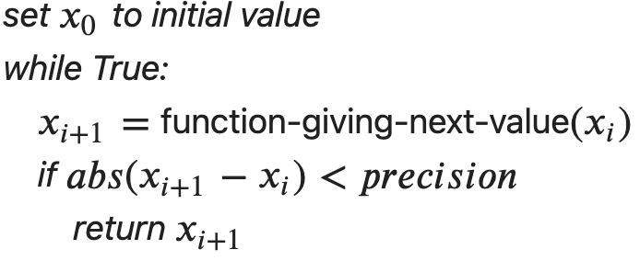
Algorithm
Iterative methods all share the same basic outline
Python does not have a repeat-until loop so we fake it with an infinite loop containing a conditional that breaks out upon convergence

Slide 7
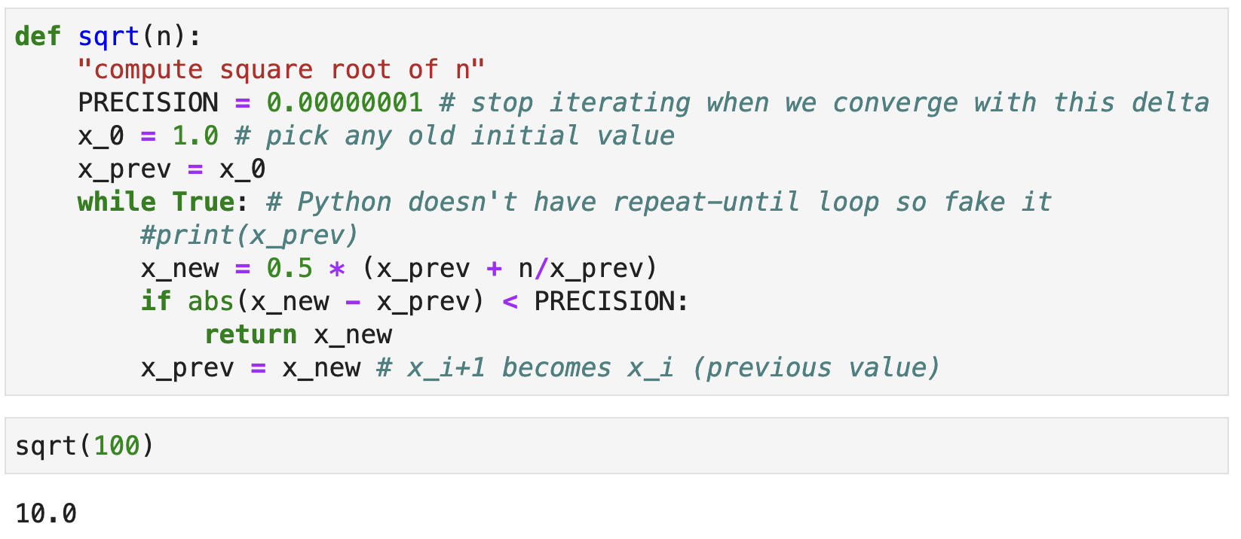

Implementation
The translation to Python is fairly straightforward but notice that we don't need to track all $x_{i}$; we just need the previous/current

Slide 8
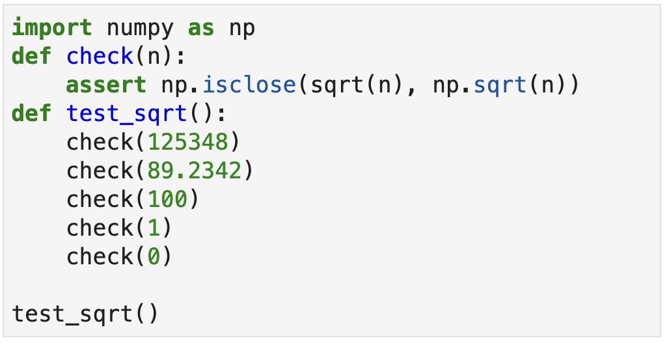
Testing our implementation
To test our square root approximation, we can compare it to math.sqrt() and use numpy's isclose() to do the comparison

Slide 9
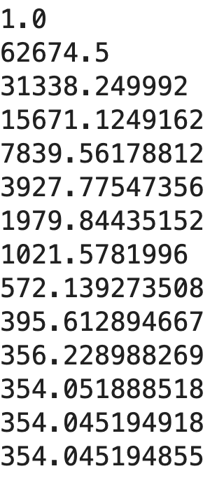
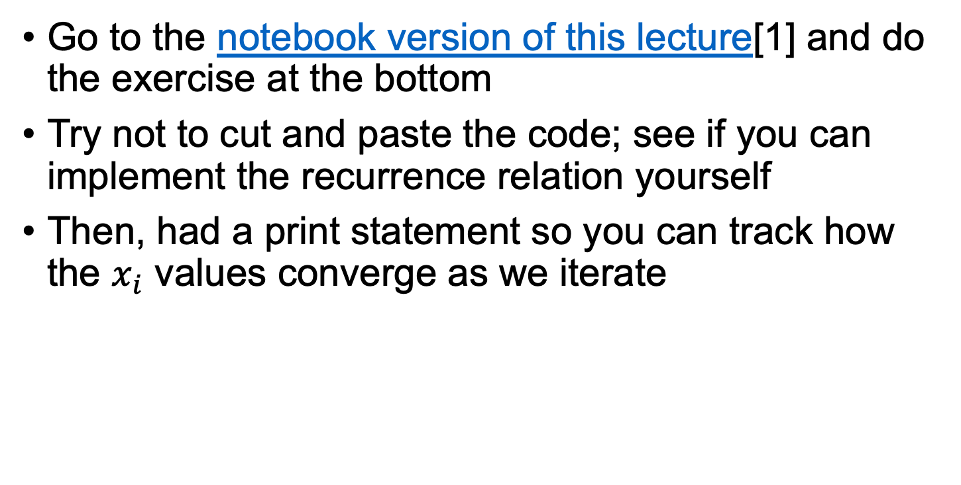
Exercise
sqrt(125348.0)
Go to the notebook version of this lecture[1] and do the exercise at the bottom
Try not to cut and paste the code; see if you can implement the recurrence relation yourself
Then, had a print statement so you can track how the $x_{i}$ values converge as we iterate
[1] https://github.com/parrt/msds501/blob/master/labs/sqrt.ipynb

