Slide 1
Programming Patterns in Python
Terence Parr
MSDS program University of San Francisco

Slide 2
Don Knuth on "geekhood"
The main characteristic is an ability to understand many levels of abstraction simultaneously, and to shift effortlessly between in-the-large and in-the-small. A geek knows that, to achieve a certain high-level goal, you need to add one to a certain counter at a certain time.

Slide 3
How programmers design programs
Experienced programmers draw from a collection of generic high-level / large-scale mental templates as starting points
There are mental templates for desktop GUI apps, machine learning classifiers, web servers, etc....
A template provides an overall structure for the program, like lawyers tweaking a contract from previous client for new one
Engineers building a new suspension bridge do not proceed as if such a thing has never been built before
Gaining experience as a programmer means recognizing and remembering patterns in your code, both high and low level

Slide 4
Example: data science program template
Acquire data, which means finding a suitable file or collecting data from the web and storing it in a file or database
Load data from disk or database and organize into a suitable data structure in memory
Normalize, filter, clean, or otherwise prepare data
Process the data, which can mean training a machine learning model, transforming the data, computing summary statistics, or optimizing a cost function
Emit results, which can be anything from simply printing an answer to saving data to the disk to generating a fancy visualization

Slide 5
Basic problem-solving strategy
Start with the end result and work your way backwards
Ask what the prerequisites are for each step
The processing step or steps preceding step i compute the data or values needed by step i
E.g., median: to pick middle value, previous step must sort data
Data science problems are often solved with an "iterative refinement of data" approach to arrive at the final result

Slide 6
Low-level programming patterns
High-level templates help us organize and plan our program
Low-level patterns are puzzle pieces that we combine to fill in details and solve parts of the overall template
These patterns have Python implementations but we design programs by selecting and applying patterns/operations, not specific code sequences
When designing a program, I never say: "Oh! I need a for-loop with an if-statement right here”; instead, I say “Oh! I need to filter for positive numbers here”

Slide 7
Sample programming patterns
You're no doubt familiar with simple patterns such as:
sum the numbers in a list
count the elements in a list
But there are many many more, such as:
find all values in a list satisfying a condition
apply an operation to each element of a list to get new list
split a list of strings into 2 or more lists
merge two sorted lists
delete records in a dataframe that satisfy a condition
Think and plan at this level or higher, not the code level

Slide 8
Visualize behavior then identify pattern
Think visually about how you would physically manipulate lists of data or extract information from data
Manually moving some data around on paper or in spreadsheet helps me to understand the operation to perform
Matrix addition
Sum elements

Slide 9
Example from images project: flip
Draw and move pixels around then identify index pattern

Slide 10
A parade of patterns

Slide 11
Accumulate
Traverse a sequence of elements and accumulate a value
In Excel, this is like using sum(...) in a cell
Can use any other arithmetic operator, such as *
Called reduce, as in map/reduce of distributed computing world
Quantity = [6, 49, 27, 30, 19, 21, 12, 22, 21]
sum = 0
for q in Quantity:
sum += q # same as: sum = sum + q
print(sum)
Experiment in pythontutor

Slide 12
Map
A very common operation maps one sequence to another, applying an operator or function to each element
It's like using a spreadsheet to create a new column containing a product’s unit price discounted by 5%
UnitPrice = [38.94, 208.16, 8.69, 195.99]
discounted = [] # empty list
for price in UnitPrice:
discounted.append(price * 0.95)
# list comprehension shines here!!
discounted = [p*0.95 for p in UnitPrice]
Be able to reverse this, going from code to pattern!
Experiment in pythontutor

Slide 13

Combine
Traverse two or more lists at once placing the result in a third list
Multiply the $i^{th}$ element from different sequences and placing the result in the $i^{th}$ position of the output sequence
Quantity = [6, 49, 27, 30]
UnitPrice = [38.94, 208.16, 8.69, 195.99]
cost = []
for i in range(len(Quantity)):
cost.append( Quantity[i] * UnitPrice[i] )
Cost = [Quantity[i] * UnitPrice[i] for i in range(len(Quantity))]
Experiment in pythontutor

Slide 14
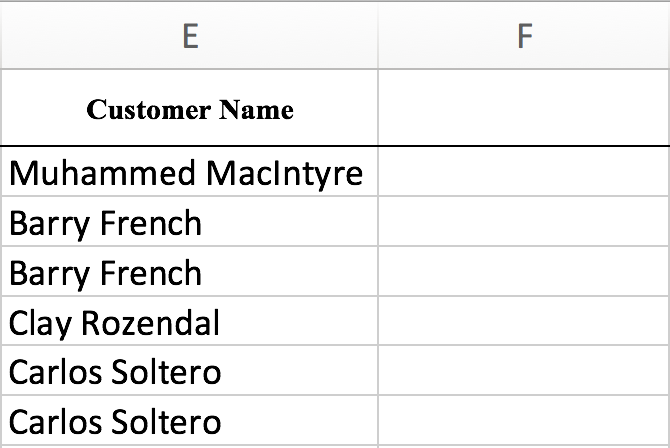
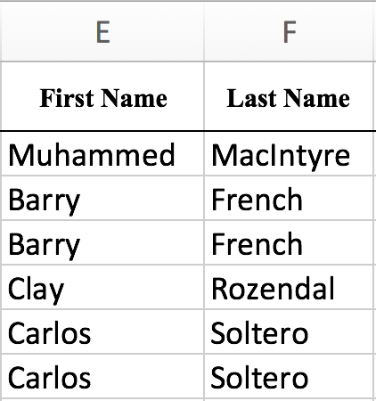
Split
The opposite of combining is splitting where we split a stream into two or more new streams
Example: split list of full names into their first and last names
names = ['Terence Parr', 'Diane Woodbridge', 'Yannet Interian']
for name in names:
print(name.split())
first = []
last = []
for name in names:
f,l = name.split()
first.append(f)
last.append(l)
Experiment in pythontutor

Slide 15
Slice a list (or string)
Some operations yield subsets of the data, such as slice, which extracts a subset of a list (that fits in memory)
Syntax is A[begin:end] where begin is inclusive and end is not
names=['Xue', 'Mary', 'Bob']
print(names[0:1])
print(names[0:2])
print(names[0:3])
print(names[2:3])
print(names[1:])
print(names[-1])
print(names[-2:])
['Xue']
['Xue', 'Mary']
['Xue', 'Mary', 'Bob']
['Bob’]
['Mary', 'Bob']
Bob
['Mary', 'Bob']
Experiment in pythontutor

Slide 16
Filter
The filter operation is similar to the map operation in that a computation is applied to each element of the input stream
Filter tests each element for a specific condition and, if true, adds that element to the new sequence
shipping = [35, 68.02, 2.99, 3.99, 5.94, 4.95, 7.72, 6.22]
shipping2 = []
for x in shipping:
if x < 10:
shipping2.append(x)
print(shipping2) # prints [2.99, 3.99, 5.94, 4.95, 7.72, 6.22]
shipping2 = [x for x in shipping if x < 10] # much easier
Experiment in pythontutor

Slide 17
Filtering rows of data
We can also filter on one column but keep the data within each row together; e.g., filter for Oscar winners
oscars = [
[1984, "A Soldier's Story", 0],
[1984, 'Places in the Heart', 0],
[1984, 'The Killing Fields', 0],
[1984, 'A Passage to India', 0],
[1984, 'Amadeus', 1],
[1985, "Prizzi's Honor", 0],
[1985, 'Kiss of the Spider Woman', 0],
[1985, 'Witness', 0],
[1985, 'The Color Purple', 0],
[1985, 'Out of Africa', 1]
]
print([movie for movie in oscars if movie[2]==1])
[[1984, 'Amadeus', 1], [1985, 'Out of Africa', 1]]
Experiment in pythontutor

Slide 18
Search
The filter operation finds all elements in a sequence that satisfy a specific condition, but often we'd like to know which element satisfies the condition first (or last)
Search returns the first (or last) position in the sequence rather than the value at that position
first=['Xue', 'Mary', 'Robert'] # our given input
target = 'Mary' # searching for Mary
index = -1
for i in range(len(first)): # i is in range [0..n-1] or [0..n)
if first[i]==target:
index = i
break
print(index)
Experiment in pythontutor

Slide 19
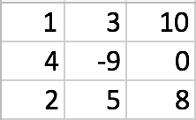
Grid/matrix processing
Any time you need to process each cell in a two dimensional structure such as an image or matrix, think "nested loop"
Single loop does 1D, nested loop does 2D, triple loop does 3D...
nrows = 3
ncols = 3
# column j value varies more quickly than the row i value
for i in range(nrows):
for j in range(ncols):
print( i, j )
# row i value varies more quickly than j
for j in range(ncols):
for i in range(nrows):
print( i, j )
Experiment in pythontutor

Slide 20
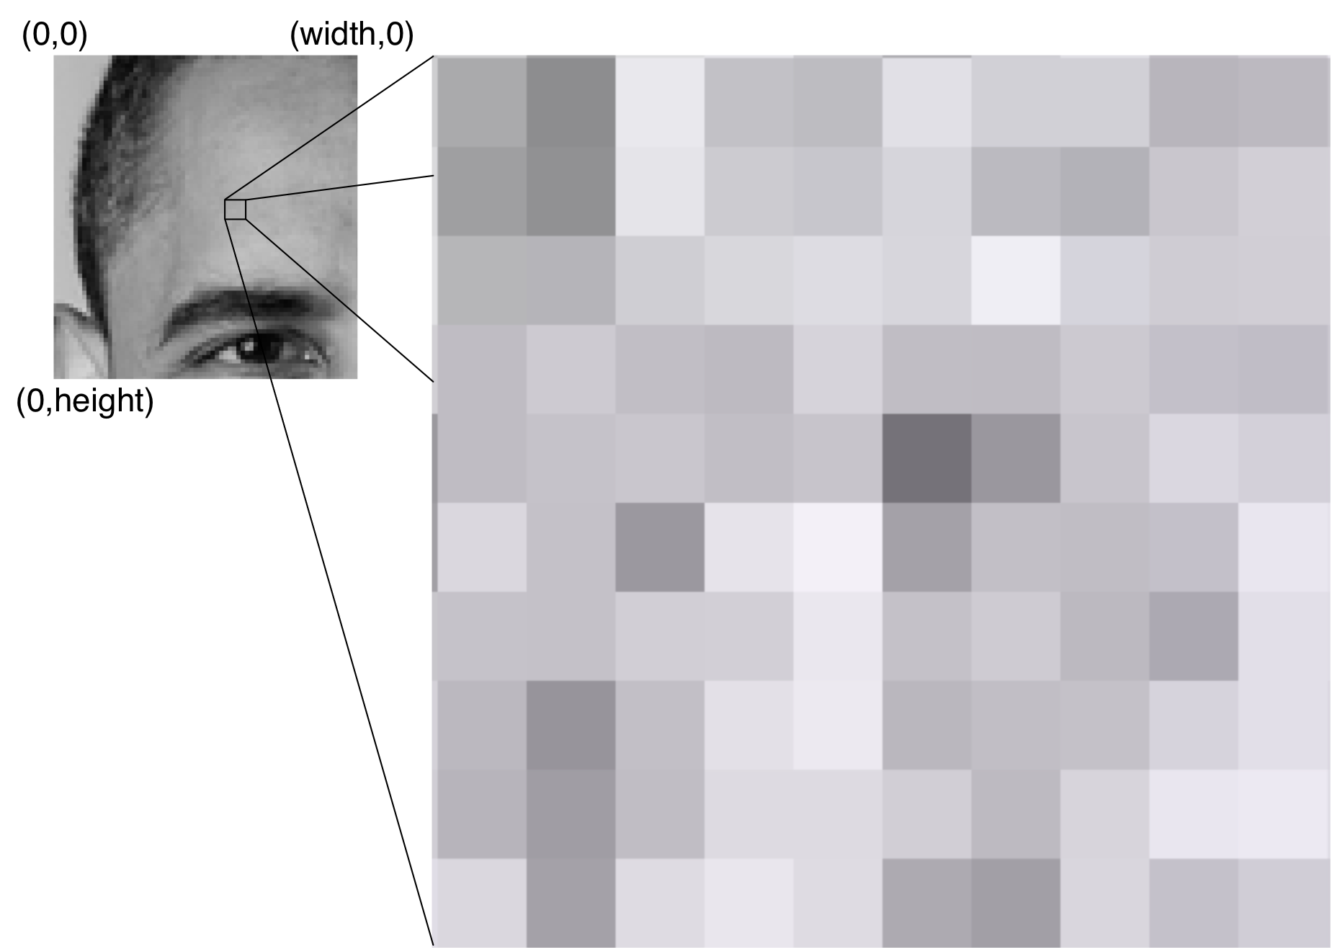
Image processing
The images project requires that you traverse the x,y coordinates of images
An image is nothing more than a 2D matrix whose entries are grayscale pixels in 0 to 255
A pixel value of 0 is black and 255 is white
# walk top-down: row-by-row of pixels
for y in range(height):
for x in range(width):
print( x, y )

Slide 21
Applying patterns
Now that we can read basic Python and have seen some pattern implementations, let's use those patterns to solve some simple problems

Slide 22
Exercise
Given a list of prices, cut the price of each in half
First, must decide if we are altering in place or creating a new; let's create a new list in general for these exercises
Which pattern should we apply?
prices = [38.94, 208.16, 8.69, 195.99]
Map...what does code look like?
prices = [p/2 for p in prices]
Experiment in pythontutor

Slide 23
Exercise
Given a list of names, get a list of string lengths called namelens; function len(x) yields length of lists, strings, etc...
Draw out what the transformation looks like
Which pattern should we apply?
names = ['Xue', 'Mary', 'Robert']
['Xue', 'Mary', 'Robert']
☞
[3, 4, 6]
Map...what does code look like?
namelens = [len(name) for name in names]
Experiment in pythontutor

Slide 24
Exercise
Given a list of prices, get a list of prices greater than $100
Which pattern should we apply?
prices = [38.94, 208.16, 8.69, 195.99]
Filter...what does code look like?
prices = [p for p in prices if p>100]
Experiment in pythontutor

Slide 25
Exercise
Given a list of prices, double any price less than $10
Which patterns should we apply?
prices = [38.94, 208.16, 8.69, 195.99]
Filter & Map
prices = [p for p in prices if p<10]
prices = [p/2 for p in prices]
prices = [p/2 for p in prices if p<10] # Or together
Experiment in pythontutor

Slide 26
Exercise (part 1)
Given a list of movie titles, how many are 3-words long?
Which patterns should we apply and how? Hmm…hard to say
What does the problem-solving process look like?
titles = ["A Soldier's Story", 'Places in the Heart', 'The Killing Fields',
'A Passage to India', 'Amadeus', "Prizzi's Honor",
'Kiss of the Spider Woman', 'Witness', 'The Color Purple',
'Out of Africa']
Think how we can gradually morph the data from titles to result, but start with the desired result and work backwards

Slide 27
Exercise (part 2)
["A Soldier's Story", 'Places in the Heart',
'The Killing Fields', 'A Passage to India', 'Amadeus', "Prizzi's Honor", 'Kiss of the Spider Woman',
'Witness', 'The Color Purple', 'Out of Africa']
Work backwards:
If we have the list of title lengths, we can filter for length 3 and count
To get list of title lengths, map len() to list of words of each title
To get the list of words for each title, apply split() to each title (map)
[3, 4, 3, 4, 1, 2, 5, 1, 3, 3]
☞
[3, 3, 3, 3]
☞
4
☞
[['A', "Soldier's", 'Story'],
['Places', 'in', 'the', 'Heart'], ...]
[3, 4, ...]
["A Soldier's Story",
'Places in the Heart',
...]
☞
[['A', "Soldier's", 'Story'],
['Places', 'in', 'the', 'Heart'],
...]

Slide 28
Exercise (part 3)
["A Soldier's Story", 'Places in the Heart',
'The Killing Fields', 'A Passage to India', 'Amadeus', "Prizzi's Honor", 'Kiss of the Spider Woman',
'Witness', 'The Color Purple', 'Out of Africa']
Now, reverse it to get the correct sequence:
Map
["A Soldier's Story",
'Places in the Heart',
...]
☞
[['A', "Soldier's", 'Story'],
['Places', 'in', 'the', 'Heart'],
...]
☞
Map
[['A', "Soldier's", 'Story'],
['Places', 'in', 'the', 'Heart'], ...]
[3, 4, ...]
Filter
[3, 4, 3, 4, 1, 2, 5, 1, 3, 3]
☞
[3, 3, 3, 3]
☞
4

Slide 29
Exercise (part 4)
titles = ["A Soldier's Story", 'Places in the Heart', 'The Killing Fields',
'A Passage to India', 'Amadeus', "Prizzi's Honor",
'Kiss of the Spider Woman', 'Witness', 'The Color Purple',
'Out of Africa']
tsplit = [t.split() for t in titles] # Map
tlen = [len(t) for t in tsplit] # Map
t3 = [n for n in tlen if n==3] # Filter
n = len(t3) # Prints 4
t3 = [t for t in titles if len(t.split())==3] # Map/Filter
n = len(t3)
Experiment in pythontutor

Slide 30
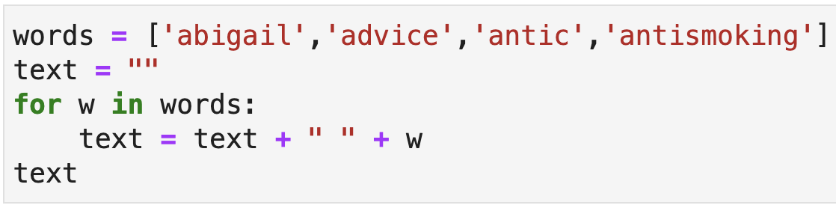
Exercise: What does it compute? What pattern is this?

Slide 31
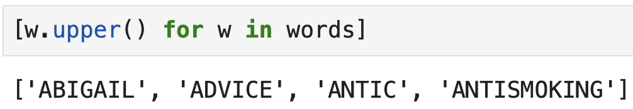
Exercise: what pattern is this?
Map a list of words to another list of words by applying upper()

Slide 32
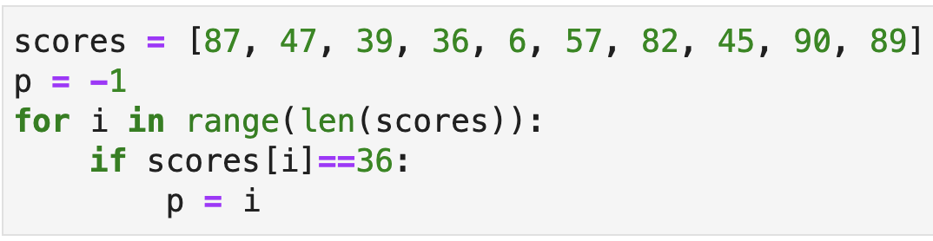
Exercise: what pattern is this?
This sets p to 3 because that is the index of the value 36 in the list An IF inside of a loop should make you think of “filtering”

Slide 33
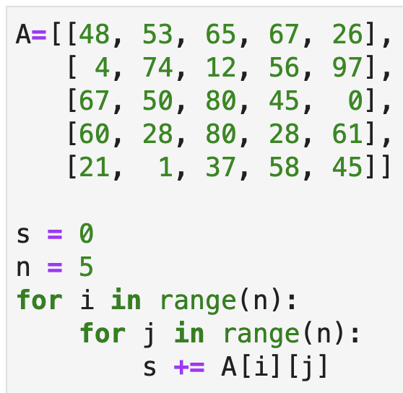
Exercise: what pattern is this?
A nested loop often means finding all combinations of the two loop indexes.
Here, I see a list of list or matrix index, so my brain thinks about image or matrix processing.
This computes the sum of all matrix elements. We are accumulating a value.

Slide 34
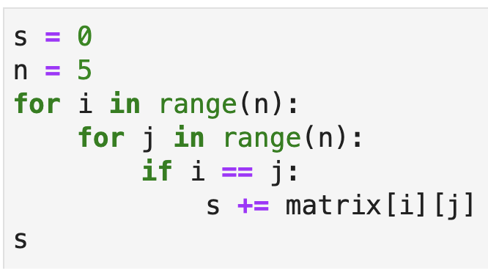
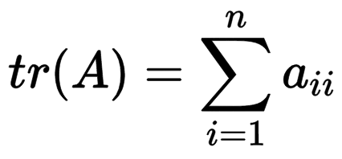
Exercise: what pattern is this?
Now I have a conditional inside of the nested loop, which just means that I’m filtering as well as accumulating.
This computes the trace of the matrix, the sum of the diagonal elements.

Slide 35
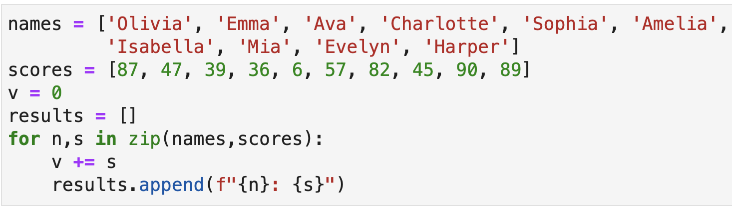
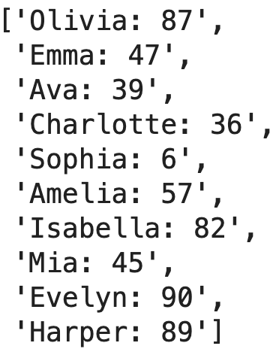
Exercise: what pattern is this?
This both accumulates the sum of the scores and combines the names and scores to get a new list in results

